Slide 1



Job Board: Hiristiq
Team Name: Bit-Manipulator
Team Member:
Jayesh Muley [22MIM10092]
Date: December 23, 2025
Notes:
Title Slide
Project Name: The title of the AWS-based project.
Team Members: Names and roles of all team members.
Date: Presentation date.

Slide 2
Introduction
Overview: Hiristiq is a comprehensive full-stack Job Portal application designed to streamline the recruitment process.
Objective: To bridge the gap between talent and opportunity by providing a seamless platform for Job Seekers and Recruiters.
Tech Stack Base: Built using the MERN Stack (MongoDB, Express, React, Node.js) for robust performance and scalability.
Key Innovation: Integrates role-based access control, real-time application tracking, and a premium glassmorphic UI for superior user experience.
Notes:
Project Objectives
Goals: Specific milestones or deliverables.
Expected Outcomes: What the project aims to achieve.

Slide 3
Project Objectives
Scalable Platform: To develop a robust full-stack job portal that scales with user growth.
Role Distinction: To implement distinct, secure workflows for Recruiters (posting jobs) and Candidates (applying).
Secure Authentication: To ensure top-tier data privacy and user management using Clerk.
Enhanced UX: To provide a seamless, modern, and responsive user interface for better engagement.
Efficiency: To streamline the hiring process with real-time application tracking and management tools.
Notes:
Project Objectives
Goals: Specific milestones or deliverables.
Expected Outcomes: What the project aims to achieve.

Slide 4
Project Scope
Target Audience: Serves two primary user groups:
  Candidates searching for jobs and Recruiters hiring talent.
Key Functionalities:
  Recruiters: Post and edit jobs, view applicant profiles, and manage application statuses (Accept/Reject).
  Candidates: Advanced job search (filter by location, role, salary), detailed job views, and one-click applications.
Technical Bound: A fully responsive web application accessible on all devices.
Security & Integration: Includes secure authentication (Clerk), file handling (Cloudinary), and automated communication (Email).
Notes:
Project Scope
Statement: The project statement as provided by the instructor.
Scope Boundaries: What is and isn't covered by the project.

Slide 5
Individual Contributions
Solo Development & Execution
Jayesh Muley (Full Stack Developer & Architect):
  Frontend Development: Built the responsive React interface with Vite and completely custom Tailwind CSS styling.
  Backend Engineering: Developed the Node.js/Express server and RESTful APIs from scratch.
  Database Management: Designed and optimized MongoDB schemas for Users, Jobs, and Companies.
  Security & Integration: Implemented Clerk authentication and Cloudinary file storage integration.
  UI/UX Design: Created the "Premium Glassmorphism" design concept and user journey flows.
Notes:
Individual Contributions
Member 1: Specific role and tasks performed.
Member 2: Specific role and tasks performed.
Member 3: Specific role and tasks performed.
Member 4: Specific role and tasks performed.
…

Slide 6
Key Concepts
React (Frontend Architecture):
  Hooks: Leveraged useState, useEffect, and useContext for efficient state and lifecycle management.
  SPA Navigation: Implemented React Router for seamless, non-refreshing page transitions.
  Modular Components: Created reusable UI elements (Cards, Navbar, Inputs) for a maintainable codebase.
Node.js & Express (Backend Logic):
  RESTful APIs: Designed structured endpoints for robust client-server communication.
  Middleware: Integrated custom and third-party middleware (Cors, Clerk) for security and request handling.
MongoDB (Data Persistence):
  Mongoose Modelling: Defined strict schemas for Jobs, Users, and Companies to ensure data integrity.
Notes:
Key Concepts
Features: Important AWS features utilized.
Services: Key AWS services employed and their significance.

Slide 7
Challenges and Solutions
Challenge 1: Secure User Authentication
  Description: Managing secure sessions and role-based access (Recruiters vs. Candidates) manually is complex and error-prone.
  Solution: Integrated Clerk Authentication to handle secure sign-in, session management, and user role metadata seamlessly.
Challenge 2: Handling Resume Uploads
  Description: Storing large files (resumes/images) directly in the database slows down performance.
  Solution: Implemented Cloudinary for efficient cloud-based storage, storing only the secure file URL in MongoDB.
Challenge 3: Real-Time State Management
  Description: Keeping the UI in sync when users apply for jobs or update profiles (CRUD operations).
  Solution: Utilized React Context API and Hooks to ensure instant UI updates and consistent global state across the app.
Notes:
Challenges and Solutions
Problem 1: Description and resolution.
Problem 2: Description and resolution.

Slide 8
Lessons Learned
Technical Insights:
  Full-Stack Integration: Gained deep understanding of connecting a React frontend with a Node.js/Express backend and MongoDB.
  API Mastery: Learned to securely integrate key third-party services like Clerk (for Auth) and Cloudinary (for media storage).
  State Management: Mastered complex state handling in React using Context API to maintain user sessions effectively.
Process Insights (Solo Development):
  End-to-End Ownership: managed the entire Software Development Lifecycle (SDLC), from initial design to final debugging.
  Critical Thinking: Enhanced problem-solving skills by independently resolving cross-stack errors (e.g., CORS, DB connections).
  Prioritization: Learned the importance of focusing on Core Features (MVP) to ensure timely project delivery.
Notes:
Lessons Learned
Technical Insights: What was learned technically.
Process Insights: What was learned about team collaboration.

Slide 9
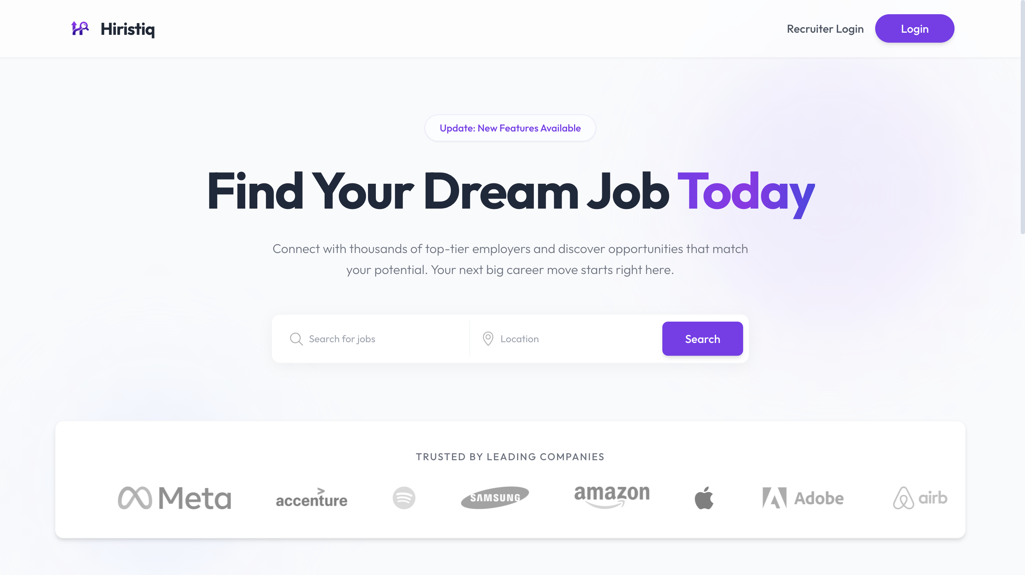
Screenshots
Home Page: Landing page with job search and featured companies.
Notes:
Screenshots
Screen Captures: Visual snapshots to showcase key elements.
Context: Description explaining what the screenshot represents.

Slide 10
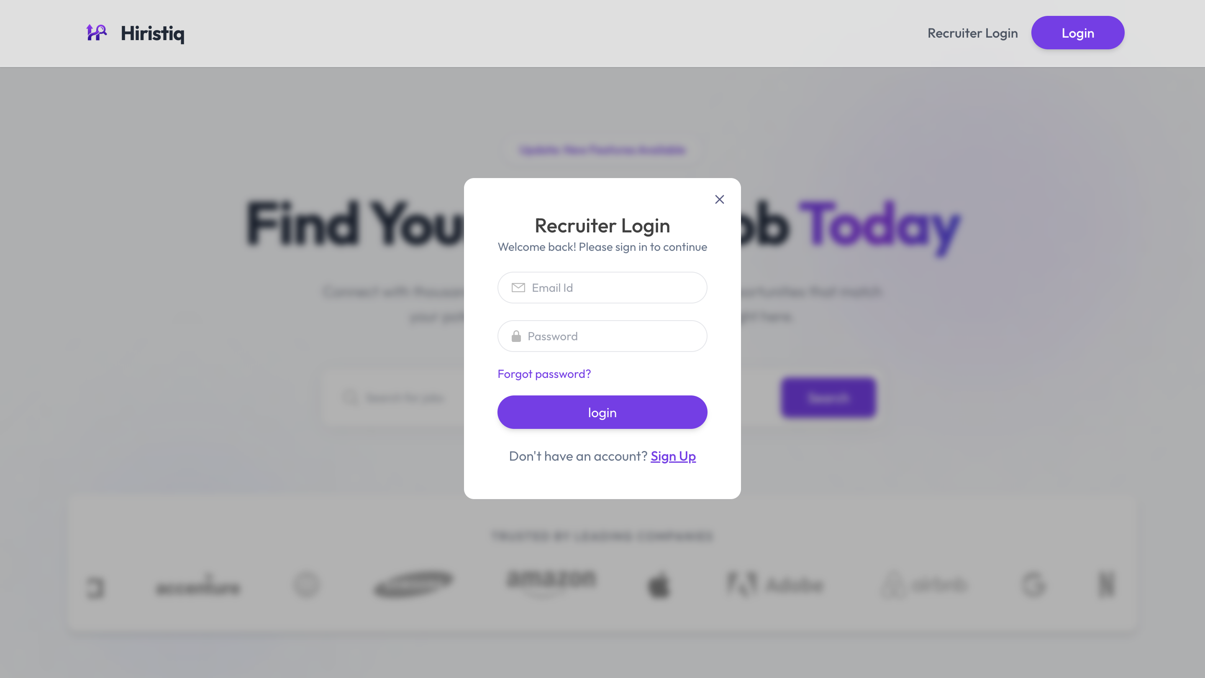
Screenshots
Job Search: Advanced filtering by category, location, and role.
Notes:
Screenshots
Screen Captures: Visual snapshots to showcase key elements.
Context: Description explaining what the screenshot represents.

Slide 11
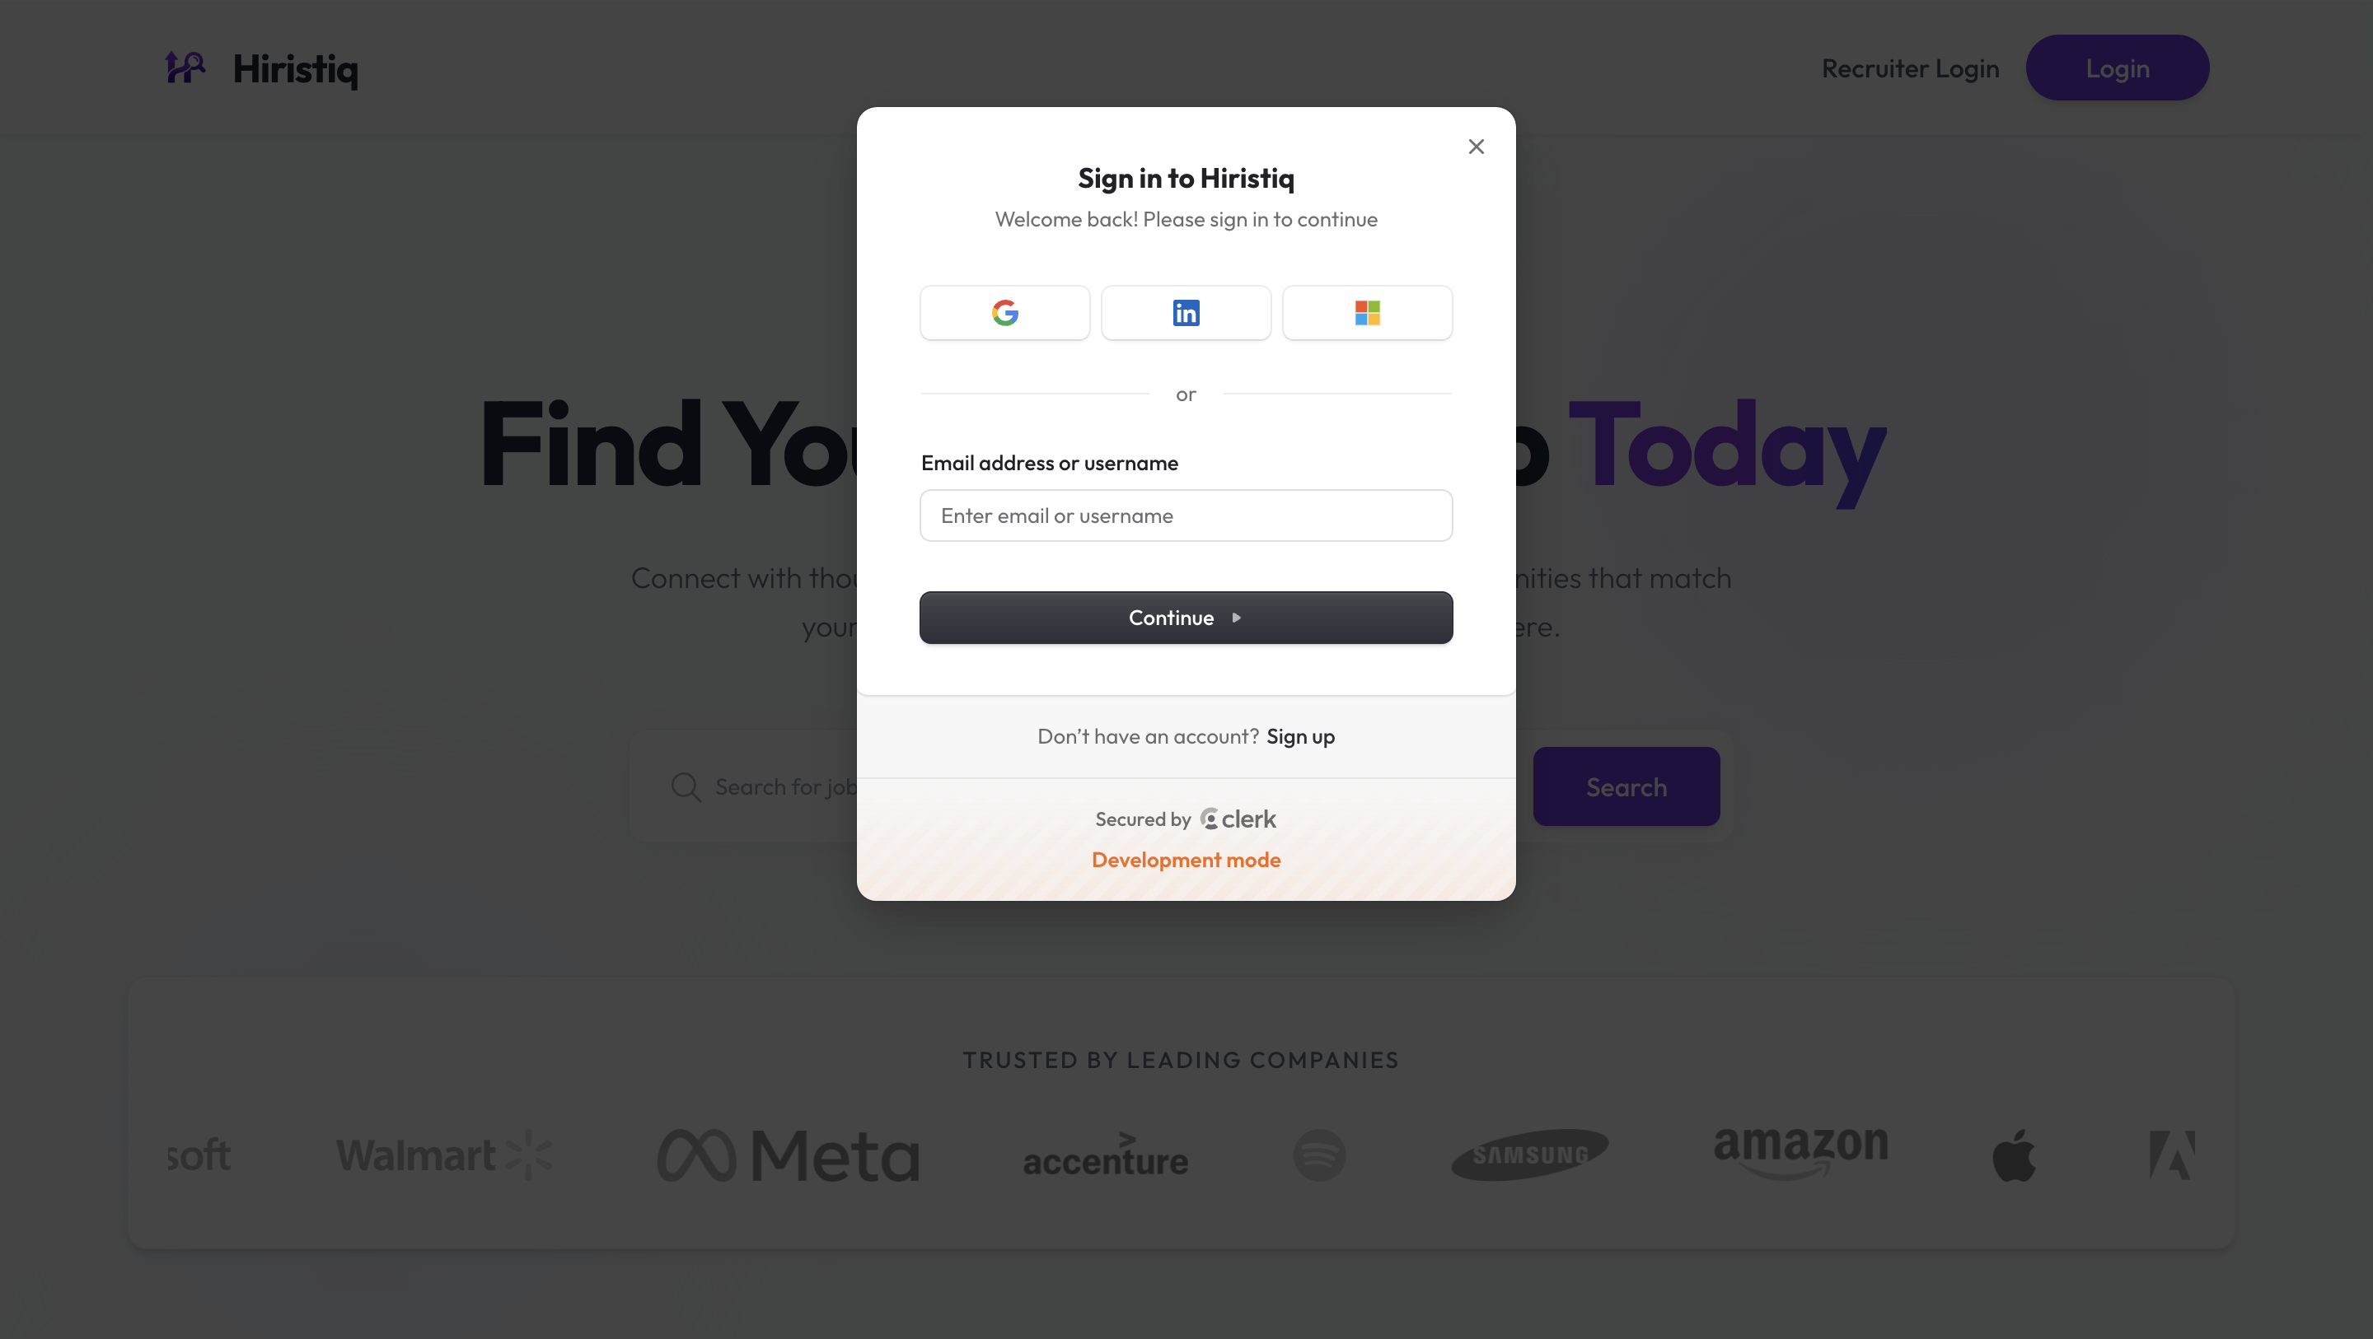
Screenshots
Job Details: Comprehensive view of job requirements and "Apply Now" action.
Notes:
Screenshots
Screen Captures: Visual snapshots to showcase key elements.
Context: Description explaining what the screenshot represents.

Slide 12
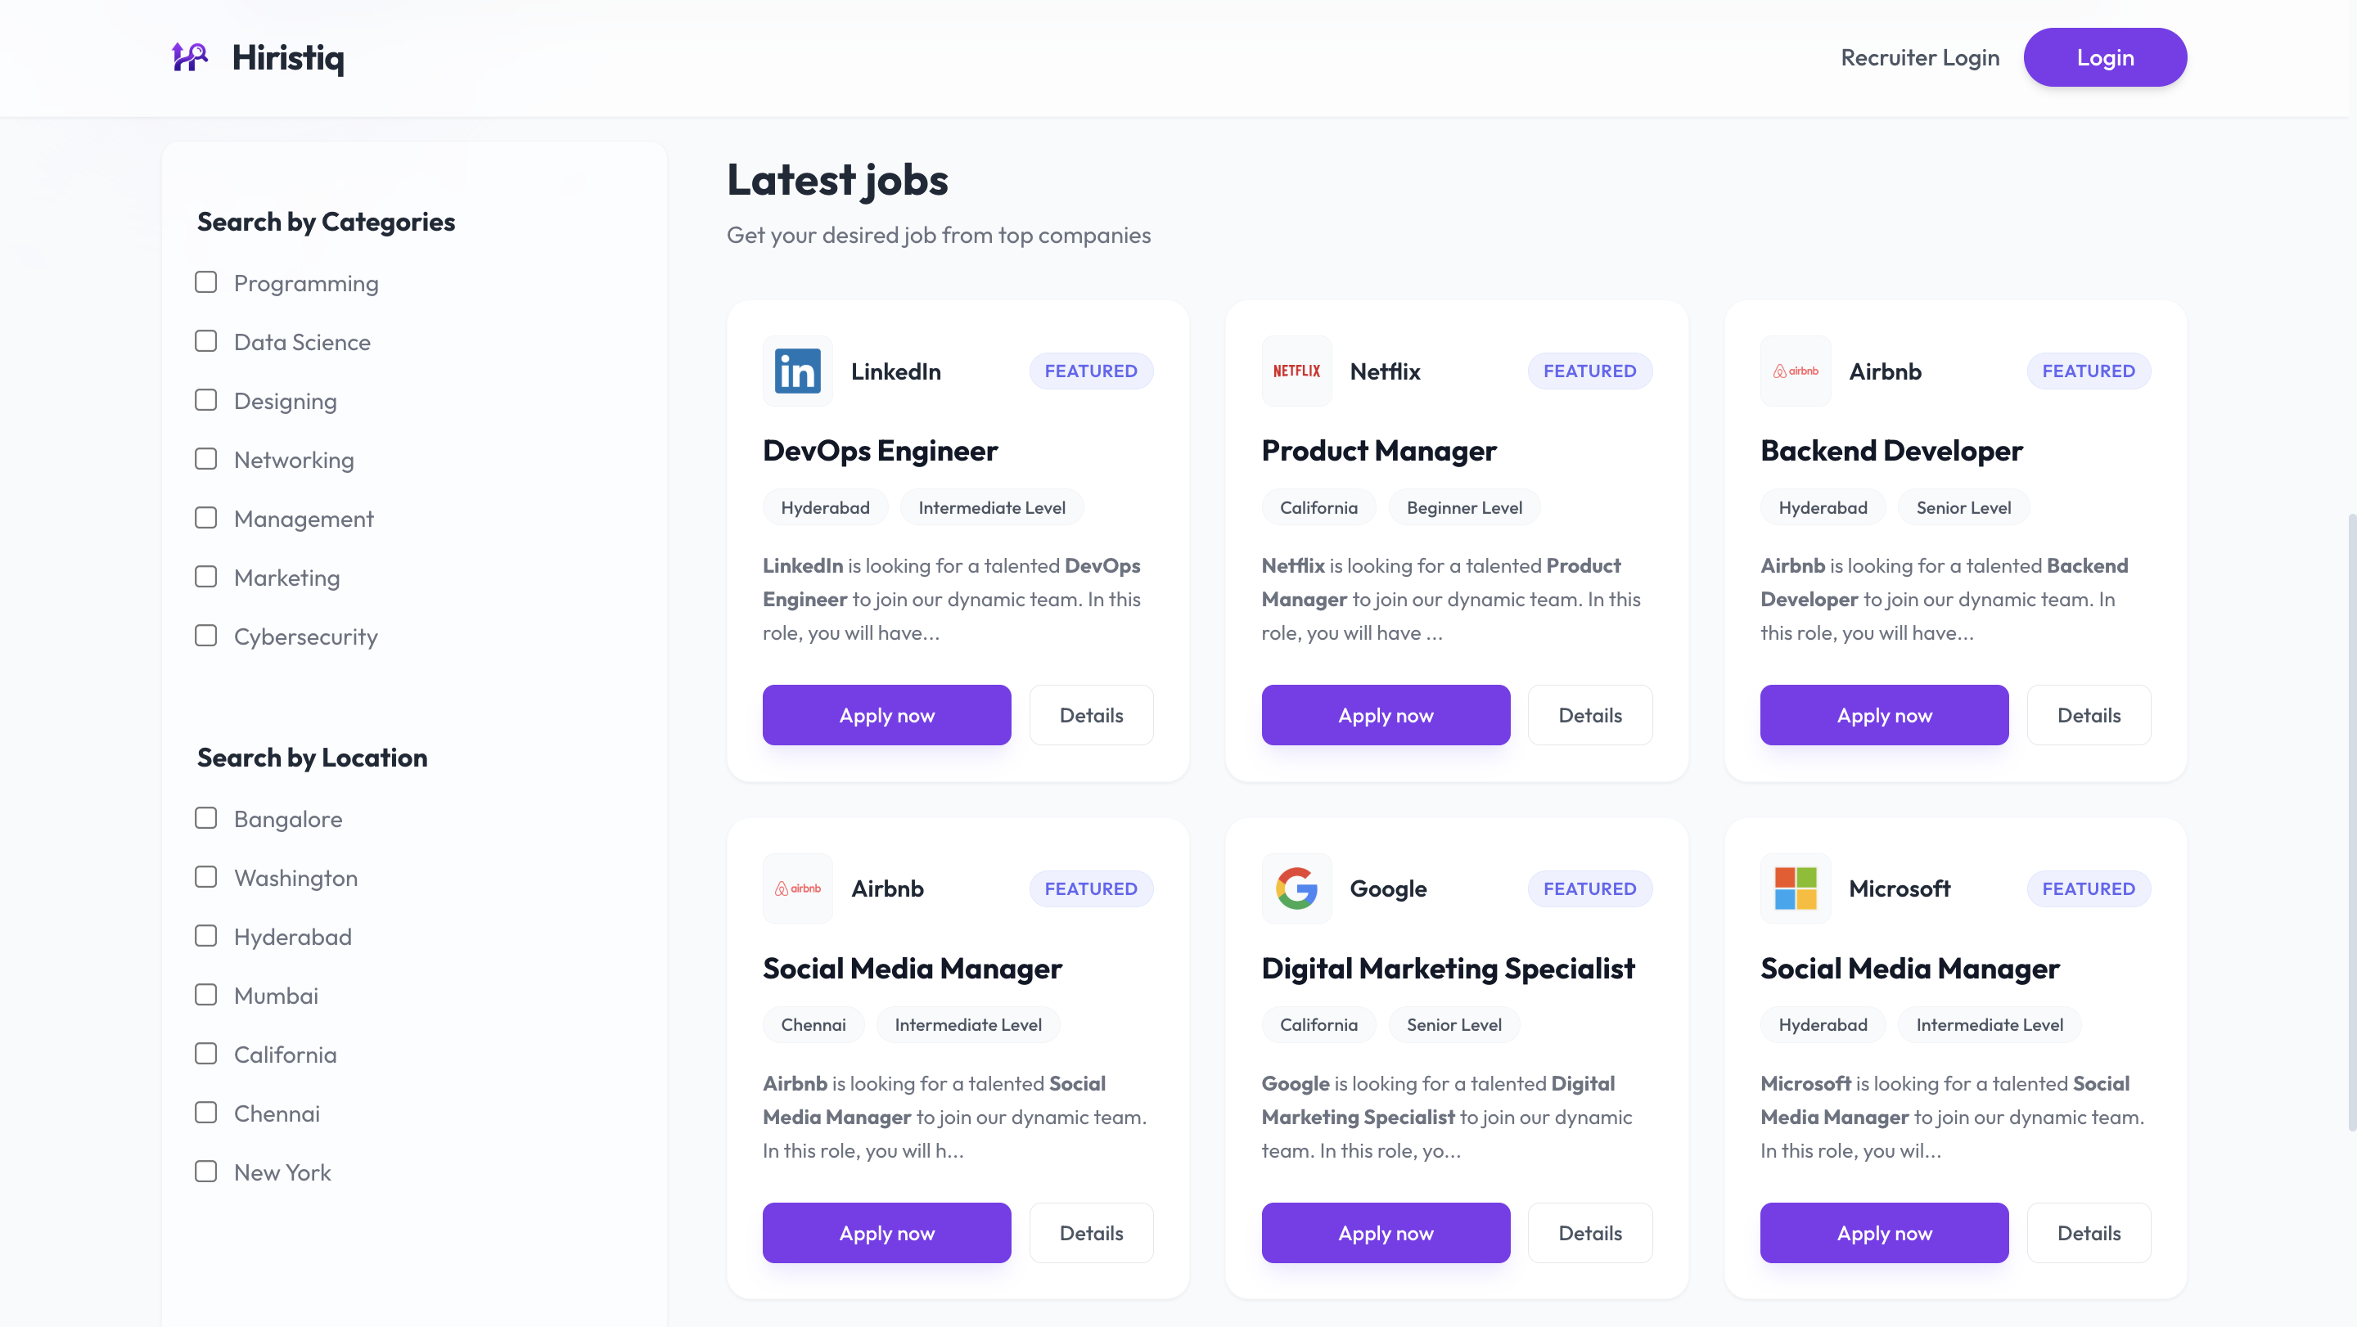
Screenshots
Authentication: Secure login and sign-up powered by Clerk.
Notes:
Screenshots
Screen Captures: Visual snapshots to showcase key elements.
Context: Description explaining what the screenshot represents.

Slide 13
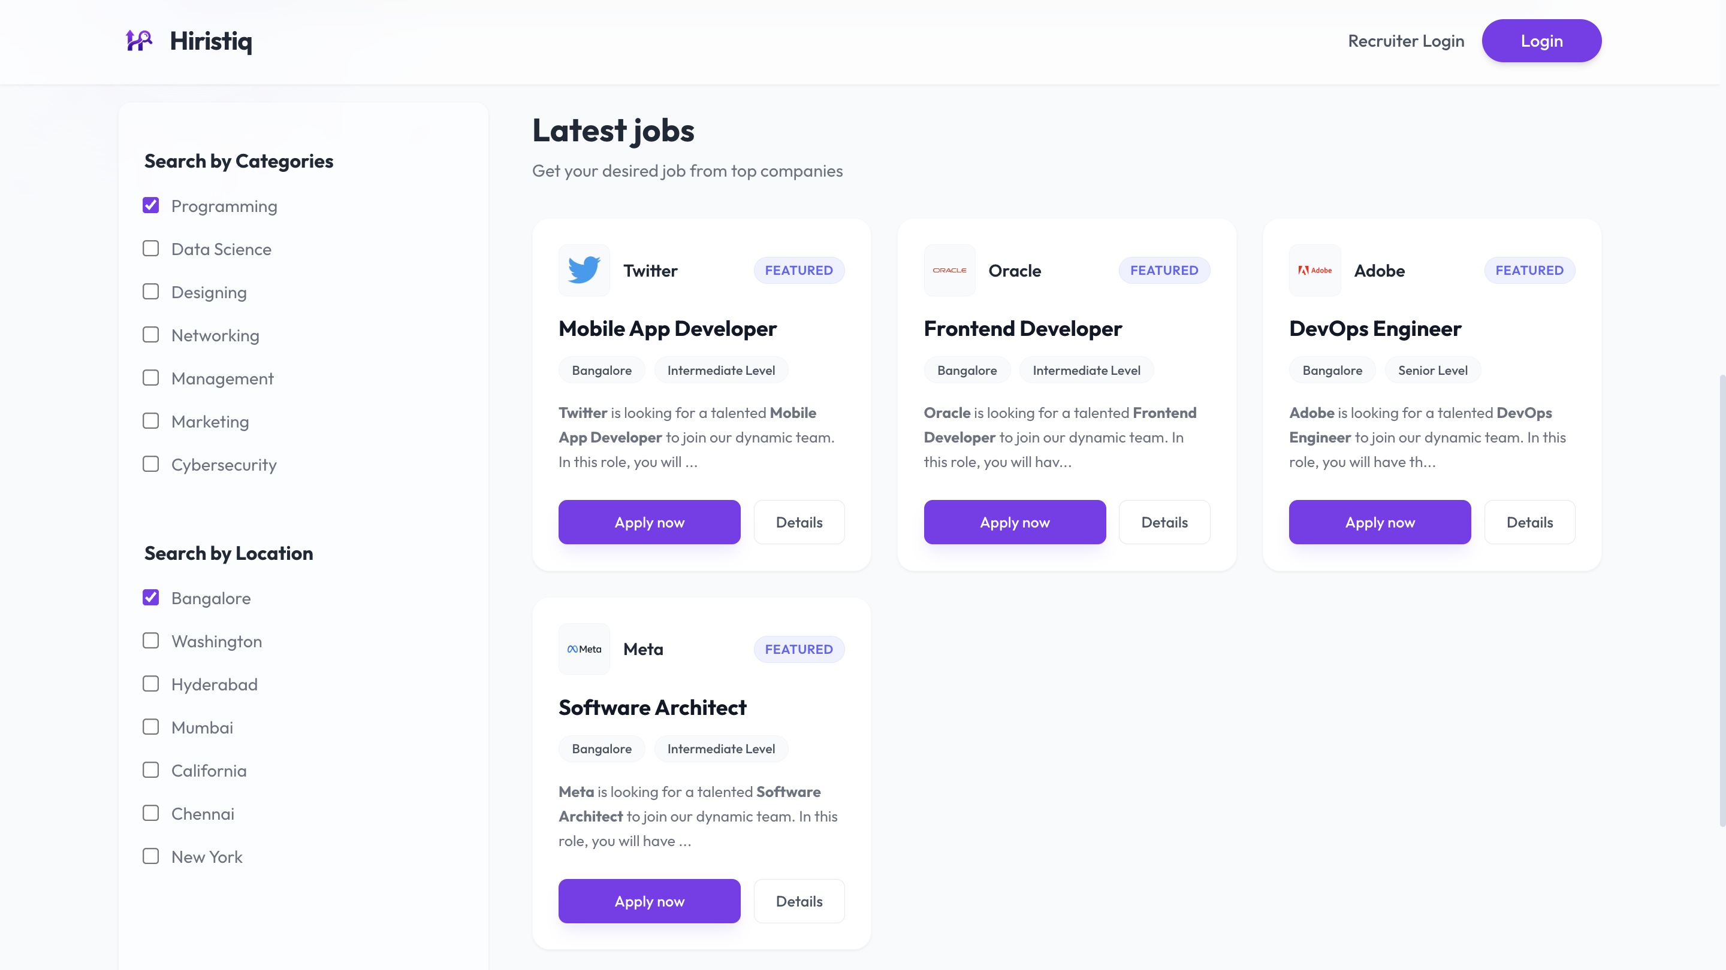
Screenshots
Job Details: Comprehensive view of job requirements and "Apply Now" action.
Notes:
Screenshots
Screen Captures: Visual snapshots to showcase key elements.
Context: Description explaining what the screenshot represents.

Slide 14
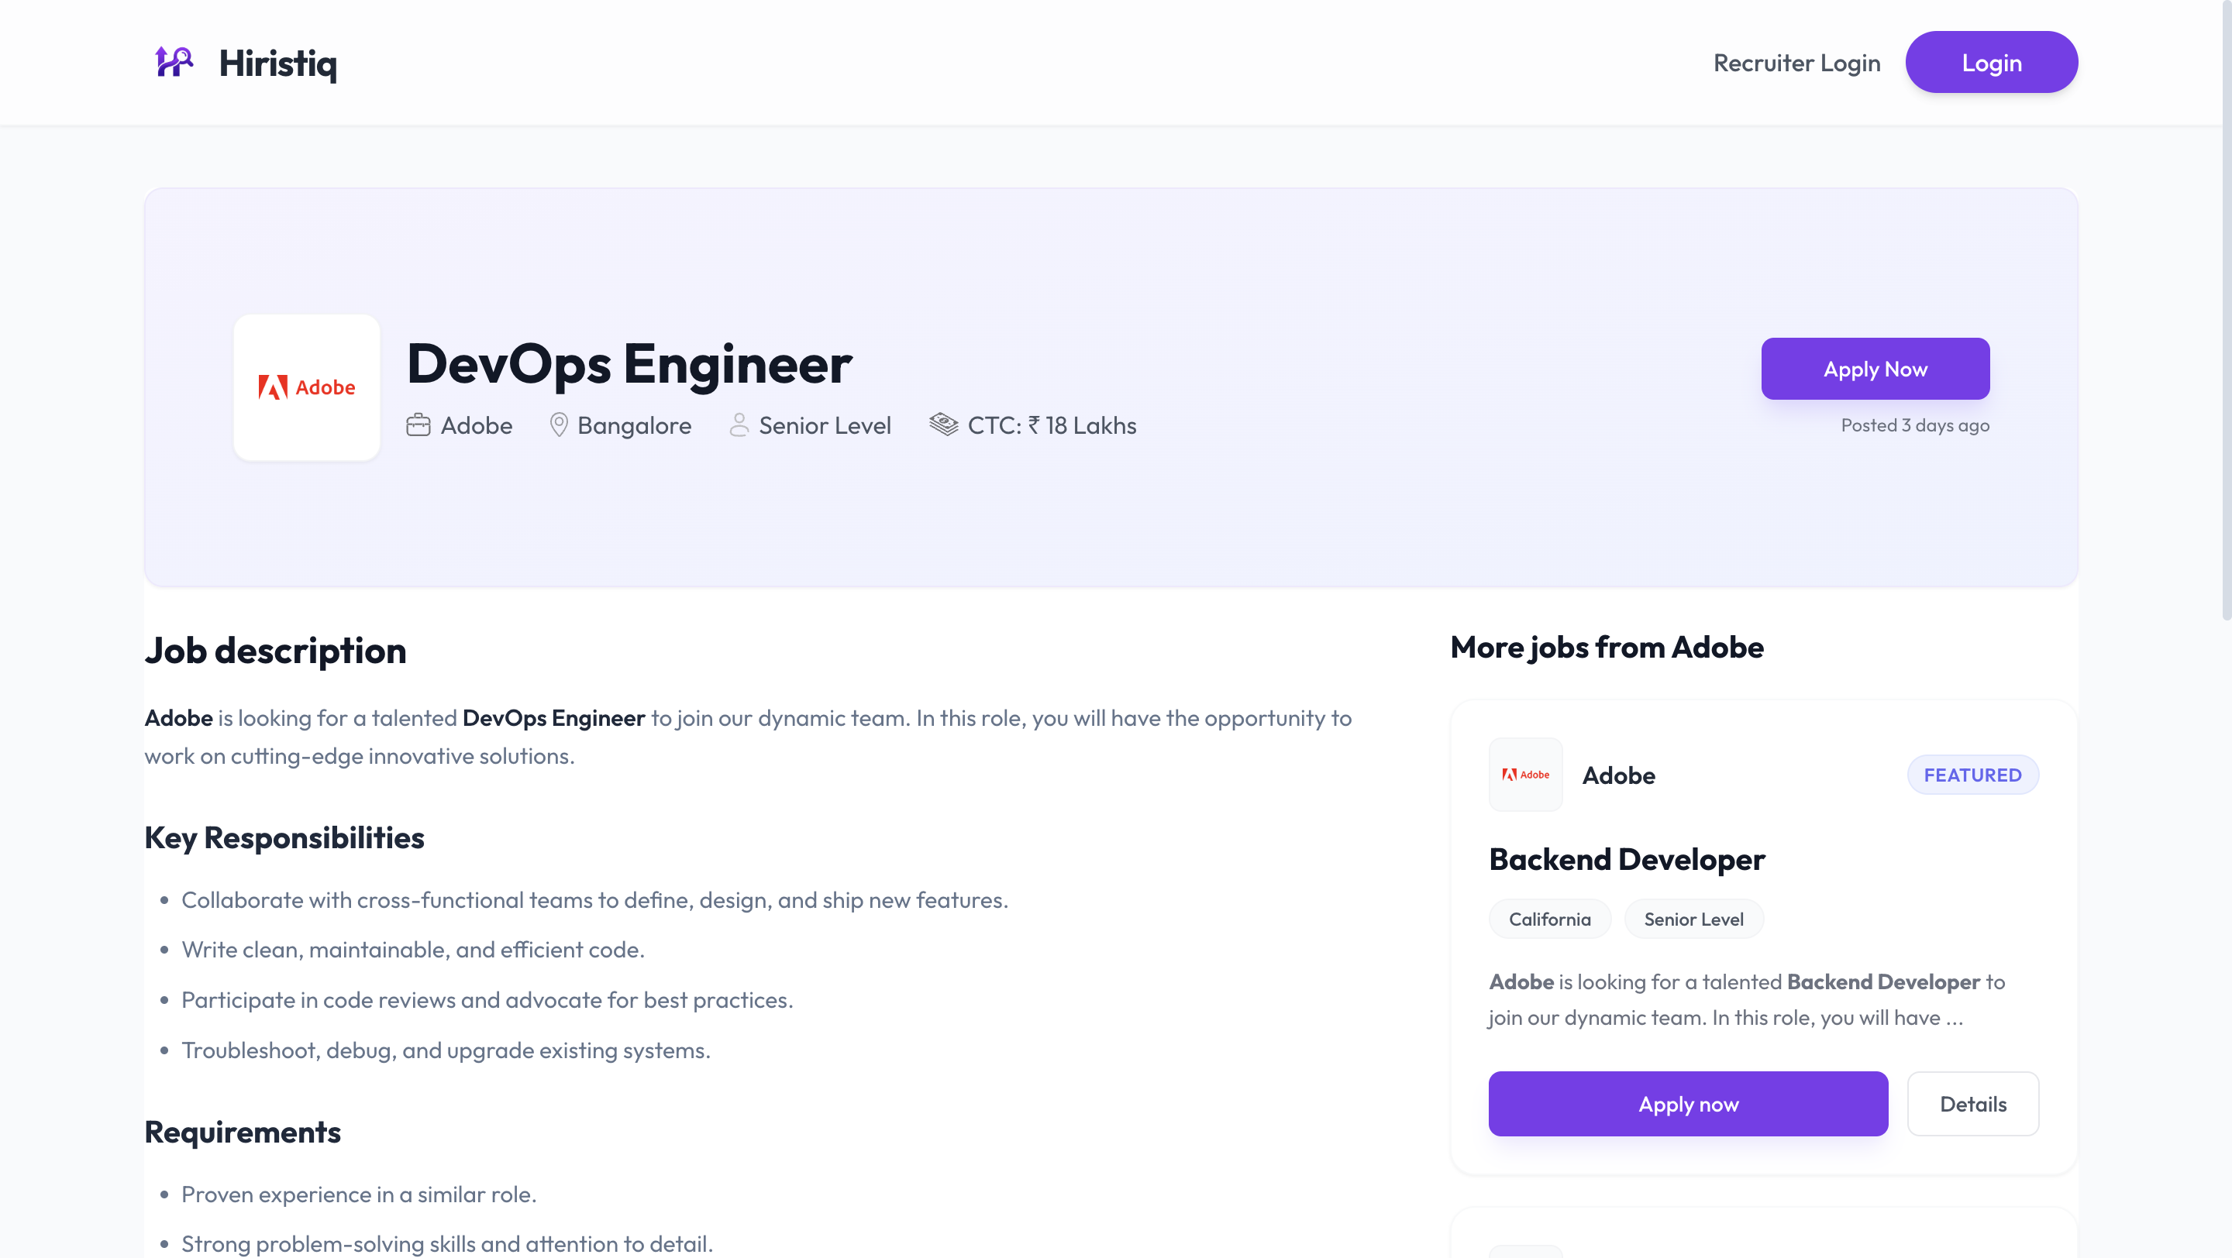
Screenshots
Job Posting: Interface for recruiters to create new job listings.
Notes:
Screenshots
Screen Captures: Visual snapshots to showcase key elements.
Context: Description explaining what the screenshot represents.

Slide 15
Screenshots
Job Posting: Interface for recruiters to create new job listings.
Notes:
Screenshots
Screen Captures: Visual snapshots to showcase key elements.
Context: Description explaining what the screenshot represents.

Slide 16
Future Scope
AI-Powered Recommendations: Implement Machine Learning algorithm to suggest jobs to candidates based on their skills and resume parsing.
Mobile Application: Develop a cross-platform mobile app using React Native to increase accessibility for users on the go.
Video Interview Integration: Add built-in video conferencing features to allow recruiters to conduct interviews directly within the platform.
Advanced Analytics: Provide recruiters with detailed dashboards showing application trends, candidate demographics, and hiring metrics.
Social & Professional Integration: Enable "Apply with LinkedIn" and direct sharing of job posts to social media platforms.
Notes:
Future Scope
Improvements: Potential updates or add-ons.
Next Steps: Future phases or expansions.

Slide 17
Questions
Project Summary:
  Hiristiq successfully demonstrates a modern, scalable, and secure job portal built with the MERN stack.
We are now open to any questions regarding the architecture, design choices, or implementation details.
Notes:
Q&A
Questions: Opening the floor for any questions from the audience.

Slide 18
Thank You!
Team Name: Bit-Manipulator
Team Member:
Jayesh Muley
Notes:
Thank You
Acknowledgments: Thanks to those who contributed.
Contact Info: How to reach the team for further queries.

Slide 19
Live Demo
Website Link: https://hiristic.vercel.app
GitHub Repo Link: https://github.com/jayesh3103/Ethnus_Certification_Project
Scenario 1: The Recruiter's Journey
  Action: Log in as a Recruiter.
  Demo: Create a new job post (e.g., "Senior React Developer") and view the "My Jobs" dashboard.
Scenario 2: The Candidate's Application
  Action: Log in as a Candidate.
  Demo: Search for the newly posted job, filter by location, and submit an application with a resume.
Scenario 3: Closing the Loop
  Action: Switch back to Recruiter view.
  Demo: Open "Applications", see the new candidate, and change status to "Accepted".
Notes:
Live Demo
Demonstration: Real-time showcase of the project's functionality and features.
A specific example or scenario illustrating the project in action.

