Slide 1
“KrushiKart”- Online Seeds, Fertilizers, Machinery And Farming Tools Store
Presented By
Pritam Chavan(229143)
Jayesh Gangurde(229151)

Slide 2
Points to be discussed
Introduction
Objectives
Specification
UML Diagrams
Screenshots
S/W and H/W
Requirement
Future Scope
Conclusion

Slide 3
INTRODUCTION
We are well-known for delivering agricultural products such as seeds, fertilizers, pesticides, plant growth regulators, irrigation, and farming tools and equipment. We provide the best pricing in the market and give free home delivery services throughout India.

Slide 4
OBJECTIVES
The objective of the project is to make an application in android platform to purchase items in an existing shop. In order to build such an application complete web support, need to be provided. A complete and efficient web application which can provide the online shopping experience is the basic objective of the project. The web application can be implemented in the form of an android application with web view.

Slide 5
TECHNOLOGIES USED
Front End – React
Back End – Java Spring Boot
Database – MySql

Slide 6
UML DIAGRAMS

Slide 7
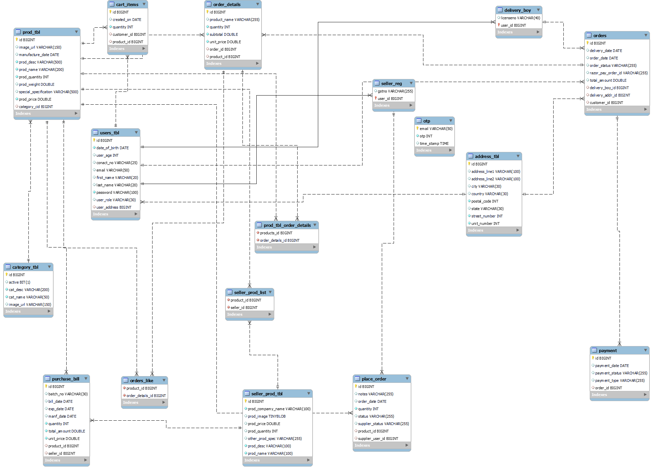
E-R DIAGRAM

Slide 8
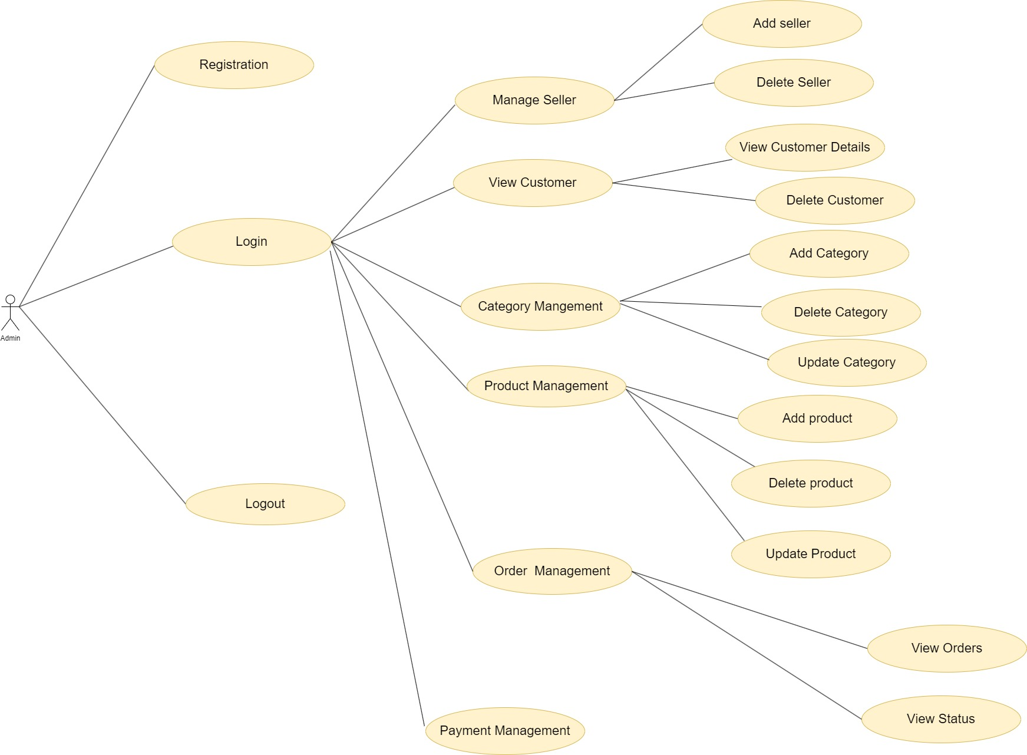
ADMIN USE CASE DIAGRAM

Slide 9
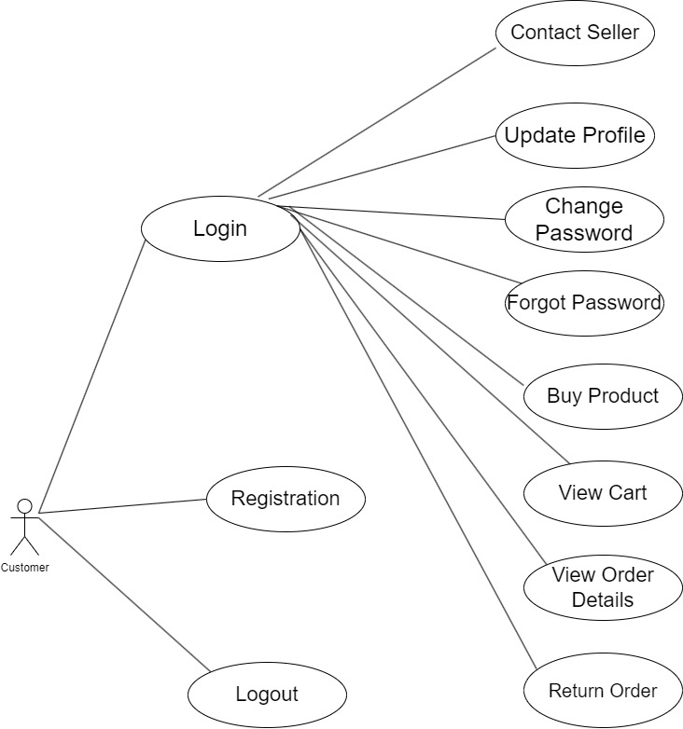
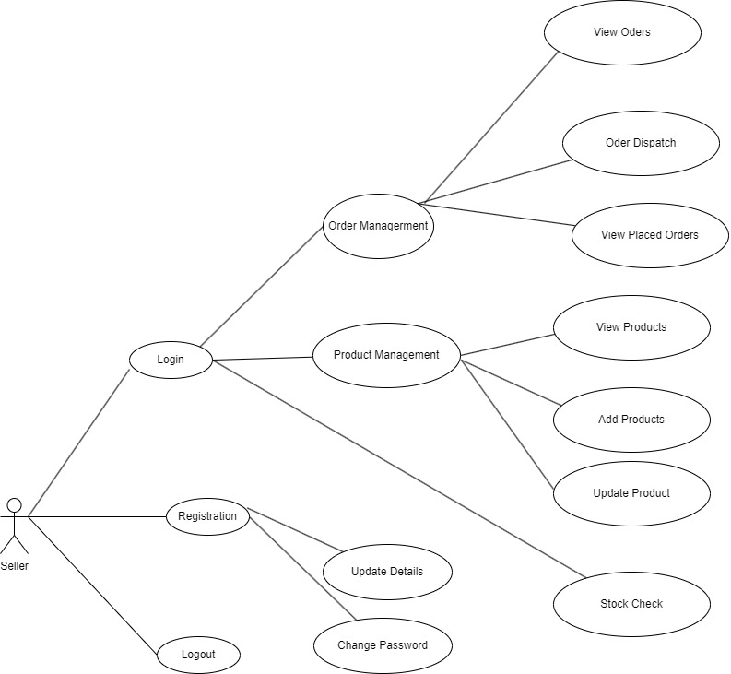
USER AND SELLER USE CASE DIAGRAM

Slide 10
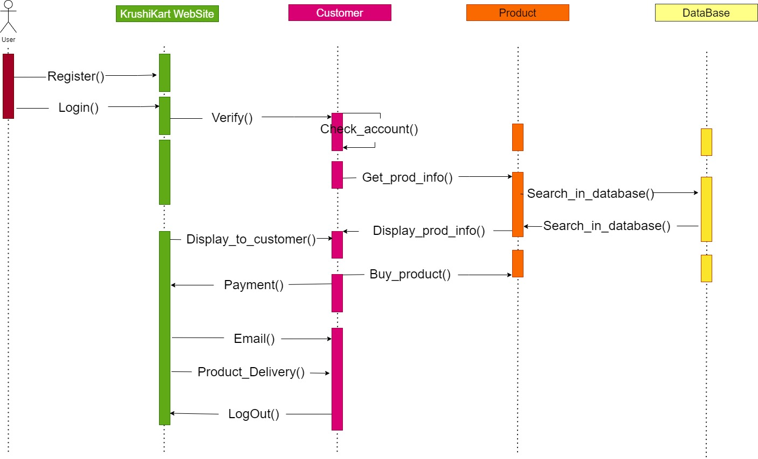
SEQUENCE DIAGRAMS

Slide 11
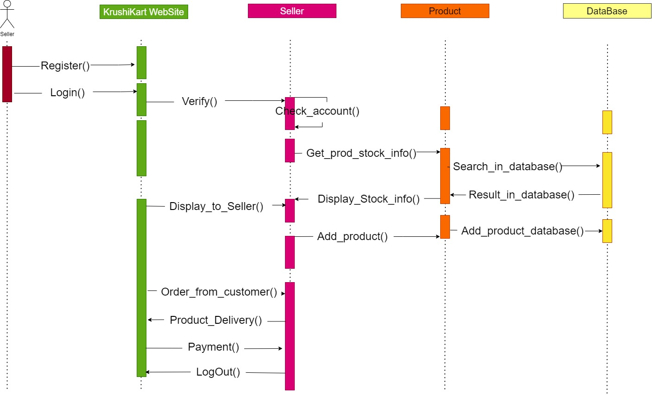

Slide 12
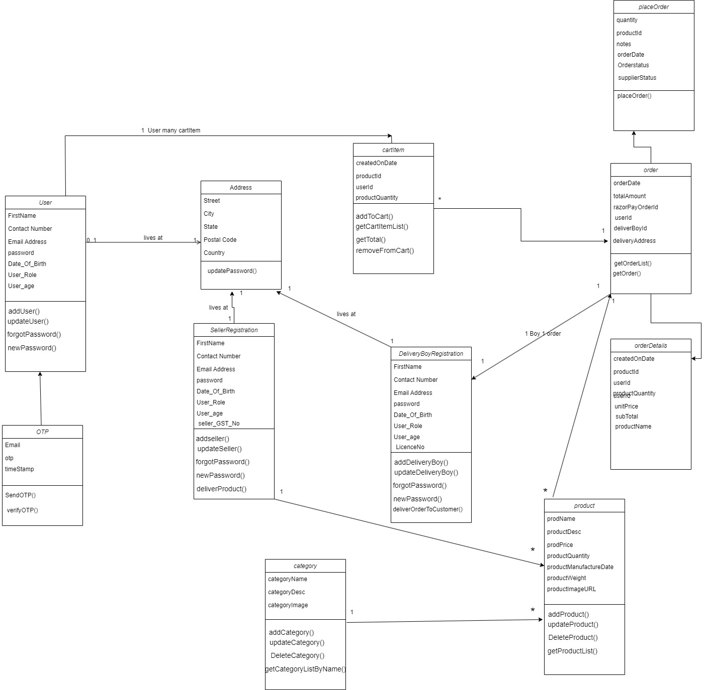
CLASS DIAGRAM

Slide 13
SCREENSHOTS

Slide 14
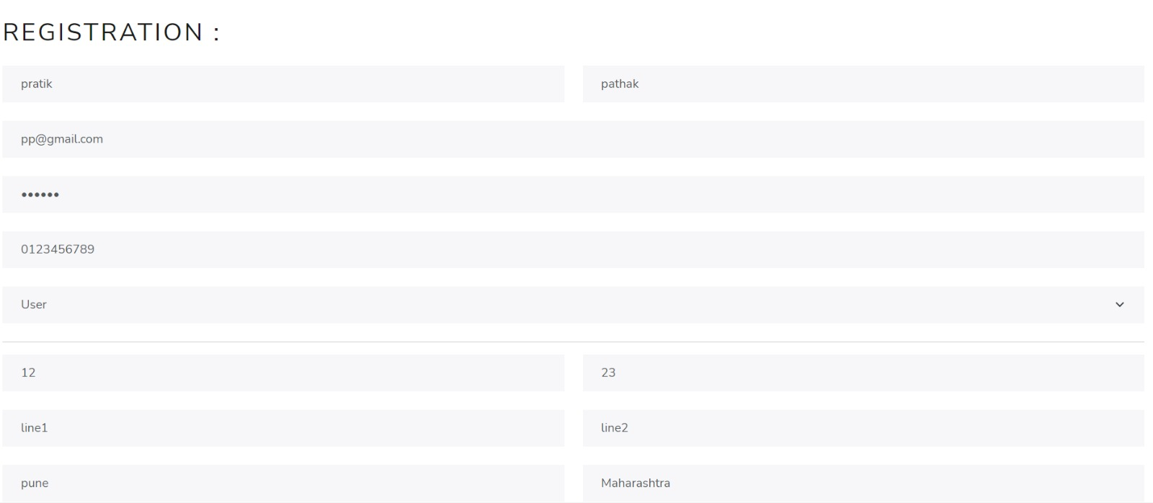
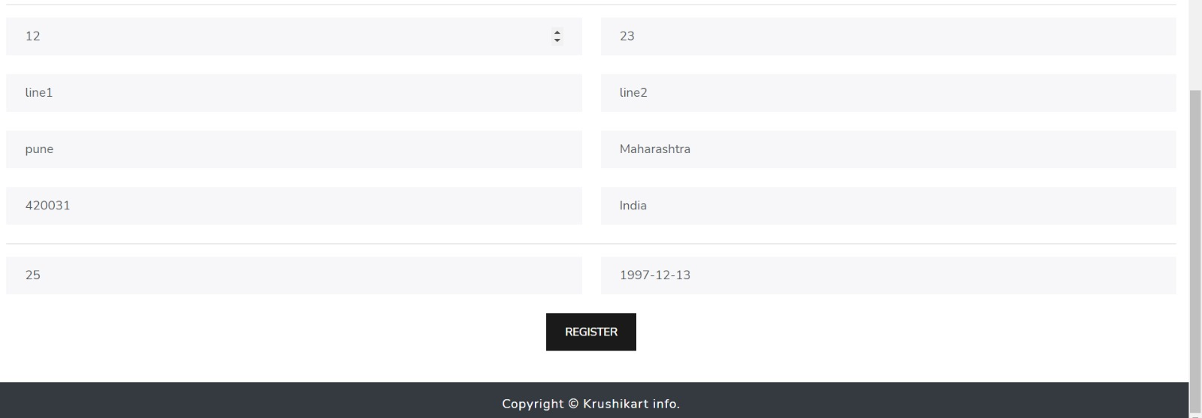
USER REGISTRATION AND LOGIN PAGE

Slide 15
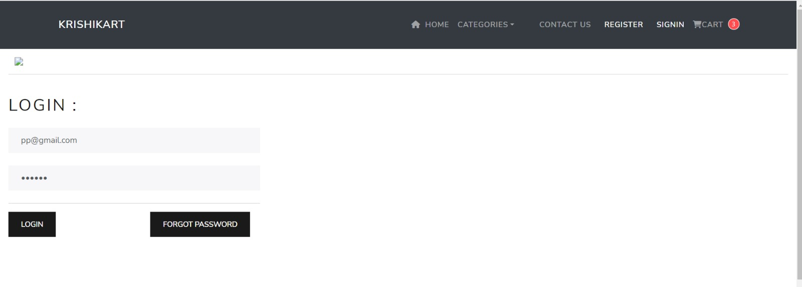

Slide 16
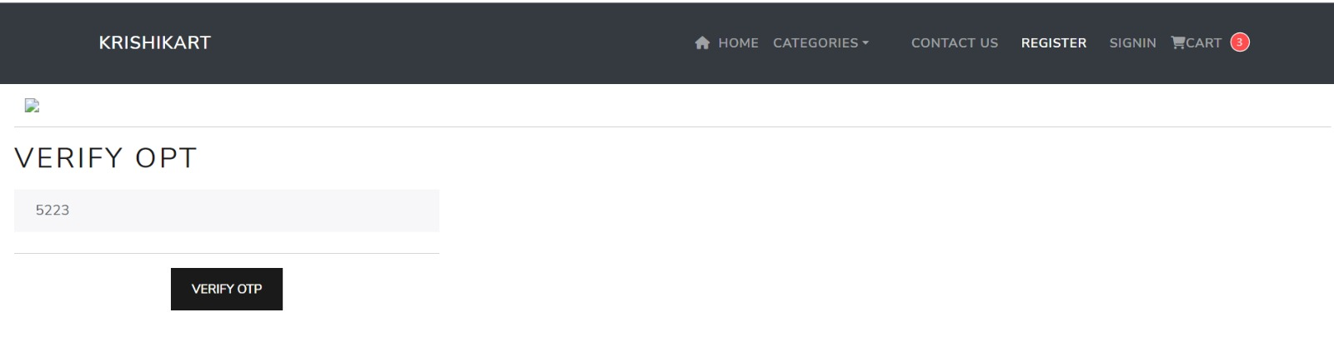
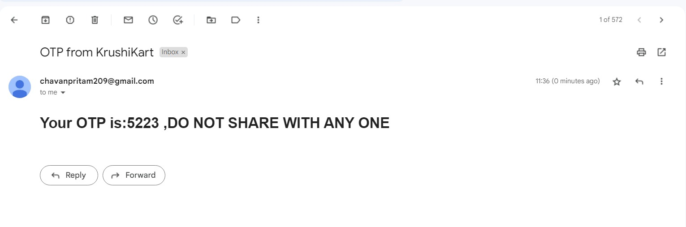
RESET PASSWORD AND EMAIL

Slide 17
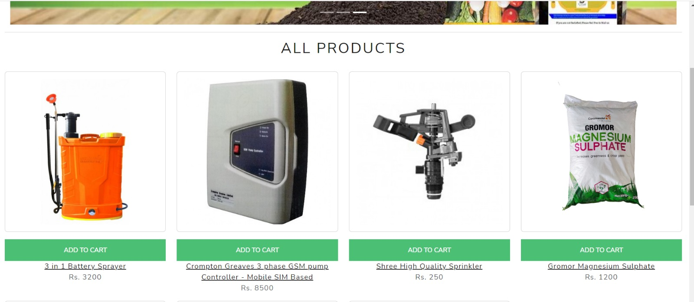
LANDING PAGE AFTER SUCCESSFUL LOGIN

Slide 18
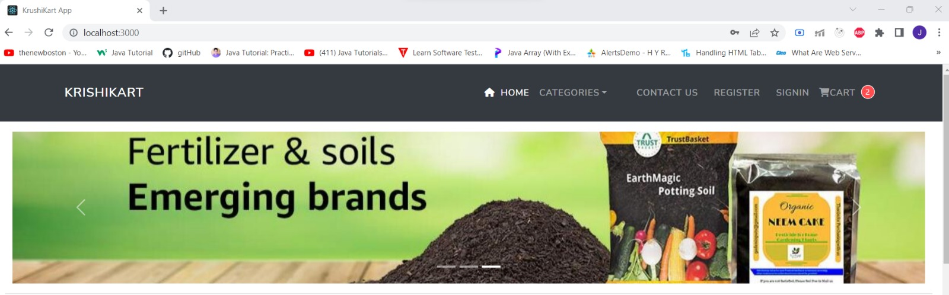
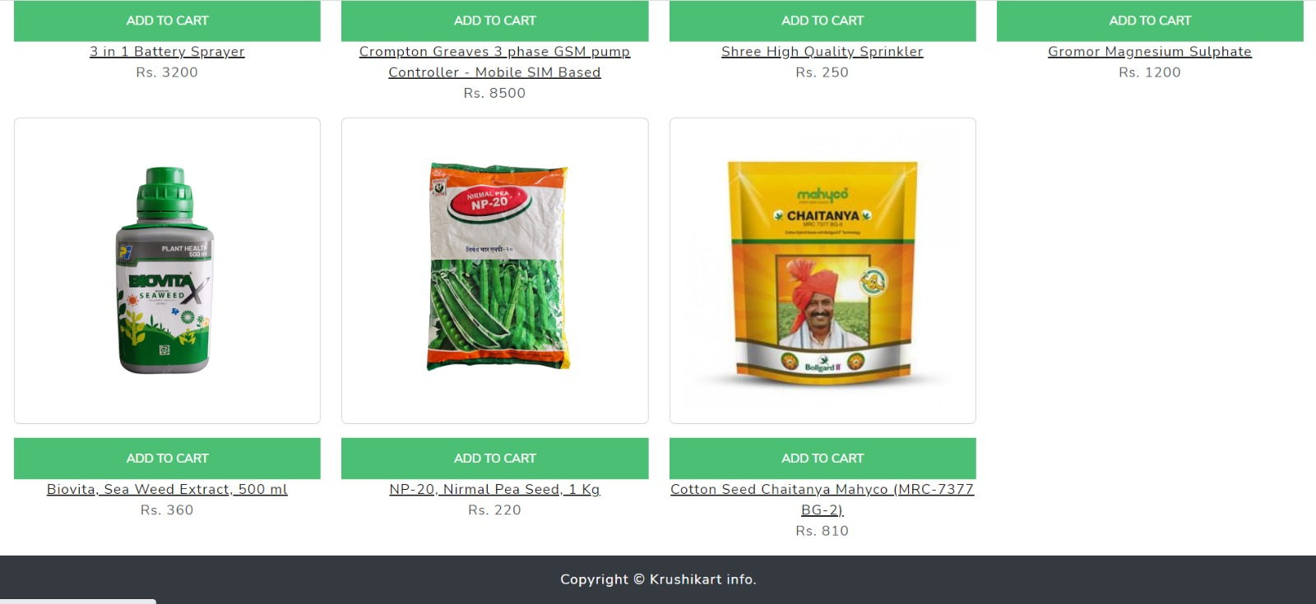

Slide 19
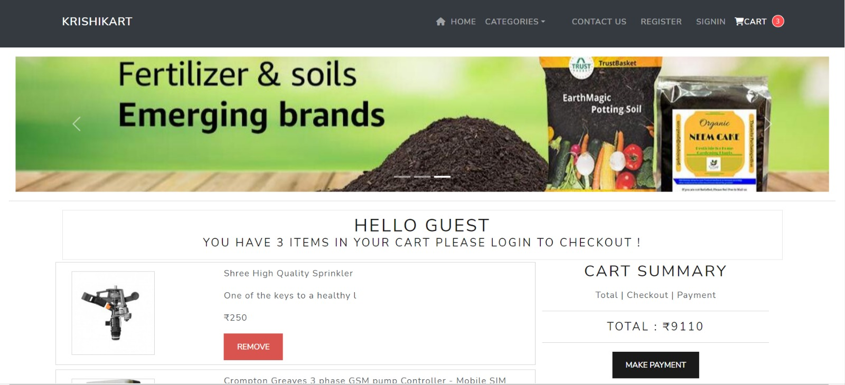
AFTER ADDING PRODUCTS IN CARTS

Slide 20
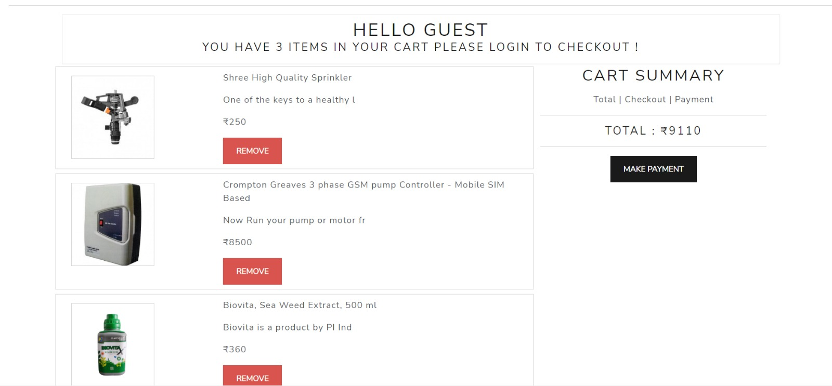

Slide 21
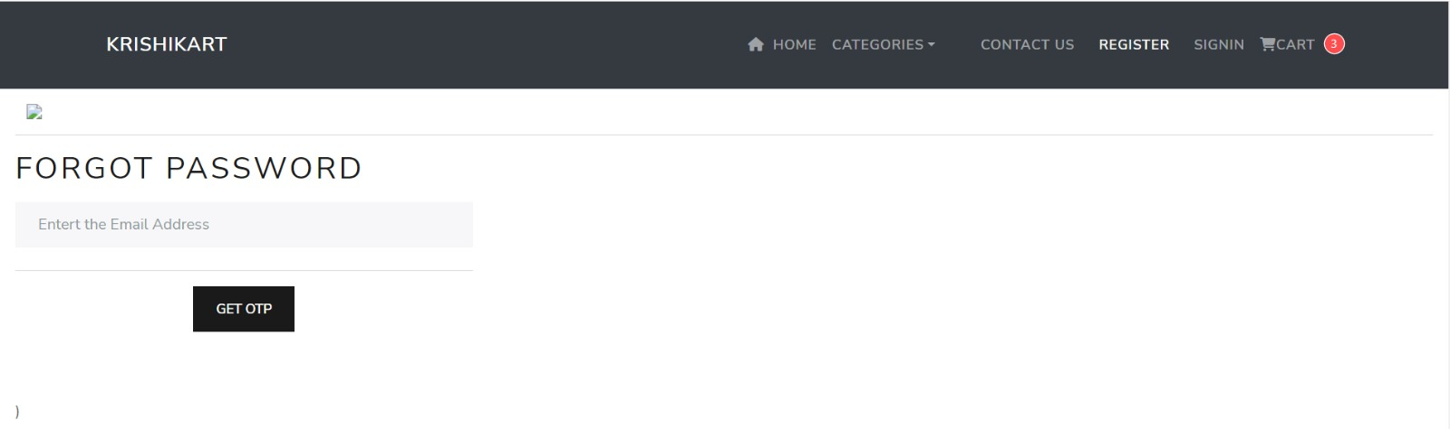
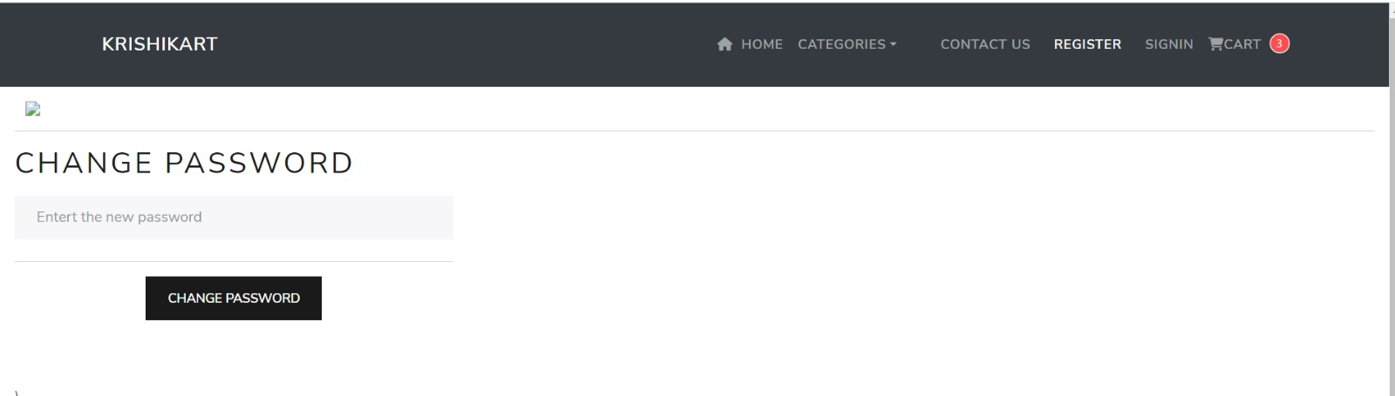
CHANGE PASSWORD

Slide 22
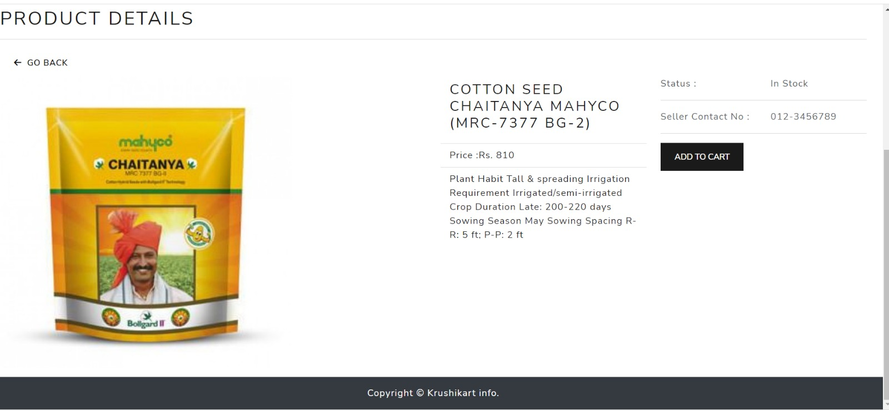
PRODUCT DETAILS

Slide 23
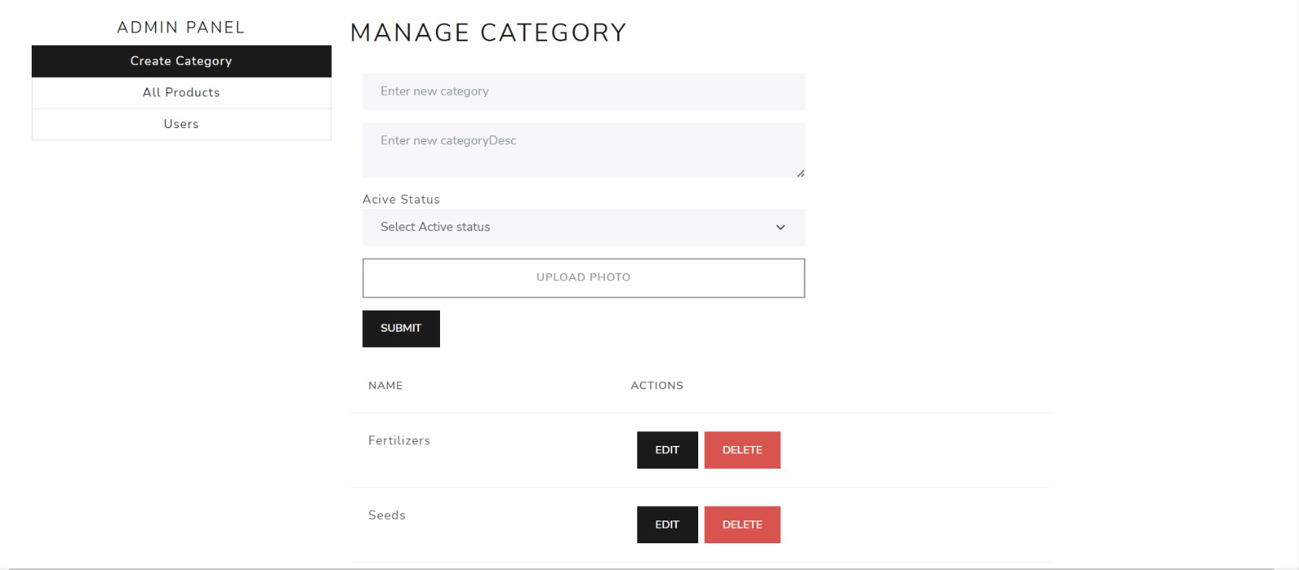
MANAGE CATEGORY DETAILS

Slide 24
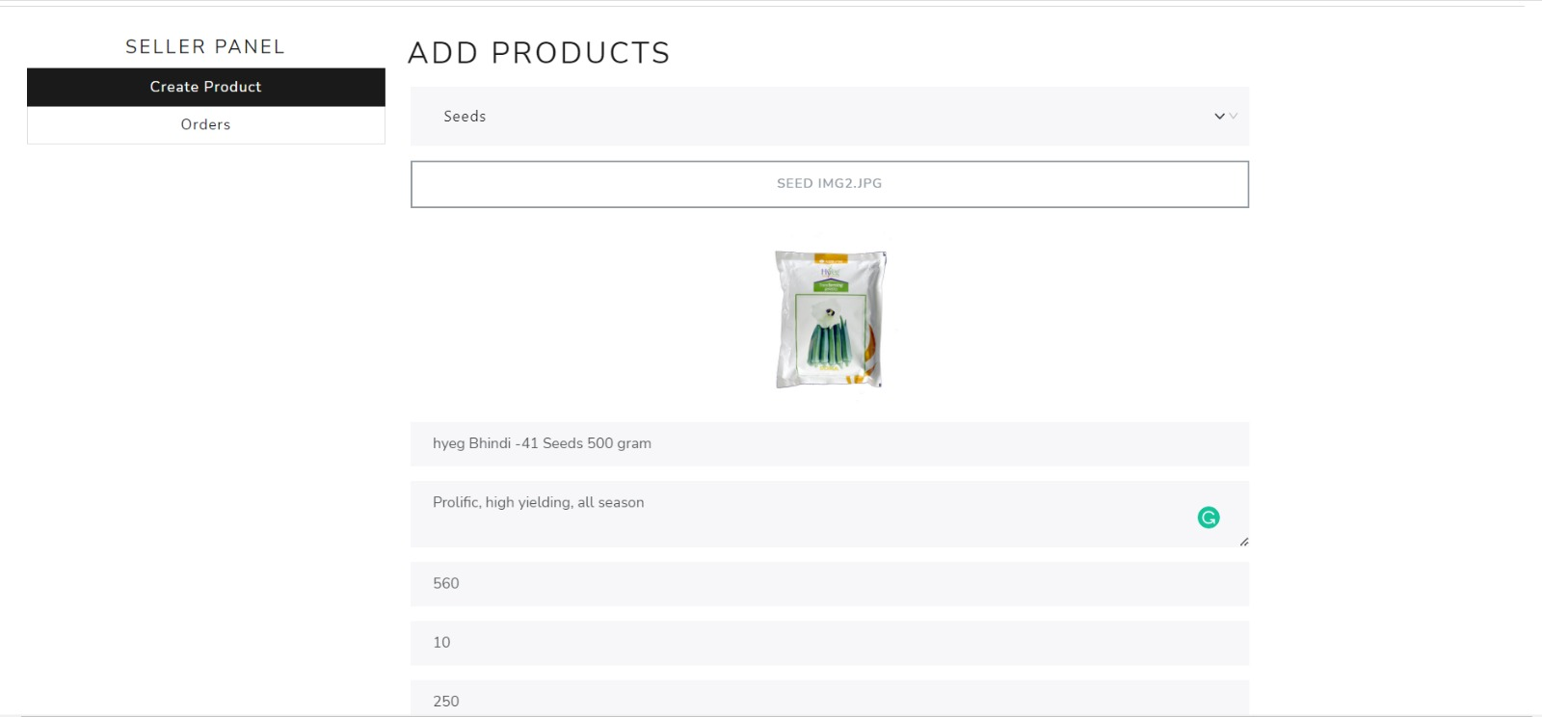

MANAGE PRODUCTS

Slide 25
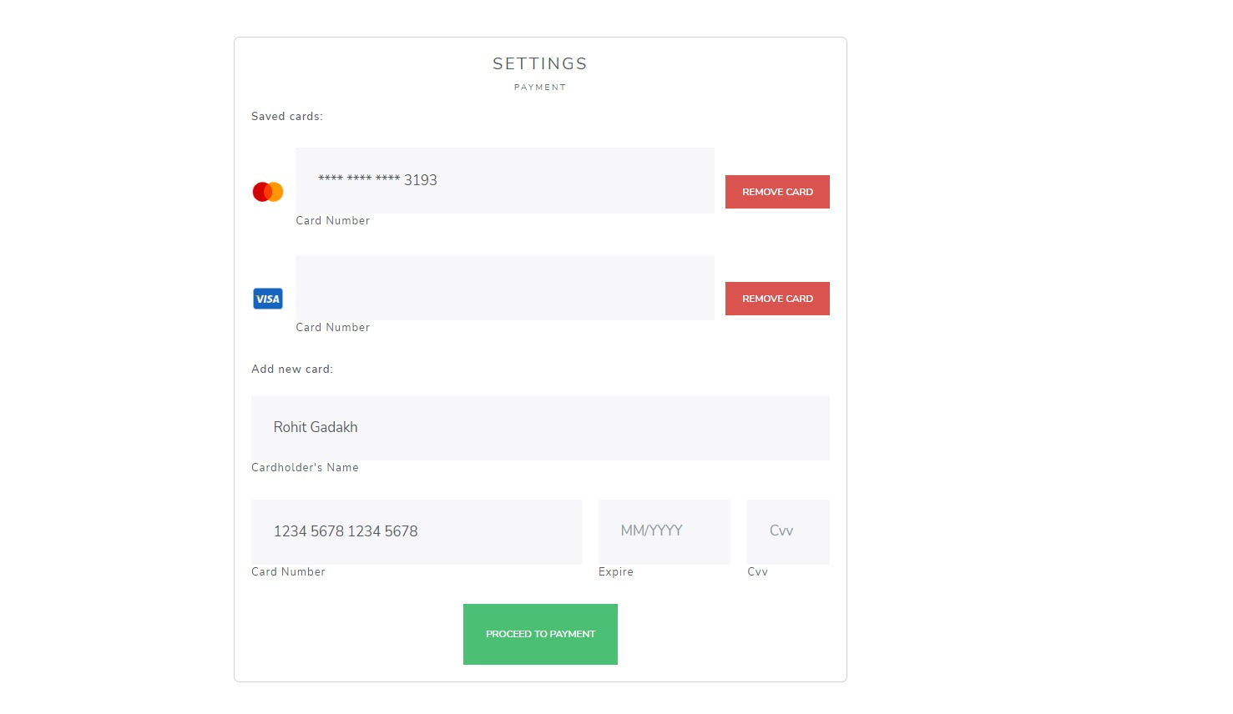
PAYMENT

Slide 26
CONCLUSION
This platform includes designing and developing a digital platform that allows certified sellers to advertise their properties online and allows customers to visit the properties online with ocean of data regarding the property.
This will aid customers with buying and renting legal properties verified with our legal team in accordance with rules and regulations everything online.

