Slide 1

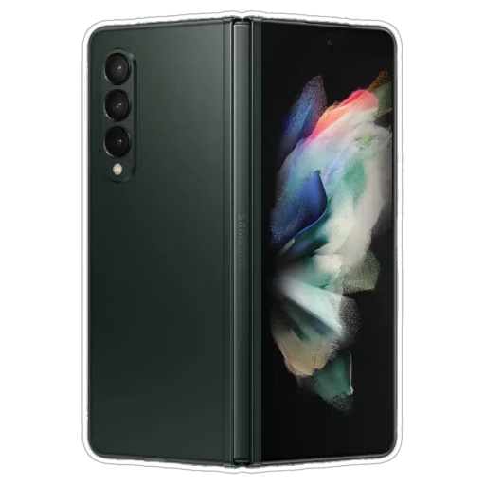
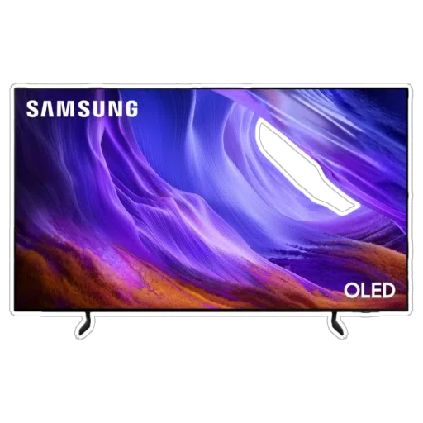
From raw transactions to
clear business decisions.
EXCEL SALES
ANALYTICS PROJECT
A visual walkthrough of sales, profit, products, regions,
stores, customers and payment behavior.
Samsung Store Maharashtra
TOTAL SALES
PROFIT
ORDERS
₹6.87 Cr
₹68.70 L
1,000
Dashboard-driven business performance review
01

Slide 2
Problem Statement/Overview
Problem Statement
The Samsung Store Maharashtra dataset contains 1,000 transaction records covering products, categories, customer details, locations, sales, discounts, profit, and payment modes.
To support effective business decision-making, an Excel dashboard is required to organize, analyze, and visualize the sales data in a clear and interactive manner.
The dashboard should present key metrics such as total sales, total profit, quantity sold, average order value, discount value, and profit margin, helping identify important sales and profitability patterns.
The analysis should help understand category performance, regional sales distribution, monthly sales trends, and product performance across Maharashtra.
02
Overview
Provide a single dashboard view to analyze the 1,000 Samsung Store Maharashtra transactions.
Identify sales trends across categories, products, regions, cities, and stores.
Understand overall business performance through total sales, profit, quantity sold, orders, and average order value.
Compare different categories such as Mobile, Home Appliance, Television, Tablet, Audio, Wearable, and Accessories.
Analyze regional sales contribution and identify the strongest markets within Maharashtra.
Evaluate profit margins and discount values to understand revenue quality profit.

Slide 3
Who Will Use This Dashboard?
Primary Users
Store Managers & Franchise Owners
To monitor sales, profit, inventory performance, and store-level results.
Sales & Marketing Teams
To identify high-performing products, categories, and sales trends for better promotional planning.
Secondary Users
Regional Managers
To compare sales performance across different regions, cities, and stores.
Business Analysts
To analyze sales, profitability, customer behavior, and identify important business trends.
Inventory & Product Teams
To understand product demand and support better stock and product planning.
Management / Decision Makers
To quickly review KPIs and make data-driven decisions regarding sales, profitability, and regional performance.
Data Analytics Learners
To use the dashboard as a practical example of Excel-based sales and business analytics.
03

Slide 4
Dashboard Design
Dashboard Design
KPI Cards
Total Sales
Total Profit
Quantity Sold
Total Orders
Average Order Value
Profit Margin
Discount Value
CHARTS
Monthly Sales Trend
Compares sales from January to December
Highlights the highest and lowest sales months
Bar Chart
Category Performance
Compares sales across Mobile, Home Appliance, Television, Tablet, Audio, Wearable, and Accessories
Regional Analysis
Regional Sales Contribution
Compares North, South, East, and West sales performance
Profitability Analysis
Category Profit Margin
Compares profitability across different product categories
Insight & Recommendation Section
Identifies top-performing categories
Highlights strongest regions
04

Slide 5
EXECUTIVE SNAPSHOT
05
The business generated ₹6.87 Cr in sales
A high-level view of the dataset before drilling into categories and locations.
TOTAL SALES
TOTAL PROFIT
QUANTITY SOLD
AVG. ORDER VALUE
DISCOUNT VALUE
₹6.87 Cr
₹68.70 L
1,279
₹68,736
₹63.04 L
1,000 unique orders
10.0% overall margin
units across all categories
sales ÷ orders
recorded discount
Mobile is the growth engine
West is the largest market
December closes strongest
Mobile contributes 48.1% of total sales, making it the dominant category.
West contributes 60.4% of sales — materially ahead of every other region.
December records the highest monthly sales at ₹67.7 L.
DATASET
1,000 rows • 20 analyzed fields • Maharashtra • 12 months
Core dimensions
Category • Region • City • Store • Product • Gender • Payment Mode
SAMSUNG STORE • MAHARASHTRA SALES ANALYSIS

Slide 6
PROJECT CONTEXT
06
Turning transaction data into a decision-ready dashboard
The attached workbook combines raw transaction records with pivot-based dashboard analysis. The presentation follows the same analytical story while giving it a cleaner, presentation-first structure.
PROJECT
OBJECTIVE
ANALYTICAL FLOW
01
RAW DATA
Orders, customers,
products & pricing
What the analysis needs to answer
02
PIVOTS
How much did the business sell and earn?
Which categories and product lines drive revenue?
Where are the strongest and weakest markets?
Which stores and payment modes matter most?
What patterns can guide future decisions?
Category, region,
city & store views
03
DASHBOARD
KPIs + charts + filters
04
INSIGHTS
Patterns → actions
SAMSUNG STORE • MAHARASHTRA SALES ANALYSIS

Slide 7
DATA OVERVIEW
07
A 1,000-order dataset with 20 core analytical fields
The presentation uses the 'Samsung Sales MH Data' sheet as the transactional source and the workbook's pivot sheets as the analytical reference.
CORE DATA FIELDS
HOW THE NUMBERS WERE READ
Order & Customer
Order_ID, Customer_ID, Gender
Revenue
SUM of Sales
Location
Region_Direction, Region, City, Store
Profit
SUM of Profit
Product
Product_Name, Category, Sub_Category
Margin
Profit ÷ Sales
Commercials
Quantity, Unit_Price, Discount, Sales
Orders
Distinct Order_ID
Profitability
Profit, Cost_Price, Discount_Value
AOV
Sales ÷ Orders
Payment
Payment_Mode
Mix
Category / Region / Payment share
Time
Order_Date
This keeps the presentation aligned with the workbook's KPI and pivot logic while adding a few decision-oriented ratios.
SAMSUNG STORE • MAHARASHTRA SALES ANALYSIS

Slide 8
DASHBOARD VIEW
08
A presentation-friendly reconstruction of the workbook's dashboard story
SALES
PROFIT
QUANTITY
ORDERS
MARGIN
₹6.87 Cr
₹68.70 L
1,279
1,000
10.0%
The workbook dashboard emphasizes monthly sales, category mix, regional sales and profitability. This presentation expands that same view into a clear business narrative.
SAMSUNG STORE • MAHARASHTRA SALES ANALYSIS

Slide 9
TREND ANALYSIS
09
Sales fluctuate through the year, with December as the strongest month
MONTHLY READOUT
PEAK
Dec • ₹67.7 L
LOW
Jun • ₹44.6 L
WHY IT MATTERS
The gap between the best and weakest month suggests a meaningful seasonal swing worth tracking in inventory and campaign planning.
SAMSUNG STORE • MAHARASHTRA SALES ANALYSIS

Slide 10
CATEGORY PERFORMANCE
10
Mobile drives nearly half of total revenue
CATEGORY TAKEAWAYS
01 MOBILE
₹330.7 L sales • 48.1% share
02 HOME APPLIANCE
₹126.9 L sales • second-largest category
03 HIGHER-MARGIN LINES
Audio 20.4% margin • Wearable 15.0% margin
04 WATCHOUT
Television has 7.7% margin, below the 10.0% overall level
SAMSUNG STORE • MAHARASHTRA SALES ANALYSIS

Slide 11
REGIONAL PERFORMANCE
11
West Maharashtra is the dominant revenue market
REGIONAL MIX
West
₹415.0 L
60.4%
East
₹138.0 L
20.1%
South
₹80.8 L
11.8%
North
₹53.6 L
7.8%
Decision point
West + Mumbai represent the strongest demand concentration; regional inventory and campaign allocation should reflect that weight.
SAMSUNG STORE • MAHARASHTRA SALES ANALYSIS

Slide 12
PROFITABILITY
12
₹68.70 L profit is generated at a 10.0% overall margin
PROFIT
OVERALL MARGIN
AVG. ORDER VALUE
DISCOUNT VALUE
₹68.70 L
10.0%
₹68,736
₹63.04 L
profit ÷ sales
per unique order
before-cost pressure
Category margin comparison
Accessory
31.6%
WHAT STANDS OUT
Audio
20.4%
Wearable
15.0%
Accessories and Audio show the strongest margins, while Television is the main margin drag among the larger revenue categories.
Mobile
9.9%
Tablet
9.8%
Home Appliance
9.2%
This suggests a balance between high-volume categories and higher-margin attachment opportunities.
Television
7.7%
SAMSUNG STORE • MAHARASHTRA SALES ANALYSIS

Slide 13
KEY FINDINGS
13
What the dashboard says — and what to do with it
01
Protect the Mobile engine
Mobile generates 48.1% of sales. Keep availability strong and use it to pull accessory and wearable attach sales.
02
Double down on West
West contributes 60.4% of revenue. Prioritize stock depth, local promotions and store execution here.
03
Use high-margin lines strategically
Audio and Wearable deliver stronger margins than the 10.0% overall average; bundles can lift order economics.
04
Watch seasonal softness
June is the weakest month at ₹44.6 L. Plan targeted campaigns and inventory actions ahead of softer periods.
Recommended focus → Revenue concentration + margin improvement + seasonal planning
SAMSUNG STORE • MAHARASHTRA SALES ANALYSIS

Slide 14
FUTURE ENHANCEMENTS
14
Turn the current dashboard into a stronger decision system
01
02
03
Interactive filters
Forecasting
Store benchmarking
Add cleaner slicer-driven views for region, category, city and store.
Use monthly sales history to build a simple demand forecast.
Compare stores on sales, profit, margin and average order value.
04
05
06
Basket analysis
Alert layer
Management scorecard
Study which products are commonly purchased together.
Flag low-margin categories, sales dips and unusual store performance.
Create a single executive page with targets vs. actuals.
SAMSUNG STORE • MAHARASHTRA SALES ANALYSIS

Slide 15
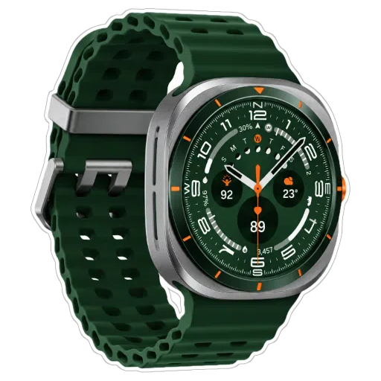
CONCLUSION
A dashboard is only useful
when the numbers lead to action.
SALES
PROFIT
₹68.70 L
₹6.87 Cr
The Samsung Store Maharashtra analysis records ₹6.87 Cr in sales and ₹68.70 L
in profit across 1,000 orders. Mobile and West Maharashtra dominate revenue, while higher-margin categories create opportunities to improve the quality of growth.
ORDERS
MARGIN
1,000
10.0%
THANK YOU
Questions / Discussion
15

