Slide 1



Madhav_Ecommerce_Sales_Dashboard
View in Power BI
Last data refresh:
08-07-2023 06:40:22 UTC
Downloaded at:
14-07-2023 11:04:00 UTC

Slide 2
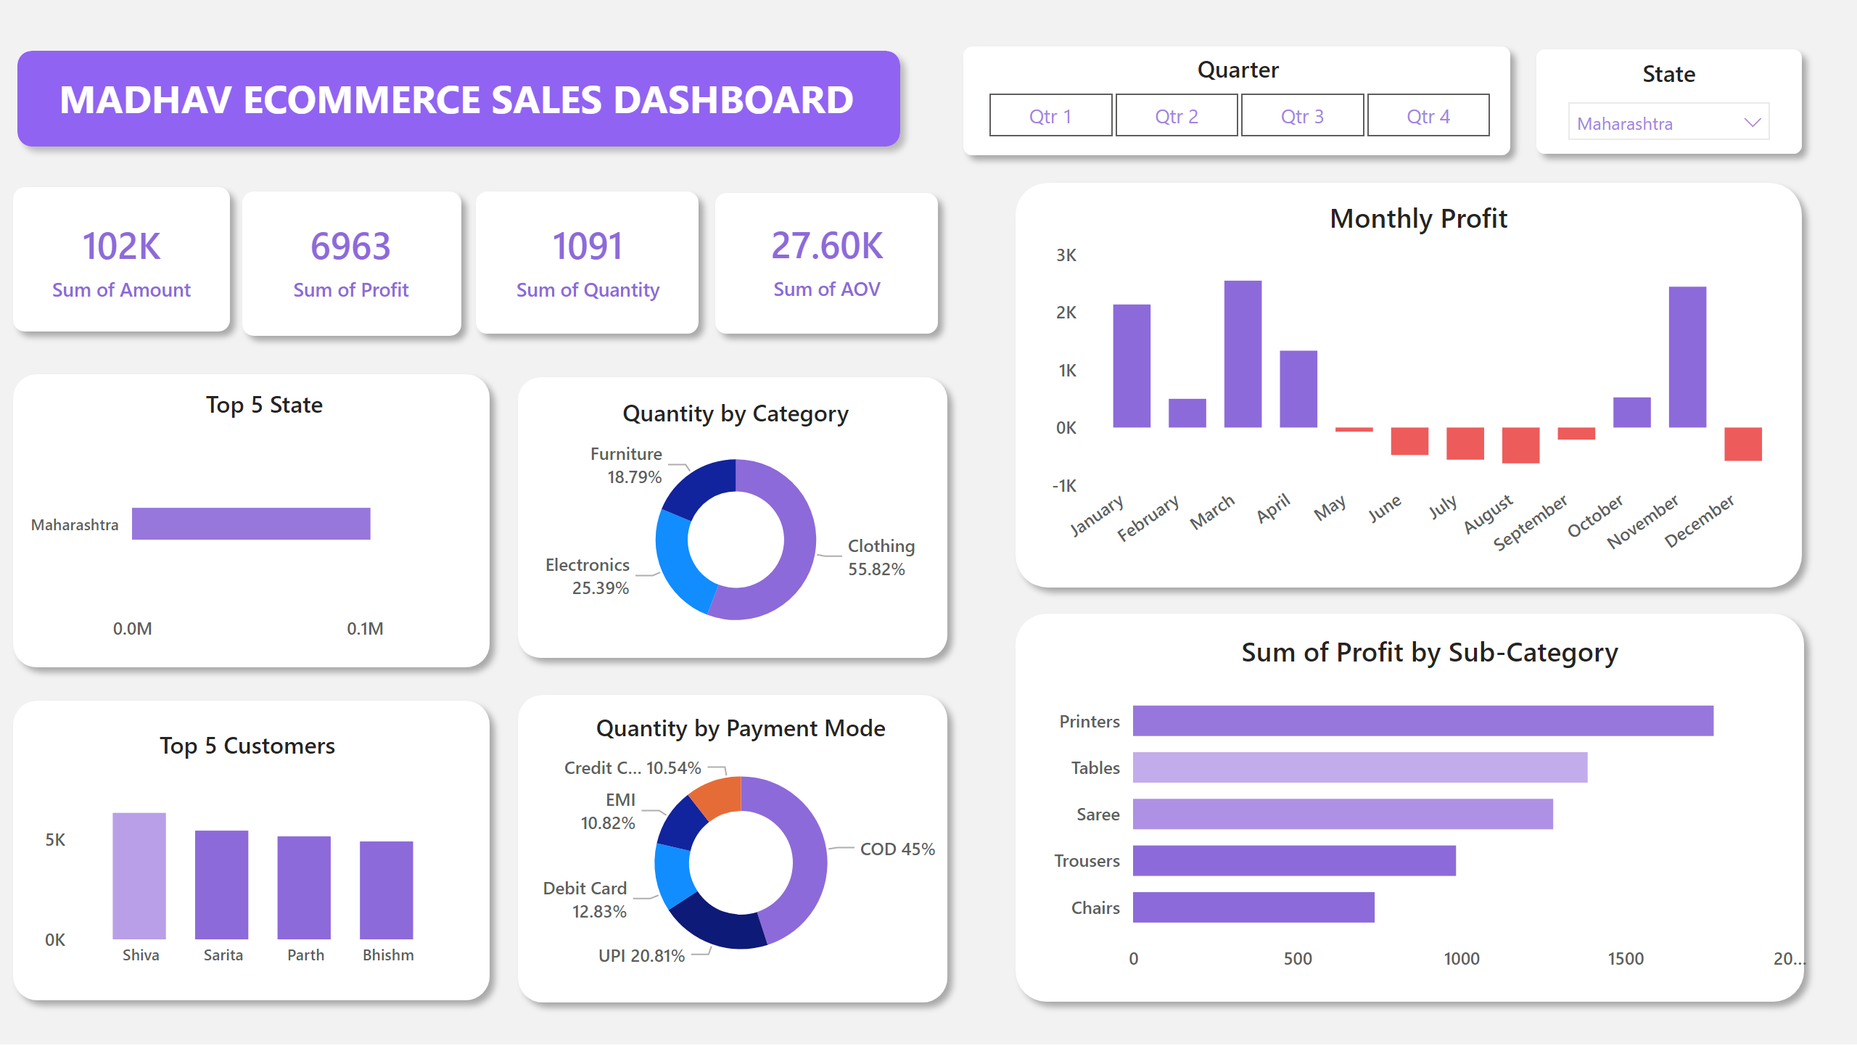
Page 1
Notes:
shape
No alt text provided
textbox
No alt text provided
shape
No alt text provided
shape
No alt text provided
shape
No alt text provided
shape
No alt text provided
shape
No alt text provided
shape
No alt text provided
shape
No alt text provided
shape
No alt text provided
shape
No alt text provided
Monthly Profit
No alt text provided
barChart
No alt text provided
card
No alt text provided
Quantity by Category
No alt text provided
shape
No alt text provided
shape
No alt text provided
shape
No alt text provided
card
No alt text provided
card
No alt text provided
card
No alt text provided
Quantity by Payment Mode
No alt text provided
Top 5 State
No alt text provided
Top 5 Customers
No alt text provided
Quarter
This is filter option on quarterly basis only.
State
This is filter option on quarterly basis only.

