Slide 1
GraphQL
The graph: a new layer in your stack
By – Jayesh

Slide 2
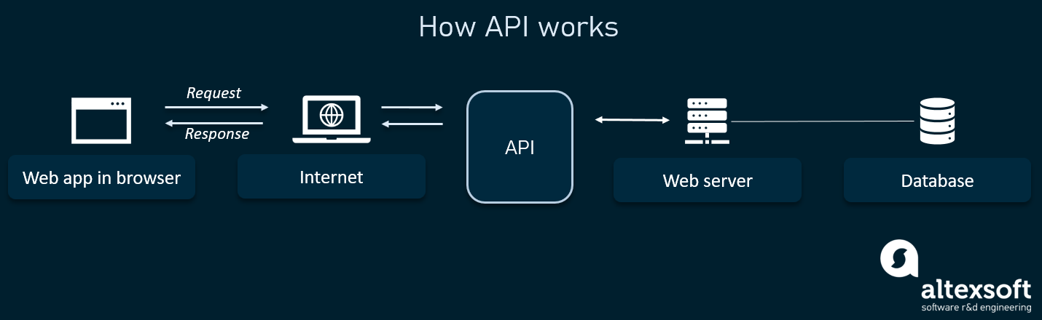
What is GraphQL ?
New API standard that provides a more efficient, powerful and flexible alternative to REST
Enables declarative data fetching
GraphQL server exposes single endpoint and responds to queries.
Notes:
An API is a set of programming code that enables data transmission between one software product and another. It also contains the terms of this data exchange.
Application programming interfaces consist of two components:
Technical specification describing the data exchange options between solutions with the specification done in the form of a request for processing and data delivery protocols
Software interface written to the specification that represents it
GraphQL is a new API standard that provides a more efficient, powerful and flexible alternative to REST. It was developed and open-sourced by Facebook and is now maintained by a large community of companies and individuals from all over the world.
APIs have become ubiquitous components of software infrastructures. In short, an API defines how a client can load data from a server.
At its core, GraphQL enables declarative data fetching where a client can specify exactly what data it needs from an API. Instead of multiple endpoints that return fixed data structures, a GraphQL server only exposes a single endpoint and responds with precisely the data a client asked for.

Slide 3



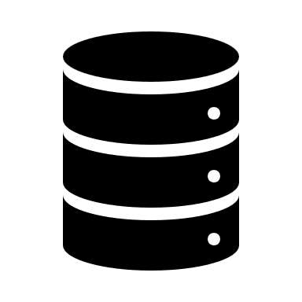

A Query Language for APIs
Notes:
GraphQL - A Query Language for APIs
Most applications today have the need to fetch data from a server where that data is stored in a database. It’s the responsibility of the API to provide an interface to the stored data that fits an application’s needs.
GraphQL is often confused with being a database technology. This is a misconception, GraphQL is a query language for APIs - not databases. In that sense it’s database agnostic and effectively can be used in any context where an API is used.

Slide 4
A more efficient Alternative to REST
Increased mobile usage creates need for efficient data loading
Variety of different frontend frameworks and platforms on client side
Fast development speed & expectation for rapid feature development
Notes:
A more efficient Alternative to REST
REST has been a popular way to expose data from a server. When the concept of REST was developed, client applications were relatively simple and the development pace wasn’t nearly where it is today. REST thus was a good fit for many applications. However, the API landscape has radically changed over the last couple of years. In particular, there are three factors that have been challenging the way APIs are designed:
1. Increased mobile usage creates need for efficient data loading
Increased mobile usage, low-powered devices and sloppy networks were the initial reasons why Facebook developed GraphQL. GraphQL minimizes the amount of data that needs to be transferred over the network and thus majorly improves applications operating under these conditions.
2. Variety of different frontend frameworks and platforms
The heterogeneous landscape of frontend frameworks and platforms that run client applications makes it difficult to build and maintain one API that would fit the requirements of all. With GraphQL, each client can access precisely the data it needs.
3. Fast development & expectation for rapid feature development
Continuous deployment has become a standard for many companies, rapid iterations and frequent product updates are indispensable. With REST APIs, the way data is exposed by the server often needs to be modified to account for specific requirements and design changes on the client-side. This hinders fast development practices and product iterations.

Slide 5
GraphQL is not only for React Developers
Facebook uses GraphQL since 2012 in their native mobile apps
First time presented publicly at React.js Conf 2015
GraphQL can be used with any programming language and framework
Notes:
Facebook started using GraphQL in 2012 in their native mobile apps. Interestingly though, GraphQL has mostly been picked up to be used in the context of web technologies and has gained only little traction in the native mobile space.
The first time Facebook publicly spoke about GraphQL was at React.js Conf 2015 and shortly after announced their plans to open source it. Because Facebook always used to speak about GraphQL in the context of React, it took a while for non-React developers to understand that GraphQL was by no means a technology that was limited to usage with React.

Slide 6
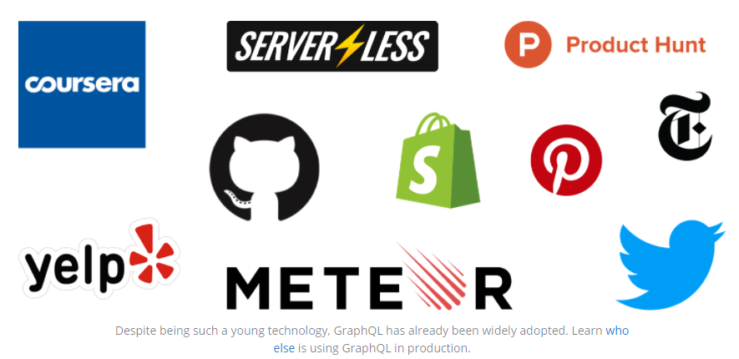
A rapidly growing Community
Other companies were working on similar ideas
Netflix open-sourced their solution Falcor
Courseera cancelled own initiatives and completely switched to using GraphQL
Conferances:
GraphQL Europe
GraphQL Summit
Notes:
Facebook started using GraphQL in 2012 in their native mobile apps. Interestingly though, GraphQL has mostly been picked up to be used in the context of web technologies and has gained only little traction in the native mobile space.
The first time Facebook publicly spoke about GraphQL was at React.js Conf 2015 and shortly after announced their plans to open source it. Because Facebook always used to speak about GraphQL in the context of React, it took a while for non-React developers to understand that GraphQL was by no means a technology that was limited to usage with React.
In fact, GraphQL is a technology that can be used everywhere a client communicates with an API. Interestingly, other companies like Netflix or Coursera were working on comparable ideas to make API interactions more efficient. Coursera envisioned a similar technology to let a client specify its data requirements and Netflix even open-sourced their solution called Falcor. After GraphQL was open-sourced, Coursera completely cancelled their own efforts and hopped on the GraphQL train.
Today, GraphQL is used in production by lots of different companies such as GitHub, Twitter, Yelp and Shopify - to name only a few.

Slide 7
GraphQL is the better REST
Why graphql is better alternative to restful apis

Slide 8
GraphQL vs REST
Great ideas in REST: stateless servers and structured access to resources
REST is strict specification – but the concept was wildly interpreted
Rapidly changing requirements on client side don’t go well with the static nature of REST
Notes:
Over the past decade, REST has become the standard (yet a fuzzy one) for designing web APIs. It offers some great ideas, such as stateless servers and structured access to resources. However,
REST APIs have shown to be too inflexible to keep up with the rapidly changing requirements of the clients that access them.

Slide 9
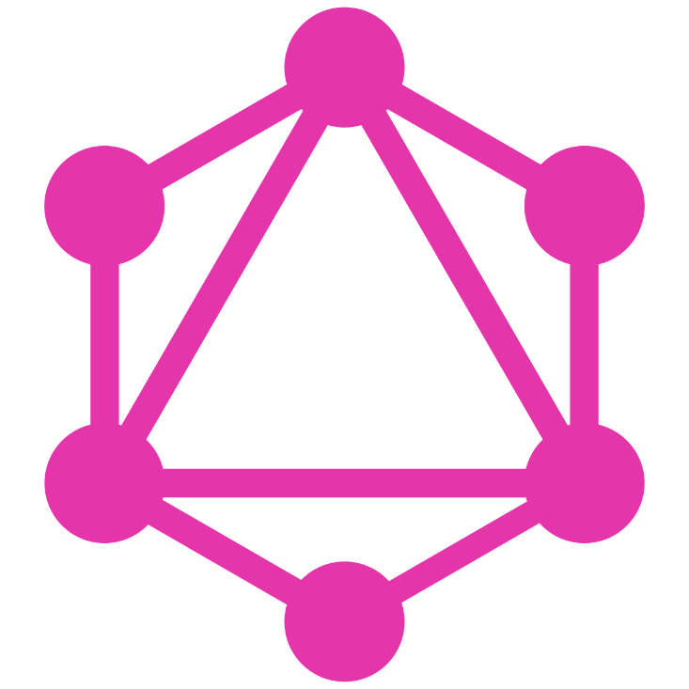
GraphQL was developed to cope with the need for more flexibility and efficiency in client server communication
Notes:
GraphQL was developed to cope with the need for more flexibility and efficiency! It solves many of the shortcomings and inefficiencies that developers experience when interacting with REST APIs.

Slide 10
Example: Blogging App
MARY
Mary’s posts
Learn grapgql today
React and graphQL – A declarative love story
Why graphQL is better than REST
Relay vs Apollo – GraphQL
Last three followers
John, Alice, Sarah
Notes:
To illustrate the major differences between REST and GraphQL when it comes to fetching data from an API, let’s consider a simple example scenario: In a blogging application, an app needs to display the titles of the posts of a specific user. The same screen also displays the names of the last 3 followers of that user. How would that situation be solved with REST and GraphQL?

Slide 11

Example Blogging App with REST
Users/<id>
Users/<id>/posts
Users/<id>/followers
3 API Endpoints
Notes:
Data Fetching with REST vs GraphQL
With a REST API, you would typically gather the data by accessing multiple endpoints. In the example, these could be /users/<id> endpoint to fetch the initial user data. Secondly, there’s likely to be a /users/<id>/posts endpoint that returns all the posts for a user. The third endpoint will then be the /users/<id>/followers that returns a list of followers per user.

Slide 12
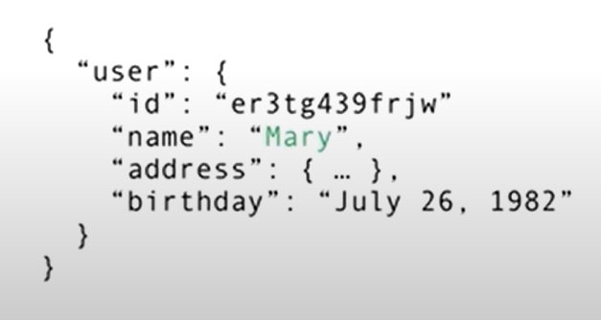
1. Fetch User Data
MARY
Mary’s posts
Last three followers
Users/<id>
Users/<id>/posts
Users/<id>/followers
Notes:
Data Fetching with REST vs GraphQL
With a REST API, you would typically gather the data by accessing multiple endpoints. In the example, these could be /users/<id> endpoint to fetch the initial user data. Secondly, there’s likely to be a /users/<id>/posts endpoint that returns all the posts for a user. The third endpoint will then be the /users/<id>/followers that returns a list of followers per user.

Slide 13
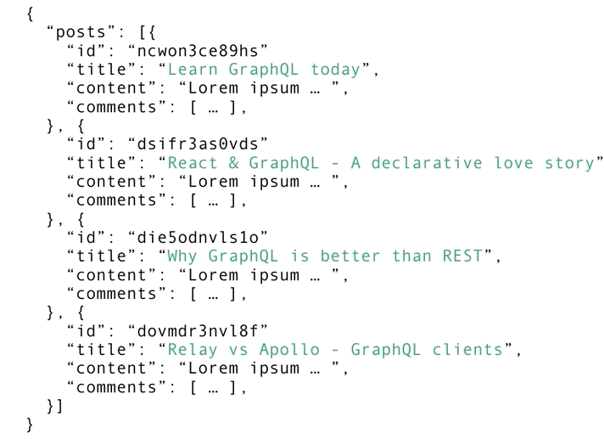
1. Fetch posts Data
MARY
Mary’s posts
Last three followers
Users/<id>
Users/<id>/posts
Users/<id>/followers

Slide 14
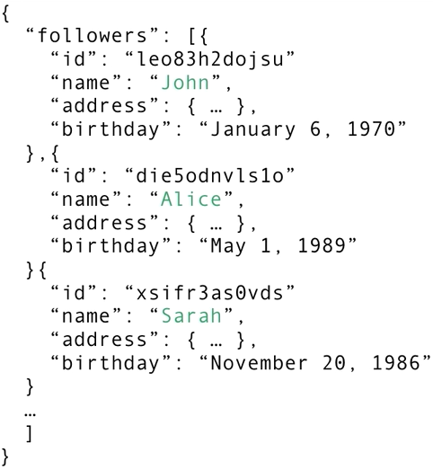
1. Fetch follower Data
MARY
Mary’s posts
Last three followers
Users/<id>
Users/<id>/posts
Users/<id>/followers
Notes:
This is not the ideal way,
In tody’s world you would want to be able to iterate quickly on your design and expriments with different features, if you had to go and adjust the API everytime you update the design in the frontent
Then you are not able to iterate quickly in product.
So how can we solve

Slide 15
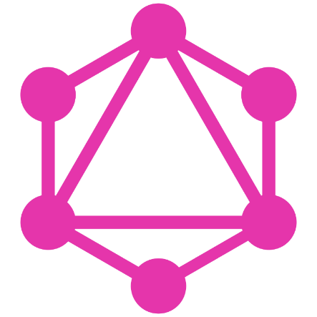
Example Blogging App with REST
1 API Endpoints
Notes:
Data Fetching with REST vs GraphQL
With a REST API, you would typically gather the data by accessing multiple endpoints.
In the example, these could be /users/<id> endpoint to fetch the initial user data.
Secondly, there’s likely to be a /users/<id>/posts endpoint that returns all the posts for a user.
The third endpoint will then be the /users/<id>/followers that returns a list of followers per user.

Slide 16
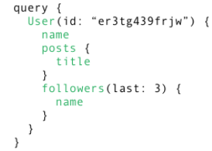
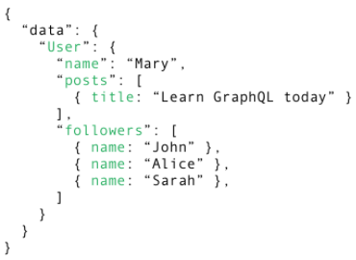
1. Fetch everything with a single request
Mary’s posts
Last three followers
Notes:
In GraphQL on the other hand, you’d simply send a single query to the GraphQL server that includes the concrete data requirements. The server then responds with a JSON object where these requirements are fulfilled.
Using GraphQL, the client can specify exactly the data it needs in a query. Notice that the structure of the server’s response follows precisely the nested structure defined in the query.

Slide 17
No More Over – and Underfetching
Overfetching: Downloading unnecessary data
Underfetching: An endpoint doesn’t return enough of the right information; need to send multiple requests (n+1 requests problem)
Notes:
No more Over- and Underfetching
One of the most common problems with REST is that of over- and underfetching. This happens because the only way for a client to download data is by hitting endpoints that return fixed data structures. It’s very difficult to design the API in a way that it’s able to provide clients with their exact data needs.
Overfetching: Downloading superfluous data
Overfetching means that a client downloads more information than is actually required in the app. Imagine for example a screen that needs to display a list of users only with their names. In a REST API, this app would usually hit the /users endpoint and receive a JSON array with user data. This response however might contain more info about the users that are returned, e.g. their birthdays or addresses - information that is useless for the client because it only needs to display the users’ names.
Underfetching and the n+1 problem
Another issue is underfetching and the n+1-requests problem. Underfetching generally means that a specific endpoint doesn’t provide enough of the required information. The client will have to make additional requests to fetch everything it needs. This can escalate to a situation where a client needs to first download a list of elements, but then needs to make one additional request per element to fetch the required data.
As an example, consider the same app would also need to display the last three followers per user. The API provides the additional endpoint /users/<user-id>/followers. In order to be able to display the required information, the app will have to make one request to the /users endpoint and then hit the /users/<user-id>/followers endpoint for each user.

Slide 18
Rapid Product Iterations
REST: structure endpoints according to clients’ data needs
No need to adjust API when product requirements and design change
Faster feedback cycles and product iterations
Notes:
Rapid Product Iterations on the Frontend
A common pattern with REST APIs is to structure the endpoints according to the views that you have inside your app. This is handy since it allows for the client to get all required information for a particular view by simply accessing the corresponding endpoint.
The major drawback of this approach is that it doesn’t allow for rapid iterations on the frontend. With every change that is made to the UI, there is a high risk that now there is more (or less) data required than before. Consequently, the backend needs to be adjusted as well to account for the new data needs. This kills productivity and notably slows down the ability to incorporate user feedback into a product.
With GraphQL, this problem is solved. Thanks to the flexible nature of GraphQL, changes on the client-side can be made without any extra work on the server. Since clients can specify their exact data requirements, no backend engineer needs to make adjustments when the design and data needs on the frontend change.

Slide 19
Insightful Analytics
Fine-grained info about what data is read by clients
Enables evolving API and deprecating unneeded API features
Great opportunities for instrumenting and performance monitoring
Notes:
Insightful Analytics on the Backend
GraphQL allows you to have fine-grained insights about the data that’s requested on the backend.
As each client specifies exactly what information it’s interested in, it is possible to gain a deep understanding of how the available data is being used. This can for example help in evolving an API and deprecating specific fields that are not requested by any clients any more.
With GraphQL, you can also do low-level performance monitoring of the requests that are processed by your server. GraphQL uses the concept of resolver functions to collect the data that’s requested by a client. Instrumenting and measuring performance of these resolvers provides crucial insights about bottlenecks in your system.

Slide 20
Benefits of Schema & Types
GraphQL uses strong type system to define capabilities of an API
Schema serves as contract between client and server
Frontend and backend teams can work completely independent from each other
Notes:
Benefits of a Schema & Type System
GraphQL uses a strong type system to define the capabilities of an API.
All the types that are exposed in an API are written down in a schema using the GraphQL Schema Definition Language (SDL).
This schema serves as the contract between the client and the server to define how a client can access the data.
Once the schema is defined, the teams working on frontend and backends can do their work without further communication since they both are aware of the definite structure of the data that’s sent over the network.
Frontend teams can easily test their applications by mocking the required data structures.
Once the server is ready, the switch can be flipped for the client apps to load the data from the actual API.

Slide 21
Core Concepts
Why graphql is better alternative to restful apis
Notes:
Core Concepts
In this part,
you’ll learn about some fundamental language constructs of GraphQL. That includes a first glimpse at the syntax for defining types as well as sending queries and mutations.

Slide 22
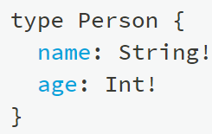
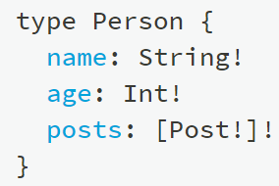
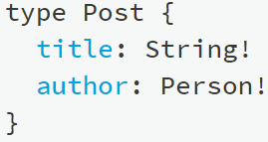

The Schema Definition Language(SDL)
Defining simple types,
Adding a relation
Notes:
The Schema Definition Language (SDL)
GraphQL has its own type system that’s used to define the schema of an API. The syntax for writing schemas is called Schema Definition Language (SDL).
Here is an example of how we can use the SDL to define a simple type called Person:
type Person { name: String! age: Int! }
This type has two fields, they’re called name and age and are respectively of type String and Int. The ! following the type means that this field is required.
It’s also possible to express relationships between types. In the example of a blogging application, a Person could be associated with a Post:
type Post { title: String! author: Person! }
Conversely, the other end of the relationship needs to be placed on the Person type:
type Person { name: String! age: Int! posts: [Post!]! }
Note that we just created a one-to-many-relationship between Person and Post since the posts field on Person is actually an array of posts.

Slide 23
Fetching Data with Queries
Notes:
Fetching Data with Queries
When working with REST APIs, data is loaded from specific endpoints. Each endpoint has a clearly defined structure of the information that it returns. This means that the data requirements of a client are effectively encoded in the URL that it connects to.
The approach that’s taken in GraphQL is radically different. Instead of having multiple endpoints that return fixed data structures, GraphQL APIs typically only expose a single endpoint. This works because the structure of the data that’s returned is not fixed. Instead, it’s completely flexible and lets the client decide what data is actually needed.
That means that the client needs to send more information to the server to express its data needs - this information is called a query.
Basic Queries
Let’s take a look at an example query that a client could send to a server:
{ allPersons { name } }
The allPersons field in this query is called the root field of the query. Everything that follows the root field, is called the payload of the query. The only field that’s specified in this query’s payload is name.
This query would return a list of all persons currently stored in the database. Here’s an example response:
{ "allPersons": [ { "name": "Johnny" }, { "name": "Sarah" }, { "name": "Alice" } ] }
Notice that each person only has the name in the response, but the age is not returned by the server. That’s exactly because name was the only field that was specified in the query.
If the client also needed the persons’ age, all it has to do is slightly adjust the query and include the new field in the query’s payload:
{ allPersons { name age } }
One of the major advantages of GraphQL is that it allows for naturally querying nested information. For example, if you wanted to load all the posts that a Person has written, you could simply follow the structure of your types to request this information:
{ allPersons { name age posts { title } } }
Queries with Arguments
In GraphQL, each field can have zero or more arguments if that’s specified in the schema. For example, the allPersons field could have a last parameter to only return up to a specific number of persons. Here’s what a corresponding query would look like:
{ allPersons(last: 2) { name } }

Slide 24
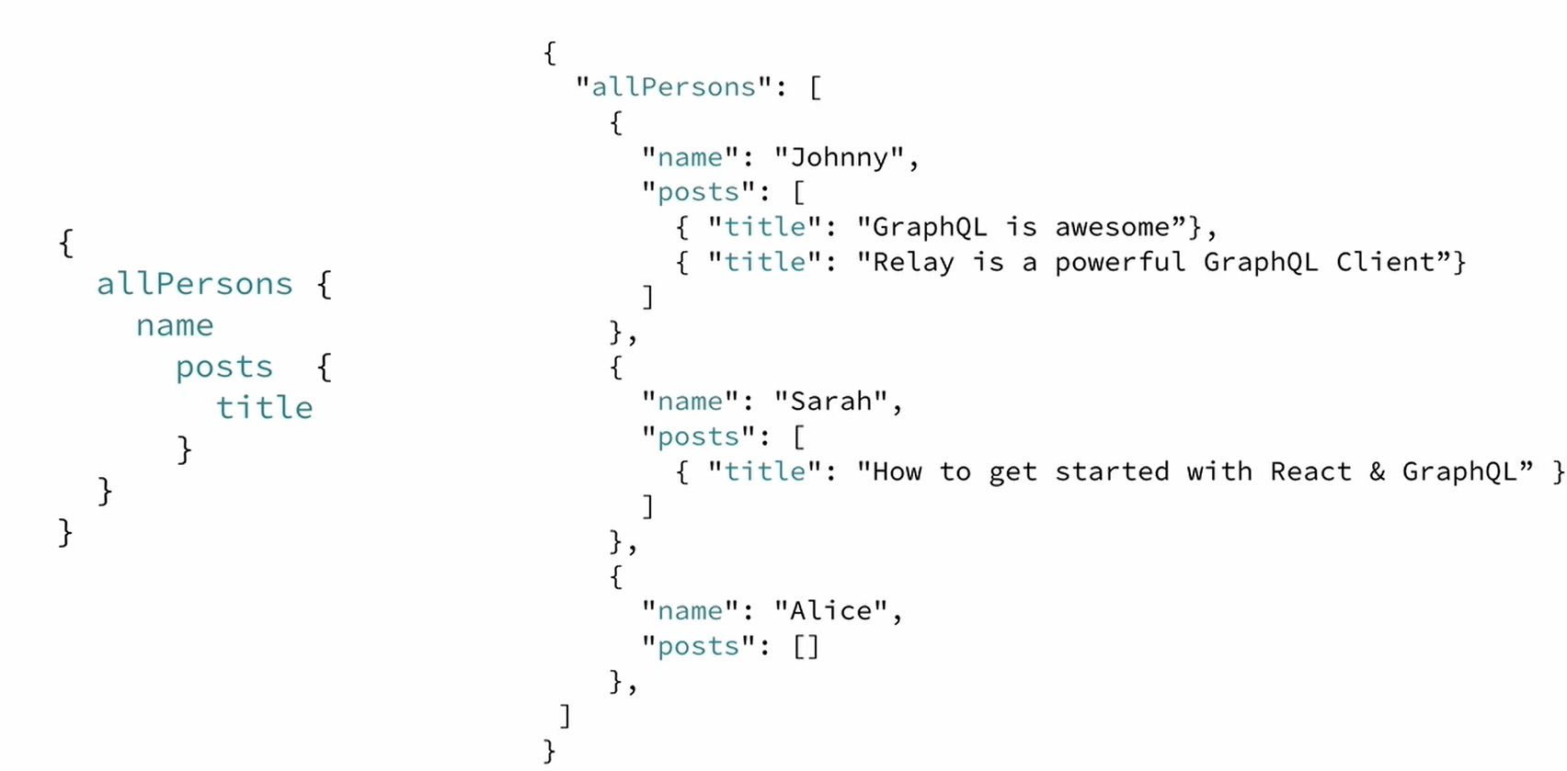
Fetching Data With Queries
Notes:
Benefits of a Schema & Type System
GraphQL uses a strong type system to define the capabilities of an API.
All the types that are exposed in an API are written down in a schema using the GraphQL Schema Definition Language (SDL).
This schema serves as the contract between the client and the server to define how a client can access the data.
Once the schema is defined, the teams working on frontend and backends can do their work without further communication since they both are aware of the definite structure of the data that’s sent over the network.
Frontend teams can easily test their applications by mocking the required data structures.
Once the server is ready, the switch can be flipped for the client apps to load the data from the actual API.

Slide 25
Writing Data with Mutations
3 kind of mutations:
Creating new data
Updating existing data
Deleting existing data
Notes:
Next to requesting information from a server,
the majority of applications also need some way of making changes to the data that’s currently stored in the backend. With GraphQL, these changes are made using so-called mutations. There generally are three kinds of mutations:
creating new data
updating existing data
deleting existing data

Slide 26
Writing Data with Mutations
Notes:
Mutations follow the same syntactical structure as queries, but they always need to start with the mutation keyword. Here’s an example for how we might create a new Person:
mutation { createPerson(name: "Bob", age: 36) { name age } }
Notice that similar to the query we wrote before, the mutation also has a root field - in this case it’s called createPerson. We also already learned about the concepts of arguments for fields. In this case, the createPerson field takes two arguments that specify the new person’s name and age.
Like with a query, we’re also able to specify a payload for a mutation in which we can ask for different properties of the new Person object. In our case, we’re asking for the name and the age - though admittedly that’s not super helpful in our example since we obviously already know them as we pass them into the mutation. However, being able to also query information when sending mutations can be a very powerful tool that allows you to retrieve new information from the server in a single roundtrip!
The server response for the above mutation would look as follows:
"createPerson": { "name": "Bob", "age": 36, }
One pattern you’ll often find is that GraphQL types have unique IDs that are generated by the server when new objects are created. Extending our Person type from before, we could add an id like this:
type Person { id: ID! name: String! age: Int! }
Now, when a new Person is created, you could directly ask for the id in the payload of the mutation, since that is information that wasn’t available on the client beforehand:
mutation { createPerson(name: "Alice", age: 36) { id } }

Slide 27
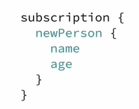
Realtime Updates with Subscriptions
Notes:
Another important requirement for many applications today is to have a realtime connection to the server in order to get immediately informed about important events. For this use case, GraphQL offers the concept of subscriptions.
When a client subscribes to an event, it will initiate and hold a steady connection to the server. Whenever that particular event then actually happens, the server pushes the corresponding data to the client. Unlike queries and mutations that follow a typical “request-response-cycle”, subscriptions represent a stream of data sent over to the client.
Subscriptions are written using the same syntax as queries and mutations. Here’s an example where we subscribe on events happening on the Person type:
subscription { newPerson { name age } }
After a client sent this subscription to a server, a connection is opened between them. Then, whenever a new mutation is performed that creates a new Person, the server sends the information about this person over to the client:
{ "newPerson": { "name": "Jane", "age": 23 } }

Slide 28
The GraphQL Schema
Defines capabilities of the API by specifying how a client can fetch and update data
Represents contract between client and server
Collection of GraphQL types with special root types
Notes:
Now that you have a basic understanding of what queries, mutations, and subscriptions look like, let’s put it all together and learn how you can write a schema that would allow you to execute the examples you’ve seen so far.
The schema is one of the most important concepts when working with a GraphQL API. It specifies the capabilities of the API and defines how clients can request the data. It is often seen as a contract between the server and client.

Slide 29
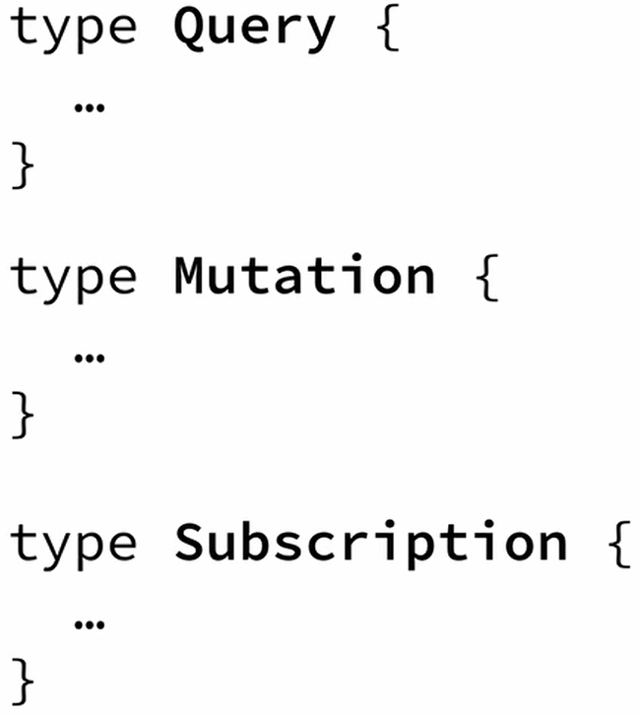
Root Types
Notes:
Generally, a schema is simply a collection of GraphQL types. However, when writing the schema for an API, there are some special root types:
type Query { ... }
type Mutation { ... }
type Subscription { ... }
The Query, Mutation, and Subscription types are the entry points for the requests sent by the client.

Slide 30
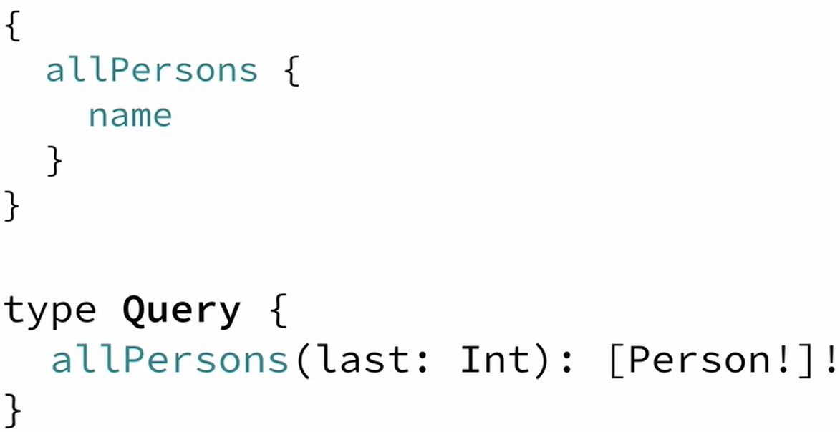
The Query Types
Notes:
To enable the allPersons-query that we saw before, the Query type would have to be written as follows:
allPersons is called a root field of the API. Considering again the example where we added the last argument to the allPersons field, we’d have to write the Query as follows:

Slide 31
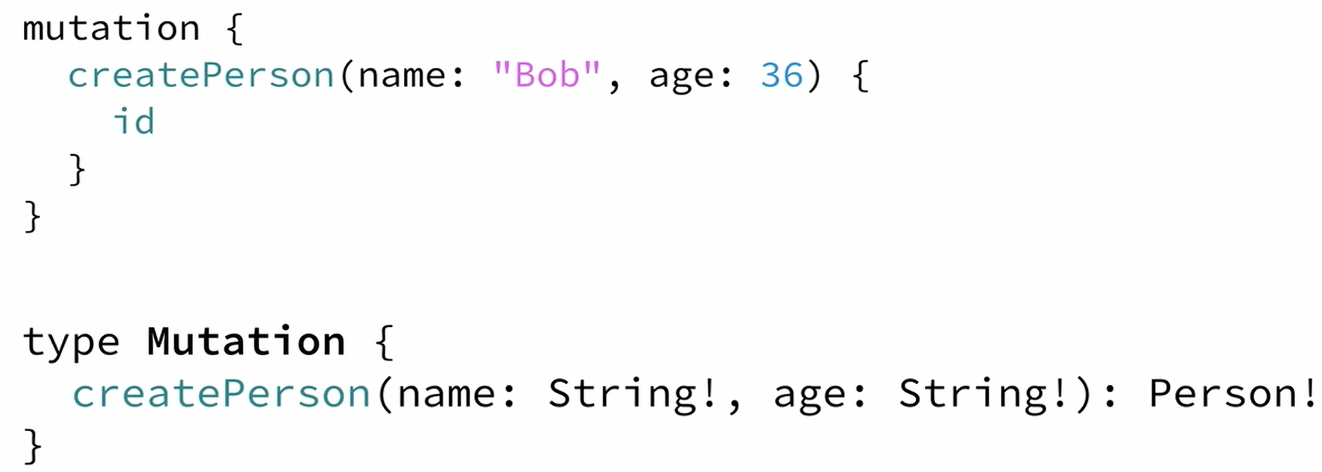
The Mutation Types
Notes:
Similarly, for the createPerson-mutation, we’ll have to add a root field to the Mutation type:
Notice that this root field takes two arguments as well, the name and the age of the new Person.

Slide 32
The Subscription Types
Notes:
Finally, for the subscriptions, we’d have to add the newPerson root field:

Slide 33
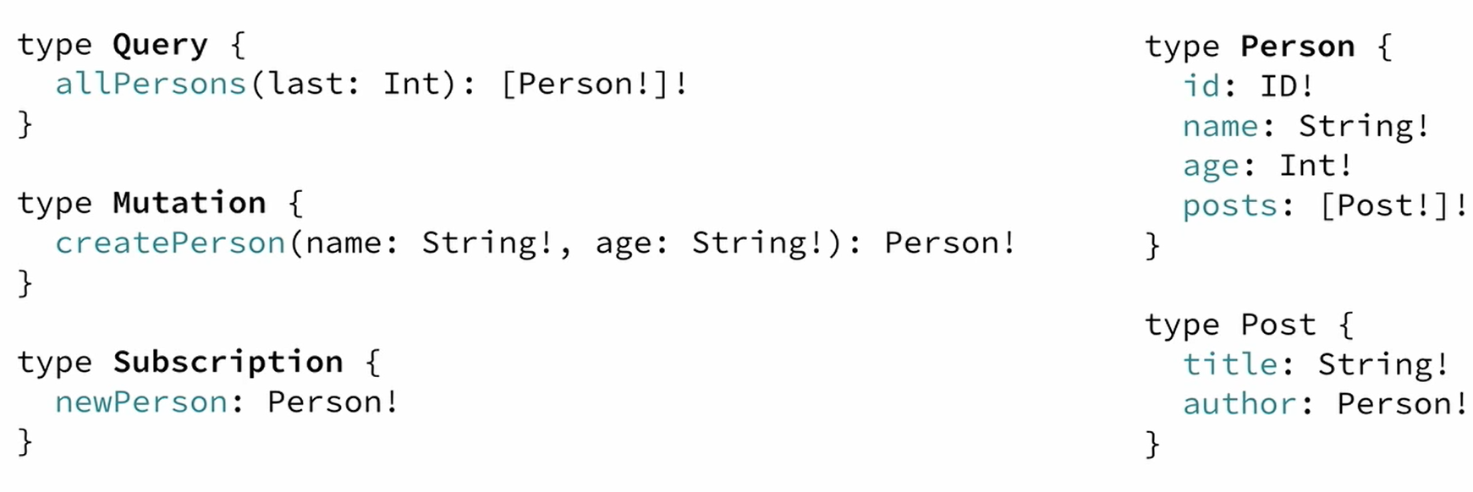
Full Schema
Notes:
Putting it all together, this is the full schema for all the queries and mutation
CRUD

Slide 34
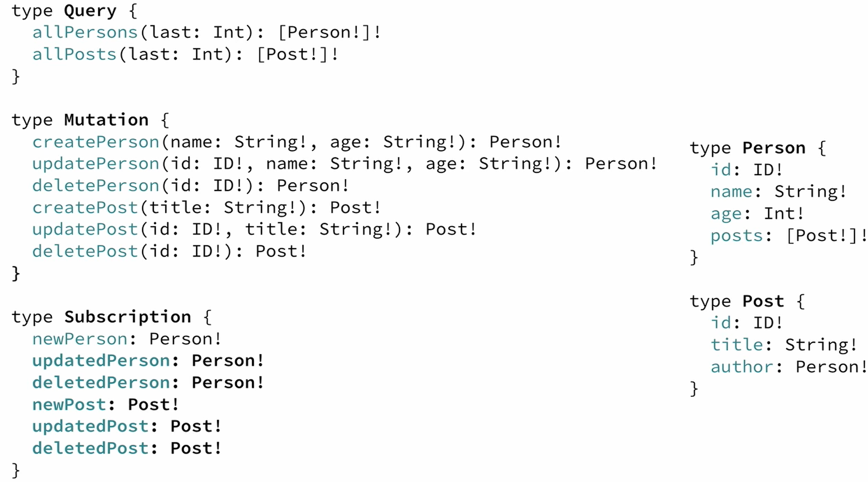
Full Schema
Notes:
Putting it all together, this is the full schema for all the queries and mutation
CRUD

Slide 35
Big Picture
Architecture
Notes:
Core Concepts
In this section will discuss some architectural use cases for graphQl as well as some major component you will find in all graphQL infrastructure

Slide 36
GraphQL is only a specification https://graphql.org/
Notes:
GraphQL has been released only as a specification. This means that GraphQL is in fact not more than a long document that describes in detail the behaviour of a GraphQL server.

Slide 37
Architectural Use Cases
GraphQL server with a connected database
GraphQL Server to integrate existing system
A hybrid approach with a connected database and integration of existing system
Notes:
we’ll walk you through 3 different kinds of architectures that include a GraphQL server:
GraphQL server with a connected database
GraphQL server that is a thin layer in front of a number of third party or legacy systems and integrates them through a single GraphQL API
A hybrid approach of a connected database and third party or legacy systems that can all be accessed through the same GraphQL API
All three architectures represent major use cases of GraphQL and demonstrate the flexibility in terms of the context where it can be used.

Slide 38
1. GarphQL server with a connected database
Often for greenfield projects
Uses single web server that implements GraphQL
Server resolves queries and constructs response with data that it fetches from database
Notes:
This architecture will be the most common for greenfield projects. In the setup, you have a single (web) server that implements the GraphQL specification.
When a query arrives at the GraphQL server, the server reads the query’s payload and fetches the required information from the database.
This is called resolving the query. It then constructs the response object as described in the official specification and returns it to the client.
It’s important to note that GraphQL is actually transport-layer agnostic. This means it can potentially be used with any available network protocol.
So, it is potentially possible to implement a GraphQL server based on TCP, WebSockets, etc.
GraphQL also doesn’t care about the database or the format that is used to store the data. You could use a SQL database like AWS Aurora or a NoSQL database like MongoDB.

Slide 39
2. GarphQL server integrating existing system
Compelling use case for companies with legacy infrastructure and many different APIs
GraphQL can be used to unify existing systems and hide complexity of data fetching logic
The server doesn’t care about the what the data sources are (databases, webservice, 3rd party APIs,…)
Notes:
Another major use case for GraphQL is the integration of multiple existing systems behind a single, coherent GraphQL API.
This is particularly compelling for companies with legacy infrastructures and many different APIs that have grown over years and now impose a high maintenance burden. One major problem with these legacy systems is that they make it practically impossible to build innovative products that need access to multiple systems.
In that context, GraphQL can be used to unify these existing systems and hide their complexity behind a nice GraphQL API. This way, new client applications can be developed that simply talk to the GraphQL server to fetch the data they need. The GraphQL server is then responsible for fetching the data from the existing systems and package it up in the GraphQL response format.
Just like in the previous architecture where the GraphQL server didn’t care about the type of database being used, this time it doesn’t care about the data sources that it needs to fetch the data that’s needed to resolve a query.

Slide 40
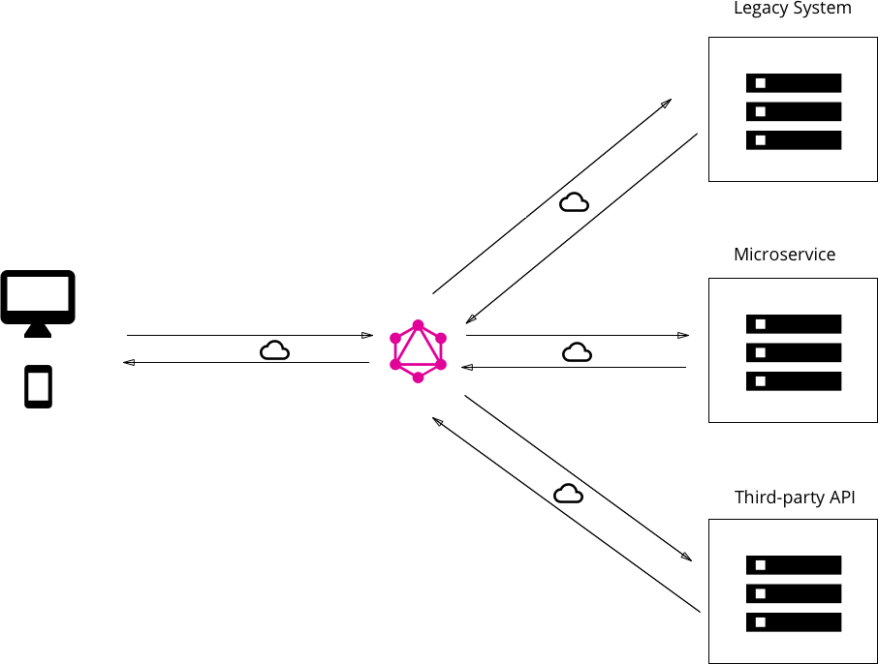
2. GarphQL server integrating existing system
Notes:
GraphQL allows you to hide the complexity of existing systems, such as microservices, legacy infrastructures or third-party APIs behind a single GraphQL interface.

Slide 41
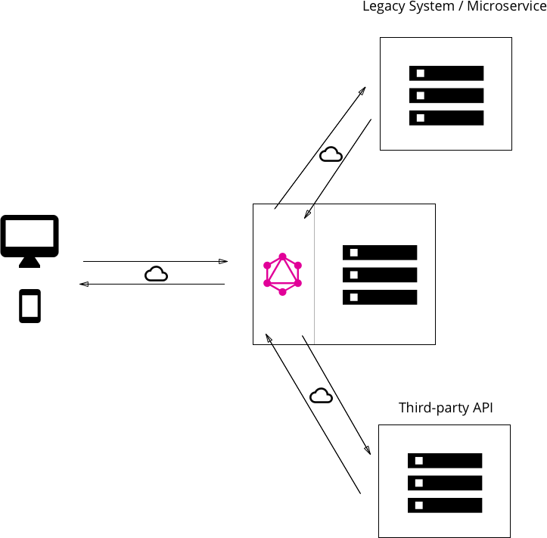
3. Hybrid Approach with connected database and integrated systems
Notes:
Finally, it’s possible to combine the two approaches and build a GraphQL server that has a connected database but still talks to legacy or third—party systems.
When a query is received by the server, it will resolve it and either retrieve the required data from the connected database or some of the integrated APIs.
Both approaches can also be combined and the GraphQL server can fetch data from a single database as well as from an existing system - allowing for complete flexibility and pushing all data management complexity to the server.

Slide 42
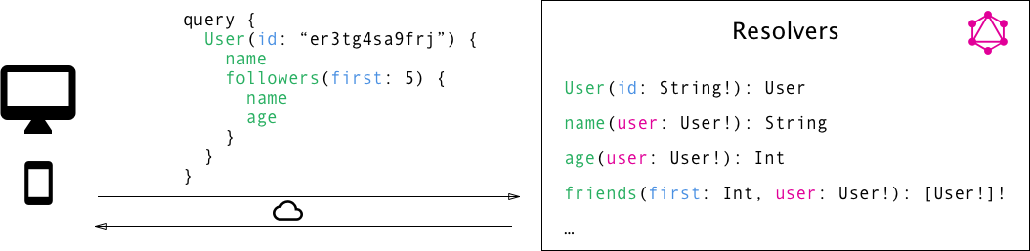
Resolver functions
GraphQL queries/mutaions consists of set of fields
GraphQL server has one resolver function per field
The purpose of each resolver is to retrieve the data for its correrponding field
Notes:
But how do we gain this flexibility with GraphQL? How is it that it’s such a great fit for these very different kinds of use cases?
As you learned in the previous chapter, the payload of a GraphQL query (or mutation) consists of a set of fields. In the GraphQL server implementation, each of these fields actually corresponds to exactly one function that’s called a resolver. The sole purpose of a resolver function is to fetch the data for its field.
When the server receives a query, it will call all the functions for the fields that are specified in the query’s payload. It thus resolves the query and is able to retrieve the correct data for each field. Once all resolvers returned, the server will package data up in the format that was described by the query and send it back to the client.
The above screenshot contains some of the resolved field names. Each field in the query corresponds to a resolver function. The GraphQL calls all required resolvers when a query comes in to fetch the specified data.

Slide 43
The GraphQL Clients
GraphQL is great for frontend developers as data fetching can be pushed to server side
Client doesn’t care where data is coming from
Opputunity for new abstractions on the frontend
Notes:
GraphQL is particularly great for frontend developers since it completely eliminates many of the inconveniences and shortcomings that are experienced with REST APIs, such as over- and underfetching. Complexity is pushed to the server-side where powerful machines can take care of the heavy computation work. The client doesn’t have to know where the data that it fetches is actually coming from and can use a single, coherent and flexible API.
Let’s consider the major change that’s introduced with GraphQL in going from a rather imperative data fetching approach to a purely declarative one. When fetching data from a REST API, most applications will have to go through the following steps:
construct and send HTTP request (e.g. with fetch in Javascript)
receive and parse server response
store data locally (either simply in memory or persistent)
display data in the UI
With the ideal declarative data fetching approach, a client shouldn’t be doing more than the following two steps:
describe data requirements
display data in UI
All the lower-level networking tasks as well as storing the data should be abstracted away and the declaration of data dependencies should be the dominant part.
This is precisely what GraphQL client libraries like Relay or Apollo will enable you to do. They provide the abstraction that you need to be able to focus on the important parts of your application rather than having to deal with the repetitive implementation of infrastructure.

Slide 44
From imperative to declarative data fetching
Construct and send HTTP request
Receive and parse server response
Store data locally
Display information in the UI
Imperative
Declarative
Describe data requirement
Display information in the UI.
Notes:
Let’s consider the major change that’s introduced with GraphQL in going from a rather imperative data fetching approach to a purely declarative one. When fetching data from a REST API, most applications will have to go through the following steps:
construct and send HTTP request (e.g. with fetch in Javascript)
receive and parse server response
store data locally (either simply in memory or persistent)
display data in the UI
With the ideal declarative data fetching approach, a client shouldn’t be doing more than the following two steps:
describe data requirements
display data in UI
All the lower-level networking tasks as well as storing the data should be abstracted away and the declaration of data dependencies should be the dominant part.
This is precisely what GraphQL client libraries like Relay or Apollo will enable you to do. They provide the abstraction that you need to be able to focus on the important parts of your application rather than having to deal with the repetitive implementation of infrastructure.

Slide 45
Thank you - Jayesh Dalal

