Slide 2
Unary Relational Operations
SELECT Operation
SELECT operation is used to select a subset of the tuples from a relation that satisfy a selection condition. It is a filter that keeps only those tuples that satisfy a qualifying condition – those satisfying the condition are selected while others are discarded.
Example: To select the EMPLOYEE tuples whose department number is four or those whose salary is greater than $30,000 the following notation is used:
σDNO = 4 (EMPLOYEE)
σSALARY > 30,000 (EMPLOYEE)
In general, the select operation is denoted by _{σ <selection condition>}(R) where the
symbol σ (sigma) is used to denote the select operator, and the selection condition is a Boolean expression specified on the attributes of relation R

Slide 3
Unary Relational Operations
SELECT Operation Properties
The SELECT operation σ _{<selection condition>}(R) produces a relation S that has the same schema as R
The SELECT operation σ is commutative; i.e.,
σ _{<condition1>}(σ _{< condition2>} ( R)) = σ _{<condition2>} (σ _{< condition1>} ( R))
A cascaded SELECT operation may be applied in any order; i.e.,
σ _{<condition1>}(σ _{< condition2>} (σ _{<condition3>} ( R))
= σ _{<condition2>} (σ _{< condition3>} (σ _{< condition1>} ( R)))
A cascaded SELECT operation may be replaced by a single selection with a conjunction of all the conditions; i.e.,
σ _{<condition1>}(σ _{< condition2>} (σ _{<condition3>} ( R))
= σ <condition1> AND < condition2> AND < condition3> ( R)))

Slide 4
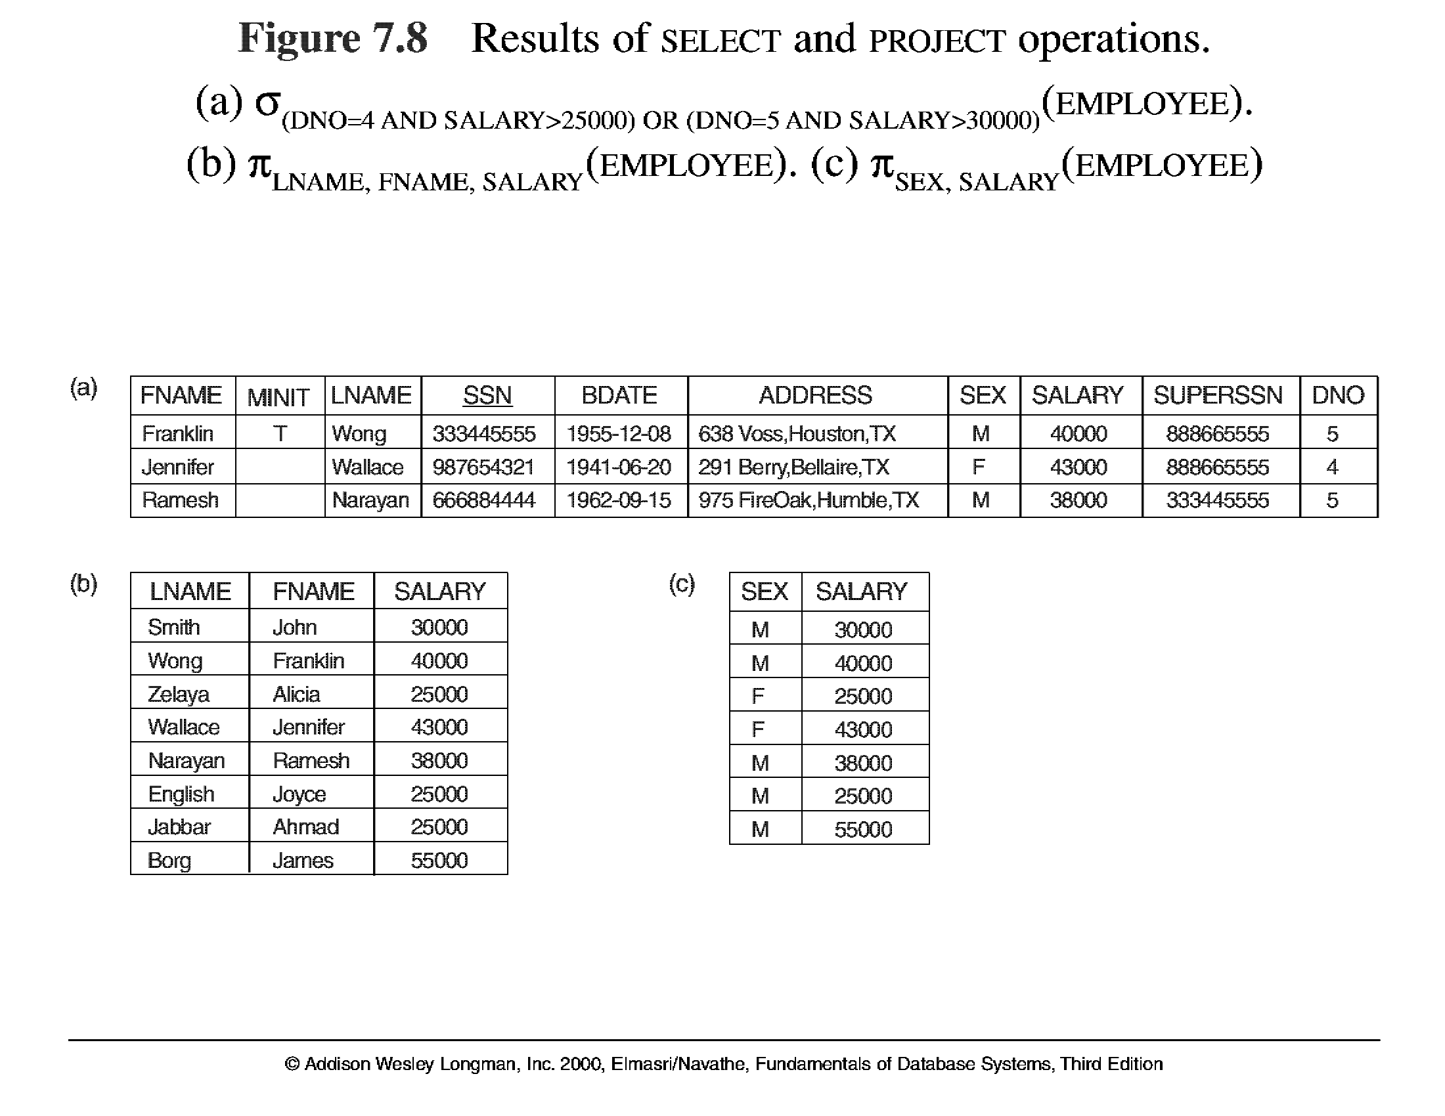
Unary Relational Operations (cont.)

Slide 5
Unary Relational Operations (cont.)
PROJECT Operation
This operation selects certain columns from the table and discards the other columns. The PROJECT creates a vertical partitioning – one with the needed columns (attributes) containing results of the operation and other containing the discarded Columns.
Example: To list each employee’s first and last name and salary, the following is used:
π_{LNAME, FNAME,SALARY}(EMPLOYEE)
The general form of the project operation is π<attribute list>(R) where π (pi) is the symbol used to represent the project operation and <attribute list> is the desired list of attributes from the attributes of relation R.
The project operation removes any duplicate tuples, so the result of the project operation is a set of tuples and hence a valid relation.

Slide 6
Unary Relational Operations (cont.)
PROJECT Operation Properties
The number of tuples in the result of projection π _{<list>} (R)is always less or equal to the number of tuples in R.
If the list of attributes includes a key of R, then the number of tuples is equal to the number of tuples in R.
π _{<list1>} (π _{<list2>} (R) ) = π _{<list1>} (R) as long as <list2> contains the attributes in <list2>

Slide 7
Unary Relational Operations (cont.)

Slide 8
Relational Algebra Operations From Set Theory
UNION Operation
The result of this operation, denoted by R ∪ S, is a relation that includes all tuples that are either in R or in S or in both R and S. Duplicate tuples are eliminated.
Example: To retrieve the social security numbers of all employees who either work in department 5 or directly supervise an employee who works in department 5, we can use the union operation as follows:
DEP5_EMPS ← σ_{DNO=5} (EMPLOYEE)
RESULT1 ← π _{SSN}(DEP5_EMPS)
RESULT2(SSN) ← π _{SUPERSSN}(DEP5_EMPS)
RESULT ← RESULT1 ∪ RESULT2
The union operation produces the tuples that are in either RESULT1 or RESULT2 or both. The two operands must be “type compatible”.

Slide 9
Relational Algebra Operations From Set Theory
Type Compatibility
The operand relations R₁(A₁, A₂, ..., A_{n}) and R₂(B₁, B₂, ..., B_{n}) must have the same number of attributes, and the domains of corresponding attributes must be compatible; that is, dom(A_{i})=dom(B_{i}) for i=1, 2, ..., n.
The resulting relation for R₁∪R₂,R₁ ∩ R₂, or R₁-R₂ has the same attribute names as the first operand relation R1 (by convention).

Slide 10
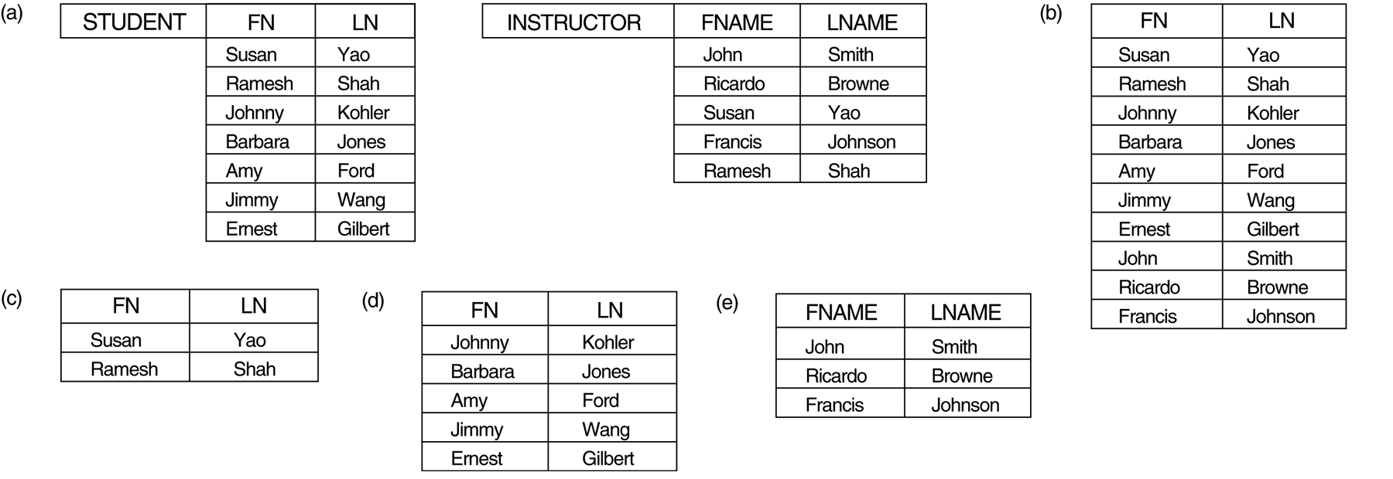
Relational Algebra Operations From Set Theory
UNION Example
STUDENT∪INSTRUCTOR

Slide 11
Relational Algebra Operations From Set Theory (cont.)
INTERSECTION OPERATION
The result of this operation, denoted by R ∩ S, is a relation that includes all tuples that are in both R and S. The two operands must be "type compatible"
Example: The result of the intersection operation (figure below) includes only those who are both students and instructors.
STUDENT ∩ INSTRUCTOR

Slide 12
Relational Algebra Operations From Set Theory (cont.)
Set Difference (or MINUS) Operation
The result of this operation, denoted by R - S, is a relation that includes all tuples that are in R but not in S. The two operands must be "type compatible”.
Example: The figure shows the names of students who are not instructors, and the names of instructors who are not students.
STUDENT-INSTRUCTOR
INSTRUCTOR-STUDENT

Slide 13
Relational Algebra Operations From Set Theory (cont.)
CARTESIAN (or cross product) Operation
This operation is used to combine tuples from two relations in a combinatorial fashion. In general, the result of R(A₁, A₂, . . ., A_{n}) x S(B₁, B₂, . . ., B_{m}) is a relation Q with degree n + m attributes Q(A₁, A₂, . . ., A_{n}, B₁, B₂, . . ., B_{m}), in that order. The resulting relation Q has one tuple for each combination of tuples—one from R and one from S.
Hence, if R has n_{R} tuples (denoted as |R| = n_{R} ), and S has n_{S} tuples, then
| R x S | will have n_{R} * n_{S} tuples.
The two operands do NOT have to be "type compatible”
Example:
FEMALE_EMPS ← σ _{SEX=’F’}(EMPLOYEE)
EMPNAMES ← π _{FNAME, LNAME, SSN} (FEMALE_EMPS)
EMP_DEPENDENTS ← EMPNAMES x DEPENDENT

Slide 14
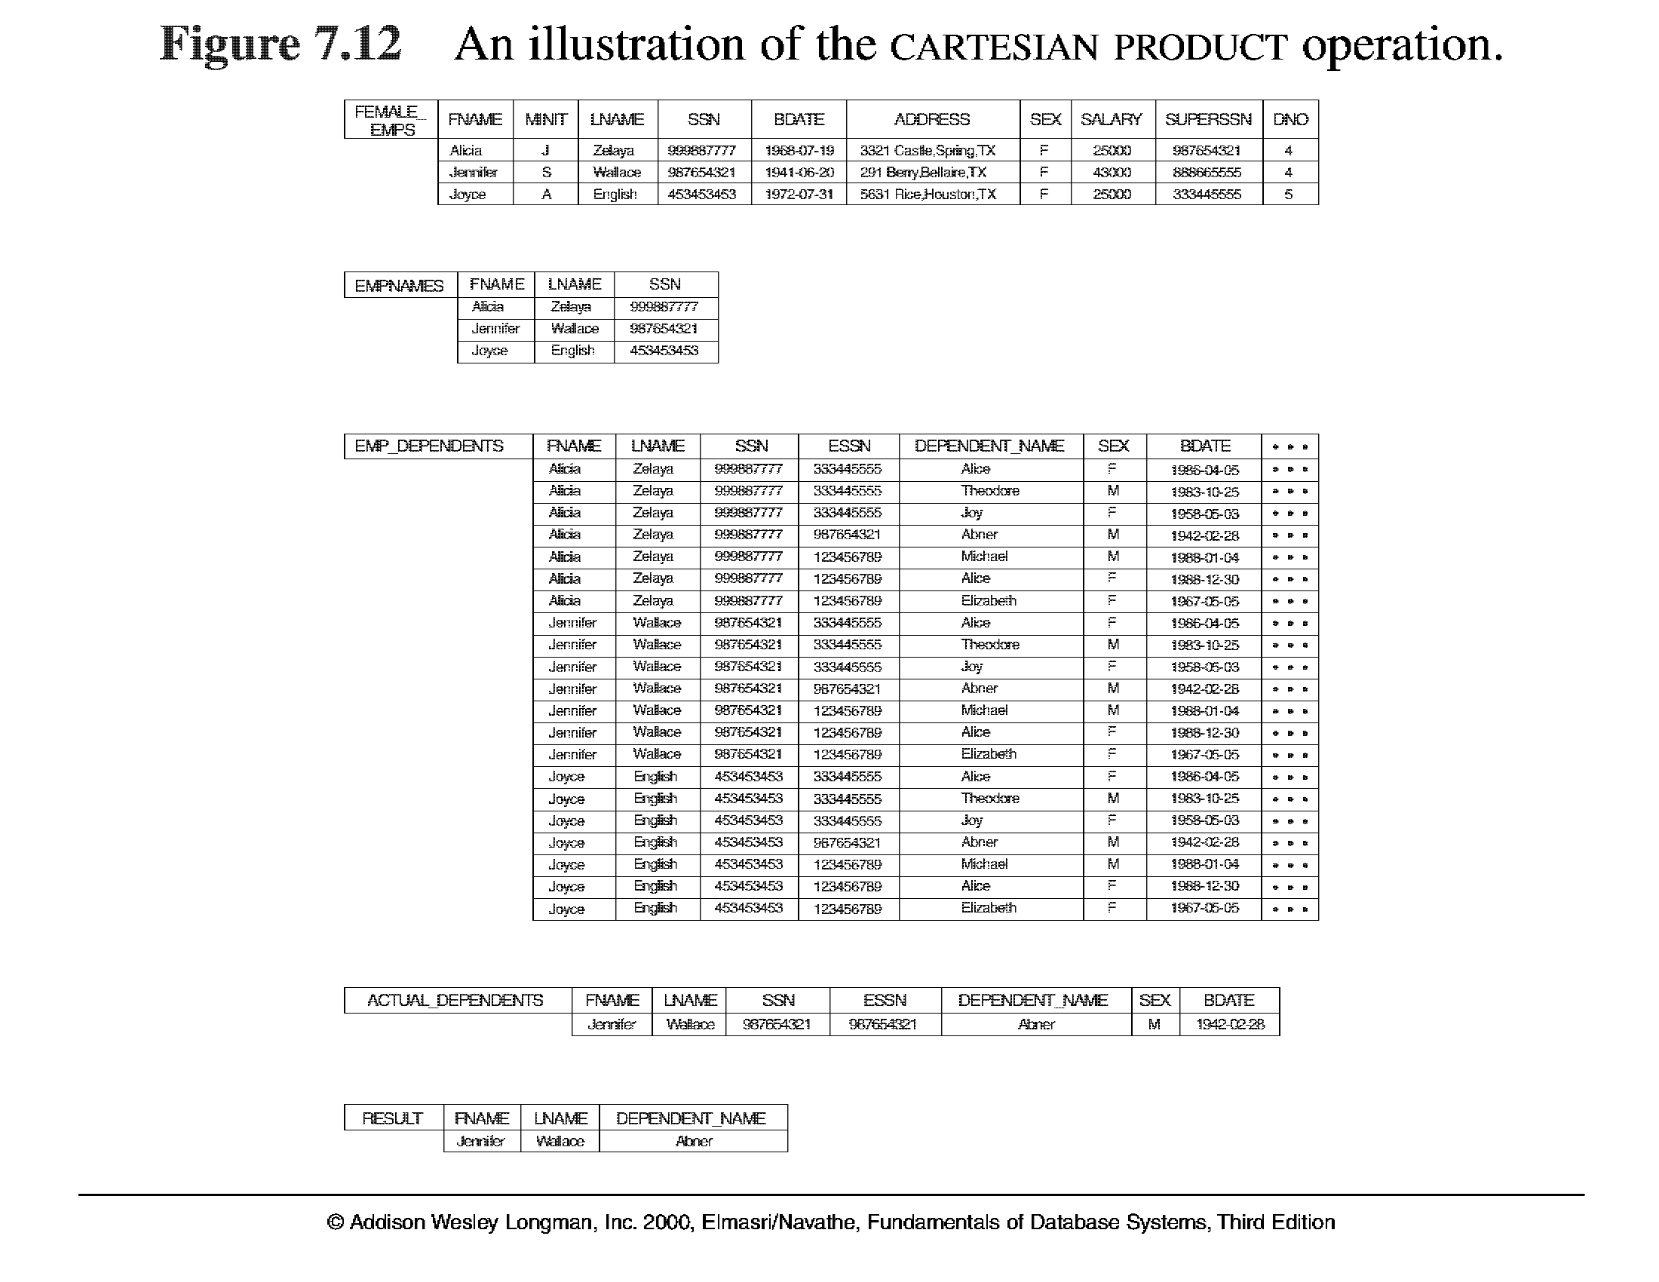
Relational Algebra Operations From Set Theory (cont.)

Slide 15
