Slide 1
AI-Driven Healthcare Appointment and Patient Relationship Management System Using Salesforce Agentforce
Jay Kumar Tiwari
BITS ID: 2024MT12101
M.Tech Software Systems
Course: S2-25_SSZG628T
Organization: Cognizant, Pune

Slide 2
Introduction
Healthcare systems increasingly rely on digital platforms
Traditional appointment systems are fragmented and manual
Need for intelligent automation and centralized CRM
Notes:
This slide introduces the motivation behind building an AI-driven healthcare CRM system.

Slide 3
Problem Statement
Manual appointment booking leads to errors
High no-show rates impact resource utilization
Lack of intelligent patient interaction
Poor integration across systems
Notes:
Here I explain the operational inefficiencies in traditional healthcare management.

Slide 4
Project Objectives
Design centralized healthcare CRM on Salesforce
Automate appointment workflows using Flows
Integrate conversational AI via Agentforce
Apply ML for no-show prediction
Ensure role-based security

Slide 5
Scope of Work
Outpatient appointment management
Patient and doctor data management
AI-assisted scheduling and status queries
Machine learning for operational prediction
No medical diagnosis included

Slide 6
Literature Review
Ileana et al. [1] highlight that without integrated CRM functionalities, distributed patient‑monitoring systems suffer from weak communication, limited personalization, and inefficient resource optimization.
Dordunoo [2] identifies the absence of a unified, data‑driven CRM framework as a major barrier to personalized patient interaction and effective healthcare service delivery.
Sunkara [3] notes a research gap in AI‑driven, CRM‑enabled platforms capable of converting raw clinical data into actionable, predictive intelligence for operational decision‑making.

Slide 7
Literature Review
Bajoria (2025) [4] argues that current healthcare CRMs function mainly as documentation repositories, lacking intelligent, proactive capabilities. Leading to administrative burden and reduced clinical efficiency.
Nelson et al. (2019) [5] demonstrate that machine learning models like logistic regression, SVMs, random forests, AdaBoost, and gradient boosting can effectively predict hospital non‑attendance, supporting operational planning.
Deina et al. (2024) [6] present a decision‑analysis framework showing that ML‑based no‑show prediction enables strategies such as targeted reminders and controlled overbooking.

Slide 8
Research Methodology
Research Type: Applied research combining system design, workflow engineering, and ML experimentation
Overall Approach:
Analyze gaps in existing healthcare CRM and appointment workflows
Design an integrated CRM + AI architecture using Salesforce
Develop automation flows, conversational interfaces, and ML prediction modules

Slide 9
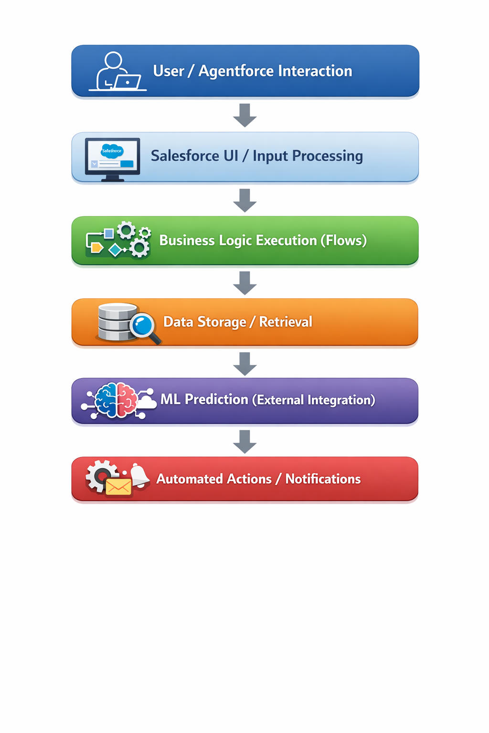
Research Methodology

Slide 10
Overall System Architecture
User Interface – Salesforce Lightning + Agentforce Chat
Business Logic – Flows & Apex
Data Layer – Custom Objects
ML Layer – External Prediction Service
Security Layer – Role-Based Access

Slide 11
Data Model Design (ER Overview)
Patient__c (Master Data)
Doctor__c (Availability & Specialization)
Appointment__c (Transactional Object)
Medical_History__c (Visit Records)
Defined 1:N and 1:1 relationships

Slide 12
Workflow Automation
Screen Flow – Appointment Booking
Record Triggered Flow – Medical History Creation
Scheduled Flow – Appointment Reminders
Validation to prevent double booking

Slide 13
Agentforce (Conversational AI)
Book appointment via natural language
Check or cancel appointments
Query doctor availability
Trigger Salesforce Flows dynamically

Slide 14
Machine Learning Module
Use Case: Appointment No-Show Prediction
Binary classification model (Random Forest Classifier)
Dataset Used:
Salazar, Luiz Henrique (2023), “Medical Appointments No‑Show”, Mendeley Data, V1, doi: 10.17632/wm6w2fvkfj.1
Used directly for training and testing
Random Forest was chosen because it handles mixed data types, class imbalance, and nonlinear relationships more effectively than simpler models, making it more reliable for real‑world no‑show prediction.
Purpose:
Enable proactive reminders
Improve scheduling and resource allocation

Slide 15
Machine Learning Module
Pipeline Overview:
Preprocessing (encoding, date conversion, leakage removal, imputations)
Train–test split (80/20)
Random Forest training with class‑balanced sampling
Threshold tuning to maximize F1 for the no‑show class
Key Results:
Best Threshold: 0.51
No‑Show Recall: ~49% (model catches about half of all no‑shows)
Overall Accuracy: ~82%
Interpretation:
For a proactive reminder system, this performance is acceptable for a first version. It identifies nearly half of potential no‑shows.

Slide 16
Dataset & Data Source
Medical Appointments No-Show dataset ( Medical Appointments No-Show - Mendeley Data )
Salazar, Luiz Henrique (2023), “Medical Appointments No-Show”, Mendeley Data, V1, doi: 10.17632/wm6w2fvkfj.1
Contains information on the no-show problem in loco at rehabilitation centre by transcribing 49,593 medical records of 2016 to2022.

Slide 17
Security & Access Control
Admin – Full Access
Doctor – Clinical Data Access
Receptionist – Booking Access Only
Field-Level Security enforced
Data privacy maintained

Slide 18
Next Steps
Integrate the trained no‑show prediction model into Salesforce
Use the serialized model (no_show_model.pkl) within backend services or middleware
Embed predictions into appointment workflows
Flag high‑risk appointments for staff
Monitor and refine model performance

Slide 19
Citations
[1] Ileana, M., Petrov, P., & Milev, V. (2025). A Distributed Web System for Patient Monitoring Integrating CRM for Improved Clinical Management. International Work‑Conference on Bioinformatics and Biomedical Engineering, 393–407. Springer Nature Switzerland.
[2] Dordunoo, L. (2025). CRM and data analytics in healthcare: Strategy and change in practice. RAIS Journal for Social Sciences, 9(1), 102–118.
[3] Sunkara, S. S. AI‑Driven Patient Transfer Summarization Using Salesforce Health Cloud as a Clinical CRM Intelligence Platform.
[4] Bajoria, A. V. (2025). Cognitive Companion CRM: Proactive Intelligence for Personalized and Efficient Healthcare. Journal of Computer Science and Technology Studies, 7(5), 727–736.
[5] Nelson, A., Herron, D., Rees, G., & Nachev, P. (2019). Predicting scheduled hospital attendance with artificial intelligence. NPJ Digital Medicine, 2(1), 26.
[6] Deina, C., Fogliatto, F. S., da Silveira, G. J., & Anzanello, M. J. (2024). Decision analysis framework for predicting no‑shows to appointments using machine learning algorithms. BMC Health Services Research, 24(1), 37.

Slide 20
Conclusion
Cloud-based scalable solution
AI + CRM integration
Operational ML implementation
Academically and industry relevant

Slide 21
Thank You
Questions & Discussion

