Slide 1
ig
Instagram Clone
SQL Project
Data Analysis & Marketing Strategy Report
Database
Total Users
Total Posts
ig_clone
100
257
By JAYESH MALI | DS JUNE 2026

Slide 2
Table of Contents
01
Problem Statement
06
Content Performance
The challenge & objectives
Hashtag analysis & top tags
02
Data Overview
07
Advertisement Strategy
Database schema & dataset stats
Personalized ad approaches
03
Approach
08
Campaigns & Projections
Methodology & SQL techniques used
Plans for growth & re-engagement
04
Engagement Analysis
09
Conclusion
Top users & engagement rates
Key takeaways & recommendations
05
User Classification
Segmentation: Highly / Moderately / Less

Slide 3
Problem Statement
You are hired as a Data Analyst at Meta and asked to collaborate with the Marketing team. The Marketing team wants to leverage Instagram's user data to develop targeted marketing strategies that will increase user engagement, retention, and acquisition. Provide insights and recommendations to address the following objectives.
✦ Increase User Engagement
✦ Improve User Retention
✦ Drive User Acquisition
✦ Targeted Marketing Strategies

Slide 4
Data Overview
7
100
257
8,782
7,488
Tables
Users
Photos
Likes
Comments
Database Tables
Table | Key Column(s) | Rows
users | id, username, created_at | 100
photos | id, image_url, user_id | 257
likes | user_id, photo_id, created_at | 8,782
comments | id, comment_text, user_id, photo_id | 7,488
follows | follower_id, followee_id | 7,623
tags | id, tag_name | 21
photo_tags | photo_id, tag_id | 501

Slide 5
Approach
01
Understanding Statistics
02
Data Cleaning & Validation
Calculated basic stats: total users, posts, likes, comments, and engagement across the ig_clone database.
Checked and removed duplicates. Treated NULL values in all 7 tables before analysis.
03
SQL Analysis
04
Data Visualization
Used CTEs, Aggregate Functions (AVG, COUNT, ROUND), Subqueries, GROUP BY, RANK(), and Window Functions.
Charted key metrics: total posts, likes, comments. Ranked users by engagement. Highlighted influential hashtags.
05
Strategy Making
06
Implementation
Prepared targeted plans to increase user retention, boost engagement activities, and improve ad effectiveness.
Discussed practical implementation of strategies for optimised and measurable results at scale.

Slide 6
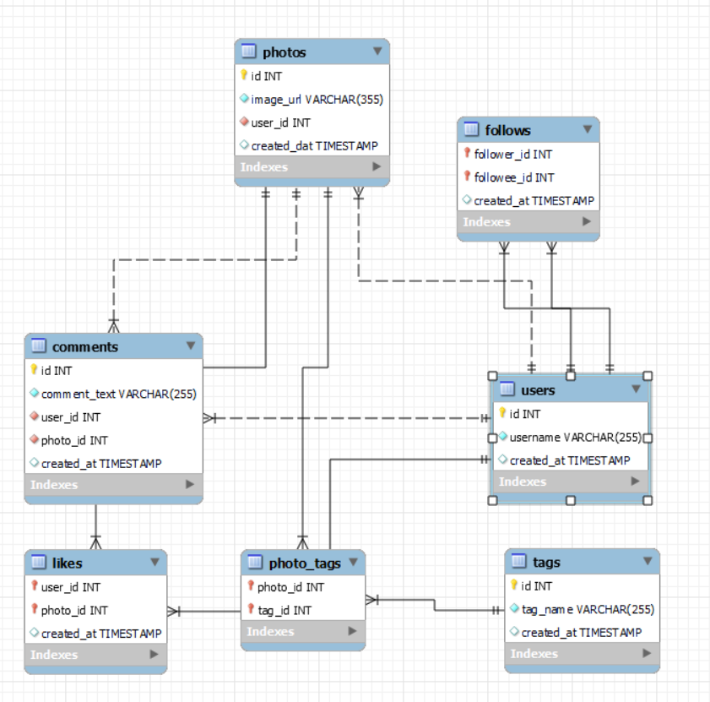
Database schema

Slide 7
Engagement Analysis
149–166
65
31
18
Top User Engagement Range
Avg Engagement Rate (all users)
Users Above Average Rate
Users with Rate > 100
Top Users — Total Engagement (Likes + Comments)

Slide 8
User Classification
Highly Engaged
Moderately Engaged
Less Engaged
43 Users
34 Users
23 Users
>150 total engagements
100–150 total engagements
<100 total engagements
User Segmentation Distribution
Old vs New Users

Slide 9
Content Performance
Key Hashtag Insights
Top Hashtags by Avg Likes/Post
'dreamy' tag leads with 35.75 avg likes per post
'beauty', 'stunning', 'delicious', 'foodie' all close behind (~34.7–35.0 avg likes)
Top tags by total posts used: smile (59), beach (42), party (39), fun (38)
Popular tags to be promoted through influencer collabs and Explore page
Contents related to top tags should be frequently shown on users' Explore pages
Tags other than 'dreamy' have similar avg likes — all should be optimised

Slide 10
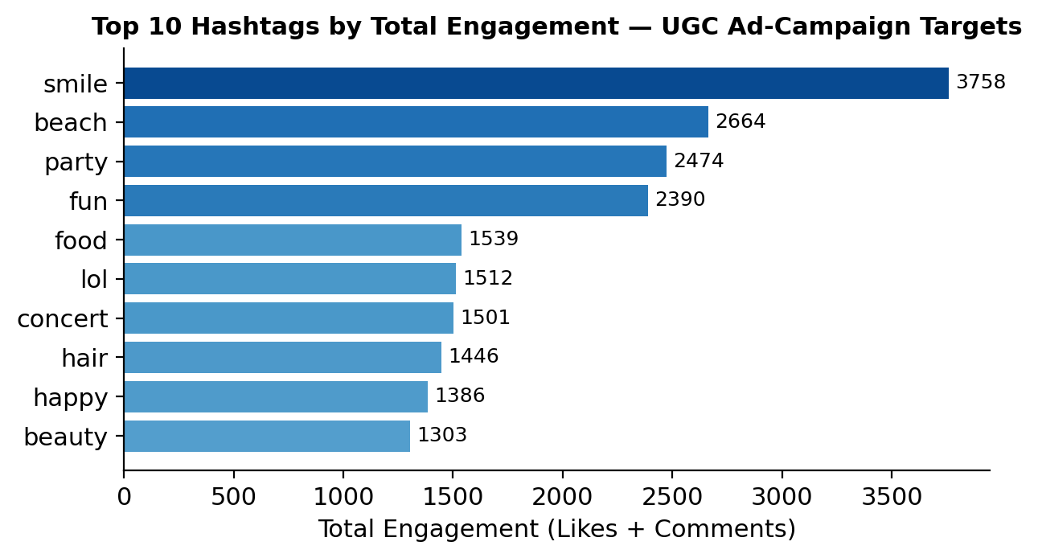
Content Performance — UGC Targets
Top Hashtags for Ad Campaigns
Total Engagement by Hashtag (Top 10)
'smile' drives the most total engagement (3,758 likes+comments), followed by 'beach' (2,664) and 'party' (2,474)
These four tags — smile, beach, party, fun — account for the largest share of UGC volume and engagement combined
Ad campaigns and influencer collabs built around these tags reach the largest, most-engaged content pool
Newton School feedback: added this chart to make the UGC targeting claim measurable instead of purely descriptive

Slide 11
Advertisement Strategy
🎯
Category-Based Ad Campaigns
🧠
Personalised Content & Ads
Run separate ad campaigns for Highly Engaged, Moderately Engaged, and Less Engaged user segments.
Utilise user data (likes, comments, hashtag usage) to deliver personalised ads and curated content feeds.
🔔
Smart Notifications
🤝
Influencer Collaborations
Notifications and recommendations based on the content users follow and interact with most frequently.
Collaborate with Highly Engaged users to promote platform activity and encourage re-engagement.
📊
Campaign Measurement
💡
Brand Ambassador Program
Track CTR, conversion rate, and ROAS. Identify low-performing campaigns and substitute or optimise them.
Users with engagement >150 AND followers >50 are ideal Top Ambassador Candidates for brand advocacy.

Slide 12
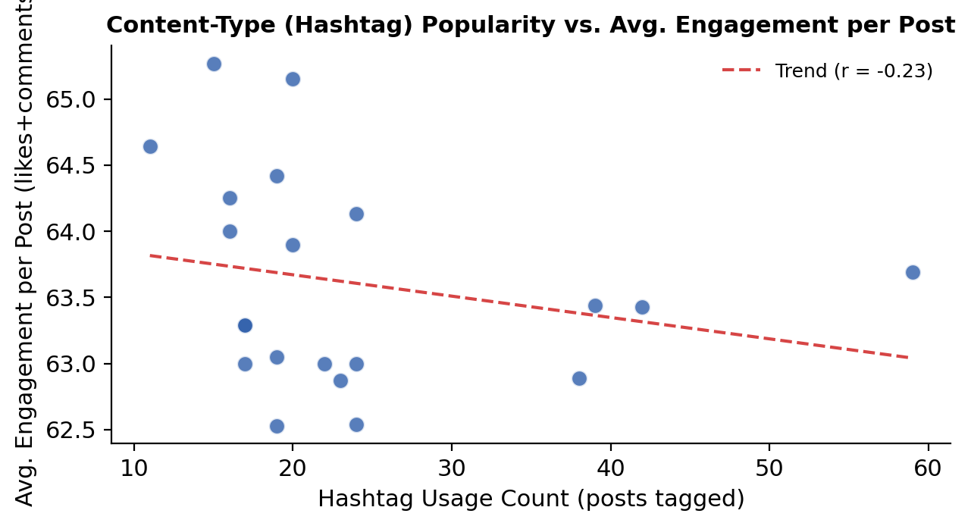
Engagement Correlation Analysis
Does Content Type Predict Engagement?
Hashtag Usage vs. Avg. Engagement/Post
Plotted each hashtag's usage volume against its avg. engagement per post to test the correlation directly
Result: r ≈ -0.23 — a weak, slightly negative correlation, not the strong link often assumed
Engagement per post is fairly consistent (~62–65) across both niche and high-volume tags
Implication: optimise content strategy for reach (high-volume tags) and timing/quality — not for chasing a specific 'high-engagement' content type

Slide 13
Campaigns & Projections
Action Plan
Avg Engagement Rate per User (Top 10)
Target audience based on user categories and browsed content
Send personalised notifications and emails to boost engagement
Make notifications catchy and non-intrusive so users engage positively
Analyse underperforming ad campaigns and substitute them promptly

Slide 14
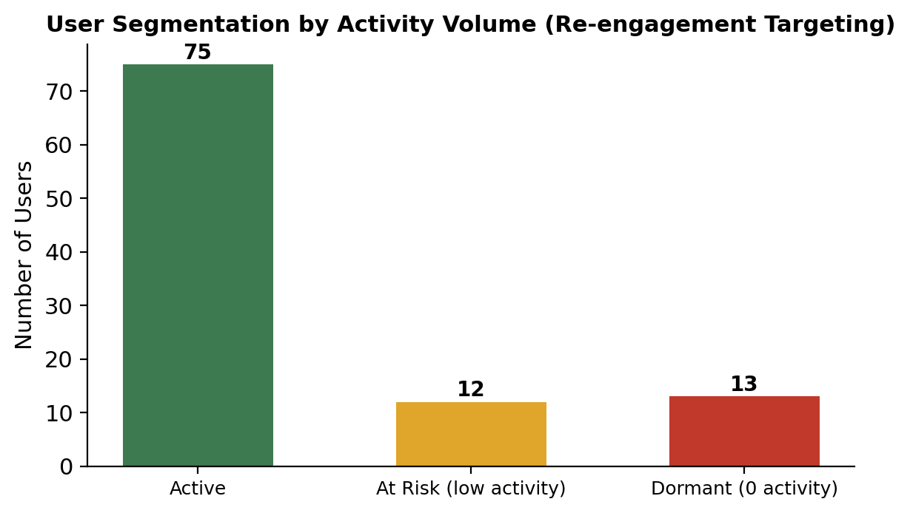
User Re-engagement Targeting
Segmenting Users by Activity
Active / At Risk / Dormant Users
Classified all 100 users by total activity (posts + likes given + comments given)
13 users are fully Dormant (zero activity) — the clearest win-back target
12 more sit in the bottom quartile of active users (At Risk)
Together, 25 users form a ready-made, data-backed segment for the re-engagement campaigns proposed earlier

Slide 15
Conclusion
👥
3-Tier User Segmentation
#️⃣
Hashtags Drive Discovery
Users divided into Highly Engaged (43), Moderately Engaged (34), and Less Engaged (23). Focus on re-engaging the less active cohort.
'Dreamy' leads avg likes (35.75); 'smile', 'beach', 'party' dominate by volume. Monitor and leverage trending tags.
🎬
Reels Are the Future
📢
Targeted Notifications Work
Short-form video is increasingly preferred by new users. Encourage influencers to create Reels tied to top hashtags.
Personalised, catchy notification campaigns (email + push) are key to improving retention and engagement rates.
🏆
Influencer & Ambassador Program
📈
Continuous Optimisation
26 users qualify as Top Ambassador Candidates (engagement >150, followers >76). Activate them for paid collabs.
Regularly audit ad campaigns for CTR, conversion, and ROAS. Replace underperformers and align with trending topics.

Slide 16
ig
THANK
YOU!
Instagram Clone
SQL Project
Data Analyst · Instagram Clone Project · DS JUNE 2026

