Slide 1
INTERNSHIP REPORT
On
Study of triggering schemes for pulsed power systems using FPGA
at RRCAT, Indore
Submitted by
JAYESH MULCHANDANI
VIIIth sem, ELECTRONICS AND TELECOMMUNICATION ENGG.

Slide 2
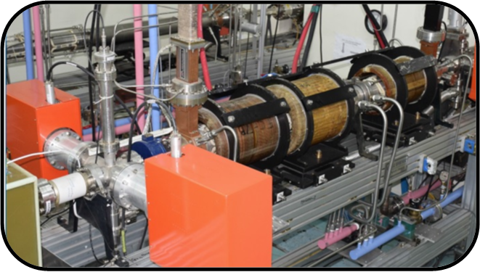
Introduction
Raja Ramanna Center For Advanced Technology (RRCAT), Indore is the unit of Government of India under the Department of Atomic Energy.
The center is performing various research activities in the fields of Lasers and Particle accelerators for industrial and medical applications.
RF systems division at RRCAT is responsible for designing and developing RF and microwave systems for various accelerators developed at RRCAT.
A 10 MeV electron Linear accelerator (Linac) is developed by RRCAT for radiation processing of medical and agricultural products.
10 MeV electron Linear accelerator
The Linac requires a pulsed microwave system of 6 MW peak power at 2856 MHz RF frequency. The microwave system requires a pulsed power supply called Pulse Modulator as source of energy for microwave power amplification.

Slide 3
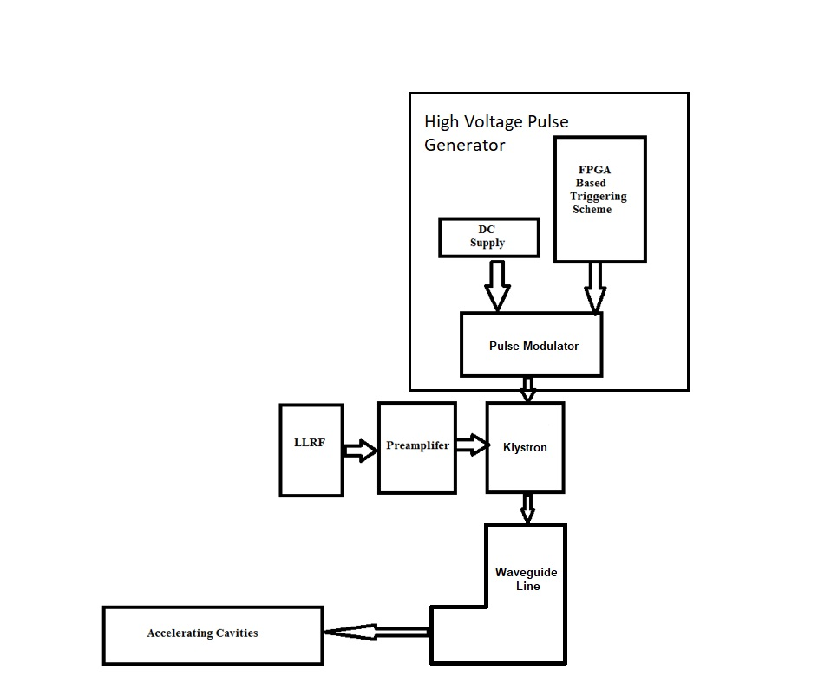
Problem statement of work assigned
In pulsed microwave system of accelerator various trigger pulses are needed in time synchronized manner and with higher accuracy.
The pulse width required is in microseconds range and pulse repetition rate is in the range of 1 to few hundreds of Hertz.
Using FPGA for such trigger pulses generation provides accuracy and flexibility both over the conventional timing circuits.
The aim is to study triggering schemes using FPGA and make a reliable trigger pulse source for Pulse Modulator.

Slide 4
Learnings
Pulsed Micorwave System :
Studied about the scheme and important components of pulsed microwave system like Klystron, Thyratron, Pulse transformer, waveguide line etc.
Study of Line type and Hard switch type Pulsed power topologies was done.
Software:
Training on the hardware modeling using Verilog was received.
Practiced and understood the verilog language and worked on it.
Learnt about the state machines in verilog and their use in pulse generators.
Learnt to simulate the output on PC for models designed in verilog.
Various example models like counter, full adder etc. were studied and simulated using Xilinx Vivado software.
Hardware:
Studied about the architecture of Arty A7 FPGA board.
Studied about the Xilinx make Artix-7 FPGA.
Learnt the interfacing and programming of Arty A7 board with PC.
Learnt about using the DSO for testing the output of FPGA board.

Slide 5
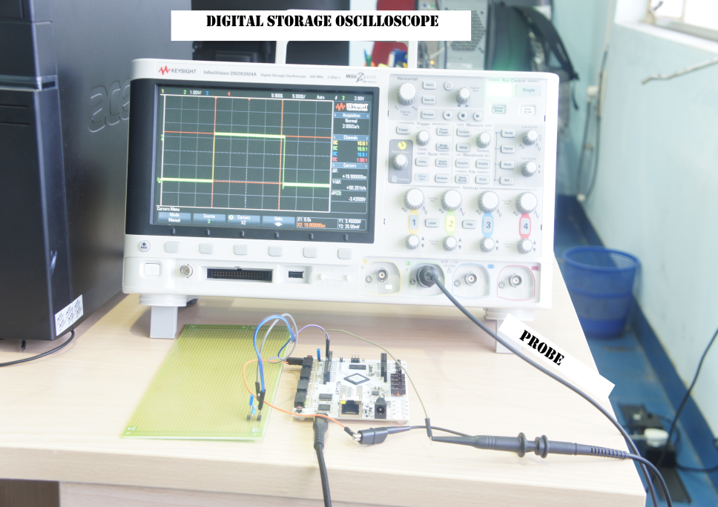
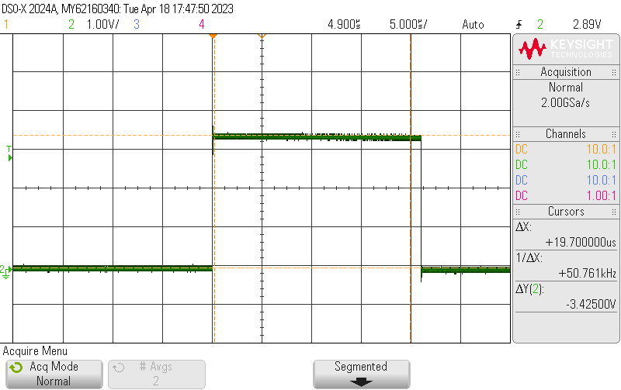
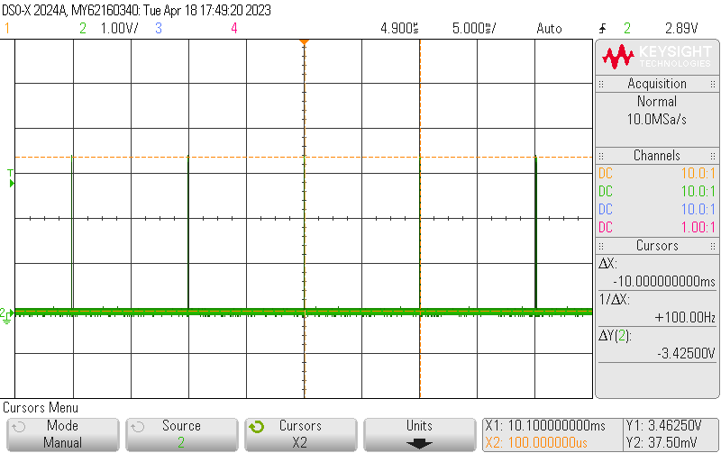
Work done
A trigger Pulse source of pulse width 22 µs and pulse repetition rate of 100 Hz was modelled and implemented using Arty A7 FPGA board.
Iverilog, Vs code and Vivado software were used for programming and simulation.
The actual output was tested using Agilent make Digital storage oscilloscope as shown in attached waveforms.
Upper waveform : Expanded pulse in µs
Lower waveform : Contracted waveform showing PRR of 100 Hz
Arty A7 FPGA board testing using DSO

Slide 6
Technical expertise gained
FPGA programming using verilog, Vs code and Vivado.
Modeling different types of hardware like counters, trigger pulse source etc.
Running these codes on FPGA board and testing of output using DSO.
Future scope
FPGA can be the centralized controller for the complete pulsed microwave system. It can be programmed to provide digital interlocks, feedback control as well as synchronized timing pulses to the system.

Slide 7
Thank You

