Slide 1
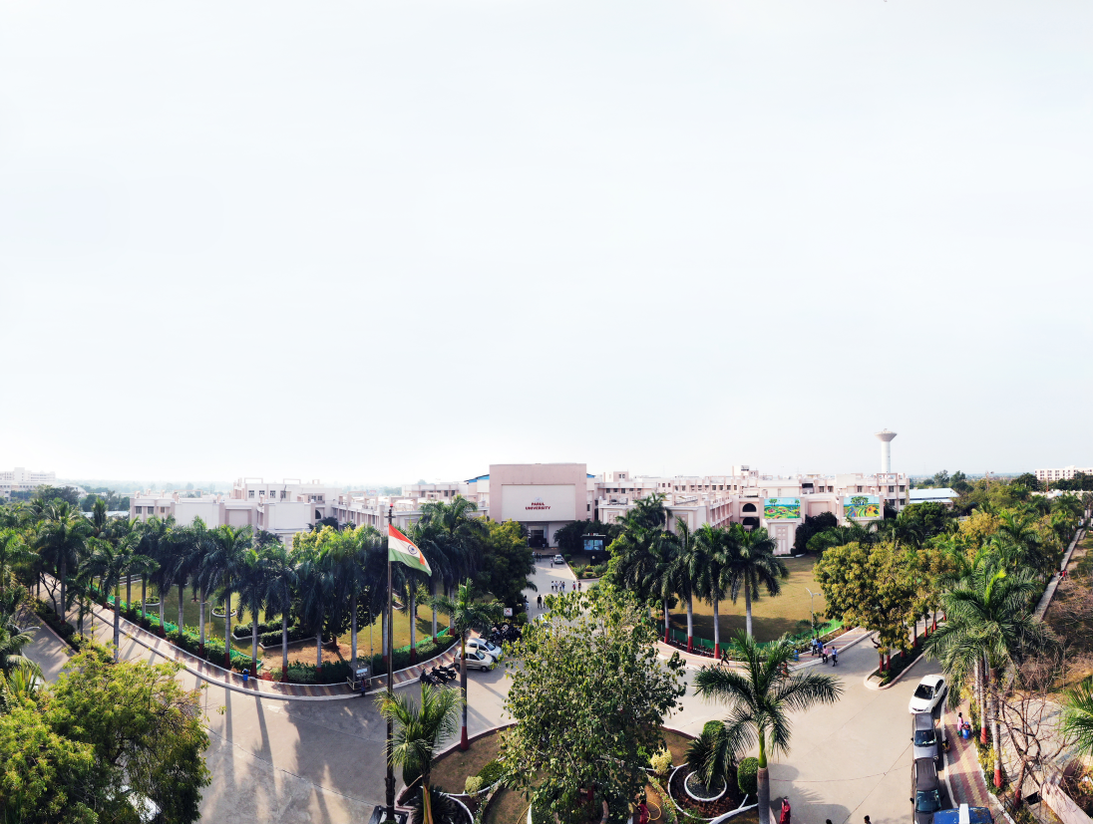



Your Project title
Presented By:
Ashish Kumavat (2403031307004)
Vishwa Solanki (2403031307006)
Jayesh Patel (2403031307009)
Suraj Singh (2403031307010)
Supervised by:
Prof. Alok Singh Kushwaha

Slide 2
OUTLINE
Introduction
Objectives of Project Work
Literature Survey
Problem Statement
Implementation with Results
Conclusion & Future Work
Reference

Slide 3
Introduction
CloudRead is a cloud-based digital library system designed to provide easy access to electronic books.
It allows users to browse, search, read, and download e-books through an online platform.
The system eliminates the dependency on physical libraries and provides access to books anytime and anywhere.
Administrators can manage books, categories, and users through an admin dashboard.
Cloud storage provides scalability, availability, backup, and reliable data management.
The system uses web technologies such as HTML, CSS, JavaScript, Node.js, MongoDB, and cloud services.

Slide 4
Objectives of PROJECT Work
To design and develop a cloud-based digital book library.
To provide users with online access to books.
To implement user registration and secure login.
To provide search functionality based on title, author, and category.
To allow users to read and download books when permitted.
To provide an admin panel for managing books and users.
To securely store digital books using cloud storage.
To provide a system that is scalable, reliable, and easily maintainable.

Slide 5
Literature Review
Sr. No. | Paper Title | Year | Method | Outcomes
1 | Libraries Perception Towards Cloud Computing | 2013 | Survey | Cloud improves library services; privacy is a major concern.
2 | Cloud Based Library Software as a Service – EZproxy | 2015 | Case Study | Remote access and cloud services reduce local infrastructure dependency.
3 | Systematic Review of Cloud Computing in Libraries | 2023 | Systematic Review | Scalability, flexibility and accessibility improve; security remains a challenge.
4 | Adoption and Uses of Cloud Computing in Academic Libraries | 2024 | PRISMA Review | Cloud storage and digital libraries are growing due to scalability and cost benefits.
5 | Cloud-Based Adoption Model for Digital Preservation | 2025 | Literature Review | Reliability, compatibility, migration and organizational readiness are important.

Slide 6
Research Gap
• Existing studies mainly focus on cloud adoption, library automation and institutional library services rather than a simple user-oriented digital book platform.
• Security, privacy, interoperability and reliable cloud storage remain important challenges in cloud-based libraries.
• There is a need for an integrated platform providing digital book storage, search, category filtering, online reading and controlled downloading.
• CloudRead addresses this gap by providing a cloud-based digital library with user authentication, book management, search functionality and scalable cloud storage.

Slide 7
Problem StatemenT
Limited Storage: Physical libraries require considerable space to store books.
Restricted Access: Users can access books only during library operating hours.
Maintenance Cost: Physical books require maintenance and infrastructure.
Difficult Management: Managing a large number of books manually is difficult.
Limited Accessibility: Users generally need to visit the library to access books.
Slow Search: Finding books manually can consume time.

Slide 8
SYSTEM IMPLEMENTATION
FRONTEND:
-> React.js
(Responsive UI for users and admins)
BACKEND:
-> Node.js
(Handles requests, authentication and logic)
DATABASE:
-> MySQL / MongoDB / Firebase
CLOUD SERVICES:
-> AWS / Google Cloud / Azure

Slide 9
Data Set Description^{[5]}
NAME | TYPE | DESCRIPTION
Item_identifier | Numeric | It is the unique product Id number.
Item_Weight | Numeric | It will include the product's weight
Item_Fat_Content | categorical | It will mean whether the item is low in fat or not
Item_Visibility | Numeric | The percentage of the overall viewing area assigned to the particular item from all items in the shop.
Item_Type | categorical | To which group does the commodity belong
Item_MRP | Numeric | The product's price list
Outlet_Identifier | Numeric | unique store ID
Outlet_Establishment_Year | Numeric | The year that the shop first opened
Outlet_Size | categorical | The amount of ground space that the store occupies
Outlet_Location_Type | categorical | The type of city in which the store is located
Outlet_Type | categorical | Whether he outlet is just a grocery or some sort of supermarket
Item_Outlet_Sales | Numeric | Product sales at that specific store. This is the outcome variable that has to be forecast.

Slide 10
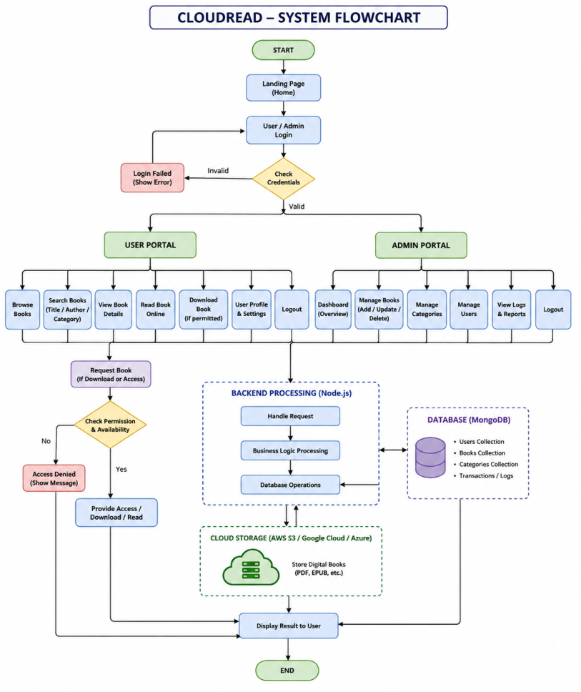
Flow Chart

Slide 11
Implementation with Results

Slide 12
Conclusion
CloudRead successfully demonstrates the use of cloud computing to create an accessible, scalable, and secure digital book library. It simplifies book management and enables users to access digital resources anytime and anywhere.
FUTURE WORK:
• Mobile application for Android and iOS
• AI-powered personalized book recommendations
• Audiobook and multimedia support
• Offline reading functionality
• Multi-language book and interface support
• Advanced security and user privacy
• Usage analytics and intelligent library management

Slide 13
References
Rimal, B. P., Choi, E., & Lumb, I., “Cloud Computing: A Digital Libraries Perspective,” IEEE CLOUD, 2010.
Scale, M.-S. E., “Assessing the Impact of Cloud Computing and Web Collaboration on the Work of Distance Library Services,” Journal of Library Administration, 2010.
Jayakanth, J., Byrappa, A. T., & Minj, F., “Migration of a Research Library's ICT-Based Services to a Cloud Platform,” Information Technology and Libraries, 2022.
Aldarthi, R. R. et al., “A Systematic Review of Cloud Computing Applications in Library and Information Management and Service,” 2023.
Asim, M., Arif, M., & Rafiq, M., “Adoption and Uses of Cloud Computing in Academic Libraries: A Systematic Literature,” Journal of Information Science, 2024.
Yuvaraj, M., “Determinants of Cloud Computing Applications Adoption in University Libraries,” 2014.
Yuvaraj, M., “Problems and Prospects of Implementing Cloud Computing in University Libraries,” Library Review, 2015.
Lee, S., “A Case Study on the Experience of Using a Cloud-Based Library Systems,” 2021.
Ibrahim, H. M. et al., “Impact of Organisational, Environmental, Technological and Human Factors on Cloud Computing Adoption for University Libraries,” 2024.
“Designing Cloud-Based Library Information Sharing for Resource Integration and Service Efficiency,” Information Resources Management Journal, 2025.

Slide 14
Web References
11. https://nodejs.org/
12. https://www.mongodb.com/docs/
13. https://aws.amazon.com/s3/
14. https://docs.aws.amazon.com/sdk-for-javascript/
15. https://firebase.google.com/docs
16. https://developer.mozilla.org/
17. https://www.w3schools.com/
18. https://www.geeksforgeeks.org/

Slide 15
Thank you

