Slide 1
Movie Success Revenue Prediction
Team 4
- Sharvari Karnik
- Jayesh Patil
- Kunal Jaiswal
- Srividya Balaji

Slide 2
Problem Statement:
A commercial success movie not only entertains the audience, but also enables film companies to gain tremendous profit. A lot of factors such as good directors, experienced actors are considerable for creating good movies. However, famous directors and actors can always bring an expected box-office income but cannot guarantee a highly rated imdb score. In this project, we will try to consider all these factors and predict the chances of a movie’s success.

Slide 3
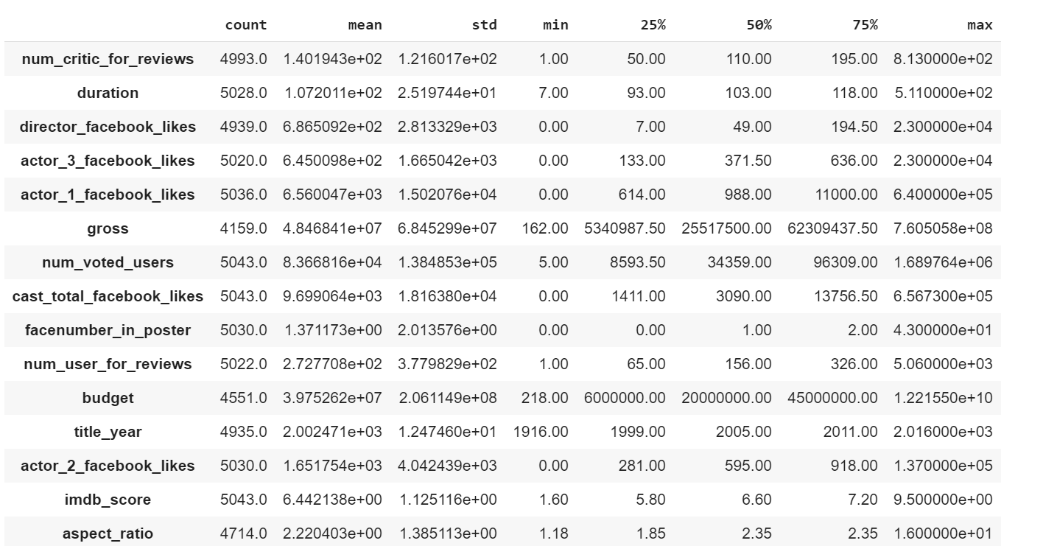
Data Description:

Slide 4
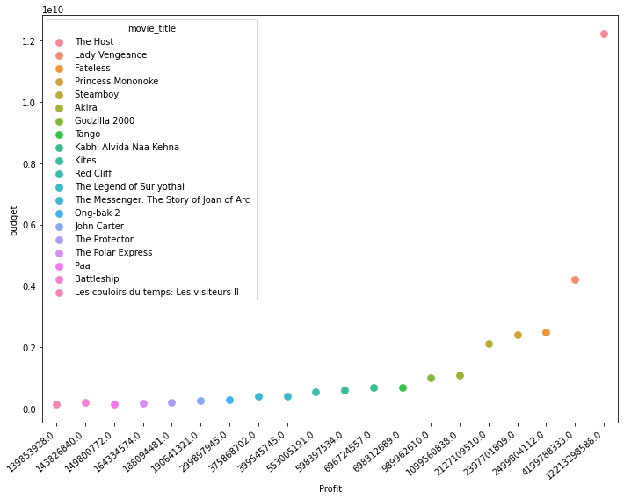
Top 20 Movies based on Profit

Slide 5
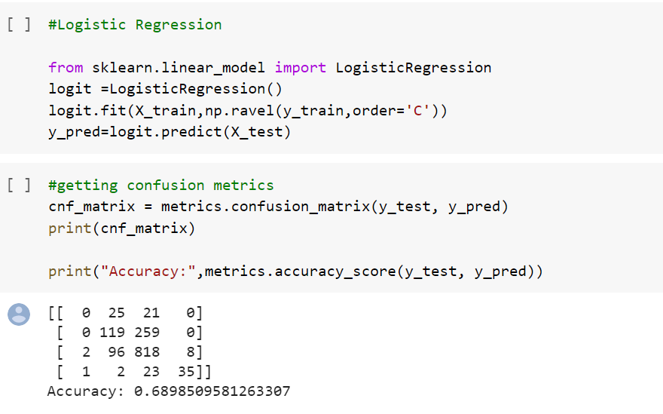
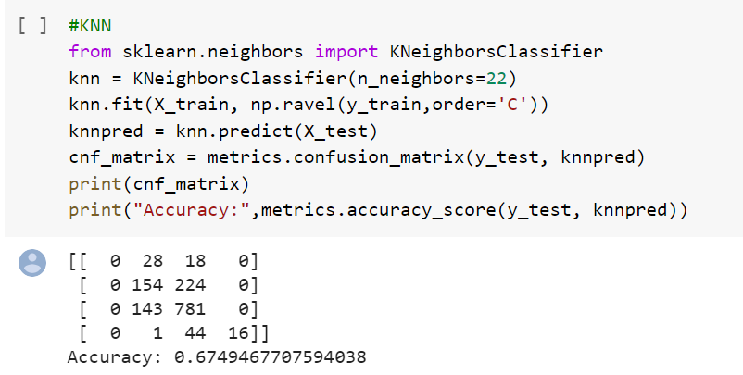
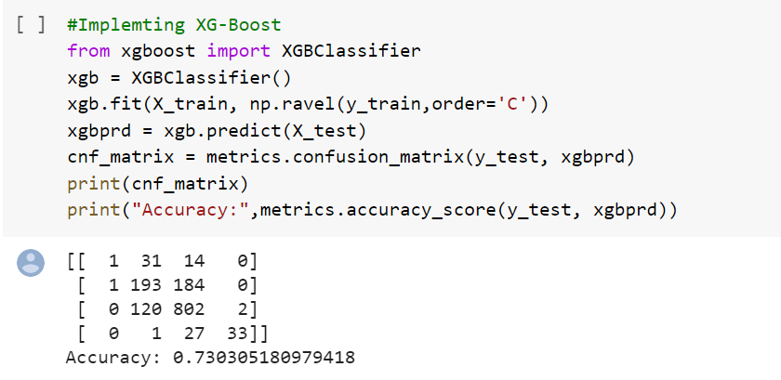
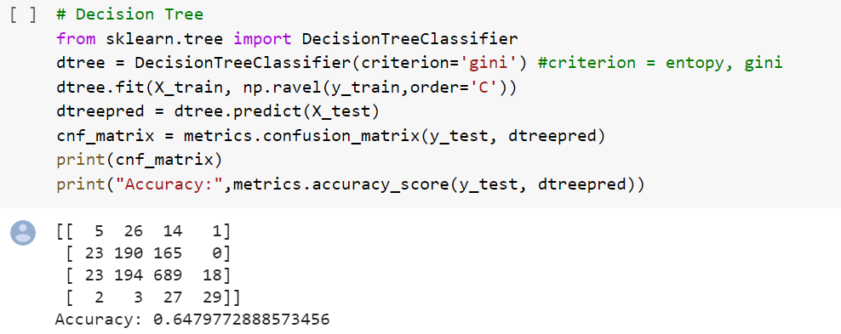
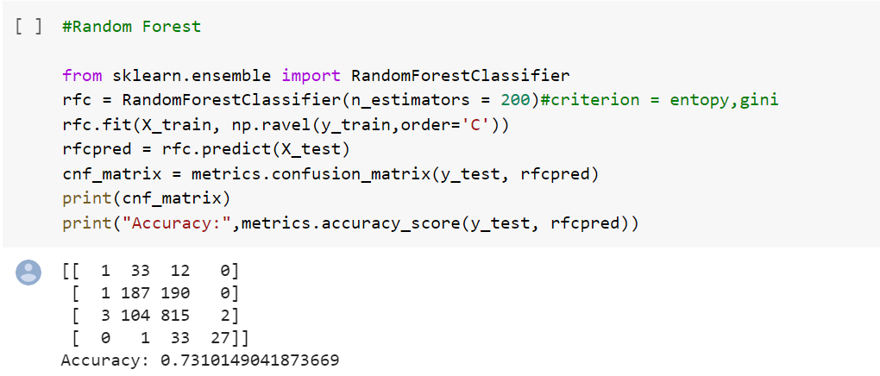
Accuracy Score for models implemented

Slide 6
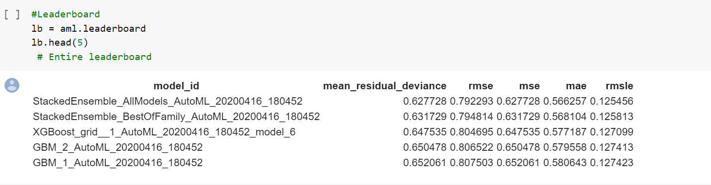
h2o AutoML Leaderboard:

Slide 7
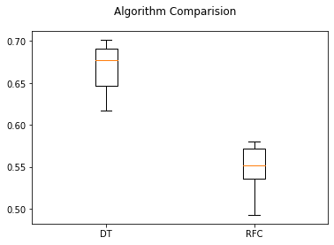
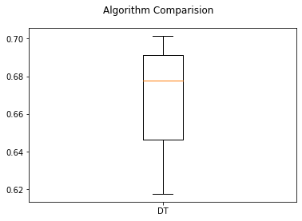
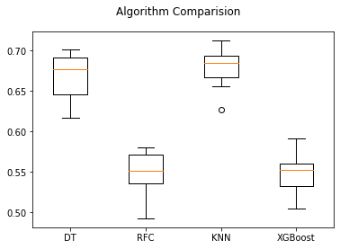
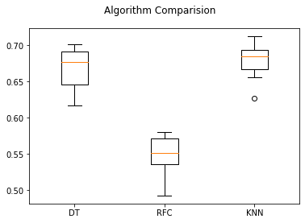
Cross Validation Score

Slide 8
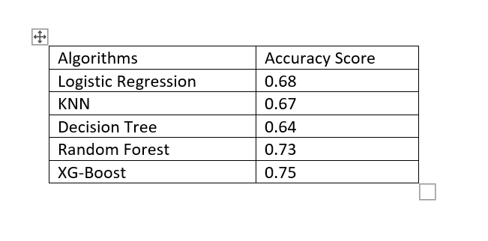
Accuracy score:

Slide 9

THANK YOU
Comments and Feedback Welcome

