Slide 1


Team Details
  Team name:
  Team leader name:
  Problem Statement:
Team Details
Team name:
Team leader: Jayesh Rajani
Problem statement: Fast, local crop triage for farmers who cannot wait for an agronomist.
Your crop can’t talk. We listen anyway.
Notes:
Team name was not present in the supplied submission materials and is left blank.

Slide 2

Note: Please download this template to make your edits and submit the final version.
To download, go to File > Download > Microsoft PowerPoint (.PPTX). Kindly refrain from sending edit requests.

Slide 3
Brief about the idea
A second opinion for a sick crop—built from more than a picture.
RootCause combines a leaf photo, a spoken symptom note and field conditions to surface likely causes, explain the evidence, show what is missing and suggest safe next steps.
Triage, not a verdict.
The farmer keeps the final say—and the KVK expert stays in the loop.
Notes:
Source: RootCause repository, docs/submission/README.md and its linked diagrams/screens. All product metrics and implementation-cost figures are reported in that README; estimates and evaluation limitations are labelled on-slide.

Slide 4
The opportunity
CONTEXT
EVIDENCE
SAFETY
Photo + voice + weather + satellite + labelled references.
Each cause earns a 0–100 fit with reasons for and against.
Weak fits stay hidden; generic actives and an expert check guide treatment.
The sky, the soil canopy and the farmer’s own words all get a vote.
A local-language second opinion; a nearby shop only after the evidence and safety guidance.
Notes:
Source: RootCause repository, docs/submission/README.md and its linked diagrams/screens. All product metrics and implementation-cost figures are reported in that README; estimates and evaluation limitations are labelled on-slide.

Slide 5
What RootCause does
01
REPORT
Photo-first. Speak in Hindi or English. Confirm the crop only when needed.
02
INVESTIGATE
Cross-check the leaf with references, local weather and Sentinel-2.
03
ACT
See likely causes, urgency, safe next steps and nearby agri shops.
Notes:
Source: RootCause repository, docs/submission/README.md and its linked diagrams/screens. All product metrics and implementation-cost figures are reported in that README; estimates and evaluation limitations are labelled on-slide.

Slide 6
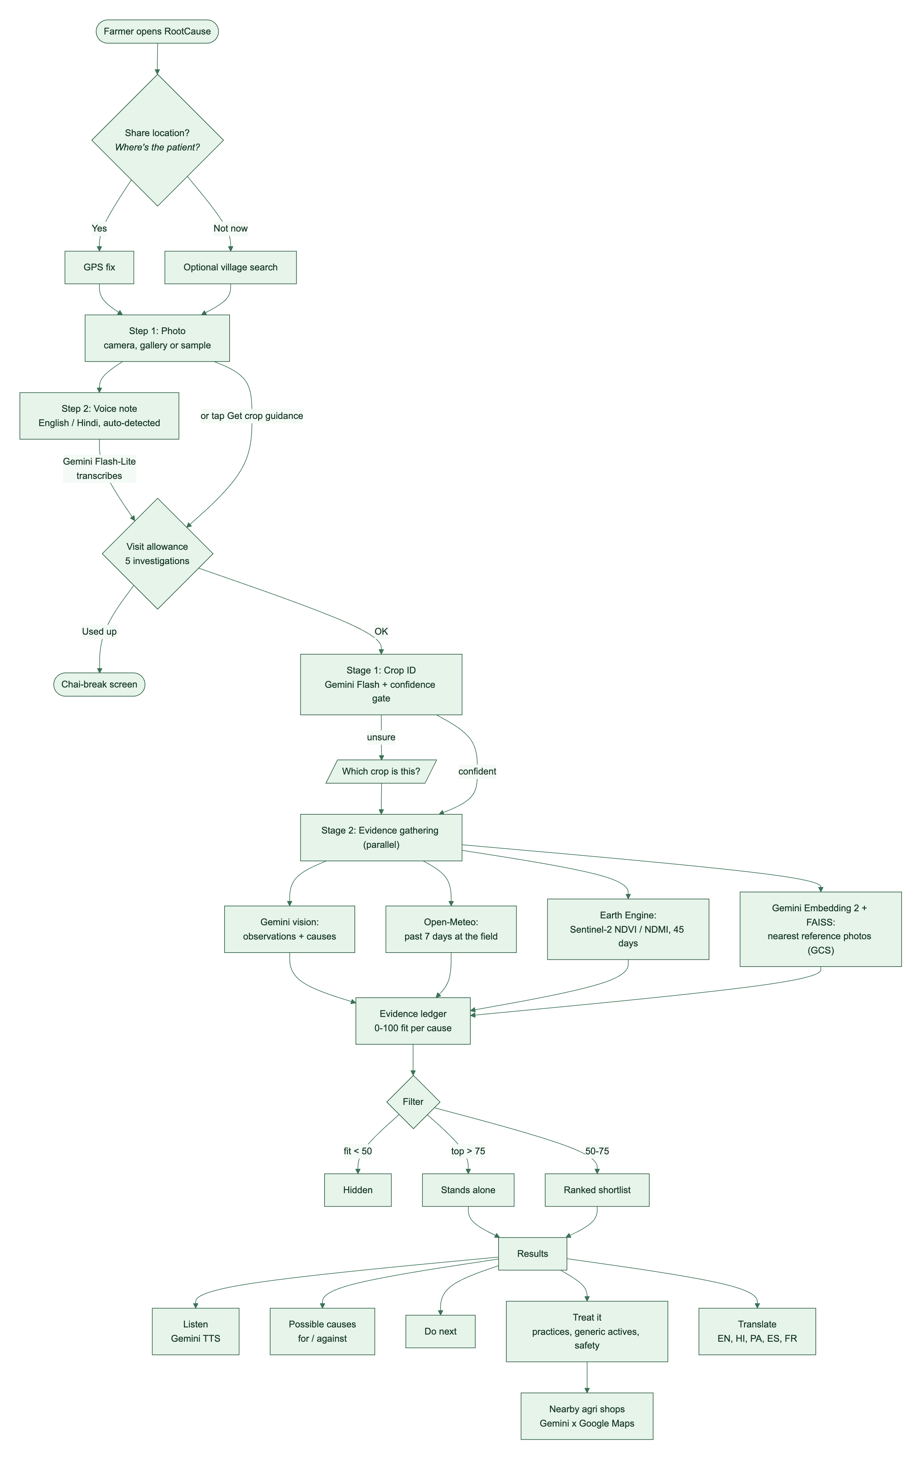
From a leaf photo to a careful next step
01
REPORT
Photo + voice; location optional.
02
IDENTIFY
Crop ID asks when confidence is low.
03
CROSS-CHECK
Weather, satellite, references and vision run together.
04
RESPOND
Ranked causes, next steps, treatment and shops.
No signal is treated as normal when it was not checked.
Notes:
Source: RootCause repository, docs/submission/README.md and its linked diagrams/screens. All product metrics and implementation-cost figures are reported in that README; estimates and evaluation limitations are labelled on-slide.

Slide 7
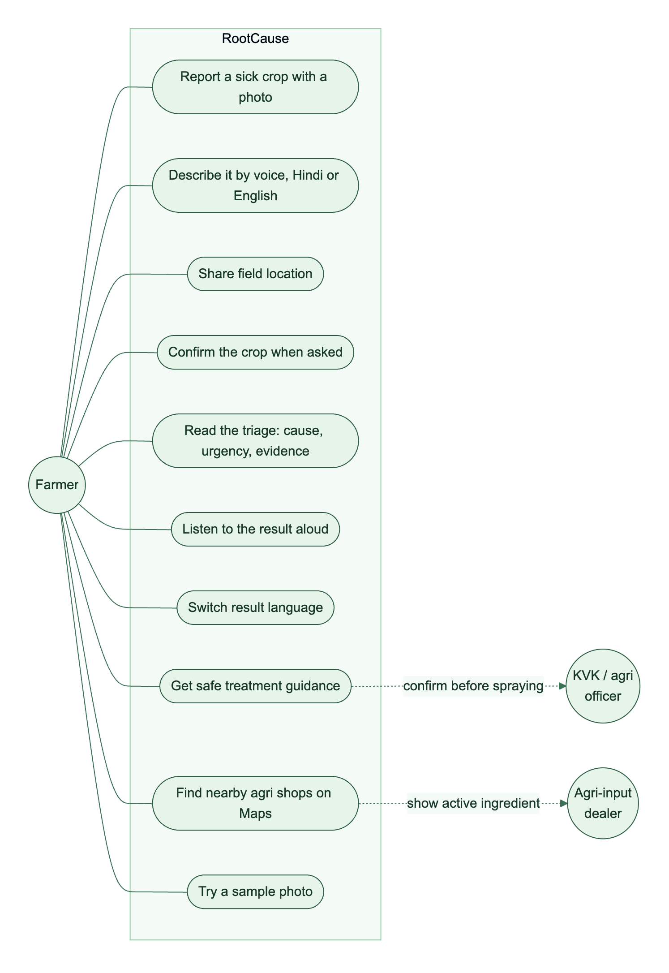
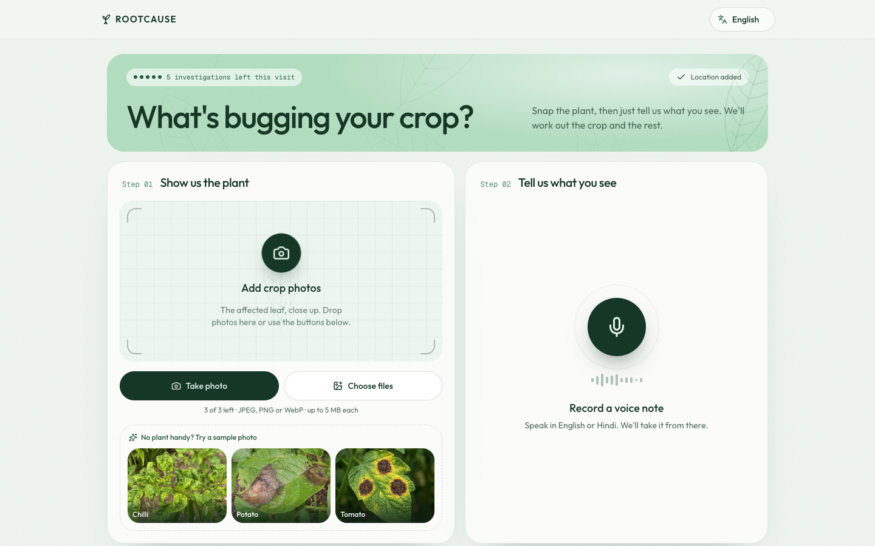
Designed around the farmer
FROM FIRST PHOTO TO PRACTICAL NEXT STEP
Optional location. Spoken or typed. Clear next steps.
Notes:
Source: RootCause repository, docs/submission/README.md and its linked diagrams/screens. All product metrics and implementation-cost figures are reported in that README; estimates and evaluation limitations are labelled on-slide.

Slide 8
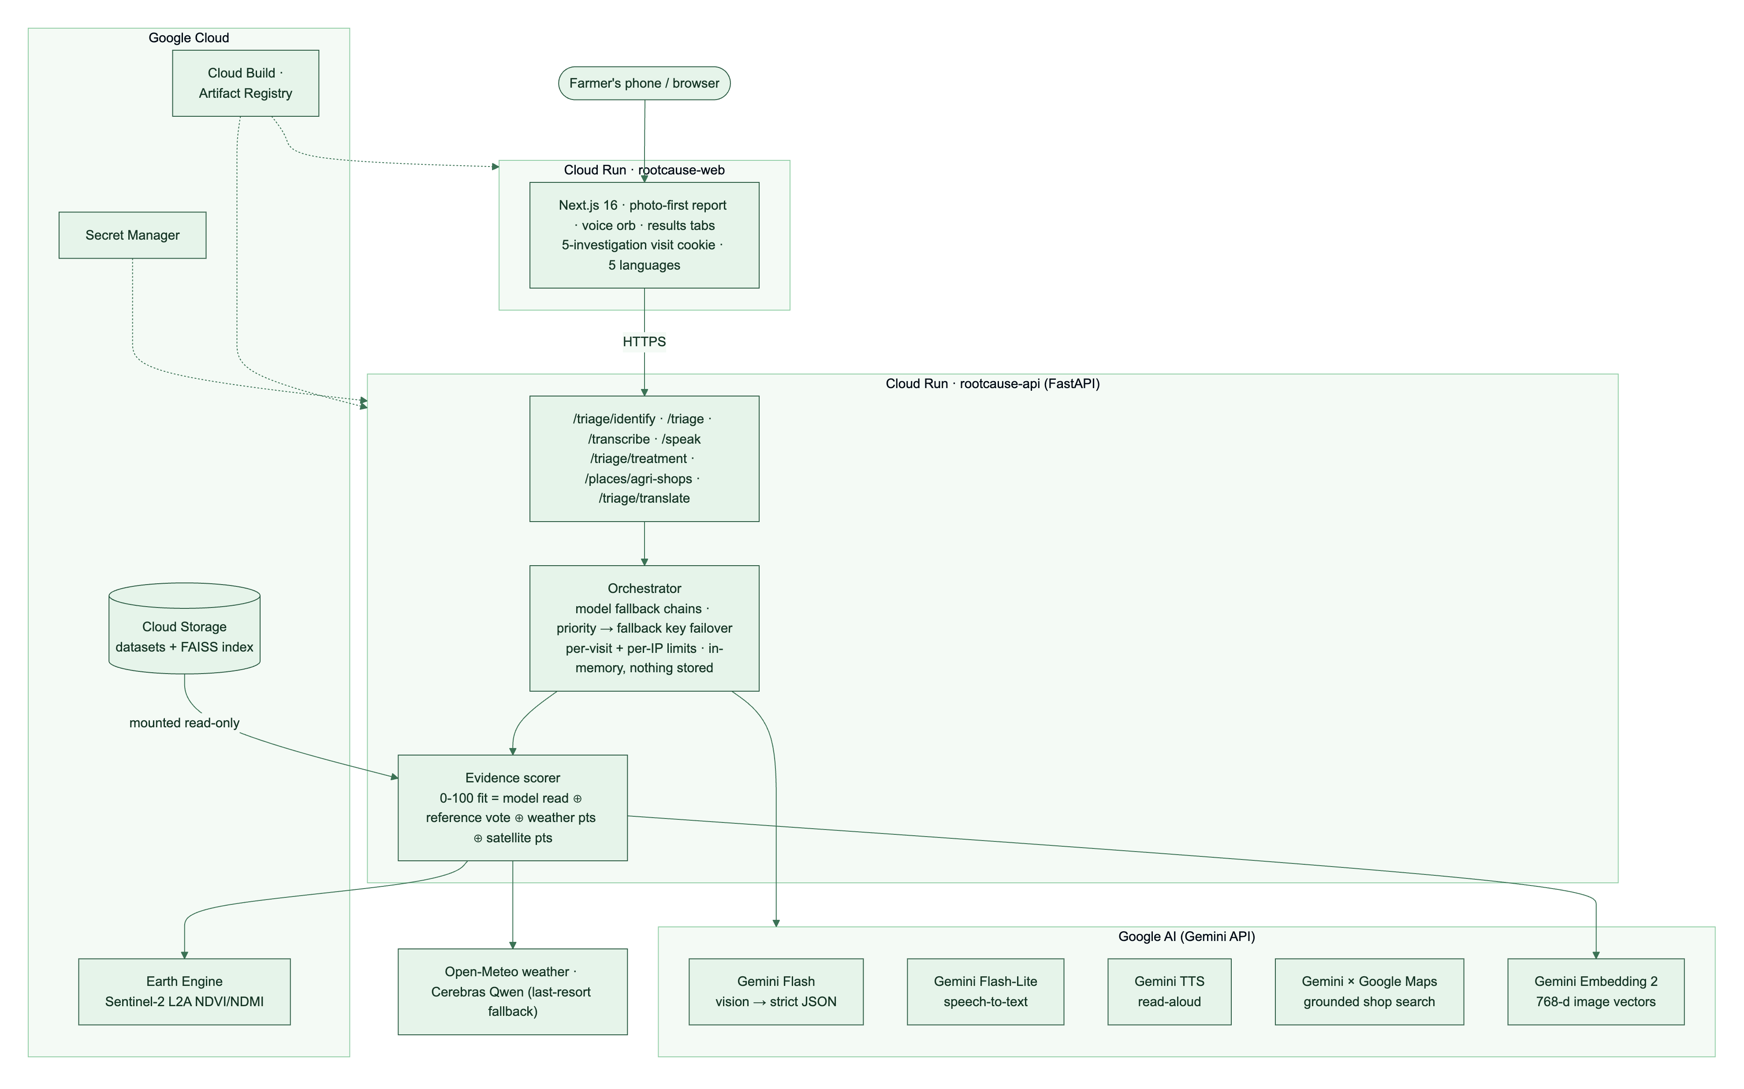
System architecture
Notes:
Source: RootCause repository, docs/submission/README.md and its linked diagrams/screens. All product metrics and implementation-cost figures are reported in that README; estimates and evaluation limitations are labelled on-slide.

Slide 9
Technology stack
GOOGLE AI
GOOGLE CLOUD
FIELD + APP
Gemini Flash · triage and vision
Gemini Embedding 2 · references
Flash-Lite · transcription
Gemini TTS · read-aloud
Gemini + Maps · real shops
Cloud Run · web + API
Cloud Build + Artifact Registry
Cloud Storage · FAISS library
Secret Manager · API keys
Earth Engine · Sentinel-2
Open-Meteo · local weather
Cerebras · last-resort model
Next.js 16 · React 19
FastAPI · Pydantic schemas
Five result languages
Notes:
Source: RootCause repository, docs/submission/README.md and its linked diagrams/screens. All product metrics and implementation-cost figures are reported in that README; estimates and evaluation limitations are labelled on-slide.

Slide 10
Prototype cost
≈ $5
ESTIMATED PROTOTYPE CASH SPEND
Gemini prepaid credit: $5
Cloud Run: ~$0 at demo traffic (scale-to-zero)
Cloud Storage: < $0.10/month
Earth Engine + Open-Meteo: $0 for this prototype use
Build, registry and secrets: within free allowances at demo volume
Planning estimate from the submission README; actual usage charges may vary.
Notes:
Source: RootCause repository, docs/submission/README.md and its linked diagrams/screens. All product metrics and implementation-cost figures are reported in that README; estimates and evaluation limitations are labelled on-slide.

Slide 11
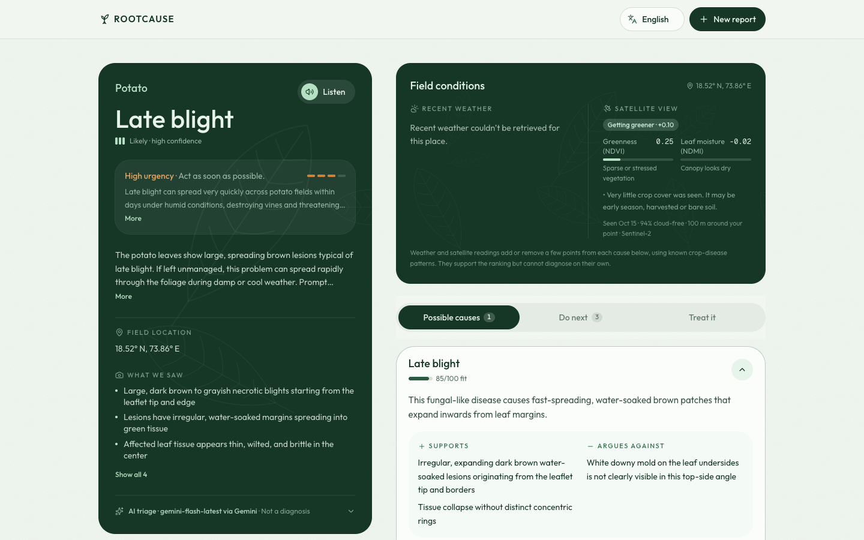
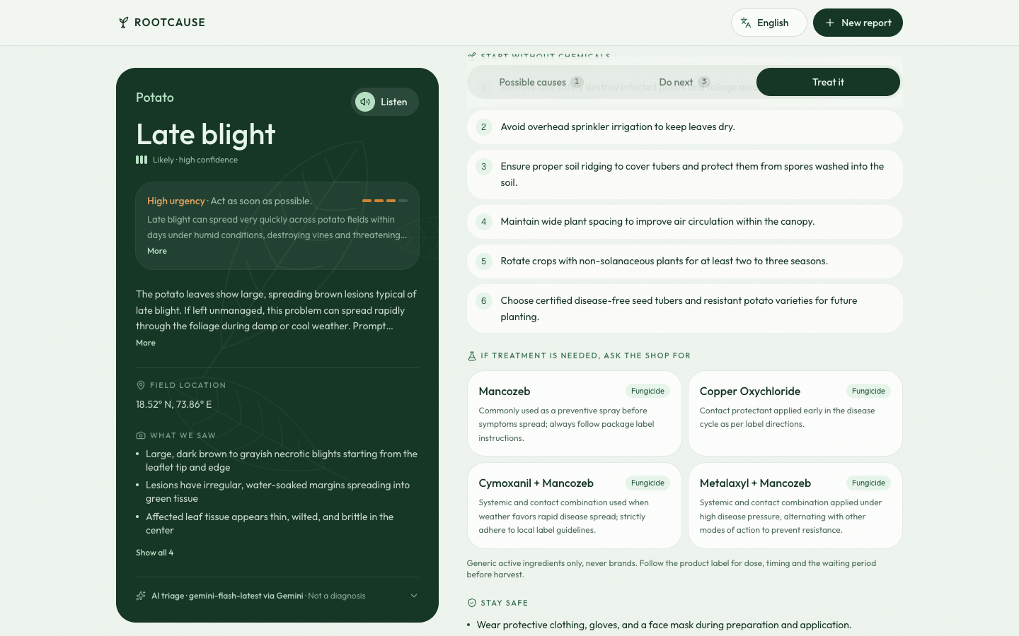
A real product, not a mock-up
EVIDENCE BEFORE CERTAINTY
PRACTICAL, SAFER ACTIONS
Causes show supporting and contradicting evidence. Treatment opens on demand and keeps the expert check visible.
Notes:
Source: RootCause repository, docs/submission/README.md and its linked diagrams/screens. All product metrics and implementation-cost figures are reported in that README; estimates and evaluation limitations are labelled on-slide.

Slide 12
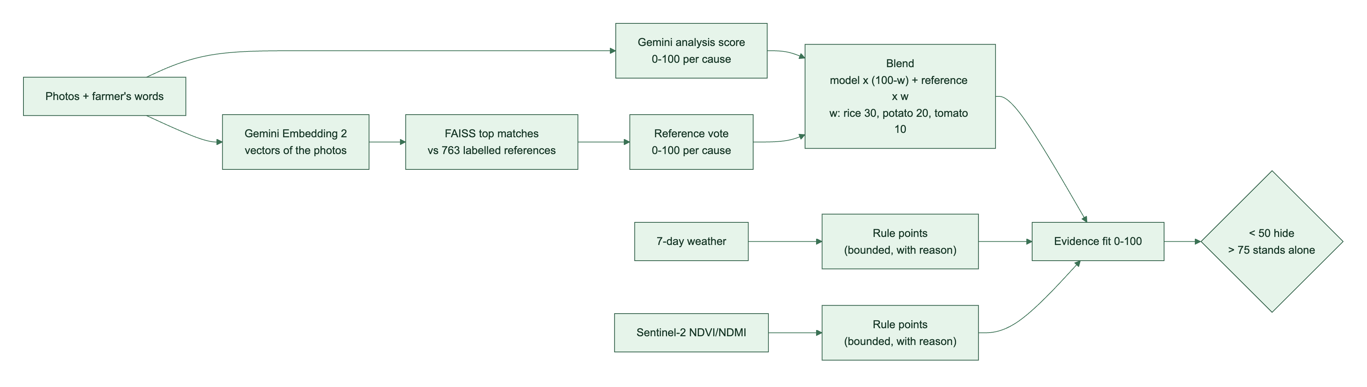
Prototype performance
763
333
25–30 s
labelled reference images
held-out evaluation images
full investigation (prototype)
Retrieval metrics in the README are DINOv2 baseline results; Gemini Embedding 2 production-index evaluation is not reported yet. Rice top-cause hit rate improved 0.50 → 0.90 on 10 held-out field photos.
Notes:
Source: RootCause repository, docs/submission/README.md and its linked diagrams/screens. All product metrics and implementation-cost figures are reported in that README; estimates and evaluation limitations are labelled on-slide.

Slide 13
What comes next
ASK BACK
A short voice question when two causes are close.
WARN EARLIER
Use the five-day forecast for disease-risk alerts.
CONNECT PEOPLE
Opt-in district signals and shareable KVK case cards.
GROW COVERAGE
More crops, regions and offline first-pass triage.
A diagnosis should lead to an expert when it needs one.
Notes:
Source: RootCause repository, docs/submission/README.md and its linked diagrams/screens. All product metrics and implementation-cost figures are reported in that README; estimates and evaluation limitations are labelled on-slide.

Slide 14
Provide links to your:
GitHub Public Repository
Demo Video Link (3 Minutes)
Final Product Link
PUBLIC REPOSITORY
https://github.com/jayeshrajani/RootCause
LIVE PRODUCT
https://rootcause-web-lp7bmse7yq-el.a.run.app/
DEMO VIDEO
Notes:
Source: RootCause repository, docs/submission/README.md and its linked diagrams/screens. All product metrics and implementation-cost figures are reported in that README; estimates and evaluation limitations are labelled on-slide.

Slide 15
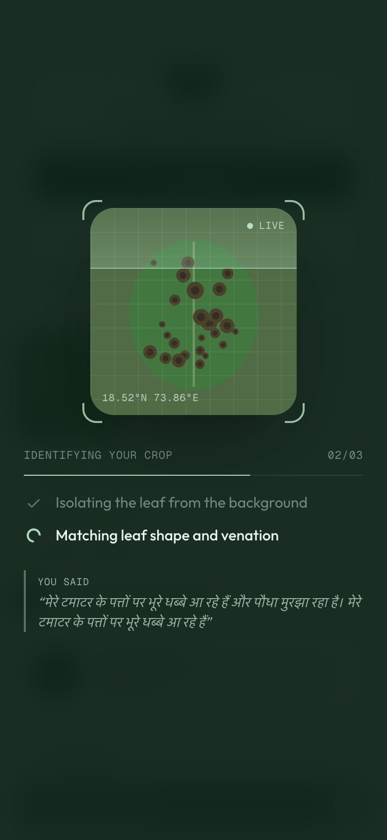
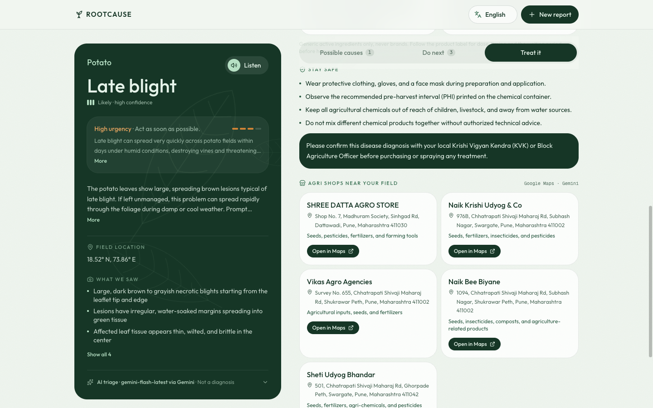
A few more things the farmer can do
REAL PLACES, OPEN IN MAPS
Photos and audio are processed in memory and never stored or logged.
STEPS SHOWN AS THEY RUN
Notes:
Source: RootCause repository, docs/submission/README.md and its linked diagrams/screens. All product metrics and implementation-cost figures are reported in that README; estimates and evaluation limitations are labelled on-slide.

Slide 16


