Slide 1
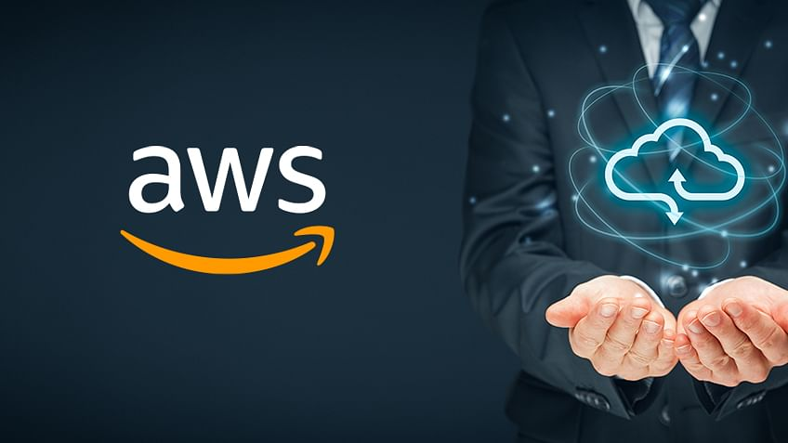

Slide 2
Who is Amazon !!
American international multibillion dollar electronic commerce company with headquarters in Seattle, Washington, USA.
started in 1995 by Jeff Bezos as an online bookstore.
but soon diversified, selling DVDs, VHSs, CDs, video and MP3 downloads/streaming, software, video games, electronics, apparel, furniture, food, toys, and jewelry.
The company also produces consumer electronics: Kindle e-book reader and the Kindle Fire tablet computer.
In 2006, Amazon officially launched the Amazon Web Services (AWS) to became a major provider of cloud computing services.

Slide 3
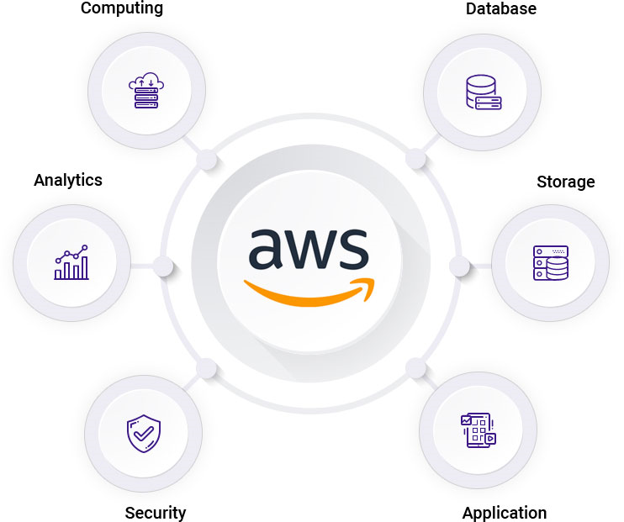
What is Amazon Web Services ?
Amazon Web Services (AWS) is a collection of remote computing services (web services) that together make up a cloud computing platform, offered over the Internet by Amazon.com.
Website: http://aws.amazon.com
Amazon Web Services (AWS) is the world's most comprehensive and broadly adopted cloud platform, offering over 200 fully featured services from data centers globally
AWS enables you to select the operating system, programming language, web application platform, database, and other services you need.

Slide 4
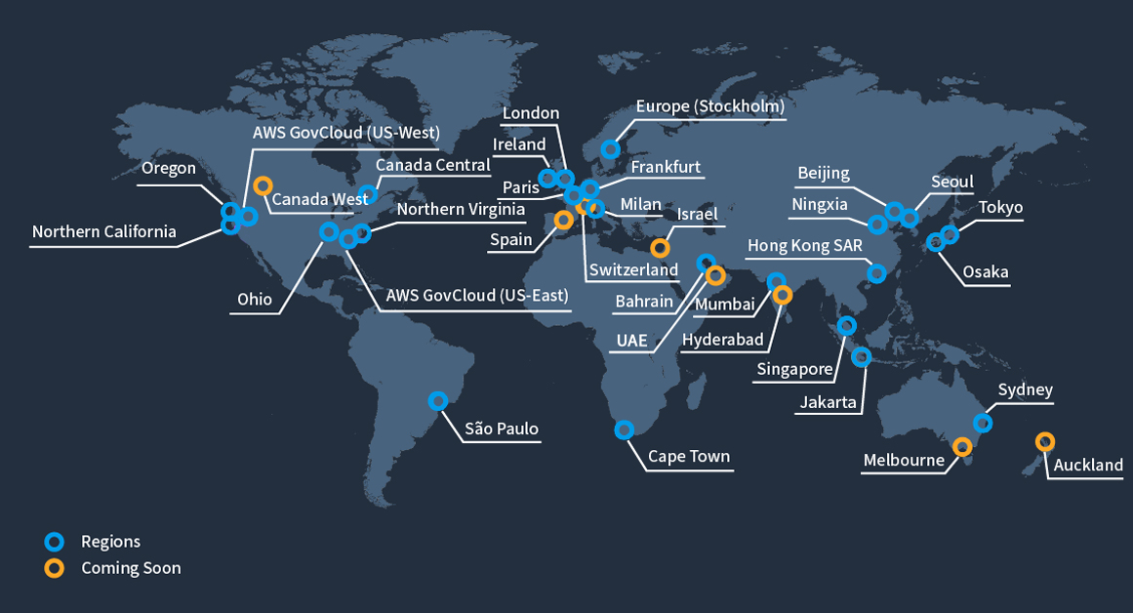
AWS Global Infrastructure
The AWS Cloud spans 93 Availability Zones within 29 geographic regions around the world, with announced plans for 18 more Availability Zones and 6 more AWS Regions in Australia, Canada, India, Israel, New Zealand, and Thailand.
Each Region has multiple 'Availability Zones', which are distinct data centers providing AWS services. Availability Zones are isolated from each other to prevent outages from spreading between Zones. However, Several services operate across Availability Zones (e.g. S3, DynamoDB).

Slide 5
What is AWS Offering?
Low Ongoing Cost:, pay-as-you-go pricing with no up-front expenses or long-term commitments.
Instant Elasticity & Flexible Capacity: (scaling up and down) Eliminate guessing on your infrastructure capacity needs.
Speed & Agility: Develop and deploy applications faster Instead of waiting weeks or months for hardware to arrive and get installed.
Apps not Ops: Focus on projects. Lets you shift resources away from data center investments and operations and move them to innovative new projects.
Global Reach: Take your apps global in minutes.
Open and Flexible: You choose the development platform or programming model that makes the most sense for your business.
Secure: Allows your application to take advantage of the multiple layers of operational and physical security in the AWS data centers to ensure the integrity and safety of your data.

Slide 6
Benefits of AWS Cloud
Usage of resources are shared amount several account holders which are isolated from each other.
The more you use the more you pay, the less you use the less you pay and if you don’t use you no need to pay. You can pay per Hour, Minute and Second. Even few services in AWS can charge for Millisecond.
Organized into product categories (Ex. Compute , Storage , Database , IOT etc.. )
No up front cost
Reduced maintenance and Admin Costs
On-Premise VS cloud Benefits of Setting up Ecommerce website on AWS compared to On-premises

Slide 7
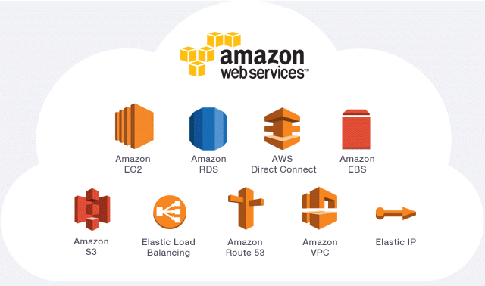
AWS Cloud Services
Compute
Storage
Database
Networking and Content Delivery
Security, Identity and Compliance

Slide 8
Amazon Elastic Compute Cloud (EC2)
A web service that provides resizable compute capacity in the cloud.
EC2 allows creating Virtual Machines (VM) on-demand. Pre-configured templated Amazon Machine Image (AMI) can be used get running immediately. Creating and sharing your own AMI is also possible via the AWS Marketplace.
Auto Scaling allows automatically scale of the capacity up seamlessly during demand spikes to maintain performance, and scales down during demand lulls to minimize costs.
Elastic Load Balancing automatically distributes incoming application traffic across multiple Amazon EC2 instances.
Provide tools to build failure resilient applications by launching application instances in separate Availability Zones.
Pay only for resources actually consume, instance-hours.
VM Import/Export enables you to easily import virtual machine images from your existing environment to Amazon EC2 instances and export them back at any time. Amazon EC2

Slide 9
Amazon Elastic Block Store (EBS)
Provides block level storage volumes (1 GB to 1 TB ) for use with Amazon EC2 instances.
Multiple volumes can be mounted to the same instance.
EBS volumes are network-attached, and persist independently from the life of an instance.
Storage volumes behave like raw, unformatted block devices, allowing users to create a file system on top of Amazon EBS volumes, or use them in any other way you would use a block device (like a hard drive).
EBS volumes are placed in a specific Availability Zone, and can then be attached to instances also in that same Availability Zone.
Each storage volume is automatically replicated within the same Availability Zone.

Slide 10
Amazon Simple Storage Service (S3)
Amazon S3 provides a simple web services interface that can be used to store and retrieve any amount of data, at any time, from anywhere on the web.
Write, read, and delete objects containing from 1 byte to 5 terabytes of data each. The number of objects you can store is unlimited.
Each object is stored in a bucket and retrieved via a unique, developer-assigned key.
– A bucket can be stored in one of several Regions.
– You can choose a Region to optimize for latency, minimize costs, or address regulatory requirements.
– Objects stored in a Region never leave the Region unless you transfer them out.
S3 charges based on per GB-month AND per I/O requests AND per data modification requests. Amazon S3

Slide 11
Amazon Virtual Private Cloud (VPC)
Amazon VPC lets you provision a logically isolated section of the Amazon Web Services (AWS) Cloud.
You have complete control over your virtual networking environment, including:
– selection of your own IP address range,
– creation of subnets, and
– configuration of route tables and network gateways.
VPC allows bridging with an onsite IT infrastructure with an encrypted VPN connection with an extra charge per VPN Connection-hour.
There is no additional charge for using Amazon Virtual Private Cloud, aside from the normal Amazon EC2 usage charges. Amazon VPC

Slide 12
THANK YOU

