Slide 1


Slide 2

What is GitHub?
GitHub is a collaboration platform built on top of a distributed version control system called Git. One does not have to worry about losing data on his hard drive or managing a project across multiple computers - one can sync from anywhere. You can track issues, build & test the things and finally deploy.

Slide 3
Why Use of GitHub for Projects?
Version Control (Allows experiments and mistakes without messing up in final product)
Keep your Code in One Place
Great Collaboration Platform
Git, GitHub, GitHub.com, GitHub Desktop

Slide 4
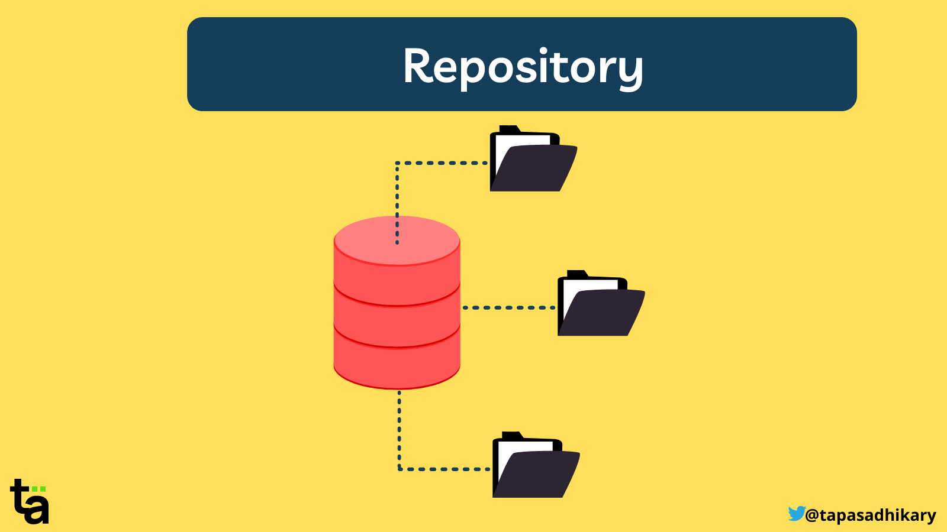

GitHub Repositories
Basic unit of GitHub, most commonly a single project. Repositories can contain folders and files, including images – anything your project needs. ReadMe – Project Description.
Contains all of the project files (including documentation), and stores each file's revision history.

Slide 5
Clone Repository
Go to the directory where you want to have your repository folder (usually, your home) and then type the clone command for your repository. For example, to get cml-cgra type-git clone <URL>
To update your repository with existing version, type
git pull origin master
If it is other branch than your master then type -
git pull origin your_branch_name
Public Repository (Any Number, Free) - Anyone can see a public repository, but you choose who can commit to it.
Private Repository (Paid Subscription) - By default, only you can see a private repository. You choose who can see and commit to this repository by adding collaborators.

Slide 6
Commit And Push
git status file.txt
git add file.txt
(You have to add before commit, You can’t skip)
git commit –m “my changes”
After commit, checking status should show
# On branch master, nothing to commit (working directory clean)
OR git commit –m ‘my changes’
git push cml-cgra master|cgra_shail
Possible Issue: Outdated commit or simultaneous commit by different developers. So, your commit can be rejected automatically. Solution - Merge/Fetch then commit.

Slide 7
Fetch/Pull
git fetch cml-cgra
Run merge, diff etc locally
git pull cml-cgra = git fetch + merge
Diff - Another Snapshotting Command!
git diff (show diff of unstaged changes i.e. after past commit)
git diff --cached (show diff of staged changes)
git diff HEAD (show diff of all staged or unstaged changes i.e. difference between working directory and last commit, ignoring the staging)
git diff –stat (show summary of changes instead of diff)

Slide 8
Branching
git branch -> list your available branches. Current branch will have a star next to it and in green color.
When you run git init it will automatically create a 'master' branch for you by default.
git branch branch_name -> Create a new branch at your last commit. So if you record some commits at this point and then switch to 'testing‘. It will revert your working directory context back to when you created the branch in the first place - you can think of it like a bookmark for where you currently are!
git checkout branch_name to switch branch we're currently on.
Shortcut: git checkout –b branch_name
git branch –v (see last commit on each branch)
git branch –d branch_name (delete a branch)
git push remote_name : branch_name (delete remote branch)

Slide 9
Merging
git merge – Merge any branch into current branch
Also performs more complex merges from various branches like modification in code rather than just addition/deletion
Merge Conflicts! – Occurs when same block of code is edited in different branches there is no way for computer to figure out.
Much like subversion, Git inserts standard merge conflict markers. We have to resolve them (manually, mostly) and then to commit changes.
git mergetool -> graphical mergetool from git
git diff -> Git inserts standard merge conflict markers
Lastly do git add - to tell Git the file has been resolved you have to stage it.

Slide 10
THANK YOU

