Slide 1
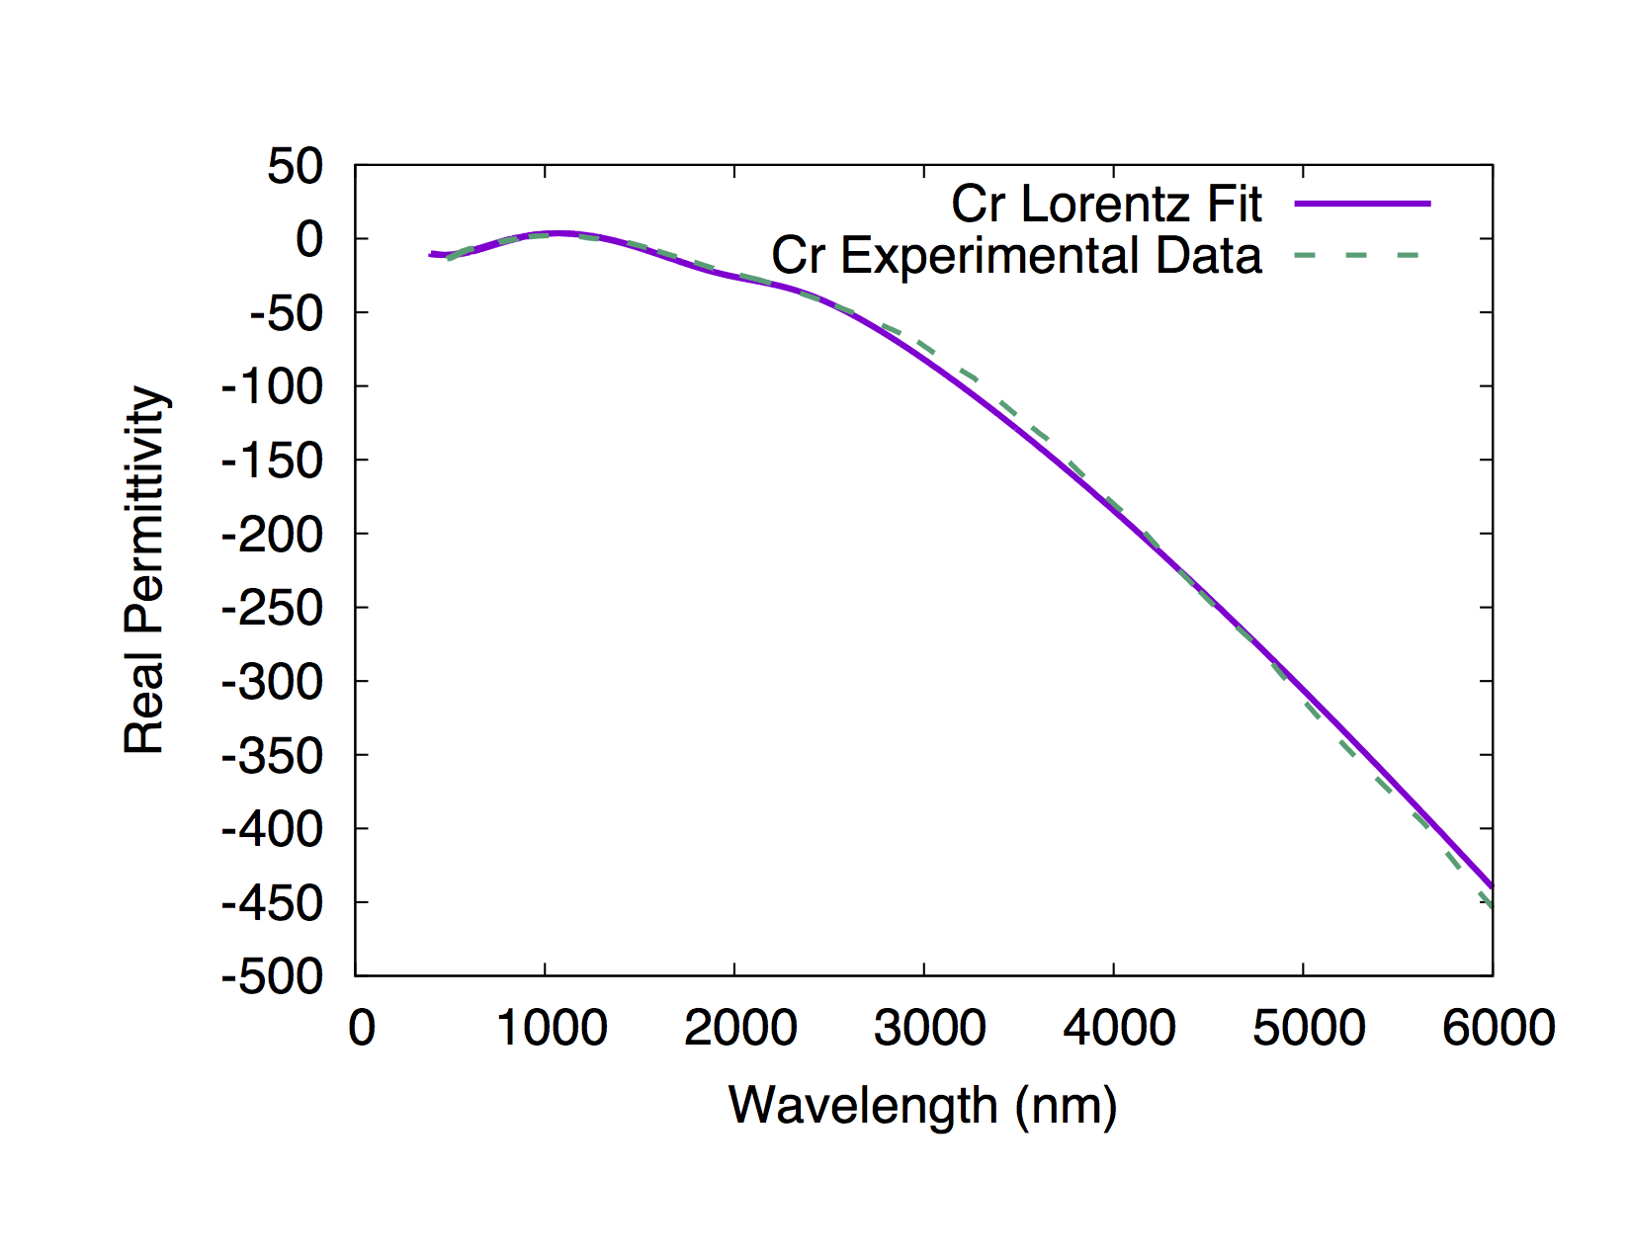
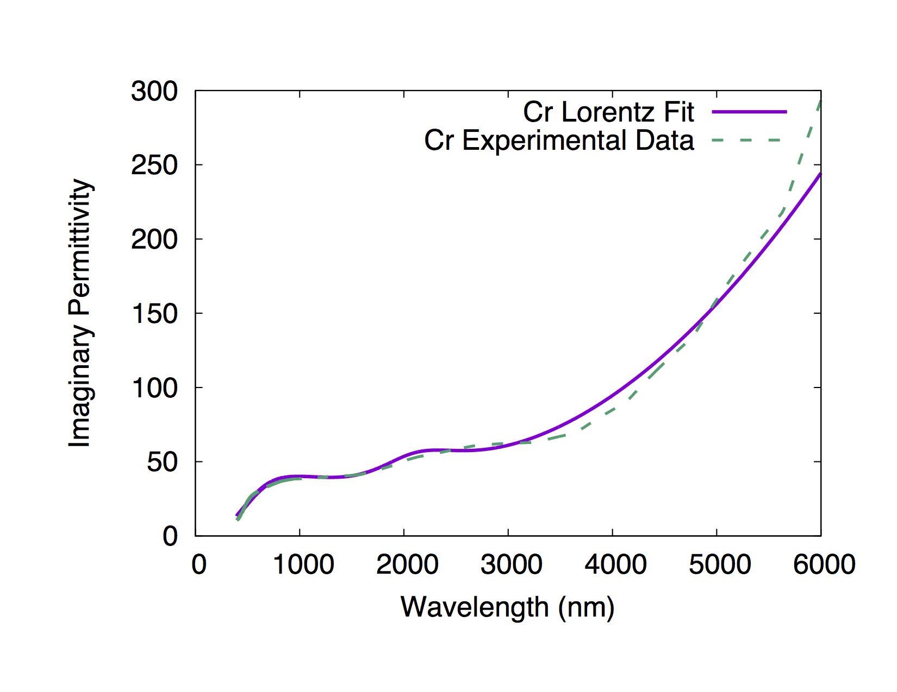
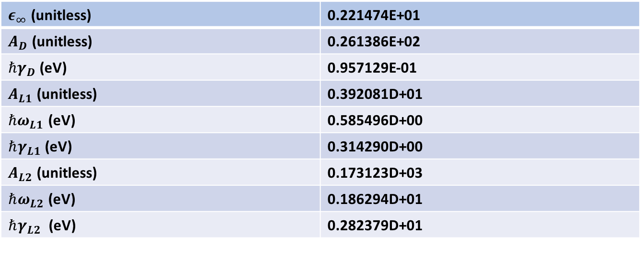
$$ε\left(ω\right)=ε_{∞}−\frac{A_{D}}{ω^{2}+i γ_{D}ω}+\frac{A_{L1}}{{(ω}_{L1}^{2}−ω^{2}) −i γ_{L1}ω}+\frac{A_{L2}}{{(ω}_{L2}^{2}−ω^{2}) −iγ_{L2}ω}$$
$ε_{∞}$ (unitless) | 0.221474E+01
$A_{D}$ (unitless) | 0.261386E+02
${ℏγ}_{D}$(eV) | 0.957129E-01
$A_{L1}$ (unitless) | 0.392081D+01
${ℏω}_{L1}$ (eV) | 0.585496D+00
$ℏγ_{L1}$ (eV) | 0.314290D+00
$A_{L2}$ (unitless) | 0.173123D+03
$ℏω_{L2}$ (eV) | 0.186294D+01
$ℏγ_{L2}$ (eV) | 0.282379D+01

Slide 2
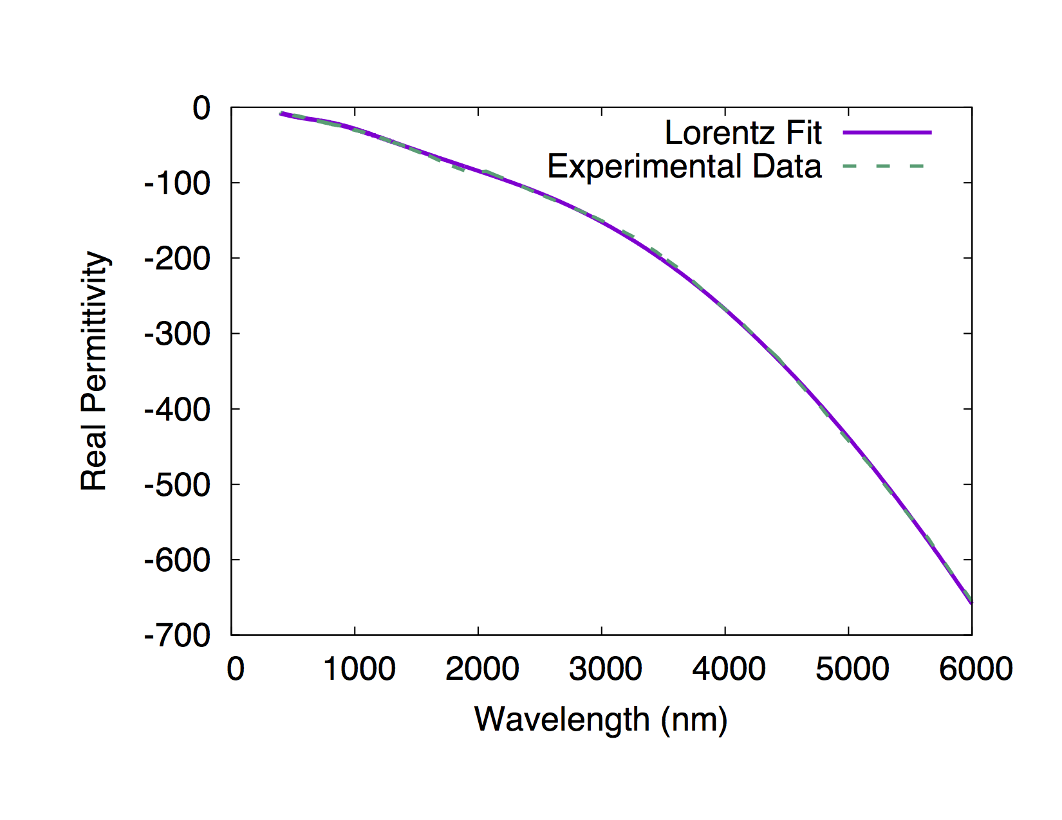
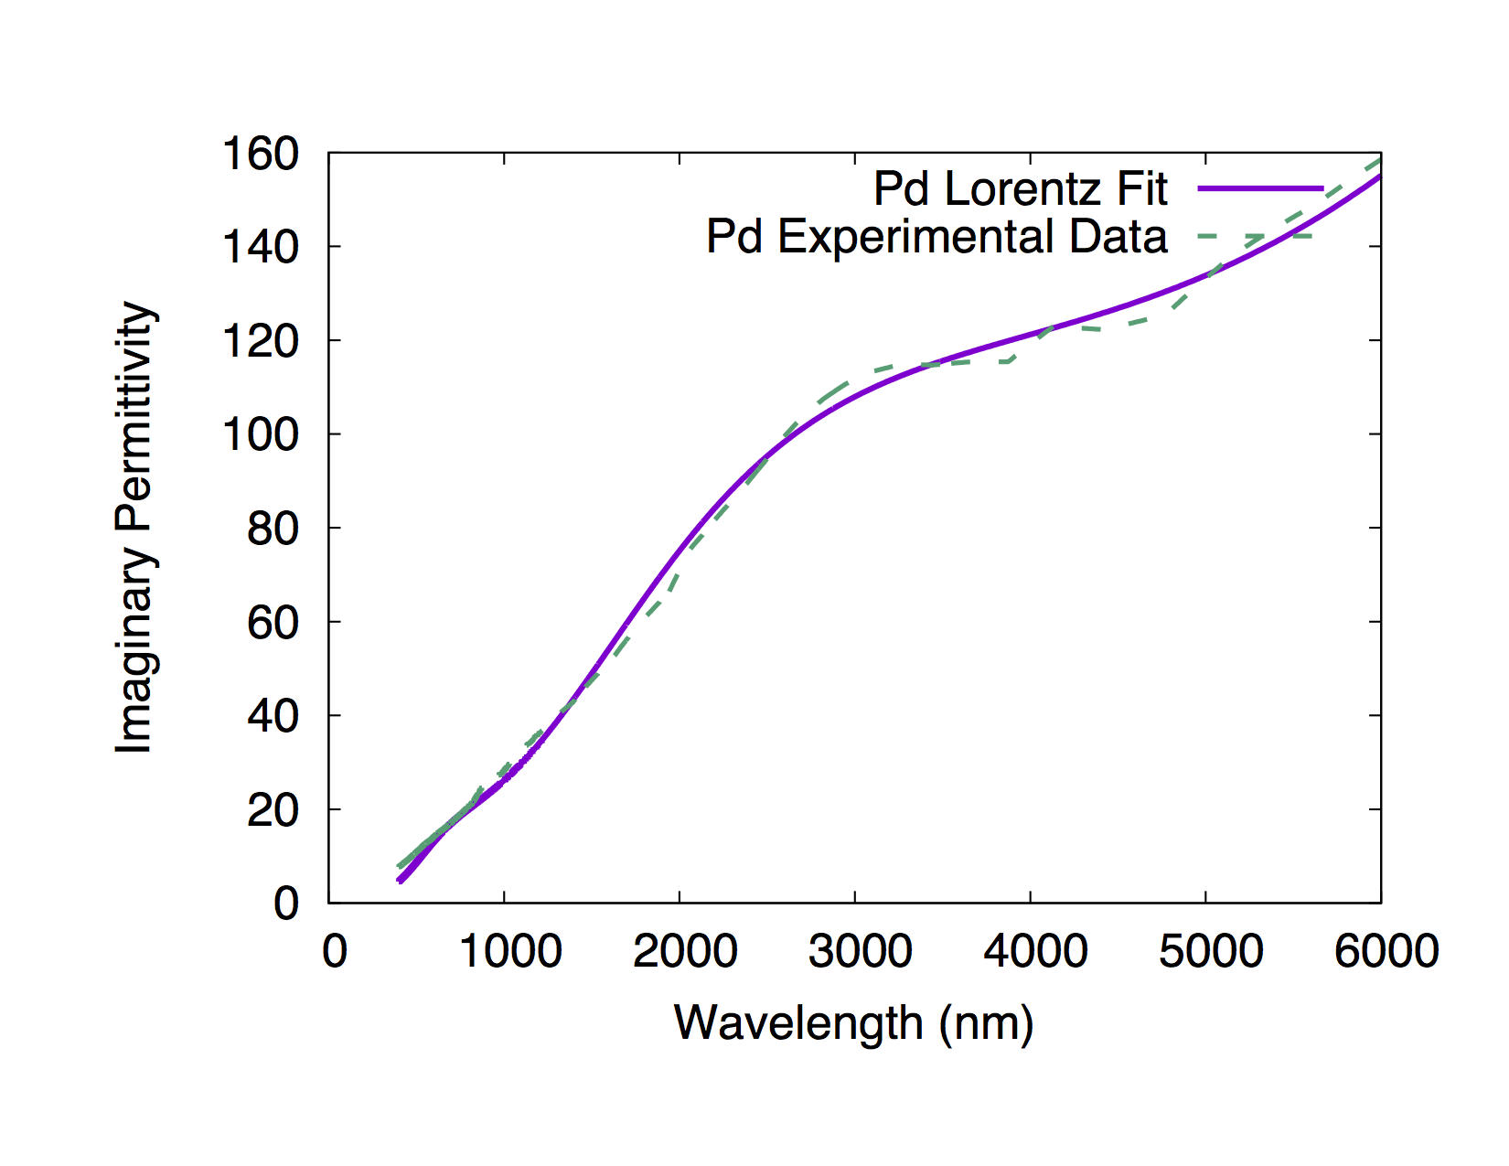
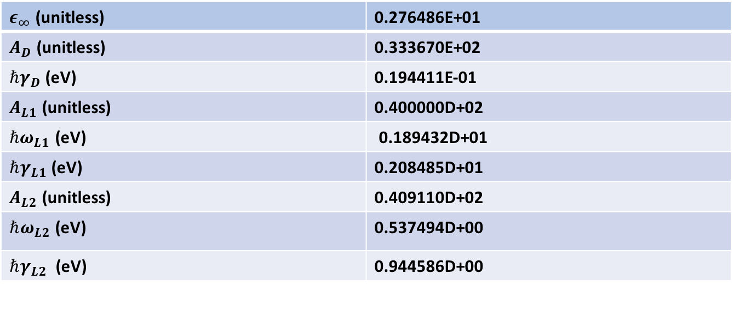
$$ε\left(ω\right)=ε_{∞}−\frac{A_{D}}{ω^{2}+i γ_{D}ω}+\frac{A_{L1}}{{(ω}_{L1}^{2}−ω^{2}) −i γ_{L1}ω}+\frac{A_{L2}}{{(ω}_{L2}^{2}−ω^{2}) −iγ_{L2}ω}$$
$ε_{∞}$ (unitless) | 0.276486E+01
$A_{D}$ (unitless) | 0.333670E+02
${ℏγ}_{D}$(eV) | 0.194411E-01
$A_{L1}$ (unitless) | 0.400000D+02
${ℏω}_{L1}$ (eV) | 0.189432D+01
$ℏγ_{L1}$ (eV) | 0.208485D+01
$A_{L2}$ (unitless) | 0.409110D+02
$ℏω_{L2}$ (eV) | 0.537494D+00
$ℏγ_{L2}$ (eV) | 0.944586D+00

Slide 3
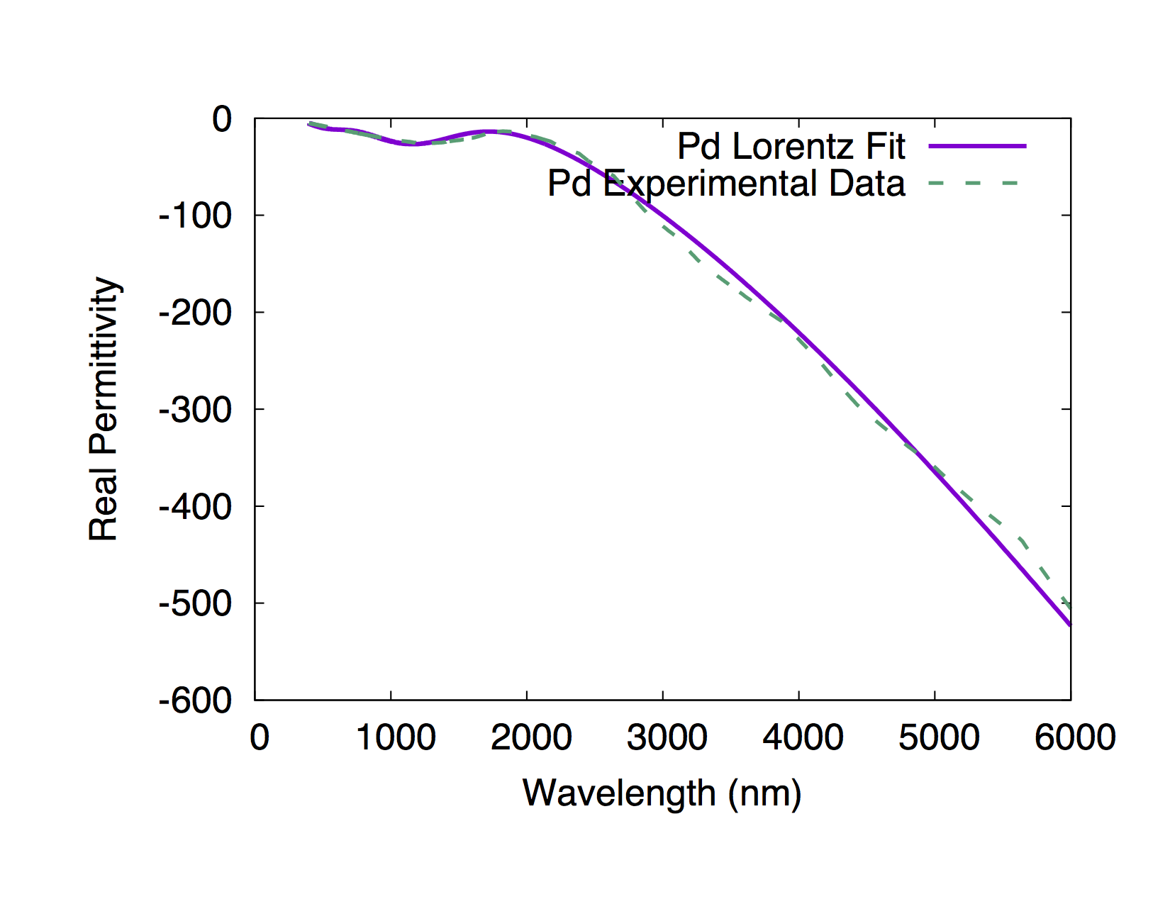
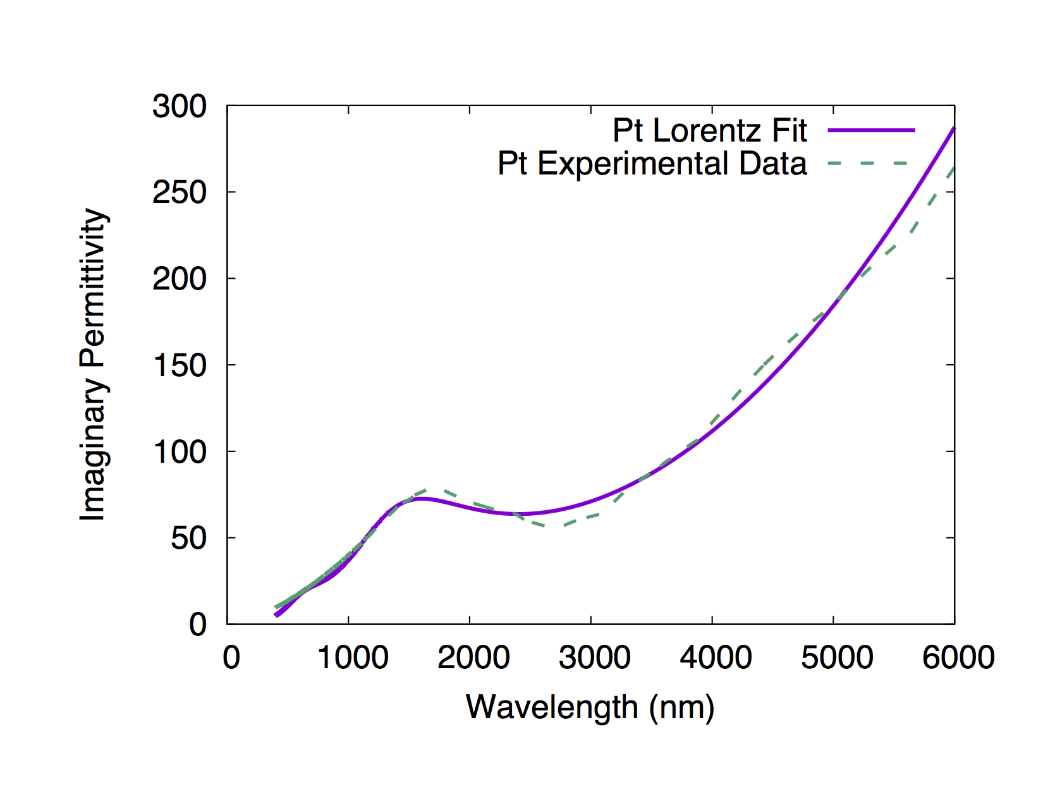
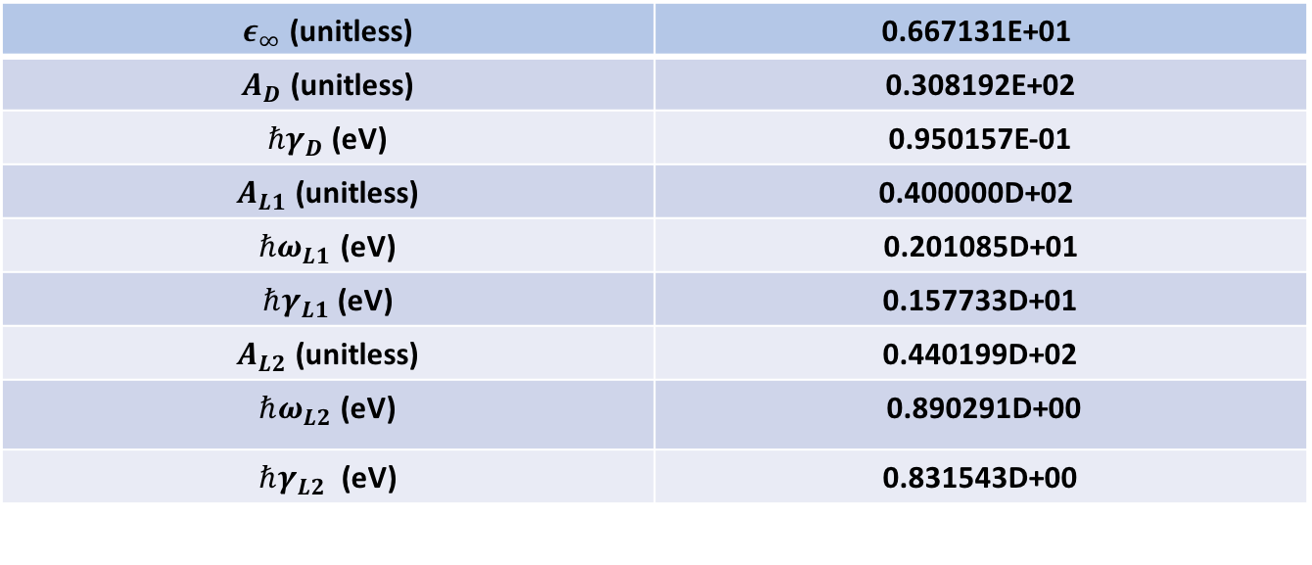
$$ε\left(ω\right)=ε_{∞}−\frac{A_{D}}{ω^{2}+i γ_{D}ω}+\frac{A_{L1}}{{(ω}_{L1}^{2}−ω^{2}) −i γ_{L1}ω}+\frac{A_{L2}}{{(ω}_{L2}^{2}−ω^{2}) −iγ_{L2}ω}$$
$ε_{∞}$ (unitless) | 0.667131E+01
$A_{D}$ (unitless) | 0.308192E+02
${ℏγ}_{D}$(eV) | 0.950157E-01
$A_{L1}$ (unitless) | 0.400000D+02
${ℏω}_{L1}$ (eV) | 0.201085D+01
$ℏγ_{L1}$ (eV) | 0.157733D+01
$A_{L2}$ (unitless) | 0.440199D+02
$ℏω_{L2}$ (eV) | 0.890291D+00
$ℏγ_{L2}$ (eV) | 0.831543D+00

Slide 4
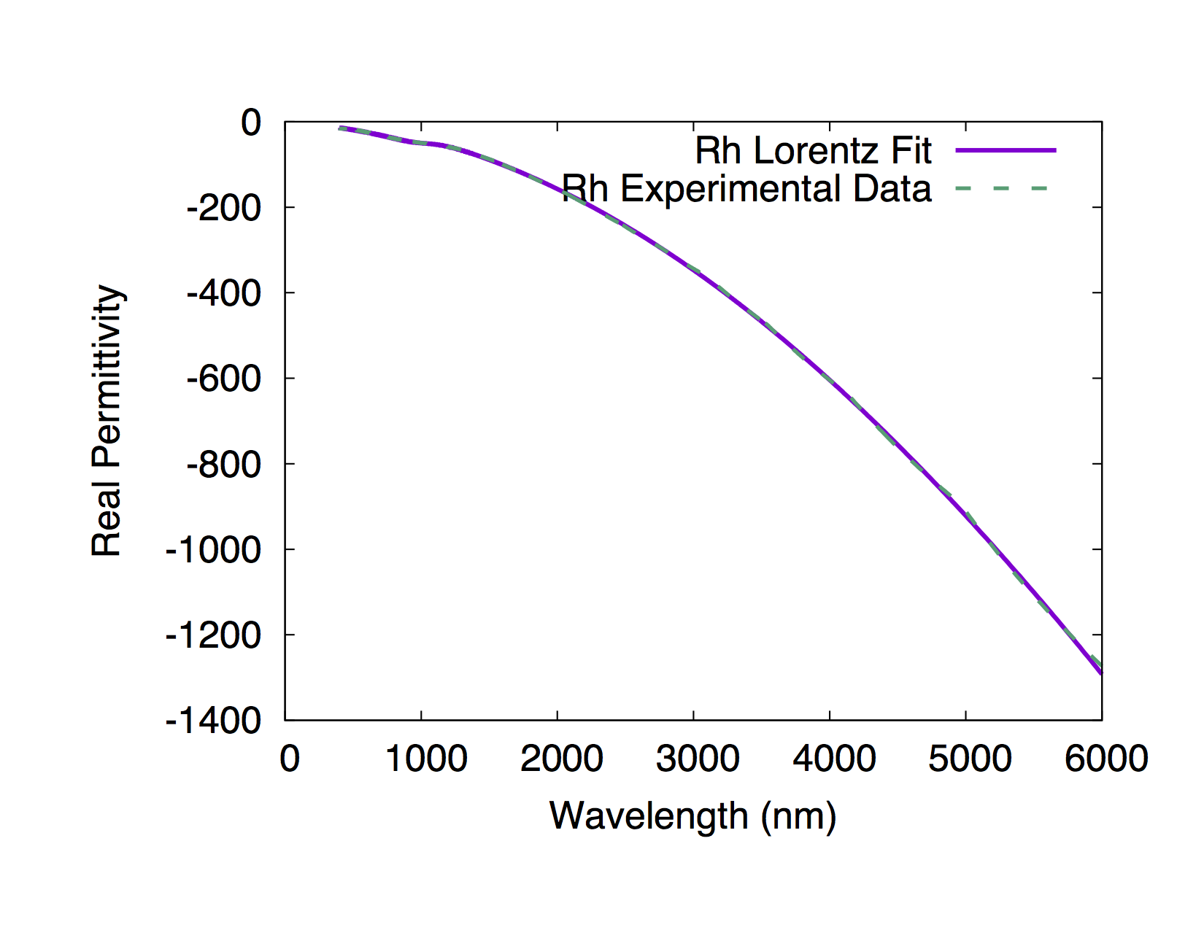
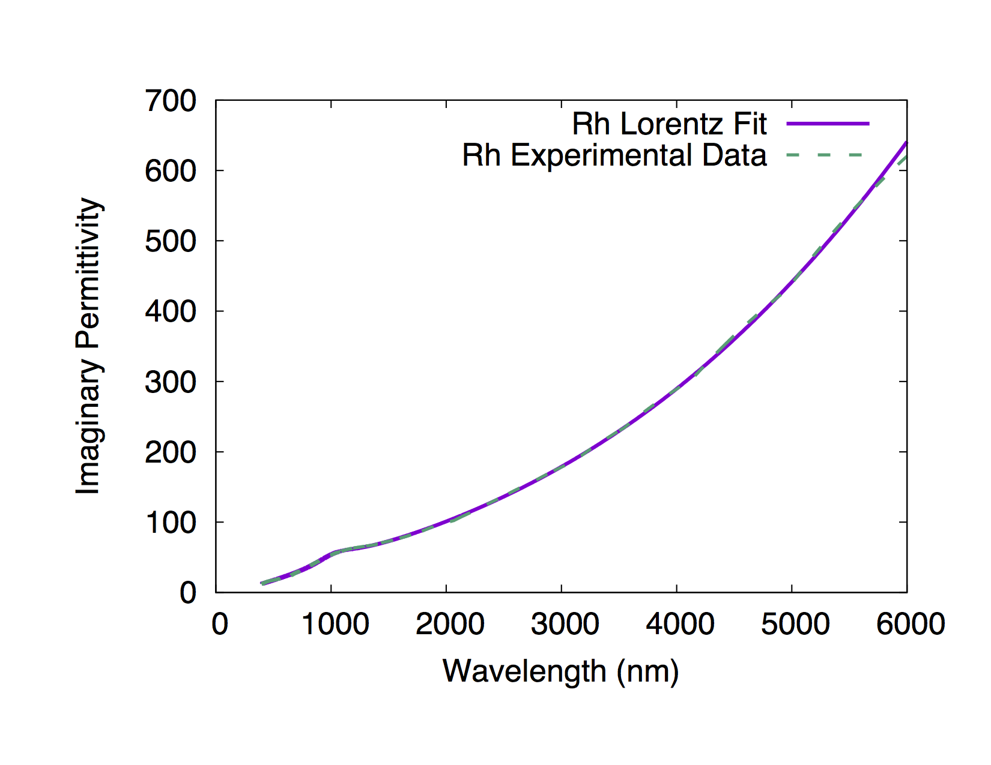
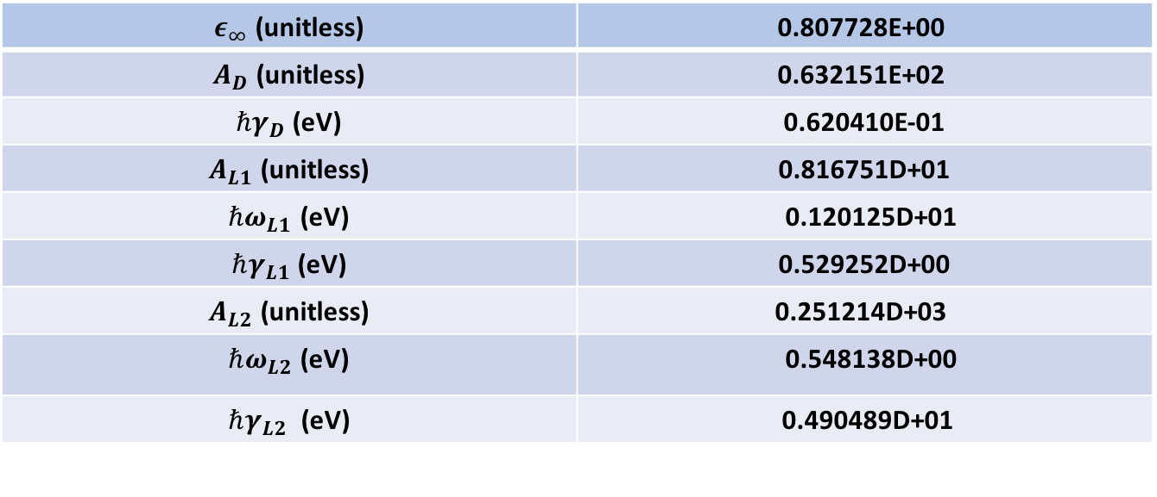
$$ε\left(ω\right)=ε_{∞}−\frac{A_{D}}{ω^{2}+i γ_{D}ω}+\frac{A_{L1}}{{(ω}_{L1}^{2}−ω^{2}) −i γ_{L1}ω}+\frac{A_{L2}}{{(ω}_{L2}^{2}−ω^{2}) −iγ_{L2}ω}$$
$ε_{∞}$ (unitless) | 0.807728E+00
$A_{D}$ (unitless) | 0.632151E+02
${ℏγ}_{D}$(eV) | 0.620410E-01
$A_{L1}$ (unitless) | 0.816751D+01
${ℏω}_{L1}$ (eV) | 0.120125D+01
$ℏγ_{L1}$ (eV) | 0.529252D+00
$A_{L2}$ (unitless) | 0.251214D+03
$ℏω_{L2}$ (eV) | 0.548138D+00
$ℏγ_{L2}$ (eV) | 0.490489D+01

Slide 5
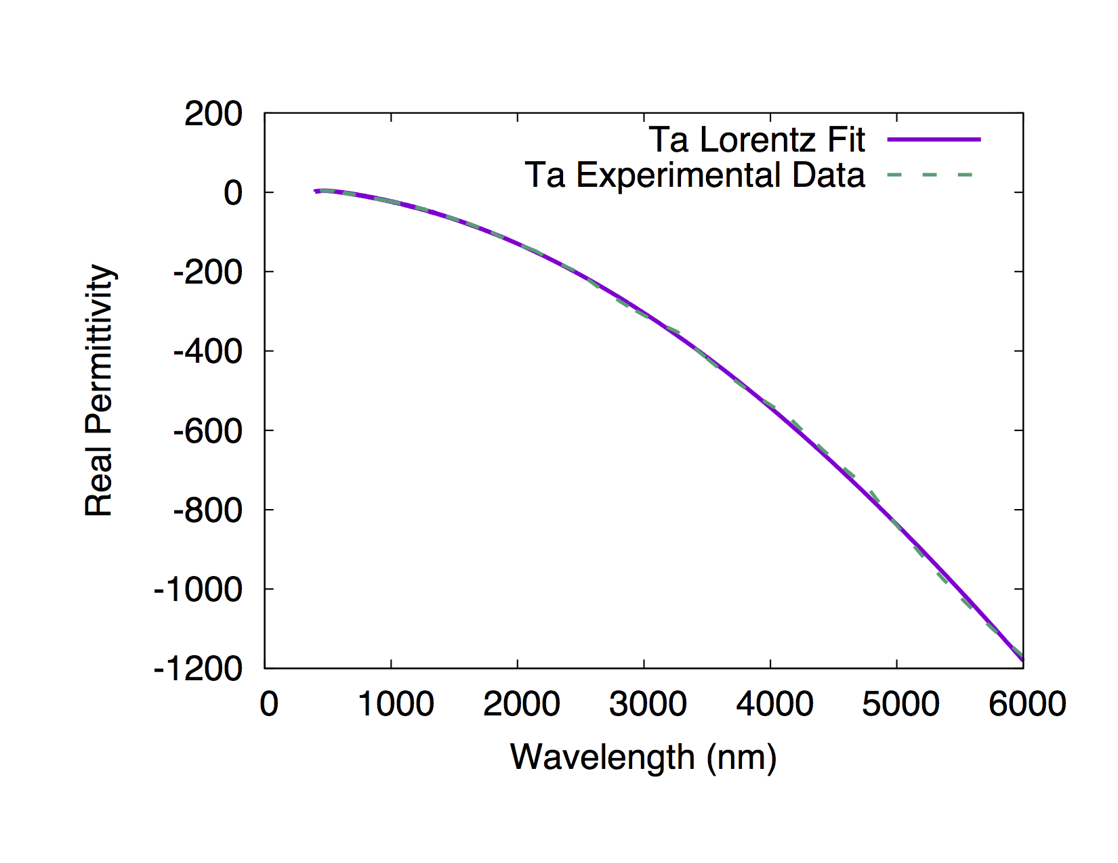
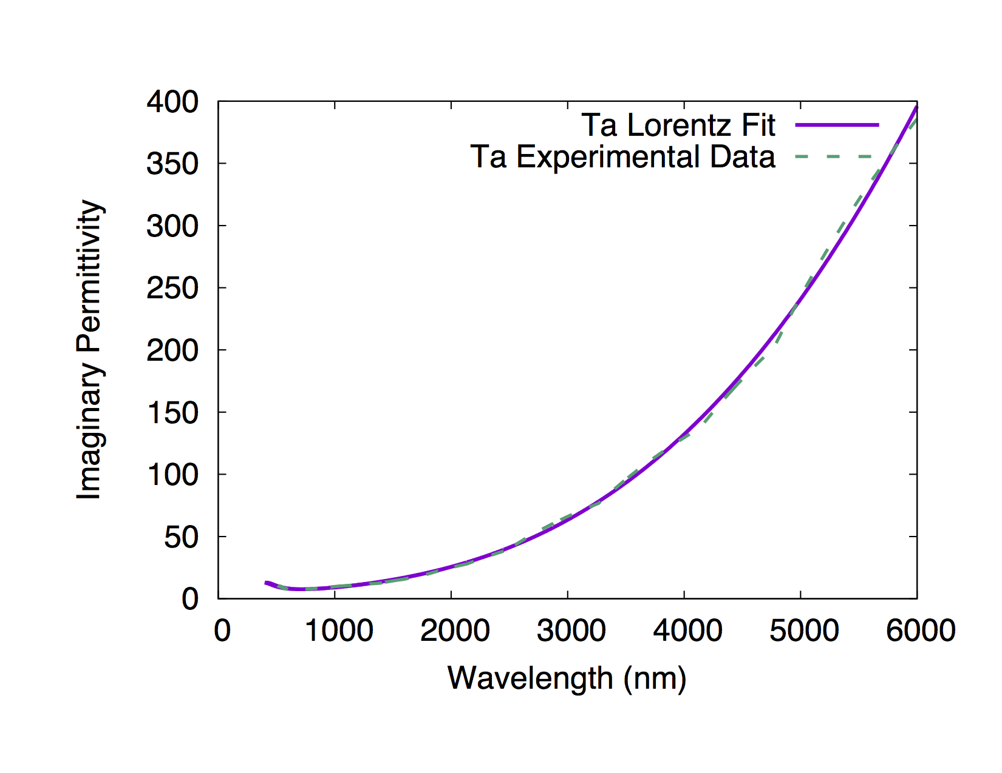
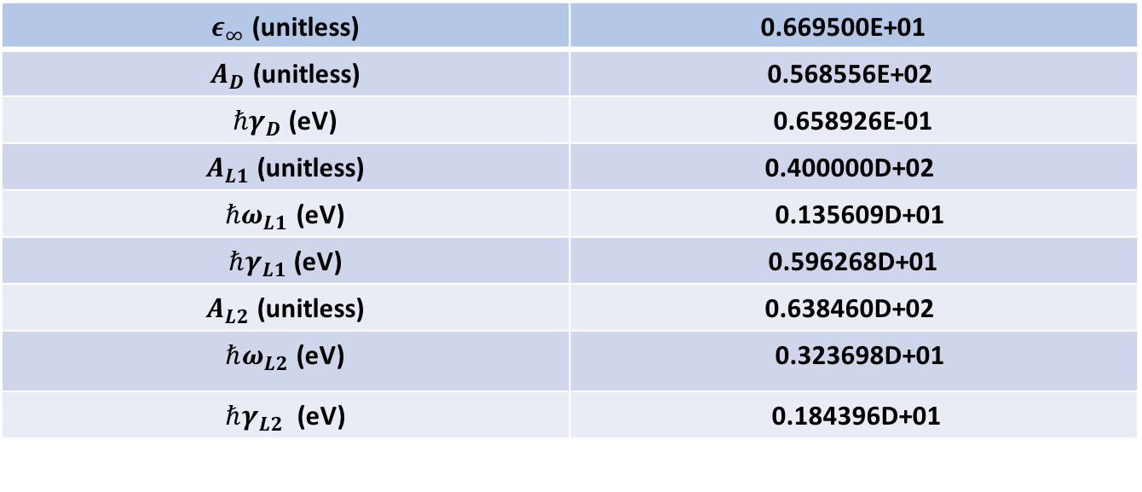
$$ε\left(ω\right)=ε_{∞}−\frac{A_{D}}{ω^{2}+i γ_{D}ω}+\frac{A_{L1}}{{(ω}_{L1}^{2}−ω^{2}) −i γ_{L1}ω}+\frac{A_{L2}}{{(ω}_{L2}^{2}−ω^{2}) −iγ_{L2}ω}$$
$ε_{∞}$ (unitless) | 0.669500E+01
$A_{D}$ (unitless) | 0.568556E+02
${ℏγ}_{D}$(eV) | 0.658926E-01
$A_{L1}$ (unitless) | 0.400000D+02
${ℏω}_{L1}$ (eV) | 0.135609D+01
$ℏγ_{L1}$ (eV) | 0.596268D+01
$A_{L2}$ (unitless) | 0.638460D+02
$ℏω_{L2}$ (eV) | 0.323698D+01
$ℏγ_{L2}$ (eV) | 0.184396D+01

Slide 6
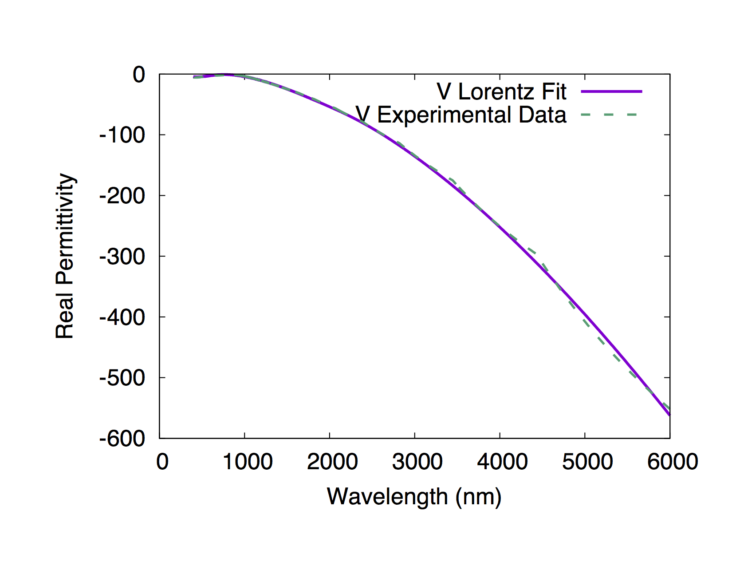
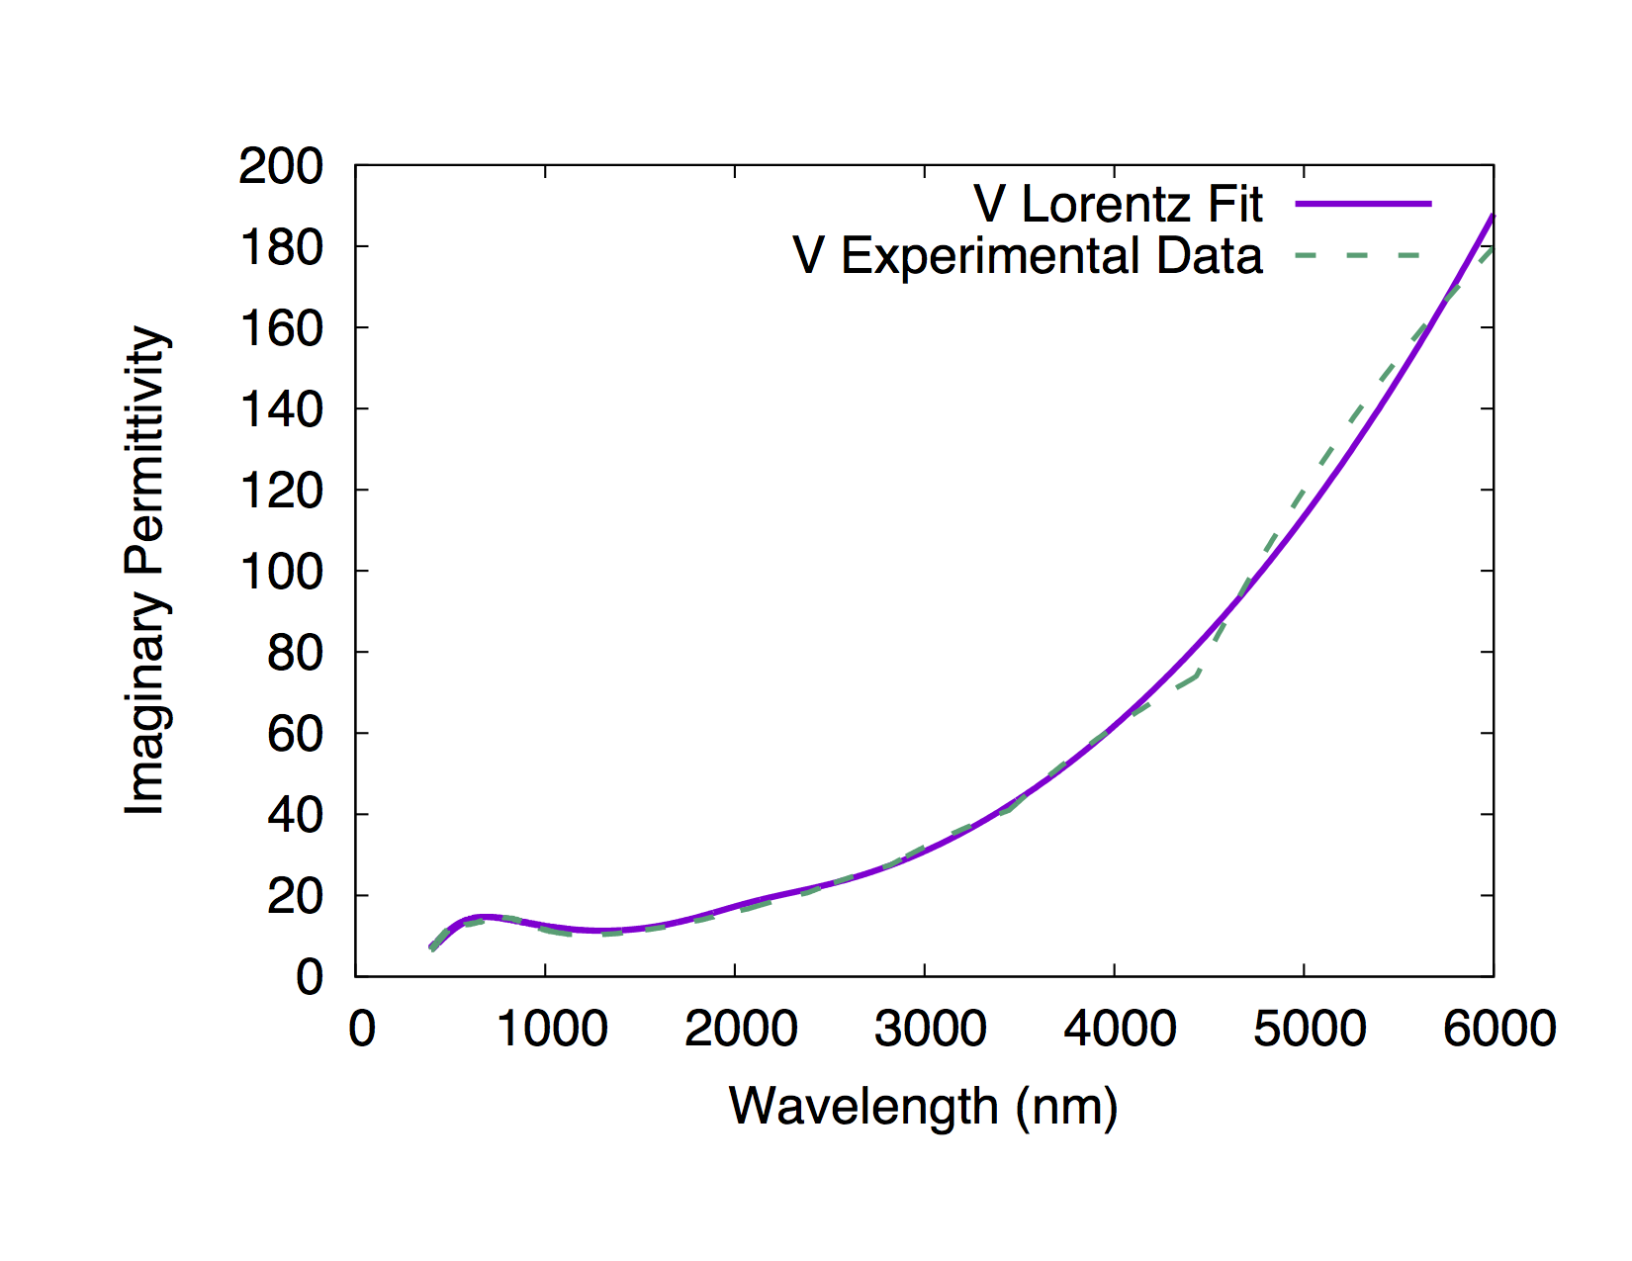
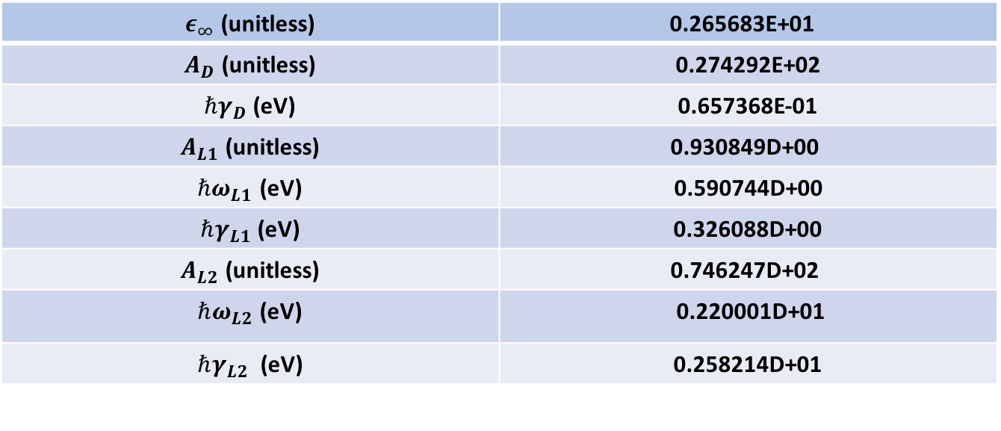
$$ε\left(ω\right)=ε_{∞}−\frac{A_{D}}{ω^{2}+i γ_{D}ω}+\frac{A_{L1}}{{(ω}_{L1}^{2}−ω^{2}) −i γ_{L1}ω}+\frac{A_{L2}}{{(ω}_{L2}^{2}−ω^{2}) −iγ_{L2}ω}$$
$ε_{∞}$ (unitless) | 0.265683E+01
$A_{D}$ (unitless) | 0.274292E+02
${ℏγ}_{D}$(eV) | 0.657368E-01
$A_{L1}$ (unitless) | 0.930849D+00
${ℏω}_{L1}$ (eV) | 0.590744D+00
$ℏγ_{L1}$ (eV) | 0.326088D+00
$A_{L2}$ (unitless) | 0.746247D+02
$ℏω_{L2}$ (eV) | 0.220001D+01
$ℏγ_{L2}$ (eV) | 0.258214D+01

Slide 7
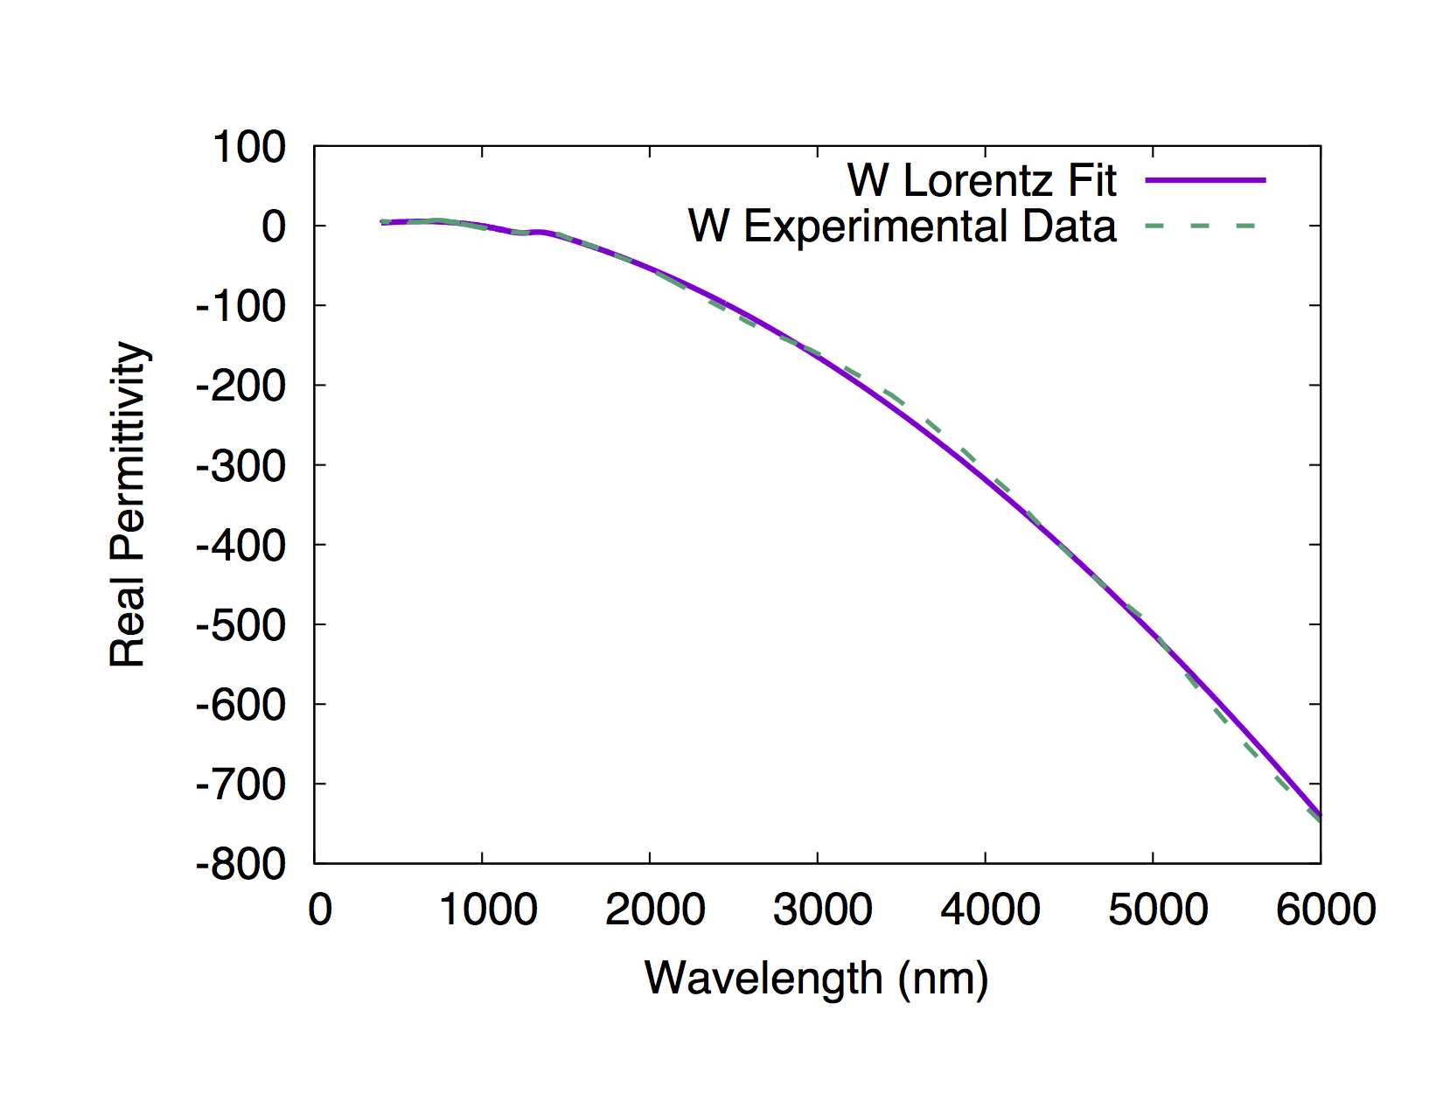
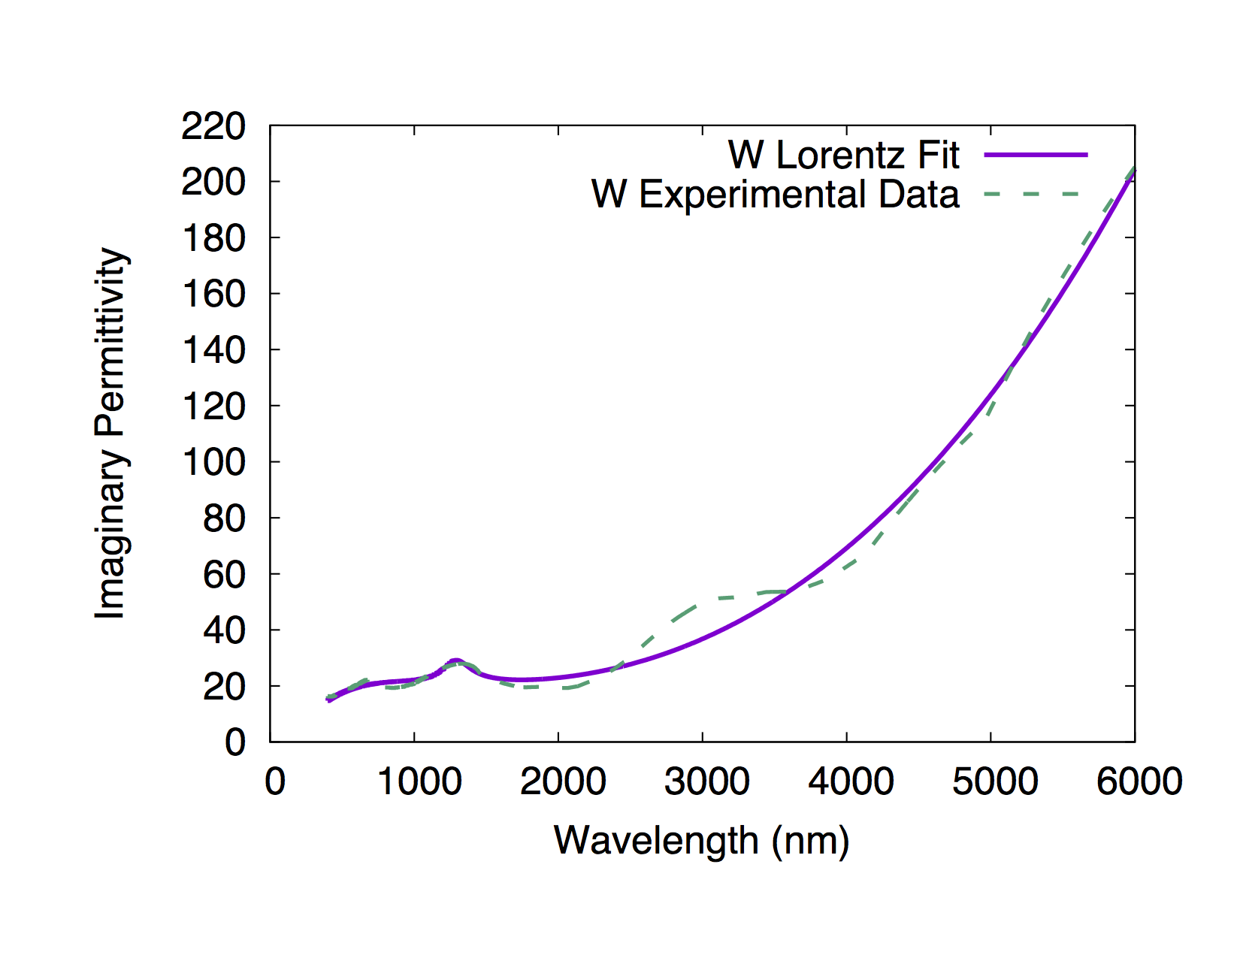
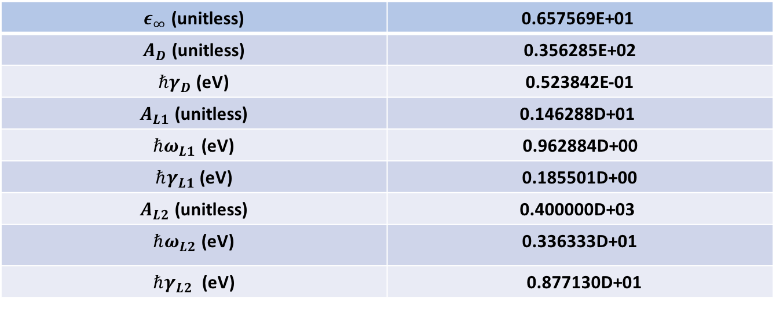
$$ε\left(ω\right)=ε_{∞}−\frac{A_{D}}{ω^{2}+i γ_{D}ω}+\frac{A_{L1}}{{(ω}_{L1}^{2}−ω^{2}) −i γ_{L1}ω}+\frac{A_{L2}}{{(ω}_{L2}^{2}−ω^{2}) −iγ_{L2}ω}$$
$ε_{∞}$ (unitless) | 0.657569E+01
$A_{D}$ (unitless) | 0.356285E+02
${ℏγ}_{D}$(eV) | 0.523842E-01
$A_{L1}$ (unitless) | 0.146288D+01
${ℏω}_{L1}$ (eV) | 0.962884D+00
$ℏγ_{L1}$ (eV) | 0.185501D+00
$A_{L2}$ (unitless) | 0.400000D+03
$ℏω_{L2}$ (eV) | 0.336333D+01
$ℏγ_{L2}$ (eV) | 0.877130D+01

