Slide 1
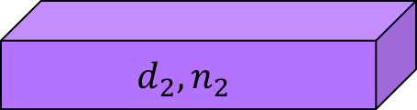
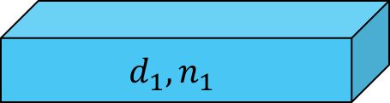
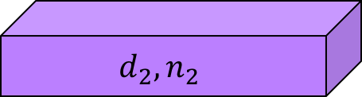

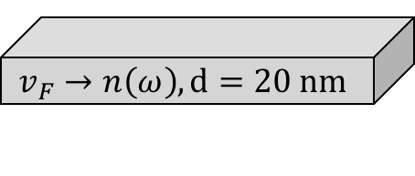

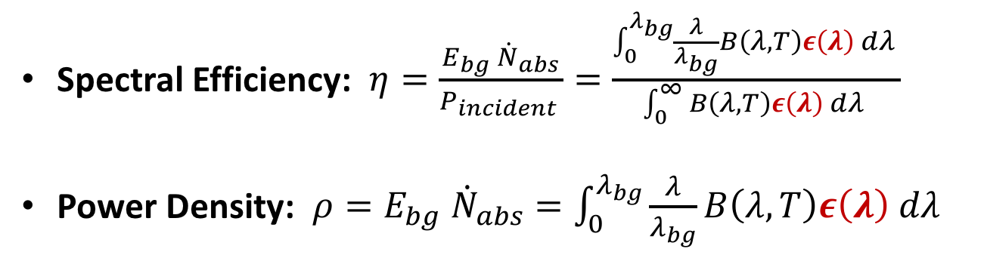
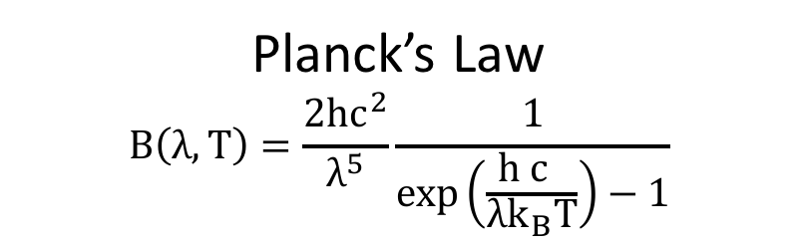

Can we engineer thermal emission in practical planar nanostructures?
Virtual Screening $↔$ Nanofabrication
W-Al₂O₃ alloy
What are we screening for?
$$v_{F}→n\left(ω\right), d=20 nm$$
$$d_{1}, n_{1}$$
Spectral Efficiency: $η=\frac{E_{bg}{ \dot{N}}_{abs}}{P_{incident }}=\frac{\int_{0}^{λ_{bg}}{\frac{λ}{λ_{bg}}B\left(λ,T\right)ε\left(λ\right) dλ }}{\int_{0}^{∞}{B\left(λ,T\right)ε\left(λ\right) dλ }}$
Power Density: $ρ=E_{bg} {\dot{N}}_{abs}=\int_{0}^{λ_{bg}}{\frac{λ}{λ_{bg}}B\left(λ,T\right)ε\left(λ\right) dλ }$
$$d_{2}, n_{2}$$
$$d_{1}, n_{1}$$
$Λ$ periods of BR
$$d_{2}, n_{2}$$
W Substrate
Planck’s Law
$$B\left(λ,T\right)=\frac{2{hc}^{2}}{λ^{5}}\frac{1}{exp\left(\frac{{h c }_{ }}{λk_{B}T}\right)−1}$$

