Slide 1
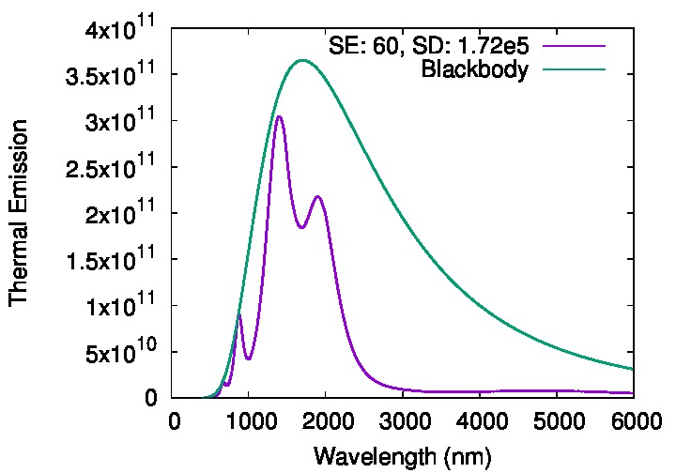
Thermal Emission of Paretto-Optimal Structure using MgO and Cr2O3 as dielectric materials
Spectral Efficiency: 60%
Spectral Density: 172,000 W/m^2
ALD W+ ALD Alumina, vf = 0.45, d = 20 nm
MgO, d = 195 nm
Cr2O3, d = 140 nm
MgO, d = 195 nm
Cr2O3, d = 140 nm
ALD Alumina, d = 10 nm
Substrate W, d = 900 nm

Slide 2
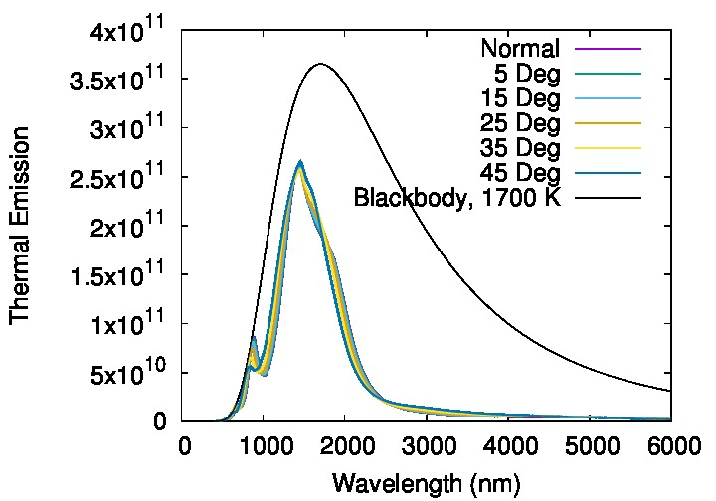
ALD W+ ALD Alumina, vf = 0.25, d = 20 nm
Angle-Dependance of Thermal Emission
SiO2, d = 223.6 nm
TiO2, d = 178.5 nm
SiO2, d = 223.6 nm
TiO2, d = 178.5 nm
ALD Alumina, d = 10 nm
Substrate W, d = 900 nm
Angle | SE (%) | SD (W/m^2)
0 | 59.9 | 141,000
5 | 59.9 | 141,000
15 | 59.7 | 141,000
25 | 59.1 | 141,000
35 | 58.3 | 141,000
45 | 57.0 | 139,000

