Slide 1
BANKING MANAGEMENT SYSTEM
Jay D. Gadhave

Slide 2
Introduction
“BANKING MANAGEMENT SYSTEM” is the management system which refers to Banking process. The Banking management system has been working for Accounts information, Withdrawal, Deposit amount. In this Software you can keep record for daily Banking transactions.
It also generate random account no. and pin for new users. It gives us the complete information about the user account.
The system provides the access to the customer to create an account, deposit/withdraw the cash from his account, also to view reports of all accounts present and to change the pin of account of a user.

Slide 3
Scope Of Project
Creating new user account.
Deposit Amount.
Withdrawal amount.
Fast cash. (Withdrawal)
Pin Change.
Maintain Reports.

Slide 4
Objective
Customer Satisfaction
Saving Customer Time
Protecting the Customer
Main Goals

Slide 5
Proposed System
There is need to develop a new system to reduce a human stress & paper work which causes waste of time. The new system should concern the requirements of user are follows:
Different operation can generate report easily.
Reduce complexity & increase the speed of project.
System satisfying user requirements & improve efficiency.
Provide accuracy in any operation.
It is difficult to achieve this goal using a manual system as the information is redundant, can be scattered & collecting relevant information may be very time consuming.
It focuses on presenting information in an easy & intelligible manner which provides facilities like user registration and account creation of users thus reducing paper work and automating the record generation process in an banking system.

Slide 6
Hardware And Software Specification
SOFTWARE REQUIREMENT:
Operating system: Windows XP/7/8/10.
Front end: JAVA NetBeans-8.2.
Framework: Swing and AWT.
Back end: MySQL Server.
HARDWARE REQUIREMENT:
Processor: Intel ® Dual Core or above.
Primary memory(RAM): 512 MB or above.
Secondary memory(ROM): 40 GB or above.

Slide 7
Feasibility study
Operational Feasibility
Technical Feasibility
Economical Feasibility

Slide 8
Fact Finding Techniques
The functioning of the system is to be understood by the system analyst to design the proposed system.
The analyst needs to fully understand the current system.
Needs data about the requirements and the techniques employed to gather this data are known as fact-finding techniques.
Various kinds of techniques are used like the personal observations made by the analyst himself.

Slide 9
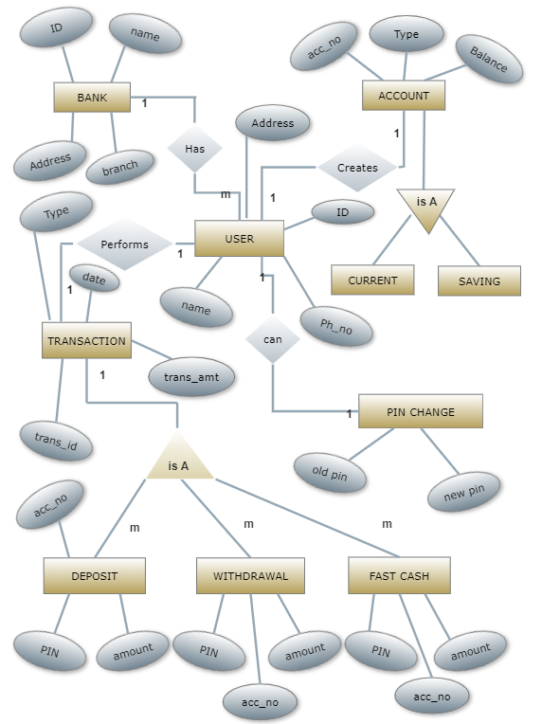

Slide 10
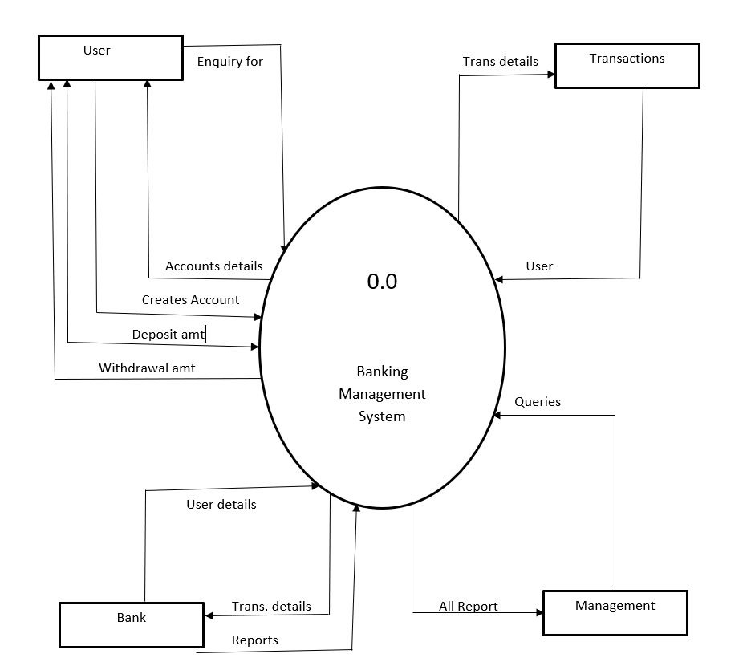

Slide 11
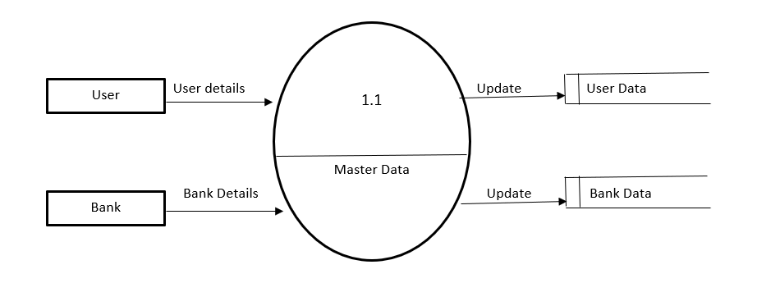

Slide 12
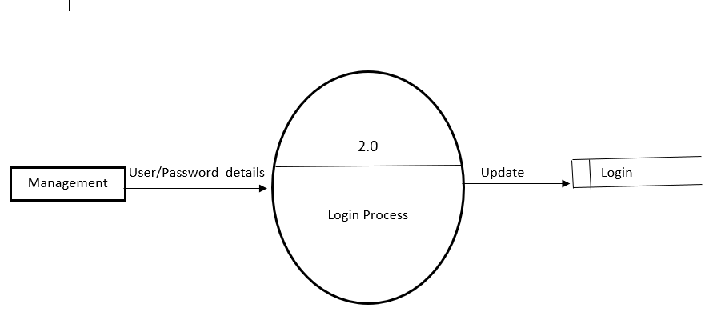
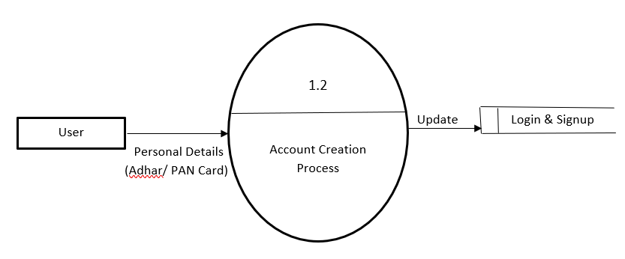

Slide 13
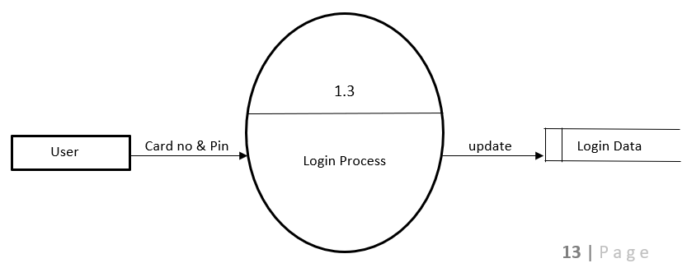

Slide 14
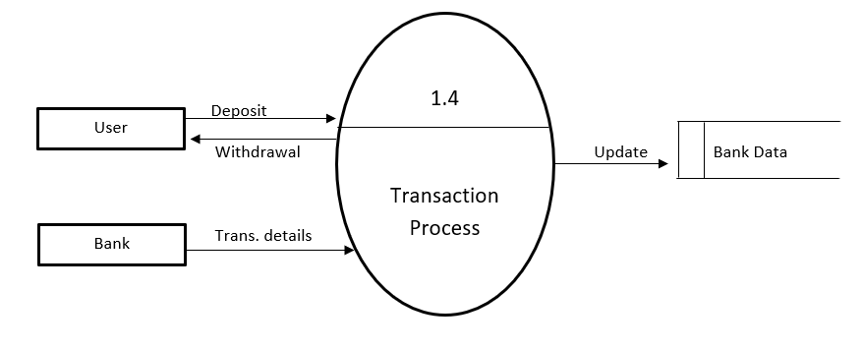

Slide 15
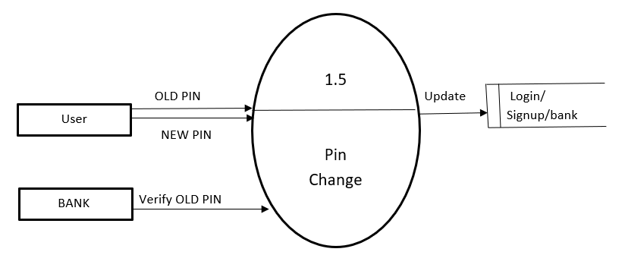

Slide 16
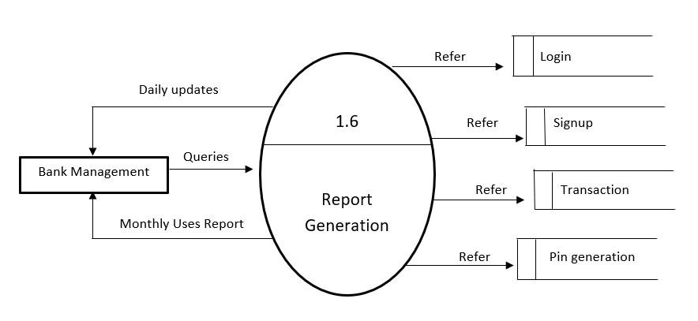

Slide 17
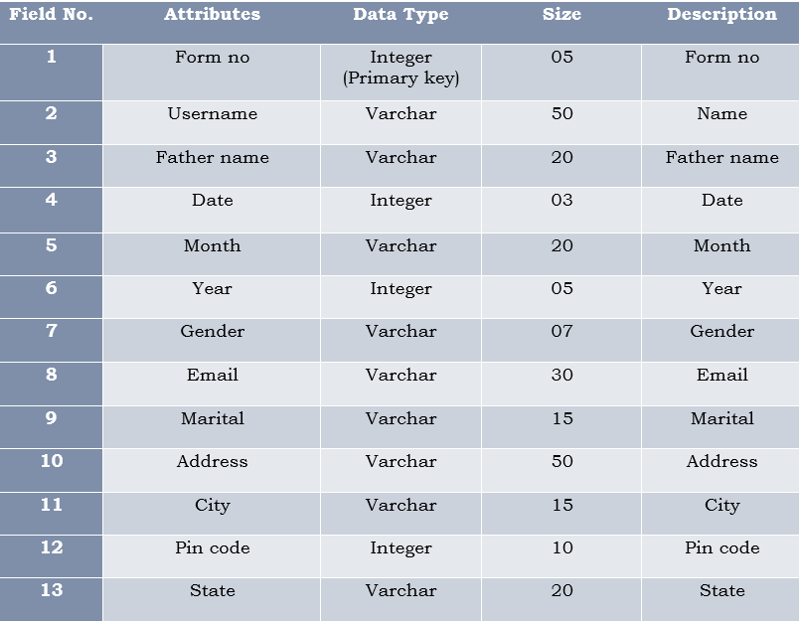
SIGNUP 1

Slide 18
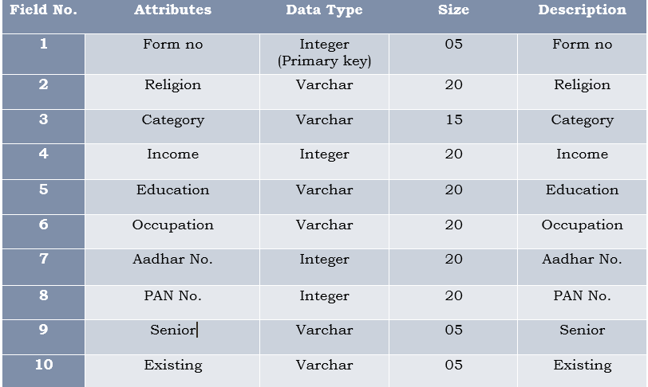
SIGNUP 2

Slide 19
SIGNUP 3
Field | Attribute | Data type | Size | Description
1 | Form no | Integer (Primary key) | 05 | Form no
2 | Account | Varchar | 20 | Account
3 | Card no | Integer | 15 | Card no
4 | Pin | Integer | 15 | Pin
5 | Service Required | Varchar | 10 | Service Required

Slide 20
LOGIN
Field No. | Attributes | Data Type | Size | Description
1 | Card No. | Integer (Primary key) | 16 | card no
2 | PIN | Integer | 05 | pin
TRANSACTION
Field | Attribute | Data type | Size | Description
1 | Form no | Integer (Primary key) | 05 | Form no
2 | Account | Varchar | 20 | Account
3 | Card no | Integer | 15 | Card no
4 | Pin | Integer | 15 | Pin

Slide 21
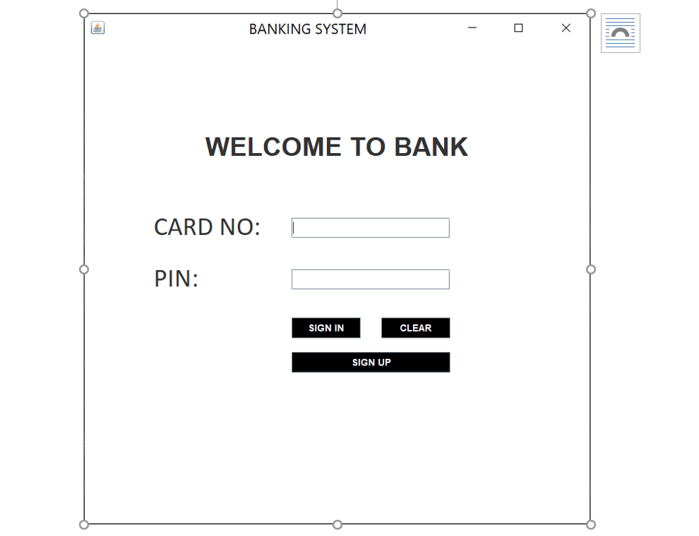

Slide 22
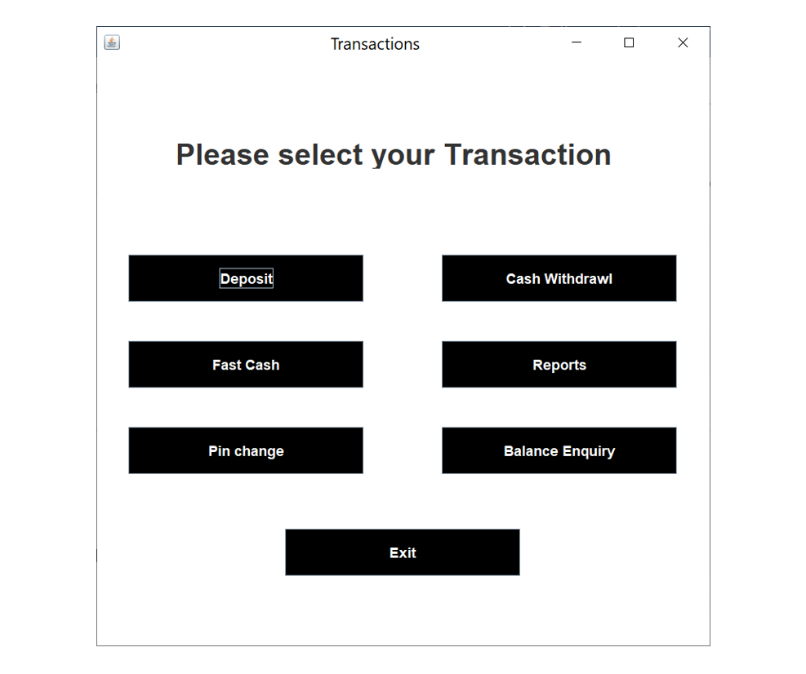

Slide 23
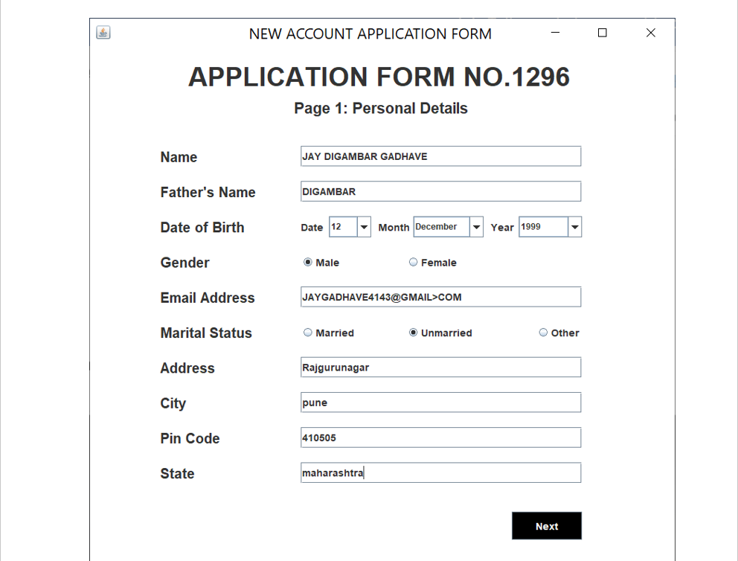

Slide 24
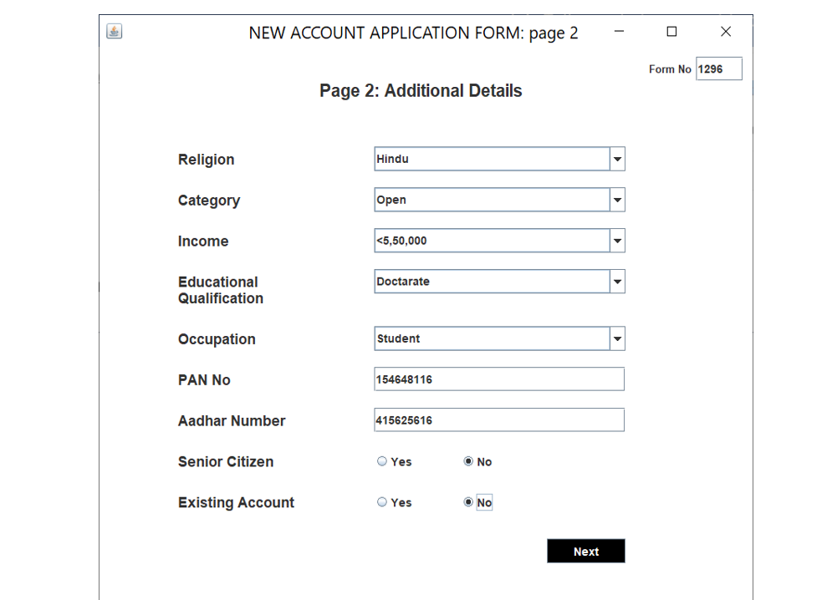

Slide 25
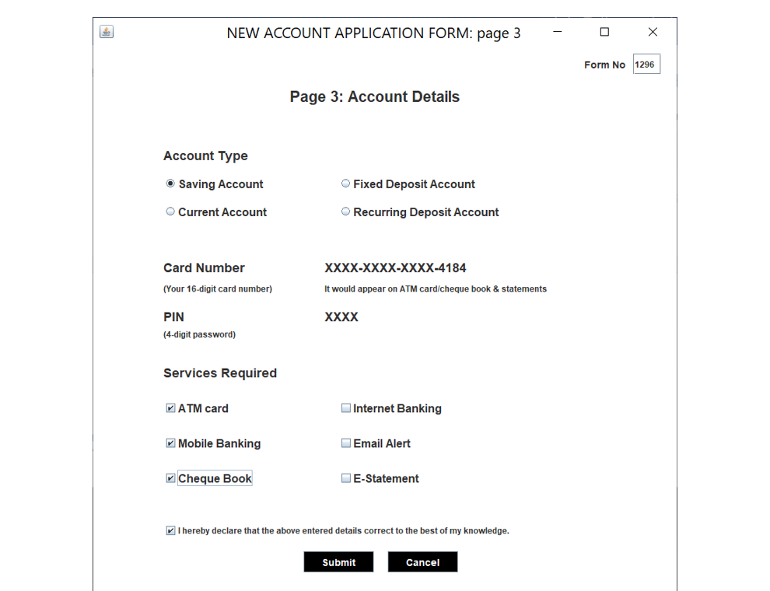

Slide 26
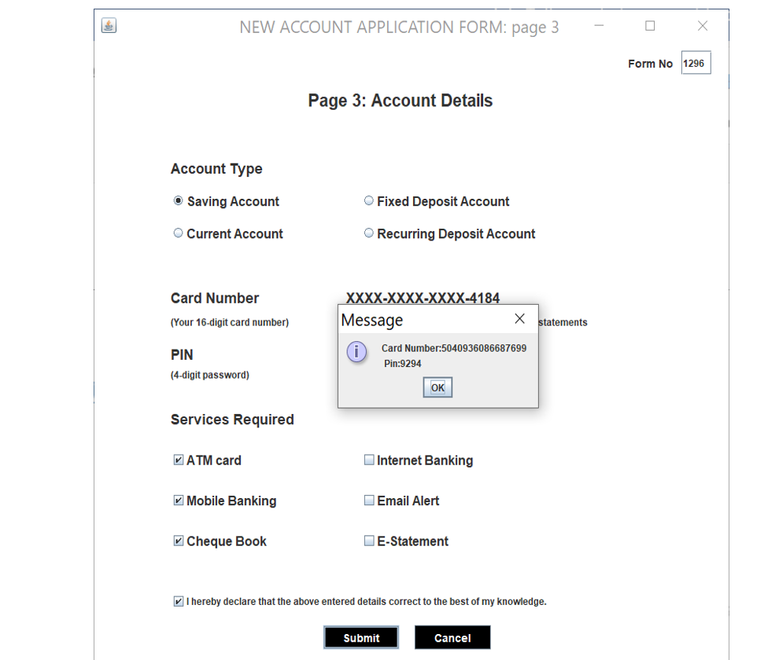

Slide 27
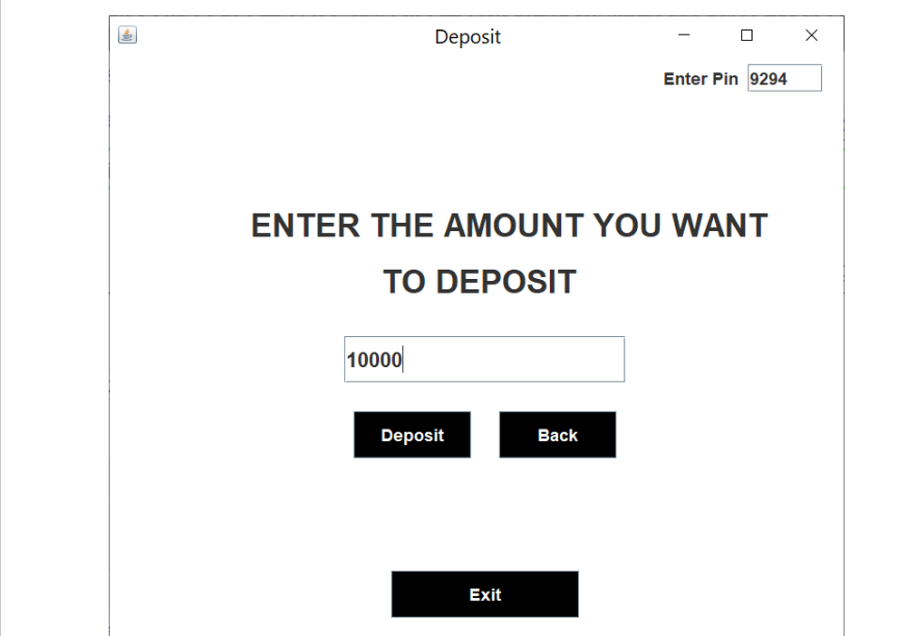

Slide 28
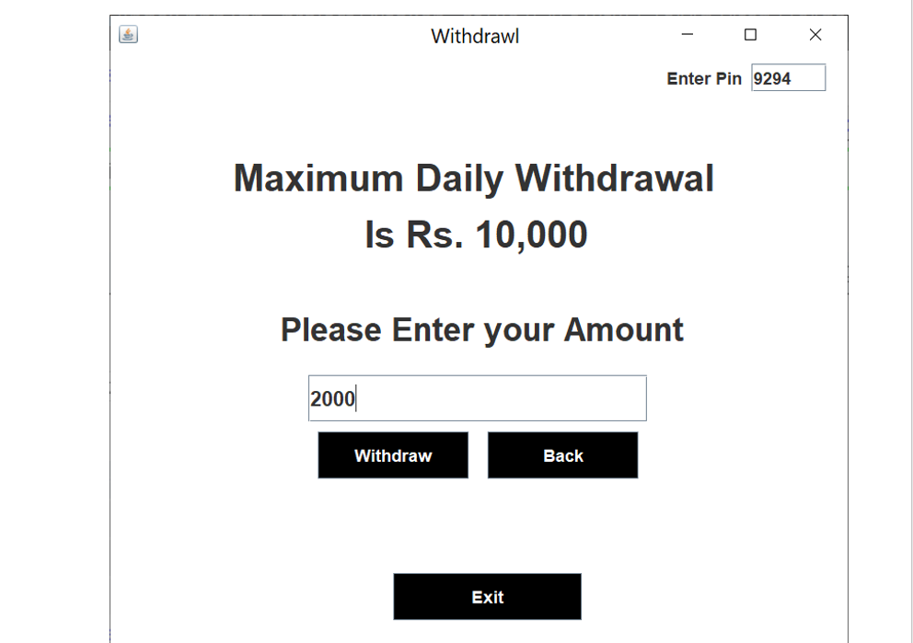

Slide 29
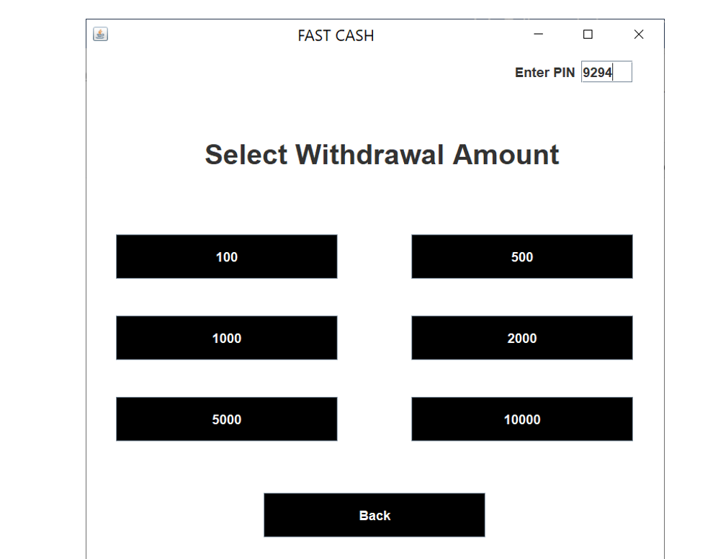

Slide 30
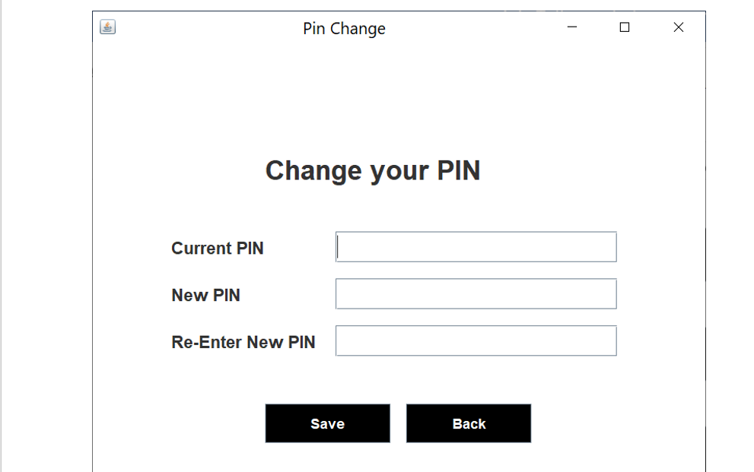

Slide 31
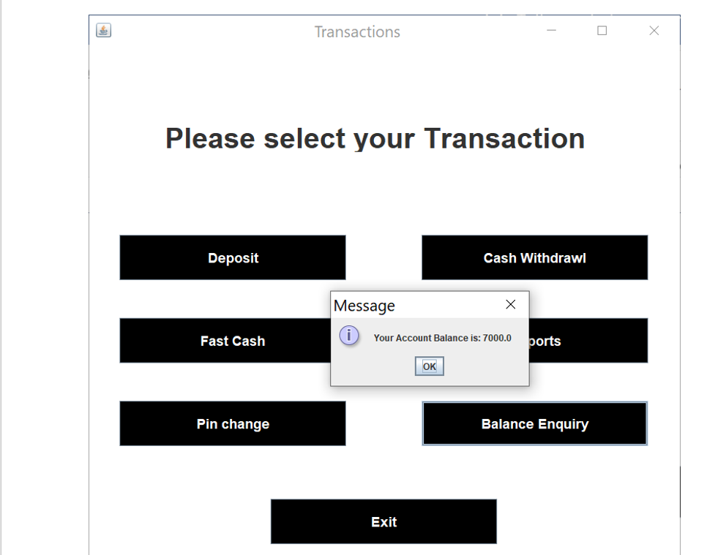

Slide 32
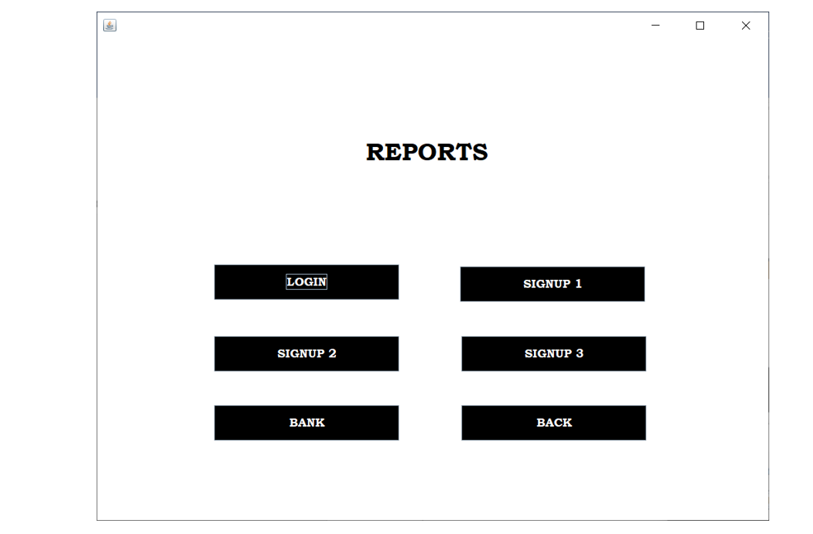

Slide 33
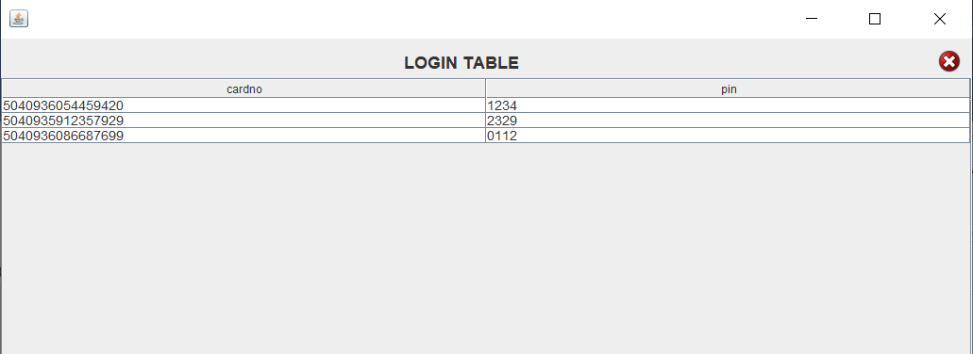

Slide 34
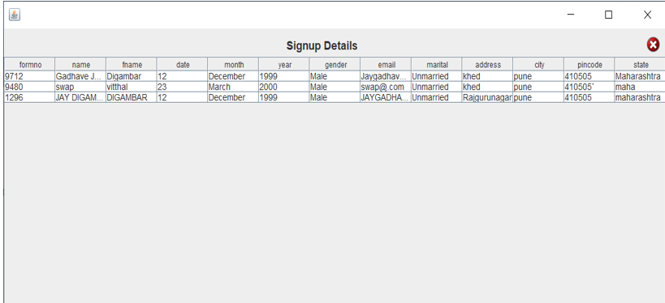

Slide 35
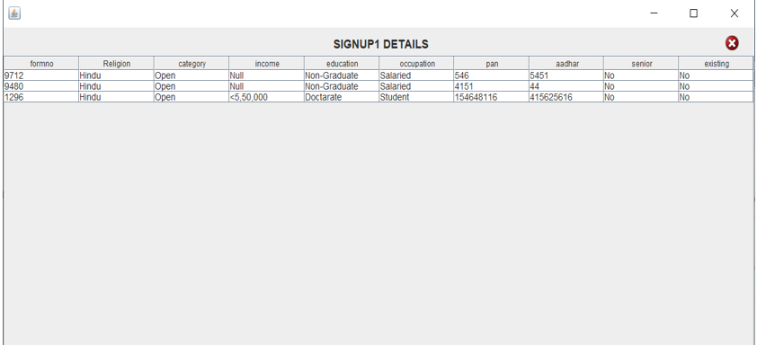

Slide 36
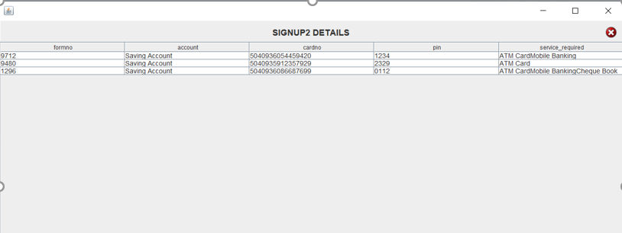

Slide 37
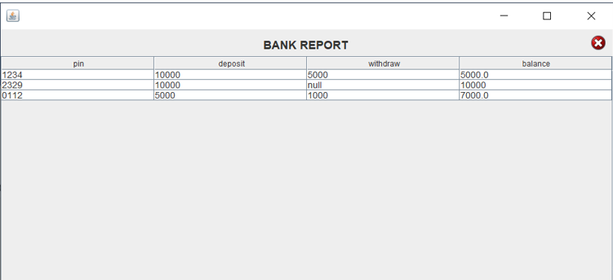

Slide 38
Advantages
No need of bank employee for creation of account into bank.
Time saving along with high quality services.
Smooth and timely execution of reports.
This management can also provide the report for every user.
The records like Transactions, creating accounts and PIN change also retrieve afterwards.

Slide 39
Future Enhancement
At a later point of time we plan to enhance our software.
The following points would be given emphasis on:
Linking and integration of any legacy system for accounting.
Integration with other bank and government agencies through Web Services
Connection to third-party OLAP applications
Electronic Data Interchange (EDI) system for ATM machine
Web Interface for net banking.
In the area of data security and system security.
Provide more online tips and help.

