Slide 1
Department Of BCA & BCS Management System
Jay D. Gadhave 37877
Akshay V. Gaikwad 37878

Slide 2
Introduction
“DEPARTMENT OF BCA & BCS MANAGEMENT SYSTEM” is the management system which refers to BCA & BCS department. This project is for many purposes because I want to give full satisfaction of the user. This system is aimed to develop the management process.
We can add new staff and students etc. and also retrieve these records afterwards.
This system maintains student report. It can be use by educational institutes to maintain record of staff and student easily. It gives us the complete information about the department.
It has user friendly and modular approach. Data storing is easier.

Slide 3
Scope Of Project
Student Entry
Staff Entry
Fees Payment Entry
Student, Staff, Fees payment Reports
Reports are easily generated

Slide 4
Objective
To provide a proper registration system to the new staff and student.
To maintain all the account of the student in digital form enrolment up to the end of the study.
To make the information accessible to the admin in easy way.
Reduce paper work.
Generate date wise report to the staff.
Fast and accurate.

Slide 5
Proposed System
There is need to develop a new system to reduce a human stress & paper work which causes waste of time. The new system should concern the requirements of user are follows:
Different operation can generate report easily.
Reduce complexity & increase the speed of project.
System satisfying user requirements & improve efficiency.
Provide accuracy in any operation.
It is difficult to achieve this goal using a manual system as the information is redundant, can be scattered & collecting relevant information may be very time consuming.
It focuses on presenting information in an easy & intelligible manner which provides facilities like student & staff registration and profile creation of students thus reducing paper work and automating the record generation process in an educational institution.

Slide 6
Hardware And Software Specification
SOFTWARE REQUIREMENT:
Operating system: Windows XP/7/8/10.
Front end: Visual Basic 6.0.
Back end: MS ACCESS 2007.
HARDWARE REQUIREMENT:
Processor: Intel ® Dual Core or above.
Primary memory(RAM): 512 MB or above.
Secondary memory(ROM): 32 GB or above.

Slide 7
Feasibility study
Economical Feasibility
Technical Feasibility
Self Feasibility

Slide 8
Fact Finding Techniques
The functioning of the system is to be understood by the system analyst to design the proposed system.
The analyst needs to fully understand the current system.
Needs data about the requirements and the techniques employed to gather this data are known as fact-finding techniques.
Various kinds of techniques are used like the personal observations made by the analyst himself.

Slide 9
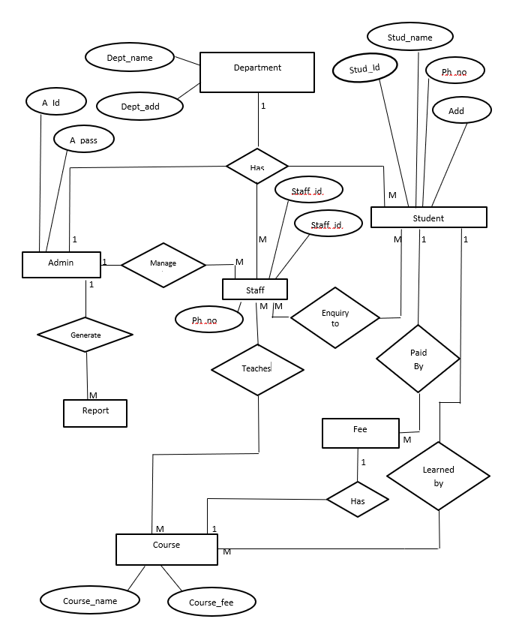

Slide 10
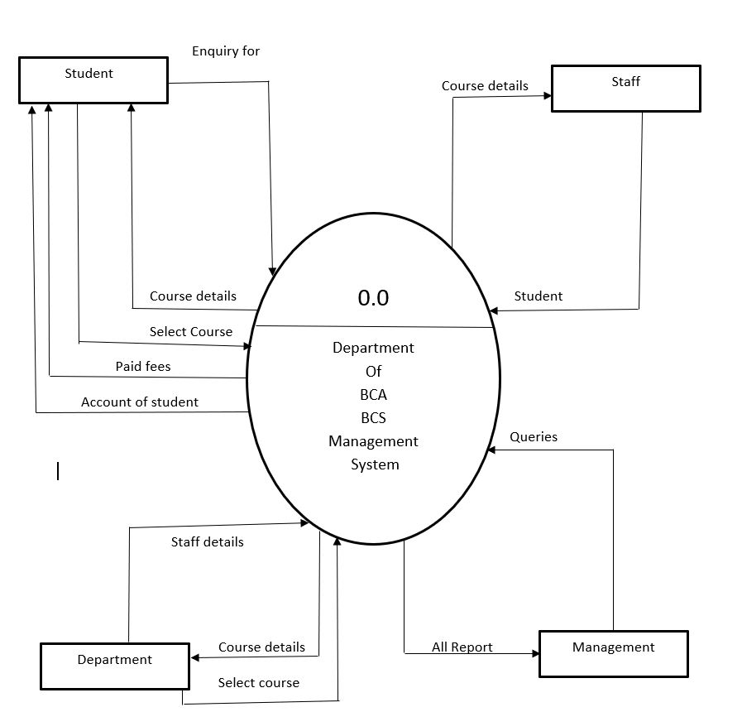

Slide 11
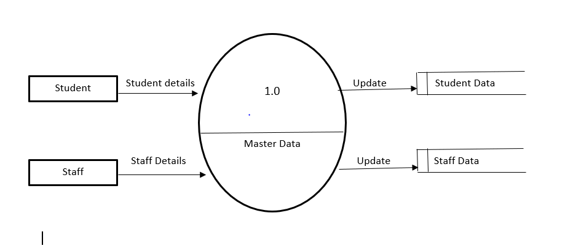

Slide 12
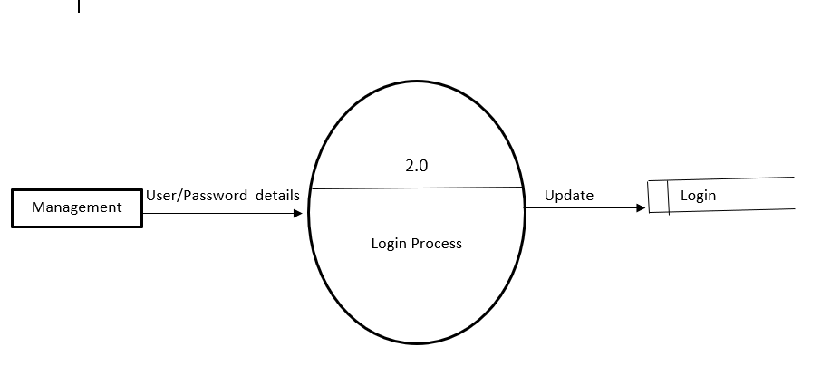

Slide 13
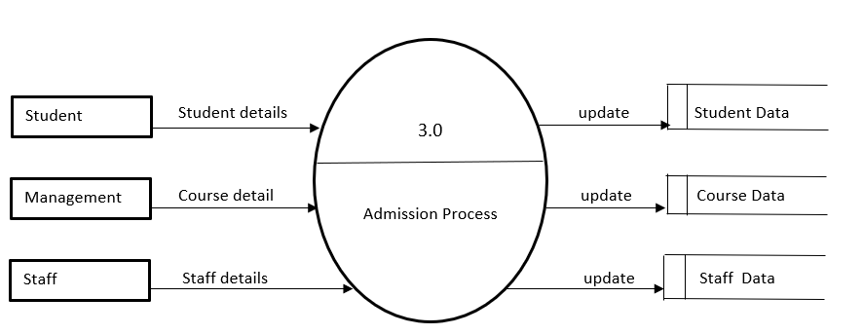

Slide 14
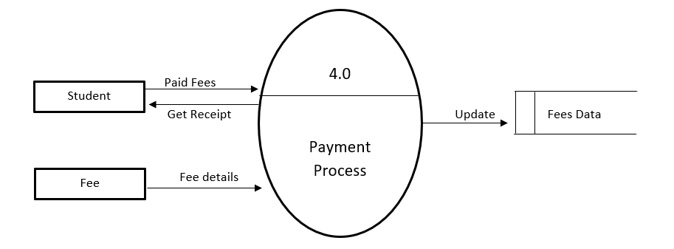

Slide 15
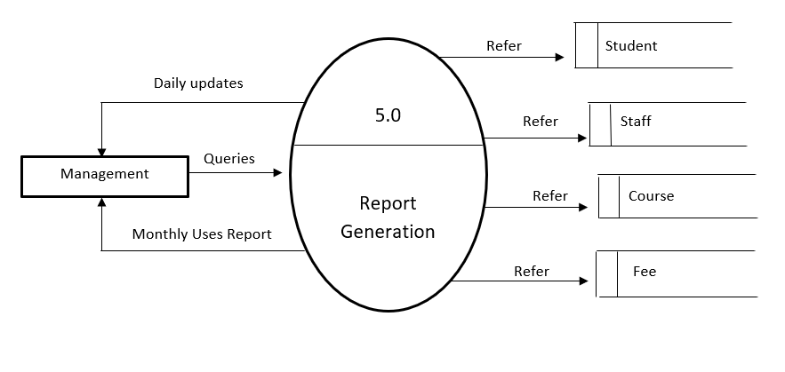

Slide 16
Students Entry
Field No. | Attributes | Data Type | Size | Description
1 | Student_RollNo | Number | 05 | Students Roll No.
2 | Student_name | Text | 20 | Students Name
3 | Student_DOB | Date/Time | 10 | Students Date of Birth
4 | Student_gender | Text | 06 | Students gender
5 | Department | Text | 15 | Students department
6 | Year | Text | 15 | Students year
7 | Student_address | Text | 40 | Students address
8 | Student_PhoneNo. | Number | 10 | Students phone no.

Slide 17
Staff Entry
Field No. | Attributes | Data Type | Size | Description
1 | Staff_ID | Number | 05 | ID
2 | Staff_name | Text | 20 | Name
3 | Staff_gender | Text | 06 | Gender
4 | Course | Text | 15 | Course
5 | Subject | Text | 15 | Subject
6 | Staff_email | Text | 20 | Email
7 | AadharNo. | Number | 15 | Aadhar no.
8 | Staff_address | Text | 40 | Address
9 | Staff_phoneNo | number | 10 | Phone no.

Slide 18
Fees Payment Entry
Field | Attribute | Data type | Size | Description
1 | Student_rollno | Number | 05 | Roll no
2 | Student_name | Text | 20 | Name
3 | Student_course | Text | 15 | Course
4 | Student_year | Text | 15 | Year
5 | Date | Date/time | 10 | Date
6 | Student_type | Text | 09 | Type
7 | Total | Number | 05 | Total fees
8 | Paidfees | Number | 05 | Paid fees
9 | pending | Number | 05 | Pending fees

Slide 19
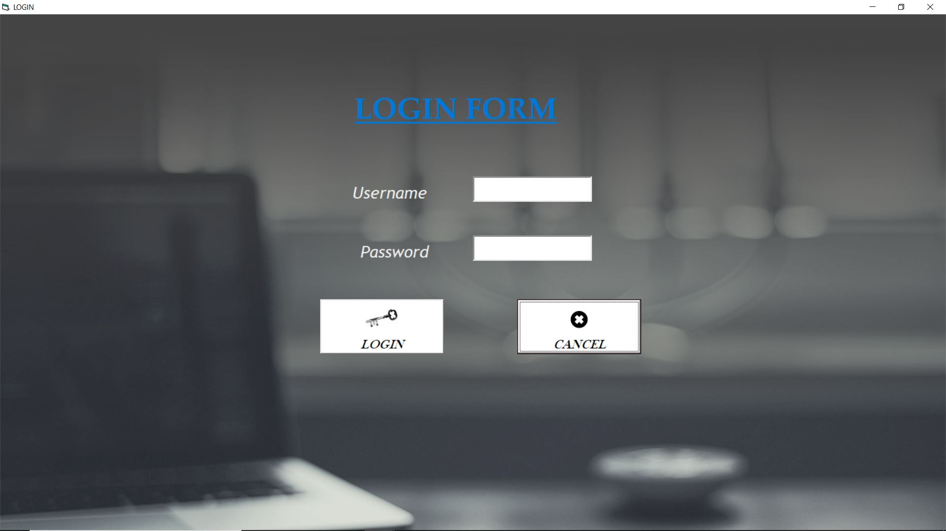

Slide 20



Slide 21
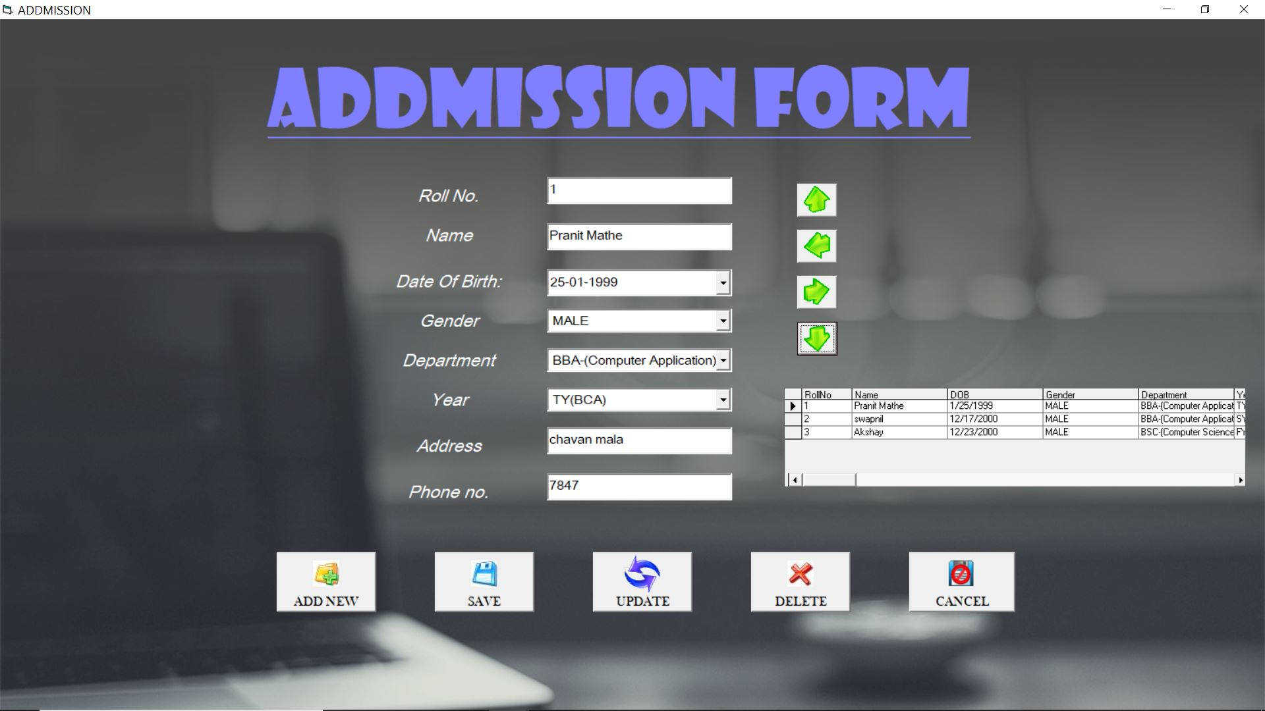

Slide 22
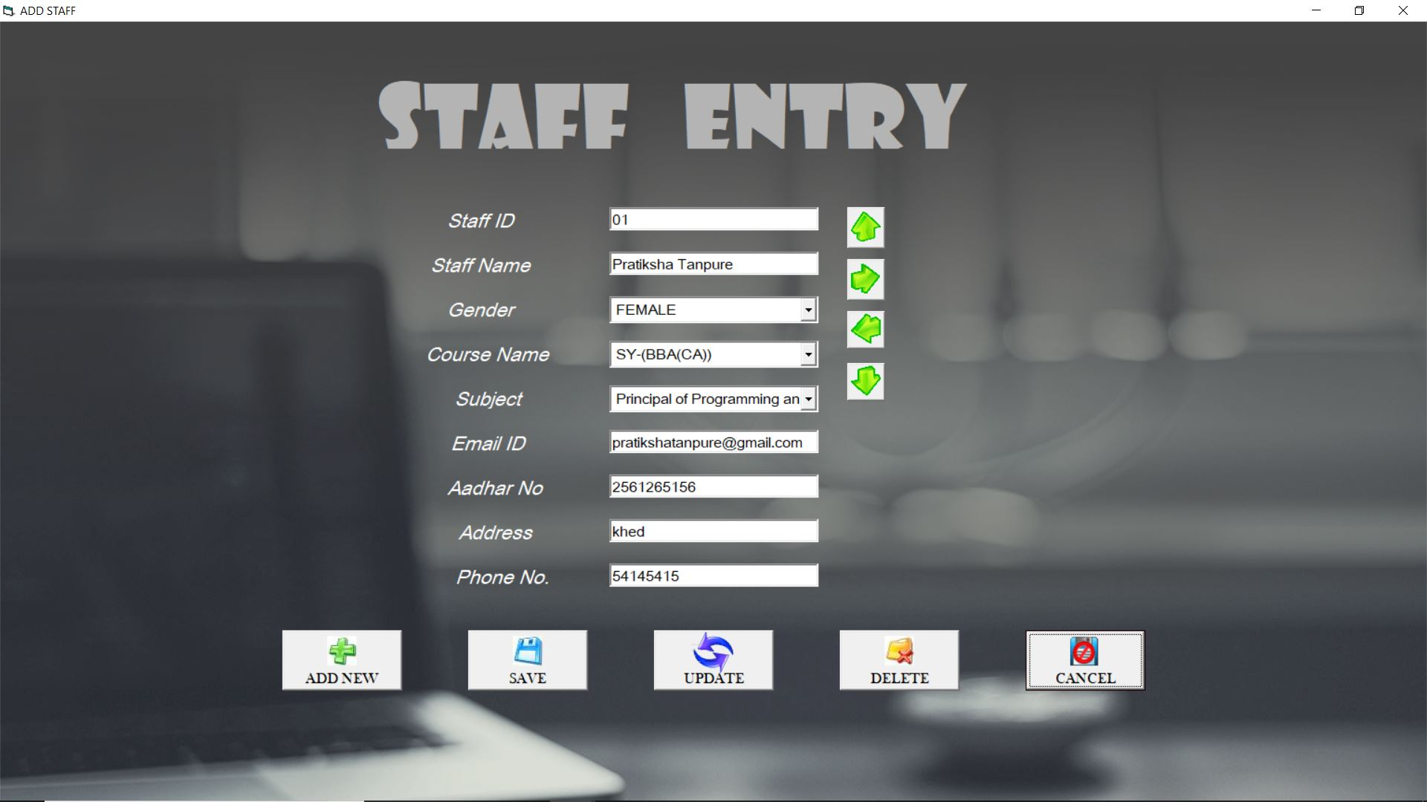

Slide 23
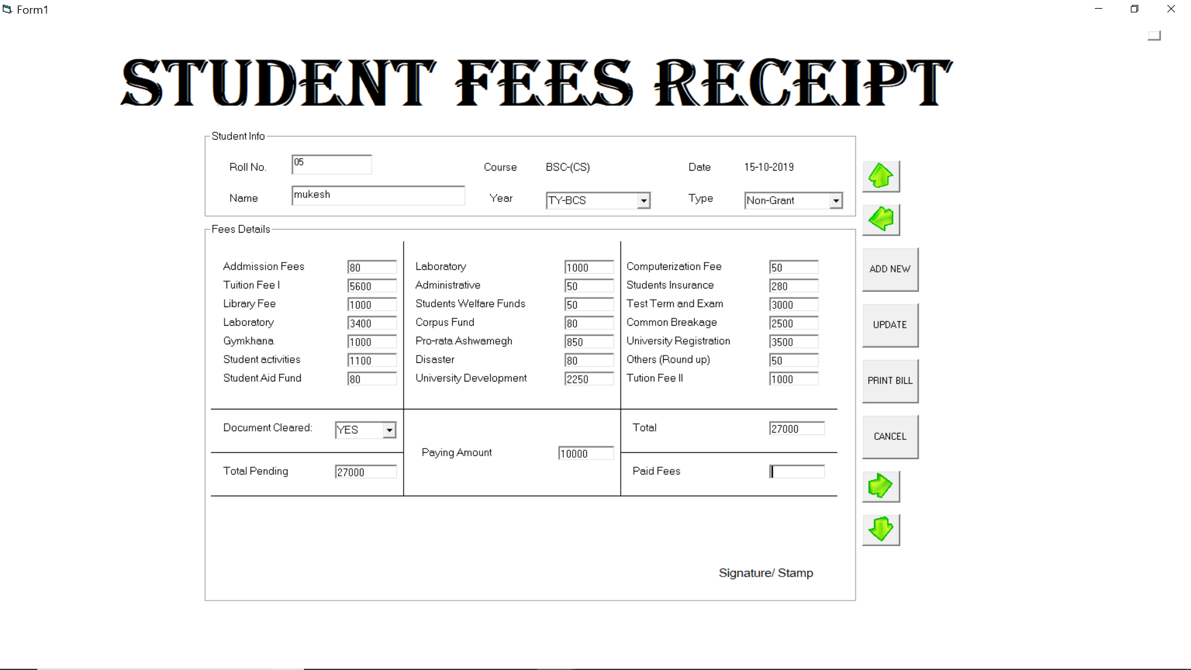

Slide 24
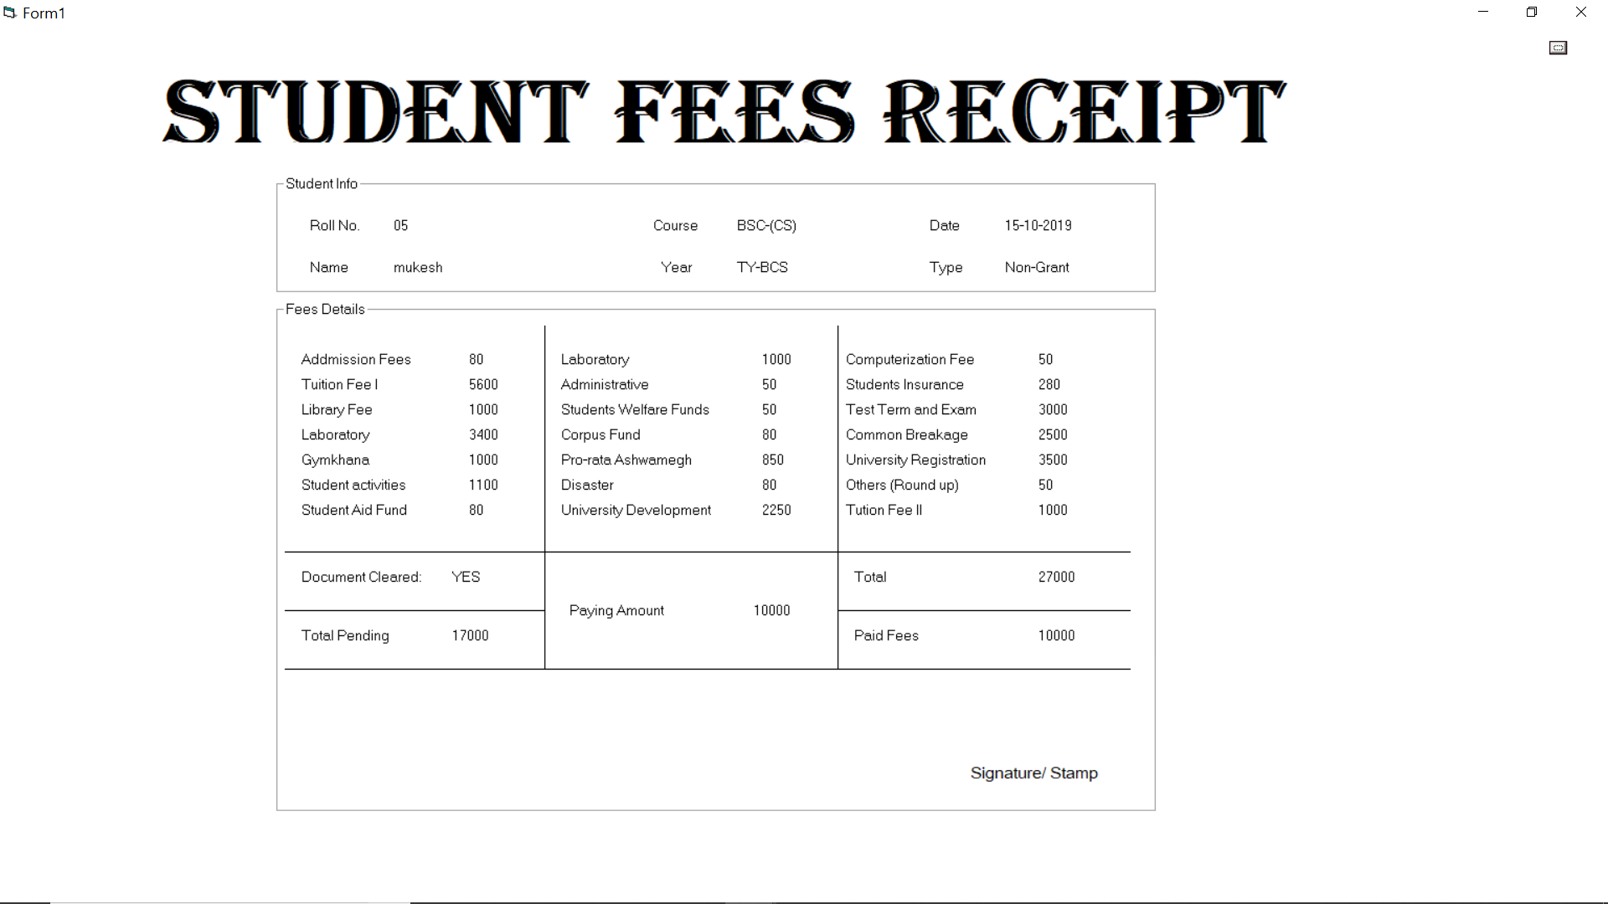

Slide 25
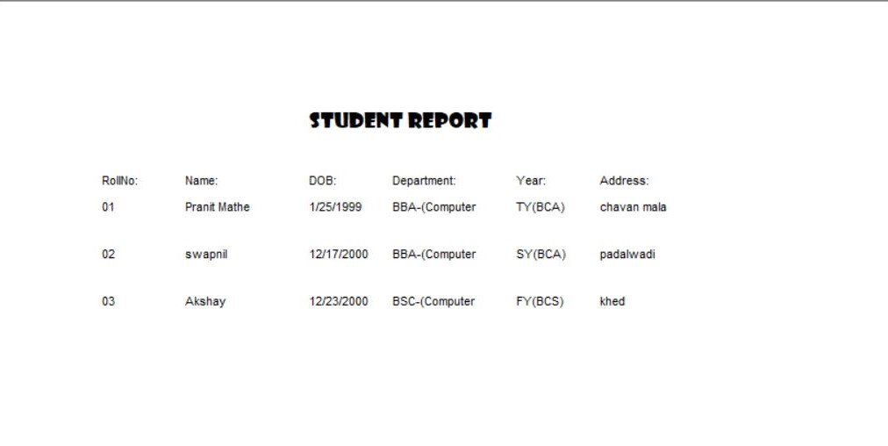

Slide 26
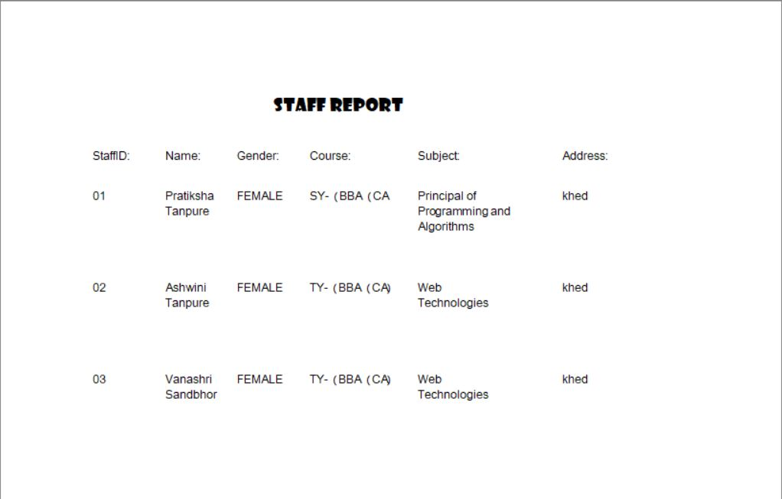

Slide 27
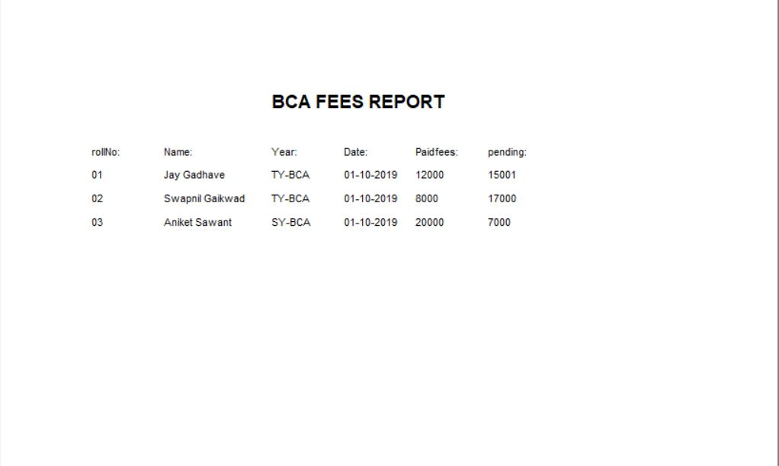

Slide 28
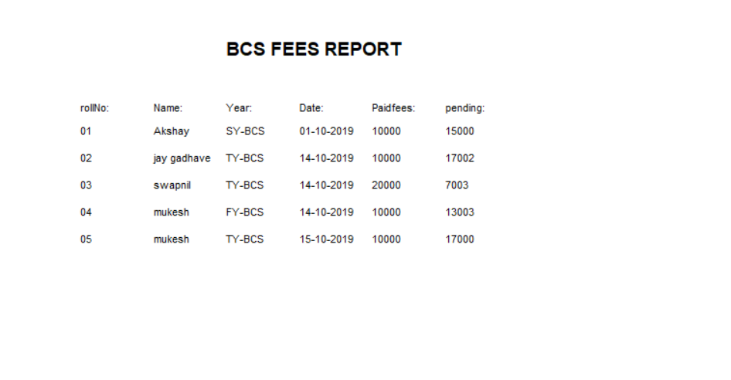

Slide 29
Advantages
Dedicated Professional staff for each subject.
Time saving along with high quality services.
Smooth and timely execution of reports.
This department can also provide the receipt for every student fee payment.
The records like admission, fees payment and staff details also retrieve afterwards.

Slide 30
Future Enhancement
At a later point of time we plan to enhance our software.
The following points would be given emphasis on:
The facility of Online registration.
The facilities such as Head of Department (HOD)would also be provided.
The facilities such as Multiple Branches Handle by one System at a time.
The record of present students per subject lecture also be provided.
We will also provide some entrance exam for new admission for freshers.

