Slide 1
CS 301 High Performance Computing
Dwarf 2 - Sparse Linear Algebra and its Application in PageRank Algorithm

Slide 2

Presented by
Jay Goswami (201501037)
Vishal Shingala (201501450)

Slide 3
PageRank
PageRank (PR) is an algorithm used by Google Search to rank websites in their search engine results.
Used Web matrix as Sparse Matrix

Slide 4

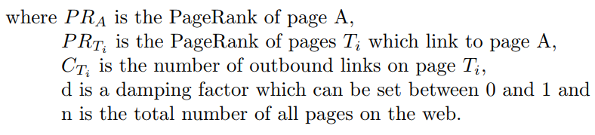
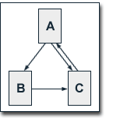
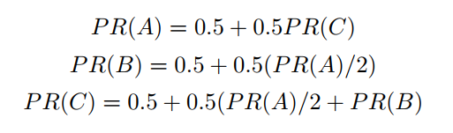
Algorithm
Sample Input and Output

Slide 5
CSR Representation
CSR stands for Compressed sparse row.
The CSR format stores a sparse n x n matrix M in row form using three (one-dimensional) arrays:
val[n];
row_ptr[e]
col_ind[n];

Slide 6
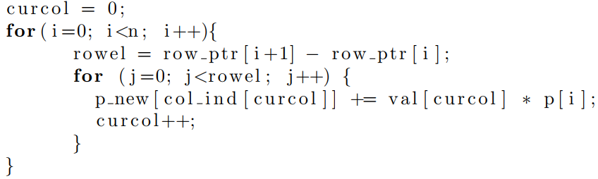
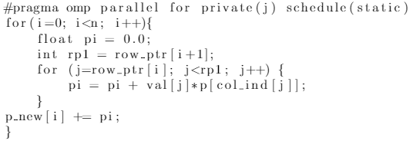
Parallel Algorithm Design
Serial Code
Parallel Code

Slide 7
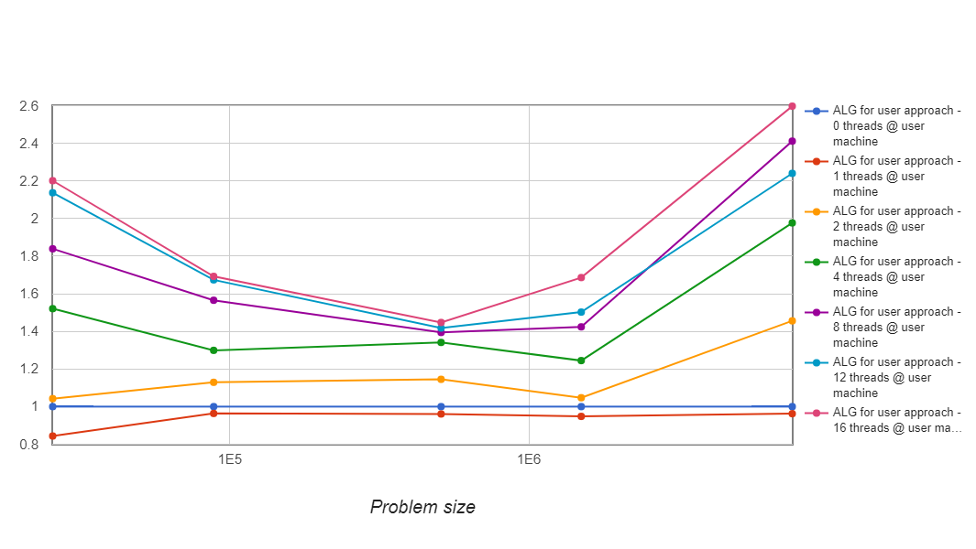
Problem Size Vs. Speedup

Slide 8
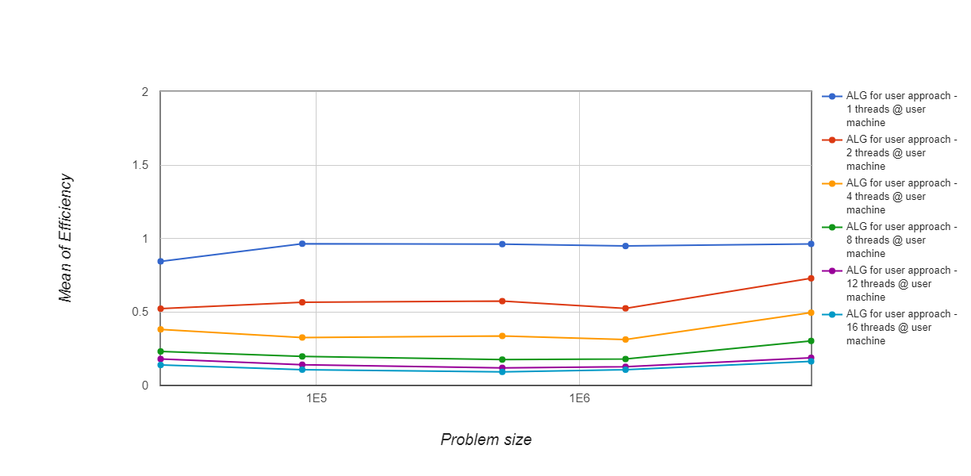
Problem Size Vs. Efficiency

Slide 9
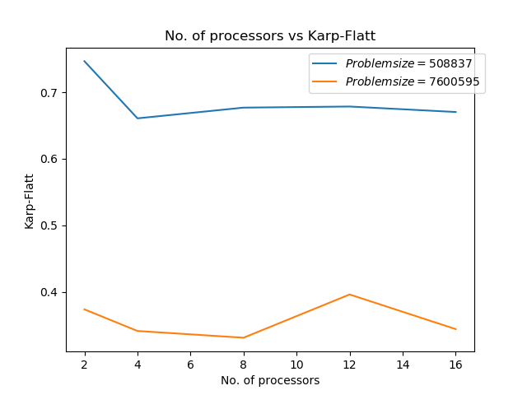
No. of Processors Vs. Karp-Flatt

Slide 10
Future Scope
Simple and fast random walk-based distributed algorithms for computing PageRank of nodes in a network. With complexity O(log n/E) and O( √ log n/E) rounds in undirected graphs.

Slide 11
Conclusion
Due to low computational operations to memory access operations to ratio(1/10 floats/byte) in CSR representation of PageRank(CSR matrix-vector multiplication).
It can be defined as “memory-bound problem“.

Slide 12
Thank You!

