Slide 1
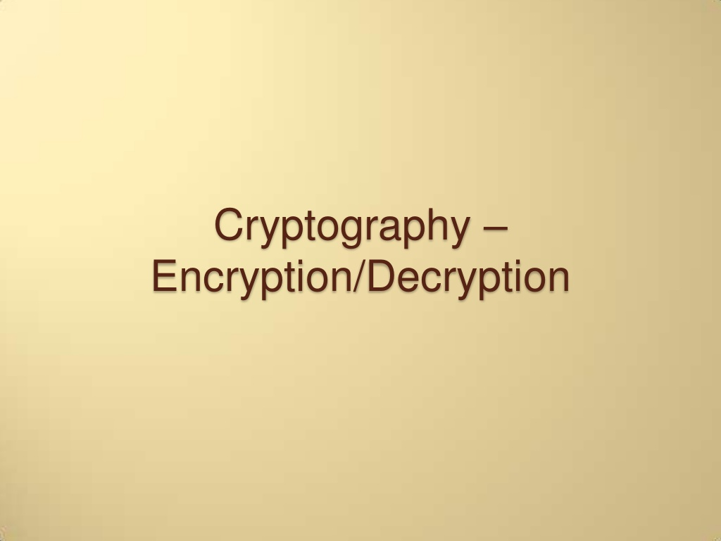

Slide 2
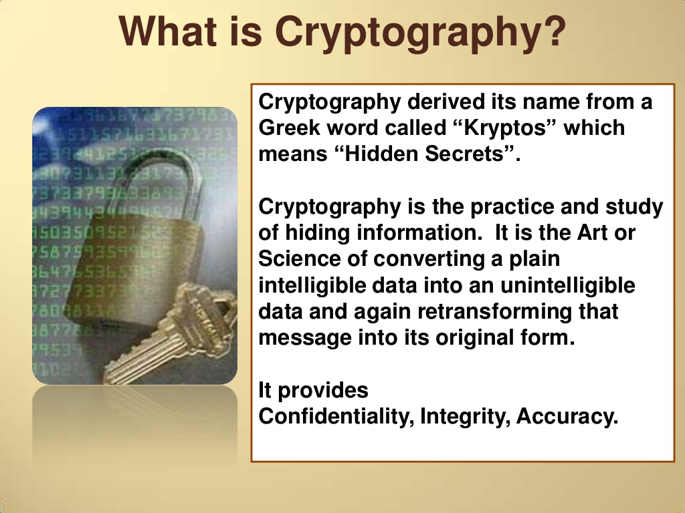

Slide 3
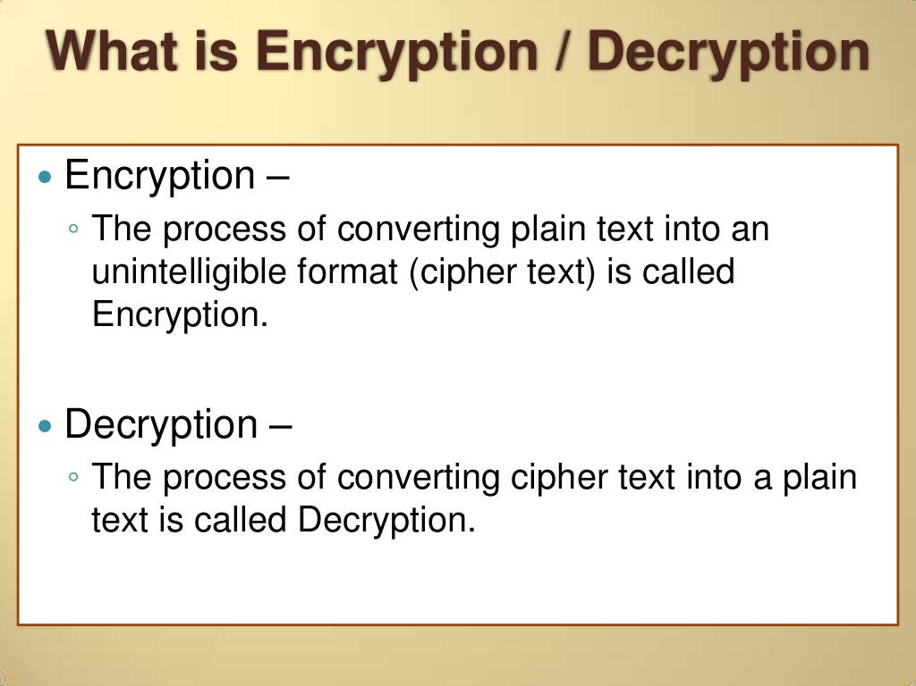

Slide 4

Caesar ciphers
A B C D E F G H I J K L M N O P Q R S T U V W X Y Z
D E F G H I J K L M N O P Q R S T U V W X Y Z A B C
Substitute the letters in the second row for the letters in the top row to encrypt a message
Encrypt(COMPUTER) gives FRPSXWHU
Substitute the letters in the first row for the letters in the second row to decrypt a message
Decrypt(Encrypt(COMPUTER))= Decrypt(FRPSXWHU) = COMPUTER

Slide 5
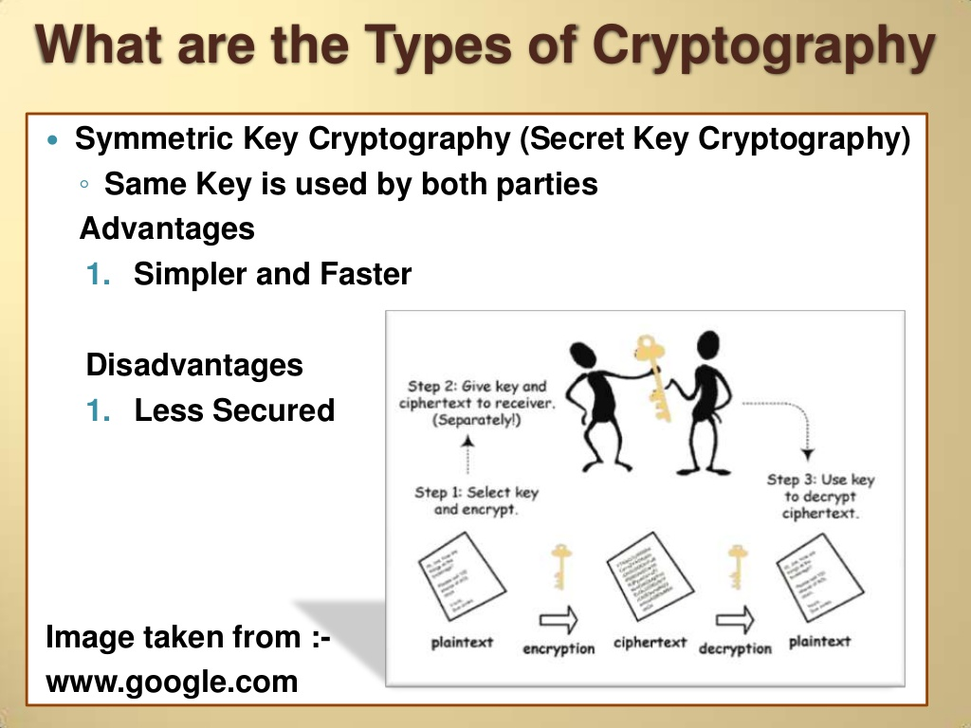

Slide 6
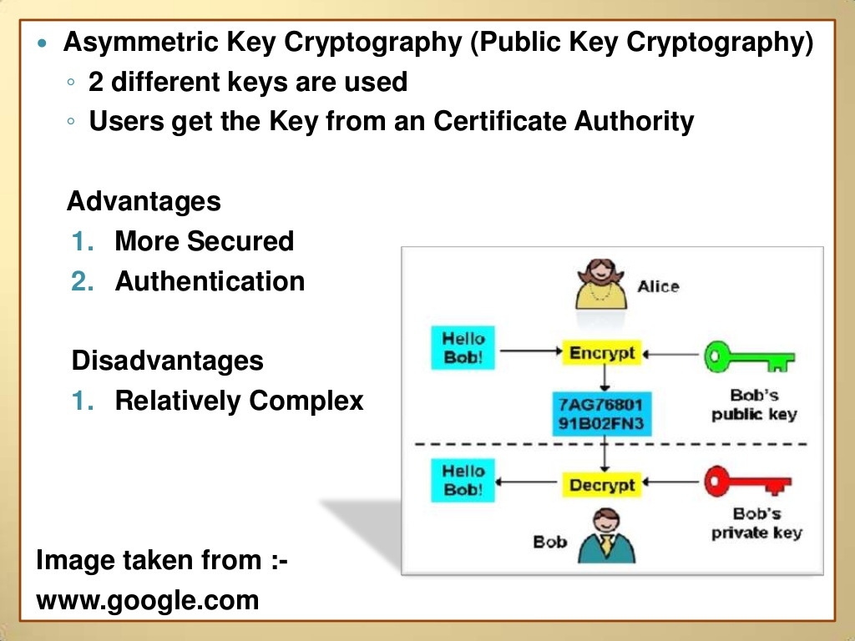

Slide 7

Here are some commonly used algorithms:
->DES/3DES or TripleDES
This is an encryption algorithm called Data Encryption Standard that was first used by the U.S. Government in the late 70's. It is commonly used in ATM machines (to encrypt PINs) and is utilized in UNIX password encryption.
-> Blowfish
Blowfish is a symmetric block cipher that is unpatented and free to use. It was developed by Bruce Schneier and introduced in 1993.
->AES
Advanced Encryption Standard or Rijndael; it uses the Rijndael block cipher approved by the National Institute of Standards and Technology (NIST).
->Twofish
Twofish is a block cipher designed by Counterpane Labs. It was one of the five Advanced Encryption Standard (AES) finalists and is unpatented and open source.

Slide 8

->IDEA
This encryption algorithm was used in Pretty Good Privacy (PGP) Version 2 and is an optional algorithm in OpenPGP. IDEA features 64–bit blocks with a 128–bit key.
->MD5
MD5 was developed by Professor Ronald Riverst and was used to create digital signatures. It is a one–way hash function and intended for 32–bit machines. It replaced the MD4 algorithm.
->SHA–1
SHA–1 is a hashing algorithm similar to MD5, yet SHA–1 may replace MD5 since it offers more security
->HMAC
This is a hashing method similar to MD5 and SHA–1, sometimes referred to as HMAC–MD5 and HMAC–SHA1.
->RSA Security
1)RC4–> RC4 is a variable key–size stream cipher based on the use of a random permutation.
2)RC5–>This is a parameterized algorithm with a variable block, key size and number of
rounds.
3)RC6–>This an evolution of RC5, it is also a parameterized algorithm that has variable block,
key and a number of rounds. This algorithm has integer multiplication and 4–bit
working registers.

Slide 9

Send Mail Securely

Slide 10
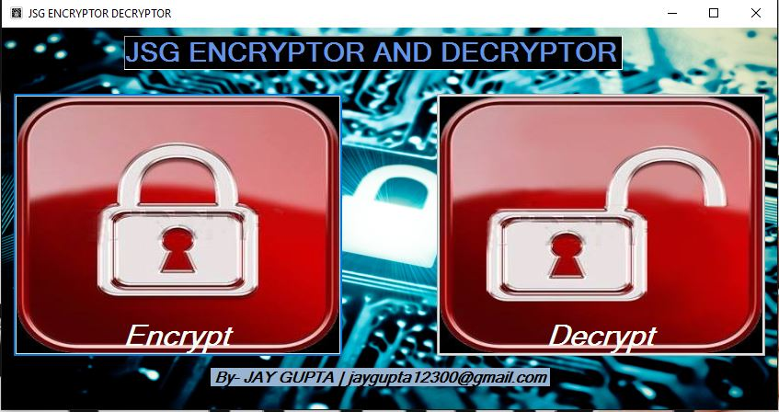

Slide 11
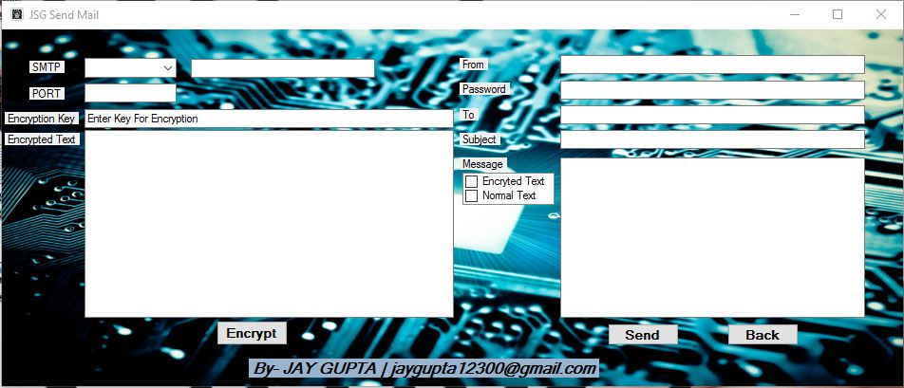

Slide 12
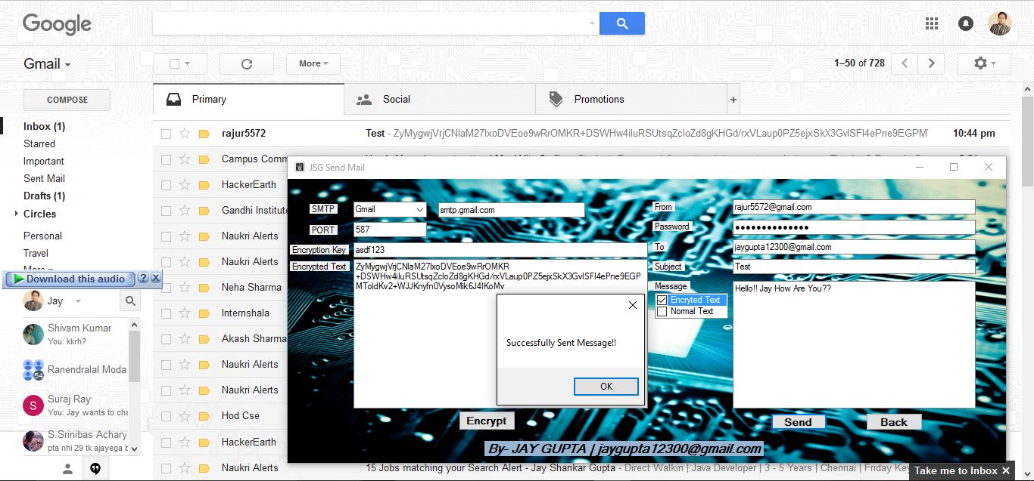

Slide 13
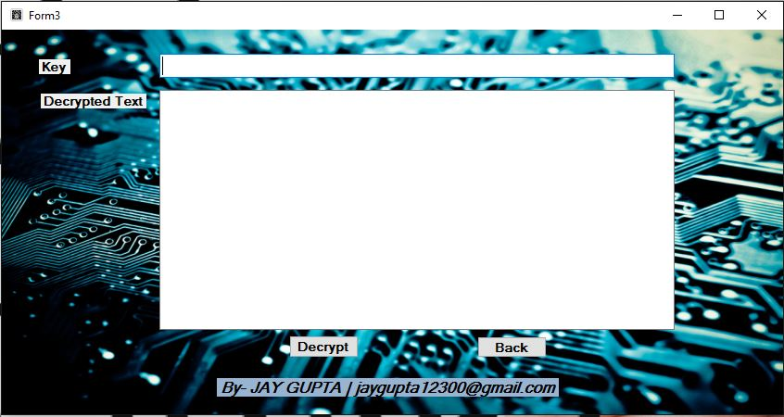

Slide 14
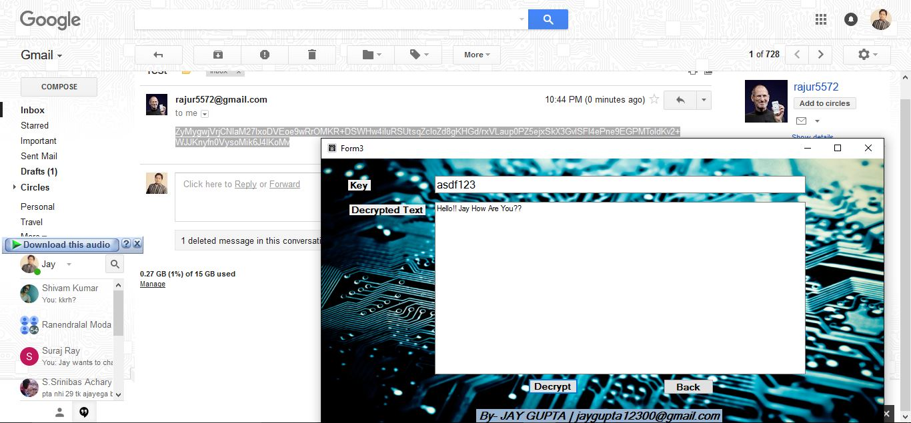

Slide 15
THANK YOU
→ 13CSE050
JAY SHANKAR GUPTA

