Slide 2
70 Million

Slide 3

Automated Sign Language Translation
Team Members:
Jay Prakash Gupta
Priyanka Voleti
Jahnavi Pudi
Alekhya Makkena
Ashutosh Singh
Kazi Nahidul
HACKSRM Feb28 – Mar 1

Slide 4
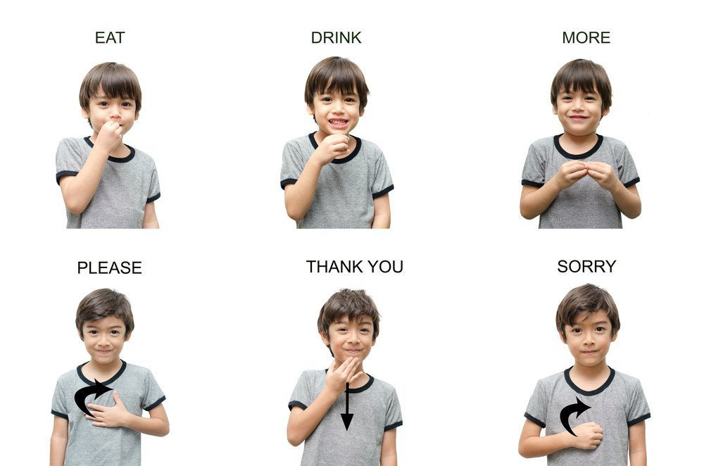

Slide 5
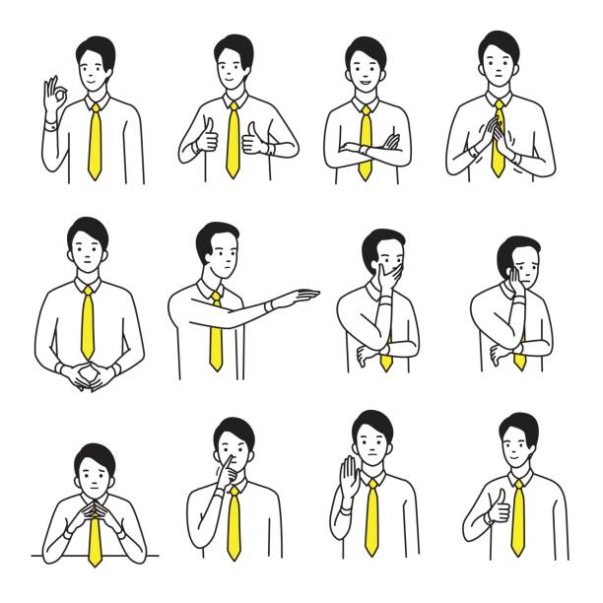


Project Description
To identify and classify sign languages used in a video clip into natural language words.
Perform sentence generation and provide recommendation of most likely words to complete the sentence
“ I want to eat some good food”
HACKSRM

Slide 6
1
Key Benefits
Allows a mute to perform day to day communication with people using sign language without the need of a translator
01
02
Allows a mute to communicate faster by providing recommendations.
HACKSRM

Slide 7
High Level Overview
1
2
Video
feature extraction
Sentence generation/ recommendation
Sequence of
labels (words)
Input
Video
Output
Sentence
HACKSRM Feb28 - Marc1

Slide 8
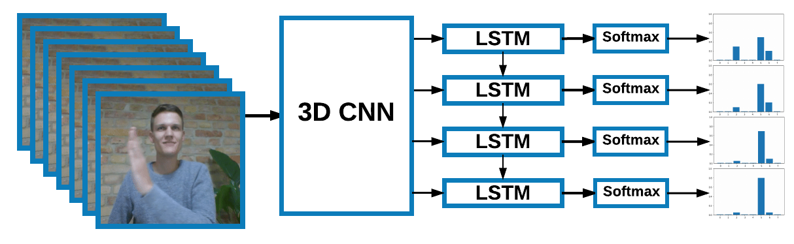
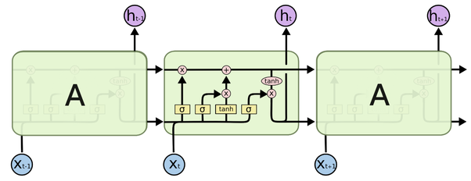
High Level Overview
1
Spatiotemporal feature extraction using 3D CNN (C3D)
Sequence of
labels (words)
depicting signs
2
Output Sentence based
on the language model

Slide 9
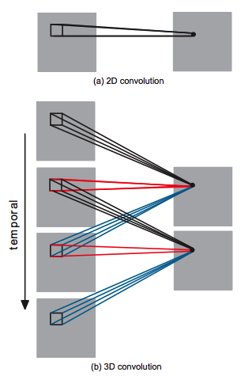
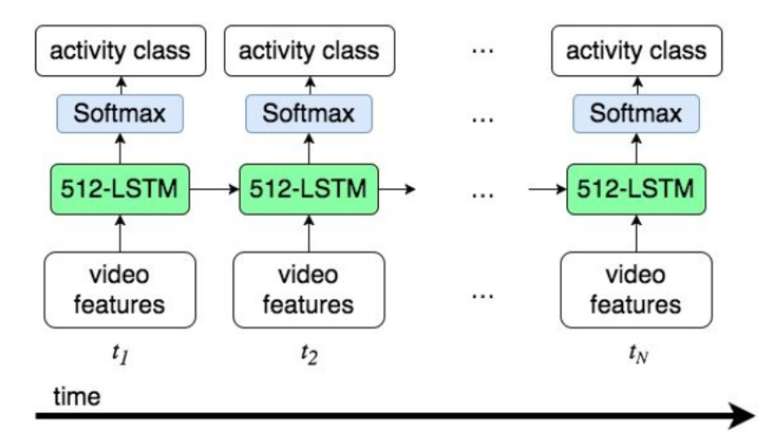
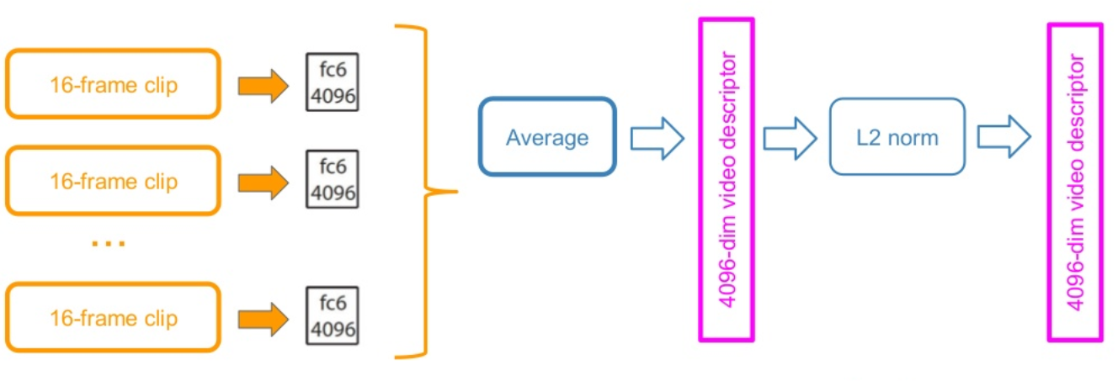
1 Spatiotemporal feature extraction using 3D CNN
A 3D CNN incorporates a temporal axis to capture the short-term temporal dynamics associated with motion and activity. For long term temporal dependency, LSTM layer will be used on top of the CNN model.

Slide 10
2 Sentence Generation from the Language Model using LSTM
We employ the popular LSTM network to generate natural language sentences based on learned language model when fed with the input of sequence of words from the output of CNN. This is effectively predicting the possible sequence of words for sentence completion.
HACKSRM

Slide 11
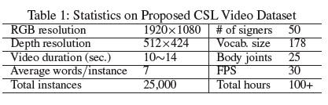
Training the model
Dataset
1. Open Source Modern Chinese Language (CSL) Dataset for continuous SLR with sentence-level annotations
2. German Sign Language Dataset RWTH-PHOENIX-Weather (Koller, Foster and Ney 2015)
HACKSRM

Slide 12


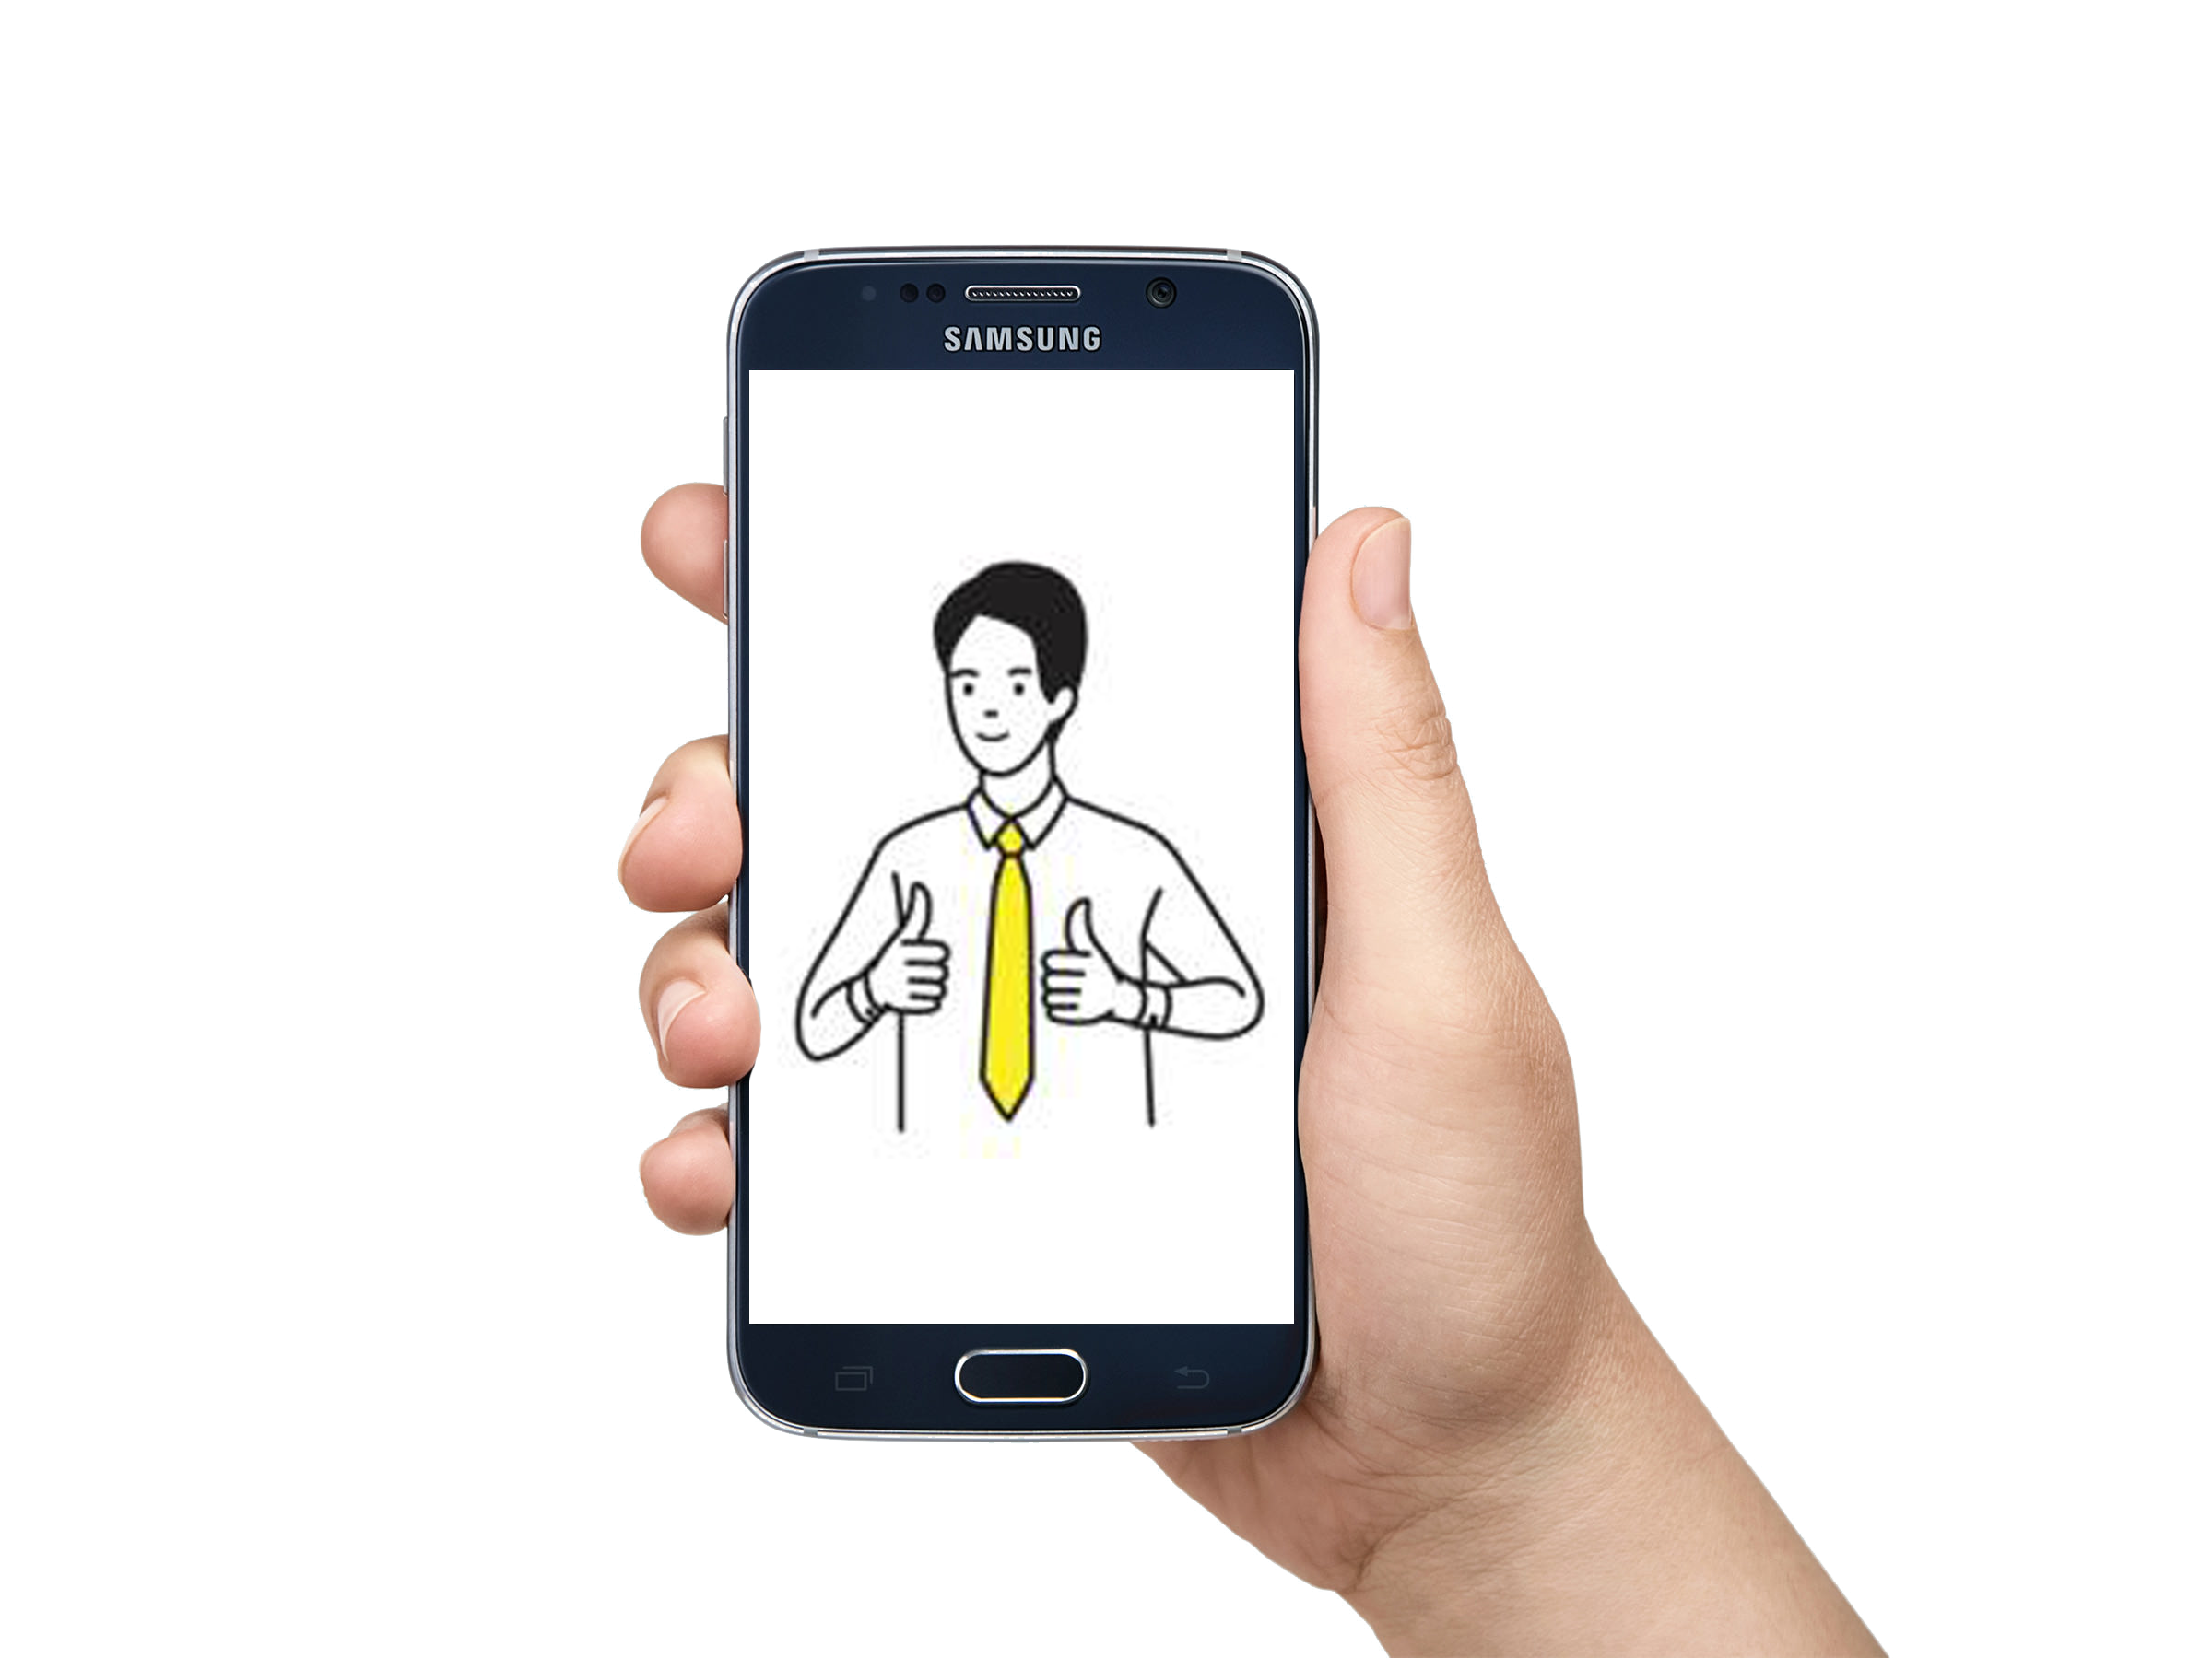


Scopes and Extension
A Two-way end to end communication
1. Extend the system by adding text-to-speech synthesis module.
2. The system can be complemented by a voice to sign language translation system to facilitate end-to-end communication.
HACKSRM

Slide 13
Thank You!

