Slide 1
DrinkMate: Development Environment & Version Control
Jay Harris
Jack Phillips
Dan Silvernail

Slide 2
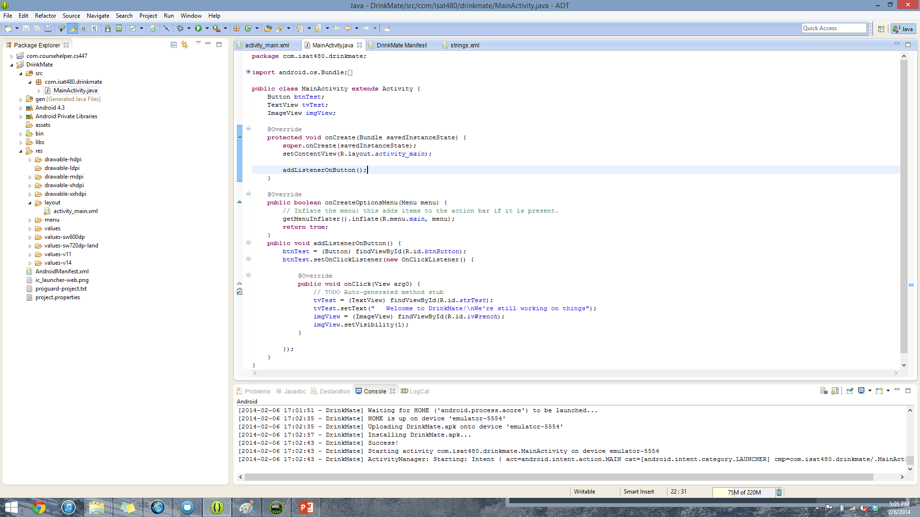
Development Environment

Slide 3
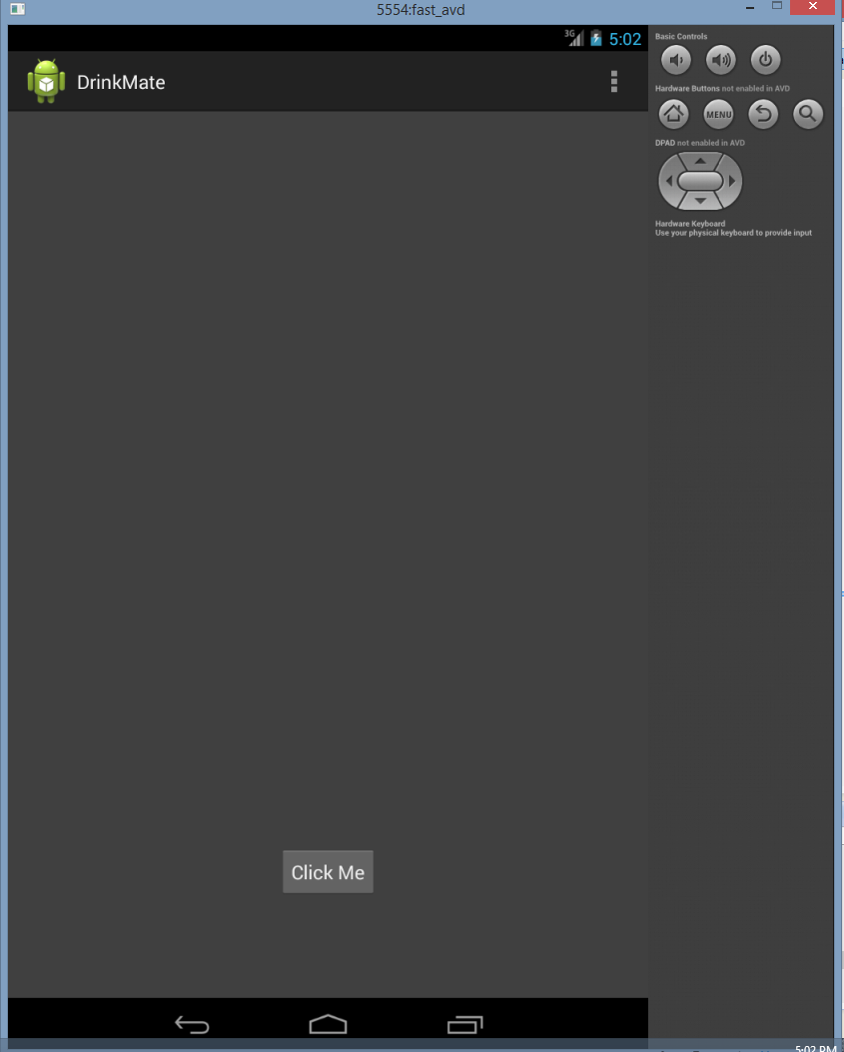
Development Environment

Slide 4
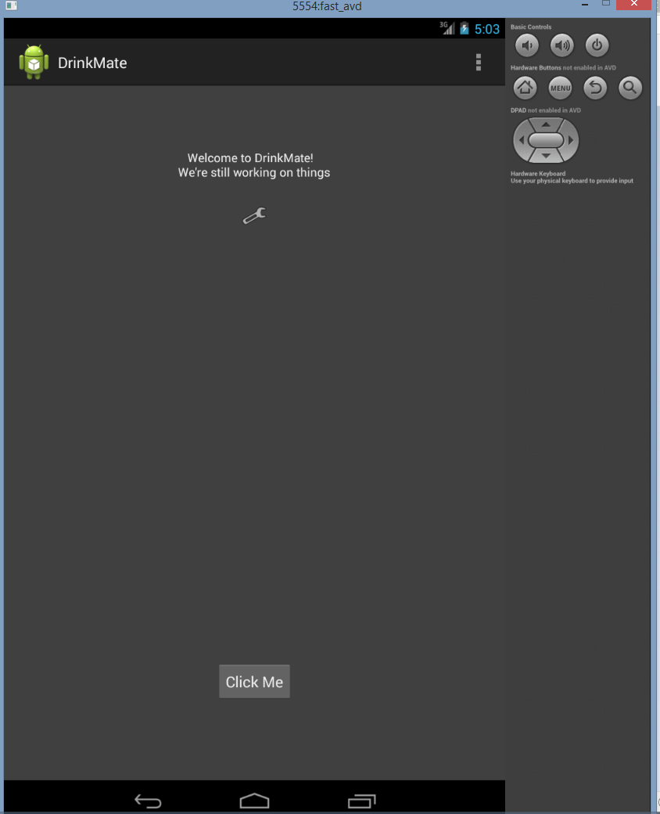
Development Environment

Slide 5
Version Control
GitHub
Files:
Source Code Folder
README.md :
Name of app & developers
Info about app
logs.md
Meeting minutes & info
group_members.txt
Sample file to ensure we could all commit changes

Slide 6
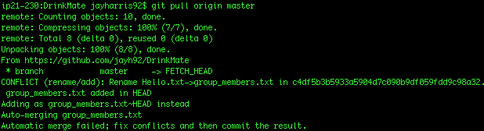
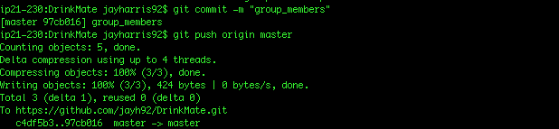
Version Control

Slide 7
Version Control

