Slide 1

Content & SEO Mid-Strategy Check-in
Ojai Recovery
Building durable organic performance with purpose.
Date: Jan 20, 2026

Slide 2
Mid-Strategy Agenda
Competitive Benchmarking
January Core Focus: Core Services, Conversions, & Structural Cleanup
Risk Flag: Cannibalization & Low-impact URLs
What’s next

Slide 3
Strategy Month: Next Checkpoint
Launch Strategy & Roadmap Review - Date TBD (Week of Feb 2)
Finalizes goals, North Star Metrics, and success benchmarks
Aligns on the execution plan across content, SEO, and site improvements
Confirms launch-ready priorities for the next phase
Signals the transition from planning → active execution

Slide 4
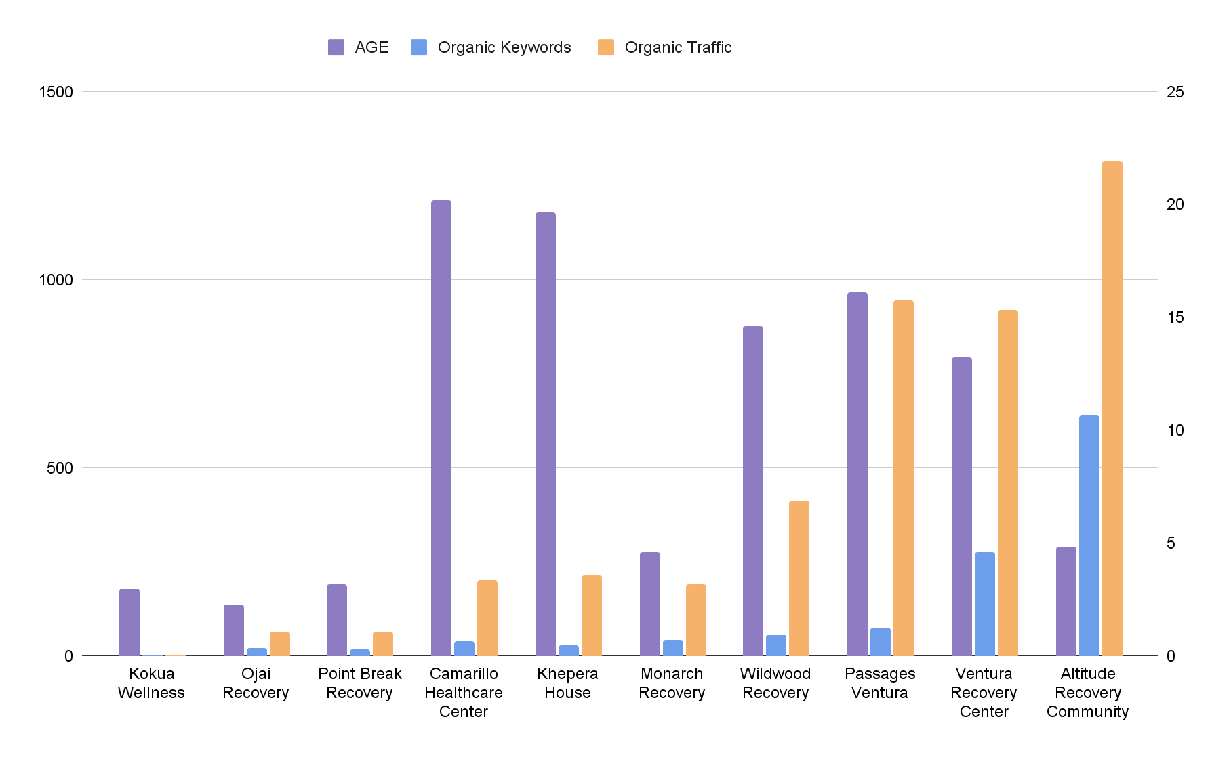
COMPETITIVE ANALYSIS BASELINE
Where you stand vs. everybody else
Top competitors have established authority through years of consistent publishing. They own more indexed pages and stronger domains.
Ojai Recovery’s smaller footprint isn’t a weakness. It means we can grow faster by focusing resources on the pages and clusters that matter most.
We’ll use this benchmark to prioritize where to scale content deliberately — building authority efficiently instead of chasing volume. Showing progress each QBR.

Slide 5
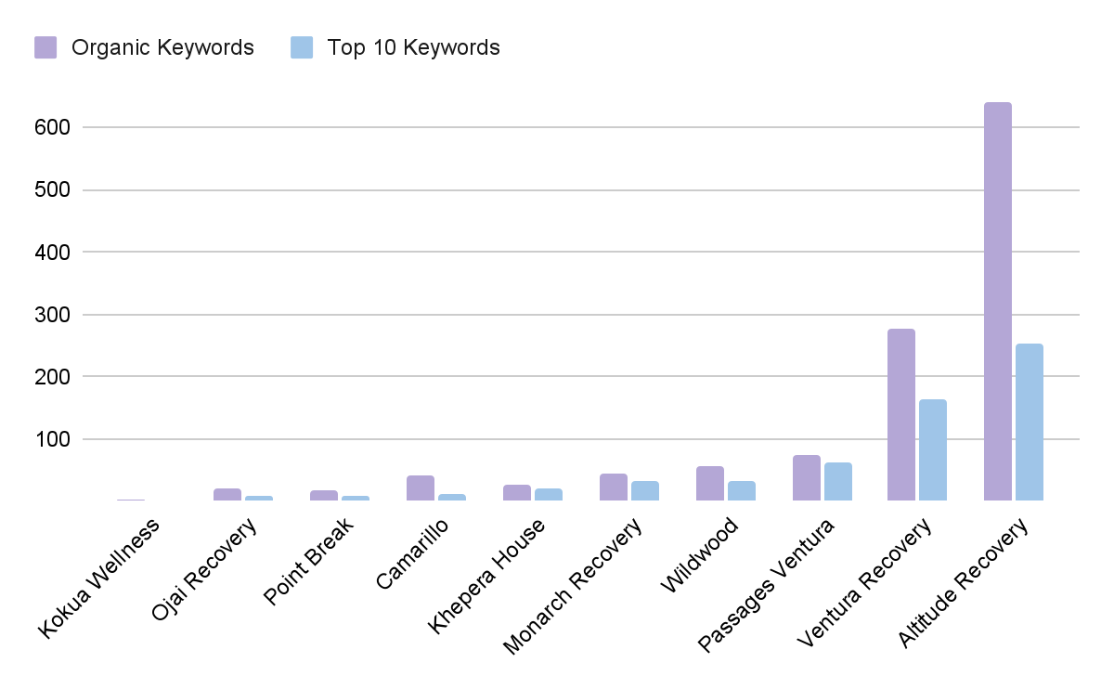
COMPETITIVE ANALYSIS BASELINE
Where you stand vs. everybody else
Competitors ranking for thousands of keywords don’t always convert that into visibility — many have shallow Top 10 presence
Ojai Recovery has a good mix of both, which we can use to leverage growth.
We’ll use this visibility data to target content clusters with low Top 10 competition and high growth potential.

Slide 6
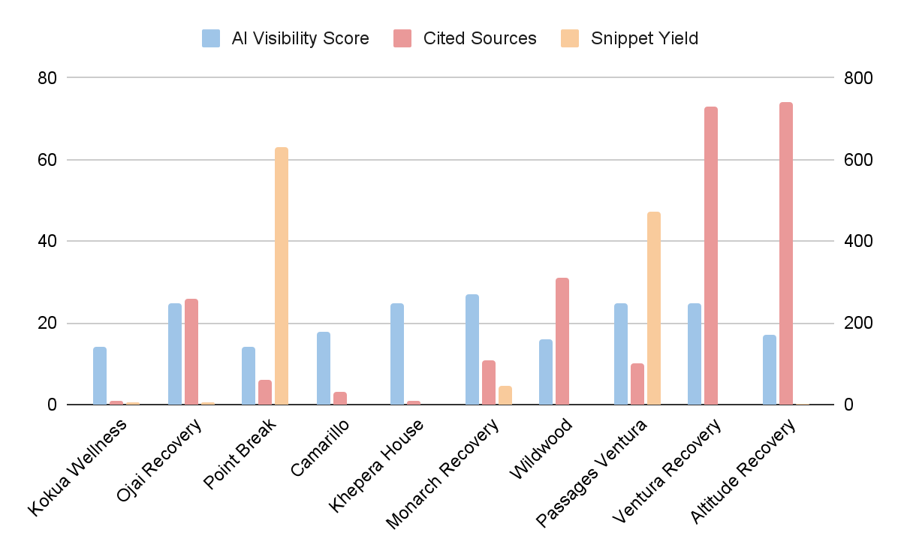
COMPETITIVE ANALYSIS BASELINE
Where you stand vs. everybody else
A few competitors appear in AI-generated results — an early sign of structured, information-rich content.
Ojai Recovery strong AI visibility today compared to competitors.
We’ll focus our efforts on appearing more in Google snippets by providing concise, direct answers to common questions [FAQs].

Slide 7
COMPETITIVE ANALYSIS BASELINE
Where you stand vs. everybody else
Across all key metrics: authority, visibility, and AI readiness, Ojai Recovery currently ranks near the bottom of the pack, giving us a clear benchmark for where to close the gap.
Ojai Recovery Competitive Efficiency Score: 20th percentile
The data shows our fastest growth levers are structure, and depth.
Not just more pages, but smarter ones that earn visibility and trust across both traditional and AI search.

Slide 8
IMMEDIATE FOCUS
Core Services, Conversions & Structural Cleanup
On-Page
January priorities are centered on clarity, consolidation, and conversion.
Defining and strengthening Ojai Recovery’s primary service pages
Detox Services (Ventura County)
Residential Treatment (Ventura County)
Fixing conversion gaps
Verify Insurance CRO updates
Launching a clear, standalone Contact Us page
Addressing structural SEO issues that are currently suppressing performance
Phase 1 navigation cleanup (conversion-focused)
Moving Admissions-related pages under About Us
Replacing the Admissions nav item with Verify Insurance
Ensuring Contact Us links directly to the new contact page

Slide 9

Phase 1 is designed to improve conversions by giving users direct access to Verify Insurance and a true Contact page, while moving Admissions and How to Get Started into About Us for a clearer, more logical path to care.
About us
How to get started
Admissions
Leadership clinical team
Tour Our Facility
Testimonials
Programs
(no change)
Mental Health Support
(no change)
Addictions Treated
(no change)
Therapies & Experiences
(no change)
Verify Insurance
/verify-insurance/
/contact-us/

Slide 10
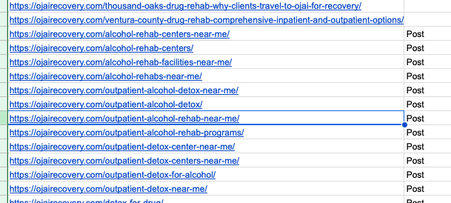
IMMEDIATE FOCUS
Core Services, Conversions & Structural Cleanup
Risk flag:
Ojai Recovery currently has dozens of overlapping URLs competing for the same keywords, many of which were created historically to target “near me,” duplicate location, or thin service variations.

Slide 11
Key insight:
Despite the volume of pages, their actual performance is extremely low.
The pages identified for removal generated only 54 organic sessions total over the last 3 months
This confirms:
They are not meaningful traffic drivers
They are not revenue-critical pages
Their removal carries minimal risk
The real issue isn’t traffic loss — it’s structural drag
These low-performing pages:
Dilute authority across dozens of URLs
Create internal competition for high-value keywords
Slow down or block ranking gains for core Detox and Residential pages
Add unnecessary crawl and index bloat

Slide 12
January action:
We are deleting and 301-redirecting low-impact, cannibalizing URLs, each averaging less than one organic visit over the past three months, so authority consolidates into the correct primary service pages.
This approach:
Reduces internal competition
Improves clarity for Google
Protects existing performance
Creates a stronger foundation for future content

Slide 13
What’s Next:
Redirect Review & Confirmation: We’ll share a list of the URLs identified for removal along with their corresponding redirect targets. This gives you full visibility into what’s being consolidated and where authority will flow before implementation.
Continued Content Planning: In parallel, we’re continuing to map out the next phase of content and site expansion. This will include a clear roadmap for February and March focused on supporting core services, strengthening topical authority, and improving conversions.
Local SEO & Visibility Foundations: As we move beyond initial cleanup and core service work, we’ll also begin laying the groundwork for local SEO initiatives, including location relevance, GBP optimization, and supporting infrastructure.

Slide 14
Next Steps
Webserv:
Content planning for the rest of Q1
Defining and strengthening Ojai Recovery’s primary service pages
Fixing conversion gaps
Phase 1 navigation cleanup (conversion-focused)
Redirect & Archiving cannibalizing URLs
Ojai Team:
Confirm the redirect plan for the cannibalizing urls
Confirm the phase 1 menu adjustment

