Slide 1

SEO Report | February 2026
Southern California Sunrise Recovery
Produced By: Olivia & Carmen
Date: March 3

Slide 2
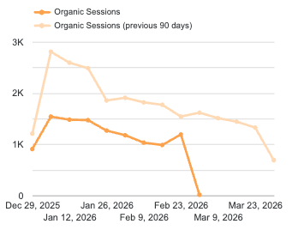
QTD Key Performance Indicators
Organic Sessions
VVOBs
VVOBs
10,835
147 Calls
13 VVOB
Goal: 46,151 l [Q1]
Jan: 114
Jan: 5
-44% behind goal
+28% MoM
+160% MoM
The 0.6% "Make a Call" conversion rate is positive after the site restructure.
There are 63 potentially viable calls in CTM that still need tagging for February.
Traffic increased by 22.1% in under two weeks, starting from 8,538 visits.
This is a positive sign that google is recognizing the quality we’re putting in.

Slide 3
Top Conversion Locations for Feb 2026
Tracking Source | # of Leads | # of VVOBs | Conversion Rate
Google My Business | 96 (24%) | 13(333%) | 13.54%(247%)
Multi-Organic Search | 47(27%) | 0(-100%) | 0.00% (-90%)
GMB conversion rate skyrocketed in February, even though GMB interactions are down 15% from Jan to Feb 2026
Most of the Leads we saw for Multi-Organic search were still on substance-abuse related pages

Slide 4
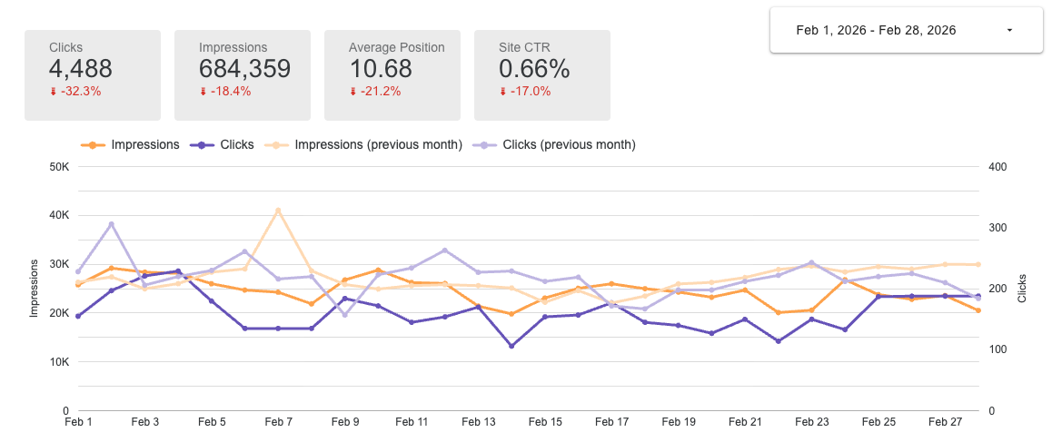
Google Search Console Performance
Note: Volatility is expected as Google recrawls & recategorizes your site

Slide 5
Keyword Tracking
Query Groups by Topic | # of Queries | % Δ | Clicks | % Δ | Impressions | % Δ | Notes
Mental Health Conditions | 10085 | -6.57% | 586 | -52.05% | 110921 | -4.13% | Traffic fluctuations are expected as Google continues to recategorize the site during our strategic pivot toward mental health.
Medications | 3886 | -23.25% | 408 | -17.41% | 55156 | -31.53% | Decline aligns with reduced focus on medication-specific content during the content audit and restructuring.
Substance Use/Alcohol/Drugs | 4101 | -35.87% | 343 | -31.40% | 49015 | -42.58% | Decline is expected as the site shifts away from substance-use-focused content and removes legacy pages.
Dual Diagnosis/Co-occurring | 2466 | -10.59% | 172 | -49.71% | 38465 | -14.39% | Slight volatility expected as related content is being reviewed and realigned with the new mental health positioning.
Other | 8448 | -22.94% | 146 | -47.29% | 52462 | -28.22% | Declines reflect broader content cleanup and de-prioritization of non-core topics during the audit phase.
Admissions/Help Now | 747 | -10.54% | 8 | 33.33% | 6867 | 13.19% | Increase in clicks and impressions is positive and aligns with stronger intent-focused traffic during the repositioning.

Slide 6
Supporting Strategic Initiatives
Initiative | Status | Notes
Remove & Redirect all SUD content. | Complete. | 42 additional calls came from organic search linked to SUD pages, which has a low conversion potential.
Update content per audit. | In progress | Includes removal of SUD on existing pages.

Slide 7
February AUDIT Content
Focus: High- or Mid- Level Rewrite, correct, polished, narrative flow, why SCSMHC stands out.
https://socalsunrise.com/treatments/trauma-disorders/
https://socalsunrise.com/programs/behavioral-therapy/
https://socalsunrise.com/treatments/anxiety/
https://socalsunrise.com/treatments/aspd/
https://socalsunrise.com/programs/narrative-therapy-orange-county/
https://socalsunrise.com/treatments/bipolar-disorder/
https://socalsunrise.com/treatments/bpd/
https://socalsunrise.com/programs/psychotherapy/
Audit Progress
Redirects | 100% done
Low Level Rewrites | 100% done
Medium Level Rewrites | 50%
High Level Rewrites | 50%

Slide 8
February Content Completion: 5 credits
Page | Target kw | Current Rank | Page Type | Credit Type | Credit Cost
Link. | What is residual schizophrenia? | 15 | Blog | Optimize | 0.5
Link. | What is trauma bonding? | 69.8 | Blog | Optimize | 0.5
Link. | OCD and Trauma | 6.8 | Blog | Optimize | 0.5
Link. | CPTSD symptoms | 9.1 | Blog | Optimize | 0.5
Link. | Intrusive thoughts example | N/A | Blog | New post | 1
Link. | How to heal childhood trauma | N/A | Blog | New post | 1
Link. | What is emotional dysregulation? | N/A | Blog | New post | 1

