Slide 1

Content & SEO Mid-Strategy Check-in
NRT: Front Range & Steamboat
Building durable organic performance with purpose.
Date: Feb 12, 2026

Slide 2
Mid-Strategy Agenda
Competitive Benchmarking
Feb Core Focus: Structural Cleanup for Forging New Lives + Foundry Front Range
What’s next

Slide 3
Strategy Month: Next Checkpoint
Launch Strategy & Roadmap Review - Date TBD (2 weeks from now)
Finalizes goals, North Star Metrics, and success benchmarks
Aligns on the execution plan across content, SEO, and site improvements
Confirms launch-ready priorities for the next phase
Signals the transition from planning → active execution

Slide 4
Domain Strategy Recommendation
The Question
Should we launch on forgingnewlives.com and switch later — or launch directly on foundrysteamboat.com?
Option 1: Launch Now, Migrate Later
Higher Complexity + Slower Momentum
Two full Google reprocessing cycles
Two indexing periods
Additional redirect management
Temporary visibility volatility
More development + SEO overhead
Option 2: Launch on foundrysteamboat.com from Day One
Cleaner + Stronger Long-Term Strategy
Aligns brand and domain immediately
No future migration required
Clearer trust + recognition signals
Builds authority in the right place from the start
Result: Stronger foundation and faster compounding authority.

Slide 5
What Happens to forgingnewlives.com?
We Will Implement a Full 301 Redirect Strategy
Because the URLs appear to have a 1:1 relationship already structured in WordPress, this will be a clean redirect process.
Execution Plan:
301 redirect every page from forgingnewlives.com → foundrysteamboat.com
Maintain identical URL paths wherever possible
Preserve any authority or signals tied to the old domain
Submit updated sitemap in Google Search Console
Monitor indexing + traffic during transition

Slide 6
Why This Is Low Risk
Site is effectively launching from zero
Minimal authority to protect
No meaningful rankings at risk
Cleaner to migrate now vs. after growth begins
Switching later creates unnecessary disruption.
Switching now creates clarity and compounding growth.

Slide 7
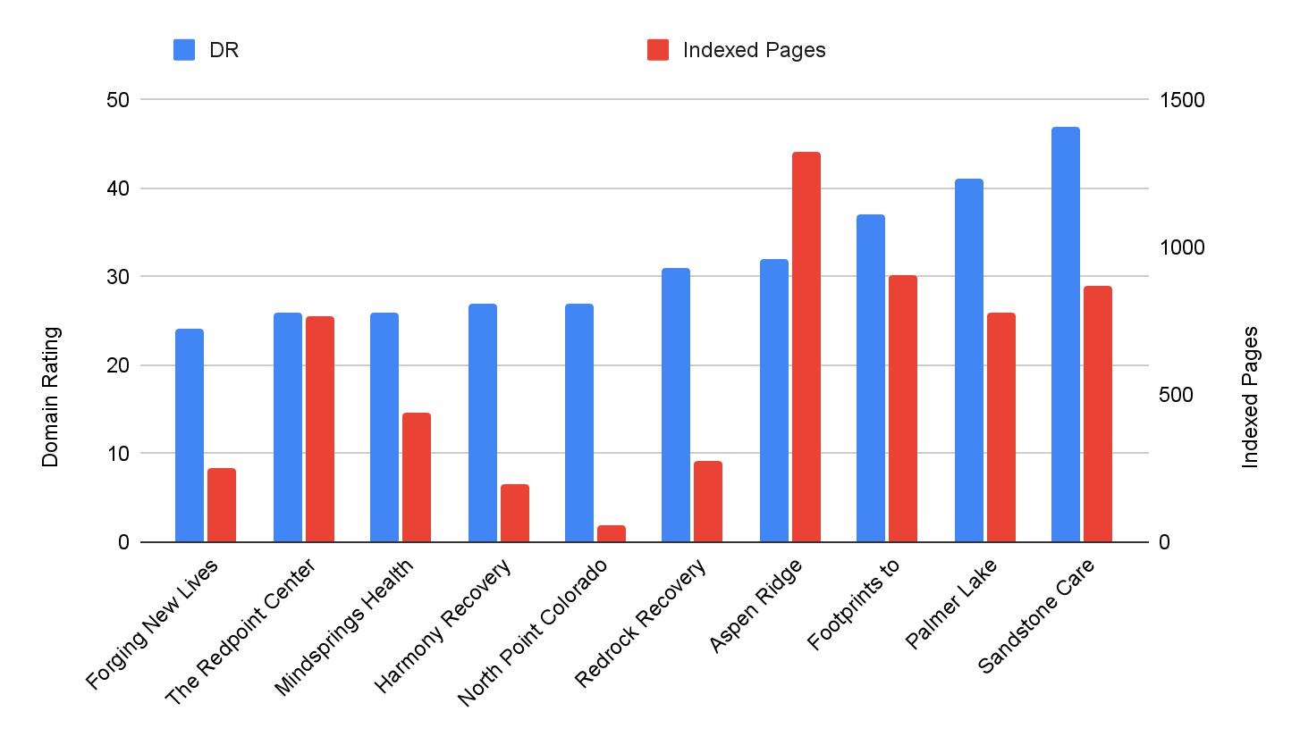
FORGING NEW LIVES: COMPETITIVE ANALYSIS BASELINE
Where you stand vs. everybody else
You have a solid DR foundation, but it’s still the lowest in the set and has fewer indexed pages.
That means your site is credible, but they’re underrepresented in search—it simply doesn’t have enough optimized, intent-aligned pages to compete across the full set of queries.
Our Opportunity:
Grow efficiently by expanding the right pages and content (Programs / Treatment / What We Treat / Admissions), strengthening internal linking, and building targeted authority—so new pages rank faster and DR gap closes.

Slide 8
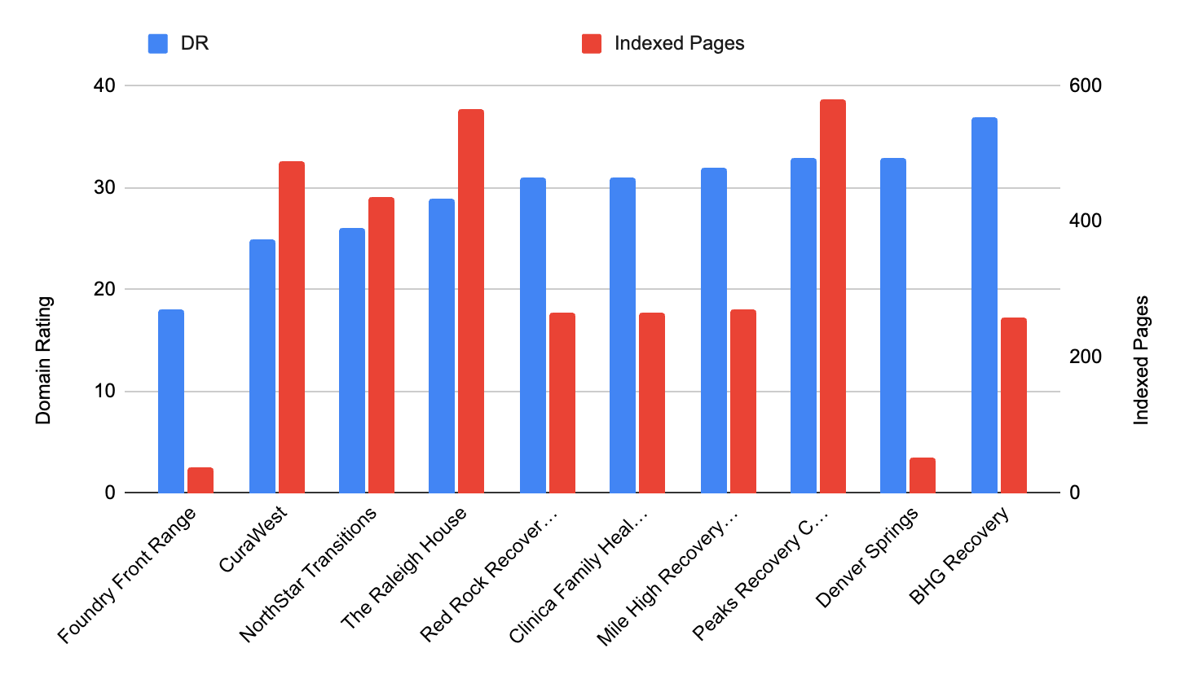
FOUNDRY FRONT RANGE: COMPETITIVE ANALYSIS BASELINE
Where you stand vs. everybody else
You’re currently lowest in DR and have one of the smallest indexed page footprints in this set. That means you’re credible—but underrepresented in search.
Opportunity: Expand intent-led, indexable pages, and strengthen internal linking, and add targeted authority building so new pages rank faster and the DR gap closes.

Slide 9
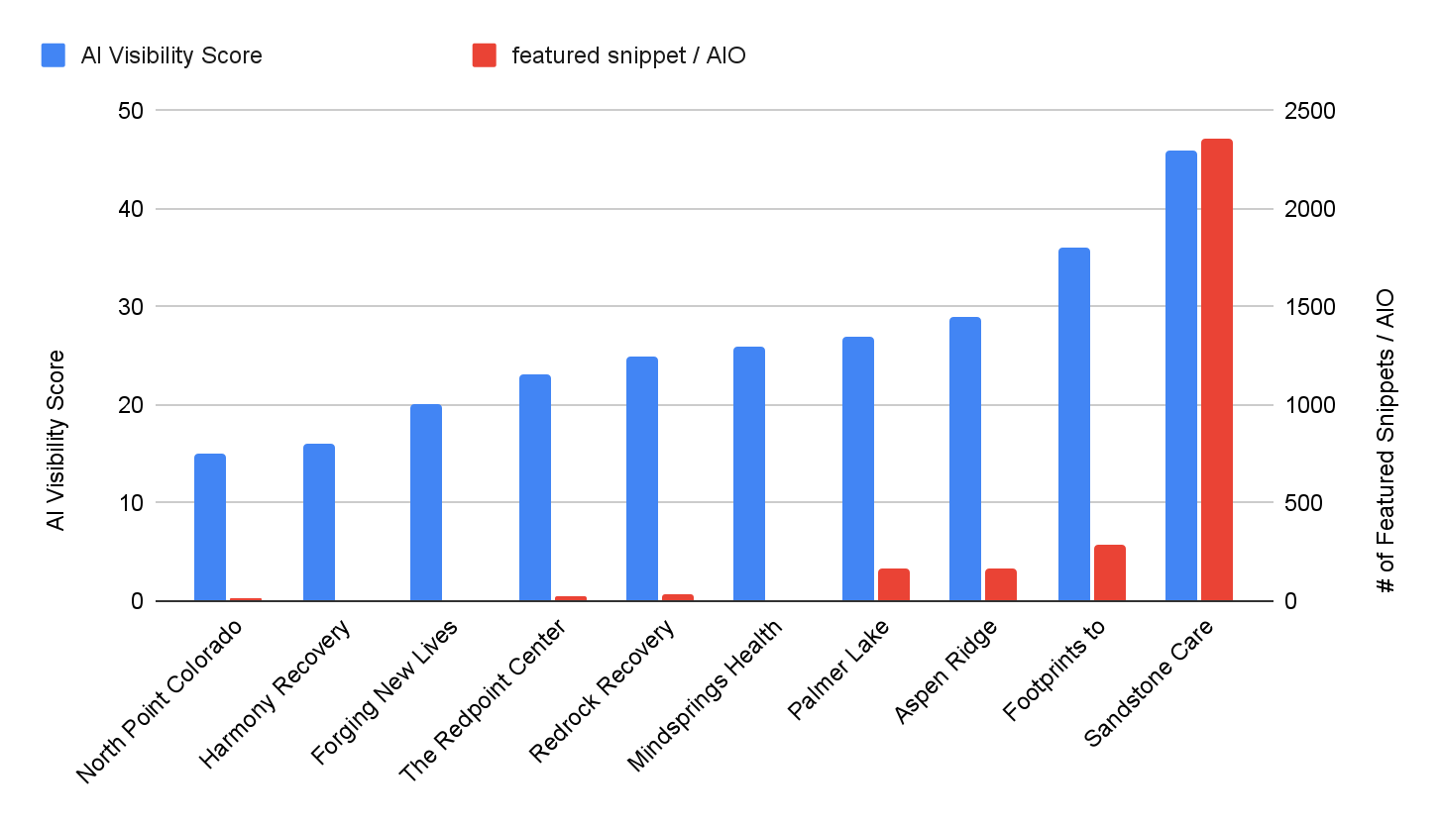
FORGING NEW LIVES: COMPETITIVE ANALYSIS BASELINE
Where you stand vs. everybody else
A few competitors are showing up more in AI-generated results and featured snippets — a sign of structured, answer-first content.
Forging New Lives is in the lower-to-mid range for AI Visibility and has minimal snippet/AIO coverage. That means they’re being recognized, but they’re not winning the “direct answer” placements that drive disproportionate clicks.
Focus: increase snippet/AIO wins by building concise FAQ-style answers across key pages, adding clear headings/definitions, and strengthening internal linking to those pages.

Slide 10
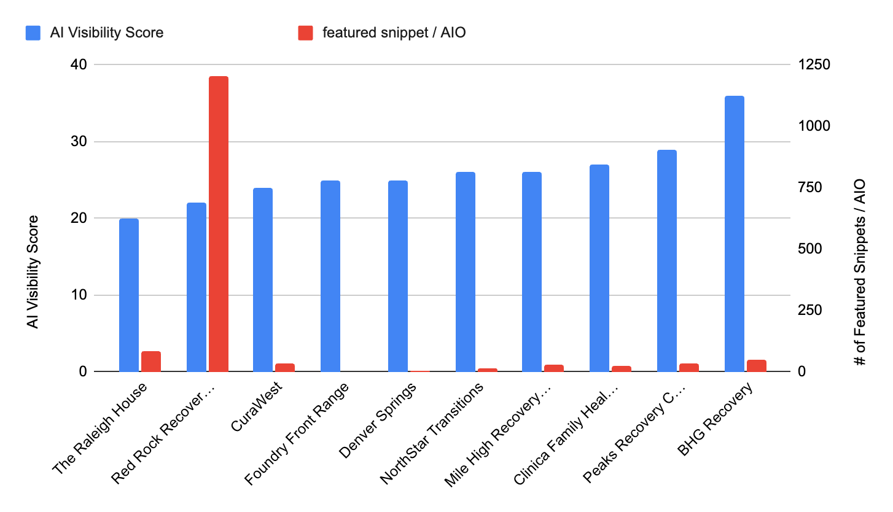
FOUNDRY FRONT RANGE: COMPETITIVE ANALYSIS BASELINE
Where you stand vs. everybody else
A few competitors are capturing featured snippets / AI answers — and that’s translating into outsized SERP visibility.
Foundry Front Range sits mid-range on AI Visibility, but has minimal snippet/AIO placements, which limits “direct answer” clicks.
Opportunity: Win more snippets/AIO by adding concise Q&A blocks + clear definitions on key pages, tightening on-page structure, and internally linking to those answers.

Slide 11
COMPETITIVE ANALYSIS BASELINE
Where you stand vs. everybody else
Across all key metrics: authority, visibility, and AI readiness, Forging New Lives currently ranks at the bottom of the pack, giving us a clear benchmark for where to close the gap.
Forging New Lives & Foundry Front Range Competitive Efficiency Score: 10th percentile
The data shows our fastest growth levers are trust, and content depth.
Not just more pages, but smarter ones that earn visibility and trust across both traditional and AI search.

Slide 12
FIRST FOCUS
Core Services, Conversions & Structural Cleanup
Our top priority for both sites is aligning on a clear, scalable site structure before production begins.
Clarify the site’s core structure: Define what lives at the top level (treatment, programs, admissions etc.) and remove navigation ambiguity. This will help us define redirects from the Outpatient Steamboat site.
Align the site with how patients evaluate treatment: Services first, conditions second, education later — reducing friction for users deciding if Invicta is the right fit.
Create a shared prioritization framework for growth: Ensure future blogs, geo pages, and condition pages support core services and scale cleanly without rework.

Slide 13
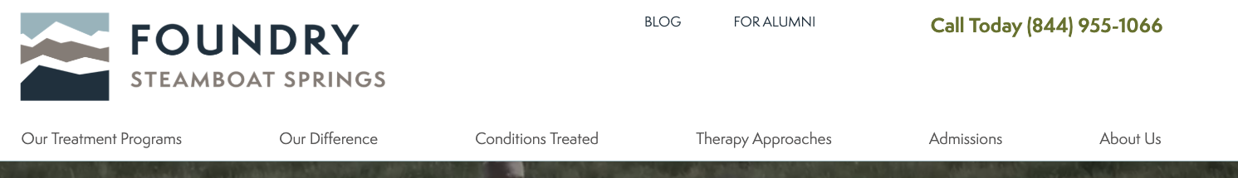
Our goal: improve both usability and search performance.
The new IA creates clear topics (Treatment / Programs / What We Treat / Admissions) that map to real searches and support stronger internal linking—helping key pages rank, earn snippets, and convert.
Current:
Future:
TREATMENT
PROGRAMS
WHAT WE TREAT
ADMISSIONS
ABOUT
RESOURCES
VERIFY INSURANCE
CALL NOW

Slide 14
A scalable blueprint for what we publish next.
We’ll grow these top-level hubs into complete topic clusters—adding the pages that matter most, in the order that drives rankings and admissions.
TREATMENT
PROGRAMS
WHAT WE TREAT
ADMISSIONS
ABOUT
RESOURCES
VERIFY INSURANCE
CALL NOW
/what-we-treat/
/what-we-treat/substance-use/
/what-we-treat/alcohol/
/what-we-treat/opioids/
/what-we-treat/stimulants/
/what-we-treat/benzodiazepines/
/what-we-treat/polysubstance/
/what-we-treat/mental-health/
/what-we-treat/trauma-ptsd/
/what-we-treat/anxiety/ /what-we-treat/depression/
/treatment/
/treatment/therapies-modalities/
/treatment/trauma-integrated-care/
/treatment/medical-psychiatry/
/treatment/wellness-experiential/
/treatment/environment-location/
/programs/
/programs/residential/
/programs/detox/
/programs/php/
/programs/iop-virtual/
/programs/iop-in-person/
/programs/aftercare-alumni/
/programs/family-program/
/admissions/
/admissions/start-here/
/admissions/insurance-cost/
/admissions/verify-insurance/
/admissions/what-to-bring/
/admissions/travel-planning/
/admissions/frequently-asked-questions/
/admissions/contact-admissions/
Notes:
What you’re seeing here isn’t something we’re rolling out all at once. This is the direction we’re building toward over the next ~6 months, based on a 4-credit monthly content cadence.
Before we start executing content, we want to make sure we’re aligned on the shape of the site — how services, conditions, and therapies will ultimately be organized — so that every page we build plugs into the same structure.”

Slide 15
About + Resources are the credibility layer.
About consolidates core E-E-A-T signals—team, standards, accreditation, and outcomes—so trust is easy to verify. Resources extends that authority through helpful, structured content (blog, FAQs, continuing education, media coverage) that answers real questions and supports search visibility over time.
TREATMENT
PROGRAMS
WHAT WE TREAT
ADMISSIONS
ABOUT
RESOURCES
VERIFY INSURANCE
CALL NOW
/about/
/about/our-story/
/about/mission-values/
/about/leadership/
/about/clinical-team/
/about/quality-accreditation/
/about/treatment-outcomes/
/about/careers/
/about/facility-tour/
/resources/
/resources/blog/
/resources/continuing-education/
/resources/in-the-media/
/resources/faq/
Notes:
What you’re seeing here isn’t something we’re rolling out all at once. This is the direction we’re building toward over the next ~6 months, based on a 4-credit monthly content cadence.
Before we start executing content, we want to make sure we’re aligned on the shape of the site — how services, conditions, and therapies will ultimately be organized — so that every page we build plugs into the same structure.”

Slide 16

Current:
Future:
TREATMENT
PROGRAMS
WHAT WE TREAT
ADMISSIONS
ABOUT
RESOURCES

Slide 17
TREATMENT
PROGRAMS
WHAT WE TREAT
ADMISSIONS
ABOUT
RESOURCES
/treatment/
/treatment/trauma-integrated-care/
/treatment/evidence-based-therapies/ (future hub)
/treatment/individual-therapy/
/treatment/group-therapy/
/treatment/family-therapy/
/treatment/psychiatry-medication-management/
/treatment/wellness-nutrition-fitness/
/programs/
/programs/detox/
/programs/residential-treatment/
/programs/womens-program/
/programs/family-program/
/programs/aftercare-continuing-care/
/what-we-treat/
/what-we-treat/alcohol/
/what-we-treat/opioids/
/what-we-treat/fentanyl/
/what-we-treat/stimulants/
/what-we-treat/cannabis/
/what-we-treat/co-occurring-disorders/

Slide 18
TREATMENT
PROGRAMS
WHAT WE TREAT
ADMISSIONS
ABOUT
RESOURCES
/about/
/about/mission-approach/
/about/tour-our-facility
/about/clinical-leadership-team/
/about/our-team/
/about/accreditation-licensing/
/about/insurance-medicaid/
/about/careers/
/resources/
/resources/blog/
/resources/faqs/
/resources/for-families/

Slide 19
What’s Next:
Confirm the proposed long-term site structure: Ensure this organization reflects how you want Invicta’s services and offerings to be understood over time.
Continued Content Planning: In parallel, we’ll map out how this works in your current scope.
Local SEO & Visibility Foundations: As we move beyond initial cleanup and core service work, we’ll also begin laying the groundwork for local SEO initiatives, including location relevance, GBP optimization, and supporting infrastructure.

Slide 20
Next Steps
Webserv:
NRT Team Team:
Confirm future site structure

