Slide 1

SEO
LAUNCH
Building performance with purpose
Bliss Recovery
Content & SEO
Date: March 24, 2026

Slide 2
Agenda
Update after the deck is built
01
02
03
Insights
What we found, and where we are in the SEO strategy
Site Navigation
Feedback & Alignment
Q1 Deliverables
Webserv’s SEO Commitments

Slide 3
01
Insights

Slide 4

High level summary of what we found
INSIGHTS
Growth isn’t blocked by lack of content — it’s blocked by structure
Core services aren’t clearly defined for search or users
Too many overlapping pages are competing instead of supporting each other
The biggest wins are efficiency, clarity, and conversion — not volume
What the Research Made Clear
Google rewards content that demonstrates real expertise, strong sourcing, and user-first intent.

Slide 5
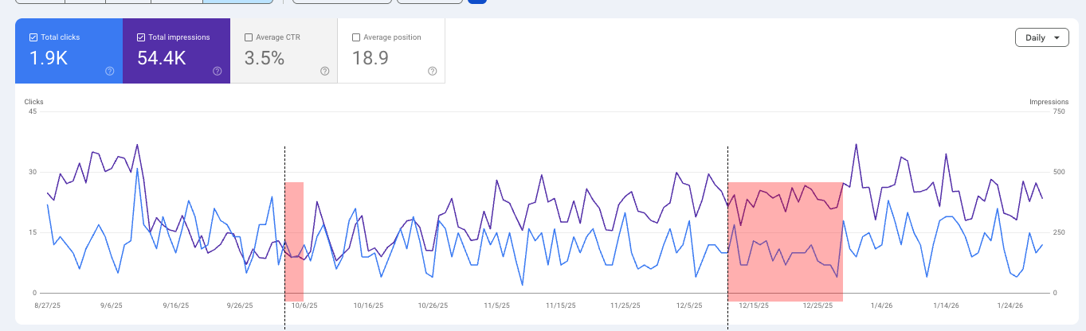
High level summary of what we found - should include a chart
INSIGHTS
Performance plateau driven by structure, not content volume: Despite significant content creation, growth has stalled due to cannibalization and unclear site hierarchy, which limits Google’s ability to understand priority pages and core offerings.
Algorithm sensitivity amplified by YMYL classification: Since August, the site has generated ~1.9K total clicks with noticeable volatility and no sustained growth trend. In a behavioral health (YMYL) category, this kind of inconsistency is often amplified when site structure and page clarity aren’t strong enough to withstand algorithm updates.

Slide 6
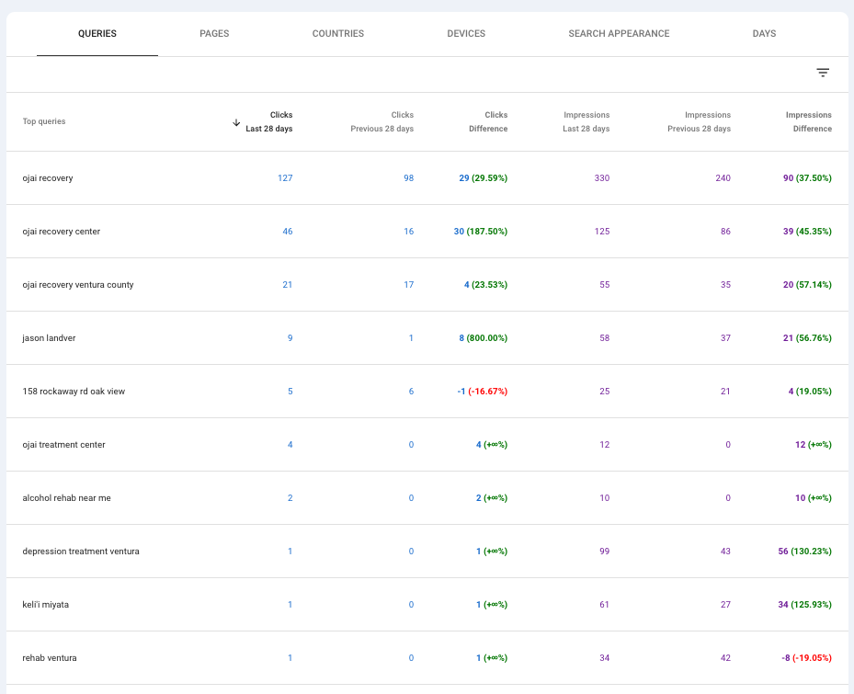
Insights from search
Search visibility is currently brand-led Most impressions and clicks are coming from branded searches, while non-brand treatment and location queries remain underrepresented — indicating room to grow beyond brand awareness.
Google lacks clear signals on priority services Low impressions across non-brand queries suggest Google is still working to understand which services and pages should be treated as authoritative and primary.
Strong opportunity to unlock non-brand growth By improving structure, reducing overlap, and clarifying core offerings, the site is well positioned to capture significantly more high-intent, non-brand search demand.
High level summary of what we found - should include some kw analysis

Slide 7
SEO Strategy for Ojai Recovery
High level summary of their site maturity - adjust as we need to
We’re here
PRIO 1
CLARIFY
PRIO 2
REMOVE FRICTION
PRIO 3
CONSOLIDATE
PRIO 4
BUILD
Define & strengthen core services
Make conversion obvious and easy
Reduce internal competition and dilution
Expansion, differentiation and visibility in SEO & AI Channels

Slide 8
03
Q1 Deliverables

Slide 9
These next slides are all pretty boilerplate, they talk about our SEO service at large
What we do Monthly

Slide 10
These next slides are all pretty boilerplate, they talk about our SEO service at large
What we do
Weekly Google Posts: Content rotates between core service pages, programs, and admissions-focused messaging. Designed to support visibility, engagement, and conversion directly within local search
Monthly Profile Health & Optimization Review: Review and refine business description, services, and attributes as needed. Ensure category alignment with current offerings
Local SEO on your Google Business Profile

Slide 11
These next slides are all pretty boilerplate, they talk about our SEO service at large
What we do
Optimize priority admissions and access pages to reduce friction and improve clarity for high-intent users
Review high-level call tracking signals to identify messaging or pathway gaps
Apply insights to CTA placement, page structure, and admissions-focused content updates
Conversion Rate Optimization

Slide 12
These next slides are all pretty boilerplate, they talk about our SEO service at large
What we do
Monitor crawlability, indexation, and visibility for issues impacting priority pages
Address high-impact technical issues that could undermine search performance
Provide strategic technical guidance when deeper development support is required
Technical SEO

Slide 13
These next slides are all pretty boilerplate, they talk about our SEO service at large
What we do
Execute against the approved quarterly content strategy and page prioritization
Create or optimize high-impact service, care access, and supporting pages
Refine existing content to reduce overlap, improve structure, and strengthen topical authority
Content Strategy

Slide 14
These next slides are all pretty boilerplate, they talk about our SEO service at large
What we do
Mid-Month Check-In Review early search performance trends, visibility changes, and high-level call/lead signals from organic search to identify issues or opportunities while there’s still time to adjust execution.
End-of-Month Performance Review Evaluate organic traffic and visibility trends, summarize call and lead attribution signals, and connect results back to the work completed during the previous month.
Forward-Looking Priority Alignment Use reporting insights to confirm what’s working, deprioritize what isn’t, and align on execution focus for the upcoming month.
Monthly Reporting

Slide 15
This is a title slide for the first month of service - for bliss since we’re basically starting Q2 this should say April, and then some copy on what we’re doing and why
We build content plans out to the end of the current quarter
SEO Strategy
February
February is concentrated on stabilizing the site’s core service architecture and strengthening conversion pathways. Work this month includes restructuring and redirecting legacy URLs, launching and optimizing priority Levels of Care and “What We Treat” pages, refining conversion-critical pages, and updating the Google Business Profile to support local visibility.
This foundational work ensures search engines clearly understand core offerings, users encounter less friction, and future SEO efforts can scale without being undermined by structural or legacy issues.

Slide 16
February
February total: 9 credits (1 over standard monthly allocation due to foundational site stabilization work).
Credit Cost | Credit Type | URL | New URL | Date published | Reasoning
0.5 | Optimization | https://ojairecovery.com/programs/ | https://ojairecovery.com/levels-of-care/ | Feb 5 | Stabilizing core service pages
0.5 | Optimization | https://ojairecovery.com/addictions-treated/ | https://ojairecovery.com/what-we-treat/ | Feb 10 | Stabilizing core service pages
0 (we do one CRO update per month) | CRO Update | https://ojairecovery.com/verify-insurance | n/a | Feb 12 | Requires update to be optimized for conversion
2 | Service | New | https://ojairecovery.com/levels-of-care/intensive-outpatient-program | Feb 17 | Stabilizing core service pages
1 | Scale | https://ojairecovery.com/ventura-county-residential-treatment/ | https://ojairecovery.com/levels-of-care/ventura-county-residential-treatment | Feb 19 | Stabilizing core service pages
2 | Service | New | https://ojairecovery.com/levels-of-care/outpatient-program | Feb 20 | Stabilizing core service pages
2 | Service | New | https://ojairecovery.com/levels-of-care/partial-hospitalization-prorgram | Feb 24 | Stabilizing core service pages
1 | Scale | https://ojairecovery.com/co-occurring-disorders/ | https://ojairecovery.com/levels-of-care/dual-diagnosis | Feb 26 | Stabilizing core service pages
9 total Credits | *credit types are allocated by the Webserv team on level of work required |  | URL changes are required for better information architecture | Due dates subject to change due to internal Webserv production workflows

Slide 17
This is a title slide for the second month of service - this should say May, and then some copy on what we’re doing and why
SEO Strategy
March
March builds on February’s foundational stabilization by expanding coverage of high-intent treatment topics and capturing demand across both service and informational search. Work this month includes launching and scaling core “What We Treat” and Levels of Care pages, publishing high-traffic educational content designed to support lead capture, and aligning site-wide conversion elements with the structural changes already in place.
This phase shifts the strategy from cleanup and stabilization to intent-driven growth, ensuring the site can capture users earlier in their decision process while reinforcing core service authority.

Slide 18
March
Credit Cost | Credit Type | URL | New URL | Date published | Reasoning
1 | Scale | N/a | https://ojairecovery.com/blog/end-stage-alcoholism | March 3 | High-traffic blog - key symptom recognition = lead capture
1 | Scale | https://ojairecovery.com/alcohol-addiction-treatment/ | https://ojairecovery.com/what-we-treat/alcohol-addiction-treatment | March 6 | Stabilizing core service pages
1 | Scale | https://ojairecovery.com/opioid-addiction-treatment/ | https://ojairecovery.com/what-we-treat/opioid-addiction-treatment | March 11 | Stabilizing core service pages
1 | Scale | N/a | https://ojairecovery.com/blog/how-long-does-detox-take | March 16 | High-traffic blog - solution aware = lead capture
2 | Service | N/a | https://ojairecovery.com/levels-of-care/detox-services/alcohol-detox | March 18 | Stabilizing core service pages
2 | Service | N/a | https://ojairecovery.com/what-we-treat/depression | March 25 | Stabilizing core service pages
0 | CRO Update | N/a | https://ojairecovery.com/ | March 30 | Requires update to go with the changes we’ve made
8 total Credits | *credit types are allocated by the Webserv team on level of work required |  | URL changes are required for better information architecture | Due dates subject to change due to internal Webserv production workflows

Slide 19
This is a title slide for the third month of service - this should say June, and then some copy on what we’re doing and why
SEO Strategy
March
March builds on February’s foundational stabilization by expanding coverage of high-intent treatment topics and capturing demand across both service and informational search. Work this month includes launching and scaling core “What We Treat” and Levels of Care pages, publishing high-traffic educational content designed to support lead capture, and aligning site-wide conversion elements with the structural changes already in place.
This phase shifts the strategy from cleanup and stabilization to intent-driven growth, ensuring the site can capture users earlier in their decision process while reinforcing core service authority.

Slide 20
March
Credit Cost | Credit Type | URL | New URL | Date published | Reasoning
1 | Scale | N/a | https://ojairecovery.com/blog/end-stage-alcoholism | March 3 | High-traffic blog - key symptom recognition = lead capture
1 | Scale | https://ojairecovery.com/alcohol-addiction-treatment/ | https://ojairecovery.com/what-we-treat/alcohol-addiction-treatment | March 6 | Stabilizing core service pages
1 | Scale | https://ojairecovery.com/opioid-addiction-treatment/ | https://ojairecovery.com/what-we-treat/opioid-addiction-treatment | March 11 | Stabilizing core service pages
1 | Scale | N/a | https://ojairecovery.com/blog/how-long-does-detox-take | March 16 | High-traffic blog - solution aware = lead capture
2 | Service | N/a | https://ojairecovery.com/levels-of-care/detox-services/alcohol-detox | March 18 | Stabilizing core service pages
2 | Service | N/a | https://ojairecovery.com/what-we-treat/depression | March 25 | Stabilizing core service pages
0 | CRO Update | N/a | https://ojairecovery.com/ | March 30 | Requires update to go with the changes we’ve made
8 total Credits | *credit types are allocated by the Webserv team on level of work required |  | URL changes are required for better information architecture | Due dates subject to change due to internal Webserv production workflows

Slide 21
Triple check this to make sure its accurate
What we do
Performance & signals Organic visibility and traffic trends, high-level call and lead signals, and early indicators of conversion health following structural changes.
Foundation readiness Confirmation that core service pages, site structure, and conversion pathways are stable and ready to scale.
What’s working vs. what’s next Identify which page types, topics, and pathways are driving momentum—and where to focus next for maximum impact.
Outcome A refined quarterly roadmap that shifts from stabilization and expansion into sustained growth and demand capture, aligned with business and admissions priorities.
Q2 QBR
Evaluate the impact of foundational stabilization and early growth execution, then align on priorities for the next phase.

Slide 22
Next Steps
Webserv:
Jay to book Monthly & Bi weekly calls
Jay to start on site work after alignment
Bliss Team:
XYZ

