Slide 1

Content & SEO Mid-Strategy Check-in
Horseshoe Ridge RV Resort
Building durable organic performance with purpose.
Date: Mar 18, 2026 Prepared by: Jay Hall

Slide 2
Mid-Strategy Month Review What’s in this deck
Competitive Benchmarking
First Core Focus: Structural Cleanup for the Bliss navigation menu and blog
What’s next

Slide 3
Our Next Checkpoint
Launch Strategy & Roadmap Review - Date TBD (2 weeks from now)
Finalizes goals, North Star Metrics, and success benchmarks
Aligns on the execution plan across content, SEO, and site improvements
Confirms launch-ready priorities for the next phase
Signals the transition from planning → active execution

Slide 4
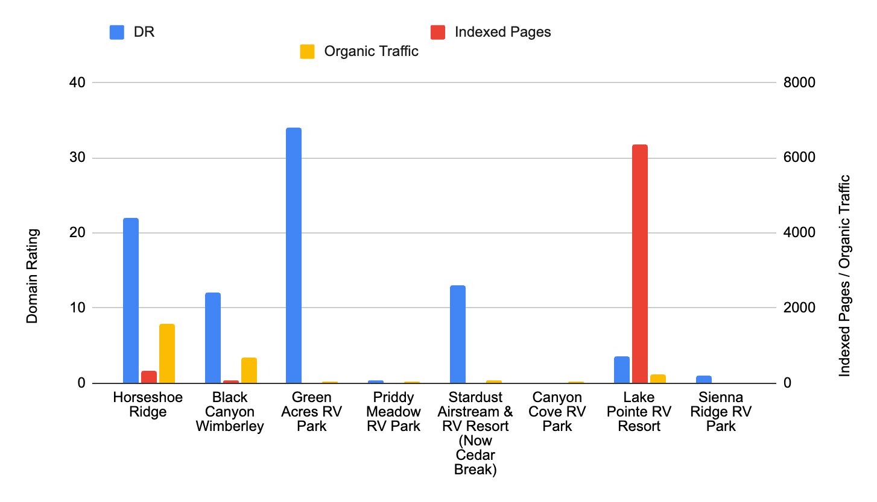
HORSESHOE RIDGE: COMPETITIVE ANALYSIS BASELINE
Where you stand vs. everybody else
Horseshoe is outperforming its size, but the site is still too dependent on a small number of pages.
Horseshoe Ridge is performing well with a relatively small page base. But too much of that visibility is tied to the homepage and a limited set of URLs, while key booking-supporting sections remain underbuilt.
As a result, the site has fewer ranking entry points than it should across accommodations, amenities, services, and trip-planning searches.
Our Opportunity:
Expand core stay, resort, and service content to convert existing demand into broader organic visibility.

Slide 5
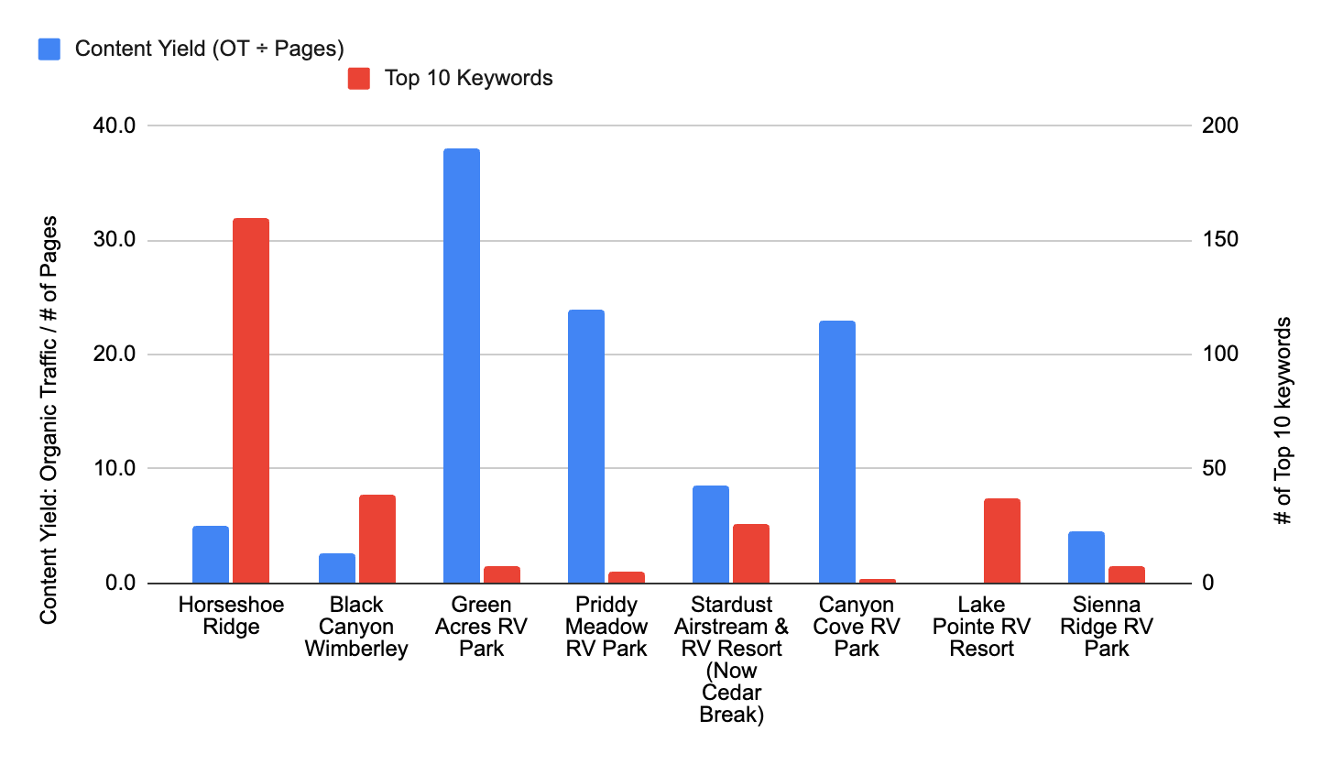
HORSESHOE RIDGE: COMPETITIVE ANALYSIS BASELINE
Where you stand vs. everybody else
You’re adding content, but it isn’t yet turning into enough Top 10 wins.
Horseshoe Ridge has built a solid page base, but competitors are getting more Top 10 rankings out of less. That signals a keyword alignment problem, not just a volume problem.
Right now, the content footprint is bigger than the ranking payoff.
Our Opportunity:
Tighten page targeting around the searches most likely to drive rankings, traffic, and bookings.

Slide 6
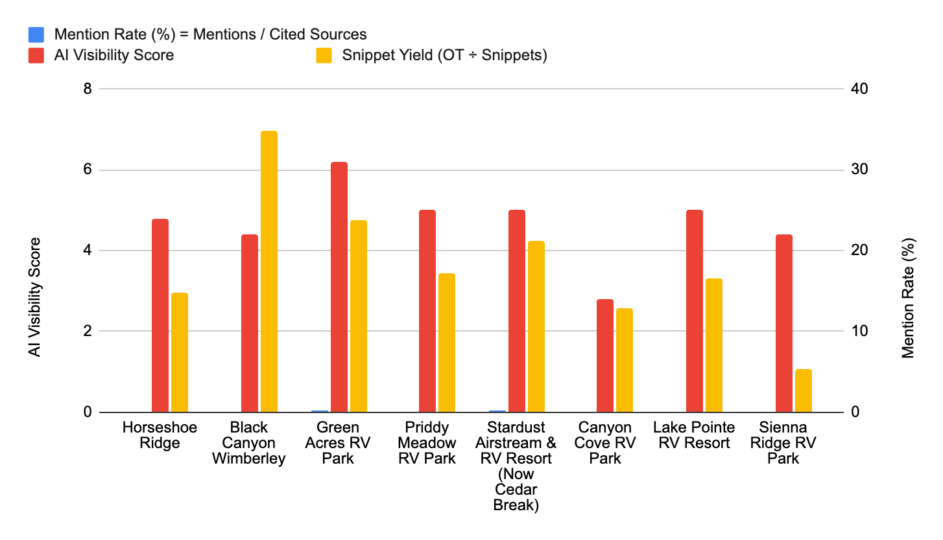
HORSESHOE RIDGE: COMPETITIVE ANALYSIS BASELINE
Where you stand vs. everybody else
Your competitors are showing up in AI answers more often than you are.
Several competitors are earning stronger AI visibility and snippet coverage, which means their content is being surfaced more often in AI-generated answers and SERP features.
Horseshoe Ridge currently has limited citation share and snippet reach, which reduces visibility in both AI results and traditional search features.
Our Opportunity:
Structure key pages with clearer answers, stronger definitions, and more snippet-friendly formatting so Horseshoe can earn more AI citations and SERP features.

Slide 7
HORSESHOE RIDGE COMPETITIVE ANALYSIS BASELINE
Where you stand vs. everybody else
Across the core metrics that matter most ... visibility, coverage, and AI readiness ... Horseshoe is competitive, but still leaving room to grow.
Horseshoe Ridge Competitive Position: Mid-pack with upside
The clearest growth levers are better content distribution, stronger page targeting, and a smarter site structure.
Not just more pages, but better-connected ones that earn visibility, support AI discovery, and turn more searches into bookings.

Slide 8
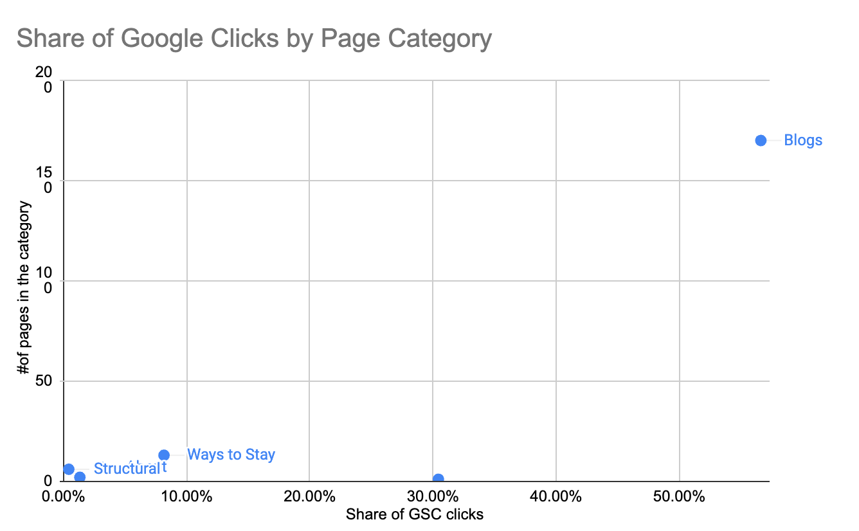
Organic visibility is too concentrated, and the site needs more entry points that can rank outside branded search.
Homepage is carrying too much of the organic load, which suggests visibility is still concentrated around branded demand instead of being distributed across the site.
Most other page types are contributing far less than they should, despite making up the majority of the site’s content footprint.
The biggest gap is in question-led content. Reframing the blog as a true FAQ-style resource hub would give Horseshoe a better shot at capturing non-brand discovery and reducing dependence on the homepage.

Slide 9
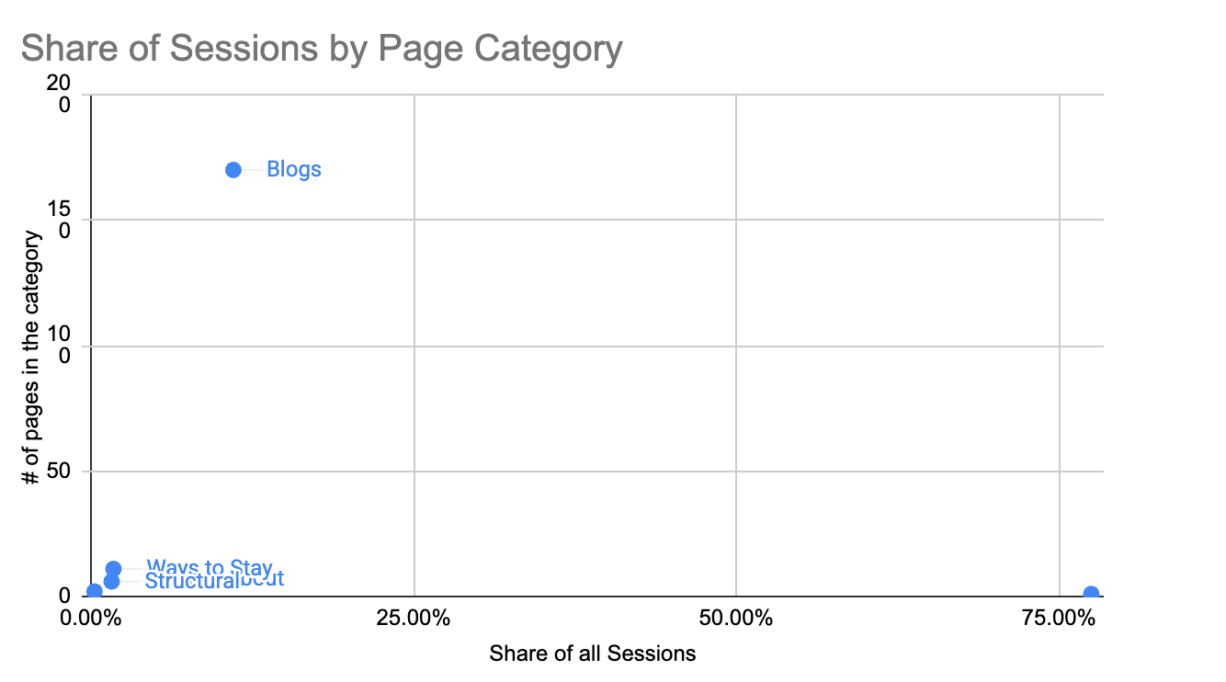
Horseshoe has session demand, but too much of it is concentrated or underleveraged at the page level.
Homepage drives 73.9% of all sessions from just 1 page. Insight: The site is attracting attention, but most of it is not being distributed deeper into the experience.
About pages generate 679 sessions across 7 pages, or 97 sessions per page. Insight: Resort and amenity content is pulling solid engagement and can do more heavy lifting if surfaced better in navigation.
Blog pages generate 952 sessions across 170 pages, or just 5.2 sessions per page. Insight: The content hub has reach, but article-level performance is thin ... which is why a question-led FAQ structure could improve both discoverability and usefulness.

Slide 10
FIRST PRIOS
Your SEO growth depends on distributing visibility beyond the homepage.
1. Fix the Funnel Between Discovery and Booking
Right now, too much visibility is concentrated in the homepage, while key stay, service, and planning pages are not pulling their weight. Expand and strengthen the pages that help users move from search interest to booking confidence.
2. Turn the Blog Into a Question-Lich FAQ Hub
The blog is already driving 1,194 clicks, but performance is spread thin across too many pages. Rebuild it around real guest questions so each article has a clearer purpose, stronger search alignment, and a better path into core booking pages.
3. Improve Navigation and Structure for AI & SERP Visibility
Competitors are showing up more often in AI answers and SERP features. Clearer navigation, stronger page hierarchy, and more direct-answer formatting will help Horseshoe earn more citations, snippets, and non-brand visibility.

Slide 11
Our goal: improve both usability and search performance.
The new IA moves up the most important parts of your site to the top level . These map to real searches and support stronger internal linking—helping key pages rank, earn snippets, and convert. New buttons to highlight Verify insurance and a font change for legibility are also recommended.
Current:
Future:

Slide 12
A scalable blueprint for what we publish next.
We’ll build out Horseshoe Ridge’s top-level hubs in the order that best supports rankings, internal linking, and admissions—starting with Programs, What We Treat, and Admissions, then expanding trust-supporting content in FAQ and Resort.
/guest-info/
general-info/
rules-policies/
contact-us/
/stay/
rv-sites/
cabins/
monthly-rv-stays/
/faq/
all-faqs/
rv-questions/
cabin-questions/
local-area-questions/
politics-planning/
/resort/
amenities/
activities/
area-attractions/
resort-map/
gallery/
/services/
golf-cart-rentals/
valet/propane/services
Notes:
What you’re seeing here isn’t something we’re rolling out all at once. This is the direction we’re building toward over the next ~6 months, based on a 4-credit monthly content cadence.
Before we start executing content, we want to make sure we’re aligned on the shape of the site — how services, conditions, and therapies will ultimately be organized — so that every page we build plugs into the same structure.”

Slide 13
What’s Next:
Webserv:
Content, keyword, and site structure planning: We’ll map the highest-priority opportunities across navigation, core pages, and question-led content so the site can capture more non-brand traffic.
Technical and visibility groundwork: We’ll continue evaluating crawlability, page structure, and local visibility foundations so Horseshoe is better positioned to grow in both search and AI-driven discovery.
Horseshoe Ridge:
Confirm the proposed long-term site structure: Take the day to think about the proposed menu and FAQs based blog. It’s a big change and if you have any questions, reach out to me.
Additional suggestion: There is strategic miss. A polished owner-led walkthrough at golden hour, showing the grounds, amenities, guest interaction, and the feel of the place, would likely help on trust, conversion, and brand differentiation.

