Slide 1


QUARTERLY BUSINESS REVIEW
Q4 2025 Review & Strategic Roadmap
Confidential Recovery
Paid Media and Content & SEO
Date: 12/10/2025
(PPC Data from The Grove)
(SEO Data is Mock Data)

Slide 2
Agenda
01
02
03
Performance Review
A transparent look at last quarter’s results, funnel movement, and NSM alignment.
Strategy Overview
The external factors shaping performance and where the market is heading.
Strategic Plan
Data-backed initiatives designed to accelerate next-quarter performance.
04
05
Roadmap & Alignment
A clear path forward with prioritized actions, timelines, and ownership.
Partnership Items
Strengthening our partnership through shared goals, referrals, and collaboration.

Slide 3
01
Performance Review
Key data and insights from Q3

Slide 4
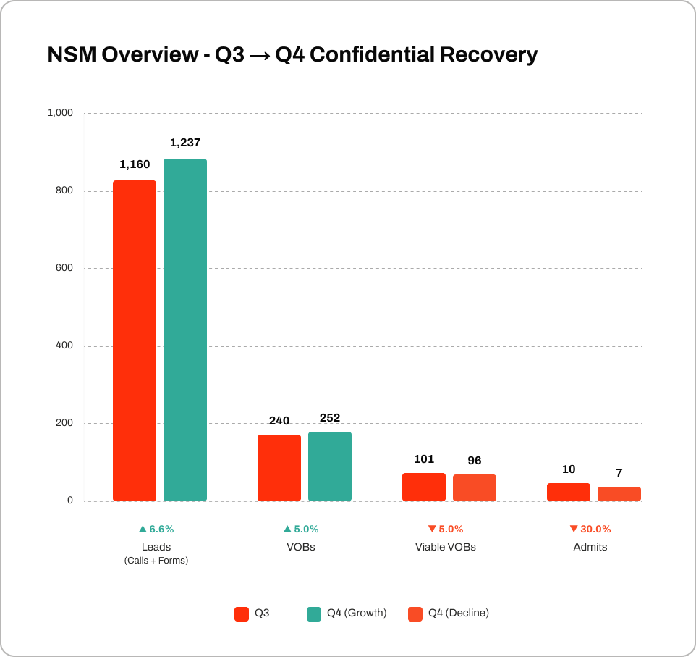
SEO NSM Overview
Search demand for treatment-focused queries lifted overall top-of-funnel activity
KPI | Q3 | Q4 | Delta Δ
Leads (Calls) | 1,160 | 1,237 | +6.6%
VOBs | 240 | 252 | +5.0%
Viable VOBs | 101 | 96 | –5.0%
Admits | 10 | 7 | –30.0%
Top-of-funnel demand grew meaningfully in Q4, but conversion tightened as insurance quality declined and deductible cycles hit.

Slide 5
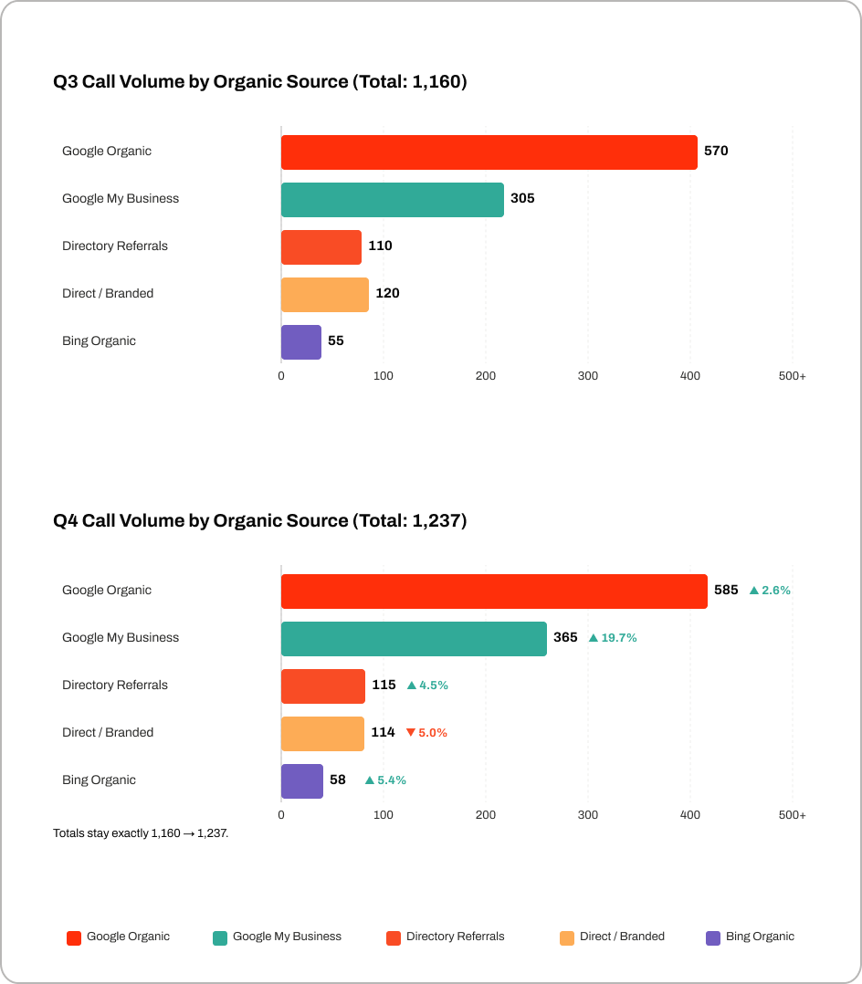
SEO Performance
Call Volume by Organic Source
Quarter-over-quarter organic calls increased due to stronger performance in high-intent sources such as Google Organic and GMB.
GMB Optimization Fueled the Largest Lift
Improved Map Pack rankings and GMB profile activity drove a sharp increase in calls, making GMB the fastest-growing source.

Slide 6
SEO Performance
Call Volume by Organic Source
Quarter-over-quarter organic calls increased due to stronger performance in high-intent sources such as Google Organic and GMB.
GMB Optimization Fueled the Largest Lift
Improved Map Pack rankings and GMB profile activity drove a sharp increase in calls, making GMB the fastest-growing source.

Slide 7
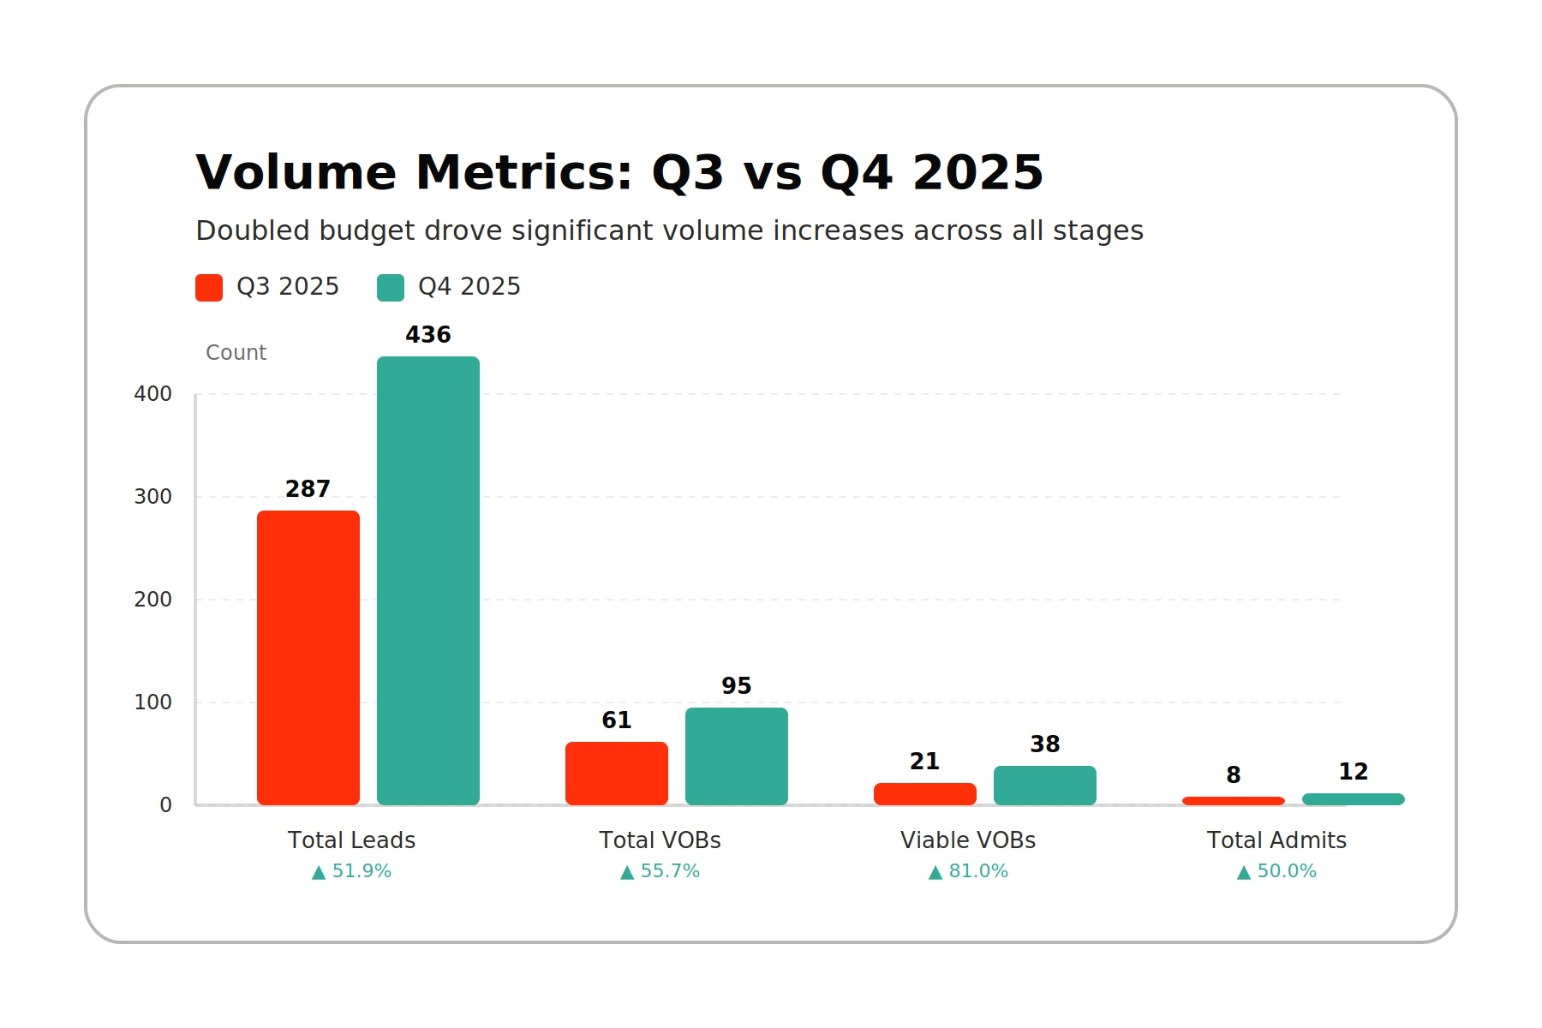
Paid Media Performance
Quarter-over-Quarter Volume Breakdown
Compared to Q3, Q4 generated more leads (+51.9%) and VOBs (+55.7%),and an increase in viable VOBs (+81%).
Admits increased by +50% - keep in mind these numbers are volume only and are mostly driven by significant budget increases.

Slide 8
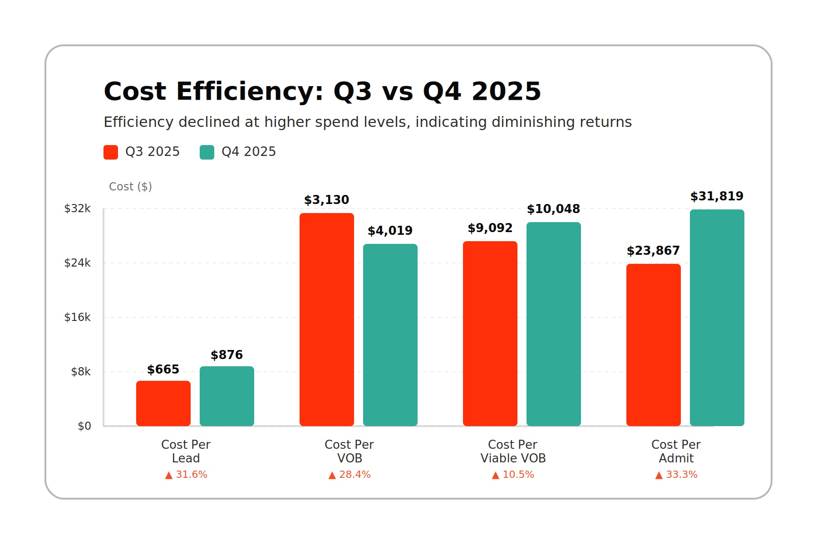
Paid Media NSM Performance
Quarter over Quarter Cost Efficiency Breakdown
We were less efficient across the board on all metrics in Q4.
While Volume rose for Q3 vs Q4, mostly due to budget increases, cost efficiency declined - a lot of this can be attributed to seasonality.
We saw a 31.6% increase in cost per lead, a 28.4% increase in cost per VOB, a 10.5% increase in cost per viable (not as bad as the other numbers), and a 33.3% increase in CPA.

Slide 9
02
Strategy Overview
Factors shaping performance

Slide 10
INSIGHTS
Market Insights - SEO
AI Overviews now appear across many treatment-related searches such as “residential rehab near me” and “IOP mental health programs.”
Sites with comprehensive service content, strong local SEO signals, and clear insurance information tend to be referenced more frequently.
This shift emphasizes the need for content clarity, local authority, and structured metadata to ensure visibility.
AI Overviews Are Reshaping Recovery Search Behavior
Google’s early rollout of AI-generated summaries is changing how patients discover treatment options.

Slide 11
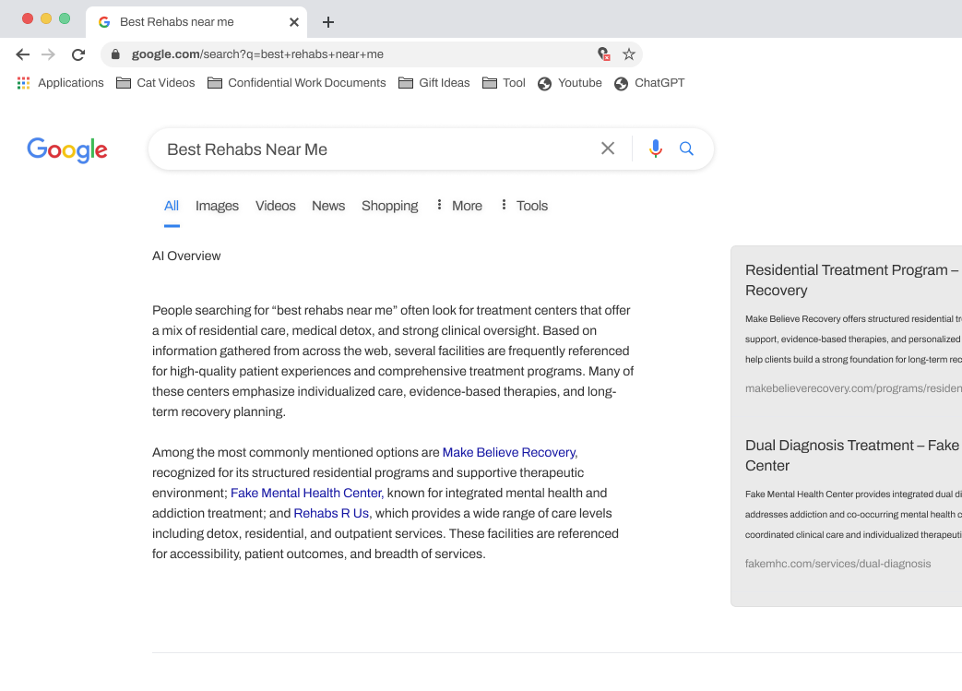
SEO Competitive Snapshot
Who’s Winning AI Overview Visibility
WHAT
AI-generated summaries now highlight facilities like Make Believe Recovery, Fake Mental Health Center, and Rehabs R Us for recovery searches.
Your competitors are receiving disproportionate visibility and early click-share.
Key Insight
Without showing up in these summaries, Confidential Recovery is missing high-intent opportunities now being redirected to competing facilities.

Slide 12
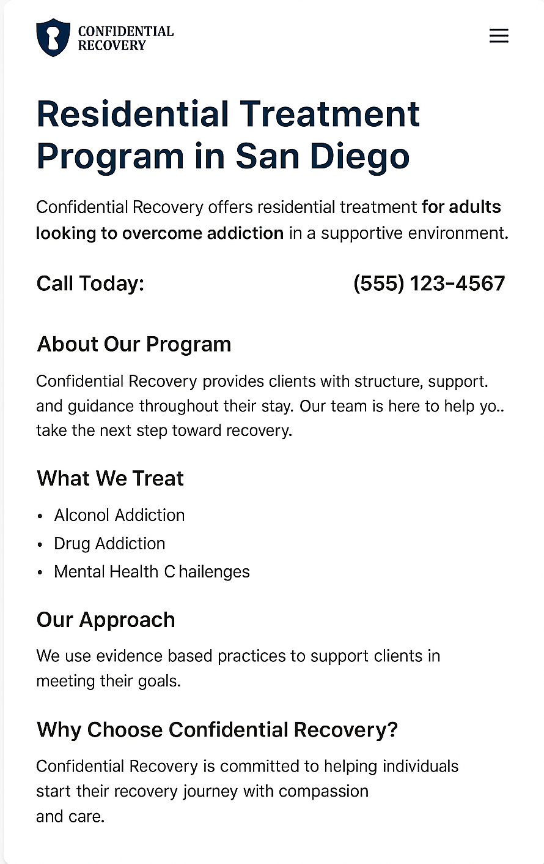
Challenges
The Challenge - SEO
Why we aren’t appearing in AI overviews
Too thin to qualify for AI Overview inclusion.
Missing the content depth competitors have.
Insufficient structured information for AI summarization.
Current content depth and update frequency limit AI Overview eligibility.
Confidential Recovery isn’t appearing in AI Overviews because priority service pages don’t yet have the depth, structure, and topical authority signals.
Content credits are spread thin, limiting our ability to produce the long-form Signature Content AI Overviews favor.
Competitors have been publishing content more frequently, reinforcing them as trusted sources.

Slide 13
SEO - Opportunity
Shift Current Content Credits for AI Overviews
KEY POINTS
Foundational SEO is in place: baseline rankings, technical improvements are now established.
AI Overviews demand depth, freshness, and structured expertise, reallocating credits lets us strengthen core service pages without increasing spend.
We recommend re-allocating content credits toward deeper, more authoritative content that aligns with AI Overview requirements.
Current Credit Allocation
Recommended Reallocation
Grow Faster
Signature Content (x1)
2 Credits
Signature Content (x1)
2 Credits
Signature Content (x1)
2 Credits
Service Content (x1)
2 Credits
Service Content
0 Credits
Service Content (x1)
2 Credits
Scale Content (x1)
1 Credit
Scale Content
0 Credit
Scale Content (x1)
1 Credit
Content Updates
0 Credits
Content Updates (x6)
3 Credits
Content Updates (x6)
3 Credits
Total: 5 Credits
Total: 5 Credits
(No Additional Investment)
Total: 8 Credits
(Additional Investment)

Slide 14
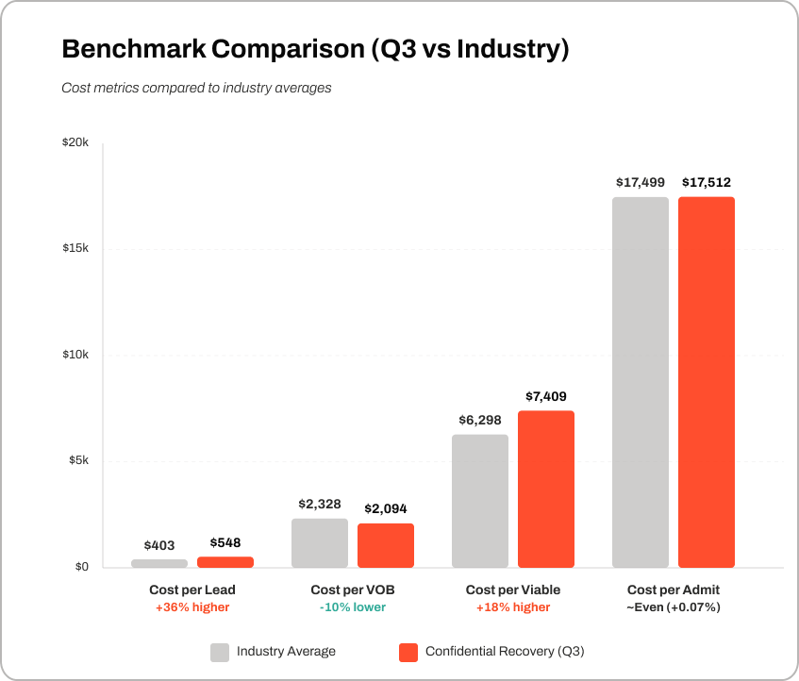
Market Insights - Paid Media
Industry Benchmarks Show Strong Relative Efficiency
Your current funnel performance outperforms the industry average across key acquisition metrics for OON residential programs.
Cost per Lead is higher, which is expected for high-competition markets like San Diego
Cost per VOB is outperforming the industry
Cost per Viable is high, indicating that improving lead quality is a key opportunity.
Cost per Admit is exactly on par with industry norms
OON residential acquisition costs continue to rise nationally due to increased auction competition and stricter insurance requirements.

Slide 15
Q2 → Q3 Data Spotlight
Viable VOBs
The Paid Media Challenge
-13% QoQ
Declining Funnel Viability Is Limiting Admit Growth
Admits grew +22%, but from fewer viable opportunities
PMAX viability often below 20-25% vs Search at 30-40%
Lower VOB-to-Viable rates reduce qualified admission opportunities.
Although lead and VOB volume stayed consistent, fewer VOBs converted into Viable VOBs this quarter. PMAX contributes volume, but with weaker viable output than Search, further constraining late-funnel performance.
Lower VOB → Viable VOB conversion reduces admit-ready opportunities
Higher cost per viable increases CPA sensitivity
Search delivers stronger viability; PMAX underperforms in quality

Slide 16
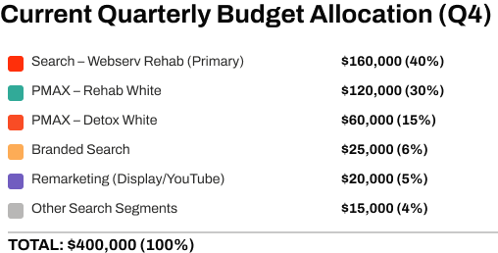
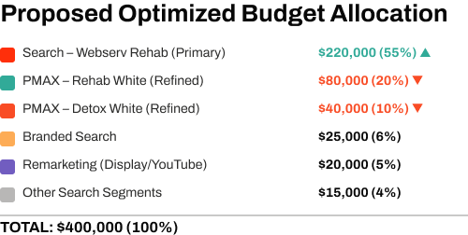
Paid Media Opportunity
Shift Budget Toward High-Performing Search
Reallocating spend strengthens viable VOB quality and improves admit consistency.
INSIGHTS
Current spend is weighted heavily toward PMAX, which delivers inexpensive VOBs but lower viable output.
By shifting 15–20% of that budget into high-performing Search campaigns, without increasing total spend, we can expand qualified opportunities and improve CPA.

Slide 17
03
Strategic Plan
Initiatives that drive next quarter’s outcomes

Slide 18
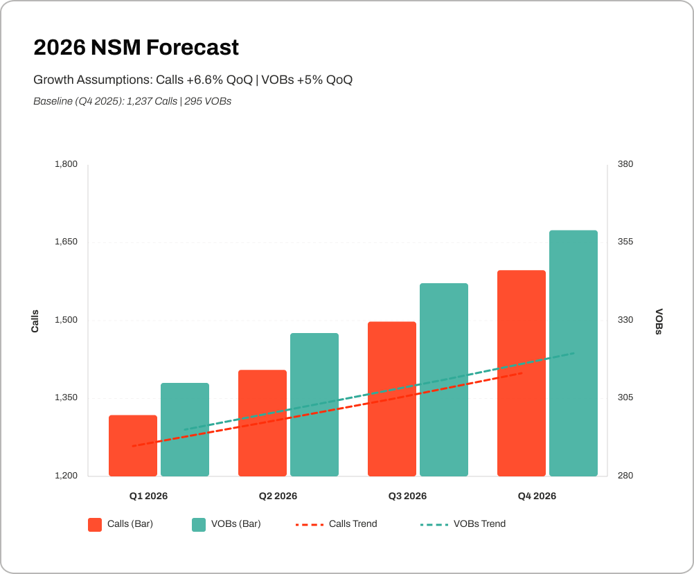
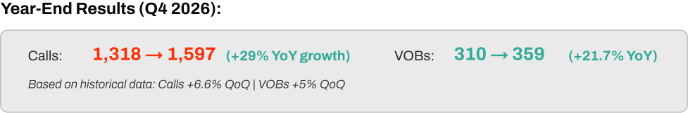
Updated SEO NSM for 2026
Projected Growth for Calls + VOBs
Based on Q4 performance and steady quarter-over-quarter momentum, we’re forecasting continued growth in both Calls and VOBs throughout 2026. This projection reflects the impact of stronger local visibility, improved service-page depth, and increased eligibility-focused content.

Slide 19

Content & SEO Q1 Tactics
SEO Q1 Tactics
Scaling Calls & VOBs Through AI Visibility & Local Expansion
WHAT
HOW
Increase total call volume and VOB generation by strengthening visibility in AI Overviews and improving performance on high-intent local searches.
Build on Q4’s foundational wins by reallocating content credits toward higher-impact updates designed to rank for predictive “summary-style” AI result formats.
Strengthen AI Overview eligibility by expanding thin content and adding structured schema.
Improve local call volume through GBP optimization and targeted city-level content.
Reallocate credits toward 1 signature piece + recurring updates to modernize priority pages.
Optimize conversion pathways with clearer insurance CTAs to increase VOB-ready intent.

Slide 20
Goal Type: Admissions
Admissions Goal:
36
Quarterly Budget:
$400,000
Cost Per Admit Needed:
$11,111
Updated Paid Media NSM for Q1 2026
NSM Q1: 36 Quarterly Admissions
Q4 Performance Data
Target CTR & CVR
Conversion Rates
Our NSM model shows exactly what it will take to hit your quarterly admit target.
Using your Q4 performance data and real funnel conversion rates, we built a forward-looking admissions model for Q1. With a quarterly budget of $400,000, the required Cost per Admit is $11,111.
Ad Click-through Rate:
6%
Lead → VOB:
16%
Landing Page Conv. Rate:
9%
VOB→ Viable:
30%
Viable → Admit:
40%
Projections
Metric
Goal
Cost-Per
Leads
1,875
$213
VOBs
300
$1,333
Viables
90
$4,444
Admissions
36
$11,111

Slide 21
Paid Media Q1 Tactics
Reducing CPA Through Budget Allocation & Funnel Optimization
WHAT
HOW
Improve Cost per Admit by shifting budget toward campaigns with stronger Viable → Admit performance and reducing spend in low-viability segments.
Strengthen late-stage conversion by improving the quality of traffic entering the funnel and tightening targeting around high-intent insurance + residential queries.
Reallocate a larger share of budget to rehab campaigns showing higher admit efficiency, while reducing allocation to detox locator traffic with weaker viability.
Expand high-intent search coverage (insurance terms, location-based residential searches) to increase VOB-ready opportunities.
Improve landing page clarity and CTAs for insurance verification to lift VOB and viable rates at the mid-funnel.
Deploy structured A/B tests on headlines, audience signals, and sitelinks to combat rising CPL and stabilize viable volume.

Slide 22
04
Roadmap & Alignment
Our 12-month approach to drive center growth

Slide 23
Content & SEO Roadmap
Goal | Quarter 1 Restructure |  |  | Quarter 2 Optimize |  |  | Quarter 3 Expand |  |  | Quarter 4 Scale
 | Q1 Initiatives |  |  | Q2 Initiatives |  |  | Q3 Initiatives |  |  | Q4 Initiatives
Channel Initiatives | Complete full technical SEO audit and implement priority fixes. Refresh all thin or underdeveloped service pages Conduct full keyword research + build a 12-month content roadmap. Identify gaps preventing AI Overview eligibility (E-E-A-T + topical coverage). Audit GBP + local listings to benchmark current local search performance. |  |  | Expand high-value pages with deeper content to align with AI Overview structure. Publish targeted supporting articles and FAQs to build topical authority. Implement content updates and CRO improvements on key service pages. Launch location-focused content to improve local call volume. Optimize internal linking across core recovery topics. |  |  | Build new content clusters to capture broader recovery-related searches. Enhance E-E-A-T signals (expert quotes, credentials, sourcing, schema). Refresh top-performing pages to protect rankings and drive additional Calls/VOBs. Expand local SEO footprint with surrounding city + neighborhood pages. Optimize pages for emerging AI Overview patterns as they continue to evolve. |  |  | Scale content output using updated credit allocation (more content updates). Publish advanced authority content to differentiate CR from similar facilities. Launch a year-end optimization sweep across all revenue-driving pages. Expand local authority with community-focused content and enhanced GBP presence. Evaluate year-end NSM progress and build the next-year strategy.
Ongoing | Content Optimization · Technical SEO · Local SEO · E-E-A-T Enhancement · CRO Improvements · AI Overview Preparedness
 | Reporting

Slide 24
Content & SEO
Next Steps
01
02
03
Choose Your Content Credit Path
Select either the recommended reallocation (no added cost) or the Grow package for faster ranking gains.
Approve Updated SEO Roadmap
Confirm the prioritized service pages and content updates that will drive call and VOB growth in Q1–Q2.
Activate Local Visibility Enhancements
Enable GMB optimization, proximity signals, and supporting location content to strengthen map-driven call volume.

Slide 25
Paid Media Roadmap
Goal | Quarter 1 Strengthen the Funnel |  |  | Quarter 2 Deepen Intent & Improve Viability |  |  | Quarter 3 Scale High-Fit Volume |  |  | Quarter 4 Accelerate Admit Growth
 | Q1 Initiatives |  |  | Q2 Initiatives |  |  | Q3 Initiatives |  |  | Q4 Initiatives
Channel Initiatives | Redirect budget toward high-performing campaigns with stronger Viable → Admit rates. Reduce wasted spend by tightening geographic, audience, and negative keyword filters. Refresh landing page messaging and insurance CTAs to improve VOB-ready conversions. Audit all conversion tracking to ensure accurate viability and admit measurement. Stabilize CPL and CPVOB through targeted bidding adjustments. |  |  | Expand insurance and residential-specific campaigns to increase qualified VOB flow. Launch structured A/B testing for ad headlines, descriptions, and call-extensions. Improve landing page conversion rate with streamlined form flow and clearer benefits. Optimize audience segments to prioritize users with demonstrated treatment-seeking intent. Enhance remarketing to recapture leads who showed mid-funnel intent but did not inquire. |  |  | Add new geo-expansion campaigns focused on nearby high-value markets. Introduce additional upper- and mid-funnel creative (YouTube / Demand Gen) to support assisted conversions. Strengthen insurance-focused funnel paths with tailored copy and segmented ad groups. Deploy automated rules to increase spend during historically high-intent hours and days. Build new ad variations informed by Q1–Q2 conversion insights. |  |  | Expand winning campaign structures with additional budgets allocated to best-fit traffic sources. Implement full-funnel creative refresh ahead of seasonal recovery peaks. Add deeper audience layering using search intent, first-party data, and eligibility patterns. Run end-of-year funnel diagnostics to identify remaining friction points impacting Cost per Admit. Finalize next-year NSM plan using full-year admit, viability, and cost-efficiency learning.
Ongoing | Ad creative optimization • Bidding strategy refinement • Negative keyword governance
 | Weekly pacing + budget control • Funnel diagnostics • Conversion rate optimization • Cross-channel reporting

Slide 26
Paid Media
Next Steps
01
02
Confirm Budget Reallocation Plan
Finalize the shift toward higher-performing campaigns to reduce wasted spend and strengthen Cost per Admit efficiency.
Approve Q1 Paid Media Roadmap
Align on the prioritized initiatives for improving viable volume, refining audiences, and increasing admit-ready intent.
03
04
Refresh Landing Page & Conv. Paths
Implement recommended updates to insurance CTAs, form flow, and page messaging to support stronger VOB and admit conversions.
Validate Tracking & Funnel Accuracy
Confirm all lead, VOB, viable, and admit events are firing correctly to ensure reliable optimization and reporting.

Slide 27
05
Partnership Items
Strengthening our partnership

Slide 28

Win-Win
Referral Program
Know another rehab center or business that could use help growing their admissions?
Refer them to us - and when they become a client, you both win. They get expert marketing support, and you get a service credit as a thank-you. Helping others grow helps you grow too!
If there is anyone in your network you think could benefit from our Paid Media, Content, and SEO services, please let us know.

Slide 29
Thank you for your continued partnership.
Every partnership helps us move closer to our goal of connecting 30,000 people with treatment by 2030. Thank you for sharing the same purpose and commitment to meaningful results.

