Slide 1


QUARTERLY BUSINESS REVIEW
Q4 2025 Review & Strategic Roadmap
Confidential Recovery
Content & SEO
Date: 12/10/2025

Slide 2
Agenda
01
02
03
Performance Review
A transparent look at last quarter’s results, funnel movement, and NSM alignment.
Strategy Overview
The external factors shaping performance and where the market is heading.
Strategic Plan
Data-backed initiatives designed to accelerate next-quarter performance.
04
05
Roadmap & Alignment
A clear path forward with prioritized actions, timelines, and ownership.
Partnership Items
Strengthening our partnership through shared goals, referrals, and collaboration.

Slide 3
01
Performance Review
Key data and insights from Q3

Slide 4
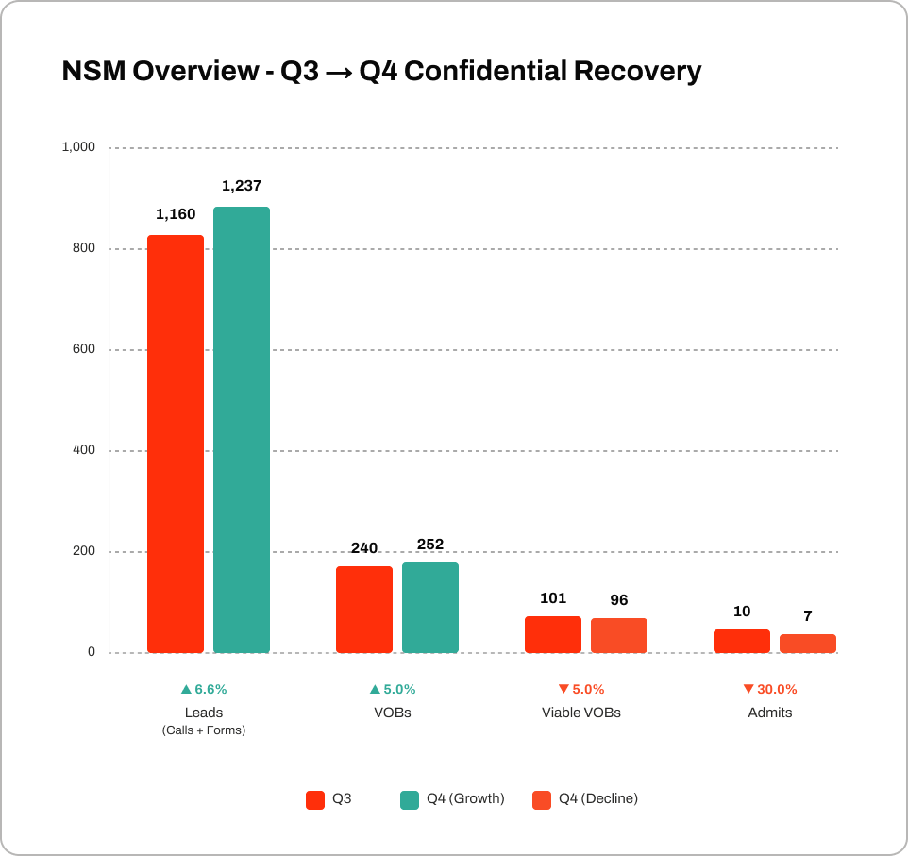
NSM Overview
Search demand for treatment-focused queries lifted overall top-of-funnel activity
KPI | Q3 | Q4 | Delta Δ
Leads (Calls) | 1,160 | 1,237 | +6.6%
VOBs | 240 | 252 | +5.0%
Viable VOBs | 101 | 96 | –5.0%
Admits | 10 | 7 | –30.0%
Top-of-funnel demand grew meaningfully in Q4, but conversion tightened as insurance quality declined and deductible cycles hit.

Slide 5
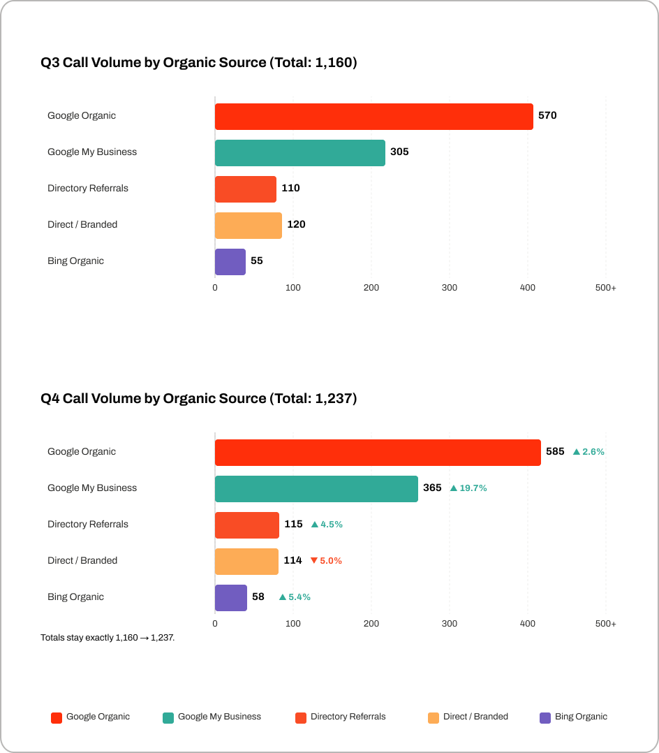
SEO Performance
Call Volume by Organic Source
Quarter-over-quarter organic calls increased due to stronger performance in high-intent sources such as Google Organic and GMB.
GMB Optimization Fueled the Largest Lift
Improved Map Pack rankings and GMB profile activity drove a sharp increase in calls, making GMB the fastest-growing source.

Slide 6
02
Strategy Overview
Factors shaping performance

Slide 7
INSIGHTS
Market Insights - SEO
AI Overviews now appear across many treatment-related searches such as “residential rehab near me” and “IOP mental health programs.”
Sites with comprehensive service content, strong local SEO signals, and clear insurance information tend to be referenced more frequently.
This shift emphasizes the need for content clarity, local authority, and structured metadata to ensure visibility.
AI Overviews Are Reshaping Recovery Search Behavior
Google’s early rollout of AI-generated summaries is changing how patients discover treatment options.

Slide 8
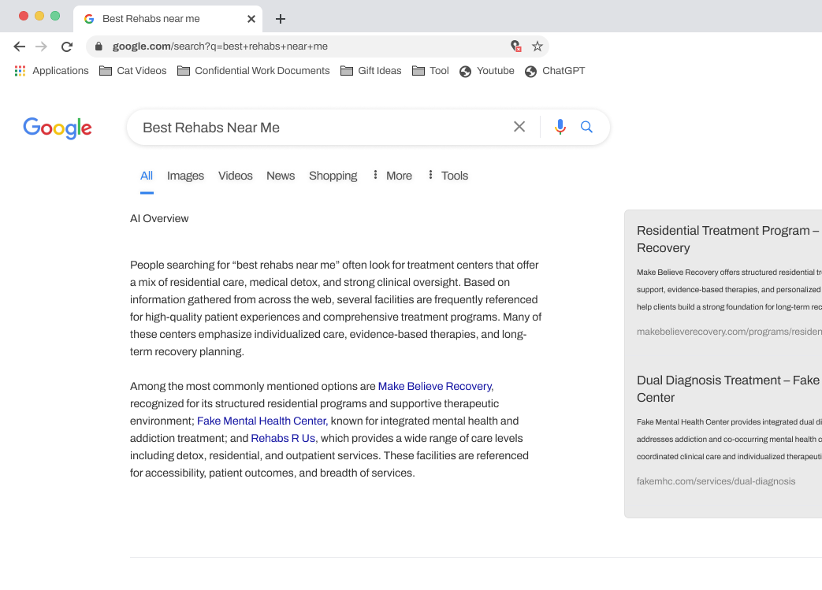
Competitive Snapshot
Who’s Winning AI Overview Visibility
WHAT
AI-generated summaries now highlight facilities like Make Believe Recovery, Fake Mental Health Center, and Rehabs R Us for recovery searches.
Your competitors are receiving disproportionate visibility and early click-share.
Key Insight
Without showing up in these summaries, Confidential Recovery is missing high-intent opportunities now being redirected to competing facilities.

Slide 9
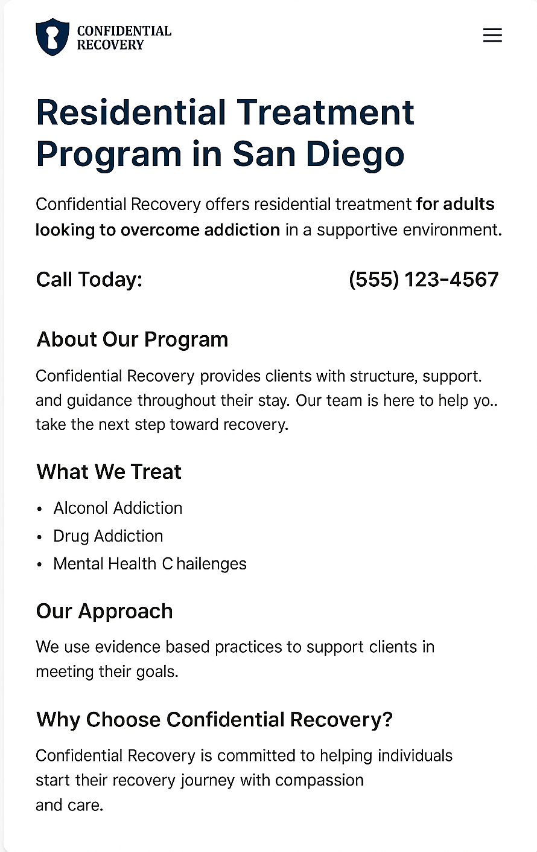
Challenges
The Challenge
Why we aren’t appearing in AI overviews
Too thin to qualify for AI Overview inclusion.
Missing the content depth competitors have.
Insufficient structured information for AI summarization.
Current content depth and update frequency limit AI Overview eligibility.
Confidential Recovery isn’t appearing in AI Overviews because priority service pages don’t yet have the depth, structure, and topical authority signals.
Content credits are spread thin, limiting our ability to produce the long-form Signature Content AI Overviews favor.
Competitors have been publishing content more frequently, reinforcing them as trusted sources.

Slide 10
Opportunity
Shift Current Content Credits for AI Overviews
KEY POINTS
Foundational SEO is in place: baseline rankings, technical improvements are now established.
AI Overviews demand depth, freshness, and structured expertise, reallocating credits lets us strengthen core service pages without increasing spend.
We recommend re-allocating content credits toward deeper, more authoritative content that aligns with AI Overview requirements.
Current Credit Allocation
Recommended Reallocation
Grow Faster
Signature Content (x1)
2 Credits
Signature Content (x1)
2 Credits
Signature Content (x1)
2 Credits
Service Content (x1)
2 Credits
Service Content
0 Credits
Service Content (x1)
2 Credits
Scale Content (x1)
1 Credit
Scale Content
0 Credit
Scale Content (x1)
1 Credit
Content Updates
0 Credits
Content Updates (x6)
3 Credits
Content Updates (x6)
3 Credits
Total: 5 Credits
Total: 5 Credits
(No Additional Investment)
Total: 8 Credits
(Additional Investment)

Slide 11
03
Strategic Plan
Initiatives that drive next quarter’s outcomes

Slide 12
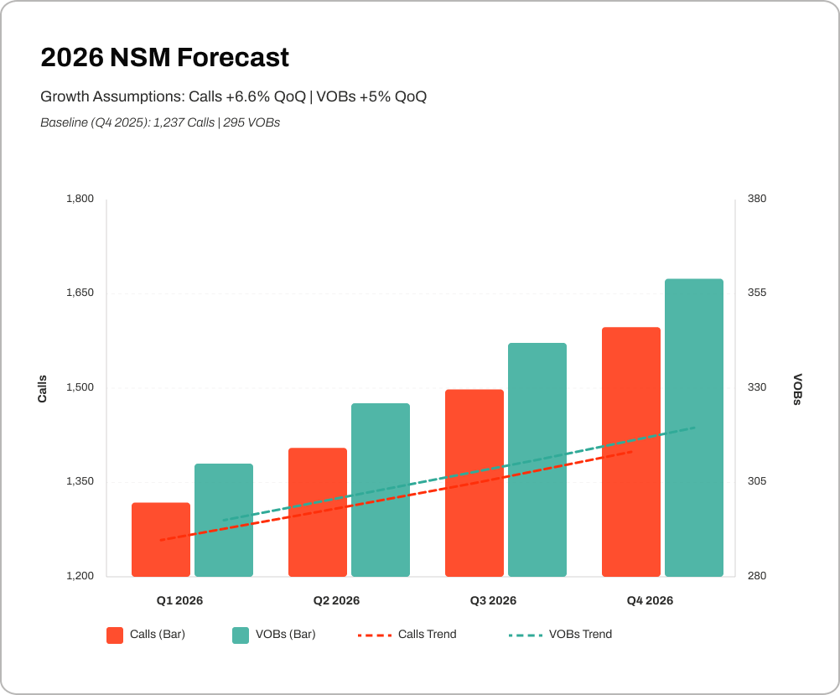
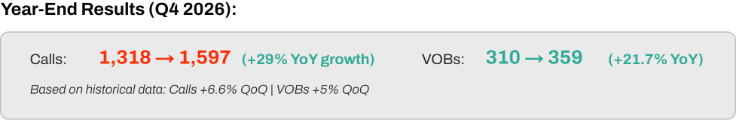
Updated NSM for 2026
Projected Growth for Calls + VOBs
Based on Q4 performance and steady quarter-over-quarter momentum, we’re forecasting continued growth in both Calls and VOBs throughout 2026. This projection reflects the impact of stronger local visibility, improved service-page depth, and increased eligibility-focused content.

Slide 13

SEO Q1 Tactics
Scaling Calls & VOBs Through AI Visibility & Local Expansion
WHAT
HOW
Increase total call volume and VOB generation by strengthening visibility in AI Overviews and improving performance on high-intent local searches.
Build on Q4’s foundational wins by reallocating content credits toward higher-impact updates designed to rank for predictive “summary-style” AI result formats.
Strengthen AI Overview eligibility by expanding thin content and adding structured schema.
Improve local call volume through GBP optimization and targeted city-level content.
Reallocate credits toward 1 signature piece + recurring updates to modernize priority pages.
Optimize conversion pathways with clearer insurance CTAs to increase VOB-ready intent.

Slide 14
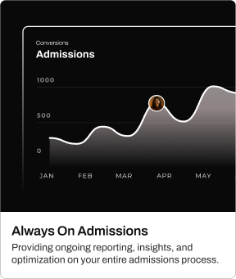
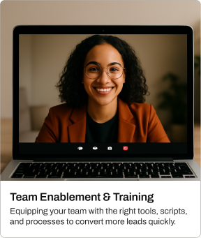
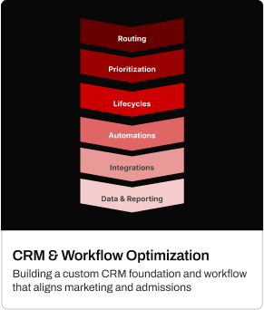
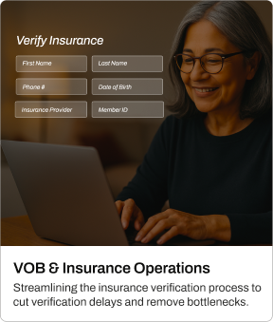
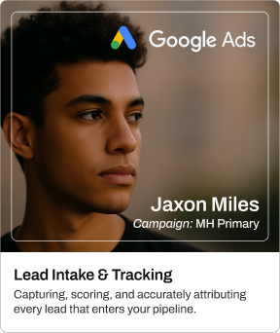
Get More Out of Your Marketing
Optimize Your Admissions Process to Increase Revenue
BENEFITS
Recover revenue lost to slow verification, missed follow-ups, and inconsistent workflows.
Increase admit conversion by accelerating VOB processing and tightening intake performance.
Eliminate lead leakage with standardized workflows.
Every missed VOB and dropped lead is lost revenue. Admission Ops fixes the gaps so more opportunities become admits.

Slide 15
04
Roadmap & Alignment
Our 12-month approach to drive center growth

Slide 16
Content & SEO Roadmap
Goal | Quarter 1 Restructure |  |  | Quarter 2 Optimize |  |  | Quarter 3 Expand |  |  | Quarter 4 Scale
 | Q1 Initiatives |  |  | Q2 Initiatives |  |  | Q3 Initiatives |  |  | Q4 Initiatives
Channel Initiatives | Complete full technical SEO audit and implement priority fixes. Refresh all thin or underdeveloped service pages Conduct full keyword research + build a 12-month content roadmap. Identify gaps preventing AI Overview eligibility (E-E-A-T + topical coverage). Audit GBP + local listings to benchmark current local search performance. |  |  | Expand high-value pages with deeper content to align with AI Overview structure. Publish targeted supporting articles and FAQs to build topical authority. Implement content updates and CRO improvements on key service pages. Launch location-focused content to improve local call volume. Optimize internal linking across core recovery topics. |  |  | Build new content clusters to capture broader recovery-related searches. Enhance E-E-A-T signals (expert quotes, credentials, sourcing, schema). Refresh top-performing pages to protect rankings and drive additional Calls/VOBs. Expand local SEO footprint with surrounding city + neighborhood pages. Optimize pages for emerging AI Overview patterns as they continue to evolve. |  |  | Scale content output using updated credit allocation (more content updates). Publish advanced authority content to differentiate CR from similar facilities. Launch a year-end optimization sweep across all revenue-driving pages. Expand local authority with community-focused content and enhanced GBP presence. Evaluate year-end NSM progress and build the next-year strategy.
Ongoing | Content Optimization · Technical SEO · Local SEO · E-E-A-T Enhancement · CRO Improvements · AI Overview Preparedness
 | Reporting

Slide 17
Content & SEO
Next Steps
01
02
03
Choose Your Content Credit Path
Select either the recommended reallocation (no added cost) or the Grow package for faster ranking gains.
Approve Updated SEO Roadmap
Confirm the prioritized service pages and content updates that will drive call and VOB growth in Q1–Q2.
Activate Local Visibility Enhancements
Enable GMB optimization, proximity signals, and supporting location content to strengthen map-driven call volume.

Slide 18
05
Partnership Items
Strengthening our partnership

Slide 19

Win-Win
Referral Program
Know another rehab center or business that could use help growing their admissions?
Refer them to us - and when they become a client, you both win. They get expert marketing support, and you get a service credit as a thank-you. Helping others grow helps you grow too!
If there is anyone in your network you think could benefit from our Paid Media, Content, and SEO services, please let us know.

Slide 20
Thank you for your continued partnership.
Every partnership helps us move closer to our goal of connecting 30,000 people with treatment by 2030. Thank you for sharing the same purpose and commitment to meaningful results.

