Slide 1
BIOF439 Final Project
Michelle Duren

Slide 2
The Output Behind the Plot
plot1 <- ggplot(data = Combined,
aes(x= `Positive Toxicology Tests` ,
y= Age))+
geom_boxplot(fill="lightgrey")+
geom_text(data=counts, aes(label = paste0("n=", n),
y=min(Combined$Age) - 0.6),
position=position_dodge(0.9),
size=3)+
stat_summary(fun.y=mean, colour="darkred", geom="point",
shape=18, size=3) +
geom_text(data = means, aes(label = Age, y = Age + 3), size = 3)+
theme_bw()+
labs(title="Age Comparison of Driver Fatalities by Substance",
subtitle="Maryland, 2006-2017",
x="Positive Toxicology Tests")+
stat_compare_means()

Slide 3
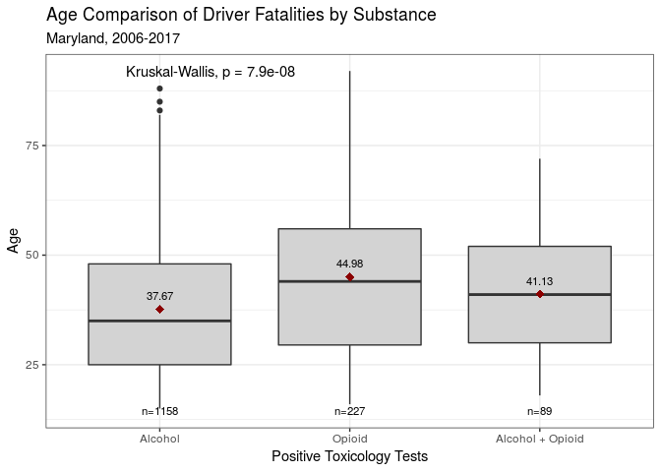
The Resulting Plot:

