Slide 1
Automatic Left Ventricle Segmentation
In Myocardial Perfusion SPECT Images
Using Deep Learning Models
Name: Md Jahid Hossain
MSc Data Science
University Of Hertfordshire
Comparative Evaluation of U-Net · Attention U-Net · Normal CNN · ViTSeg
Deep Learning for Medical Imaging | Cardiac SPECT Segmentation

Slide 2
Introduction
Clinical Context
Research Objective
Myocardial Perfusion refers to the flow of blood through the heart muscle.
Out of the four chambers of our heart, left ventricle is the strongest and the most important one. It distributes oxygenated blood throughout the body and sends blood into the main artery.
Left Ventricle (LV) segmentation is critical for quantifying myocardial perfusion deficits, measuring heart functions and detecting disease such as Cardiomyopathy or heart failures.
While manual delineation is time-consuming and observer-dependent, automated deep learning segmentation can enable reproducible, fast and scalable results.
Can lightweight, scratch-trained models achieve clinically relevant segmentation on 70×70 cardiac SPECT slices?

Slide 3
Previous Work
Ronneberger et al. (2015)
Introduced the encoder-decoder architecture with skip connections — the foundational model tested here.
U-Net: Convolutional Networks for Biomedical Image Segmentation
Oktay et al. (2018)
Extended U-Net with soft attention gates at skip connections; adopted here for LV boundary focus.
Attention U-Net: Learning Where to Look for the Pancreas
Long et al. (2015)
Established FCN-style encoder-decoder baseline — the design behind NormalCNN tested here.
Fully Convolutional Networks (FCN) for Semantic Segmentation
Dosovitskiy et al. (2020)
Introduced Vision Transformers (ViT); adapted here as ViTSeg with 7×7 patches for 70×70 SPECT.
An Image is Worth 16×16 Words: Transformers for Image Recognition
Betancur et al. (2018)
Demonstrated CNN applicability to myocardial perfusion SPECT clinical tasks.
Deep Learning for Prediction of Obstructive Disease from Fast MPI
|

Slide 4
What We Did — Research Plan
• Dataset: PhysioNet MPS Image Database v1.0 (96 usable SPECT patients)
• Task: 2D slice-level LV myocardial wall segmentation (binary mask)
• Train four architectures two from scratch and two pretrained weights
– U-Net · Attention U-Net · CNN · ViTSeg
• Unified training pipeline: same loss, optimizer, augmentation for all models
– BCE + Dice loss · Adam · CosineAnnealingWarmRestarts · Early stopping
• Evaluate on held-out test set (14 patients) using various metrics
– DSC · IoU · Sensitivity · Specificity ·
• Identify the best model for clinical deployment based on DSC ≥ 0.80 threshold
|

Slide 5
Dataset — PhysioNet MPS Image Database v1.0
Dataset Overview
Key Properties
Link: https://www.physionet.org/content/myocardial-perfusion-spect/1.0.0/
Patient-level split → no data leakage
Format: DICOM volumes + NIfTI masks (.nii)
across train / val / test boundaries
Resolution: 70 × 70 pixels (native, no resize)
Total patients: 99
Target: binary LV myocardial wall mask
Excluded (BAD_UIDS): 3
(mask binarised at threshold 0.5)
• 2 — missing segmentation mask
DICOM pixel arrays stacked into 3D
• 1 — corrupted mask (~19 KB)
Usable patients: 96
Volumes: NIfTI masks transposed to
Split (patient-level):
match DICOM (z, y, x) orientation
• Train: 68 patients
• Validation: 14 patients
• Test: 14 patients
|

Slide 6
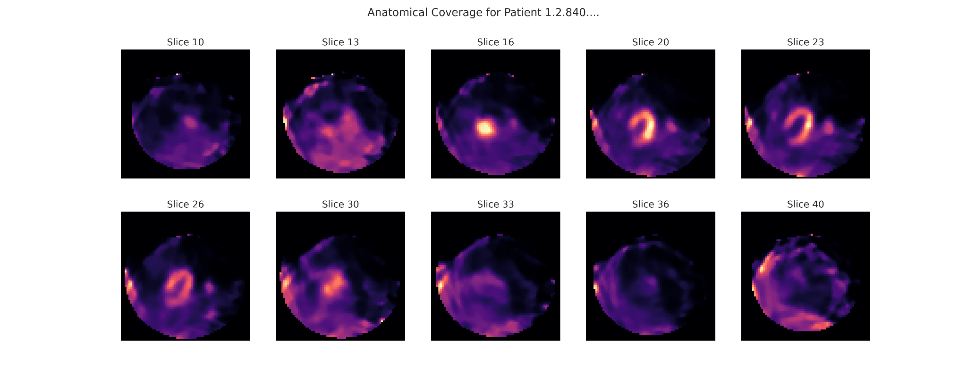
Dataset — PhysioNet MPS Image Database v1.0

Slide 7
Ethical Implications
Patient Privacy
• PhysioNet MPS dataset is publicly available and de-identified.
• DICOM metadata does not contain direct patient identifiers.
• No additional IRB approval required for use of this public repository.
Algorithmic Fairness
• Dataset demographics not disclosed — performance may vary across subpopulations.
• Models should be validated on diverse multi-site SPECT datasets before deployment.
Clinical Safety
• Automated segmentation aids — not replaces — cardiologist review.
• DSC ≥ 0.80 is a guideline threshold; clinical sign-off remains mandatory.
• False negatives (missed LV tissue) carry higher clinical risk than false positives.
Reproducibility
• All code, model architectures, and hyperparameters are fully disclosed.
• Publicly available dataset ensures independent replication.
|

Slide 8
Exploratory Data Analysis (EDA)
96
70×70
3
Usable Patients
Native Resolution (no resizing)
Excluded (BAD_UIDs)
68 / 14 / 14
≥ 10 px
5
Train / Val / Test (patient-level)
Min foreground pixels per slice
Augmentation transforms @ p=0.5
Key observation: SPECT images are low-resolution (70×70) and exhibit tracer uptake in adjacent organs (liver, bowel) that can bleed into the LV boundary — making precise delineation non-trivial.
|

Slide 9
Pre-processing Pipeline
1
DICOM Loading
All DICOM frames per study loaded via pydicom. Pixel arrays stacked into 3D volumes (z, y, x).
2
NIfTI Mask Alignment
Ground-truth masks loaded via nibabel. Transposed to (z, y, x) to match DICOM orientation.
3
Slice Filtering
Only slices with ≥ 10 foreground LV pixels retained (min_mask_pixels = 10). Eliminates near-empty frames.
4
Intensity Normalisation
Volume-level min-max normalisation to [0, 1] using v_min and v_max computed per 3D volume.
5
Mask Binarisation
Mask values thresholded at 0.5 → binary {0, 1} segmentation targets.
6
Augmentation (train only)
Horizontal flip · Vertical flip · Rotation ±10° · Brightness ×[0.8,1.2] · Gaussian noise σ=0.02 — each at p=0.5
|

Slide 10
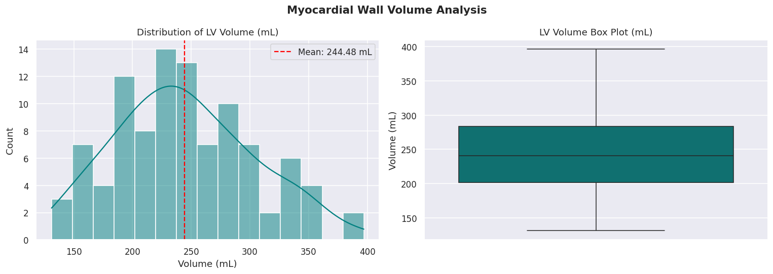
Dataset — PhysioNet MPS Image Database v1.0
|

Slide 11
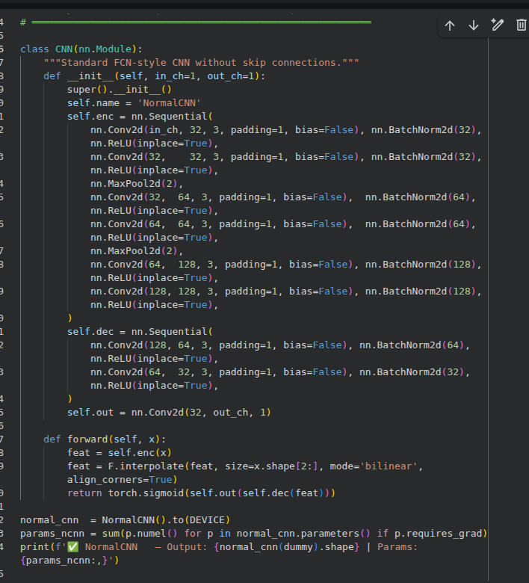
Model Architectures (CNN Model)
|

Slide 12
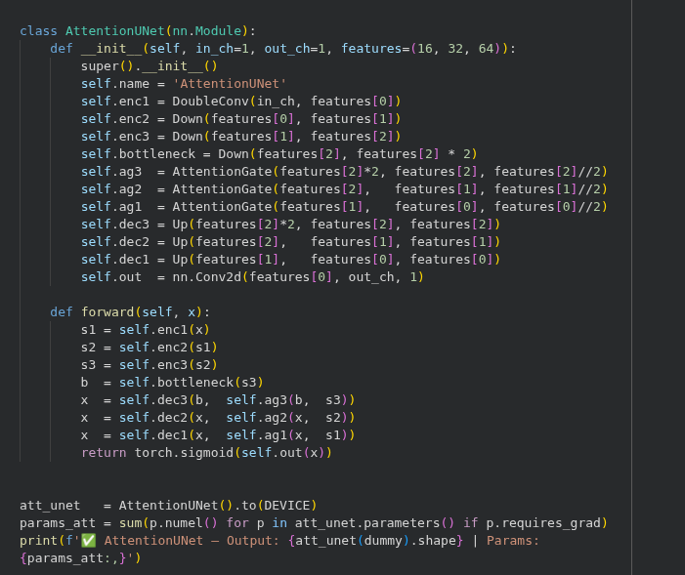
Model Architectures (Attention U-net Model)
|

Slide 13
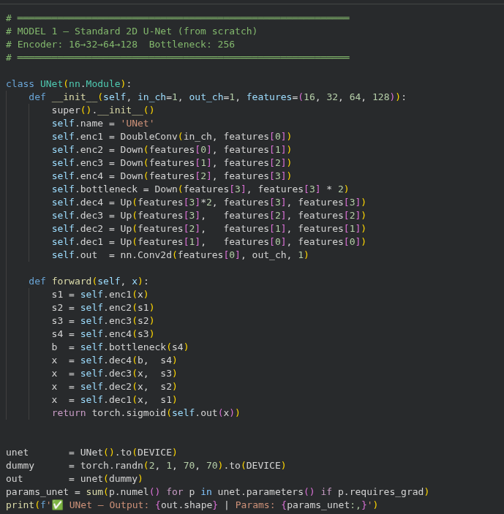
Model Architectures (U-net Models)
|

Slide 14
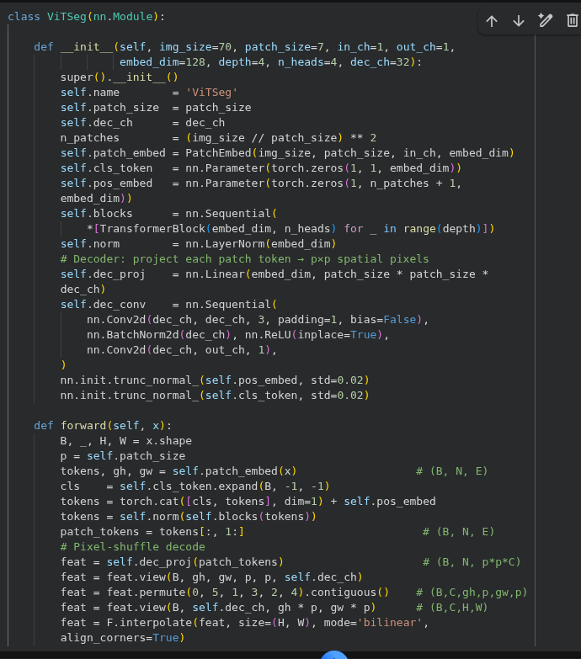
Model Architectures (Vit Models)
|

Slide 15
Model Results — Test Set Performance
Model
Phase
DSC ↑
IoU ↑
Sens. ↑
Spec. ↑
Params ↓
Latency (ms)
Attention
U-Net
Hyper-Tuned
0.9204
0.8536
0.9879
0.9849
490,914
15.01
Test Set
0.8816
0.7923
0.9743
0.9901
—
—
U-Net
Hyper-Tuned
0.9174
0.8486
0.9896
0.9840
1,942,289
16.61
Test Set
0.8931
0.8097
0.9191
0.9943
—
—
ViTSeg
Test Set
0.8007
0.7093
0.8272
0.9936
—
—
Normal CNN
Test Set
0.7928
0.7040
0.8012
0.9949
—
—
|

Slide 16
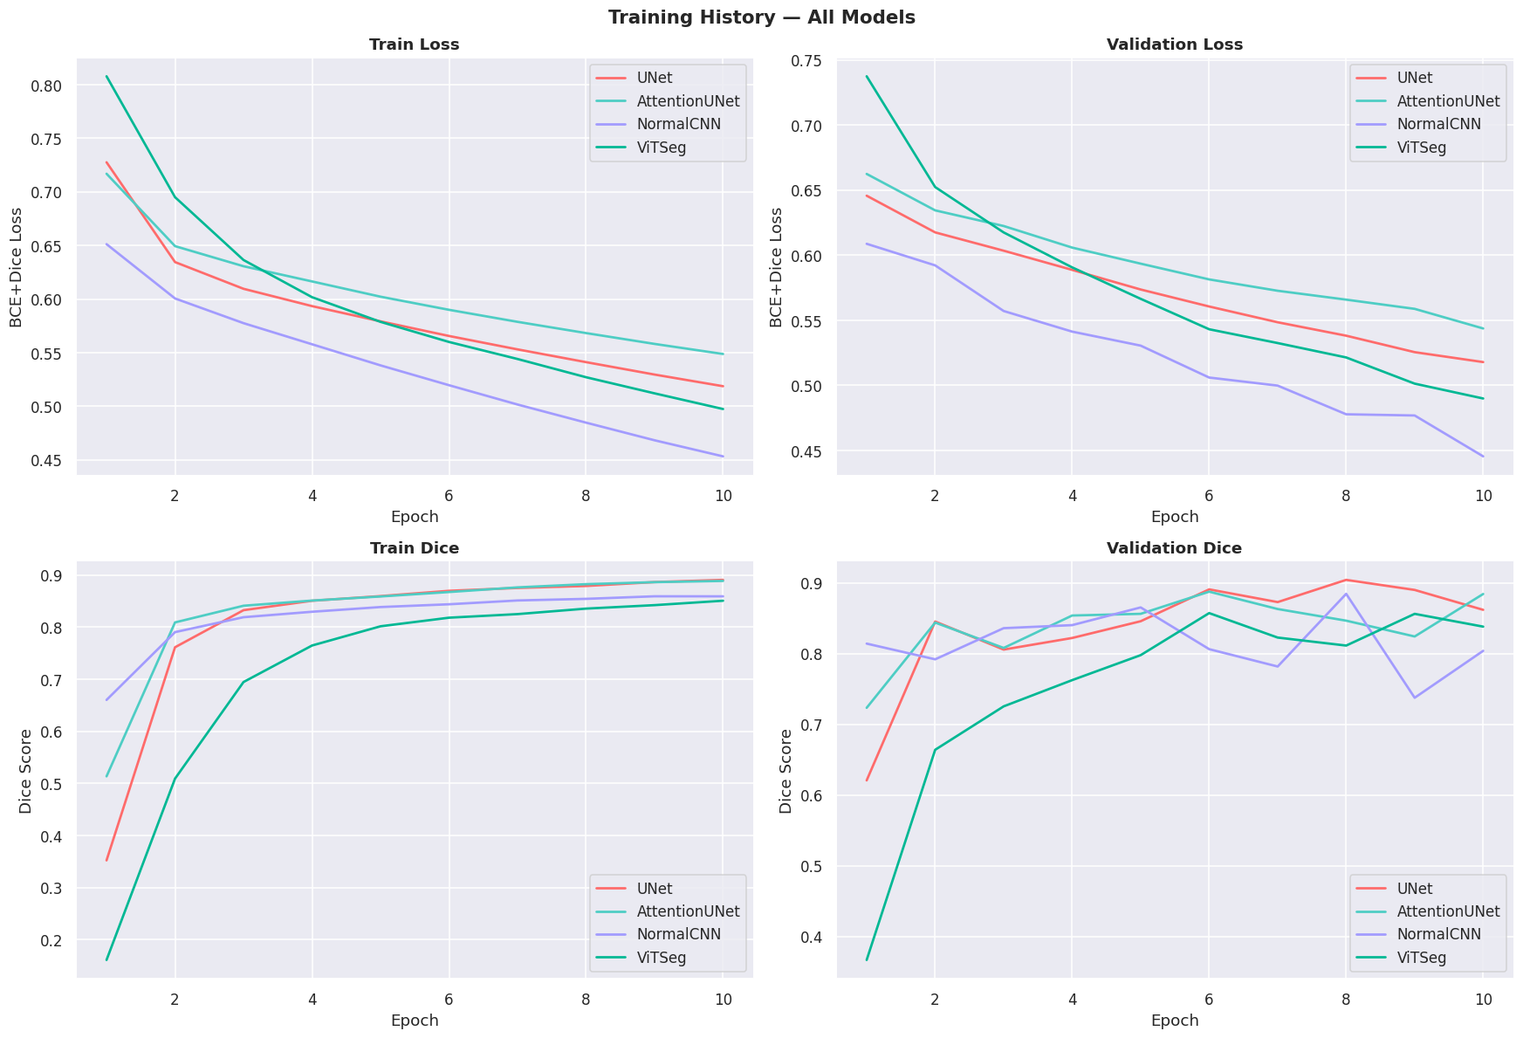
Model Architectures (4 Models)
|

Slide 17
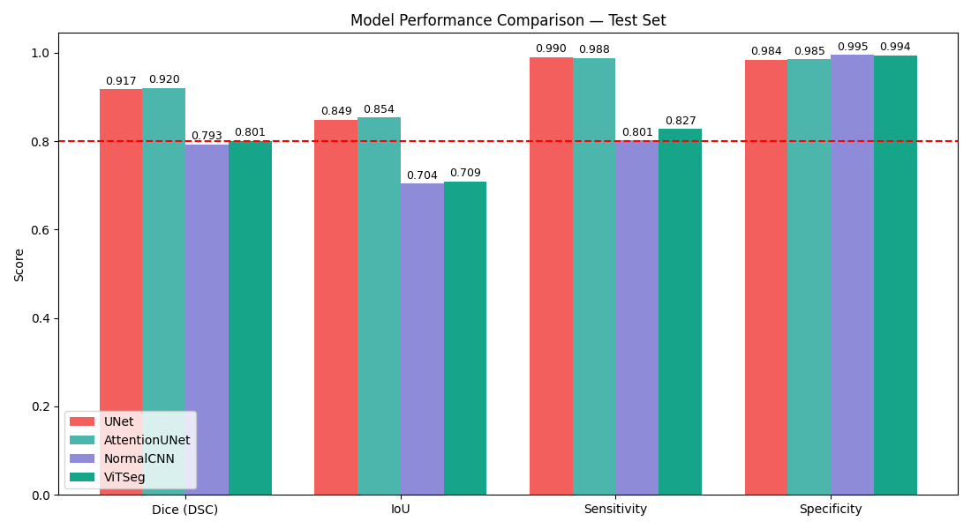
Model Architectures (4 Models)
|

Slide 18
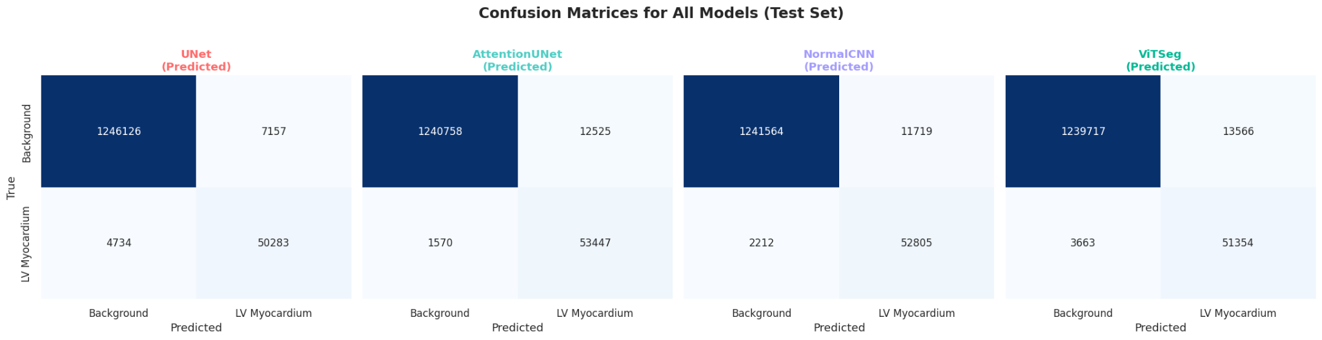
Model Architectures (4 Models)
|

Slide 19
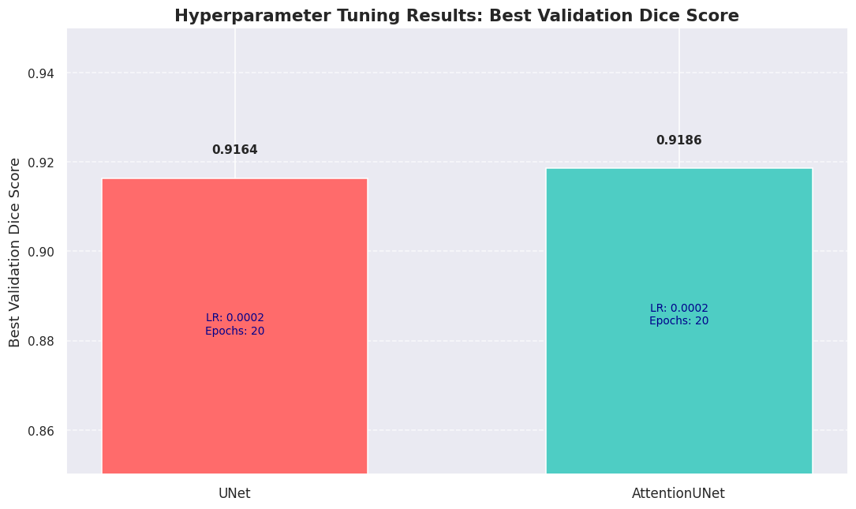
Model Architectures (4 Models)
|

Slide 20
Analysis & Discussion
Performance Leader
Attention U-Net achieved the highest overall performance with peak Hyper-Tuned DSC of 0.9204, final Test DSC of 0.8816, and best clinical Sensitivity (0.9743) on the test set.
Hyper-Tuning Success
Hyper-parameter tuning pushed Attention U-Net to a validation DSC of 0.9204, with strong stability on the final test set (0.8816), confirming the model generalises well.
Boundary Accuracy
While Attention U-Net leads in overlap, the standard U-Net achieves the tightest contour with HD = 2.22 px and a Test DSC of 0.8931, making it a robust baseline when geometric precision is prioritised.
Threshold Benchmarking
U-Net achieves best HD = 2.22 px (tightest boundary) while Attention U-Net leads on DSC. Skip connections + bilinear decoder precision favour U-Net for geometric accuracy.
Clinical Threshold: 3 of 4 Models
Attention U-Net, U-Net, and ViTSeg all exceed DSC ≥ 0.80. Normal CNN (0.7928) narrowly misses — skip connections appear necessary to consistently reach the clinical threshold on this 70×70 SPECT dataset.
|

Slide 21
Summary & Future work
Top Performance & Efficiency
Attention U-Net achieved peak Hyper-Tuned DSC of 0.9204 and final Test DSC of 0.8816, with best clinical Sensitivity (0.9743) — using only ~25% of the parameters (490,914 vs 1,942,289) at just 15.01 ms/slice.
Boundary Accuracy
Standard U-Net achieves the tightest contour with HD = 2.22 px (Test DSC 0.8931), remaining a robust baseline when geometric precision is prioritised.
Clinical Threshold
3 of 4 models (Attention U-Net, U-Net, ViTSeg) exceed DSC ≥ 0.80. Normal CNN (0.7928) narrowly misses — skip connections appear necessary on this 70×70 SPECT dataset.
Future Work — 3D Volumetric U-Net
Transition from 2D slice segmentation to 3D convolution kernels to exploit inter-slice spatial context and volumetric continuity.
Future Work — Paired Perfusion Analysis
Develop a dual-stream framework for stress-rest paired SPECT analysis to improve diagnostic specificity of perfusion defect detection.
Future Work — Multi-site Validation
Validate models on diverse multi-centre SPECT datasets to assess generalisability across scanner types and patient demographics before clinical deployment.
|

Slide 22
References
[1] Ronneberger, O., Fischer, P., & Brox, T. (2015). U-Net: Convolutional Networks for Biomedical Image Segmentation. MICCAI 2015. Springer, LNCS 9351, pp. 234–241.
[2] Oktay, O., et al. (2018). Attention U-Net: Learning Where to Look for the Pancreas. MIDL 2018. arXiv:1804.03999.
[3] Long, J., Shelhamer, E., & Darrell, T. (2015). Fully Convolutional Networks for Semantic Segmentation. CVPR 2015, pp. 3431–3440.
[4] Dosovitskiy, A., et al. (2020). An Image is Worth 16×16 Words: Transformers for Image Recognition at Scale. ICLR 2021. arXiv:2010.11929.
[5] Betancur, J., et al. (2018). Deep Learning for Prediction of Obstructive Disease from Fast Myocardial Perfusion SPECT. JACC: Cardiovascular Imaging, 11(11), 1654–1663.
[6] Goldberger, A. L., et al. (2000). PhysioBank, PhysioToolkit, and PhysioNet. Circulation, 101(23), e215–e220. DOI: 10.13026/ce2z-dw74.
[7] Paszke, A., et al. (2019). PyTorch: An Imperative Style, High-Performance Deep Learning Library. NeurIPS 2019.
[8] van der Walt, S., et al. (2014). scikit-image: Image processing in Python. PeerJ 2:e453. (hausdorff_distance implementation)
|

