Slide 1
K-Nearest Neighbor Classifiers (KNNC)
J.-S. Roger Jang (張智星)
jang@mirlab.org
http://mirlab.org/jang
MIR Lab, CSIE Dept.
National Taiwan University

Slide 2
Concept of KNNC
Concept: 近朱者赤、近墨者黑
Steps:
Find the first k nearest neighbors of a given point.
Determine the class of the given point by voting among k nearest neighbors.
Quiz!
: class-A point
: class-B point
: point with unknown class
Feature 2
3 nearest neighbors
➔ The point is classified as B via 3NNC.
Feature 1

Slide 3
Flowchart for KNNC
General flowchart of PR:
KNNC:
Feature
extraction
From raw data to features
Model
construction
Clustering (optional)
Model
evaluation
KNNC evaluation
on test dataset

Slide 4
Decision Boundary for 1NNC
Voronoi diagram: piecewise linear boundary
Quiz!

Slide 5
Characteristics of KNNC
Strengths of KNNC
Intuitive
No computation for model construction
Weakness of KNNC
Massive computation required when dataset is big
No straightforward way
To determine the value of K
To rescale the dataset along each dimension
Quiz!

Slide 6
Preprocessing/Variants for KNNC
Preprocessing:
Z normalization to have zero mean and unit variance along each feature
Value of K obtained via trials and errors
Variants:
Weighted votes
Nearest prototype classification
Edited nearest neighbor classification
k+k-nearest neighbor
Quiz!

Slide 7
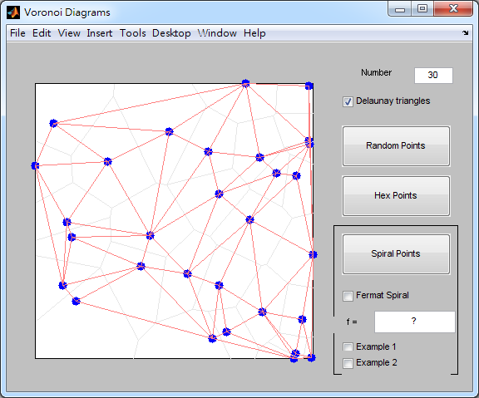
Demos by Cleve Moler
Cleve’s Demos of Delaunay triangles and Voronoi diagram
books/dcpr/example/cleve/vshow.m

Slide 8
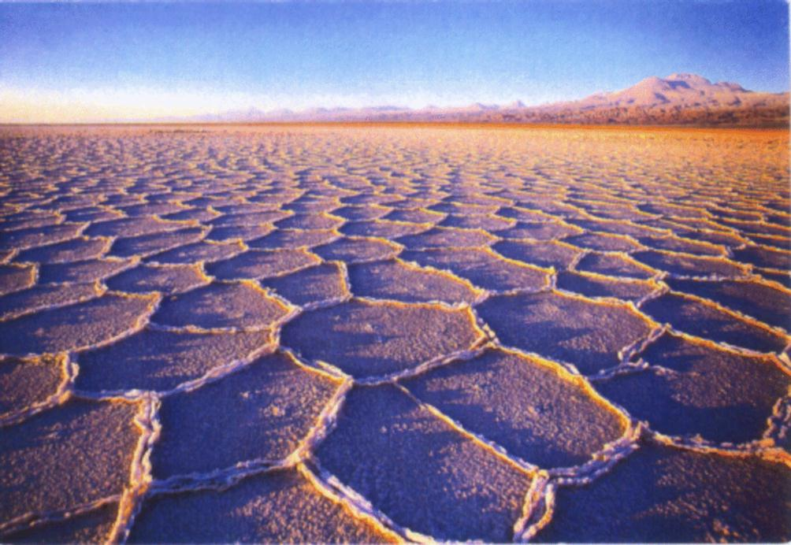
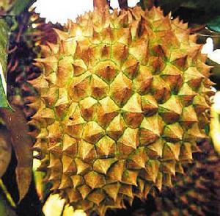
Natural Examples of Voronoi Diagrams (1/2)

Slide 9
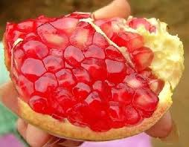
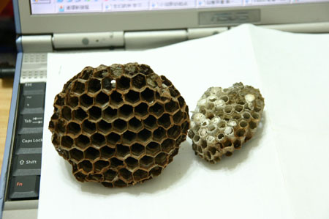
Natural Examples of Voronoi Diagrams (2/2)

Slide 10
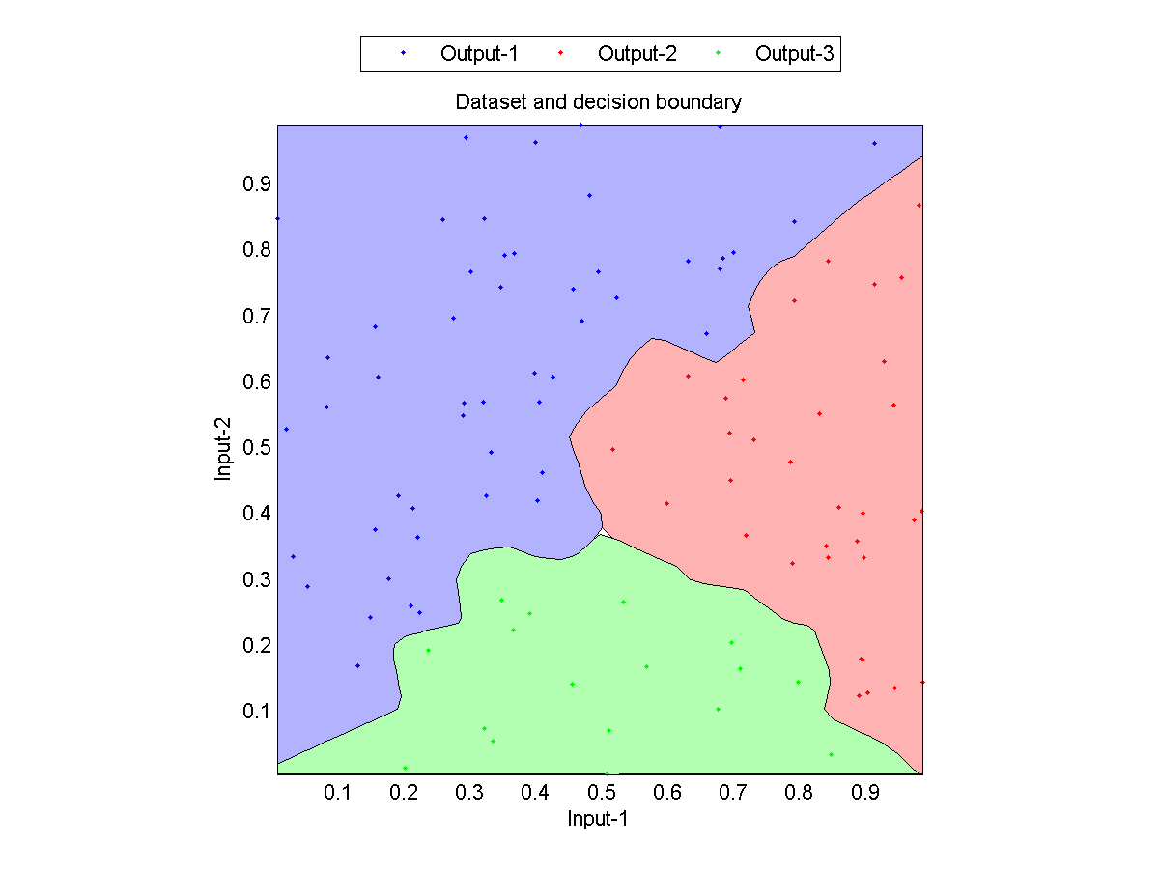
1NNC Decision Boundaries
1NNC Decision boundaries

Slide 11
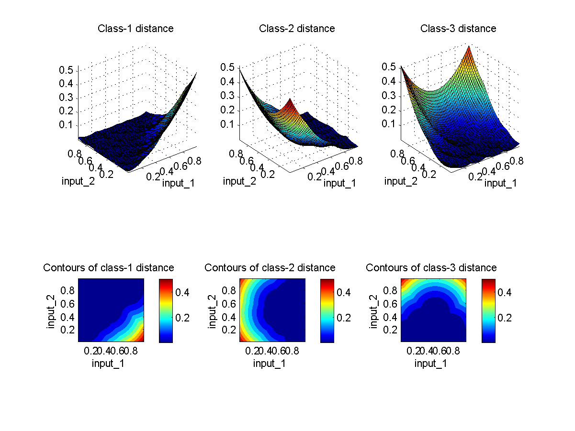
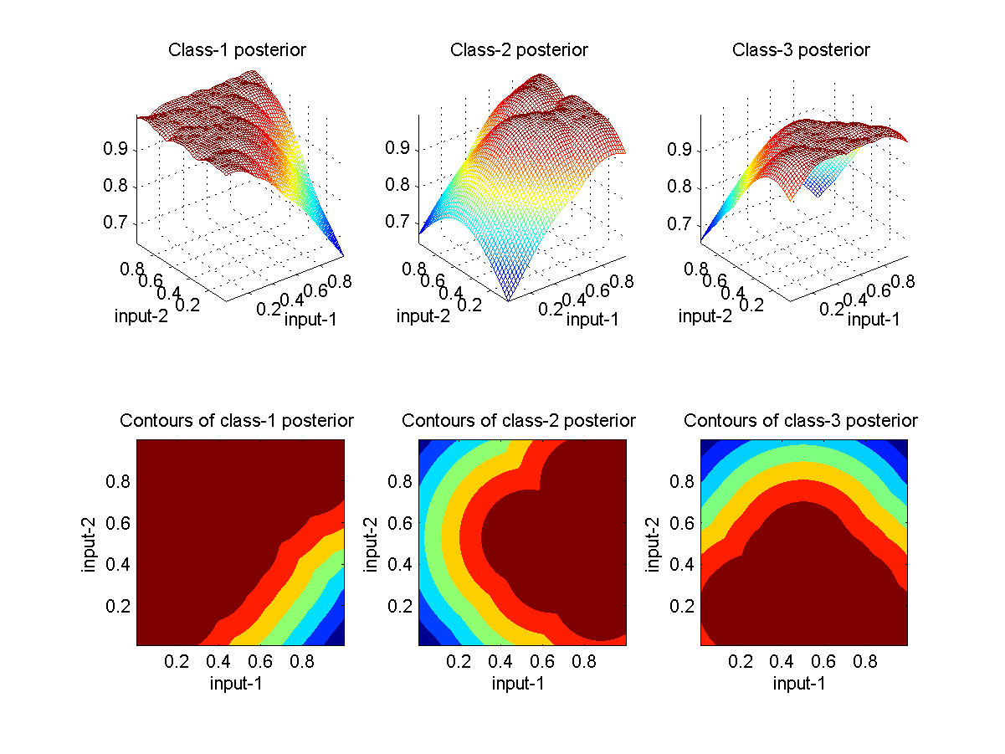
1NNC Distance/Posterior as Surfaces and Contours

Slide 12
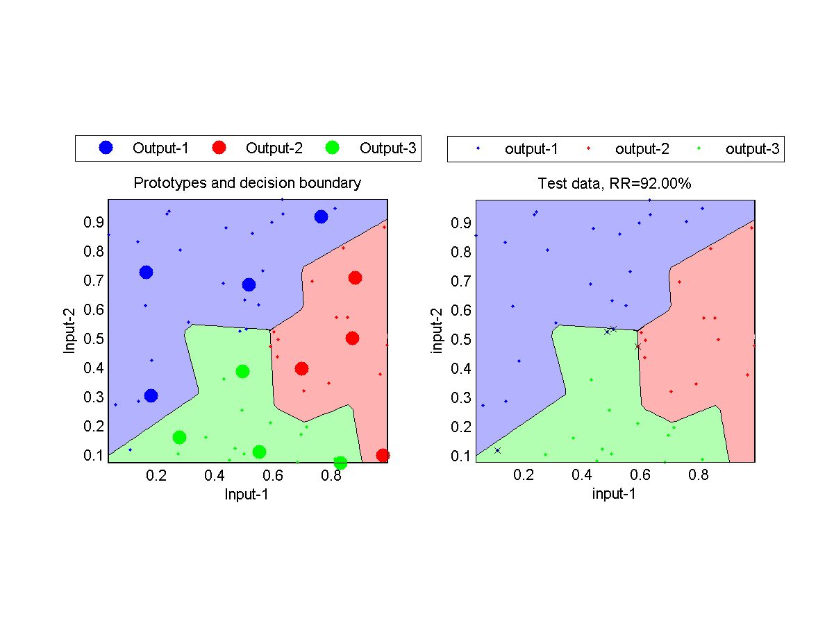
Using Prototypes in KNNC
No. of prototypes for each class is 4.

Slide 13
Decision Boundaries of Different Classifiers
Naive Bayes classifier
Quadratic classifier
1NNC classifier

