Slide 1
音樂類型辨識
組員 : 高至柔 盧晏慈 陳彥儒 洪浩祐

Slide 2
Introduction
讓使用者聆聽兩種風格迥異的音樂並測量其腦波，利用得到的腦波訊號來訓練ML分類器模型，最後以訓練完的模型來辨識使用者現在正在聽哪種類型的音樂。

Slide 3
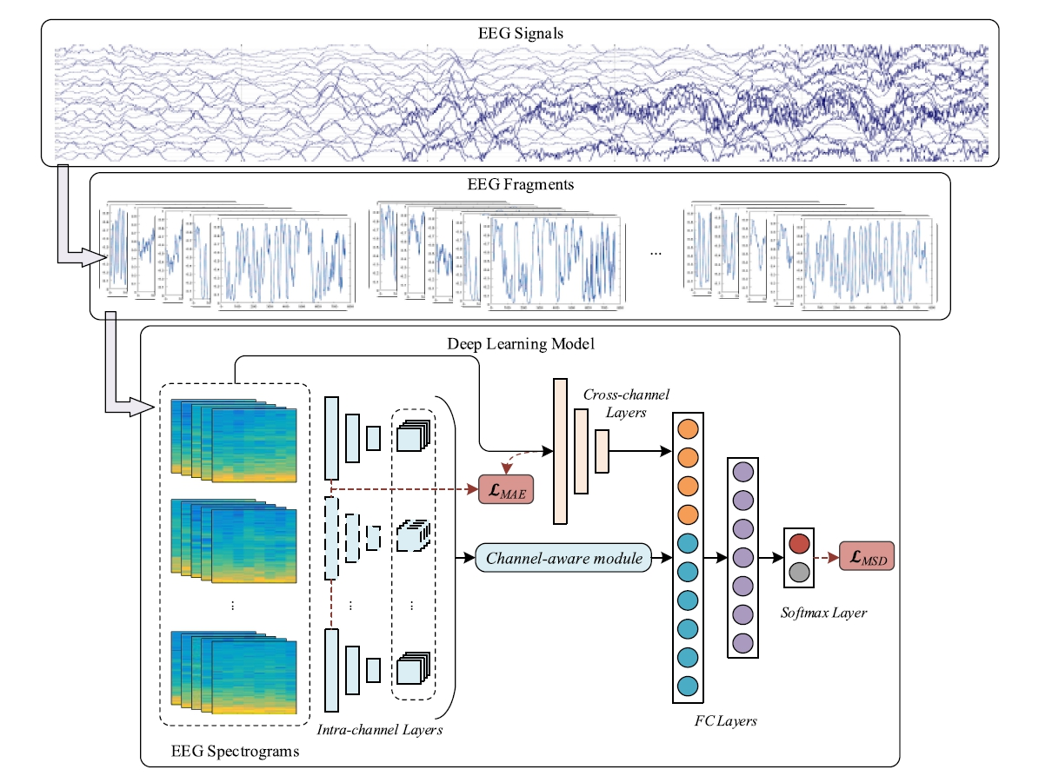
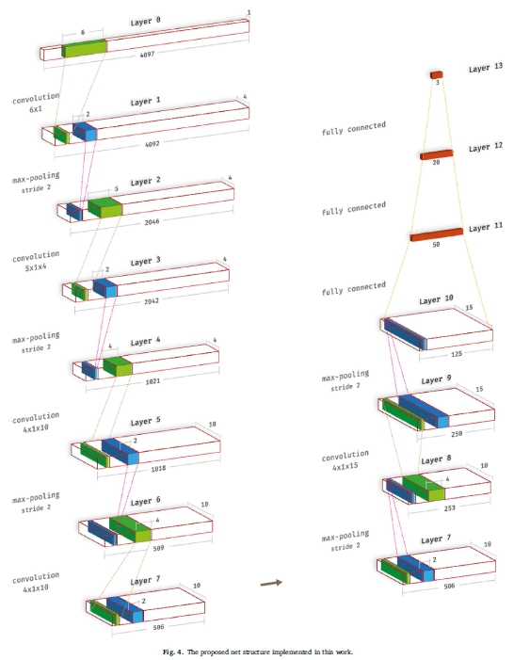
Software/Algorithm Design
NeuroSky收腦波->以一分鐘為單位切割->轉頻譜(FFT/STFT)
->ML model(classifier)

Slide 4
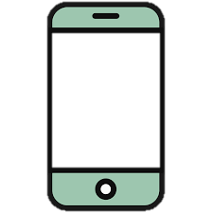
UI
正在播放
系統猜測

Slide 5
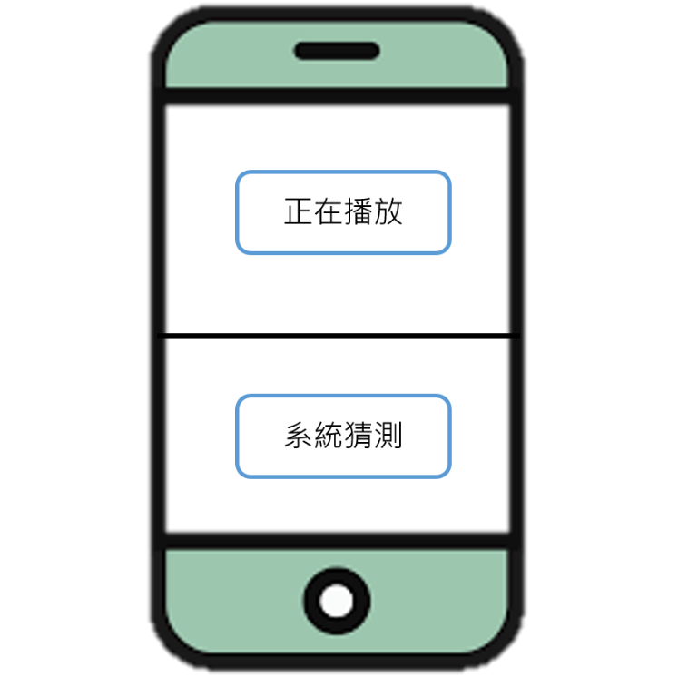
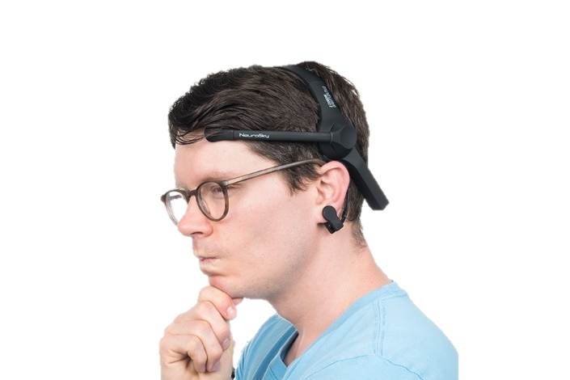

Product design/appearance
Bluetooth

Slide 6
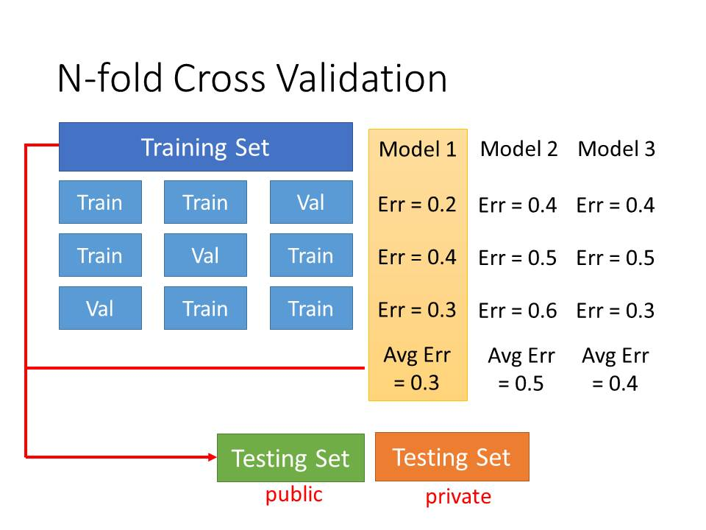
Testing scenarios

Slide 7
Reference
音樂對腦波的影響 :
-The Releasing Stress Effect of Mozart Music on Human
(http://www.airitilibrary.com/Publication/alDetailedMesh?DocID=a0000553-201812-201901110009-201901110009-100-116)
Mozart Effects on the Preschoolers' Concentration
(http://www.airitilibrary.com/Publication/alDetailedMesh?DocID=10276149-201806-201901070028-201901070028-81-98)
Effects of Different Musical Wave Types on the EEG: A Pilot Case Study
(http://www.airitilibrary.com/Publication/alDetailedMesh?DocID=18102093-200409-2-3-213-217-a)
The Study of Brain Stimulation Caused by Visual Images and Music Using Brainwave Headsets
(http://www.airitilibrary.com/Publication/alDetailedMesh?DocID=22216170-201709-201803260007-201803260007-71-77)
ML :
- A Multi-View Deep Learning Framework for EEG Seizure Detection
(https://ieeexplore.ieee.org/document/8470079?arnumber=8470079&SID=EBSCO:edseee)
- Deep convolutional neural network for the automated detection and diagnosis of seizure using EEG signals
(https://www.sciencedirect.com/science/article/pii/S0010482517303153)

