Slide 1
Lab 10
Semaphores
TA: Yu-Cheng Yu
Professor: Hsung-Pin Chang
Operating System Lab

Slide 2
Race Condition
A situation that several tasks access and manipulate the same data concurrently and the outcome of the execution depends on the particular order in which the access take place.
NCHU System & Network Lab

Slide 3
Race Condition (cont.)
“counter++” is implemented as
register₁ = counter
register₁ = register₁ + 1
counter = register₁
“counter--” is implemented as
register₂ = counter
register₂ = register₂ - 1
counter = register₂
The concurrent execution of “counter++” and “counter--” is equivalent to a sequential execution where the low-level statements are interleaved in some arbitrary order.
NCHU System & Network Lab

Slide 4
Race Condition (cont.)
Thread 1 | register₁ | Thread 2 | register₂ | counter
register₁ =counter | 5 | --- | --- | 5
register₁=register₁ + 1 | 6 | --- | --- | 5
--- | --- | register₂ =counter | 5 | 5
--- | --- | register₂=register₂ − 1 | 4 | 5
counter =register₁ | 6 | --- | --- | 6
--- | --- | counter =register₂ | 4 | 4
NCHU System & Network Lab

Slide 5
Process Synchronization
To guard against the race condition mentioned above, we need to ensure that only one process at a time can be manipulating the variable counter.
To make such a guarantee, we require some form of synchronization for the processes---semaphore
NCHU System & Network Lab

Slide 6
Process Synchronization (cont.)
Semaphore S
  An integer variable that, apart from initialization, is accessed only through two standard atomic operations.
    wait()
    signal()
NCHU System & Network Lab

Slide 7
Process Synchronization (cont.)
A blocking implementation of semaphores.
typedef struct {
int value;
struct process *L;
}semaphore;
void wait(semaphore S) {
S.value--;
if(S.value < 0) {
add this process to S.L;
block();
}
}
void signal(semaphore S) {
S.value++;
if(S.value <= 0) {
remove a process P from S.L;
wakeup(P);
}
}
NCHU System & Network Lab

Slide 8
Process Synchronization (cont.)
The following pseudocode protects a critical section if the semaphore variable S is initially 1.
wait(&S); /* entry section */
<critical section>
signal(&S); /* exit section */
<remainder section>
NCHU System & Network Lab

Slide 9
Normal Execution
Critical Section
Blocked on
semaphore
S.L
S.value
A
B
1
wait(S)
0
Critical Section
wait(S)
B
-1
signal(S)
Critical Section
0
signal(S)
1
NCHU System & Network Lab

Slide 10
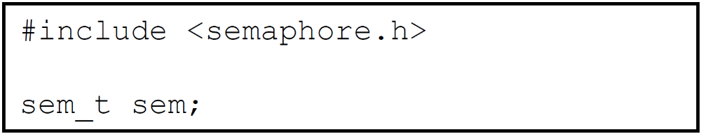
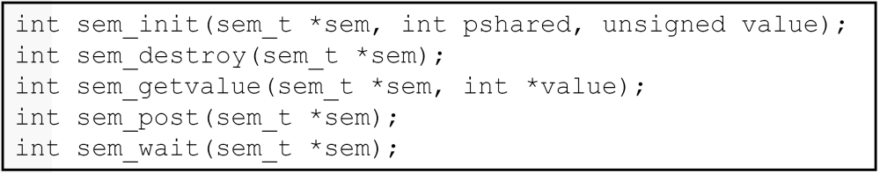
POSIX Semaphores
Declare a semaphore variable called sem.
Operations:

Slide 11
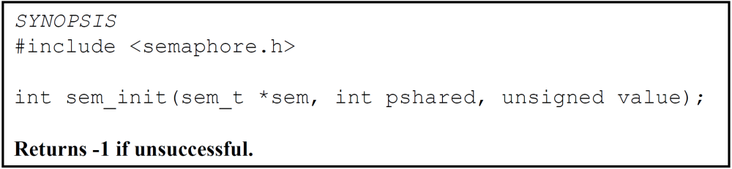
POSIX Semaphores(cont.)
sem_init(): Initialize the semaphore referenced by sem to value. The semaphores must be initialized before they used.
value: cannot be negative.
pshared:
  A flag indicating whether or not the semaphore should be shared with forked processes.
  Pshared == 0 only threads of process creating semaphore can use semaphore.

Slide 12
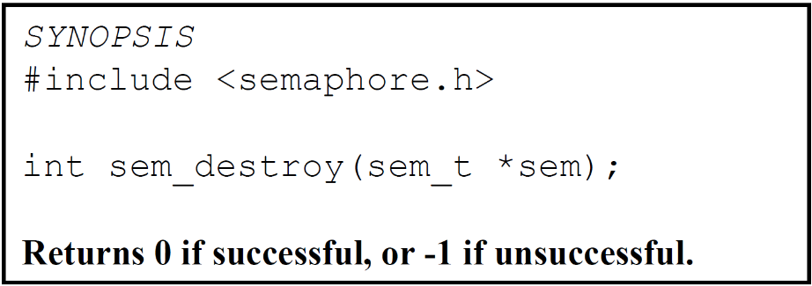
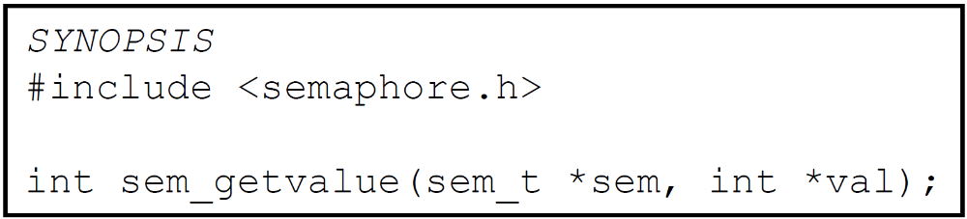
POSIX Semaphores (cont.)
sem_destroy(): Destroy a previously initialized semaphore referenced by the sem parameter.
sem_getvalue(): Get the current value of sem and places it in the location pointed to by val
NCHU System & Network Lab

Slide 13
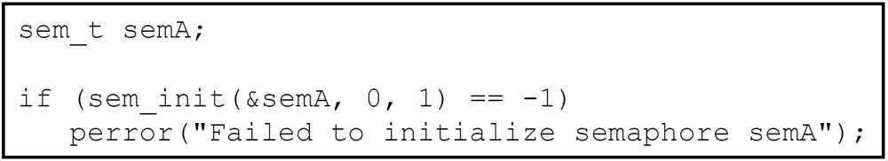
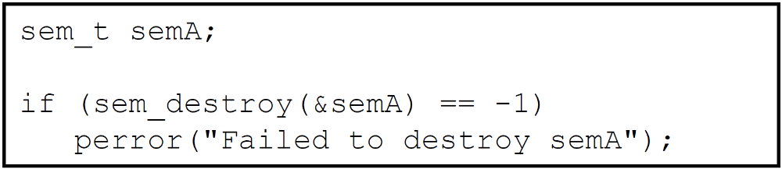
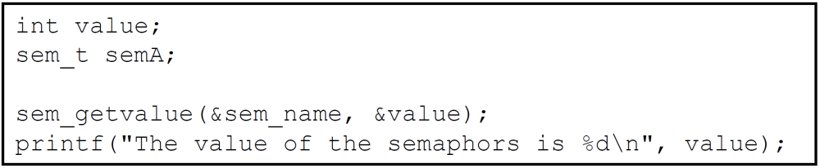
Examples
sem_init()
sem_destroy()
sem_getvalue()

Slide 14
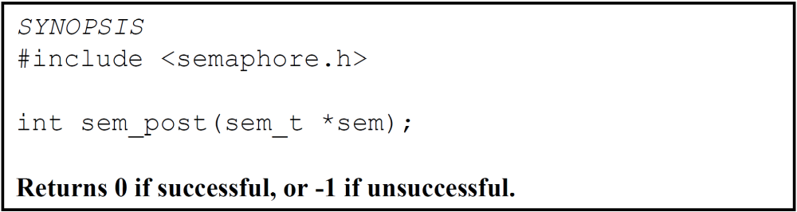
POSIX Semaphores (cont.)
sem_post(): Implement classic semaphore signaling.
  It increments the value of the semaphore and wakes up a blocked process waiting on the semaphore, if any.
NCHU System & Network Lab

Slide 15
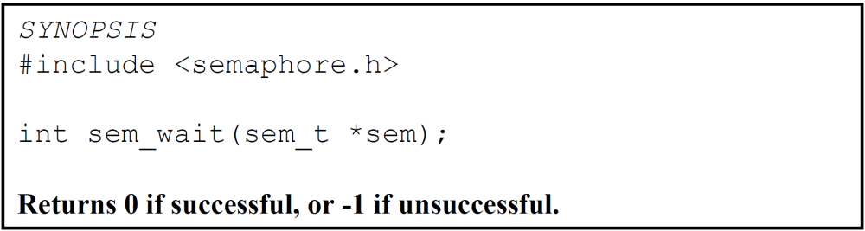
POSIX Semaphores (cont.)
sem_wait(): Implement the classic semaphore wait operation.
NCHU System & Network Lab

Slide 16
Solution to the Race Condition
Thread 1 | register₁ | Thread 2 | register₂ | counter
sem_wait(&semA); |  | --- |  | 5
--- |  | sem_wait(&semA); |  | 5
register₁ =counter | 5 | /* blocked */ | --- | 5
register₁=register₁ + 1 | 6 | /* blocked */ | --- | 5
counter =register₁ | 6 | /* blocked */ |  | 6
sem_post(&semA); |  | /* blocked */ |  | 6
 | --- | register₂ =counter | 6 | 6
 | --- | register₂=register₂ − 1 | 5 | 6
 | --- | counter =register₂ | 5 | 5
 |  | sem_post(&semA);

Slide 17
Example
#include <semaphore.h>
#include <pthread.h>
#include <stdio.h>
int count=0;
void inc(void);
void dec(void);
int main(void){
int i=0;
pthread_t id[4];
pthread_create(&id[0],NULL,(void*)dec,NULL); pthread_create(&id[1],NULL,(void*)inc,NULL); pthread_create(&id[2],NULL,(void*)dec,NULL); pthread_create(&id[3],NULL,(void*)inc,NULL); for(i=0;i<4;i++){
pthread_join(id[i],NULL);
}
printf("\noutput is %d\n",count);
pthread_exit(NULL);
}

Slide 18
Example (cont.)
void inc(void){
int i=0;
for(i=0;i<25000000;i++){
count++;
}
pthread_exit(NULL);
}
void dec(void){
int i=0;
for(i=0;i<25000000;i++){
count--;
}
pthread_exit(NULL);
}
NCHU System & Network Lab

Slide 19
Exercise1
Compile previous example code and execute it ten times.[+20pt.]
Using semaphore to solve the race condition occurred in previous example code.[+30pt.]
NCHU System & Network Lab

Slide 20
Exercise2
Devise a semaphore solution to the multiple Producer-multiple Consumer problem.[+40pt.]
Constraint:
  10 producers and 10 consumers.
  The maximum amount of items is 5.
  The minimum amount of items is 0.
  No items are consumed from an empty state.
  No items are produced from an full state.
  Only one Producer or Consumer can produce or consume at the same time.
  Print every transaction.(The amount of items)
NCHU System & Network Lab

Slide 21
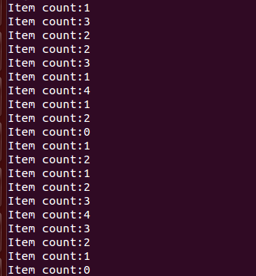
Hint(Exercise2)
PSEUDO CODE
  semaphore fillCount = 0; // items produced
  semaphore emptyCount = BUFFER_SIZE; // remaining space
  procedure producer() {
  item = produceItem();
  wait(emptyCount);
  putItemIntoBuffer(item);
  post(fillCount);
  }
  procedure consumer() {
  wait(fillCount);
  item = removeItemFromBuffer();
  post(emptyCount);
  consumeItem(item);
  }
Bug!
Only one Producer or Consumer can produce or consume at the same time
NCHU System & Network Lab

Slide 22
References
IBM
http://publib.boulder.ibm.com/infocenter/iseries/v5r3/index.jsp?topic=/rzahw/rzahwsemco.htm
Synchronizing Threads with POSIX Semaphores
http://www.csc.villanova.edu/~mdamian/threads/posixsem.html
NCHU System & Network Lab

