Slide 1
Lab 13 Record Locking
TA:Guo-Wei Chen
Professor: Hsung-Pin Chang
Operating System Lab

Slide 2
Record Locking
What happens when two process attempt to edit the same file at the same time ?
Record locking is the ability of a process to prevent other processes from modifying or reading a region of a file while the first process is working on it.
Notes:
當兩個進程嘗試同時編輯同一個文件時會發生什麼？
Record locking是process的一個功能，當目前有一個process正在使用這個檔案，他可以防止其他process去修改這個檔案

Slide 3
Advisory vs. Mandatory Locking
Advisory (default in Linux distribution)
All access functions handle record locking in a consistent way.
But advisory locking doesn’t prevent other process that has write permission for file from writing.
file
fget()
read()
A rude process with write permission of the file
fput()
Notes:
詢問與強制鎖定
諮詢（默認在Linux發行版）
所有訪問功能以一致的方式處理記錄鎖定。
但是建議鎖定並不妨礙寫入文件的寫入權限的其他進程。
一個具有文件寫入權限的粗體進程

Slide 4
Advisory vs. Mandatory Locking
Mandatory (default in Windows)
Kernel checks every read(), write(), open() operation to prevent the calling process from violating the lock rule.
Linux kernel
fget()
write()
file
check
read()
fput()
Notes:
強制（在Windows中默認）
內核檢查每個read（），write（），open（）操作，以防止調用進程違反鎖規則。

Slide 5
Read lock vs. Write lock
Read lock (Shared lock) | Any number of processes can have a shared read lock on a given region of a file. All of them can read from the file but can’t write to it.
Write lock (Exclusive lock) | Only one process can have an exclusive lock on a given region of a file. The other process are prevented from getting locks or reading and writing.
Lock Request Current lock type | Read lock (Share lock) | Write lock (Exclusive lock)
no lock | Yes | Yes
Read lock (Share lock) | Yes | No
Write lock (Exclusive lock) | No | No
NCHU System & Network Lab
Notes:
任何數量的進程可以在文件的給定區域上具有共享讀鎖定。
所有這些都可以從文件中讀取，但無法寫入。
只有一個進程可以在文件的給定區域上具有排他鎖。
另一個過程被阻止獲得鎖或閱讀和寫作。
當目前的鎖是read lock 下一個要求是read lock是可以進來的，就是可以做read，write lock要求不被接受，不能做寫入的動作
當目前的鎖是write lock 下一個要求是read lock或write lock都不能進來，就是read，write不被接受

Slide 6
Record Locking Functions
Record locking functions：
fcntl()
Support write lock、read lock and record lock.
If successful, return 0
If fail, return -1
lockf()
Only support write lock and a part of record lock.
Now we focus only on fcntl() function.
Notes:
記錄鎖定功能
fcntl()
支持寫鎖，讀鎖和記錄鎖。
如果成功，返回0
如果失敗，返回-1
lockf()
只支持寫鎖和記錄鎖的一部分。

Slide 7
fcntl() Function (1/5)
fcntl() function can change the properties of a file that is already open.
The fcntl() is used for five different purposes :
#include <fcntl.h> int fcntl (int filedes, int Cmd, /*struct flock *flockptr*/…);
Cmd | Description
F_DUPFD | Duplicate an existing descriptor
F_GETFD,F_SETFD | Get/set file descriptor flags
F_GETFL,F_SETFL | Get/set file status flags (O_RDWR … etc)
F_GETOWN,F_SETOWN | Get/set asynchronous I/O ownership
F_GETLK,F_SETLK, F_SETLKW | Get/set/lock file lock, it discussed later.
Notes:
fcntl（）函數可以更改已經打開的文件的屬性。
fcntl（）用於五個不同的目的
(最後一個)獲取/設置/鎖定文件鎖定，稍後再討論。

Slide 8
fcntl() Function (2/5)
For record locking ,the third argument of fcntl() is a pointer to a flock structure :
struct flock { short l_type; /* F_RDLCK, F_WRLCK, F_UNLCK */ short l_whence; /* SEEK_SET, SEEK_CUR, SEEK_END */ off_t l_start; /* offset in bytes, start of the blocking lock*/ off_t l_len; /* length, in bytes ; 0 means lock to EOF */ pid_t l_pid; /* returned with F_GETLK */ }
Notes:
對於記錄鎖定，？fcntl（）的第三個參數是指向一個flock結構的指針：
以byte為單位的偏移量，blocking lock 的開始
長度，以字節為單位; 0表示鎖定到EOF(檔案結尾)
用F_GETLK返回

Slide 9
fcntl() Function (3/5)
Three commands of fcntl() :
F_GETLK
To check the lock described by flockptr :
The information pointed by flockptr is overwritten by an existing lock .
If no lock exists, flockptr.l_type = F_UNLCK
F_SETLK
Set the lock described by flockptr.
If we try to obtain an illegal record lock, fcntl() will return error ,EAGAIN.
F_SETLKW
A blocking version of F_SETLK, waiting until the file can be locked.
Notes:
fcntl（）的三個命令：
F_GETLK
檢查flockptr鎖：
flockptr會是現有的鎖的狀況。
如果沒有鎖存在，flockptr.l_type = F_UNLCK
F_SETLK
設置flockptr鎖。
如果我們嘗試非法的獲取被鎖的東西，fcntl（）將返回錯誤EAGAIN。
F_SETLKW
block的F_SETLK，等待文件可以再次被鎖定。

Slide 10
fcntl() Function (4/5)
Example code:
#include <stdio.h> #include <unistd.h> #include <fcntl.h> #include <string.h>
struct flock* file_lock(short type, short whence) { static struct flock ret; ret.l_type = type ; // lock type ret.l_start = 0; ret.l_whence = whence; ret.l_len = 0; // EOF }

Slide 11
fcntl() Function (5/5)
Example code (cont.):
int main() {
int fd = open(argv[1], O_WRONLY|O_APPEND);
Int lock=fcntl(fd, F_SETLK, file_lock(F_WRLCK, SEEK_SET));
//if (lock==?)…
//read/write( )
// It will return 0 if the file is locked successfully!
……
fcntl(fd, F_SETLKW, file_lock(F_UNLCK, SEEK_SET));
……
}
Notes:
O_RDONLY : 唯讀
O_WRONLY : 唯寫
O_RDWR : 讀寫
O_APPEND 從檔案末端開始寫
O_CREAT : 檔案不存在時建立新檔
O_TRUNC : 檔案存在時建立新檔覆蓋原有檔案

Slide 12
Example 1: Advisory Locking

Slide 13
Advisory Locking (1/7)
We used two programs to lock the same file.
Program1: file_lock.c
Program2: try_to_lock.c
Locked file: lock.txt
Program1 have RL and WL option.
Program2 try to lock the same file which the program1 was already
locked(lock.txt).
Notes:
勸告鎖
使用兩個programs來鎖住同一個檔案

Slide 14
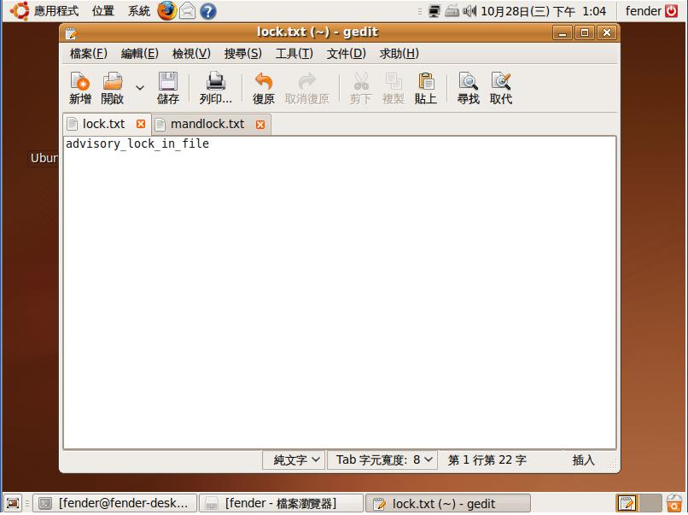
Advisory Locking(2/7)
lock.txt

Slide 15
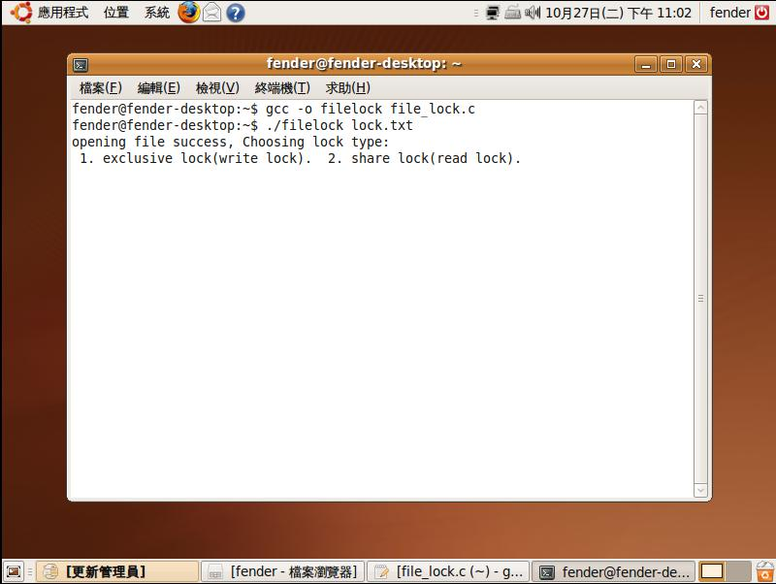
Advisory Locking(3/7)
Program1 (file_lock.c)
Two option, WL and RL.

Slide 16
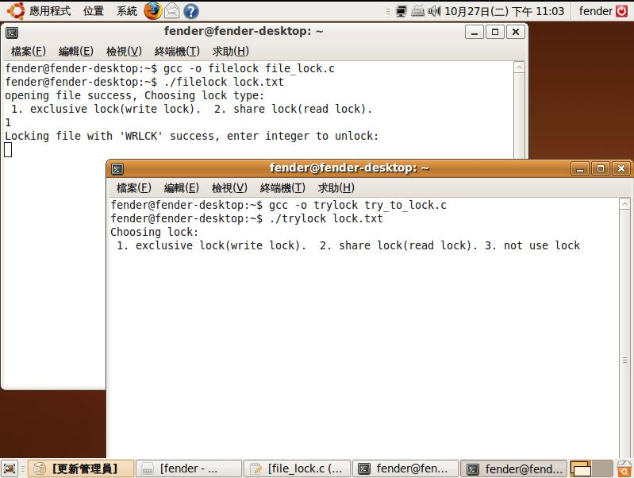
Advisory Locking(4/7)
Program2 (try_to_lock.c)
choosing WL
Program2 try to lock the same file.
(file: lock.txt)

Slide 17
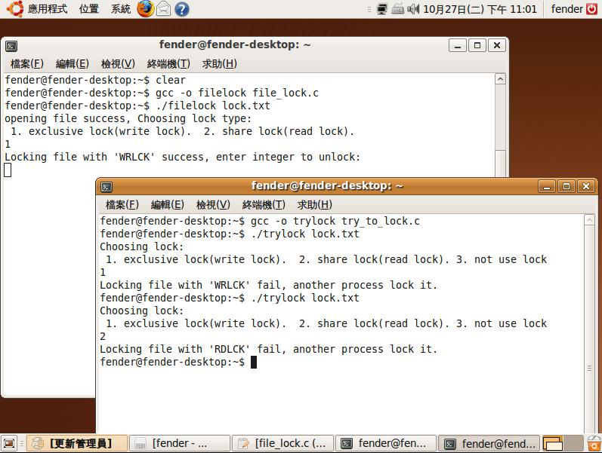
Advisory Locking(5/7)
WL now
If file was locked by WL already, another program can’t lock (WL or RL) the same file.

Slide 18
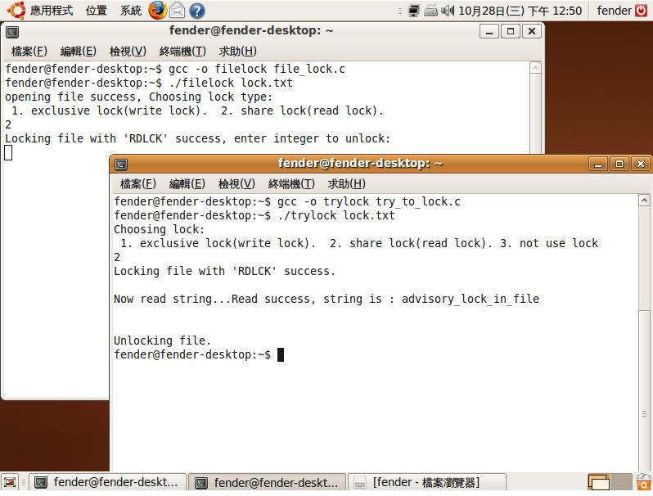
Advisory Locking(6/7)
RL now
If file was locked by RL already, another program only can use RL to locked the same file. (WL can’t)

Slide 19
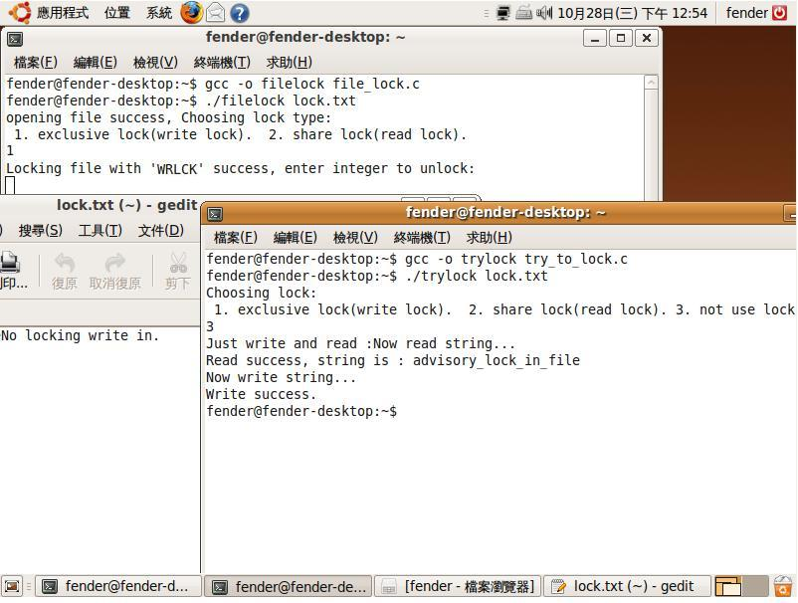
Example: Advisory Locking(7/7)
Not use lock, reading and writing the file directly.
WL now
File Content has been modified.
(contrast with page 13)
Why?
Notes:
不使用lock的話可以讀取修改已經被鎖住的檔案
因為預設的鎖是勸告鎖
只對有事先詢問是否可以lock的程式有用
無法強制阻擋沒有事先詢問的程式

Slide 20
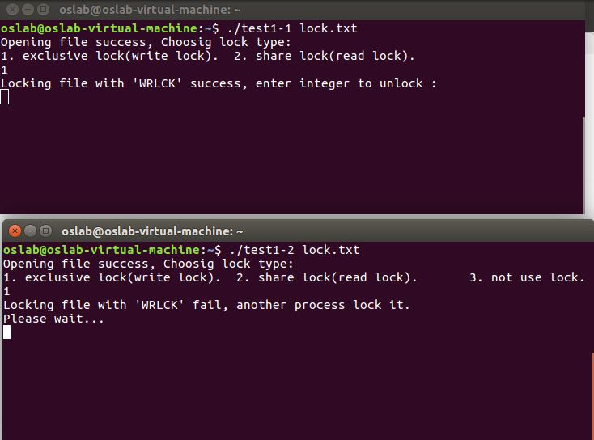
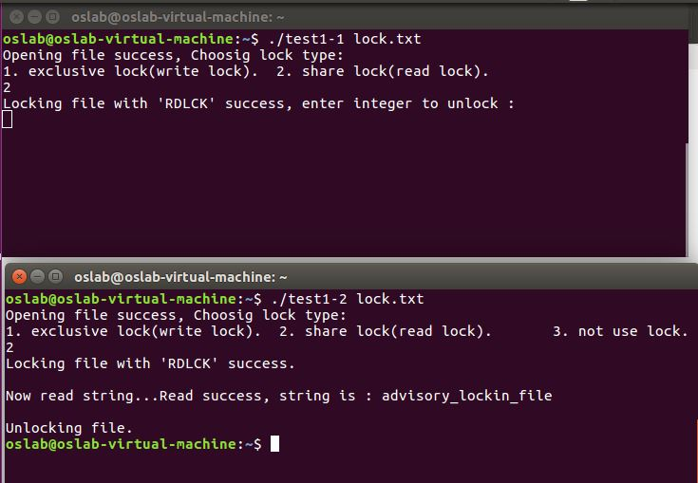
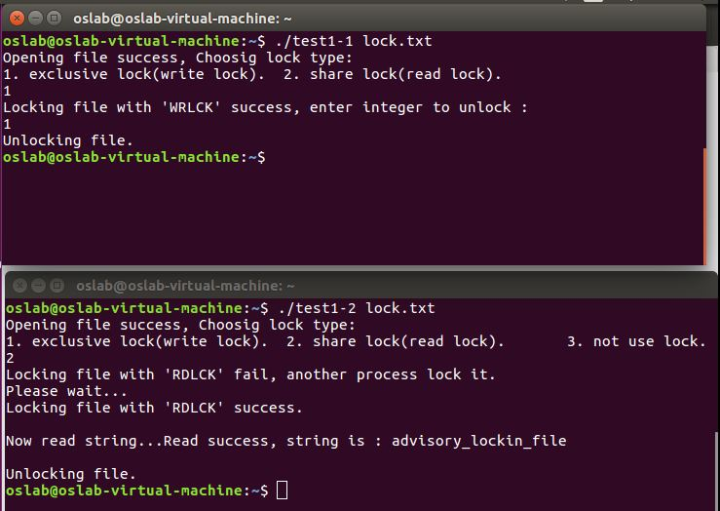
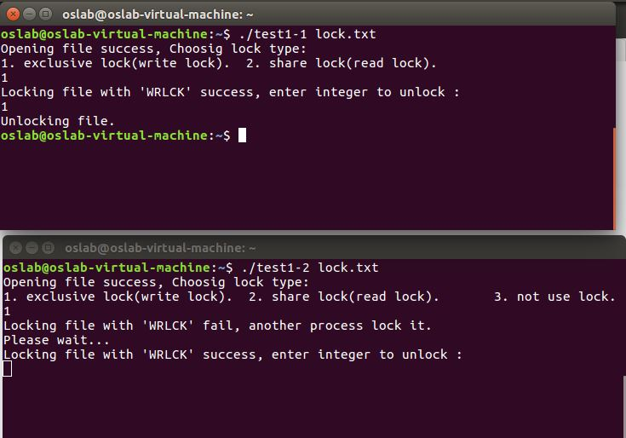
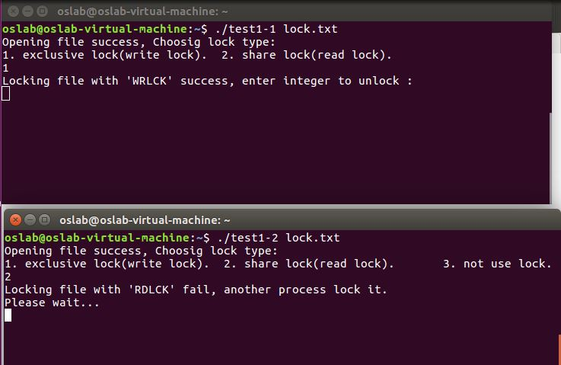
Excises I
Using advisory locking.
Running two processes, one process use write lock to lock a file, another process waits until the same file can be locked (using WL or RL). [+25pt]
Following above exercise, two processes use RL to lock the same file.
Must show the file contents. (display on the screen.) [+25pt]
In page 18, why program2 can read and write a already locked file ? [+10pt]

Slide 21
Example 2: Mandatory Locking

Slide 22
Mandatory Locking (1/8)
Mandatory: (newly supported by Linux kernel)
Step 1 :
Mounting the file system with the mand option:
# mount /dev/device /location
(ex: mount /dev/sda3 /mnt)
# mount –o remount,mand /dev/mount device /location
(ex: mount –o remount,mand /dev/sda3 /mnt)
You could use mount | grep mnt to check mount state.
Notes:
強制鎖
目前linux kernel有支援
需要自行修改lock種類
下面是修改的步驟
重新掛載，並加入參數為 mand
Device :裝置的名稱
Location: 掛載到哪裡

Slide 23
Mandatory Locking(2/8)
Step 2:
Setting permissions which file you want to locked:
# chmod g+s zzz.txt (ex: chmod g+s lock.txt)
# chmod g-x zzz.txt (ex: chmod g-x lock.txt)
Setting group id bit and clear group execute bit.
These steps let your kernel know you want to use mandatory locking.
Notes:
設置要鎖定的文件的權限
g+s : SGID 是 Set Group ID的意思
和清除group exe 權限。
這些步驟讓您的內核知道您要使用強制鎖定

Slide 24
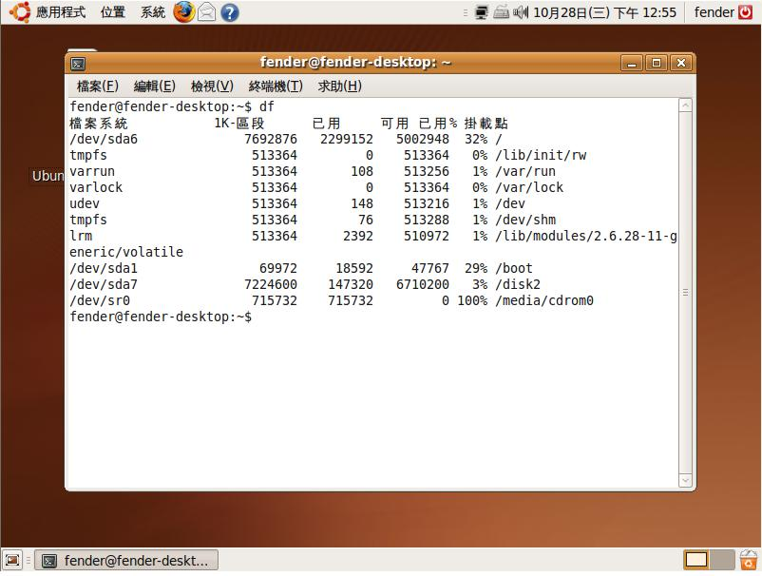
Mandatory Locking(3/8)

Slide 25
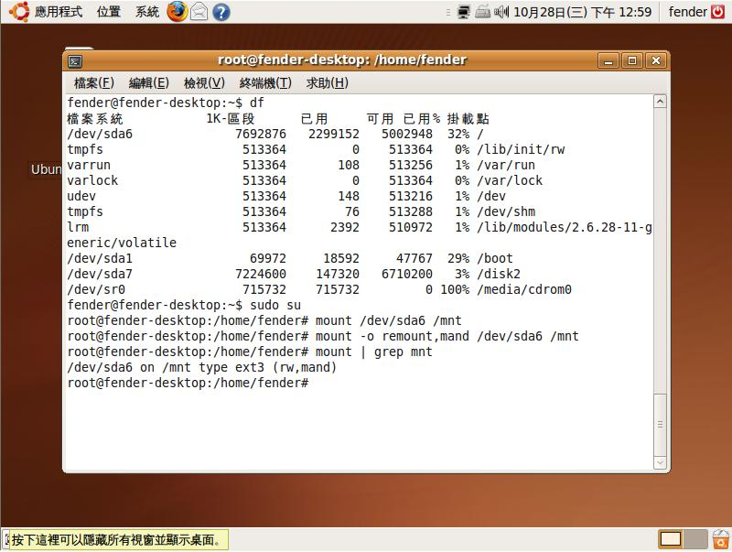
Mandatory Locking (4/8)
Making your file system support mandatory locking

Slide 26
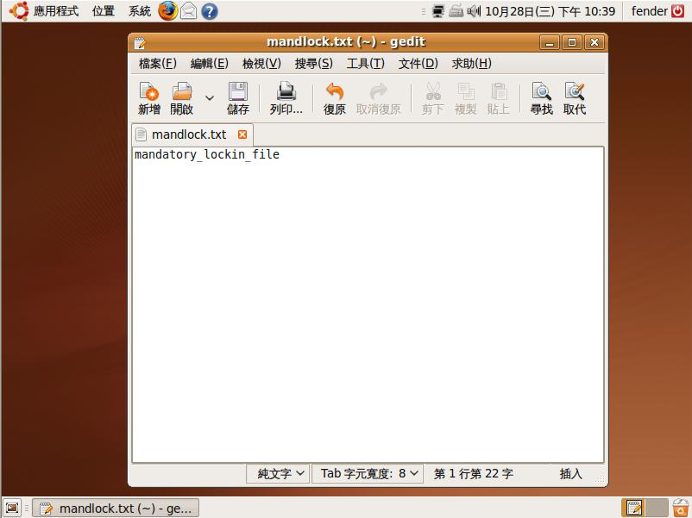
Mandatory Locking(5/8)
mandlock.txt

Slide 27
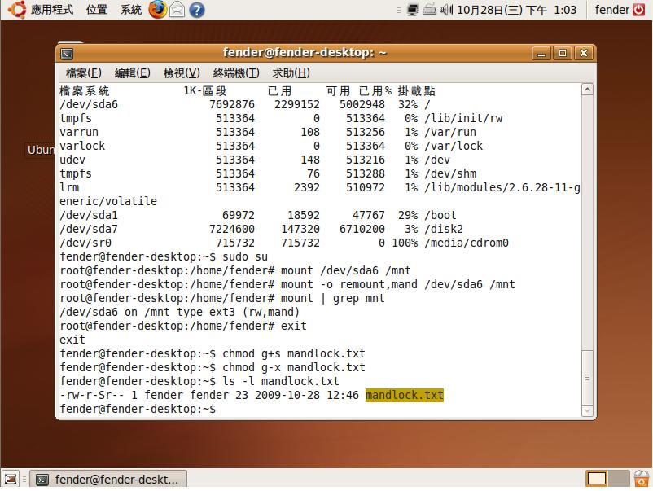
Mandatory Locking (6/8)
Change file permissions.

Slide 28
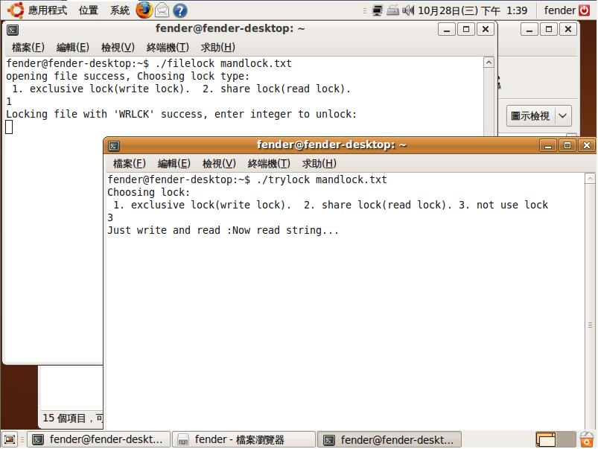
Mandatory Locking (7/8)
WL now
Can’t read and write file.

Slide 29
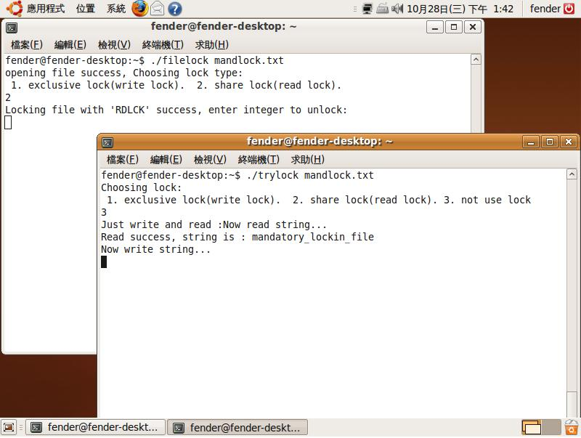
Mandatory Locking (8/8)
RL now
Can read file but can’t write.

Slide 30
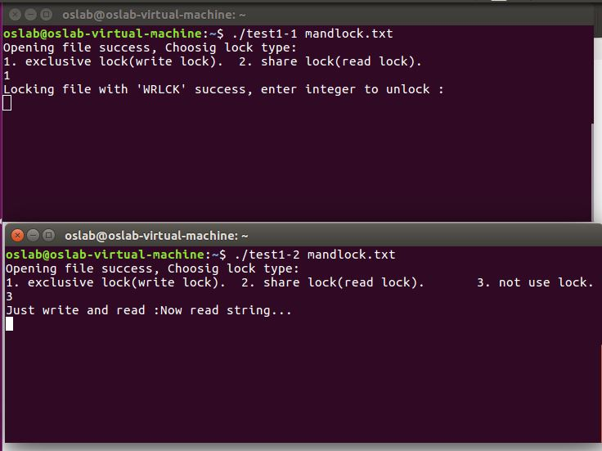
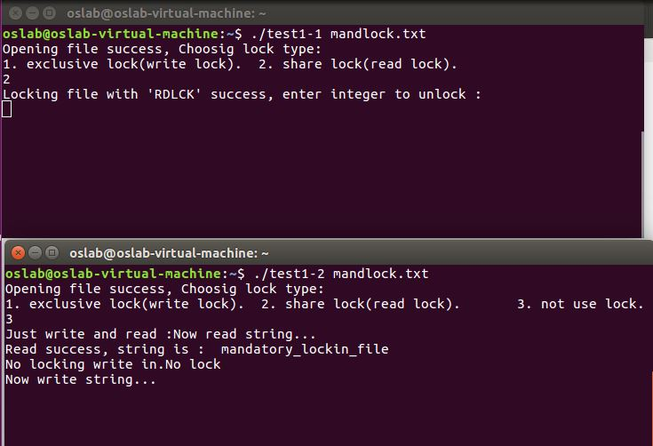
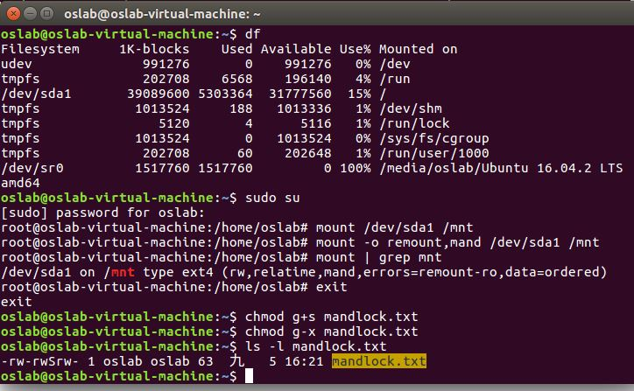
Excises II
Using mandatory locking.
One process lock (WL or RL) a file, another process write or read the same file directly(not use lock).
Write lock test. [+15pt]
Read lock test. [+15pt]

Slide 31
Reference
Mandatory vs Advisory
http://boson4.phys.tku.edu.tw/UNIX/Unix%20Dictionary/UNIX%20M.htm#Mandatory locking
Fcntl() function:
https://fresh2refresh.com/c-programming/c-file-handling/fseek-seek_set-seek_cur-seek_end-functions-c/
http://www.ibm.com/developerworks/cn/linux/l-cn-filelock/index.html
http://hi.baidu.com/mgqw/blog/item/1f1e57398fd2bbfb3b87cecc.html
Mandatory in linux:
http://www.hackinglinuxexposed.com/articles/20030623.html
Others:
http://www.unixresources.net/linux/clf/program/archive/00/00/43/60/436084.html#article436190
http://hi.baidu.com/zmingliu/blog/item/40636f3d7b710f06bba1673d.html

