Slide 1
Lab 1 Installing Linux
Professor: Hsung-Pin Chang
TA: Guo-Wei Chen
Operating System Lab

Slide 2
Outline
Introduction
Install virtual machine on Windows
Install virtual machine on Ubuntu
Install Ubuntu on a virtual machine
Exercise
References

Slide 3
Introduction
We can install Linux on a physical machine
In addition, we can also install it on a virtual
machine

Slide 4
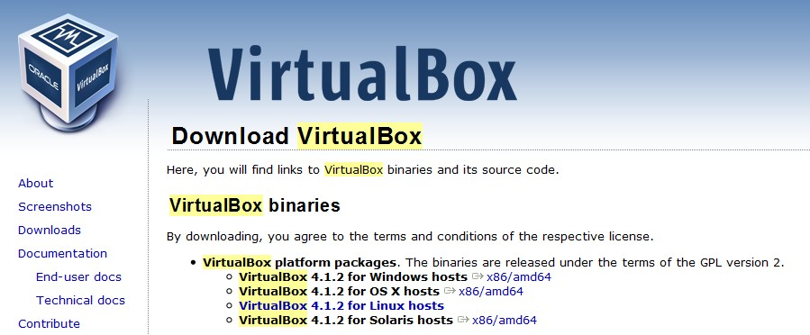
Install virtual machine on Windows (1/10)
Step1 - download VM from the internet
http://www.virtualbox.org/wiki/Downloads

Slide 5
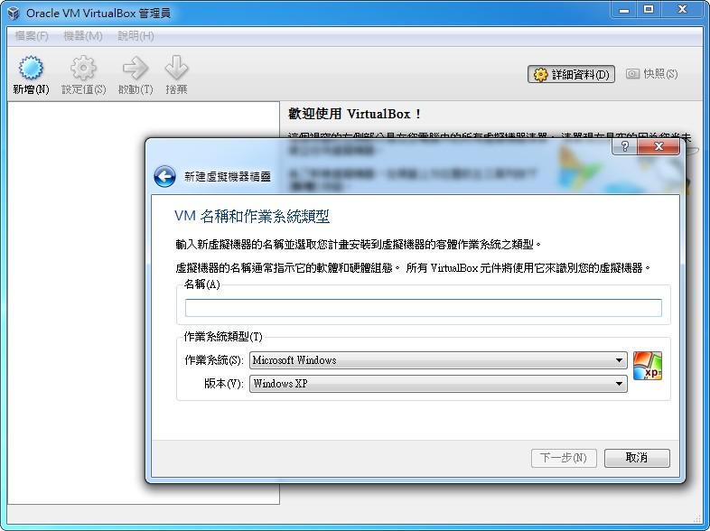
Install virtual machine on Windows (2/10)
Step2 - create a new VM

Slide 6
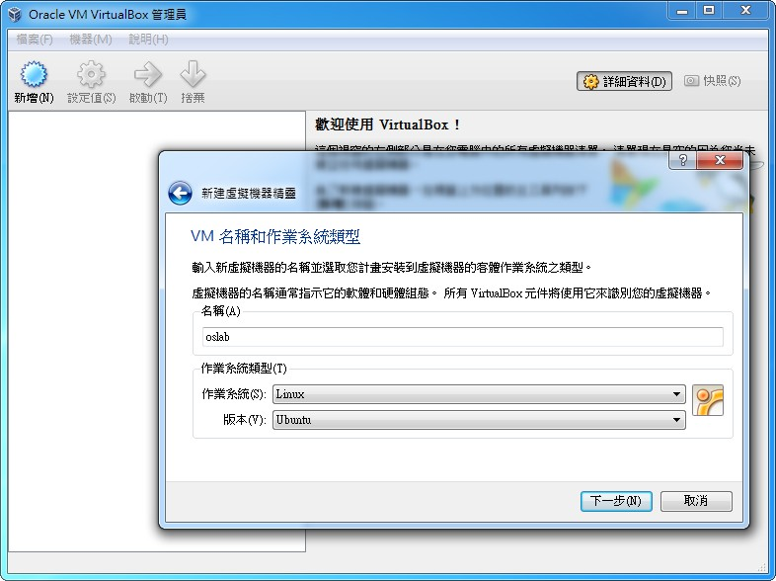
Install virtual machine on Windows (3/10)
Step3 - enter the VM’s name and choose the OS type

Slide 7
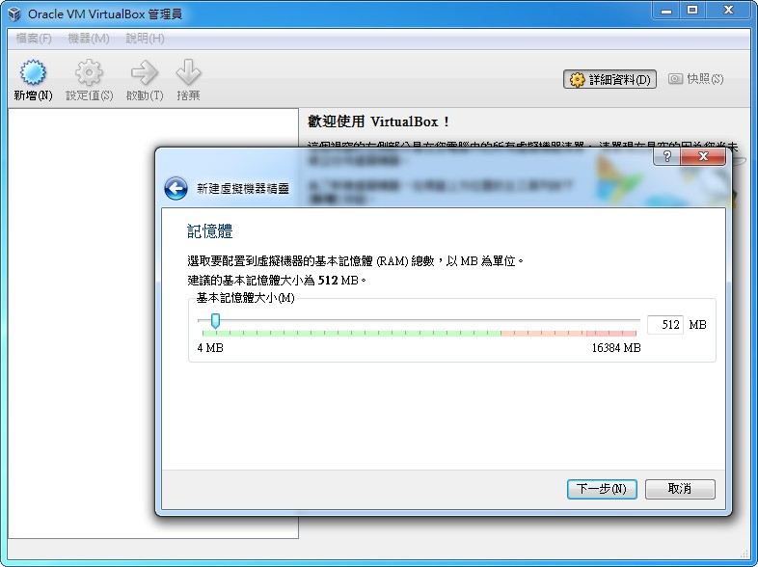
Install virtual machine on Windows (4/10)
Step4 - memory allocation

Slide 8
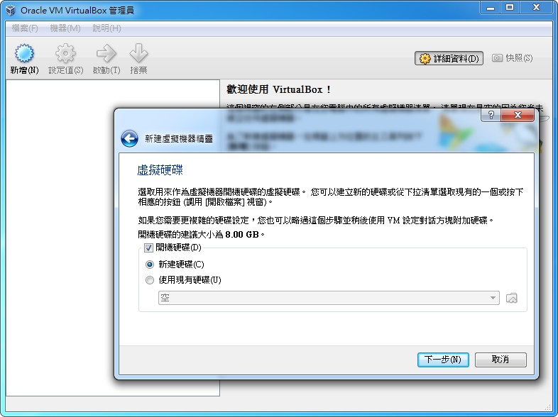
Install virtual machine on Windows (5/10)
Step5 - create a virtual disk

Slide 9
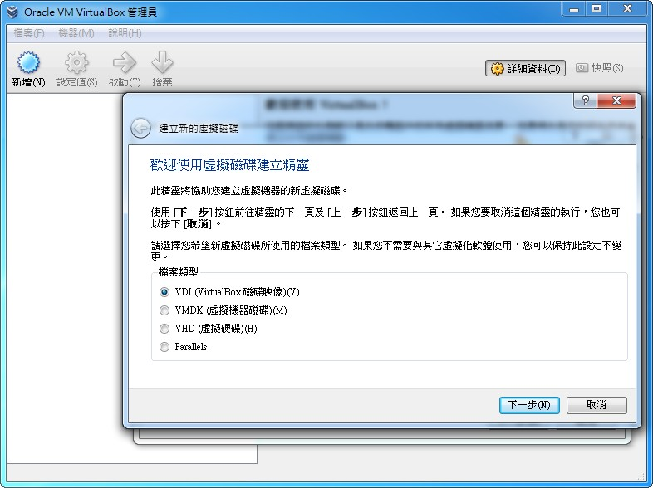
Install virtual machine on Windows (6/10)

Slide 10
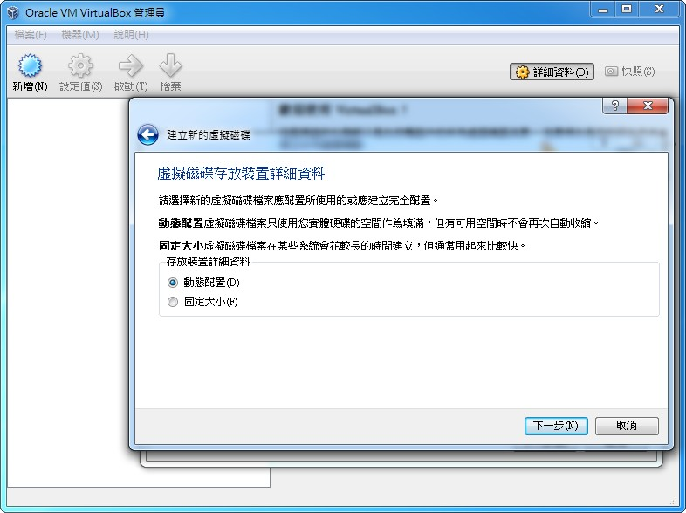
Install virtual machine on Windows (7/10)

Slide 11
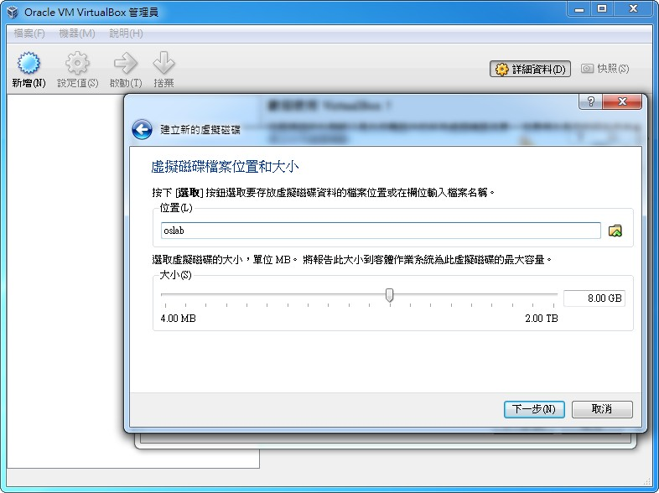
Install virtual machine on Windows (8/10)
Step6 - choose the size

Slide 12
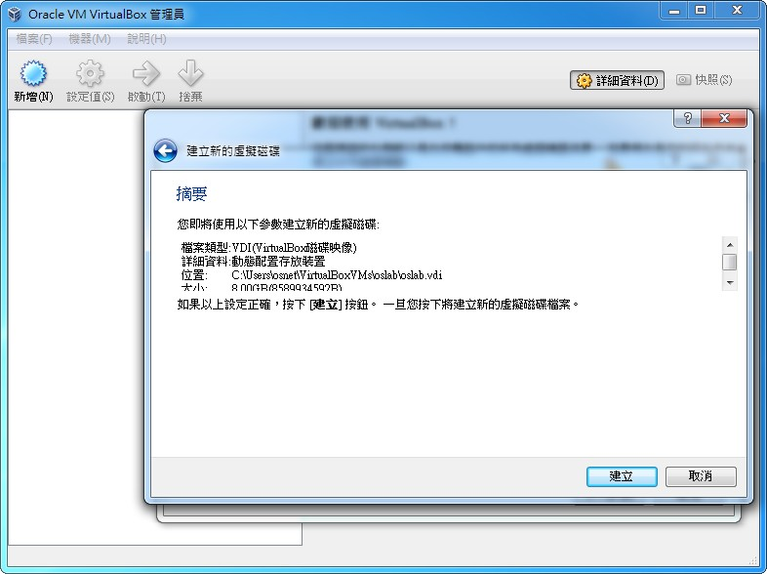
Install virtual machine on Windows (9/10)
Step7 - create virtual disk successfully

Slide 13
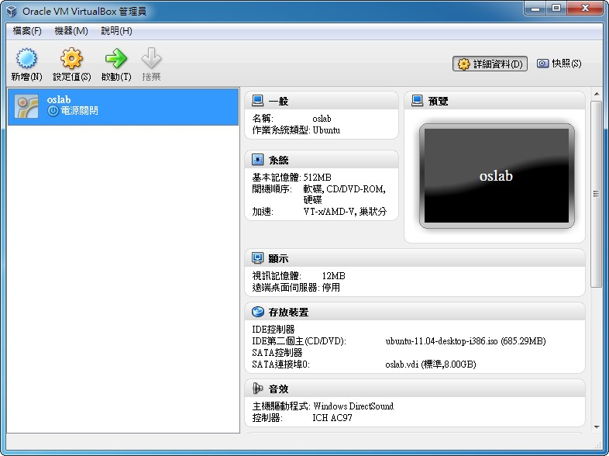
Install virtual machine on Windows (10/10)
Step8 - create VM successfully

Slide 14
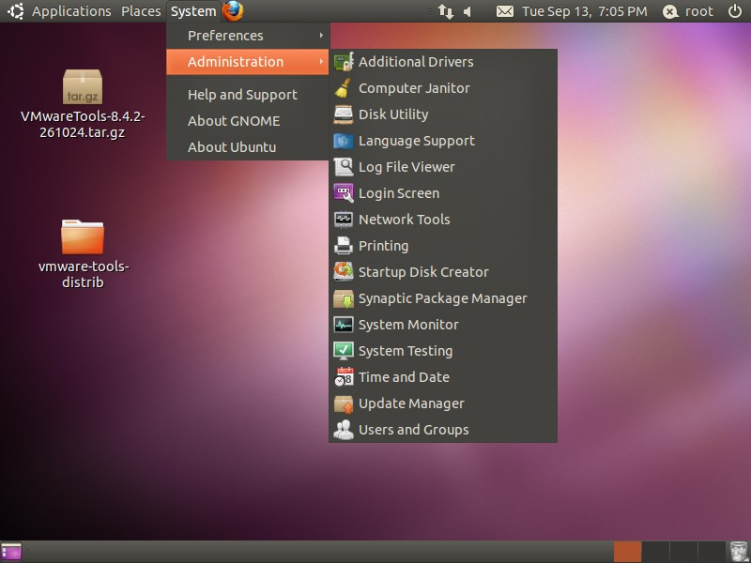
Install virtual machine on Ubuntu (1/9)
Step1 - open Synaptic Package Manager

Slide 15
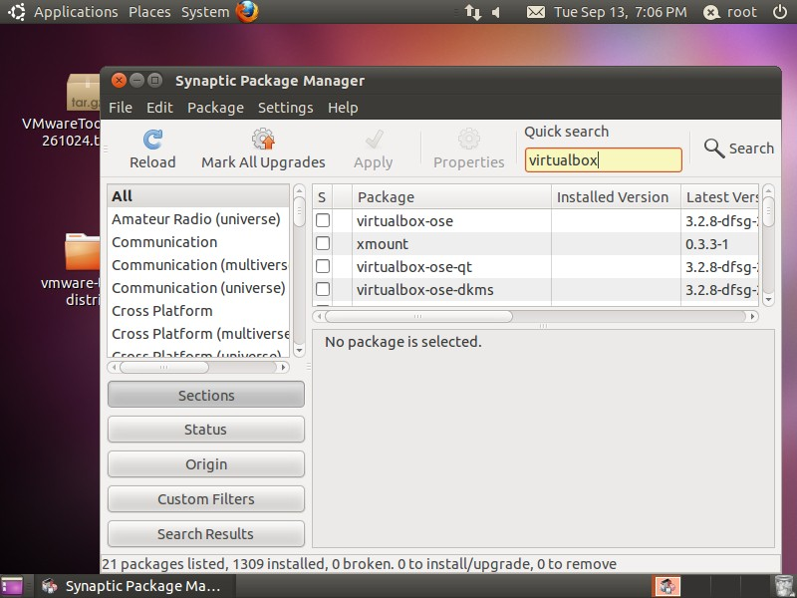
Install virtual machine on Ubuntu (2/9)
Step2 - click “Reload” and search virtualbox

Slide 16
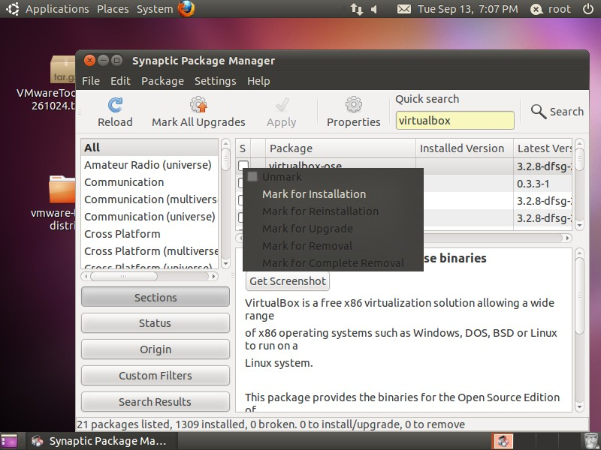
Install virtual machine on Ubuntu (3/9)
Step3 - choose “virtualbox-ose” and mark for installation

Slide 17
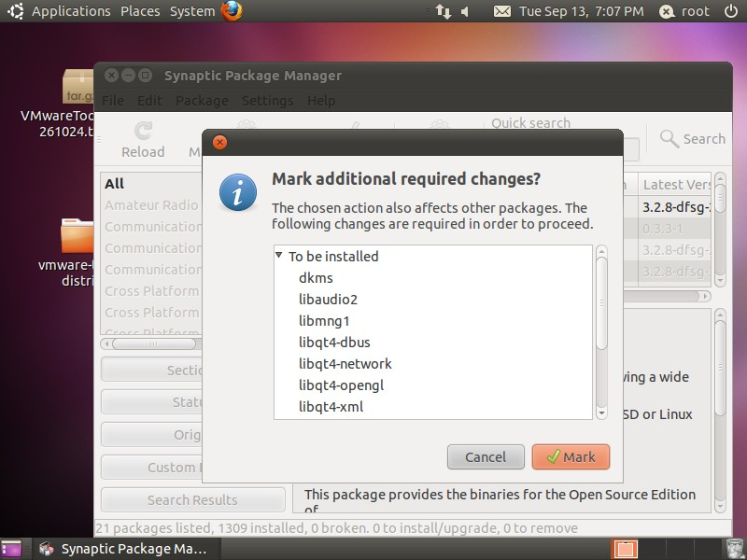
Install virtual machine on Ubuntu (4/9)
Step4 - click the “Mark” button

Slide 18
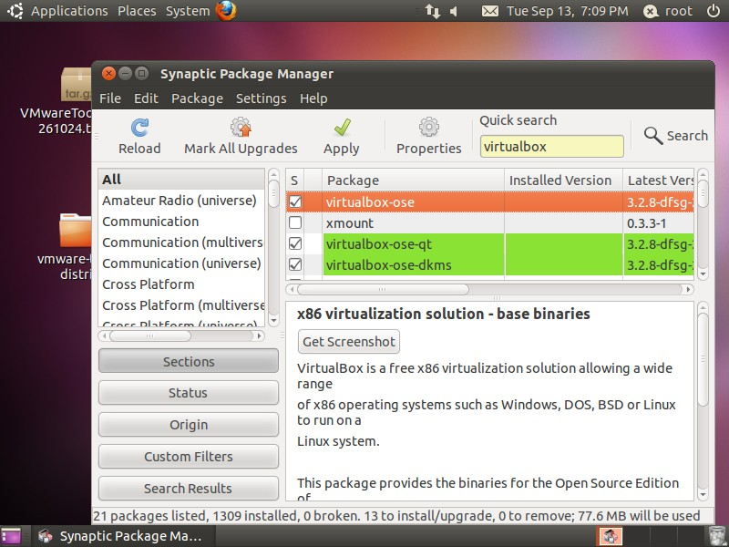
Install virtual machine on Ubuntu (5/9)
Step5 - click “Apply” button

Slide 19
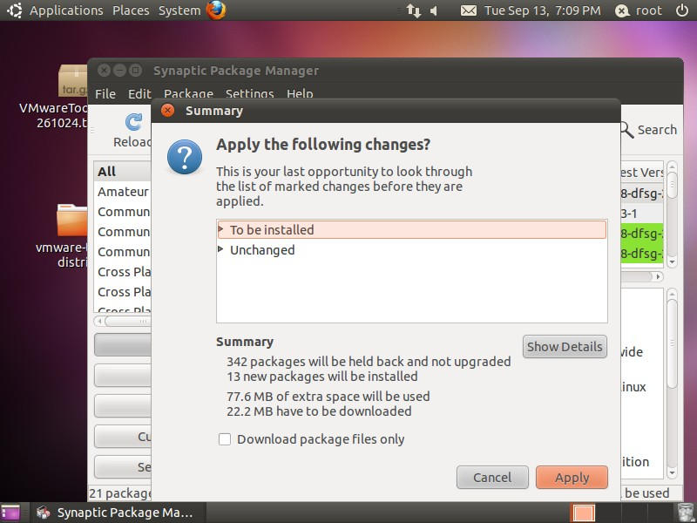
Install virtual machine on Ubuntu (6/9)
Step6 - click “Apply” button

Slide 20
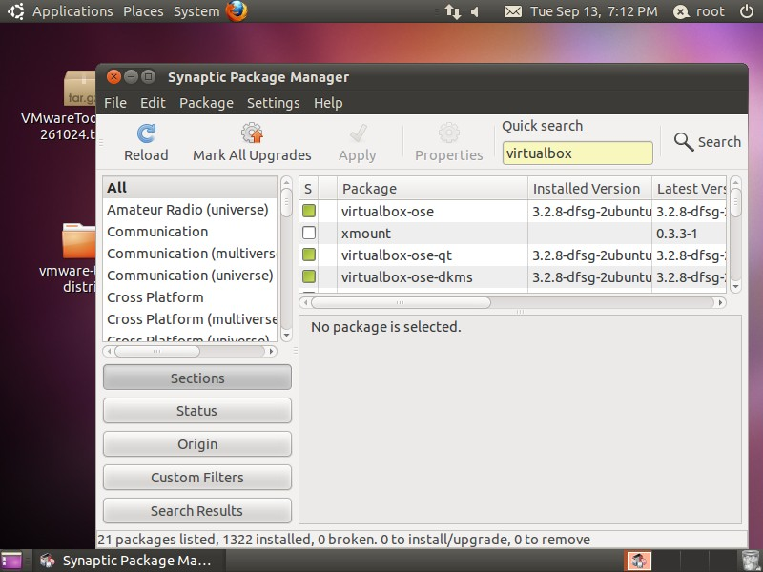
Install virtual machine on Ubuntu (7/9)
Step7 - add virtualbox successfully

Slide 21
Install virtual machine on Ubuntu (8/9)
The following installing steps are similar to the steps of installing virtualbox on Windows

Slide 22
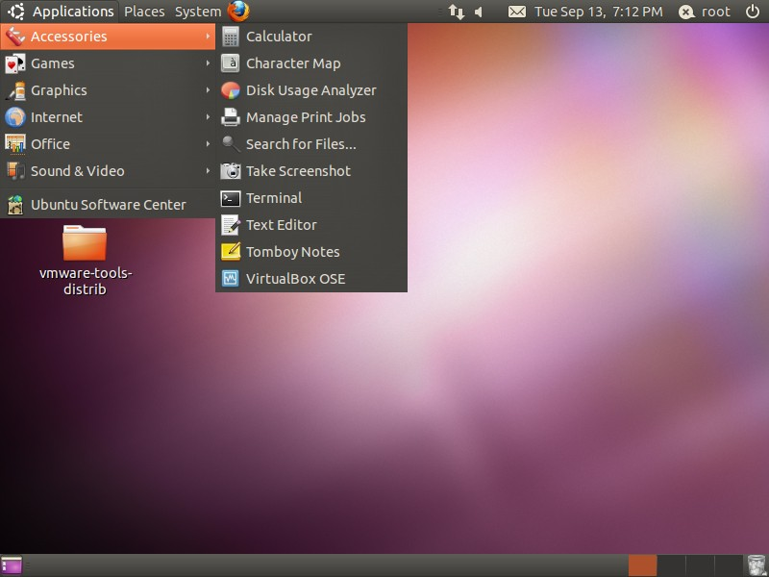
Install virtual machine on Ubuntu (9/9)
We can start virtualbox from

Slide 23
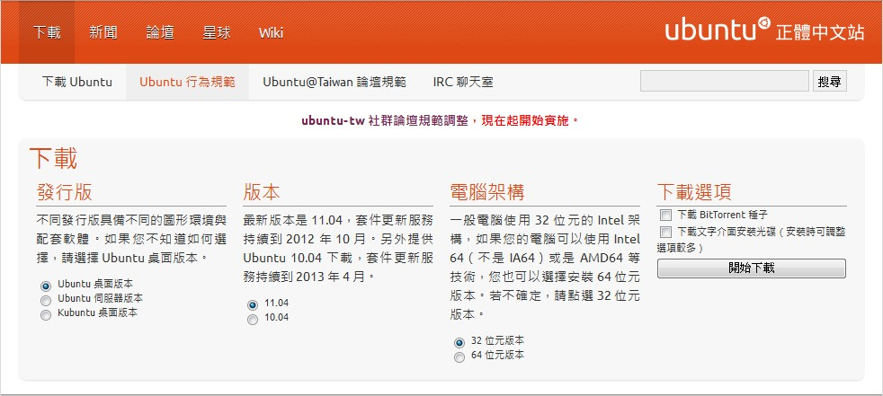
Install Linux on VM (1/11)
Step1 - download Ubuntu from the internet
http://www.ubuntu-tw.org/modules/tinyd0/

Slide 24
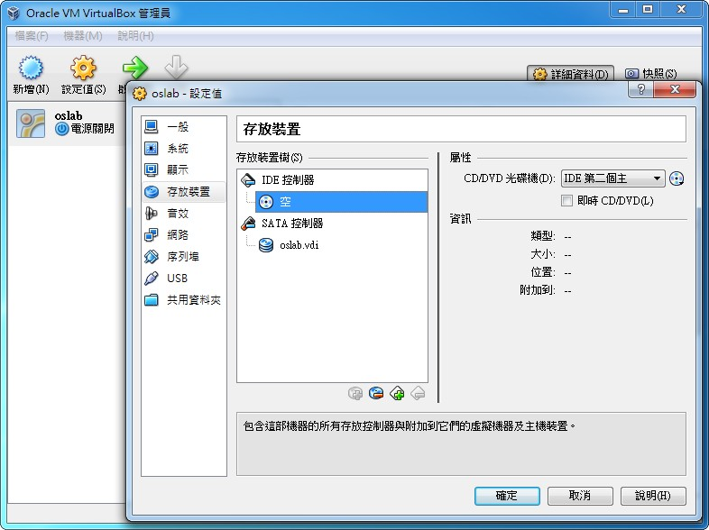
Install Linux on VM (2/11)
Step2 - choose the VM you want and choose the storage device

Slide 25
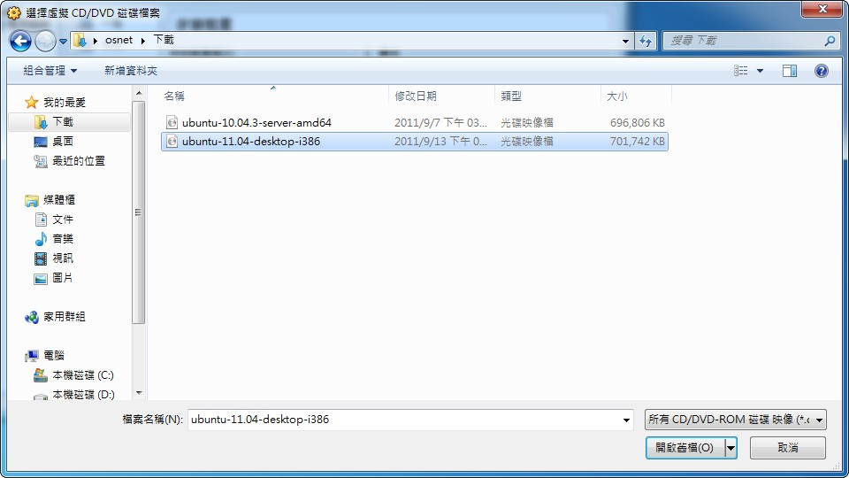
Install Linux on VM (3/11)
Step3 - add the Linux system file

Slide 26
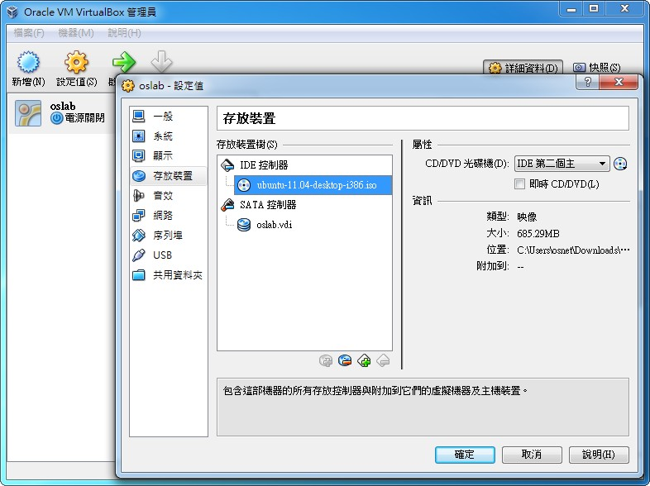
Install Linux on VM (4/11)

Slide 27
Install Linux on VM (5/11)
Step4 - start the virtual machine
Step5 - the virtual machine will load the Linux set-up file automatically

Slide 28
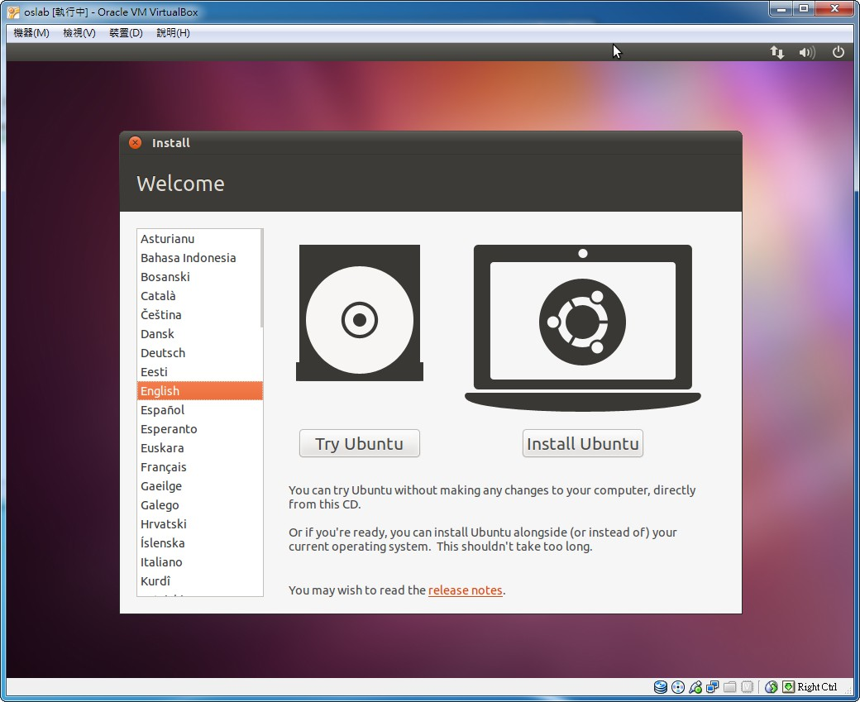
Install Linux on VM (6/11)
Step6 - choose the language

Slide 29
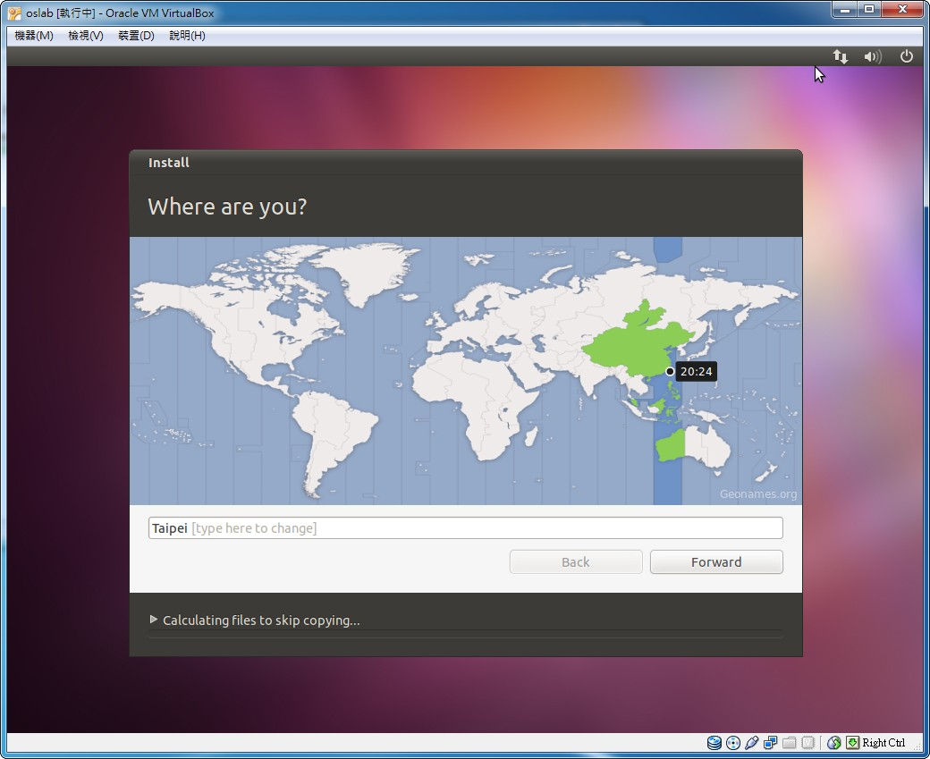
Install Linux on VM (7/11)
Step7 - choose the region and time zone

Slide 30
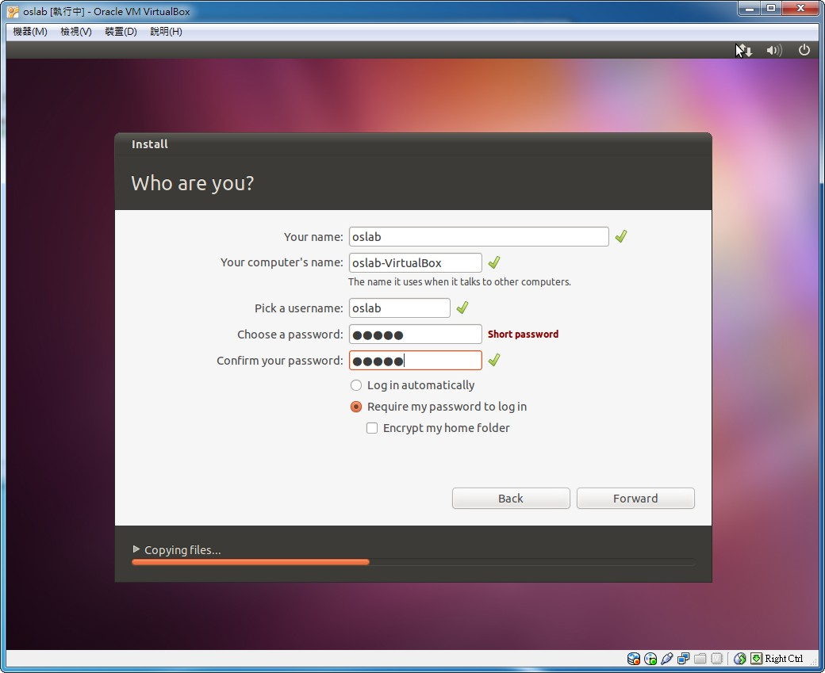
Install Linux on VM (8/11)
Step8 - create user account

Slide 31
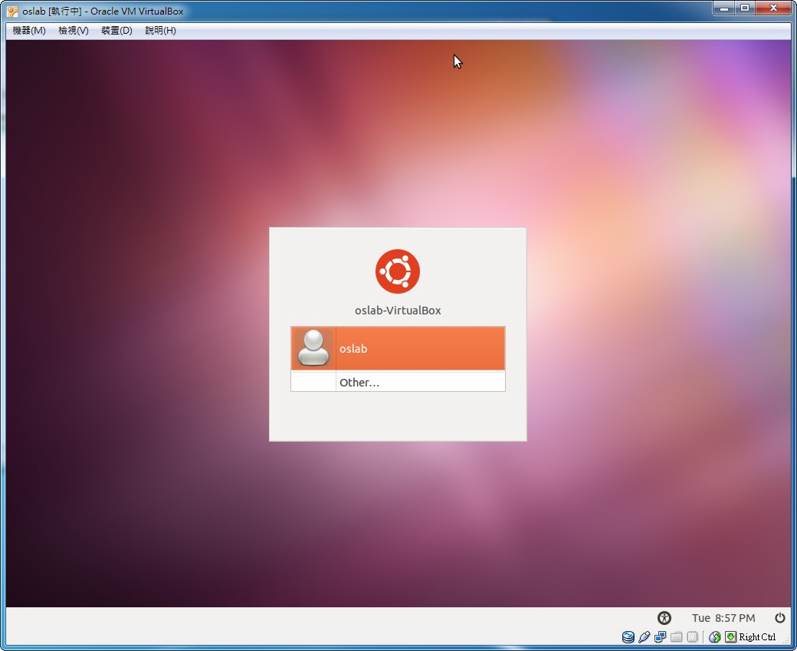
Install Linux on VM (9/11)
Step9 - log in

Slide 32
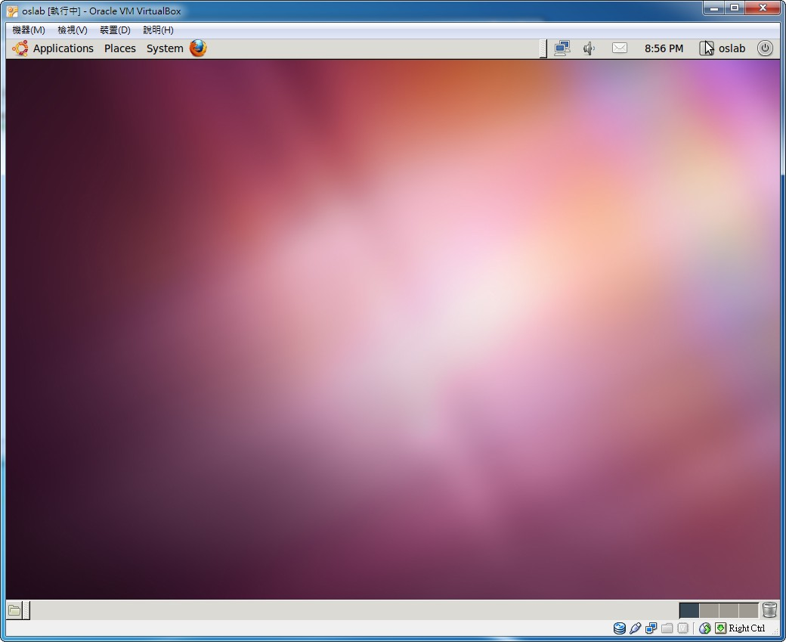
Install Linux on VM (10/11)
Step10 - finish

Slide 33
Install Linux on VM (11/11)
The installation steps of Linux on VM on Ubuntu are similar to that on Windows

Slide 34
Exercise
Use Synaptic Package Manager to install VirtualBox in Ubuntu (60 pt)
Download the Ubuntu CD image from Ubuntu
website (15 pt)
Create a new virtual machine in VirtualBox and install Ubuntu in the virtual machine (15 pt)

Slide 35
References
Ubuntu
- http://www.ubuntu-tw.org/modules/tinyd0/
VirtualBox
- http://www.virtualbox.org/wiki/Downloads

