Slide 1

Lab 2
Shell Script
NCHU OSLAB
Created by Olli Wang

Slide 2
Outline
Introduction
Vim Basics
Bash Shell Scripting Tutorial
Exercise

Slide 3

Introduction
A shell script is a script written for the shell, or command line interpreter, of an operating system
It is often considered a simple domain-specific programming language (DSL)

Slide 4
Introduction
Typical operations performed by shell scripts include
  file manipulation
  program execution
  printing text

Slide 5
Vim Basics
Vim is a popular and cross-platform editor
Type vim /path/to/file in shell to open a file
Start typing something by pressing i
Exit vim by pressing Esc then writting :q and pressing Enter
Save your file similarly but using :w

Slide 6
Vim Basics
Hello Vim!
Install Vim through apt-get command in shell
Create a file named “helloworld”
Type “Hello World!” using insert mode
Return to normal mode by pressing Ese
Save and quit the file

Slide 7

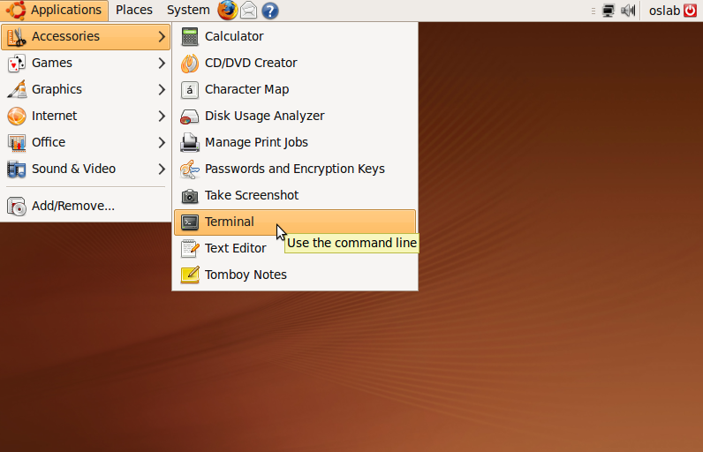
Step 1. Open Terminal Window
Open Terminal window through Applications > Accessories menu

Slide 8
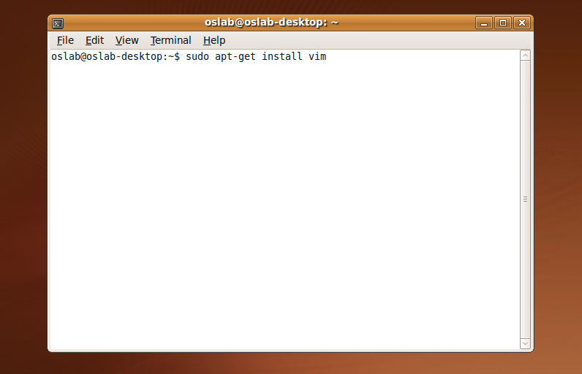
Step 2. Install Vim by Advanced Packaging Tool (APT)
Type “sudo apt-get install vim” to install Vim in shell

Slide 9
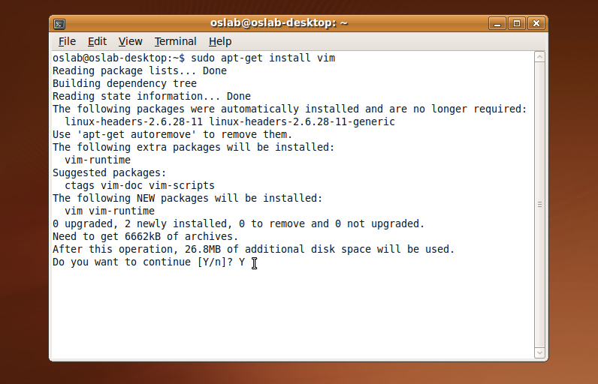
Step 3. Review and Confirm
Review the summary and type “Y” to continue

Slide 10
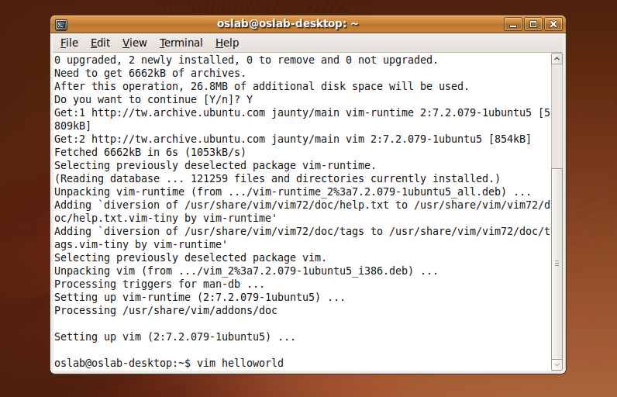
Step 4. Create a file named helloworld
Type “vim helloworld” to create a file named helloworld

Slide 11
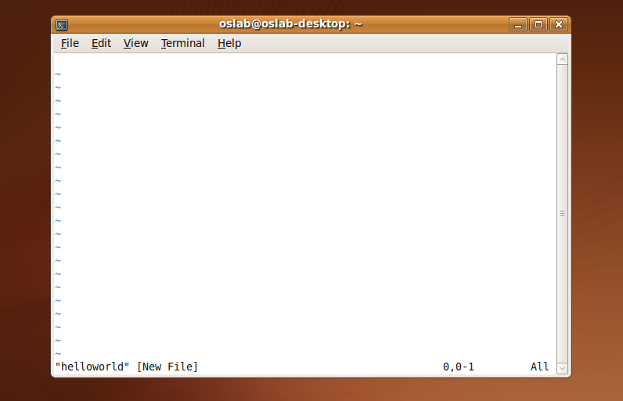
Step 5. Enter Insert Mode
You need to enter insert mode by pressing “i” before typing something

Slide 12
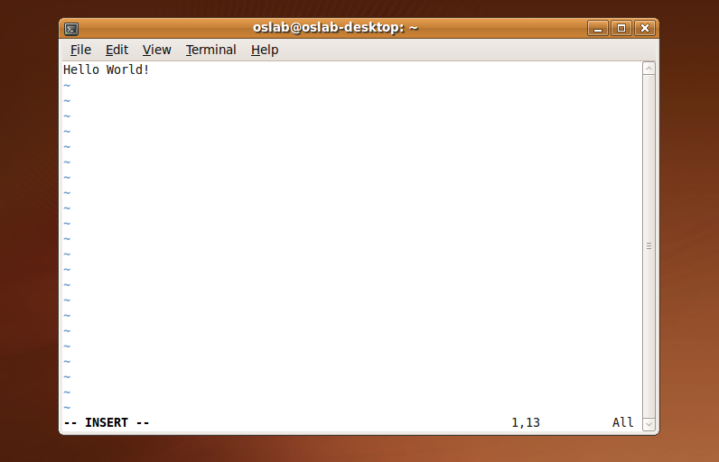
Step 6. Type something
Notice the “-- INSERT --” on bottom left and you can type something now

Slide 13

Step 7. Return to Normal Mode
Press “Ese” to return to normal mode

Slide 14

Step 8. Save the File
Type “:w” in normal mode to save your file

Slide 15

Step 9. Quit Vim
Type “:q” in normal mode to quit Vim

Slide 16
Bash Shell Scripting Tutorial
Bash is a free software Unix shell written for the GNU Project
It is the default shell on most systems built on top of the Linux kernel as well as on Mac OS X and Darwin
You still can do the same thing by other programming languages like Perl, Python, etc

Slide 17
Bash Shell Scripting Tutorial
Hello World!
The simplest Hello World example

Slide 18
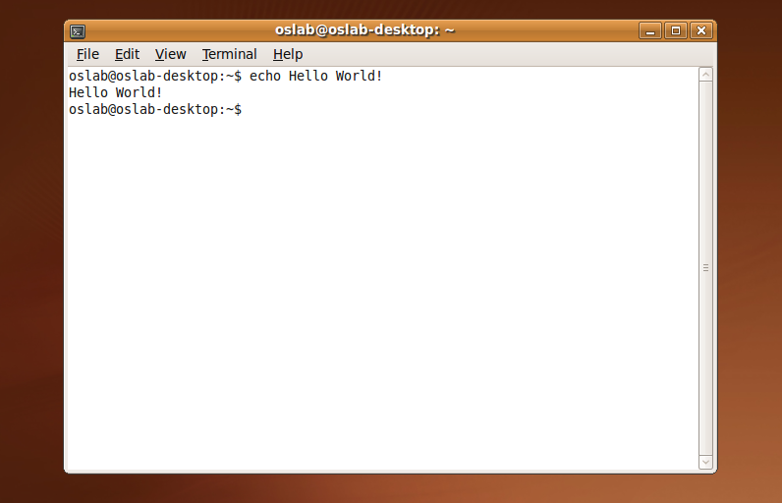
Hello World in Shell
Just simply type “echo Hello World!” in your shell and it’s done!

Slide 19
Bash Shell Scripting Tutorial
Hello World using .sh File
Now let’s use .sh file to do the same thing

Slide 20
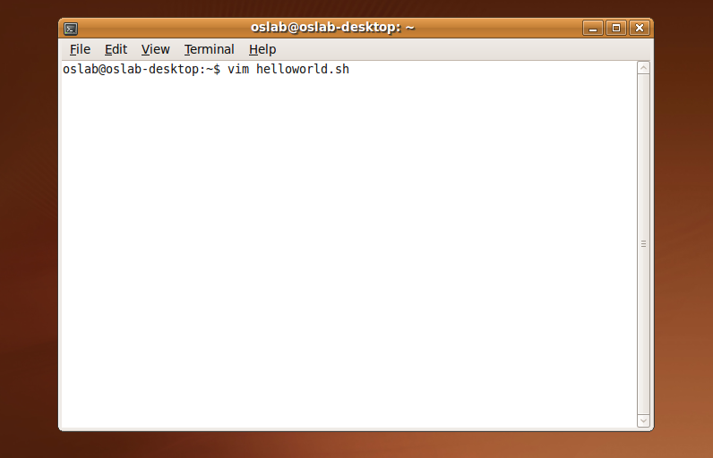
Step 1. Create a file with .sh extension
Type “vim helloworld.sh” in shell to create a new shell file

Slide 21
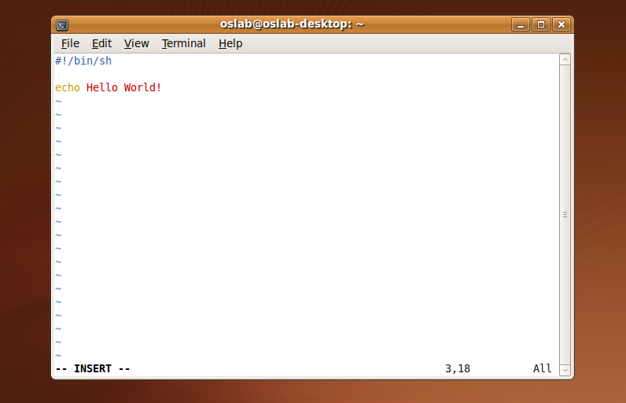
Step 2. Write the script
Enter the insert mode to write our hello world script

Slide 22

Step 3. Save and Quit the File
Return to the normal mode and type “:wq” to save and quit the file

Slide 23
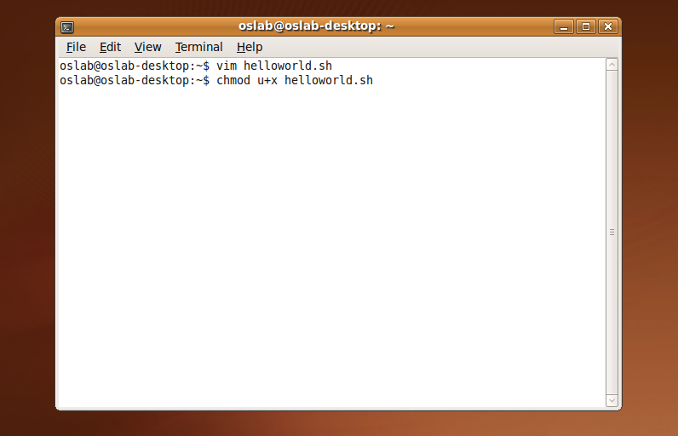
Step 4. Grant execute permission
Use chmod command to grant execute permission to the shell file

Slide 24
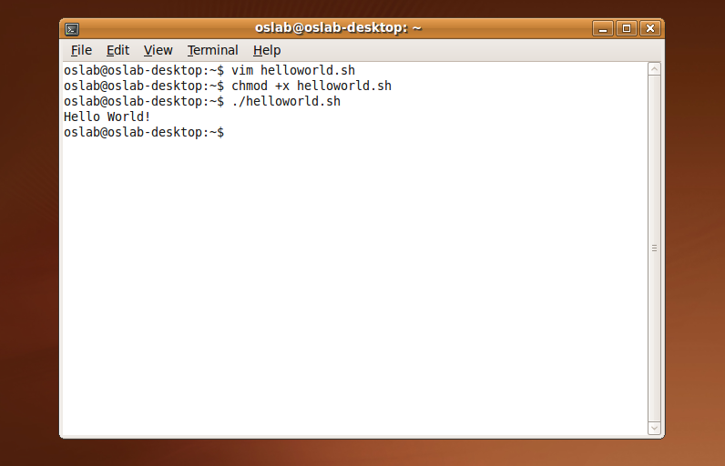
Step 5. Execute the script
Now we can execute the script directly by “./helloword.sh” command

Slide 25
Bash Shell Scripting Tutorial
Variable in Shell
There are two types of variable
  System variables
    Ex: use “echo $PWD” to print your current working directory
  User defined variables (UDV)
    Ex: use “no=10” to set variable no and use “echo $no” to print 10 on your screen

Slide 26
Bash Shell Scripting Tutorial
Shell Arithmetic
Syntax: expr op1 math-operator op2
  $ expr 1 + 3 # print 4
  $ expr 2 - 1 # print 1
  $ expr 10 \* 3 # print 30
  $ echo `expr 6 + 3` # print 9

Slide 27
Bash Shell Scripting Tutorial
More about Quotes
Double quotes (“): Anything enclosed in double quotes removed meaning of that characters (except \ and $)
Single quotes (‘): Enclosed in single quotes remains unchanged
Back quotes (`): To execute command

Slide 28
Bash Shell Scripting Tutorial
More about Quotes
  $ var=Hi
  $ echo $var, there!
Hi, there!
  $ echo “$var there!”
  Hi, there!
  $ echo ‘$var there!’
  $var, there!

Slide 29
Bash Shell Scripting Tutorial
The read Statement
Syntax: read variable1 variable2 …
Example:
  echo “What’s your full name:”
  read fname lname
  echo “Hello, $fname $lname.”
  What’s your full name: Chuck Bass
  Hello, Chuck Bass.

Slide 30
Bash Shell Scripting Tutorial
Arguments
# myshell.sh
echo “Welcome to use $0”
echo “Hi, $1 $2. We have $# argument(s).
$ ./myshell.sh Chuck Bass
Welcome to use ./myshell.sh
Hi, Chuck Bass. We have 2 argument(s).

Slide 31
Bash Shell Scripting Tutorial
Pipes
A pipe is a way to connect the output of one program to the input of another without any temporary file
Ex: think about the ls and sort commands
  We can use ls to list directory contents
  We can also use “ls | sort -r” to list sorted directory contents reversely

Slide 32
Bash Shell Scripting Tutorial
Conditionals
if-then
  if [ “foo” = “foo” ]; then
  echo You can see me
  fi
  if [ “foo” = “bar” ]; then
  echo You cannot see me
  fi

Slide 33
Bash Shell Scripting Tutorial
Conditionals
test command or [ expr ]
  used to see if an expression is true
  returns 0 for true and nonzero for false
  Use test command:
  if test “foo” = “bar”; then
  echo You cannot see me
  fi
  Use [ expr ]:
  if [ “foo” = “bar” ]; then
  echo You cannot see me
  fi

Slide 34
Bash Shell Scripting Tutorial
Conditionals
test command or [ expr ]
-eq | is equal to
-ne | is not equal to
-lt | is less than
-le | is less than or equal to
-gt | is greater than
-ge | is greater than or equal to
Operators for Mathematics

Slide 35
Bash Shell Scripting Tutorial
Conditionals
test command or [ expr ]
str1 = str2 | str1 is equal to str2
str1 != str2 | str1 is NOT equal to str2
str1 | str1 is NOT NULL or not defined
-n str1 | str1 is NOT NULL or does exist
-z str1 | str1 is NULL and does exist
Operators for Strings

Slide 36
Bash Shell Scripting Tutorial
Conditionals
if-then-else
  if [ “foo” = “foo” ]; then
  echo You can see me
  else
  echo You cannot see me
  fi

Slide 37
Bash Shell Scripting Tutorial
Conditionals
Conditionals with variables
  T1=”foo”
  T2=”bar”
  if [ “$T1” = “$T2” ]; then
  echo You can see me
  else
  echo You cannot see me
  fi

Slide 38
Bash Shell Scripting Tutorial
Conditionals
if-then-elif-then-else
  if [ “foo” = “bar” ]; then
  echo You cannot see me
  elif [ “foo” = “foo” ]; then
  echo You can see me
  else
  echo You still cannot see me
  fi

Slide 39
Bash Shell Scripting Tutorial
Loops
for loop
  for i in 1 2 3 4 5; do
  echo Item $i
  done
  for ((i=1; i<6; i++)); do
  echo Item $i
  done
Result:
Item 1
Item 2
Item 3
Item 4
Item5

Slide 40
Bash Shell Scripting Tutorial
Loops
while loop
  i=1
  while [ $i -lt 6 ]; do
  echo Item $i
  i=`expr $i + 1`
  done
Result:
Item 1
Item 2
Item 3
Item 4
Item5

Slide 41
Bash Shell Scripting Tutorial
The case Statement
Syntax
  case $var in
  pattern1) command;;
  pattern2) command;;
  patternN) command;;
  *) command;;
  esac

Slide 42
Bash Shell Scripting Tutorial
The case Statement
Example: name.sh
  case $1 in
  "Chuck") echo "Chuck Bass";;
  "Nate") echo "Nate Archibald";;
  "Blair") echo "Blair Waldorf";;
  "Serena") echo "Serena van der Woodsen";;
  *) echo "Enter a character’s first name " \
  "in Gossip Girl..."
  esac

Slide 43
Bash Shell Scripting Tutorial
The case Statement
Result
  $ ./name.sh
  Enter a character’s first name in Gossip Girl…
  $ ./name.sh Serena
  Serena van der Woodsen
  $ ./name.sh Chuck
  Chuck Bass
  $ ./name.sh Blair
  Blair Waldorf

Slide 44
Bash Shell Scripting Tutorial
Function
Example
  num=10
  PrintNumber() {
  echo “The number is $num!”
  }
  PrintNumber;
  Result:
  The number is 10!

Slide 45
Exercises
Number Guessing Game
  Define the number range between 1 and 10
  Ask the user to enter a target number at beginning
  Keep narrowing down the number range until the player guessing the right target number

Slide 46
Exercises
Example:
Welcome to the Number Guessing Game!
Please enter the target number: 7
Please enter a number between 1 and 10: 10
Please enter a number between 1 and 9: 4
Please enter a number between 4 and 7: 7
Bingo!

Slide 47
Exercises
Use echo, read, loop and conditionals [75 pt]
Use function to ask for guessing number [+5 pt]
Use argument to set the target number [+5 pt]
Bonus: use other scripting language like Perl and Python to do the same thing. [+5 pt]

Slide 48
References
Shell script
Advanced Packaging Tool (APT)
New to Vim
BASH Programming - Introduction
Linux Shell Scripting Tutorial
Common LINUX Command

