Slide 1
Lab 7 Message Queue and Shared Memory
Teacher: Hsung-Pin Chang
TA: Yen-Ru Hwang

Slide 2
Message Queue
Provide a reasonably easy and efficient way of passing data between two unrelated processes
Process A
Process B
Message Queue
message

Slide 3
Message Queue Structure in Linux
struct msqid_ds
ipc_perm structure
struct msg
*next
*next
type
type
*msg_first
*msg_last
message
message

Slide 4
Create a Message Queue
#include <sys/msg.h>
int msgget( key_t key, int msgflg);
If a message queue has been created successfully, the msgget() function returns a queue identifier
Key : The value for the key parameter can be IPC_PRIVATE or a random number other than zero
IPC_PRIVATE : To ensure that the function returns a new message queue ID

Slide 5
Create a Message Queue (cont.)
#include <sys/msg.h>
int msgget( key_t key, int msgflg);
msgflg : IPC_CREAT, IPC_EXCL and permission
IPC_CREAT : msgget() either returns the message queue identifier for a newly created message queue, or returns the identifier for a queue which exists with the same key value
IPC_EXCL : If IPC_EXCL is used along with IPC_CREAT, then either a new queue is created, or if the queue exists, the call fails with -1
Permission :
0
0
0
r
w
x
r
w
x
r
w
x
owner
group
others

Slide 6
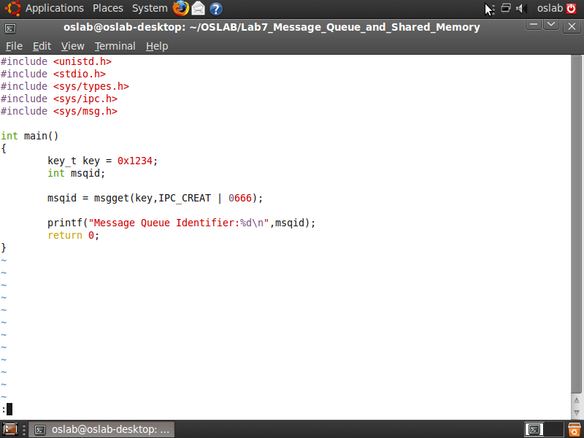
Example
Create a message queue which key value is 0x1234

Slide 7
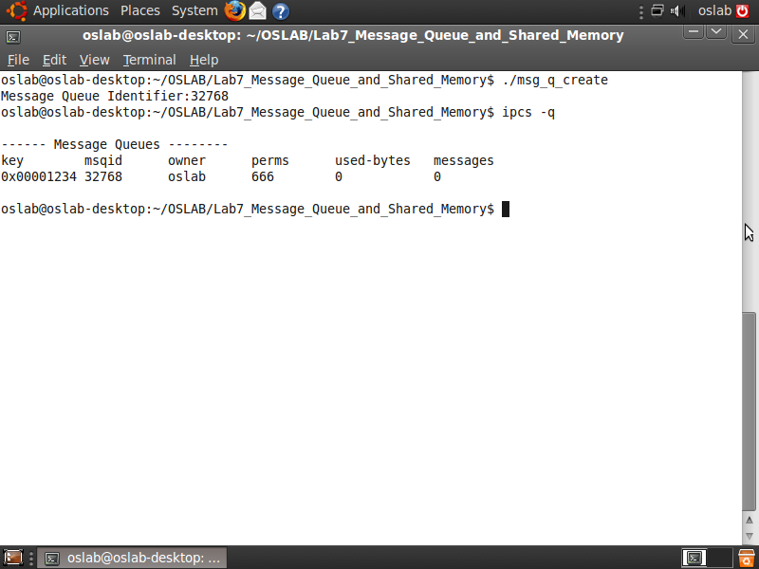
Example (cont.)
Use command “ipcs -q” to see the existing message queue

Slide 8
Send Message to Message Queue
int msgsnd( int msqid, const void *msg_ptr,
size_t msg_sz, int msgflg);
msqid : the ID of the message queue
msg_ptr : a pointer to the msgbuf structure that contains the message.
msg_sz : the size of the data array in the msgbuf structure.
msgflg : The msgflg argument can be set to 0 or IPC_NOWAIT IPC_NOWAIT : If the message queue is full, then the message is not written to the queue, and control is returned to the calling process.
Return 0 on success, -1 on error.

Slide 9
msgbuf structure
struct my_message { long int message_type; /* The data you wish to transfer */
}
The msgbuf structure is the message you send to and retrieve from the message queue.
Must follow the following rules 1.The size must smaller than the system limit
2.The first field in the structure must be long int type (represent the message type)
3. message type must be a positive number.

Slide 10
Retrieves Messages from Message Queue
int msgrcv( int msqid, void *msg_ptr,
size_t msg_sz,long int msgtype, int msgflg);
msytype : = 0 : The process receives the message at the head of the queue. > 0 : The process receives the first message of the requested positive-integer type < o : The process receives the first message that the negative-integer type must be less than or equal to the absolute value of msgtyp.
msgflg : The msgflg argument can be set to 0 or IPC_NOWAIT
returns a value equal to the number of bytes actually stored , -1 on error

Slide 11
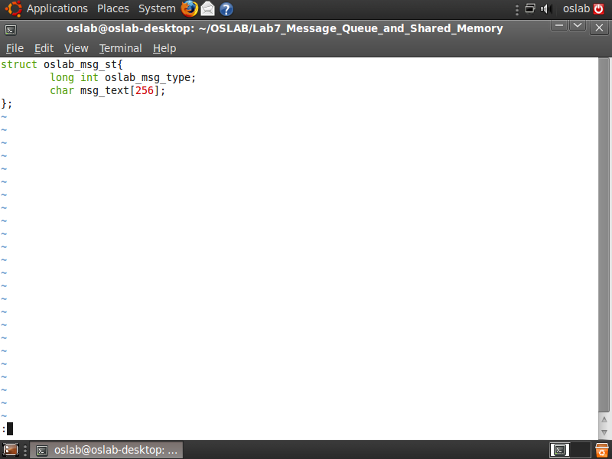
Example
Declare the oslab_msg_st structure in msg_que.h

Slide 12
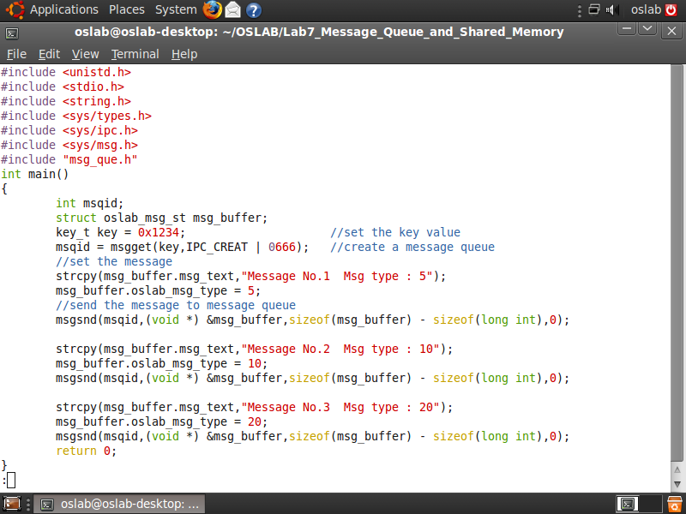
Example (cont.)
Create a message queue and send 3 messages to the queue

Slide 13
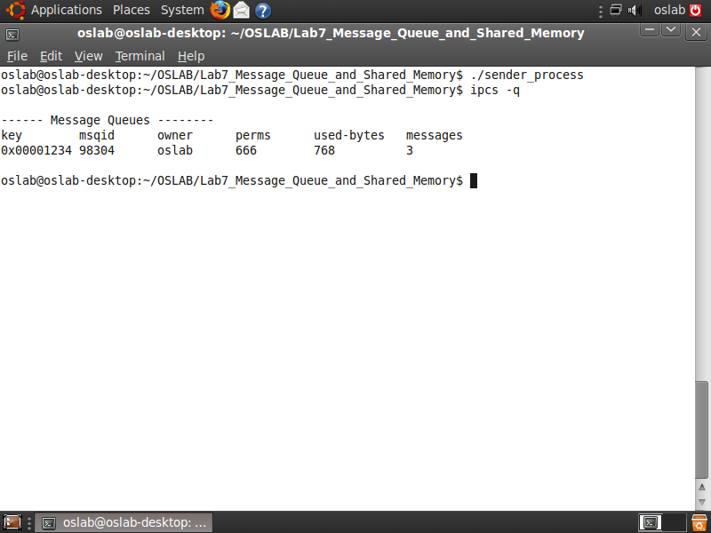
Example (cont.)
Now, we have 3 messages in the message queue

Slide 14
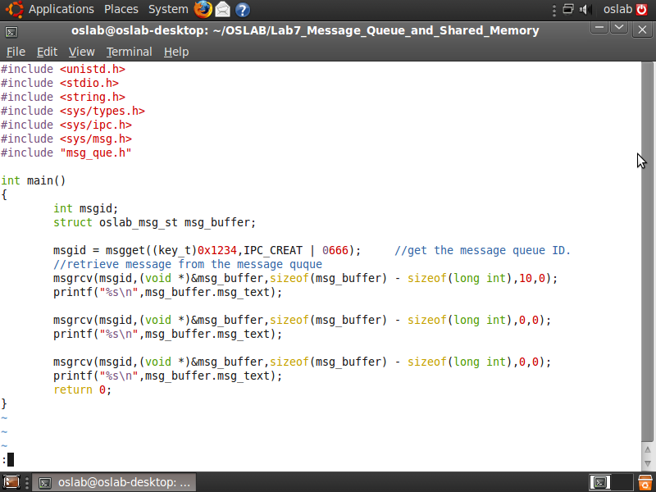
Example (cont.)
Retrieve messages from the message queue

Slide 15
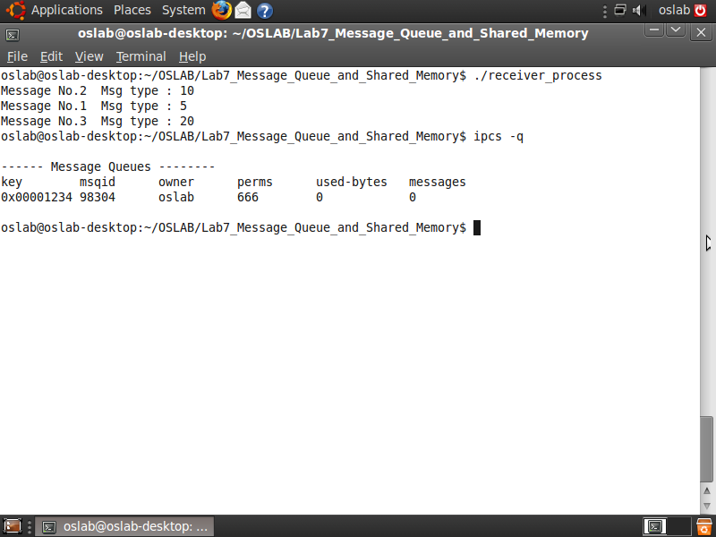
Example (cont.)

Slide 16
Control Function
int msgctl( int msqid, int command,
struct msqid_ds *buf);
command : IPC_STAT : Query the message queue ID by copying the contents of its associated data structure into the buf structure IPC_SET : Sets the message queue ID by copying values found in the buf structure into corresponding fields in the msqid_ds structure associated with the message queue ID IPC_RMID : Removes the message queue ID and deallocates its associated msqid_ds structure
buf : point to a msqid_ds data structure
return 0 on success, -1 on error.

Slide 17
msqid_ds structure
struct msqid_ds{
struct ipc_perm msg_perm;
struct msg *msg_first;
struct msg *msg_last;
u_short msg_cbytes;
u_short msg_qnum;
u_short msg_qbytes;
u_short msg_lspid;
ushort msg_lrpid;
time_t msg_stime;
time_t msg_rtime;
time_t msg_ctime;
};
struct ipc_perm {
ushort uid;
ushort gid;
ushort cuid;
ushort cgid;
ushort mode;
ushort seq;
key_t key;
};

Slide 18
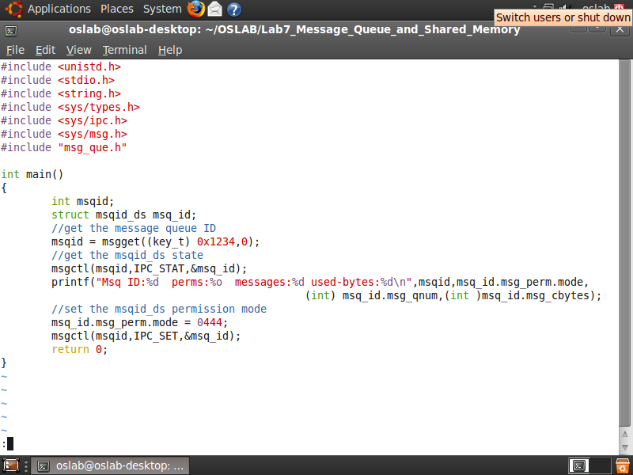
Example
use msgctl() to get msg. queue state and set the permission

Slide 19
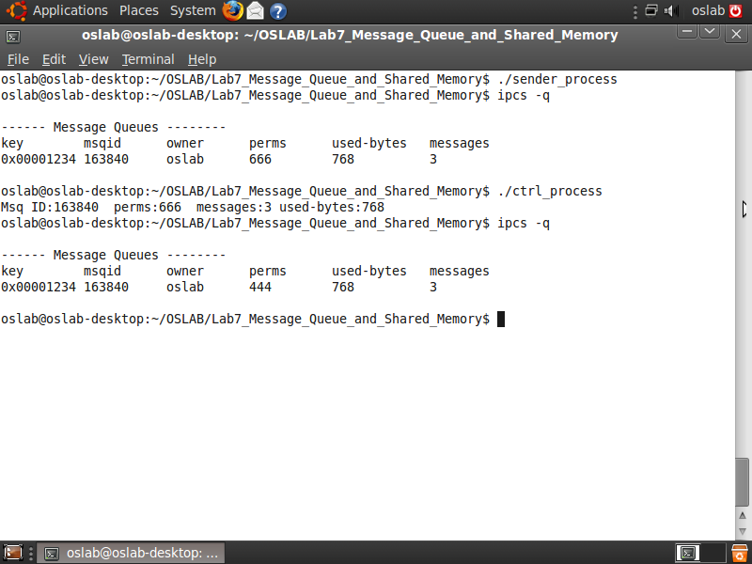
Example (cont.)

Slide 20
Lab I (45 pts.)
Write two program
Program A : create a message queue user can iteratively type strings send message to message queue
Program B : iteratively receive message from message queue show the message on screen
When user type “exit”, then the two program are both terminated and the message queue is deleted.

Slide 21
Result Example
$ ./lab1_sender
Enter some text: This is OSLab
Enter some text: Hello
Enter some text: World
Enter some text: exit
$ ./lab1_receiver
Received: This is OSLab
Received: Hello
Received: World
Received: exit

Slide 22
Appendix
You might use these functions:
- fgets(char *s, int n, FILE *stream)
Get string from *stream to *s with length n. Use stdin in *stream filed to get input from keyboard.
Ex: fgets(buf, BUFSIZ, stdin)
- strncmp(string str1, string str2, int len)
Compare str1 and str2 with length len. Return 0 if equal.
Ex: strncmp(message, “hello”, 5)
- memset(void * ptr, int value, size_t num)
Fill num bytes of value into memory *ptr.
Ex: memset(message, 0, BUFSIZ)

Slide 23
POSIX Shared memory
Two techniques that allow unrelated
processes to share memory regions for IPCs
shared memory‐mapped file
Need to explicitly create a file
Shared memory
Without needing to create a corresponding mapped file

Slide 24
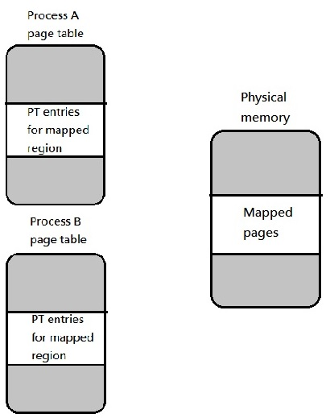
POSIX Shared memory

Slide 25
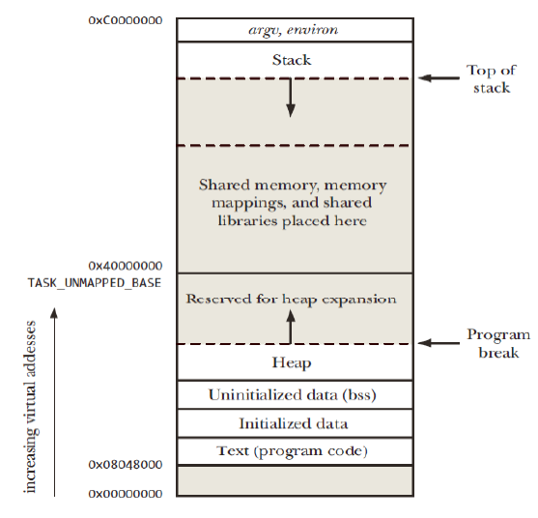
Locations of Shared Memory, Memory Mappings, and Shared Libraries (x86‐32)

Slide 26
POSIX Shared Memory (Cont.)
To use a POSIX shared memory object
Use the shm_open() function to open or create an object with a specified name
Return a file descriptor referring to the object
Analogous to the open() system call
Pass the file descriptor in a call to mmap()
Specifies MAP_SHARED in the flags argument

Slide 27
POSIX Shared Memory (Cont.)
Linux create a pseudo‐file for shared memory
objects in a special location /dev/shm
The shared memory has kernel persistence
The objects will persist even if no process currently has them open
Until the system is shut down or calling unlink()

Slide 28
POSIX Shared Memory (Cont.)
Similar to the memory‐mapped files
Use a semaphore (or other synchronization primitive) to synchronize their accesses, if two or more processes access a memory‐mapped file simultaneously
Introduced later in Lab 8

Slide 29
Creating Shared Memory Objects
#include <fcntl.h>
#include <sys/stat.h>
#include <sys/mman.h>
Int shm_open( const char *name,
int oflag, mode_t mode);
name: the shared memory object to be created or opened.
oflag: shown below.
mode: as shown in previous page.
Return file descriptor on success, or -1 on error.

Slide 30
Creating Shared Memory Objects (cont.)
Bit values for the mq_open() oflag argument
Flag | Description
O_CREAT O_EXCL | Create object if it doesn’t already exist With O_CREAT, create object exclusively
O_RDONLY O_RDWR | Open for read-only access Open for read-write access
O_TRUNC | Truncate object to zero length

Slide 31
Creating Shared Memory Objects (cont.)
Constants for File Permission Bits
Constant | Octal value | Permission bit
S_ISUID S_ISGID S_ISVTX | 04000 02000 01000 | Set-user-ID Set-group-ID Sticky
S_IRUSR S_IWUSR S_IXUSR | 0400 0200 0100 | User-read User-write User-execute
S_IRGRP S_IWGRP S_IXGRP | 040 020 010 | Group-read Group-write Group-execute
S_IROTH S_IWOTH S_IXOTH | 04 02 01 | Other-read Other-write Other-execute

Slide 32
Creating Shared Memory Objects (cont.)
void *mmap(void *addr, size_t length,
int prot, int flags, int fd, off_t offset);
addr:the starting address for the new mapping
If addr is NULL, the kernel chooses the address at which to create the mapping
lenghth:specifies the length of the mapping
prot: see next slice
flags: see next slice

Slide 33
Creating Shared Memory Objects (cont.)
prot argument
Flag | Description
PROT_EXEC | Pages may be executed
PROT_READ | Pages may be read
PROT_WRITE | Pages may be written
PROT_NONE | Pages may not be accessed
flags argument
Flag | Description
MAP_SHARED | Share this mapping
MAP_PRIVATE | Create a private copy-on-write mapping

Slide 34
Creating Shared Memory Objects (cont.)
int shm_unlink(const char *name);
shm_unlink() function performs the converse operation, removing an object previously created by shm_open()

Slide 35
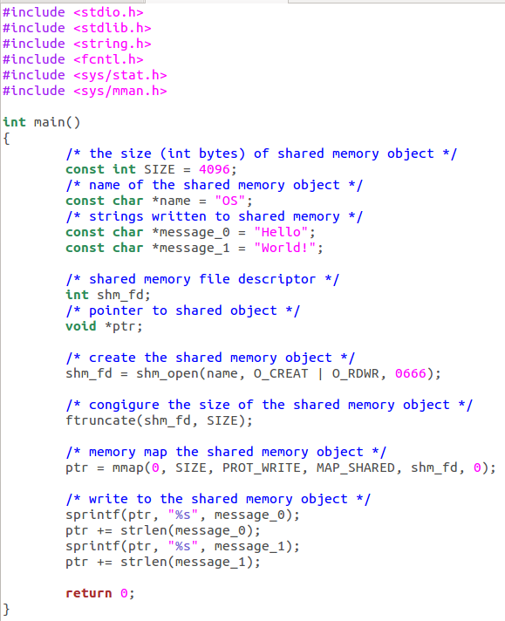
Example-producer.c

Slide 36
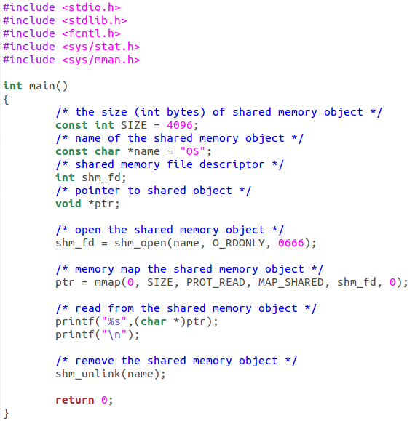
Example-consumer.c

Slide 37
Creating Shared Memory Objects (cont.)
On Linux, programs employing the POSIX IPC mechanisms must be linked with the librt Library
Specifying the –lrt option to the gcc command.

Slide 38
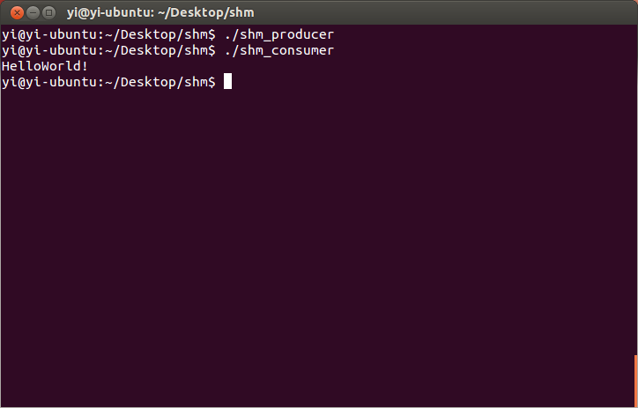
Example

Slide 39
Lab II (45 pts.)
Write two program
Program A : create a shared memory user can type some message into the shared memory
Program B : print the context of shared memory on the screen

Slide 40
Reference
The Linux Tutorial
http://www.linux-tutorial.info/modules.php?name=MContent&pageid=288
The Linux Programmer’s Guide
http://tldp.org/LDP/lpg/
Tru64 UNIX Version 5.0A Section 2 Reference Pages
http://h30097.www3.hp.com/docs/base_doc/DOCUMENTATION/V50A_HTML/MAN/MAN2/INDEX.HTM

