Slide 1
Lab 8
Thread Management
  Teacher: Hsung-Pin Chang
  TA: Yen-Ru Hwang

Slide 2
Why We Need Threads?
A traditional process
  Needs a fair amount of "overhead“
  Has a single thread of control
If the process has multiple threads of control, it can do more than one task at a time.
Threads
  Run as independent entities largely because they duplicate only the bare essential resources that enable them to exist as executable code
NCHU System & Network Lab

Slide 3

What Is a Thread?
NCHU System & Network Lab

Slide 4
What Is a Thread? (cont.)
A thread is a flow of control within a process.
A multithreaded process contains several different flows of control within the same address space.
A thread has a thread ID, a program counter, a register set, and a stack, and is similar to a process has.
However, a thread shares with other threads in the same process its code section, data section, and other OS resources.
  Thus, thread is lightweight
NCHU System & Network Lab

Slide 5
The Benefits of Multithreaded Programming
Responsiveness
  A process can still execute even if some part of process is paused or taking a long time.
Resource sharing
  Share resources of the process to which they belong.
Economy
  Allocating memory and resources for process creation is costly.
  Threads that share resources of the process to which they belong is more economical to create and context switch threads.
Utilization of multiprocessor architectures
  Be greatly increased in a multiprocessor architecture.
NCHU System & Network Lab

Slide 6
Challenges When Using Thread
Because threads within the same process share resources:
  Changes made by one thread to shared system resources will be seen by all other threads.
  Reading and writing to the same memory locations at the same time by two different thread is possible
    Race condition
    Therefore, thread needs explicit synchronization by the programmer.
NCHU System & Network Lab

Slide 7
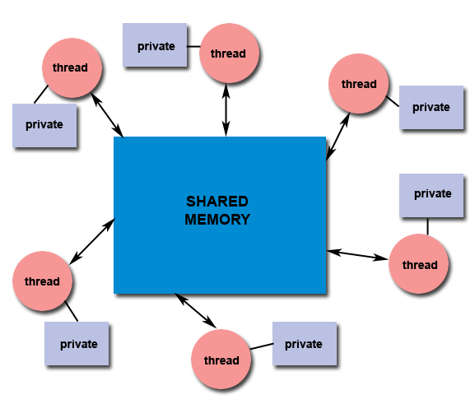
Designing Threaded Programs
Shared Memory Model:
  All threads have access to the same global, shared memory.
  Threads also have their own private data.
  Programmers are responsible for synchronizing access (protecting) globally shared data.
NCHU System & Network Lab

Slide 8
What Are Pthreads?
Historically, hardware vendors have implemented their own proprietary versions of threads .
  Difficult for programmers to develop portable threaded applications.
For UNIX systems, a standardized programming interface has been specified by the IEEE POSIX 1003.1c standard (1995).
Implementations which adhere to this standard are referred to as POSIX threads, or Pthreads.
Pthreads are defined as a set of C language programming types and procedure calls, implemented with a pthread.h header/include file and a thread library.
NCHU System & Network Lab

Slide 9
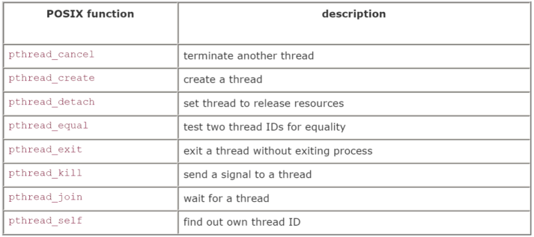
The Pthreads API
There is a whole set of library calls associated with threads, most of whose names start with pthread_.
To use these library calls, we must include the file pthread.h, and link with the pthread library using -pthread.
NCHU System & Network Lab

Slide 10
Referencing Threads by ID
pthread_self: A thread can find out its ID.
pthread_equal: To compare thread IDs for equality.
#include<pthread.h>
pthread_t pthread_self(void);
#include<pthread.h>
int pthread_equal(pthread_t t1,pthread_t t2);
/*Return a nonzero value if t1 equals t2,
0 if the thread IDs are not equal*/
NCHU System & Network Lab

Slide 11
Creating a Thread
pthread_create: creates a thread.
#include<pthread.h>
int pthread_create(pthread_t *thread,
const pthread_att_t *attr,
void *(*start_routine)(void *), void *arg);
/*Return 0 if successful*/
thread: Points to the ID of the newly created thread.
attr: An attribute object that encapsulates the attributes of a thread.
NULL for the default values.
start_routine: The C routine that the thread calls when it begins execution
arg: The argument that is to be passed to start_routine. NULL may be used if no argument is to be passed.
NCHU System & Network Lab

Slide 12
Exiting
If the main thread has no work to do after creating other threads, it should either block until all threads have completed or call pthread_exit(NULL).
#include<pthread.h>
pthread_t pthread_exit(void *value_ptr);
NCHU System & Network Lab

Slide 13
Joining
pthread_join: causes the caller to wait for the specified thread to exit.
#include<pthread.h>
pthread_t pthread_join(pthread_t thread,
void **value_ptr);
/*Return 0 if successful*/
thread: The ID of the terminating thread.
value_ptr: Provides a location for a pointer to the return status that the target thread passes to pthread_exit. The caller does not retrieve the target thread return status if NULL.
NCHU System & Network Lab

Slide 14
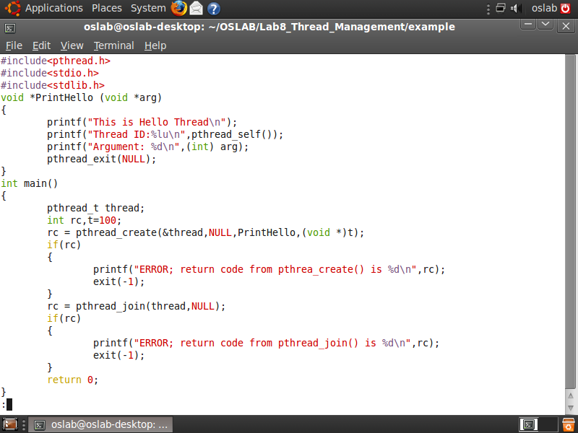
Example
NCHU System & Network Lab

Slide 15
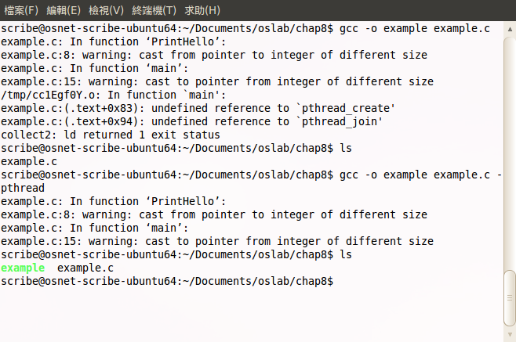
Compile
While compiling pthread program, ensure to add “-pthread” option to command line. (Link libpthread.a library)
NCHU System & Network Lab

Slide 16
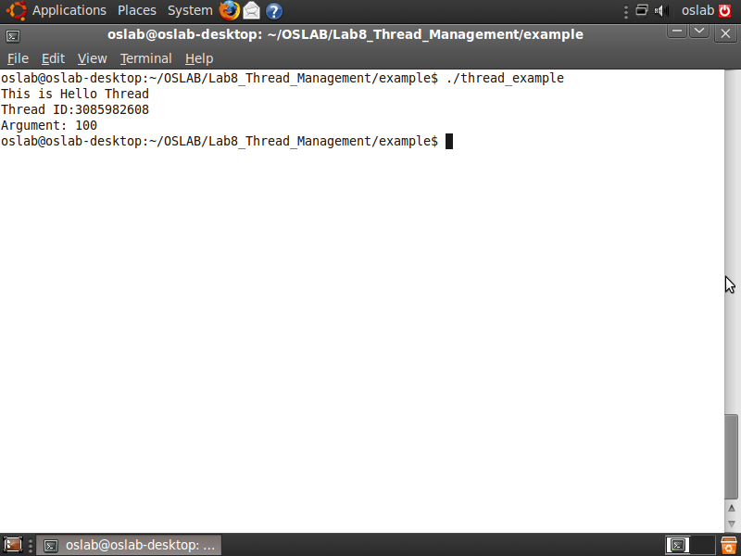
Example (cont.)
NCHU System & Network Lab

Slide 17
Lab1 (40pts.)
A program starts and immediately creates four identical threads
  Also declare a global variable count = 0.
  The main program passes a value containing the number of iterations to the threads.
Each thread increments the same global variable 250,000 times
  Each thread prints the number of iterations from argument and its thread ID.
  So count is incremented a total of 1,000,000 times.
NCHU System & Network Lab

Slide 18
Lab1 (cont.)
The main program waits for the four threads to complete
  Then print out the global count variable at last.
Example:
$ ./lab1
Thread 1: ID 4073392 Completed.
Thread 0: ID 4073072 Completed.
Thread 3: ID 4078520 Completed.
Thread 2: ID 4078200 Completed.
Value = 1000000 (?)
NCHU System & Network Lab

Slide 19
Lab 1-1
Run your Lab1 program several times
Questions:
  Observe all of the results you got, and think about what problem does it have? (10pts.)
  Compare to fork() process by doing all the same thing to the global variable, can you figure out what’s the difference between them? (10pts.)
NCHU System & Network Lab

Slide 20
Lab 2 (50pts.)
Using the message queue which we learned last week
Create two processes, each of them has two threads
  One thread can allow user type messages iteratively and send those messages to a queue.
  The other one can receive the messages which be sent to the queue by the other process and print on screen.
The two processes use the same message queue, but assign different message type to distinguish each other
NCHU System & Network Lab

Slide 21
Lab2 (cont.)
Process A
Message Queue
Process B
NCHU System & Network Lab

Slide 22
Lab2 Result Example
$ ./lab2_A
Lab2_A_Process
Enter some text: Hello This is A.
Enter some text:
Received: Hello, I'm B.
Received: Nice to meet you
me too
Enter some text: bye
Enter some text:
Received: 881
Received: exit
exit
$ ./lab2_B
Lab2_B_Process
Enter some text:
Received: Hello This is A.
Hello, I'm B.
Enter some text: Nice to meet you
Enter some text:
Received: me too
Received: bye
881
Enter some text: exit
Received: exit
NCHU System & Network Lab

Slide 23
References
Avi Silberschatz, Peter Baer Galvin and Greg Gagne, “Operating System Concepts,” John Wiley & Sons, 6th Edition, 2001
POSIX thread programming
http://www.llnl.gov/computing/tutorials/pthreads/
“Unix Systems Programming: Communication, Concurrency, and Threads” by Kay A. Robbins, Steven Robbins
Neil Matthew and Richard Stones, “Beginning Linux Programming,” Wiley publishing, 3rd Edition, 2004
W. Richard Stevens, “Advanced Programming in the UNIX Environment,” Addison-Wesley, 1992
NCHU System & Network Lab

Slide 24
References (cont.)
Marshall Brain, “Win32 System Services: The Heart of Windows 95 and Windows NT,” Prentice Hall PTR, 2nd Edition, 1996
IBM
http://publib.boulder.ibm.com/infocenter/iseries/v5r3/index.jsp?topic=/rzahw/rzahwsemco.htm
NCHU System & Network Lab

