Slide 1
Lab12 Paging
TA: Yu-Cheng Yu
Professor: Hsung-Pin Chang
Operating System Lab

Slide 2
Address Translation Scheme
Address generated by CPU is divided into:
Page number (p) – used as an index into a page table which contains base address of each page in physical memory
Page offset (d) – combined with base address to define the physical memory address that is sent to the memory unit
page number
page offset
p
d
m - n
n

Slide 3
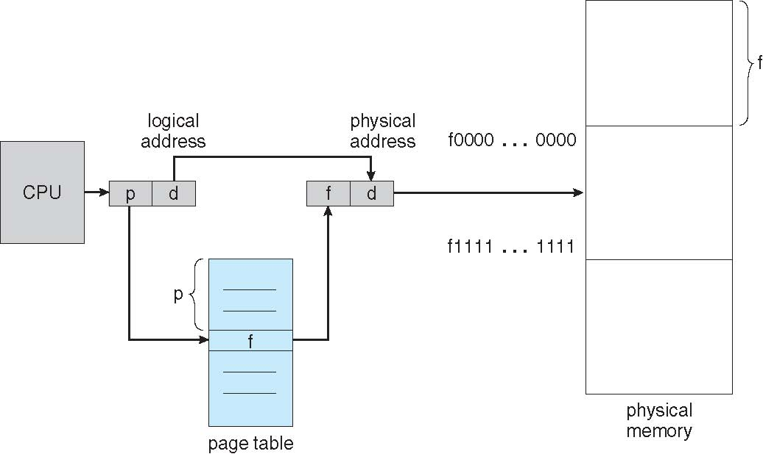
Paging Hardware

Slide 4
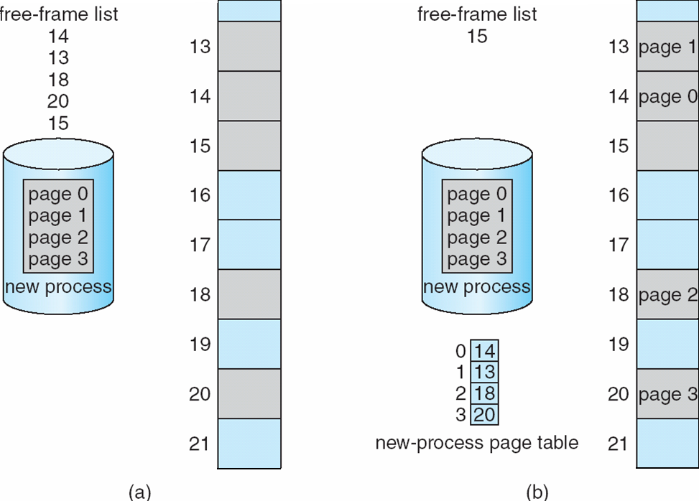
Free-frame list

Slide 5
Paging Hardware Example
Physical Address
Frame No. Offset:value
Page No. Frame No.
0(000) | Used
1(001)
2(010) | Used
3(011) | Used
4(100)
5(101)
6(110) | used
7(111)
Logical Address
Page No.
Logical address
001:0
0:A
1:B
0(000)
1(001)
2(010)
3(011)
1
offset | value
0 1 | A B
0 1 | C D
0 1 | E F
0 1 | G H
001:1
000:0
7
0(000)
000:1
001:0
5
1(001)
CPU
4
010:0
0:G
1:H
2(010)
100:1
Page table
101:0
0:E
1:F
3(011)
011:1
111:0
0:C
1:D
Free frame list
7(111)
4(100)
5(101)
1(001)
1(001)
5(101)
1(001)
4(100)
5(101)
1(001)
Physical memory

Slide 6
Exercise(90%)
Write a simulate paging program
There are 2 processes(see next page).
Paging them into physical memory by using free-frame list and page table.
Please show
logical memory list + page table (60%)
physical memory list + free frame list (30%)
Non-contiguous memory allocation(use random)
Page size:2-byte
Memory size: 32-byte

Slide 7
Exercise(cont.)
Physical memory
0 | ef
1
2
3 | ab
4
5 | zz
6 | rx
7
8
9 | cd
10
11
12 | vy
13
14
15
Free frame list
Logical memory
0 | 3
1 | 0
2 | 9
4
7
8
13
1
2
11
10
14
15
0 | ab
1 | ef
2 | cd
3 | rx
4 | yy
5 | zz
Page table A
0 | 6
1 | 12
2 | 5
Page table B

Slide 8
Exercise(cont.)
To page in the pages (ProcessName/page No.)
ProcessA 0
ProcessB 1
ProcessA 4
ProcessB 5
ProcessB 7
ProcessA 7
ProcessA 2
ProcessB 6

Slide 9
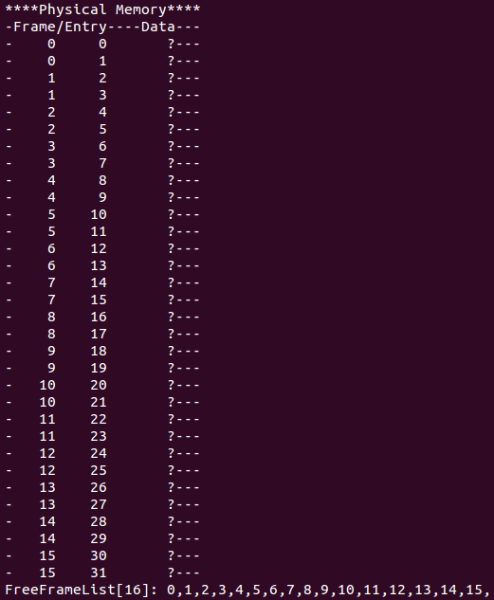
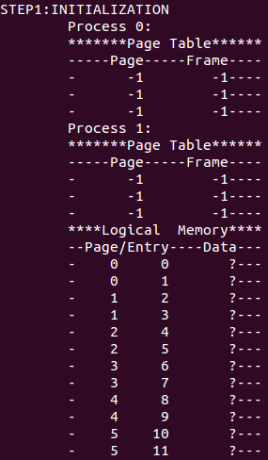
Exercise(cont.)

Slide 10
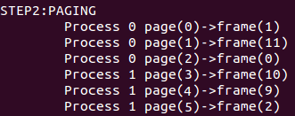
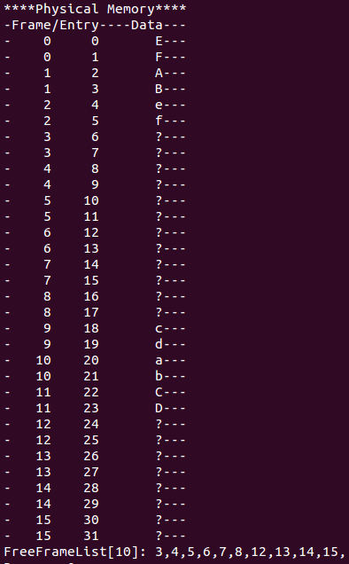
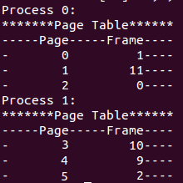
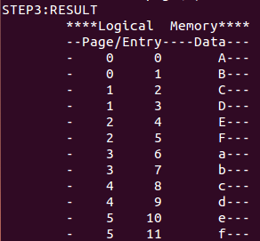
Exercise(cont.)

Slide 11
Page in & page out
When we want to run a process , we need to page in(place the page into physical memory).
When the physical memory has no free-frame to page in pages, we need to do ”page out”.
Page out means that you swap out the pages which are not needed anymore in physical memory.

Slide 12
Page in & page out(cont.)
Example:
Look at Fig.pf, the physical
Memory is out of free-frames.
Now, a new process need to
page in, what should we do?
Fig.pf
0 | ee
1 | sa
2 | zz
3 | ww
4 | xz
5 | aa
6 | gg
7 | bb
8 | cc
Physical memory

Slide 13
Page in & page out(cont.)
Solution:
We just page out the pages
which are not needed anymore
(use algorithm that likes LRU or
Others)
Then we have free-frames to page
in.
Fig.pf
0 | ee(page out)
1 | sa
2 | zz(page out)
3 | ww
4 | xz(page out)
5 | aa
6 | gg
7 | bb(page out)
8 | cc
0
1 | sa
2
3 | ww
4
5 | aa
6 | gg
7
8 | cc
Physical memory

Slide 14
Reference
Operating System Concepts Eight Edition
Ch8 main memory
http://codex.cs.yale.edu/avi/os-book/OS8/os8c/slide-dir/PDF-dir/ch8.pdf

