Slide 1
Lab 15
I/O Multiplexing
TA: Yen-Ru Hwang
Professor: Hsung-Pin Chang
Operating System Lab

Slide 2

Deal with Many Descriptors: Example 1
Example :
  A telnet program
    We write/read to/from network connection.
    We write/read to/from terminal (standard in/out ).
      Keyboard (standard in)
      Monitor (standard out)
    How do you deal with these descriptors simultaneously?
      The blocking I/O scheme used previously is not suitable

Slide 3
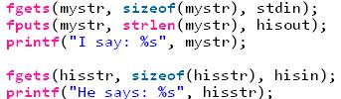
Deal with Many Descriptors: Example 2
System calls like read() and write() etc will block until the device or data is ready
But, in a MSN-like application
  If user A in computer A does not entered any texts, the process will be blocked in fgets().
  When user B in computer B has typed some text.
    User A is still blocked at the first line, i.e., fgets(mystr ...),
  As a result, user A cannot see the text typed by user B on the screen.
NCHU System & Network Lab

Slide 4
I/O Mechanism and Waiting States
I/O Mechanism
  Synchronous (process active)
    The process will wait until the kernel respond.
  Asynchronous (process passive)
    The process does not need to wait the kernel respond
    When the kernel ready to respond, it will then notify the process.
Waiting States
  Blocking I/O
    No matter the process waits for the kernel respond or not, it cannot do other works.
  Non-Blocking I/O
    No matter the process waits for the kernel respond or not, it can do other works.
NCHU System & Network Lab

Slide 5
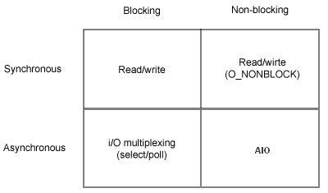
I/O Models
The combination of I/O mechanisms and waiting states leads to four I/O Models
  Synchronous Blocking I/O
  Synchronous Non-Blocking I/O
  Asynchronous Blocking I/O
  Asynchronous Non-Blocking I/O
NCHU System & Network Lab

Slide 6
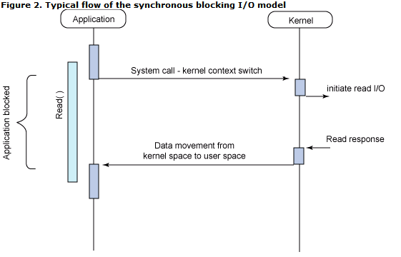
1. Synchronous Blocking I/O
The I/O operation blocks and waits (not doing any other work) all the way.
NCHU System & Network Lab

Slide 7
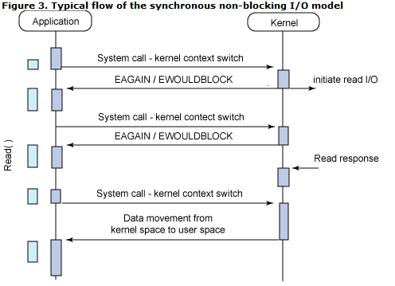
2. Synchronous Non-blocking I/O
I/O operations must be completed when invoked
  Otherwise, if I/O operation could not be immediately satisfied, an error code is returned.
NCHU System & Network Lab

Slide 8
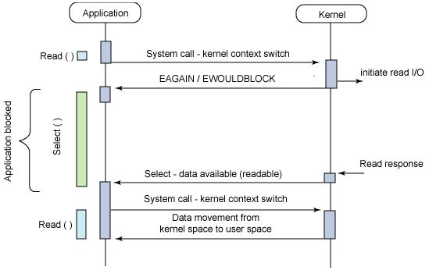
3. Asynchronous Blocking I/O
Set N descriptors (devices) you are interested, and wait T seconds to be notified of the state of these N descriptors.
NCHU System & Network Lab

Slide 9
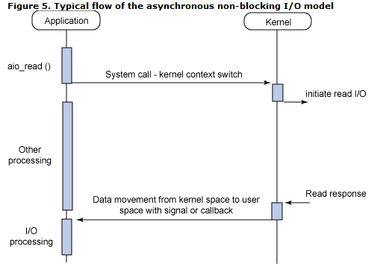
4. Asynchronous Non-Blocking I/O
Overlapping processing with I/O operation.
NCHU System & Network Lab

Slide 10
I/O Multiplexing
What makes this type of I/O model useful ?
  I/O multiplexing combines asynchronous mechanism and blocking notifications.
    It provides notification for more than one descriptors.
    You can request notifications of each descriptor’s read, write or error condition.
    We won’t be blocked on I/O operation
NCHU System & Network Lab

Slide 11
select()
select() function
  The select() function lets us do I/O multiplexing under all POSIX-compatible platforms.
    We use select() to tell kernel :
      Which fd and what condition of that fd we are interested in.
      How long we want to wait.
    On the return from select()
      The total count of the number of ready descriptors.
      select() will check the descriptors that we are interested in :
        If it is ready , the bit is “1”.
        Regular file’s 3 states are always “ready” through select()
        “Ready” means you can do I/O now without blocking
NCHU System & Network Lab

Slide 12
select() (cont.)
  int select(int maxfdp1, fd_set * readfds, fd_set * writefds, fd_set * exceptfds, struct timeval * tvptr);
Maxfdp1 | Max file descriptor plus 1 /*fd_set[k] starts from 0*/
readfds writefds exceptfds | Three fd_sets contains the status of each file descriptor, you can use NULL as input.
tvptr | struct timeval{ long tv_sec; // seconds long tv_usec; // and microseconds } /*In Linux, you must initialize timeval{} ,and each time select() called will reset timeval{}
Return value | -1: Failure 0: Timeout >1: Ready to operate
NCHU System & Network Lab

Slide 13
select() (cont.)
  int select(int maxfdp1, fd_set * readfds, fd_set * writefds, fd_set * exceptfds, struct timeval * tvptr);
fd 0
fd 1
fd 2
fd 3
fd 4
readfds
0
0
1
0
0
…..
writefds
0
1
0
0
0
…..
exceptfds
0
0
0
0
0
…..
NCHU System & Network Lab

Slide 14
select() (cont.)
1. Mark the fds that we are interested in.
1 | 1 | 1 | 1 | 0
0 | 1 | 1 | 1 | 0
0 | 0 | 0 | 0 | 0
read
write
except
select()
0 | 0 | 0 | 0 | 0
0 | 0 | 0 | 0 | 0
0 | 0 | 0 | 0 | 0
1 | 1 | 1 | 0 | 0
0 | 0 | 0 | 1 | 0
0 | 0 | 0 | 0 | 0
2. Wait for ready fd, returned if timeout
3. Ready fds are returned.
NCHU System & Network Lab

Slide 15
Supported Functions for select()
Functions :
#include <sys/select.h>
fd_set tmpset; /* create a fd_set */
int FD_ISSET(int fd, fd_set *fdset);
/* Returns 1 if fd is set, 0 otherwise */
void FD_CLR(int fd, fd_set *fdset);
/* Clear a single bit in a fdset */
void FD_SET(int fd, fd_set *fdset);
/* Set a single bit in a set if you are interested in*/
void FD_ZERO(fd_set *fdset);
/* An fd_set is set to all zero bits (read, write, except) */
NCHU System & Network Lab

Slide 16

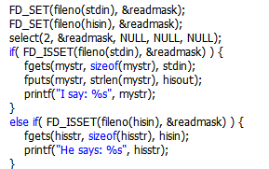
Example of select()

Slide 17
Exercise (90pts)
Write a program to connect two devices.
Use select()to check whether the device is ready or not
  Once ready, read the data and show it on screen.
In this case, we use FIFO named pipe to emulate 2 devices.
Device A
Connection1
HOST
read if ready
Show on screen
Device B
Connection2
NCHU System & Network Lab

Slide 18
Exercise - Devices
Make a new FIFO named pipe:
  $ mkfifo (pipe name)
  Ex: mkfifo fifo1
Check if pipe is created:
  $ ls –l
  For example, we created two pipes named fifo1 and fifo2.
To send a data to a pipe, use echo:
  $ echo “Test” > fifo1
prw-r--r-- 1 user user 0 2010-12-20 20:28 fifo1
prw-r--r-- 1 user user 0 2010-12-20 20:28 fifo2
NCHU System & Network Lab

Slide 19
Exercise - Host
Use open() to open two devices:
  #include <fcntl.h>
  int fd1 = open("fifo1", O_RDONLY);
  In practice, we must use O_RDWR instead of O_RDONLY. Or you will encounter an unknown error.
Initialize fd_set:
  fd_set [variable_name];
  FD_ZERO(&[variable_name]);
Set the timeout value:
  struct timeval tv;
  tv.tv_sec = (Seconds);
  tv.tv_usec = (Microseconds);
NCHU System & Network Lab

Slide 20
Exercise – Host (Cont.)
Set the devices we are interested in reading:
  FD_SET(fd1, &[variable_name]);
Finally, use select() to wait if the device is readable:
  int ready = select(maxfdp1, &readfds, NULL, NULL, &tv);
  Remember after each select() all fd_sets and timeval will be reset.
  So after each select(), you must set the fd_set and timeval again.
  A good design to solve that is to put them at first in an infinite loop.
∞ loop {
FD_ZERO(…);
FD_SET(…);
tv.tv_sec = …;
if(select(…))
}
NCHU System & Network Lab

Slide 21
Exercise - Result
Host
$ ./exercise
Timeout. Try another select().
Read fifo1 available.
Hello from pipe1
Timeout. Try another select().
Timeout. Try another select().
Read fifo2 available.
Hey from p2
Read fifo2 available.
Hey from p2
Read fifo1 available.
Hello from pipe1
Timeout. Try another select().
$ echo "Hello from pipe1" > fifo1
$ echo "Hey from p2" > fifo2
$ echo "Hey from p2" > fifo2
$ echo "Hello from pipe1" > fifo1
Device
NCHU System & Network Lab

Slide 22
#include <stdio.h>
#include <fcntl.h> // for open(), close(), read()
#include <string.h> // for memset()
#include <sys/select.h> // for FD_*, select()
#include <limits.h> // for PIPE_BUF
int main(){
char buffer[PIPE_BUF];
…
fd1 = open(…);
…
∞ loop {
…
memset(&buffer, 0, PIPE_BUF);
if((ready = select(…)) < 0){ // Failure
…
}else if(ready == 0){ // Timeout
…
}else{ // Ready
if(FS_ISSET(fd1, …)){ // fd1 is readable
printf(“Device 1 can read.\n“);
read(fd1, &buffer, PIPE_BUF);
printf("%s\n", buffer);
}
if(FS_ISSET(fd2, …)){ // fd2 is readable
…
}
}
}
…
return 0;
}
NCHU System & Network Lab

Slide 23
Reference
Advanced Programming in the UNIX Environment 2nd
Author : Richard Stevens, Stephen A.Rago, Publisher : Addison-Wesley
Beginning Linux Programming
Author : Richard Stones, Neil Matthew Publisher : Wrox
Mechanism and Waiting states
  http://www.cppblog.com/converse/archive/2009/05/13/82879.html
IBM Learn how to use the POSIX AIO API
  http://www-128.ibm.com/developerworks/linux/library/l-async/?ca=dgr-lnxw02aUsingPOISIXAIOAPI
石頭閒語 (http://blog.roodo.com/rocksaying) select() - I/O Multiplexer
  http://blog.roodo.com/rocksaying/archives/2333878.html
NCHU System & Network Lab

