Slide 1
Lab 3 Setuid
TA：Guo-Wei Chen
Professor：Hsung-Pin Chang
Operating System Lab

Slide 2
Outline
Introduction
Example
Exercises
References

Slide 3
Privilege escalation (上升）
In Chapter 1.9, you learn the privilege escalation (上升）
  Allows user to change to effective ID
  Example: SUID(setuid) in UNIX

Slide 4
What is SUID?
SUID means Set UID.
The SUID attribute on a program causes that program to run with the user ID of the owner of the file rather than the current user’s ID
The process runs with this effective UID until it turns off the extra privileges or terminates.

Slide 5
Why we need SUID?
An user sometimes needs to change privileges to gain extra permissions for an activity.
For example, if root creates a file and hope other user can modify it through a restricted way, root can achieve this by :
  Set this file writable only with root.
  Design a program to write this file, and also give a SUID attribute on this program.
    To make other users get a temporary root privilege to write file successfully through executing the program.
  In Linux, a scenario is passwd and shadow file
    Discuss later.

Slide 6
Background – file’s permission
Octal notation
4 2 1 4 2 1 4 2 1 = 755
d r w x r w x r w x 2 root root Name
User
Group
Other
User
Group
Three Classes
Owner
To indicate what type it is:
: not a directory
d: directory

Slide 7
What is SUID? (cont.)
Example with SUID：passwd
  Because the new password must be written to the /etc/shadow file and that file is writable only by root.
  we can let other users to modify shadow by “SUID attribute”.
    Set “SUID attribute” on passwd.
    Other users can run passwd as a root ID.
    Passwd can change password file - shadow.
-r-s—x--x 1 root root 19336 Mar 15 2008 /usr/bin/passwd
-rw-r--r-- 1 root root 1529 Mar 15 2008 /etc/shadow

Slide 8
How to set SUID attribute on executable file
-r-x--x--x 1 root root 19336 Mar 15 2008 /usr/bin/exec
  $ chmod 4755 /usr/bin/exec
file
-rwsr-xr-x 1 root root 19336 Mar 15 2008 /usr/bin/exec

Slide 9
Effective user ID vs. Real user ID
Assume an user kevin executes the /usr/bin/passwd file
  If the /user/bin/passwd is a setuid program
    real user ID : 500 (kevin).
    effective user ID : 0 (root).
Here, effective user ID means a temporary privileges of ID 0 (root).
In this example, user kevin execute passwd with a temporary privileges of ID 0 (root) for modifying shadow file.

Slide 10
Data Types and Functions (cont.)
Two header files are required in C:
  sys/types.h
  unistd.h
Data type:
  uid_t: used to represent the user ID

Slide 11
Data Types and Functions (cont.)
Functions:
  uid_t getuid(void):
    get the real user ID
  uid_t geteuid(void):
    get the effective ID
  int setuid(uid_t uid):
    set the user ID to uid
    Return value:
      0: set successfully
      1: error

Slide 12
Data Types and Functions (cont.)
  int seteuid(uid_t uid):
    set the effective user ID to uid
    note: Older system (those without the _POSIX_SAVED_IDS feature) don’t have this function
    Return value:
      0: set successfully
      1: error
  Example with seteuid()
    Disabling
      seteuid (real_user_id)
    Enabling after disabling
      seteuid(effective_user_id)

Slide 13
Example
Use getuid ( ) and geteuid ( ) to get the real user ID and the effective user ID
You must have two users
  user1
    Design a program to get the real user ID and the effective user ID of the process
    Switch your current user account to new created user
  user2
    Execute the program to print the result

Slide 14
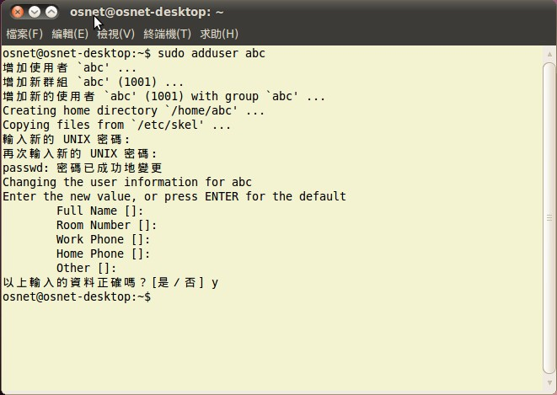
Example
Step 1. Add a new user

Slide 15
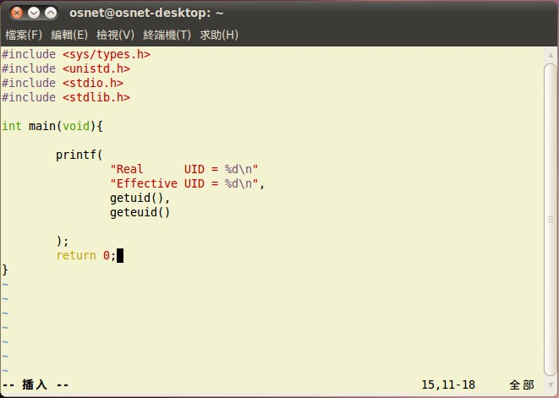
Example
Step 2. Write the program to print user ID

Slide 16
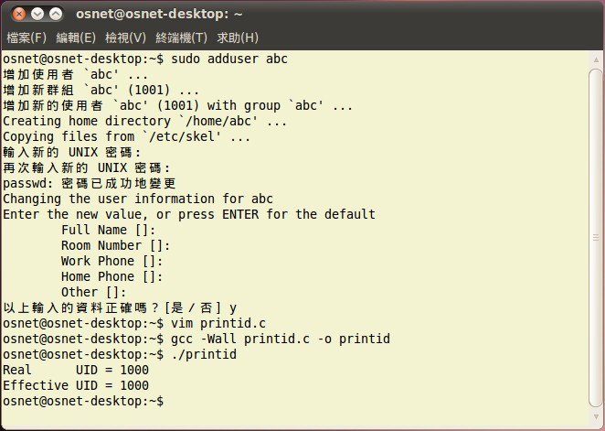
Example
Step 3. User1 runs the program to print the ID

Slide 17
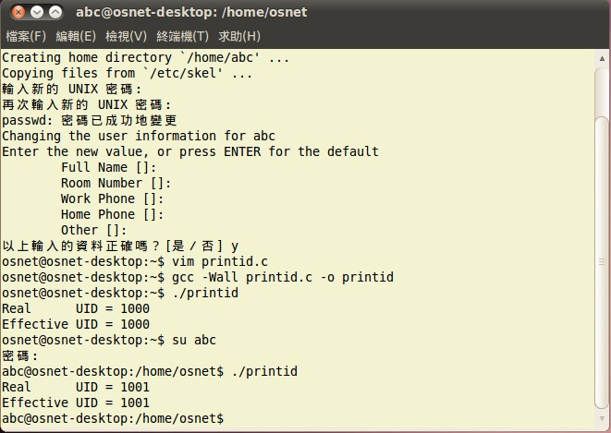
Example
Step 4. User2 runs the program, and we can see the different outputs

Slide 18
Exercise 1 [75 pt]
Write a program “printid.c” with the authority of superuser to print the real user ID and the effective user ID
Create a new user
Add the setuid attribute
Change to the new user
Execute the “printid” to print the real user ID and the effective user ID
The result should be as follow:
  Real user id: 1000
  Effective user id: 0

Slide 19
Exercise 2 [+10 pt]
You must create these as a root identity
  Another user
  An empty file for writing data
    vim datafile, and quit with “:wq!”.
    Should be writable only by the root.
      chmod 644 datafile
  An executable file
    gcc –Wall changefile.c –o changefile
    changefile.c is introduced in next slide.
    chmod 755 changefile
-rw-r--r-- 1 root root 0 July 15 2008 datafile
-rwxr-xr-x 1 root root 15365 July 15 2008 changefile

Slide 20
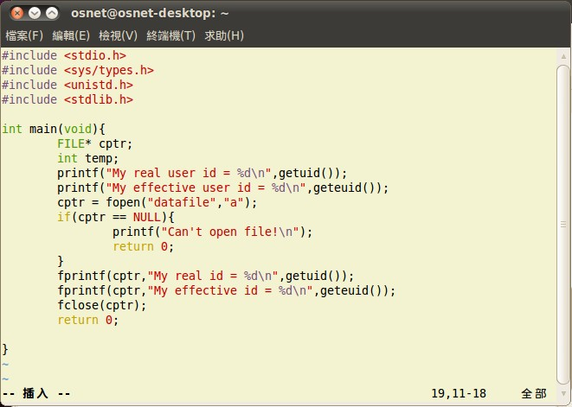
Exercise 2 (cont.)
changefile.c

Slide 21
Exercise 2 (cont.)
Execute changefile with the authority “root”
  You’ll find the file is executed successfully
Switch to another user and execute changefile
  E.g. su John
  Execute changefile
  Then an error message will be shown.
  You can verifying datafile.
You should try to find out the reason why this error occurred in other user’s execution!

Slide 22
Exercise 2 [+5 pt]
Your job is to make a solution to the problem
  You can try two methods as follows:
    By setting changefile with a SUID attribute.
    Modify SourceCode.c with seteuid() function.
In these methods, only one work correctly.
  Please discuss your idea with your T.A. for getting you a higher grade.

Slide 23
References
Avi Silberschatz, Peter Baer Galvin and Greg Gagne, “Operating System Concepts,” John Wiley & Sons, 7th Edition, 2004
http://linux.vbird.org/
Wikipedia: File system permissions
Wikipedia: setuid
Setuid Program Example
UID Setting Functions
Chmod commamd Example

