Slide 1
Uniform Cost Search
Strategy: expand lowest path cost
The good: UCS is complete and optimal!
The bad:
Explores options in every “direction”
No information about goal location
c ≤ 1
…
c ≤ 2
c ≤ 3
Start
Goal
[Demo: contours UCS empty (L3D1)]
[Demo: contours UCS pacman small maze (L3D3)]

Slide 2

Video of Demo Contours UCS Empty

Slide 3
Video of Demo Contours UCS Pacman Small Maze

Slide 4

Informed Search

Slide 5
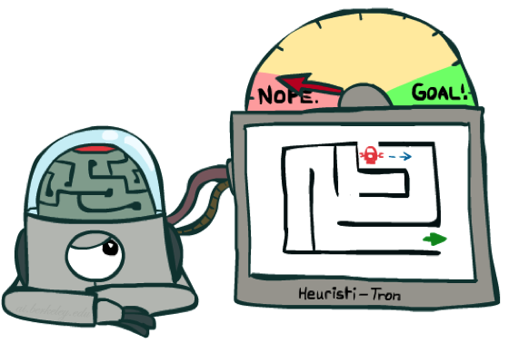
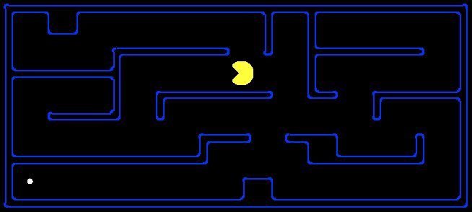
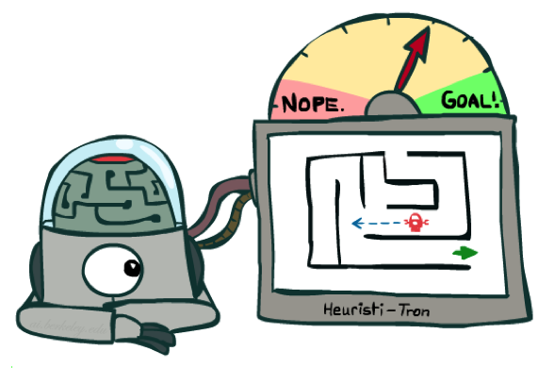
Search Heuristics
A heuristic is:
A function that estimates how close a state is to a goal
Designed for a particular search problem
Examples: Manhattan distance, Euclidean distance for pathing
10
5
11.2

Slide 6
Video of Demo Contours Greedy (Pacman Small Maze)

Slide 7



A* Search
UCS
Greedy
A*
Notes:
Notes: these images licensed from iStockphoto for UC Berkeley use.

Slide 8
Combining UCS and Greedy
Uniform-cost orders by path cost, or backward cost g(n)
Greedy orders by goal proximity, or forward cost h(n)
A* Search orders by the sum: f(n) = g(n) + h(n)
8
g = 0 h=6
S
e
h=1
g = 1 h=5
a
1
1
3
2
g = 2 h=6
g = 9 h=1
S
a
d
G
b
d
g = 4 h=2
e
h=6
1
h=5
h=2
h=0
1
g = 3 h=7
g = 6 h=0
g = 10 h=2
c
b
c
G
d
h=7
h=6
g = 12 h=0
G
Example: Teg Grenager

Slide 9

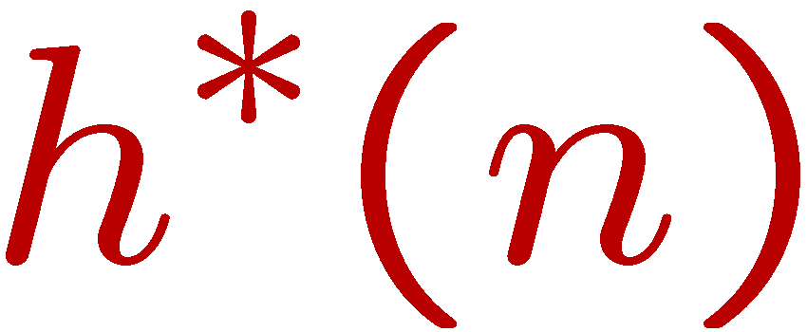
Admissible Heuristics
A heuristic h is admissible (optimistic) if:
where is the true cost to a nearest goal
Examples:
Coming up with admissible heuristics is most of what’s involved in using A* in practice.
15

Slide 10

Optimality of A* Tree Search

Slide 11


Optimality of A* Tree Search
Assume:
A is an optimal goal node
B is a suboptimal goal node
h is admissible
Claim:
A will exit the fringe before B
…

Slide 12

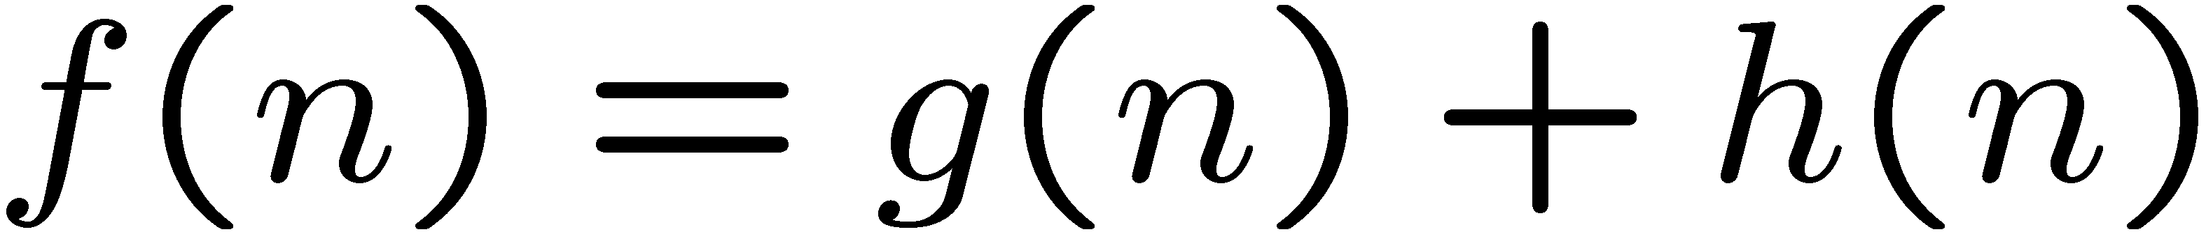
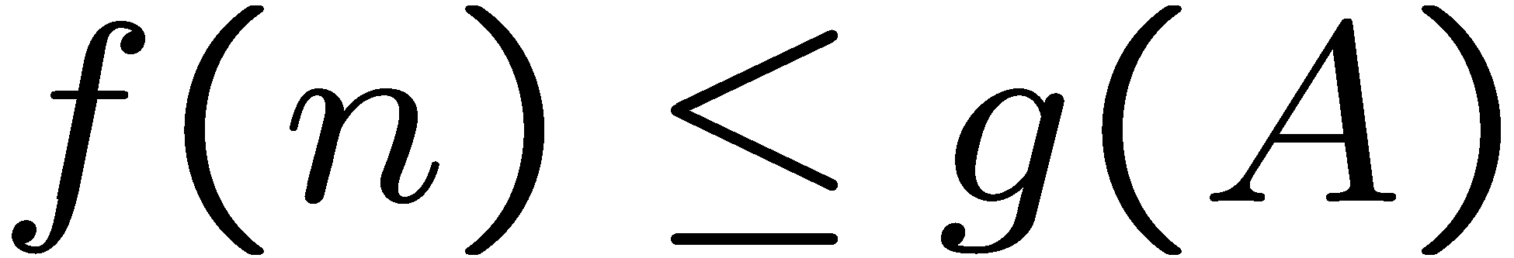
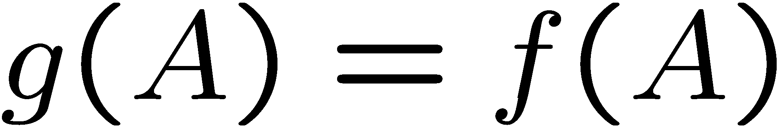
Optimality of A* Tree Search: Blocking
Proof:
Imagine B is on the fringe
Some ancestor n of A is on the fringe, too (maybe A!)
Claim: n will be expanded before B
f(n) is less or equal to f(A)
…
Definition of f-cost
Admissibility of h
h = 0 at a goal

Slide 13
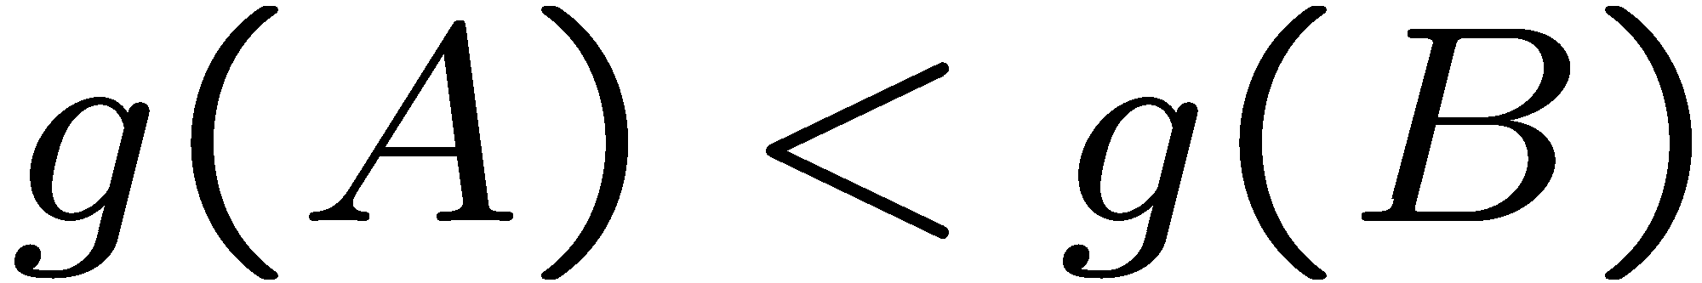
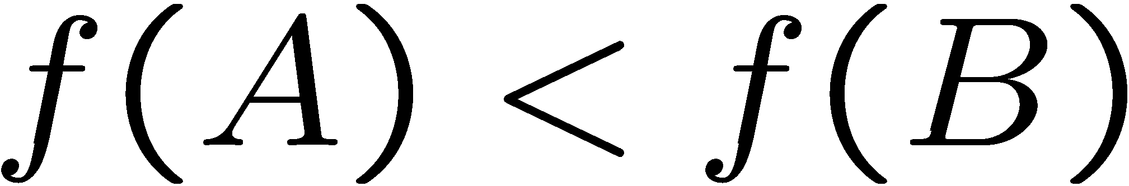
Optimality of A* Tree Search: Blocking
Proof:
Imagine B is on the fringe
Some ancestor n of A is on the fringe, too (maybe A!)
Claim: n will be expanded before B
f(n) is less or equal to f(A)
f(A) is less than f(B)
…
B is suboptimal
h = 0 at a goal

Slide 14

Optimality of A* Tree Search: Blocking
Proof:
Imagine B is on the fringe
Some ancestor n of A is on the fringe, too (maybe A!)
Claim: n will be expanded before B
f(n) is less or equal to f(A)
f(A) is less than f(B)
n expands before B
All ancestors of A expand before B
A expands before B
A* search is optimal
…

Slide 15
Properties of A*

Slide 16
Properties of A*
Uniform-Cost
A*
b
b
…
…

Slide 17
UCS vs A* Contours
Uniform-cost expands equally in all “directions”
A* expands mainly toward the goal, but does hedge its bets to ensure optimality
Start
Goal
Start
Goal
[Demo: contours UCS / greedy / A* empty (L3D1)]
[Demo: contours A* pacman small maze (L3D5)]

Slide 18
Video of Demo Contours (Pacman Small Maze) – A*

Slide 19
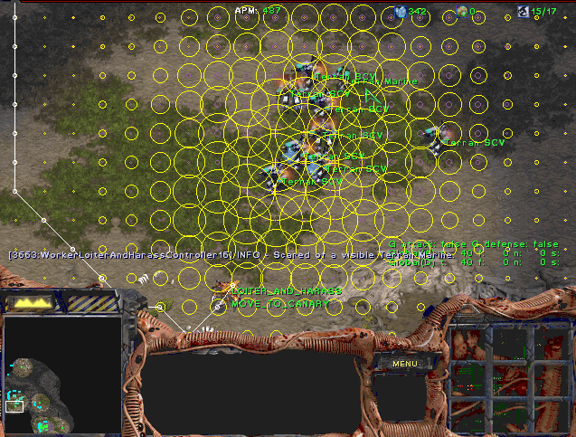
A* Applications
Video games
Pathing / routing problems
Resource planning problems
Robot motion planning
Language analysis
Machine translation
Speech recognition
…
[Demo: UCS / A* pacman tiny maze (L3D6,L3D7)]
[Demo: guess algorithm Empty Shallow/Deep (L3D8)]

Slide 20
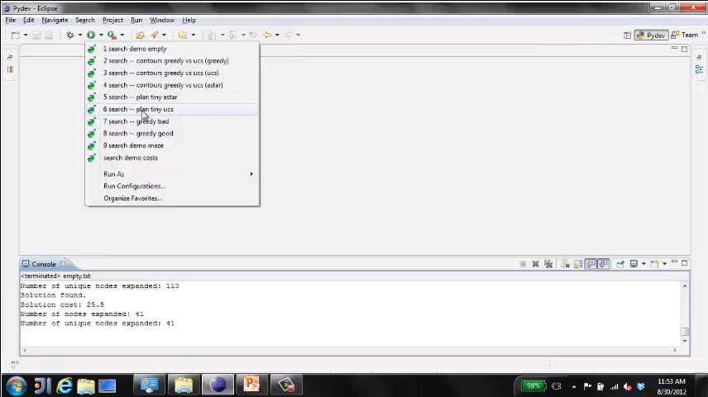
Video of Demo Pacman (Tiny Maze) – UCS / A*

