Slide 1

Search Problems

Slide 2







Search Problems
A search problem consists of:
A state space
A successor function
(with actions, costs)
A start state and a goal test
A solution is a sequence of actions (a plan) which transforms the start state to a goal state
“N”, 1.0
“E”, 1.0
Notes:
Often comes back on exams
Goal test – sometimes more than one state that satisfies having achieved the goal, for example, “eat all the dots”
Abstraction

Slide 3

Search Problems Are Models

Slide 4
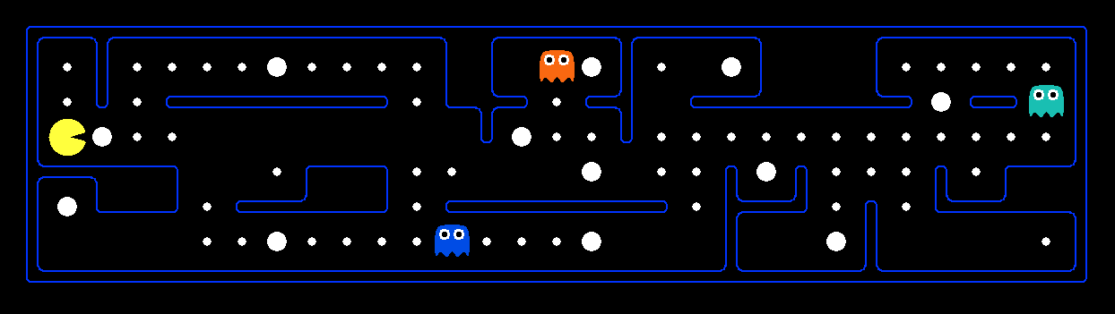
What’s in a State Space?
The world state includes every last detail of the environment
A search state keeps only the details needed for planning (abstraction)
Problem: Pathing
States: (x,y) location
Actions: NSEW
Successor: update location only
Goal test: is (x,y)=END
Problem: Eat-All-Dots
States: {(x,y), dot booleans}
Actions: NSEW
Successor: update location and possibly a dot boolean
Goal test: dots all false
Notes:
Wrong example for “eat-all-dots”: (x, y, dot count)

Slide 5
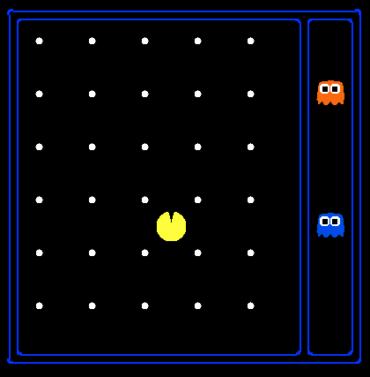
State Space Sizes?
World state:
Agent positions: 120
Food count: 30
Ghost positions: 12
Agent facing: NSEW
How many
World states?
120x(2³⁰)x(12²)x4
States for pathing?
120
States for eat-all-dots?
120x(2³⁰)
Notes:
90 * (2^30-1) + 30 * 2^29 = 145 billion
2^29 = 536 870 912

Slide 6
Quiz: Safe Passage
Problem: eat all dots while keeping the ghosts perma-scared
What does the state space have to specify?
(agent position, dot booleans, power pellet booleans, remaining scared time)

Slide 7

State Space Graphs and Search Trees

Slide 8
State Space Graphs
State space graph: A mathematical representation of a search problem
Nodes are (abstracted) world configurations
Arcs represent successors (action results)
The goal test is a set of goal nodes (maybe only one)
In a state space graph, each state occurs only once!
We can rarely build this full graph in memory (it’s too big), but it’s a useful idea

Slide 9
State Space Graphs
State space graph: A mathematical representation of a search problem
Nodes are (abstracted) world configurations
Arcs represent successors (action results)
The goal test is a set of goal nodes (maybe only one)
In a search graph, each state occurs only once!
We can rarely build this full graph in memory (it’s too big), but it’s a useful idea
a
G
b
c
e
d
f
S
h
p
q
r
Tiny search graph for a tiny search problem

Slide 10
Search Trees
This is now / start
“N”, 1.0
“E”, 1.0
Possible futures
A search tree:
A “what if” tree of plans and their outcomes
The start state is the root node
Children correspond to successors
Nodes show states, but correspond to PLANS that achieve those states
For most problems, we can never actually build the whole tree
Notes:
Different plans that achieve the same state, will be different nodes in the tree.

Slide 11
State Space Graphs vs. Search Trees
State Space Graph
Each NODE in in the search tree is an entire PATH in the state space graph.
Search Tree
S
a
G
d
e
p
b
c
q
b
c
e
h
r
d
e
f
a
a
h
r
p
q
f
S
h
We construct both on demand – and we construct as little as possible.
p
q
f
q
c
G
p
q
r
q
c
G
a
a

Slide 12
Tree Search

Slide 13
Depth-First Search
Strategy: expand a deepest node first
Implementation: Fringe is a LIFO stack
a
G
a
c
b
c
b
e
d
e
d
f
f
S
h
h
p
p
r
q
r
q
S
d
e
p
b
c
e
h
r
q
a
a
h
r
p
q
f
p
q
f
q
c
G
q
c
G
a
a

Slide 14
Search Algorithm Properties
Complete: Guaranteed to find a solution if one exists?
Optimal: Guaranteed to find the least cost path?
Time complexity?
Space complexity?
Cartoon of search tree:
b is the branching factor
m is the maximum depth
solutions at various depths
Number of nodes in entire tree?
1 + b + b² + …. b^{m} = O(b^{m})
1 node
b
…
b nodes
b² nodes
m tiers
b^{m} nodes

Slide 15
Depth-First Search (DFS) Properties
What nodes DFS expand?
Some left prefix of the tree.
Could process the whole tree!
If m is finite, takes time O(b^{m})
How much space does the fringe take?
Only has siblings on path to root, so O(bm)
Is it complete?
m could be infinite, so only if we prevent cycles (more later)
Is it optimal?
No, it finds the “leftmost” solution, regardless of depth or cost
1 node
b
…
b nodes
b² nodes
m tiers
b^{m} nodes

Slide 16
Breadth-First Search
Strategy: expand a shallowest node first
Implementation: Fringe is a FIFO queue
a
G
b
c
d
e
f
S
h
p
q
r
S
d
e
p
Search
Tiers
b
c
e
h
r
q
a
a
h
r
p
q
f
p
q
f
q
c
G
q
c
G
a
a

Slide 17
Breadth-First Search (BFS) Properties
What nodes does BFS expand?
Processes all nodes above shallowest solution
Let depth of shallowest solution be s
Search takes time O(b^{s})
How much space does the fringe take?
Has roughly the last tier, so O(b^{s})
Is it complete?
s must be finite if a solution exists, so yes!
Is it optimal?
Only if costs are all 1 (more on costs later)
1 node
b
…
b nodes
s tiers
b² nodes
b^{s} nodes
b^{m} nodes

Slide 18
Cost-Sensitive Search
a
GOAL
2
2
b
c
3
2
1
8
2
e
d
f
3
9
8
2
START
h
1
4
2
p
4
r
15
q
BFS finds the shortest path in terms of number of actions.
It does not find the least-cost path. We will now cover
a similar algorithm which does find the least-cost path.

Slide 19
Uniform Cost Search
2
G
a
Strategy: expand a cheapest node first:
Fringe is a priority queue (priority: cumulative cost)
b
c
1
8
2
2
e
3
d
f
9
8
2
S
h
1
1
p
q
r
15
0
S
d
3
e
9
p
1
b
4
e
5
h
17
r
11
q
16
c
11
Cost contours
a
6
a
h
13
r
7
p
q
f
p
q
f
8
q
c
G
q
c
a
11
G
10
a

Slide 20
Uniform Cost Search (UCS) Properties
What nodes does UCS expand?
Processes all nodes with cost less than cheapest solution!
If that solution costs C* and arcs cost at least ε , then the “effective depth” is roughly C*/ε
Takes time O(b^{C*/ε}) (exponential in effective depth)
How much space does the fringe take?
Has roughly the last tier, so O(b^{C*/ε})
Is it complete?
Assuming best solution has a finite cost and minimum arc cost is positive, yes!
Is it optimal?
Yes! (Proof next lecture via A*)
b
c ≤ 1
…
C*/ε “tiers”
c ≤ 2
c ≤ 3

Slide 21
Uniform Cost Issues
Remember: UCS explores increasing cost contours
The good: UCS is complete and optimal!
The bad:
Explores options in every “direction”
No information about goal location
We’ll fix that soon!
…
c ≤ 1
c ≤ 2
c ≤ 3
Start
Goal
[Demo: empty grid UCS (L2D5)]
[Demo: maze with deep/shallow water DFS/BFS/UCS (L2D7)]

