Slide 1
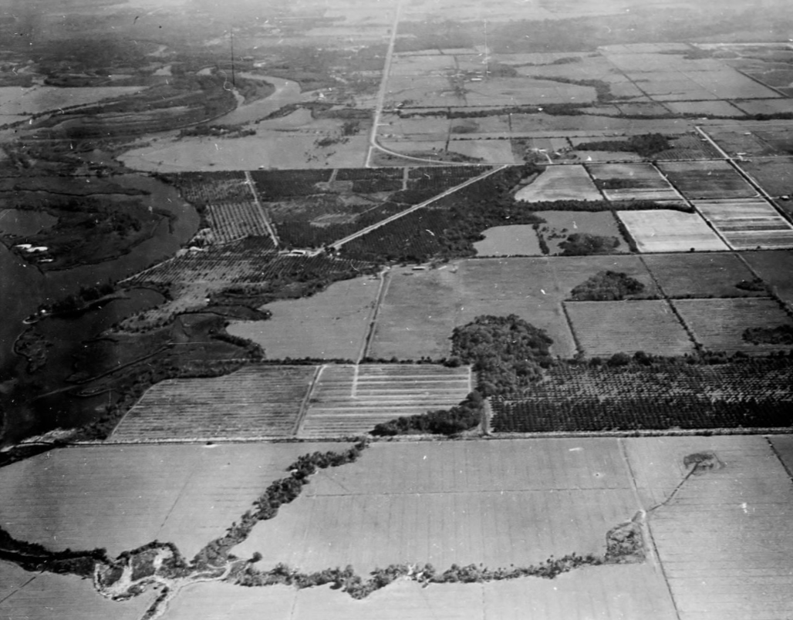
Manatee Wayback Machine
Historical Water Quality Trends
Intern: Jay Irby
Mentor: Greg Blanchard

Slide 2
Purpose
Revive old data to inform present-day discussions
Explore the long-term changes of conductance in the Upper Manatee River

Slide 3





Methods
Modeling &
Interpolation
Data Mining
Data Cleaning
Analyze Results

Slide 4
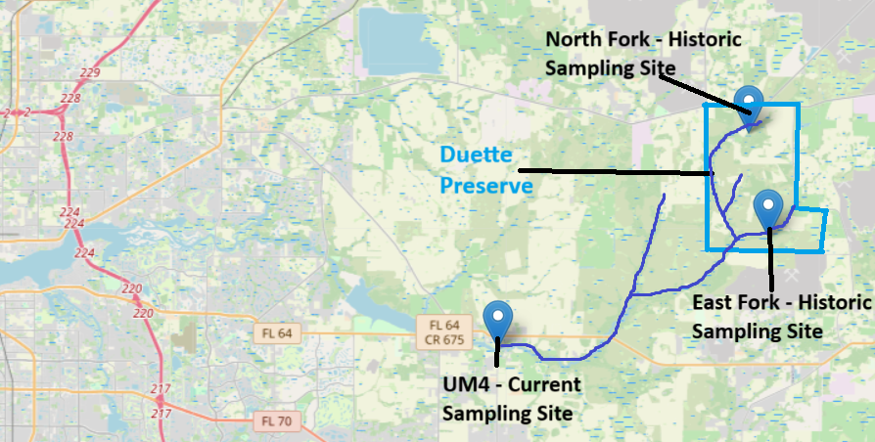
Sampling Locations

Slide 5
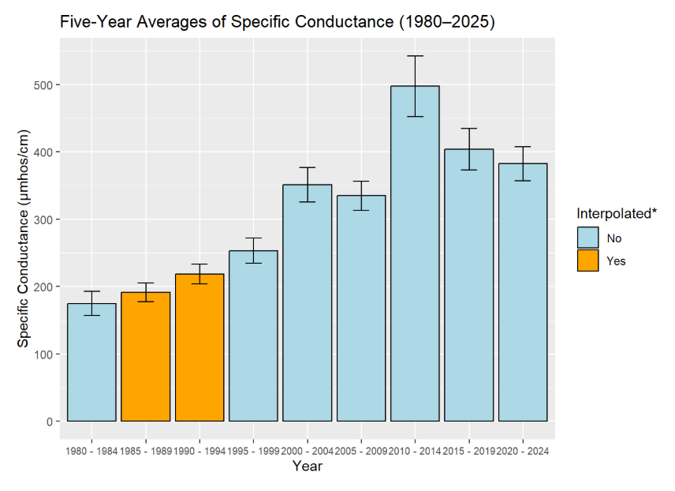
Results
The total change from the first five years to the most recent five years is 207.6 µmhos/cm, a
118% increase.

Slide 6
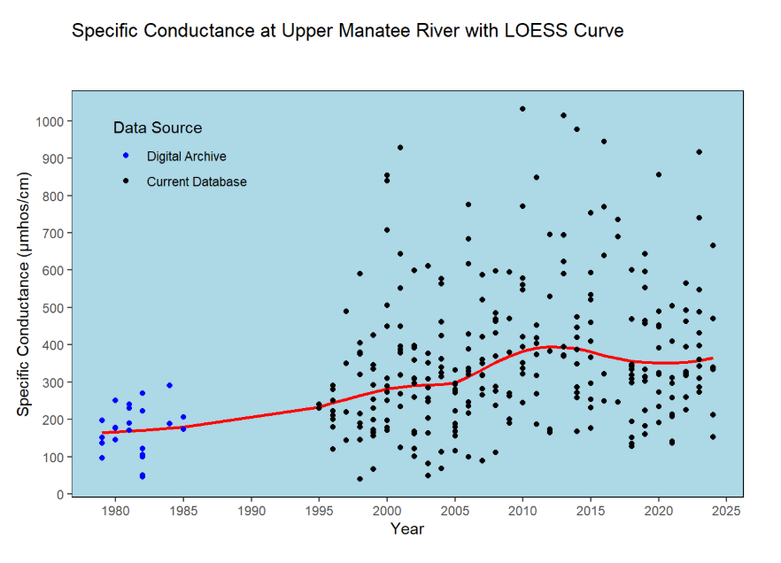
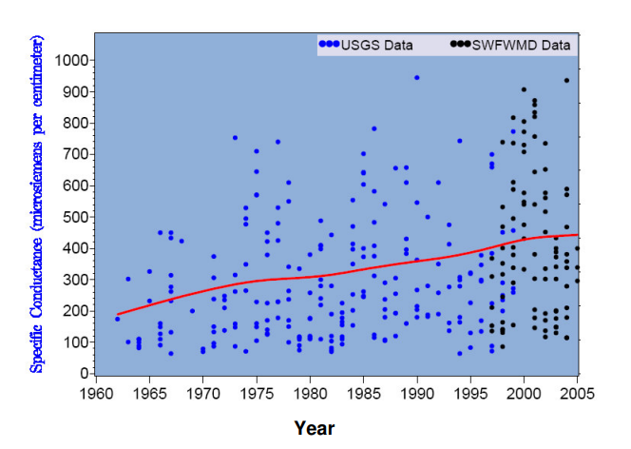
Similar Results in Horse Creek, Hardee County
Specific Conductance at Horse Creek
Manatee River Results
Horse Creek Results

Slide 7
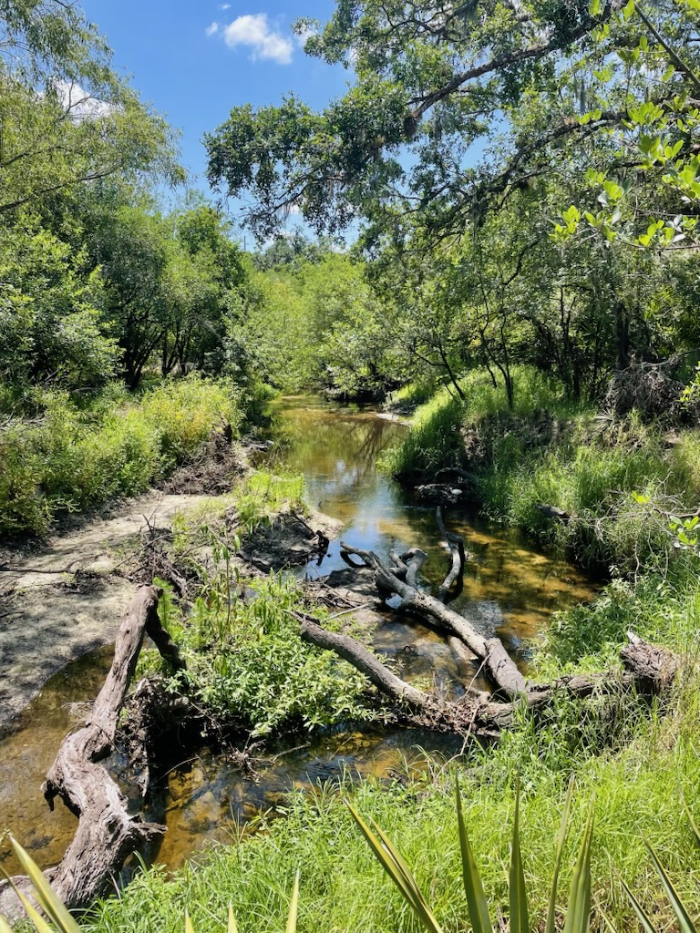
Questions

