Slide 1

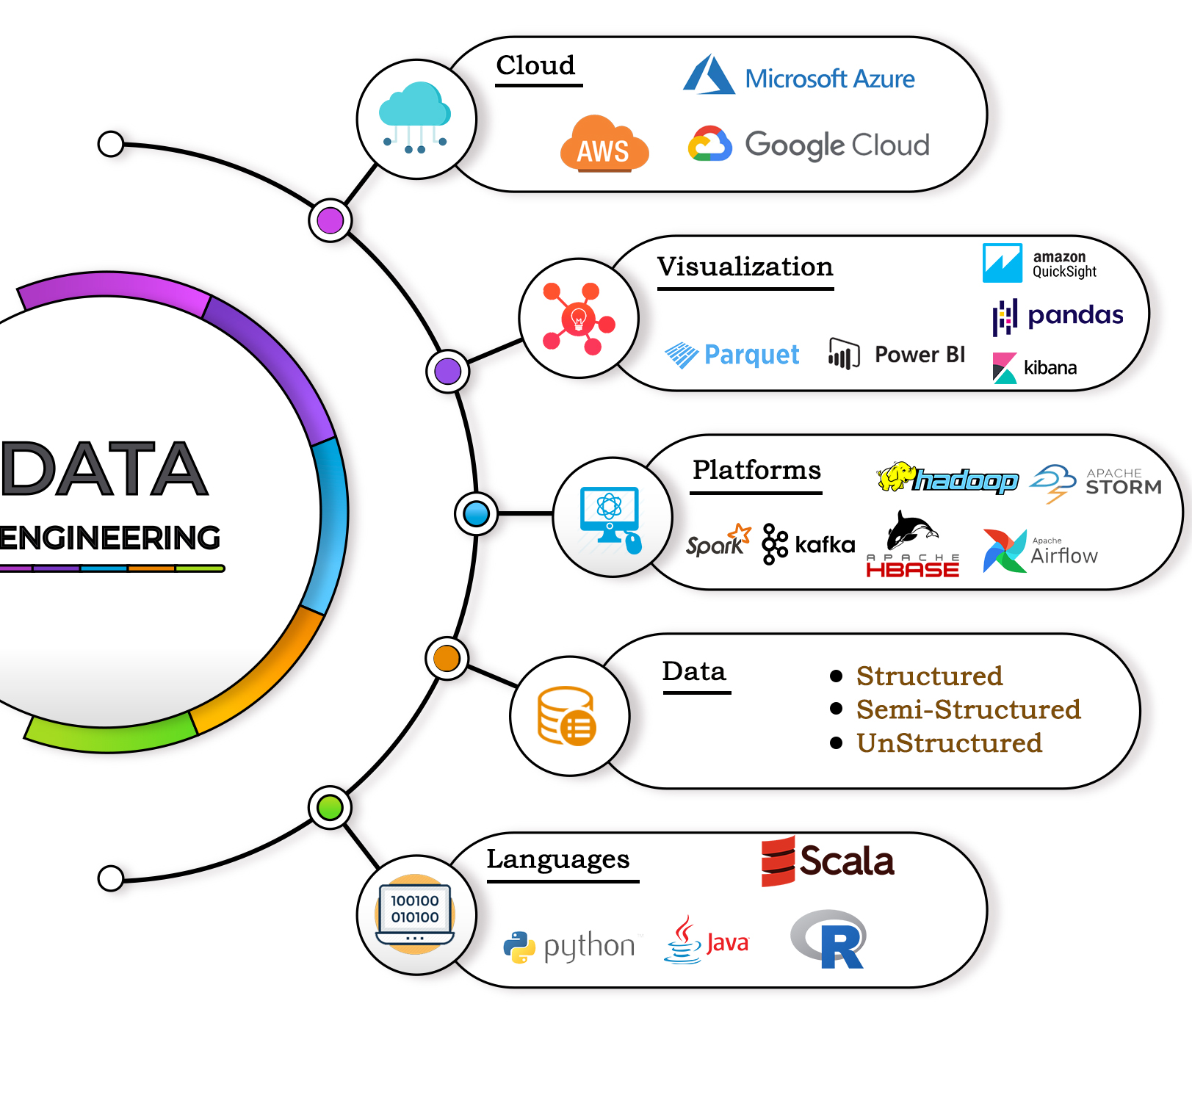
Olympics Data
Engineering Project
By Jay Jathar

Slide 2
Objectives
Ingest Olympic Games data from sources into your data ecosystem and transform it for efficient storage and analysis.
Enable data analysis and reporting capabilities to derive insights from Olympic Games data.
Ensure data security and compliance with relevant regulations and standards.

Slide 3





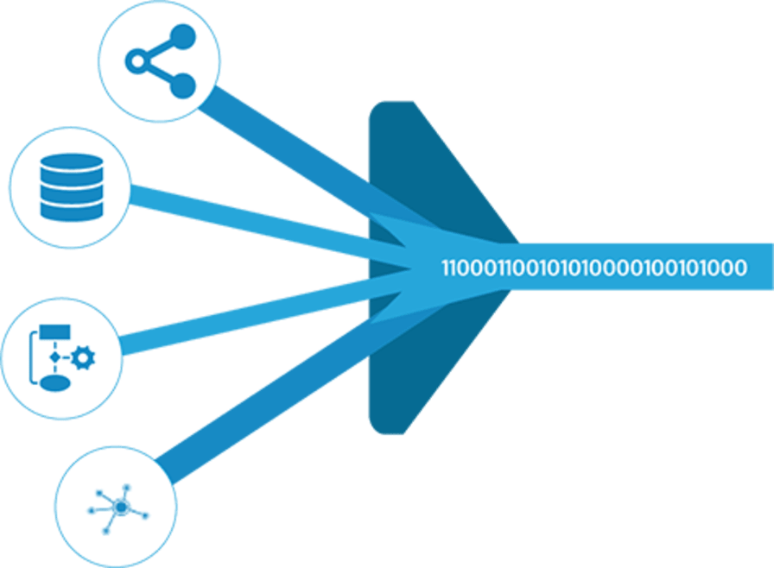





OLYMPIC DE SOLUTION ARCHITECTURE
SOURCE
INGESTION/
ETL
STORAGE/
ANALYSIS
BI
P1
P1
P1
P2
P2
P3
P2
P3
P3
P4
P4
P4

Slide 4
Stage 1: Source
MySQL
Amazon S3
Azure Blob
Open-source database management system with a relational database and an SQL server
Scalable object storage service for securing and managing data storage
Data storage facility designed for multimedia files with data encryption measures

Slide 5
Stage 2: Ingestion / ETL
Sqoop
Copy-into
Snowflake Snow Pipe
Provides a command-line solution for transferring data between Hadoop and relational databases. Great for integrating big data analytics with existing data storage.
An effective way to copy data from files hosted on cloud storages and databases, enabling easy data ingestion.
Automated ingestion service, facilitating data transfer from cloud data sets to Snowflake and then to the cloud again.

Slide 6
Stage 3: Storage / Analysis
Hive
Apache HBase
Snowflake
Data warehousing software for big data analysis and processing in real-time. Provides SQL-like capabilities.
A NoSQL database, horizontally distributed and scalable for large datasets. Best for supporting real-time processing of data.
A cloud-based data management system, providing data warehousing, devoid of configuration and administration. Great for instant and secure analysis of multiple data types.

Slide 7
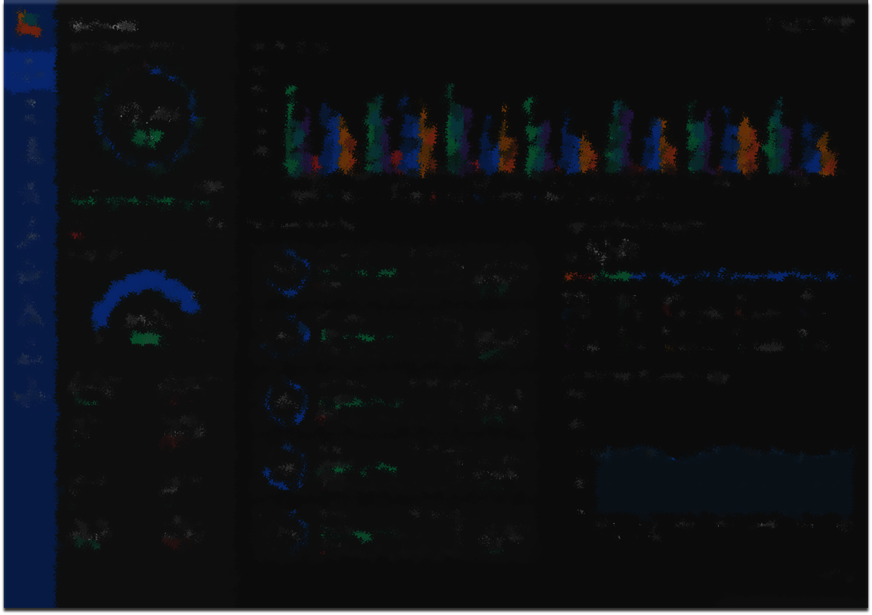
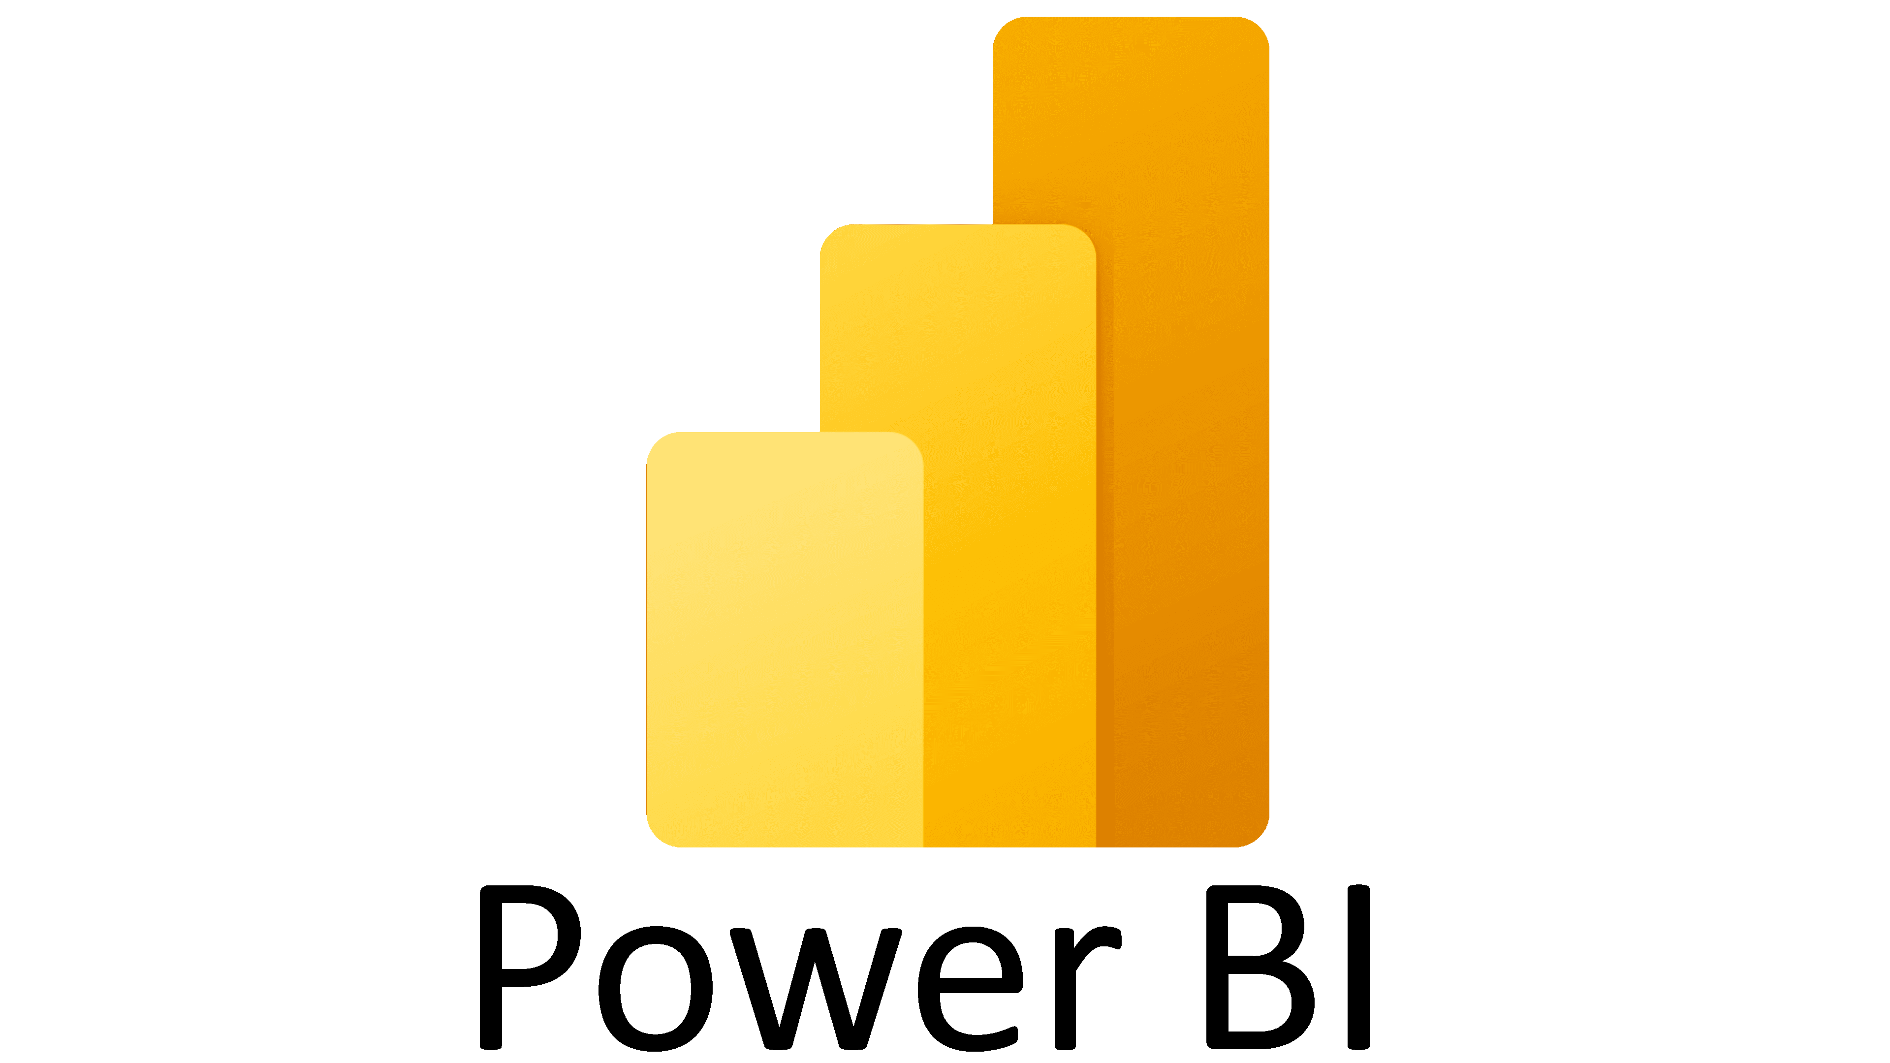
Stage 4: BI
Power BI
Microsoft Power BI is a business intelligence-focused software product created by Microsoft, specializing in interactive data visualization. It forms an integral part of the Microsoft Power Platform.

Slide 8
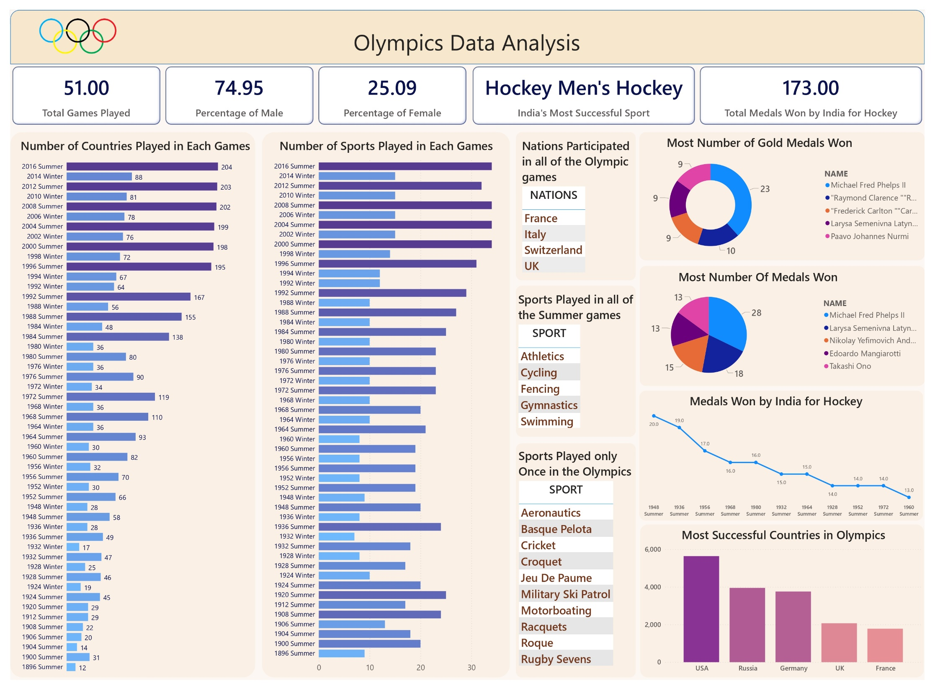

Slide 9

Conclusion
The right data engineering solution architecture is critical for companies looking to make the most of their data. In this presentation, we've explored different stages and components of this architecture, including the source, ingestion, storage, analysis, and BI components. By combining these components cleverly, you can improve your data processing and delivery for better business insight.

Slide 10
Thank you

