Slide 1
Domain Separation Networks
Konstantinos Bousmalis, George Trigeorgis, Nathan Silberman, Dilip Krishnan, Dumitru Erhan
Google Brain, NIPS 2016

Slide 2
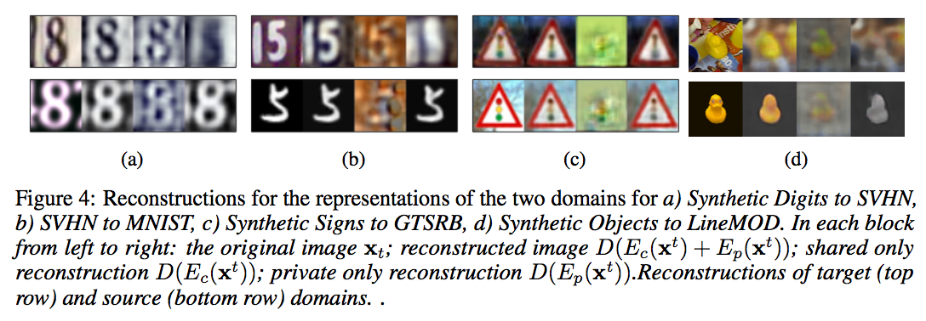
Domain Adaptation Task

Slide 3
Related Work
find a mapping from representations of the source domain to those of the target
Correlation Alignment (CORAL)
find representations that are shared between the two domains
Domain–Adversarial Neural Networks (DANN)
the Maximum Mean Discrepancy (MMD) metric

Slide 4
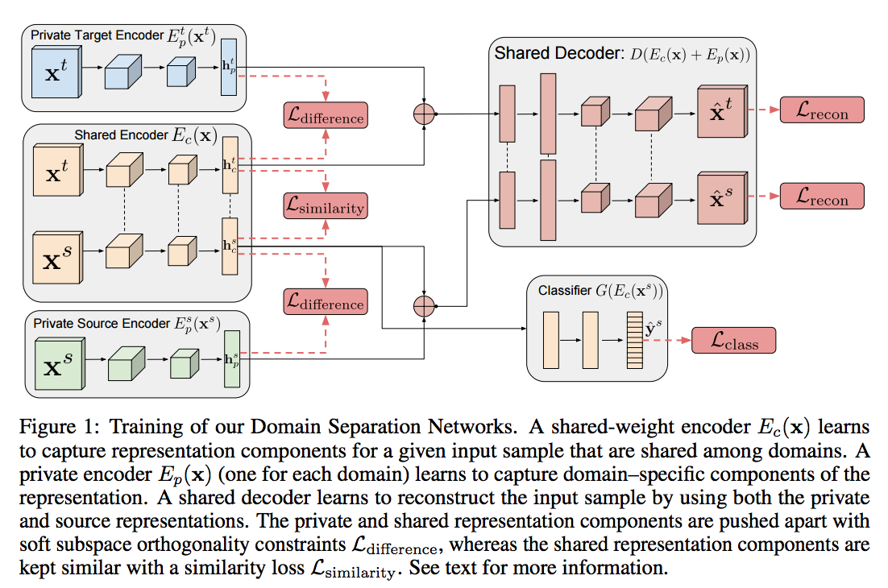
DSN Model

Slide 5
Learning
Minimize the loss:
where α, β, γ are weights that control the interaction of the loss terms

Slide 6

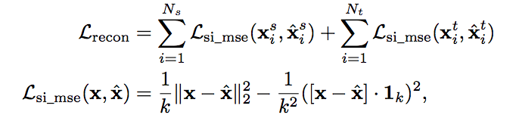
Learning
the classification loss
the reconstruction loss
si_mse: scale–invariant mean squared error

Slide 7

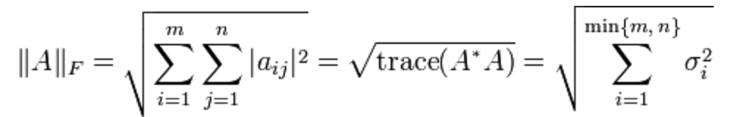
Learning
the difference loss

Slide 8


Similarity Losses
Gradient Reversal Layer (GRL)
Formally, for some function f(u), the GRL is defined as Q (f(u)) = f(u) with a gradient $\frac{d}{du}$ Q(f(u)) = − $\frac{d}{du}$f(u).
The DANN loss

Slide 9
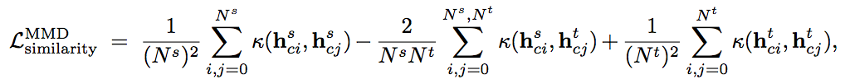
Similarity Losses
The Maximum Mean Discrepancy (MMD) loss
a linear combination of multiple RBF kernels:

Slide 10
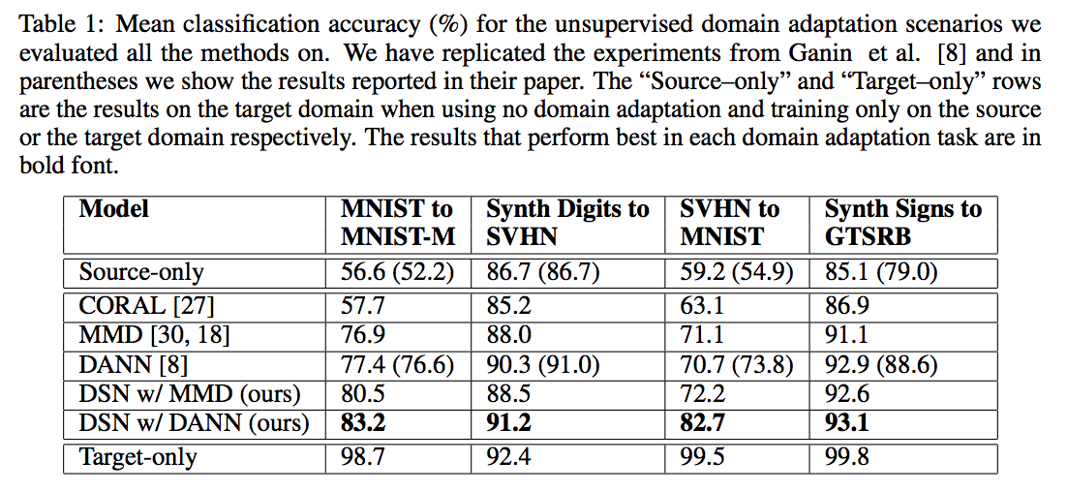
Evaluation

Slide 11
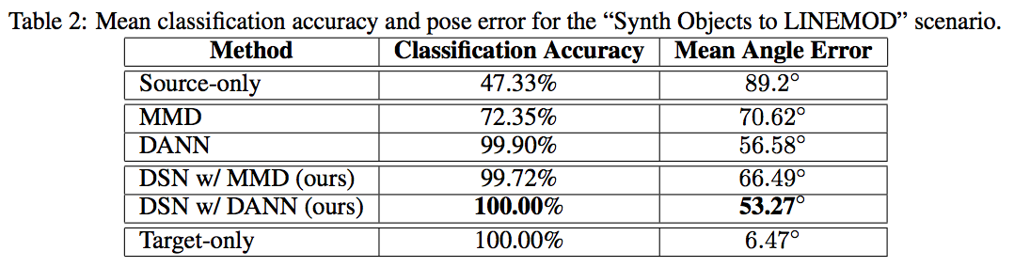
Evaluation

Slide 12
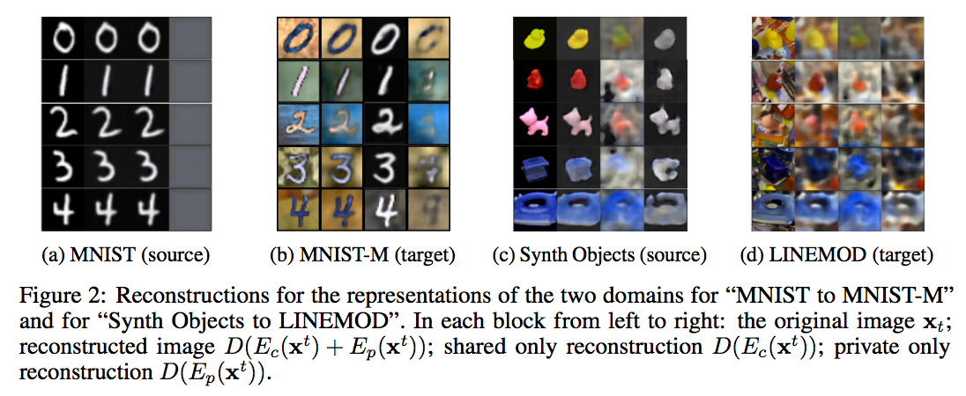
Visualization

Slide 13
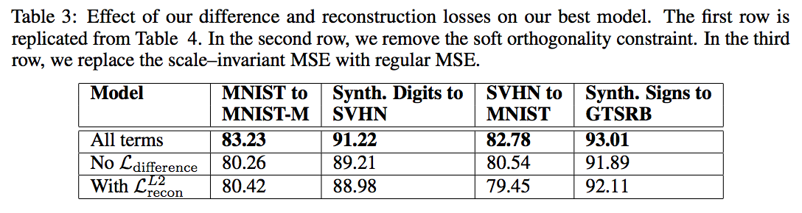
Implementation Details

Slide 14
Thank you

