Slide 1
Convolutional Deep Neural Networks for Document-based Question Answering
Jian Fu and Xipeng Qiu
Fudan University , NLPCC 2016

Slide 2
Document-based Question Answering
Problem
Text match
Sentence pair architecture
Sentence model + Match(interaction)
(bidirectional) LSTM , CNN
Alignment , Similarity match , Attention mechanism

Slide 3
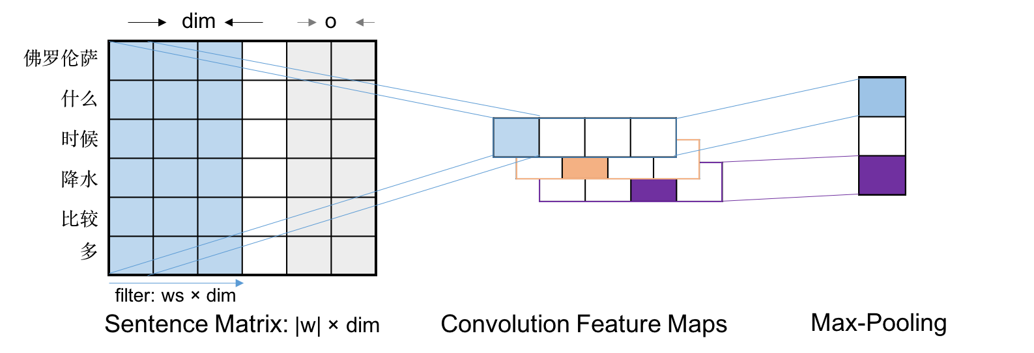
Convolutional Sentence Model

Slide 4

Convolutional Sentence Model
Goal
learn intermediate feature representations
Embedding layer
pre-trained word2vec embedding
word overlap features
we get sentence matrix :

Slide 5
Convolutional Sentence Model
Convolution layer
extract patterns
Non-linearity layer
learn non-linear decision boundaries
Max-pooling layer
aggregate the information and reduce the representation

Slide 6
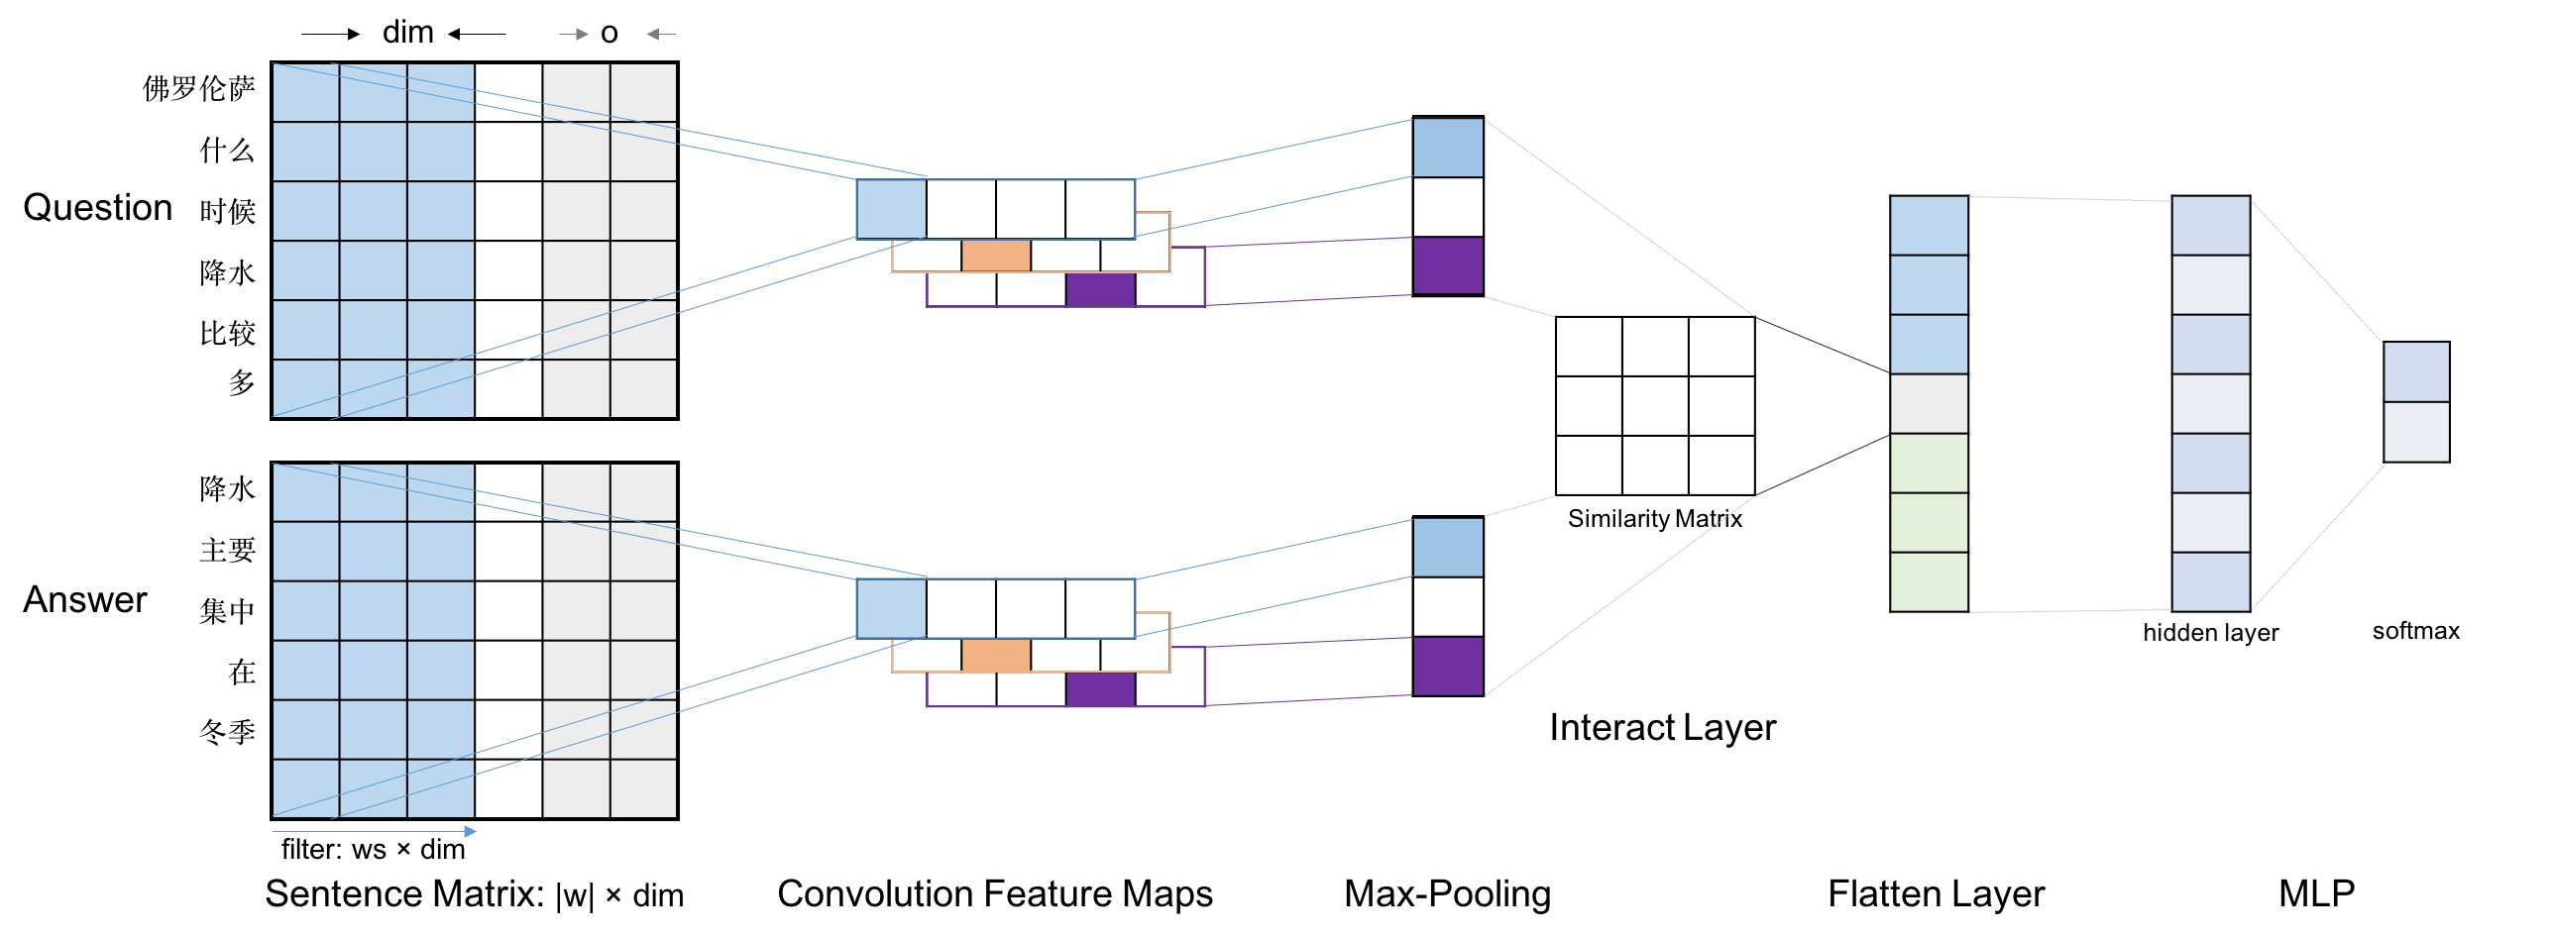
Convolutional Matching Model

Slide 7


Convolutional Matching Model
Interact layer
s
where is a similarity matrix and is optimized during the training

Slide 8


Convolutional Matching Model
Multi-layer perceptron
hidden layer :
logistic regression :

Slide 9

Convolutional Matching Model
Training
minimise the cross-entropy cost function:

Slide 10
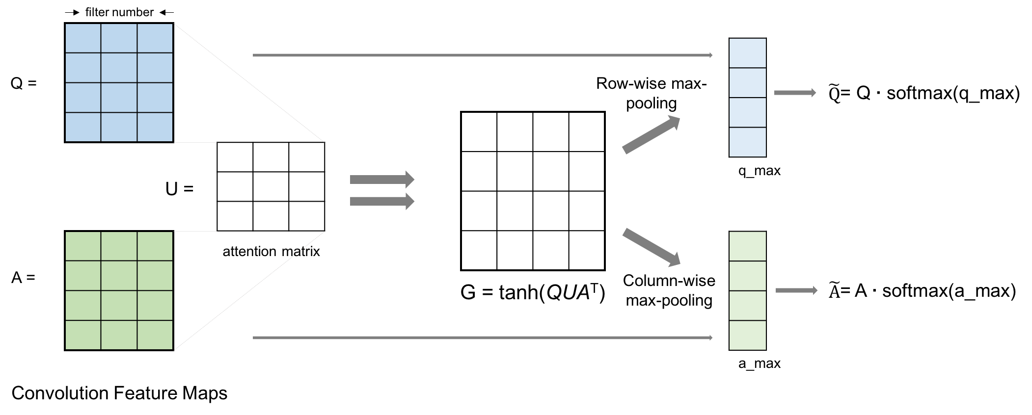
Attentive Pooling

Slide 11

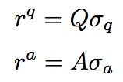
Attentive Pooling
compute the attention matrix G :
apply row-wise and column-wise max-pooling over G
the representations are computed as dot product

Slide 12
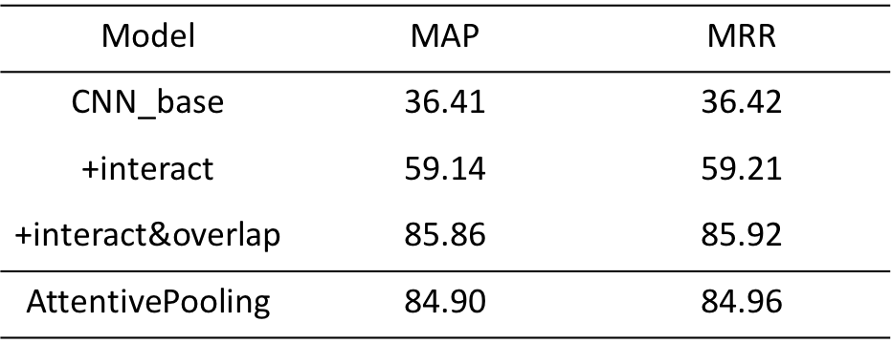
Experiments
Experimental results on the NLPCC-DBQA Task

Slide 13
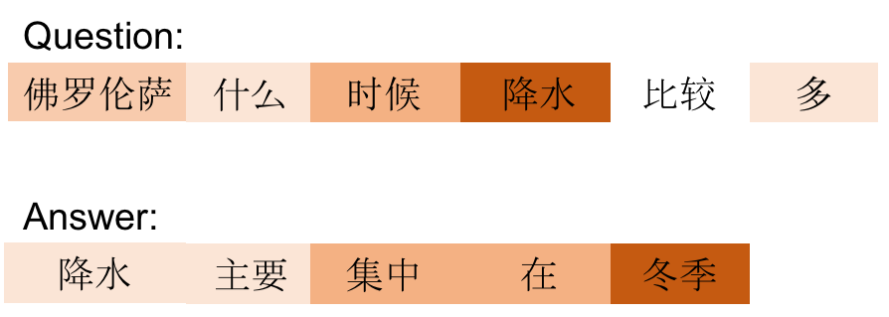
Experiments
Attentive pooling Visualization

Slide 14
Thank you

