Slide 1
Wasserstein Auto-Encoders
Ilya Tolstikhin, Olivier Bousquet, Sylvain Gelly, Bernhard Schoelkopf
Max Planck Institute for Intelligent Systems & Google Brain
ICLR 2018

Slide 2
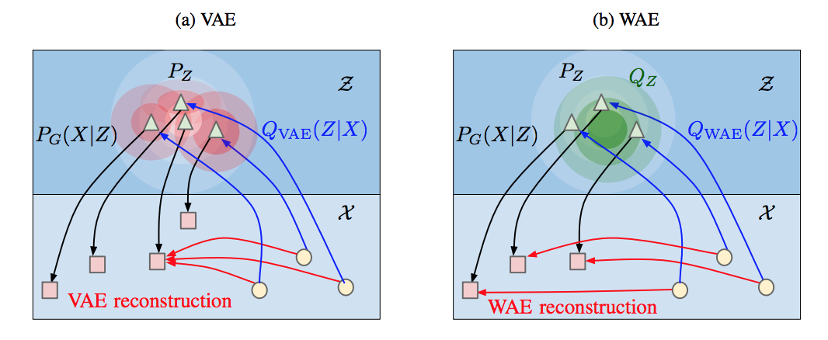
VAE vs WAE

Slide 3

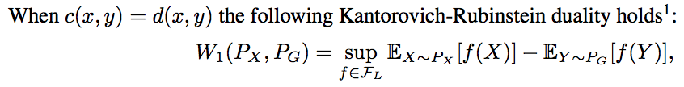
Optimal transport

Slide 4
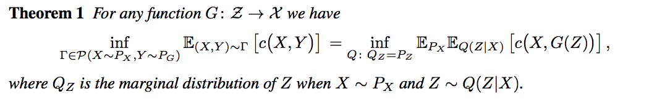

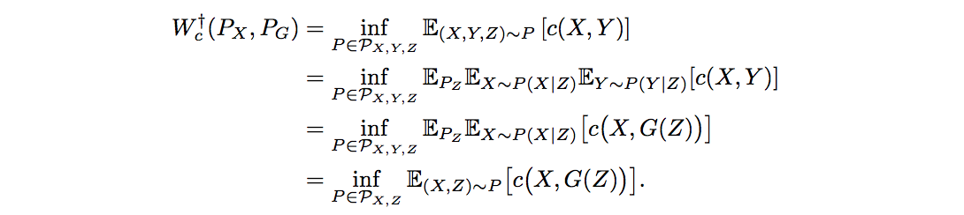
WAE

Slide 5
WAE objective

Slide 6

WAE: 2 applications
GAN-based D_{Z}：
Use an discriminator in the latent space Z
MMD-based D_{Z}:

Slide 7
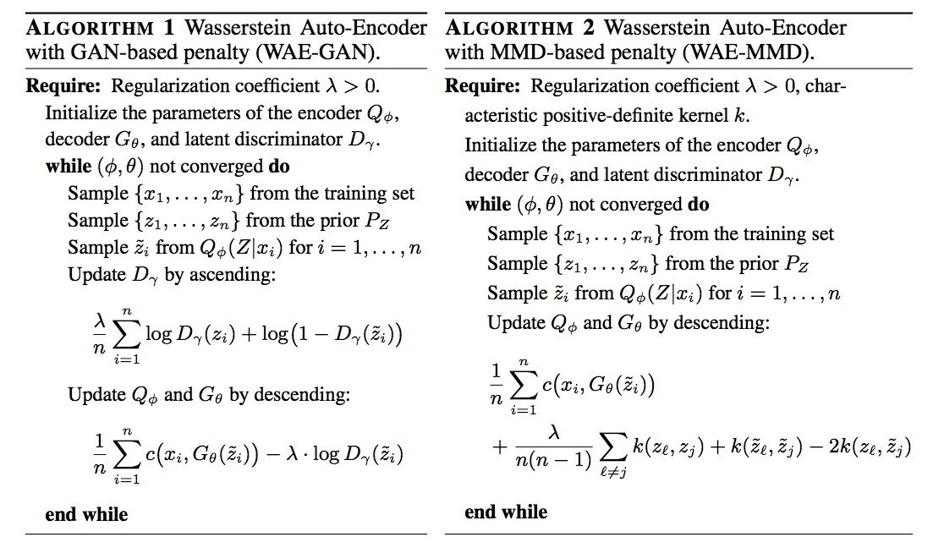
WAE: algorithm

Slide 8
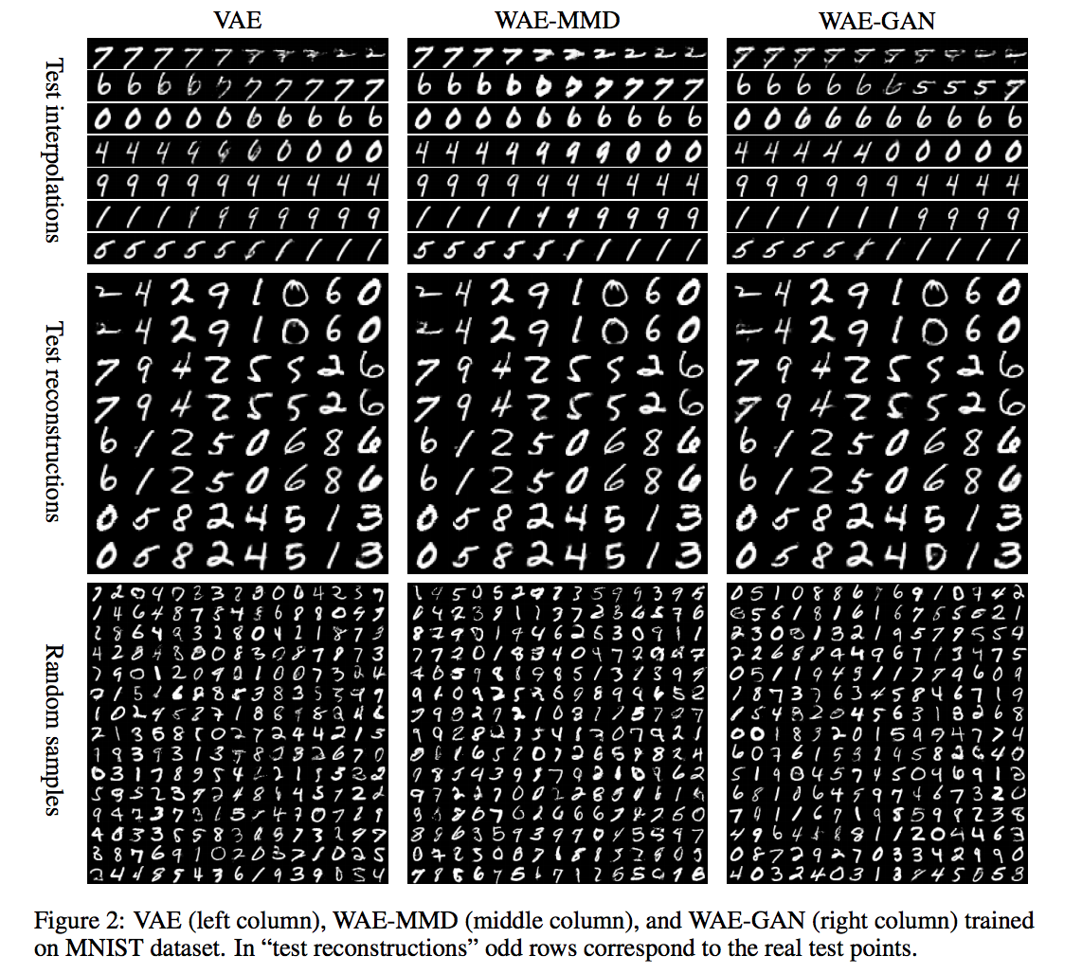
Experiments

Slide 9
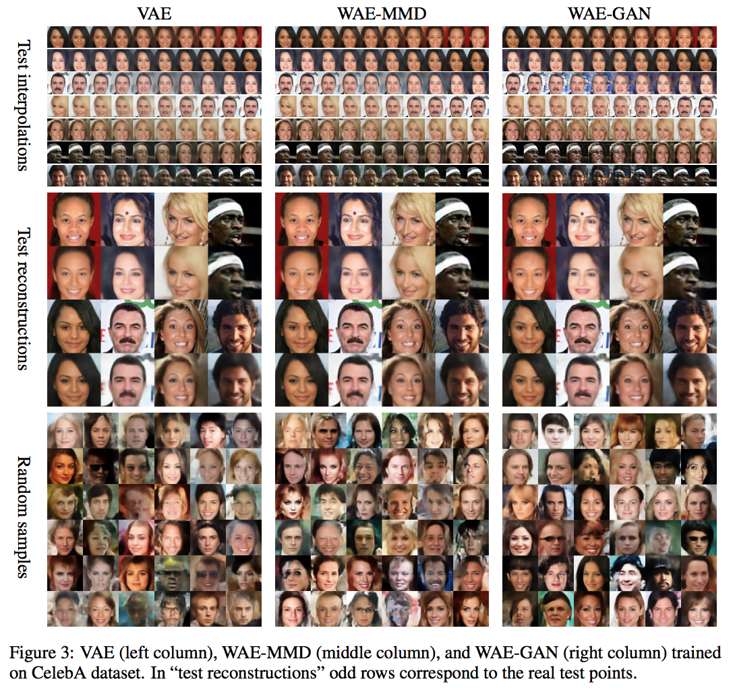
Experiments

Slide 10
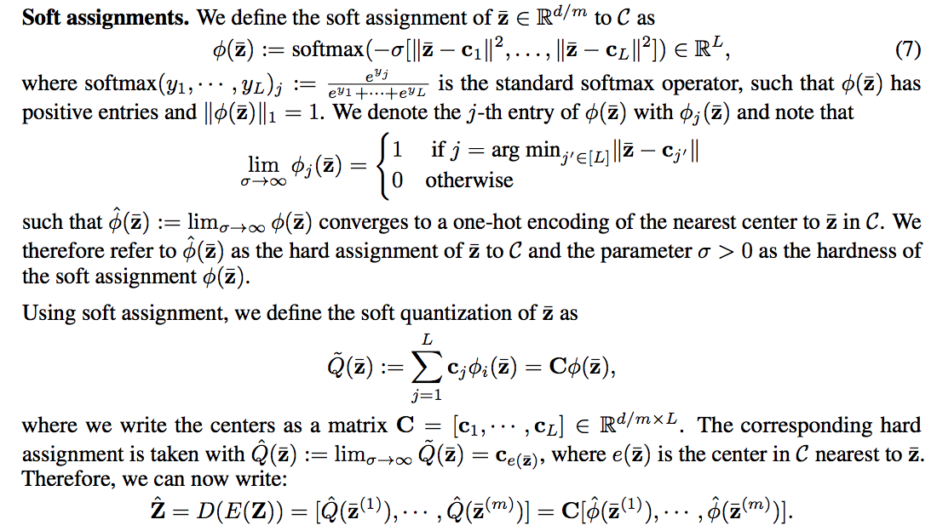
Soft-to-Hard Vector Quantization for End-to-End Learning Compressible Representations

Slide 11
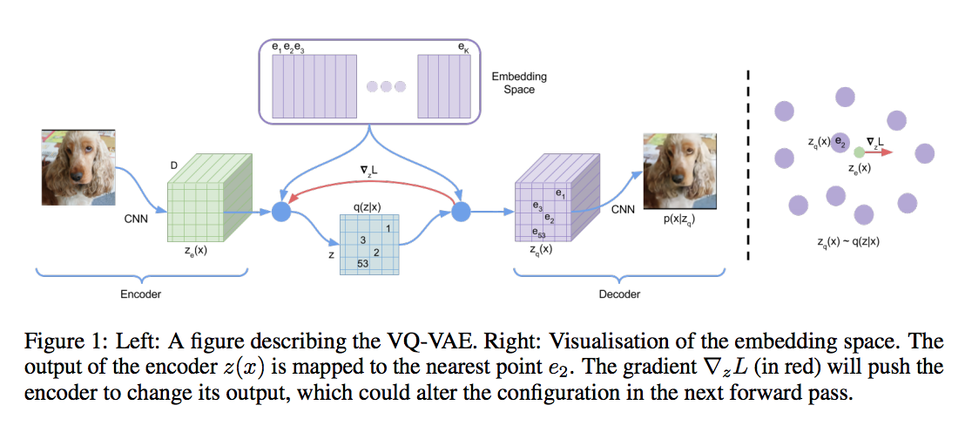
Neural Discrete Representation Learning

Slide 12
Neural Discrete Representation Learning
training objective：

Slide 13
Thank you

